Slide 1


$$Heaven’s Light Is Our Guide$$ Rajshahi University of Engineering & Technology
Department of Electronics & Telecommunication Engineering

Slide 2
Welcome to our project presentation

Slide 3

Course title : Electronic Project Design & Development. Course N0: ETE 300.
Project Title:Android Based Home Automation Using Bluetooth Module.
Supervised by: Mr. Imran Hasan Assistant Professor Department of ETE
Prepared By Prepared By Md. Linkon hasan Hasan sarker Roll no: 114060 Roll no: 114041 Dept: ETE Dept: ETE

Slide 4
WHAT IS HOME AUTOMATION?
A technique to use computer/smartphone and Information Technology in controlling Home appliances and Home features is called Home Automation.
Home automation is the residential extension of "building automation".
It is automation of the:
Home
Housework or
Household activity.
Home automation may include centralized control:
Lighting of entire house
HVAC (heating, ventilation and air conditioning)

Slide 5

ANDROID:
Android has an active community of developers who use the Android Open Source Project (AOSP) source code to develop and distribute their own modified versions of the operating system.

Slide 6
COMPONENTS USED:
The components used in HA is
a) Micro Controller ATMEGA8
b) Relay ( 2 pcs_6V/1A)
c) Bluetooth Device HC_05
d) Bulb as load( 2 pcs_60W)
e) Light Emitting Diode(2 pcs_3.5V/2mA)
f) Android Mobile(2.2_still now(4.0))
g)Resistor(2 pcs_1K)
h)Capacitor(2 pcs_220uF/16V ,100uF/16V)
i)IC LM7805 (i/p_5V-18V& o/p_4.8v-5.2v) &
j)Bipolar junction transistor_BC547 (2 pcs_6V/100mA)

Slide 7
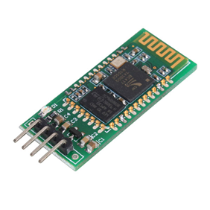
Bluetooth Module:
HC-05 is a Bluetooth Smart module targeted for low-power sensors and accessories.
It integrates all features required for a Bluetooth Smart application.
It is powered directly from a standard 3V coin cell battery or a pair of AAA batteries.
In the lowest power sleep mode it merely consumes 500 nA and will wake up within a few hundred microseconds.
4Pins( VCC,GND,TRX,TDX)

Slide 8
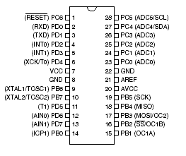
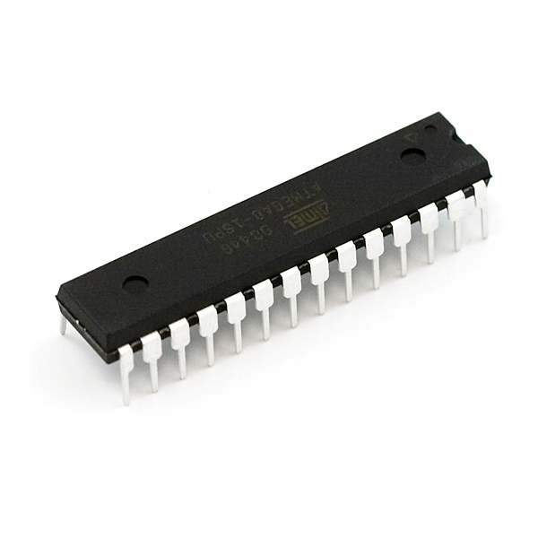
Microcontroller_ATMEGA8
High-performance, Low-power consumption
8-bit Microcontroller, Fully Static Operation
Pin No._28
Peripheral Features
Two 8-bit Timer/Counters
One 16-bit Timer/Counter
Programming Lock for Software Security
Data retention: 20 years at 85°C/100 years at 25°C(1)
Operating Voltages
4.5 - 5.5V (ATmega8)
Speed Grades
0 - 16 MHz (ATmega8)

Slide 9
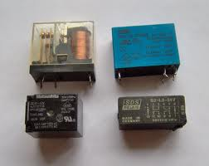
Relay :
A relay is an electrically operated switch.
Relays are used where it is necessary to control a circuit by a low-power signal.
Relays protect electrical circuits from overload or faults.
Rating: 6V/1A

Slide 10
BLOCK DIAGRAM:
Main Control Board
(Bluetooth module, ATMEGA8
Relay)
Smart Phone
(Android GUI)
Home
Appliance
User
Bluetooth connection

Slide 11
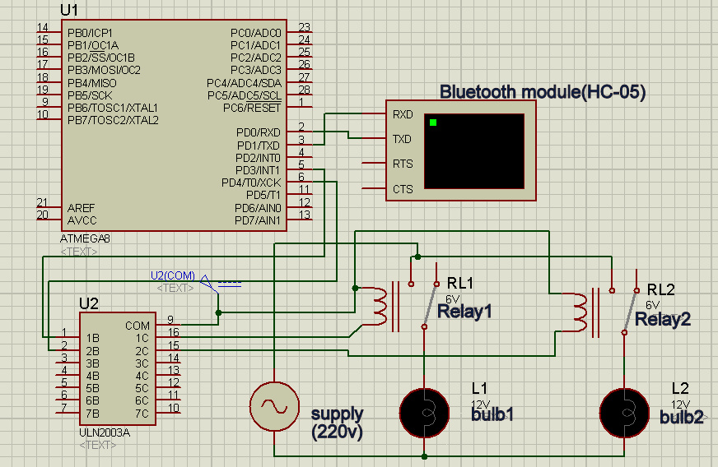
CIRCUIT DIAGRAM:

Slide 12
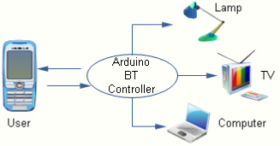
Interface :

Slide 13
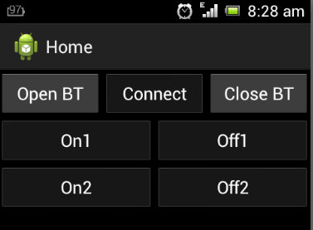
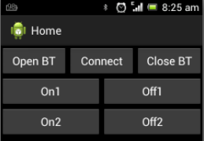
SCREEN SHOTS :

Slide 14
ADVANTAGES & DISADVANTAGES:
Advantages:
The main advantage of “Home Automation through Android Mobile” is that the “Physically Challenged and Disabled People” .
controlled through one common device
Fast enough to realize the true power of wireless technology
Replace television, air conditioner etc., remotes for sleep mode.
Smart Home.
Disadvantages:
It can be used in a limited area(30ft=9.14m).
It is expensive too.
It can not repair easily.

Slide 15
APPLICATION:
Yet there is an increasing demand for smart homes, where controlled through one common device.
This wireless technology is especially useful in home environment.
Lights and appliances (direct, power line or wireless)
TV, VCR, DVD, Tivo (IR)
Monitor weather
Temperature
Thermostats
Internet Information

Slide 16
FURTHER IMPROVEMENT:
Using wifi technology
Also can be used with temperature controlled devices.
CONCLUSION:
prime objective is to assist handicapped/old aged people
This project is based on Android platform which is FOSS(Free Open Source Software).
The design consists of Android phone with home automation devices.
prime objective is to assist handicapped/old aged people
This project is based on Android & Arduino platform both of which are FOSS(Free Open Source Software).
The design consists of Android phone with home automation devices.

Slide 17
THANK YOU……..

