Slide 1

Home Automation using ARDUINO
Prepared by:
Doaa radadad.
Wafa dabak.
Yasmeen kanaan.
Supervised by: Dr.Ahmed .

Slide 3
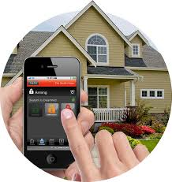
What is Home Automation?

Slide 4
What is Home Automation?
Home automation involves introducing a degree of computerized or automatic control to certain electrical and electronics system in a building.
These lighting, temperature control, etc.., this paper demonstrate a simple home automation system which contains a remote mobile host controller and several client module (home appliances).
The client modules communicate with host controllers through a wireless device such as a Bluetooth enabled mobile phone, in this case, an android based smart phone.

Slide 5
What are the benefits of an automated home?
Home automation keeps your home secure by being able to look your front door from your smart phone or tablet and do not be worry. because you misplaced your keys inside home.
Home automation saves your money.

Slide 6
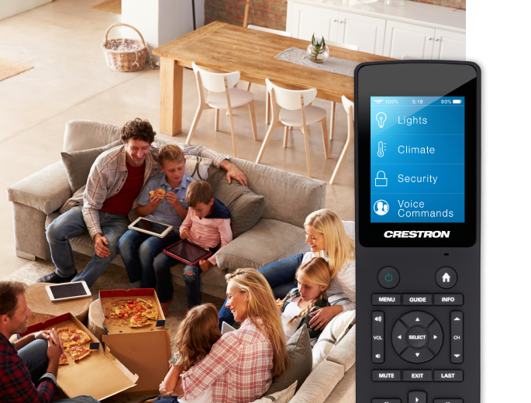
What are the benefits of an automated home?
Home automation keeps your family comfortable. .

Slide 7
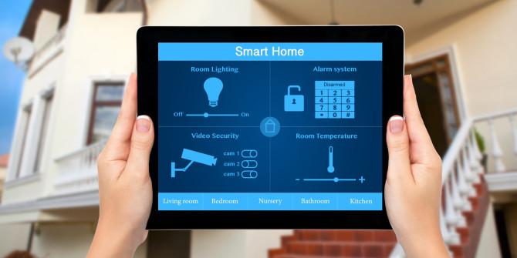
What are the benefits of an automated home?
control over your home from any location .
The greatest benefits of home automation system are added of sense of security and peace of mind.

Slide 8

Disadvantages of home automation:
Equipment and installation costs.
System Compatibility.
Human errors.

Slide 9
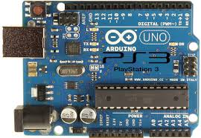
Technology used:
Arduino Uno
The main piece in our project is an arduino ATmega328 kit attached by GPRS/GSM Shield.

Slide 10
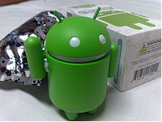
CONTENT:
Introduction
Components used
Bluetooth module
Relays
Screen shots
Implementation
Android ADK
Software design
ii

Slide 11
CONTENT:
Block diagram and hardware design .
Home automation.
Conclusion.

Slide 12
INTRODUCTION
There is an increasing demand for smart homes, where appliances react automatically to changing environmental conditions and can be easily controlled through one common device.
This paper presents a possible solution whereby the user controls devices by employing a central Field Programmable Gate Array (FPGA), where control is communicated to the FPGA from a mobile phone through its Bluetooth interface.

Slide 13
COMPONETNS USED:
The Main components used :
1) Bluetooth module .
2) Relay.

Slide 15
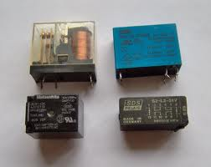
Relay :
A relay is an electrically operated switch.
Relays are used where it is necessary to control a circuit by a low-power signal.
Relays protect electrical circuits from overload or faults.

Slide 16
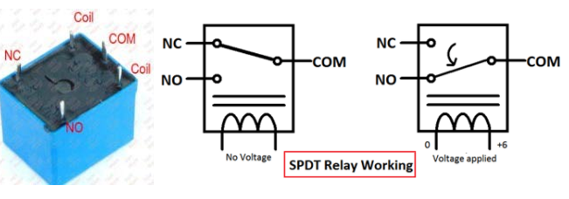
Relay working :

Slide 17
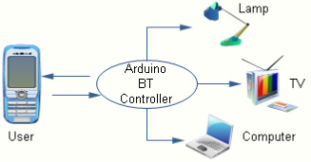
Interface :

Slide 18
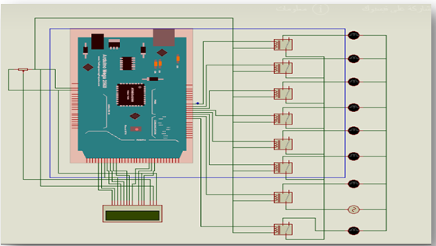
PROTUES Connection(circuit diagram )

Slide 19
Working Explanation:
First we need to download and install the Bluetooth Terminal App in our Android Phone from the Play Store and then pair it with Bluetooth Module HC05 like we normally pair 2 bluetooth devices. .
Now we have Bluetooth Terminal App installed in our Android phone through which we can send data to Bluetooth ModuleHC05. HC05 Bluetooth Module is connected to Arduino Mega to serially receive the data sent by Bluetooth terminal App through Android Smart Phone. A 16x2LCD is used to display the On and Off status of Electronic Appliances. And is used 8 Relay which are directly connected to 7 Buls.

Slide 20
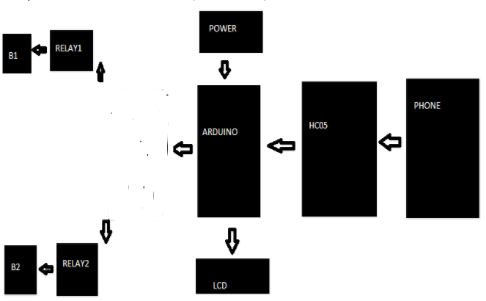
Working Exeplanation:

Slide 21
Bluetooth App :
Download and install Bluetooth Controller.
Turned ON mobile Bluetooth.
Now open Bluetooth controller app.
Press scan.
Select desired (BluetoothModule HC-05).
Now set keys by pressing set button on screen.

Slide 22
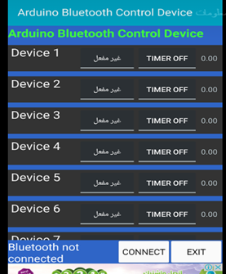
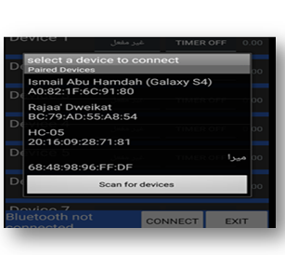
Screen shots:

Slide 23
Conclusion :
Home Automation is undeniably a resource which can make a home environment automated. People can control their electrical devices via these Home Automation devices and set up controlling actions through Mobile.
In future this product may have high potential for marketing.

Slide 24
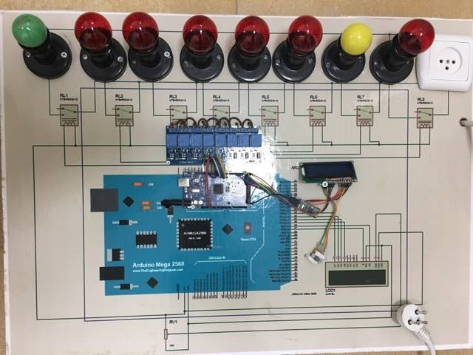
Project devices:

Slide 25
THANK YOU . . .

