Slide 1
The Bishnoi Movement: Pioneers of Environmental Conservation
A Historical Insight into Sustainable Living
Submitted by:
Himanshu and Priya
2nd Semester
Shaheed Bhagat Singh College

Slide 2
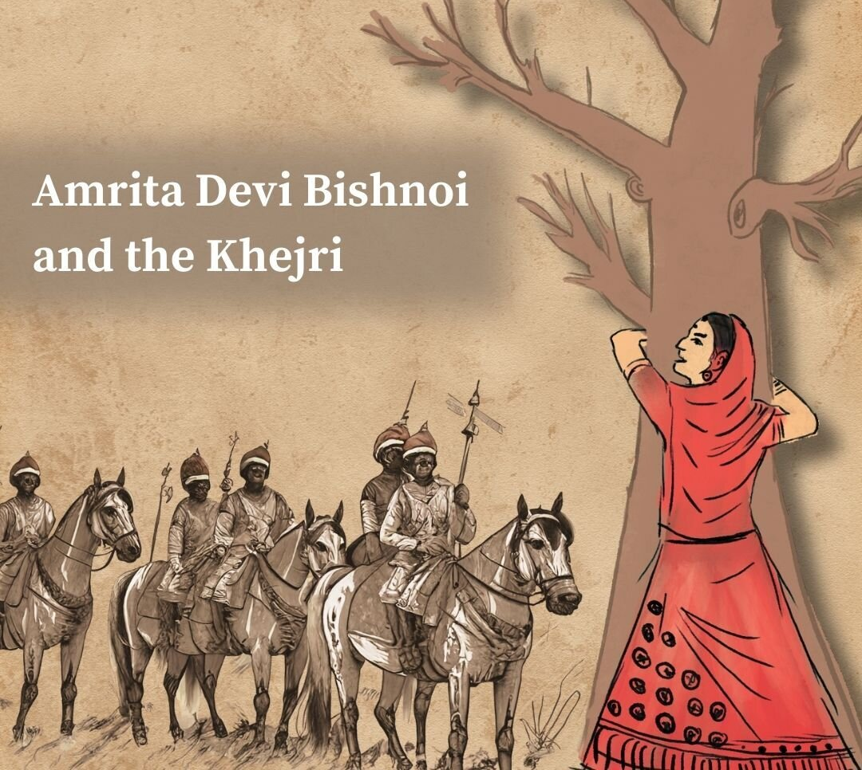

Slide 3
ENVIRONMENTAL MOVEMENT
An environmental movement can be defined as a social or political movement, for the conservation of environment or for the improvement of the state of the Environment.
The terms ‘green movement’ or ‘conservation movement’ are alternatively used to denoted the same.
The environmental movements favor the sustainable management of natural resources.

Slide 4

Cultural and Environmental Significance
Dedication to nature as part of religious belief
Role in preserving local flora and fauna

Slide 5
The Khejarli Massacre: A Defining Moment
In 1730, Amrita Devi and 362 Bishnois sacrificed their lives to protect Khejri trees.
This act became a symbol of environmental activism in India.

Slide 6

Influence on Environmental Movements
Inspiration for subsequent movements like Chipko
Influence on modern environmentalism

Slide 7
Modern Bishnoi Community
Bishnois today continue to live by the principles, actively engaging in wildlife protection.
They run rehabilitation centers for animals and participate in afforestation projects.

Slide 8
Contemporary Challenges
Balancing traditional practices with modern development pressures.
Legal battles against poaching and illegal tree felling.

Slide 9
Global Relevance
The Bishnoi principles offer insights into sustainable living and biodiversity conservation.
Their model demonstrates the importance of community-based conservation.

Slide 10


