Slide 1
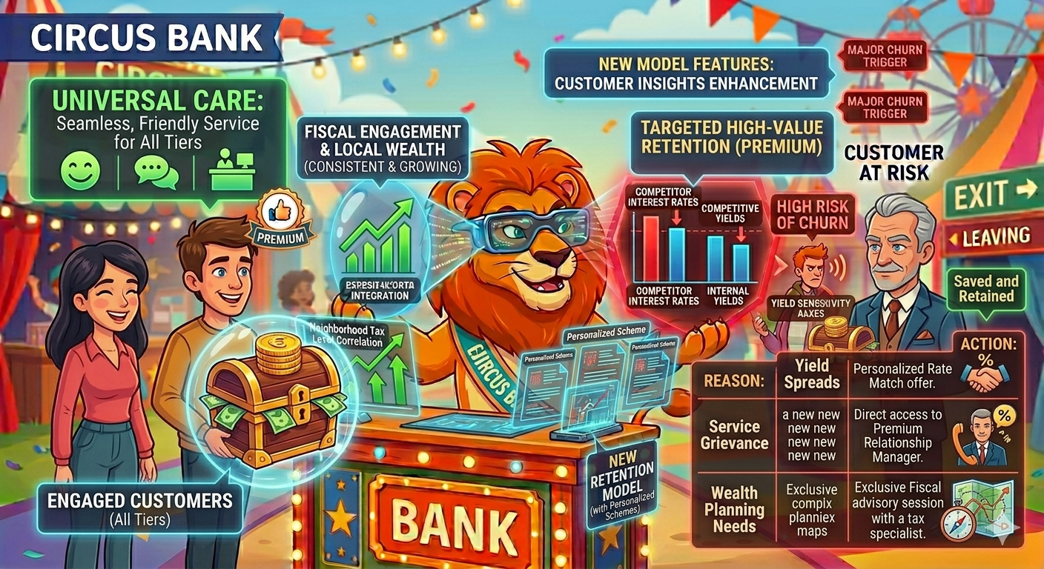

Slide 2



The One-Size-Fits-All Risk
High-Value Concentration
Uniform Retention Struggles
Customers holding savings balances above 100,000 EUR make up a very small minority of our standard client roster.
Our current approach evaluates customer churn risk as a single general group. This triggers broad, flat retention offers across all tiers of savers.
Yet they hold over 60% of our entire deposit portfolio.
Generic offers—such as a small 20€ voucher or automatic fee waivers—are highly inefficient. They fail to capture the attention of high-net-worth clients while unnecessarily reducing our overall profit margins on standard accounts.
Treating this vital capital bedrock with low-tier automated responses leaves millions in assets open to aggressive competitor marketing.

Slide 3


Spotting Churn Before the Exit
Enriched Churn Intelligence
Rather than relying only on standard transaction patterns, we integrate external data indicators to spot warning signs and run smarter campaigns:
Regional Tax & Income Trends: Blending public postal-code tax data to detect subtle household disposable wealth shifts.
Competitor Interest Yields: Flagging outbound money flows the moment regional competitors announce superior savings rate adjustments.
Internal Monetary Velocity: Tracking transaction deceleration habits to flag disengagement months before a final account closure.

Slide 4




The Multi-Tiered Implementation
2. Segment Filter
4. Bespoke Offers
The system splits mass-market indicators from high-value accounts (>100k) to isolate distinct behaviors.
Bankers deploy personalized retention efforts, such as custom rate matching or exclusive advisory perks.
1. Data Fusion
3. Priority Alert
We blend internal transactions with external neighborhood economic indicators and competitor yields.
When high-value accounts trigger a warning, an automated alert is routed directly to personal bankers.

Slide 5


Expected Business Outcomes
60%
10x+
Deposit Capital Secured
Improved Campaign ROI
Focusing specialized models on clients holding over 100k EUR helps insulate our critical asset foundation from competitor rate movements.
Moving away from flat, generic vouchers to high-touch personal outreach minimizes wasted incentive spend and improves response rates.

