Slide 1
Secure Data Hiding in image using steganography
CAPSTONE PROJECT
Presented By:
Student Name :
College Name & Department :
Vinay Kumar
Heritage Institute of Technology, Kolkata, WB
(Applied Electronics and Instrumentation Engineering)

Slide 2
OUTLINE
Problem Statement
Technology used
Wow factor
End users
Result
Conclusion
Git-hub Link
Future scope

Slide 3
Problem Statement
The problem involves securely hiding sensitive data within an image using steganography to ensure confidentiality and prevents unauthorized access. Traditional methods of transmitting sensitive data, such as encryption, often draw attention, making them vulnerable to interception or forced decryption attempts.
This project provides a secure, undetectable, and user-centric solution to hide sensitive information within images while ensuring data integrity and access control.

Slide 4
Technology used
Programming Language: Python
Libraries:
OpenCV (Image processing and pixel manipulation)
hashlib (SHA-256 password hashing for secure authentication)
struct (Binary data packing/unpacking for metadata handling)
os (File system operations)
Image Format: PNG (lossless compression to preserve hidden data)
Platform: Cross-platform (Windows, macOS, Linux)

Slide 5
Wow factors
This project stands out through its unique integration of security and usability:
Dual Security Layers: Combines steganography (data hiding) with SHA-256 password hashing (access control).
Lossless Data Integrity: Uses PNG format to prevent pixel corruption, unlike JPEG-based tools.
Input Support: Accepts text input .
Educational Value: Modular codebase demonstrates steganography principles, making it ideal for cybersecurity learners.
LSB-Based Steganography: Hides data in the Least Significant Bit, ensuring security without visible changes in image.

Slide 6
End users
Journalists/Activists: Securely share confidential information without detection.
Corporations: Protect intellectual property during digital communications.
Cybersecurity Professionals: Demonstrate steganography techniques in training programs.
General Users: Privacy-conscious individuals seeking discreet communication.
Educators/Students: Teach or learn steganography and cryptography fundamentals.
Government & Defense Agencies: Securely embed sensitive data in images for intelligence and confidential operations.
Researchers/Academics: Study and improve steganographic techniques for data security and cryptography.

Slide 7
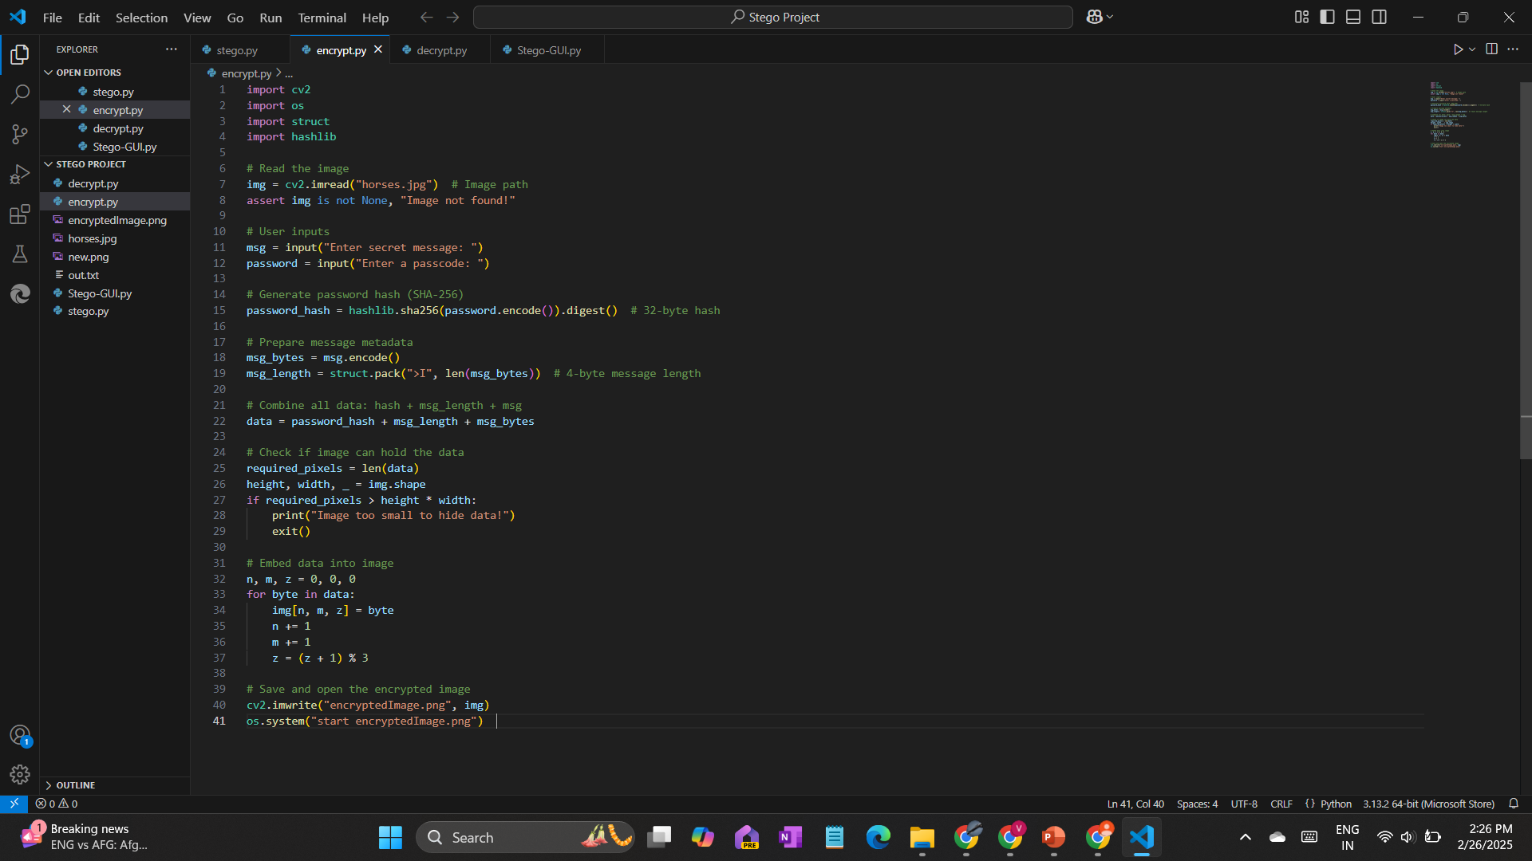
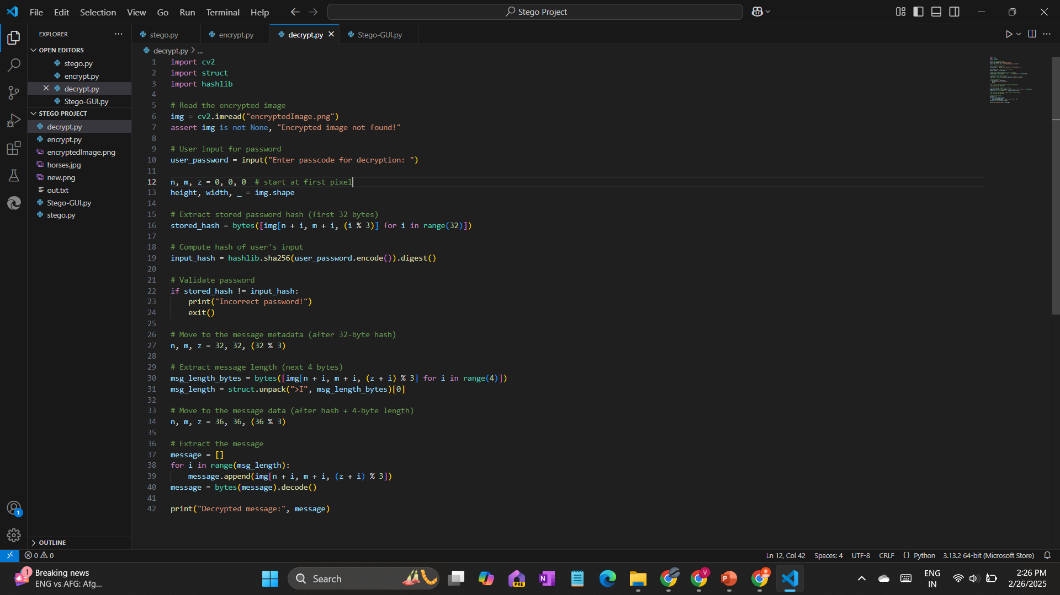
Results

Slide 8
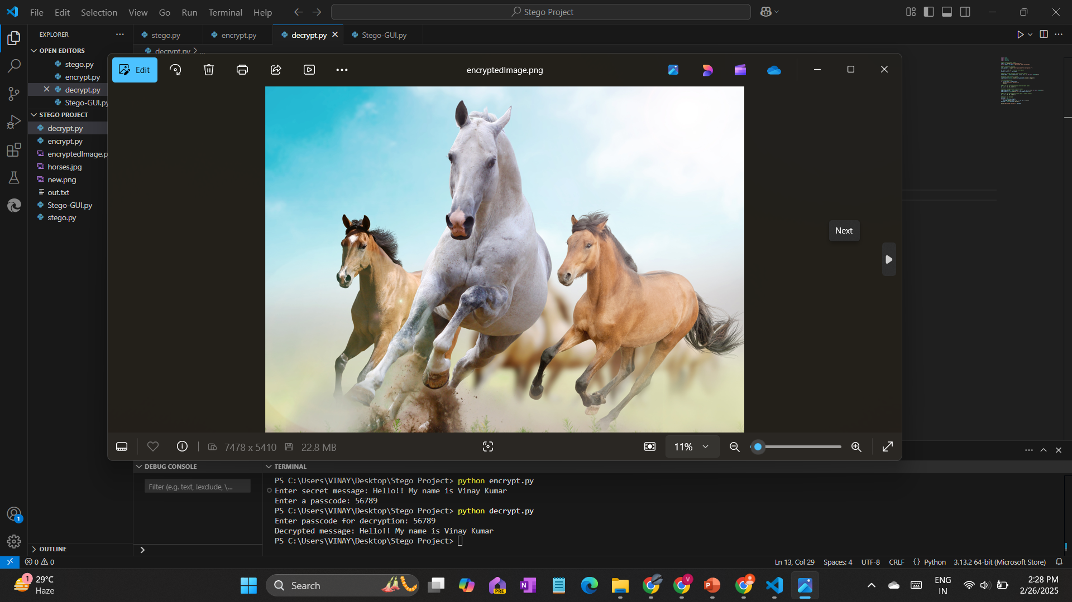
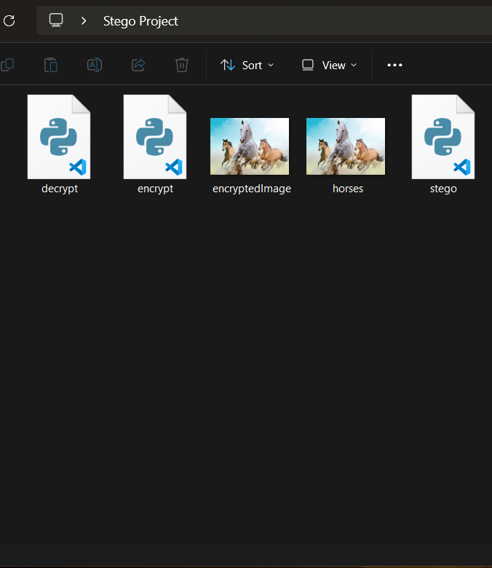
Results

Slide 9
Conclusion
This project successfully bridges the gap between security and usability in covert data transmission. By hiding sensitive information within ordinary images and enforcing password-based access, it ensures both invisibility (avoiding suspicion) and security (preventing unauthorized access).
The use of lossless PNG preserves data integrity. This tool not only solves the problem of detectable encrypted communication but also empowers non-technical users to protect their data confidently.

Slide 10
GitHub Link
https://github.com/imvinxx/Steganography-Project-Using-Python.git
Description :
This Python-based Project enables secure hiding of secret messages within images using steganography, combined with robust password protection. Designed for both security and usability.
Repository Contents:
Source code (encrypt.py & decrypt.py)
Sample Image (horses.jpg)
Presentation (Steganography-project.pptx)

Slide 11
Future scope
GUI: Develop a user-friendly GUI to make embedding and extracting messages easily.
Extended File Support: Embed documents (PDF, ZIP) and multimedia files.
Enhanced Encryption: Integrate AES-256 for end-to-end message encryption.
Cloud Integration: Directly fetch/save images from cloud storage (Google Drive, Dropbox).
Mobile App: Develop Android/iOS versions for on-the-go use.
Machine Learning: Implement AI-driven pixel selection for optimized data hiding.
Multi-Factor Authentication: Add OTP/biometric verification for decryption.
Metadata Scrubbing: Remove EXIF data to enhance anonymity.

Slide 12
THANK YOU

