Slide 1
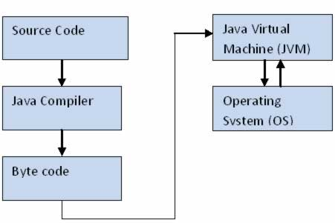
Java Architecture

Slide 2
OOPS Concepts – Object Oriented Programming System
Object – Is an instance of the class. It has state and the behavior
Example: Human or animal. State -> Name, color, Height. Behavior -> walk(), eat(), play(), sleep() etc
Class - Is a template/blue-print/container to create an object. User cannot communicate to the class directly. We have to create an object before making use of it.
Example: Student, Fruit, Vegetable etc.
Properties of a Student -> Name, DOJ, Roll Number, Tasks/Behior of a Student -> read(), write()
Abstraction – Hiding the implementation details
Example: Downloading the apps from play store, Driving the car without knowing its implementation details
Encapsulation – Binding variables and methods under single entity. Protecting the data
Example: Student
Inheritance – Acquiring properties from one class to another class. Explained in next slide
Polymorphism – Performing the same task in different ways. Function overloading and overriding
Notes:
Refer SeleniumQANov\src\OOPs package for examples
/Selenium-Java/src/Excercise/

Slide 3
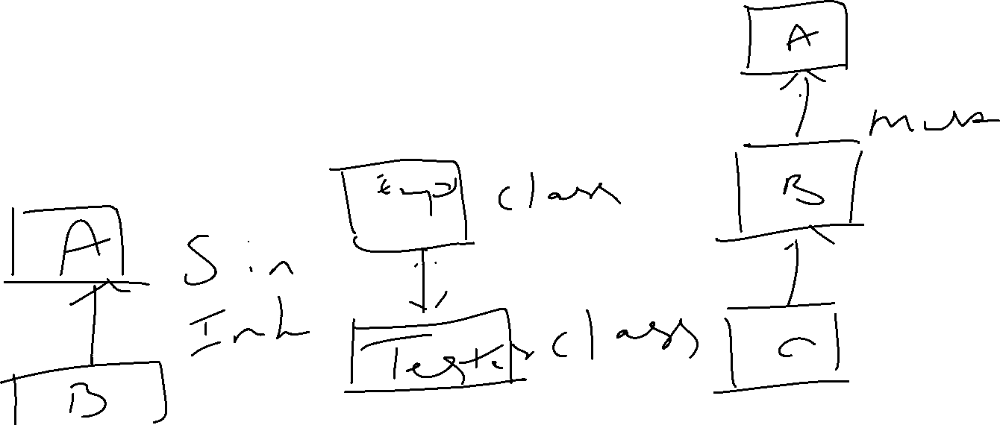
Class- Template/Blueprint & Object ->Physical reality/instance of a class
House1
House2
Template/blueprint
House3 - objects

Slide 4
Encapsulation
Protecting the data from the user
Inheritance
Using extends keyword
Student class
Variables – Name, Roll No, Date of Joining
Methods – read(), write(), play()
Parent class
Super/Base class
Child class
Sub/Derived class
Polymorphism
Different types of Inheritance
Single
Multi-level
Hierarchical
sum() or add()
sum(int a, int b)
sum(double x, double y)
drawPolygan()
- can draw square, rectangle or triangle
Method overloading
Method overriding
Notes:
Refer SeleniumQANov\src\OOPs package for examples

Slide 5
Access Specifiers
sd
Public
protected
Default
Private
Class
Notes:
Public –> code is accessible for all classes; private -> code is accessible within the class; default-> code is accessible in the same package
Protected-> code is accessible in the same package and subclasses

Slide 6
Multi level
Grand Parent class
hierarchical level
Parent class
Super/Base class
Parent class
Child class
Sub/Derived class
Child class
Child class
Child class
Notes:
SeleniumQANov->Inheritence package has Inheritance example
Refer SeleniumQANov\src\OOPs package for Sub and Super examples

Slide 7
Method overriding
Vehicle
Parent class -> Demo1
Object -> car, bus, truck etc
Vehicle car = new Vehicle();
Method sum()
Function/method sum() can have many functions with the same name as long as the parameters or the return types are different
Child class -> Demo2
Method sum()
Notes:
SeleniumQANov\src\OOPs -> Refer Sub and Super example
/Selenium-July-Batch/src/OOPs/AccessSpecifier.java

Slide 8
Interface – It is used to declare methods. Methods declared inside the interface doesn’t have the implementation details (below Java 8 version). It is the responsibility of the class that implements the interface to have the implementation details of the methods that are declared in the interface.
This is how we achieve multiple inheritance in Java. B’cas class cannot extend more than one class.
How to create an interface ?
How to declare the methods and constants in an interface
How to implement the interface in a class
Note: When you implement the interface in a class, we have to implement all the methods present in the interface. In addition to that, we can create our own methods in the class itself
super brings the value from the parent class
this brings the value from the current object level
Constructor – It is similar to method. Only difference is, it does not return any value. Constructor name should have the same name as the class name. If we don’t define, compiler will call the default constructor.
Significance of constructor – Generally we use constructor to initialize some value or property. So that, it will get invoked automatically when the object is called.
Notes:
SeleniumQANov\src\OOPs\Child.java, refer Child class for “super, this” keywords. Also for ‘constructor’ example
SeleniumQANov\src\Inheritance\GrandSon.java. And interfacedemo\BankingDemoClass.java
Selenium-JanBatch\src\JavaBasics\ConstructorDemo.java

Slide 9
Loops
For, while, do-while
Conditions
If, else if, switch,
Arrays
int[] position = new int[]{10,12,23,34};
int a[][]= {{2,4,6},{1,3,5}}; -> Two Dimensional
Keywords
final, access modifiers (private, protected, this, super) etc
Topics
1. Try catch block -Selenium-Java\src\Excercise\Switch.java
2. Banking interface Demo - SeleniumQANov\src\interfacedemo
3. Upcasting - SeleniumQANov\src\interfacedemo
4. Access Specifiers - SeleniumQANov\src\OOPs\AccessSpecifierDemo1.java
5. Back to Selenium scripting
6. Demonstrate the script on both Chrome, FireFox browsers
Notes:
/Selenium-Java/src/Excercise

Slide 10
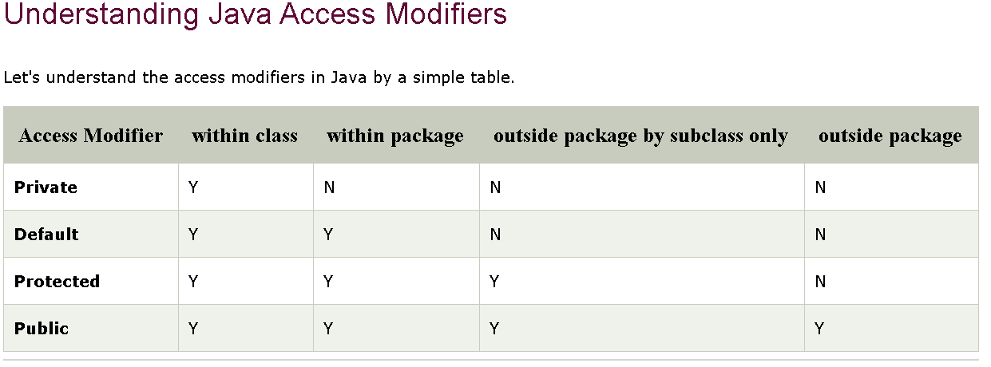
Access modifiers
It specifies the accessibility or scope of a field, method, constructor, or class. We can change the access level of fields, constructors, methods, and class by applying the access modifier on it
Ex: SeleniumQANov->Javaprograms->MainClass.java
Private: The access level of a private modifier is only within the class. It cannot be accessed from outside the class.
Default: The access level of a default modifier is only within the package. It cannot be accessed from outside the package. If you do not specify any access level, it will be the default.
Protected: The access level of a protected modifier is within the package and outside the package through child class. If you do not make the child class, it cannot be accessed from outside the package.
Public: The access level of a public modifier is everywhere. It can be accessed from within the class, outside the class, within the package and outside the package.
Notes:
Selenium-JanBatch\src\JavaBasics\Test.java & Student.java has access modifier ‘name’, /Java-May/src/JavaPractice/Paliandrome.java
SeleniumQANov\src\OOPs\AccessSpecifierDemo1.java

Slide 11
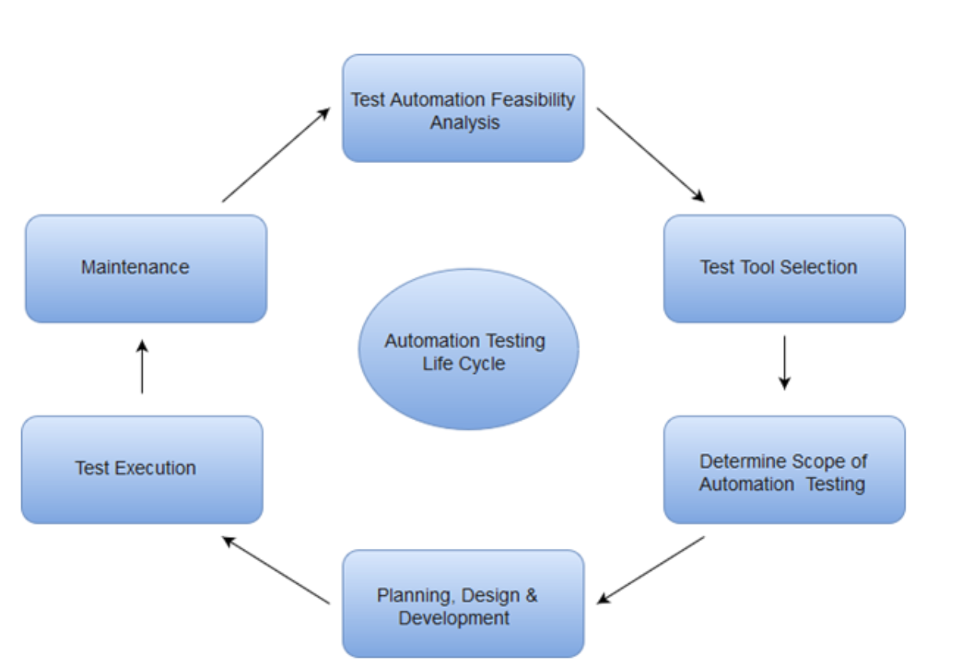
Notes:
C:\Users\HP\Desktop\Selenium-Training\Selenium-BasicFAQs, Java-Selenium

Slide 12
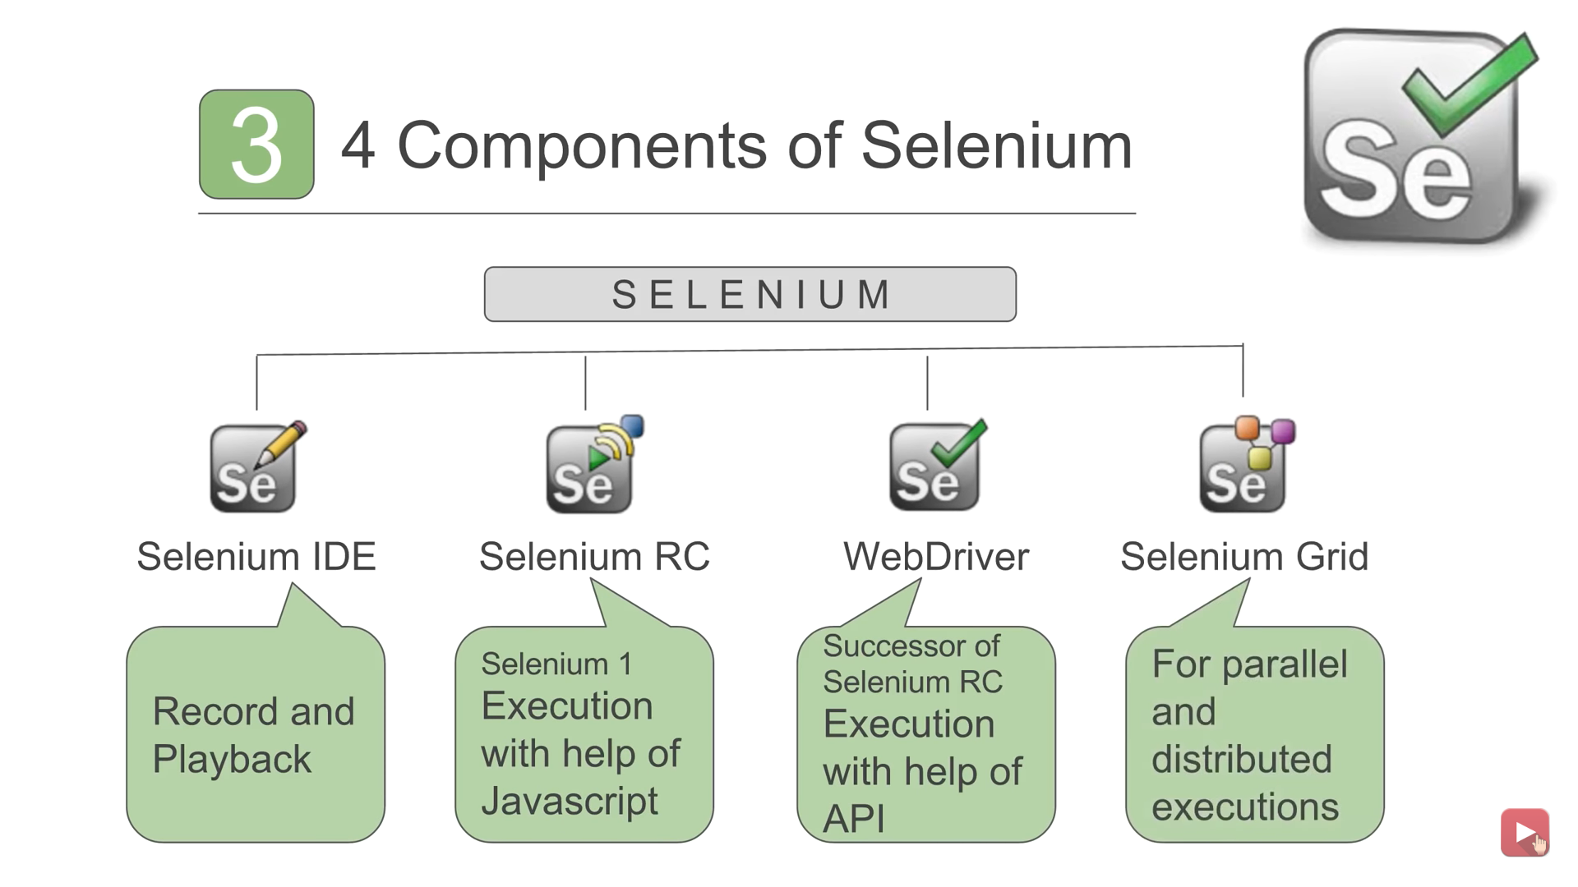

Slide 13
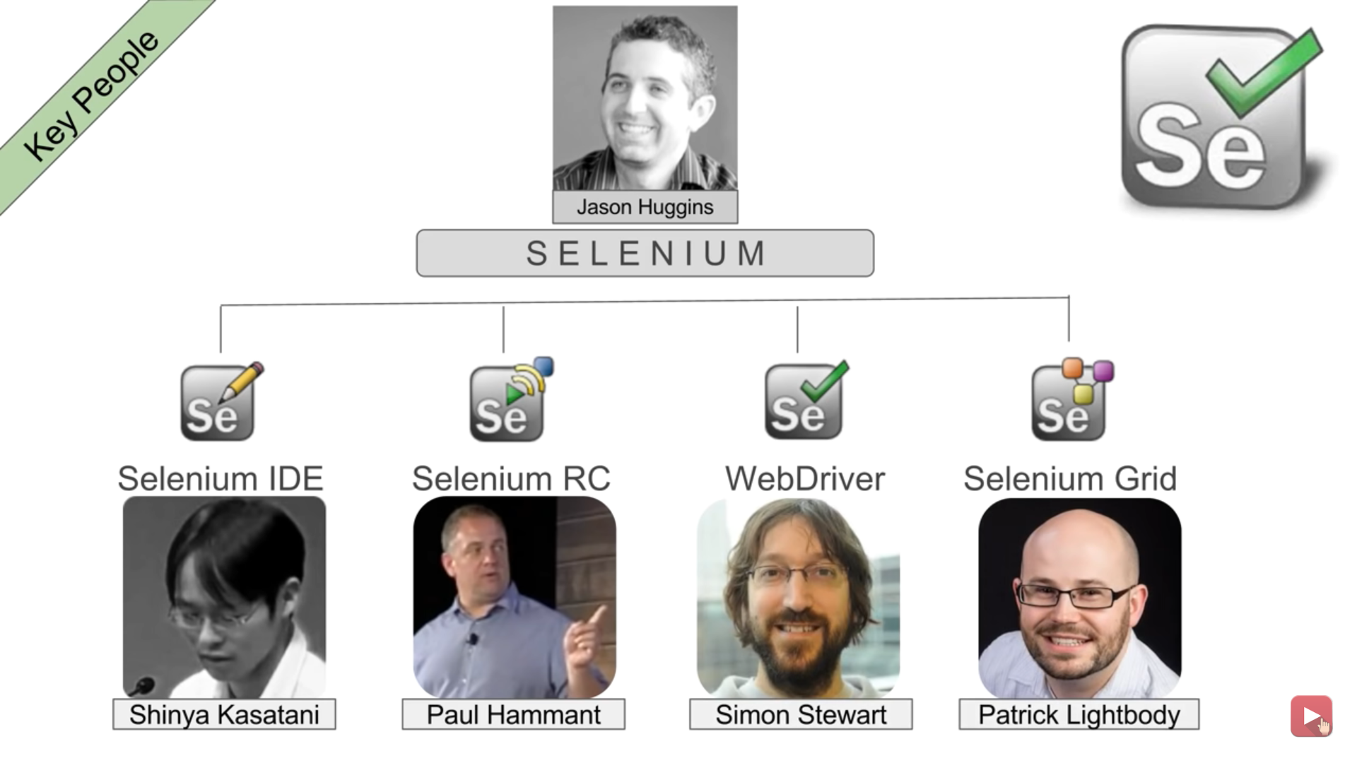

Slide 14
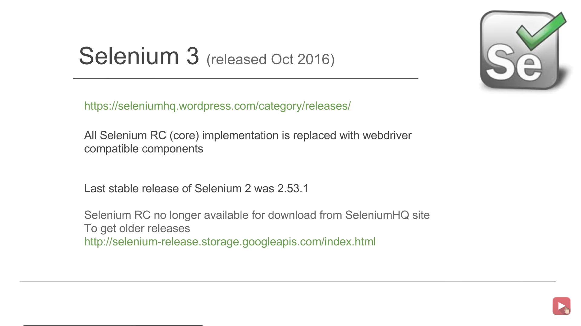
Notes:
https://selenium-release.storage.googleapis.com/index.html

Slide 15
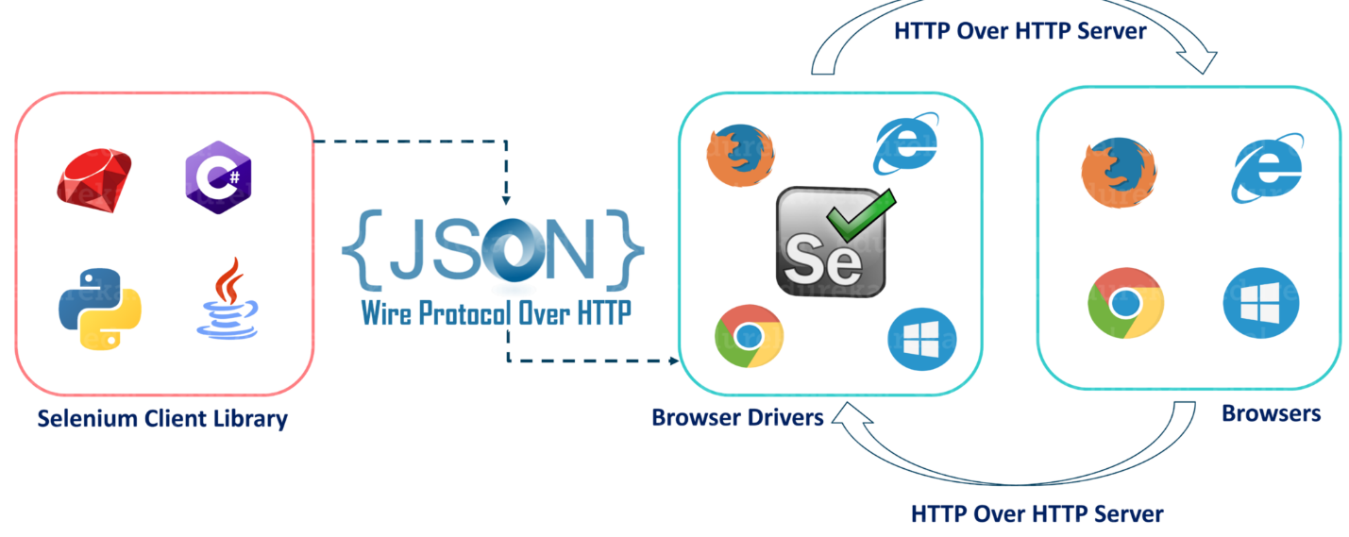
Selenium Architecture Simplified
After you trigger the Test, complete Selenium code (Client) which we have written will be converted to JSON format
Generated Json is sent to Browser Driver (Server) through http Protocol
Note: Each browser contains a separate browser driver
Browser drivers communicate with its respective browser and executes the commands by interpreting JSON which It received on the browser.
Browser Driver receives responses back from the browser and it sends Json response back to Client.
Notes:
https://selenium-release.storage.googleapis.com/index.html
https://www.selenium.dev/selenium/docs/api/java/index.html?org/openqa/selenium/WebDriver.html
https://www.toolsqa.com/selenium-webdriver/selenium-testing/
https://www.tutorialspoint.com/selenium/selenium_test_design_techniques.htm
https://www.guru99.com/xpath-selenium.html

Slide 16
Demo on First Selenium program
Download Selenium-Java Jars from the location - https://selenium.dev/downloads/ and include in your project
Download the browser driver(Chrome & FF) from the above location and include in the appropriate place
https://chromedriver.storage.googleapis.com/index.html
Set the system property and instantiate the browser object from the class to invoke the browser
Perform upcasting of browser object to webdriver and start implementing the methods of webdriver
Demonstrate use of get(), getTitle(), getCurrentUrl(), close(),navigate() methods
Validate the title page by using equals method
Locators in Selenium
Locator techniques are used to identify the Web elements/objects on web page such as text boxes, buttons, links, dropdowns, checkboxes, Radio buttons, Alerts/popups, forms etc.
Different types of locators are available in Selenium to identify objects on web applications
Name, id, classname, linktext, partiallinktext, xpath, css,tagName
https://login.salesforce.com/?locale=in
General Syntax – Xpath ->//Tagname[@attribute=’value’] || CSS -> Tagname[attribute=’value’]
css – tagname#attribute-value (input#username) in SF) || #attribute-value || tagname.attribute-value
css – [@class=’username’] or [#username] or .class-value or div#error.loginerror (SF login error msg)
driver.findElement(By.cssSelector(“[@class=’username’] ”)) → cssSelector(“.value”)→ cssSelector("#value ")
xpath - //input[@value=’Log In’] → //input[@type='submit’], //input[contains(@name,’procee’)] in Rediff
//<tagname>[@id=’value’] or/and //*[@id=’value’] → * indicate any tag
Gmail.com -> //input[@type='email' and @id='identifierId’]
http://cafetownsend-angular-rails.herokuapp.com/login -> /html[1]/body[1]/div[1]/footer[1]/p[2]//child::a
//div[@class='fsl fwb fcb']/following-sibling::div[1], //div[@class='fsl fwb fcb’]/previous-sibling::div[1]
https://www.tutorialspoint.com/about/about_careers.htm //ul[@class='toc chapters']/child::li[10]
Notes:
SeleniumNov3\src\SeleniumDemo\Demo1.java; /WebTest/src/GoogleNavigation.java
https://www.selenium.dev/documentation/en/webdriver/driver_requirements/
Selenium 4 -> Relative locators

Slide 17
Hierarchy of Classes and Interfaces in Selenium
SearchContext Interface
WebDriver Interface
Once driver object is created, we have to implement the methods of webdriver to automate the scenarios on the browser. Hence we are doing upcasting. By doing this, we can run the scripts on any browser.
How to create an object from the class
Class name = X
X <objectname> = new X();
ChromeDriver driver = new ChromeDriver();
RemoteWebDriver class
ChromeDriver class
FirefoxDriver class
IE or Safari driver class
WebDriver driver = new ChromeDriver(); upcasting to achieve run time polymorphism
Notes:
https://selenium.dev/documentation/en/getting_started_with_webdriver/locating_elements/
https://www.selenium.dev/selenium/docs/api/java/index.html?org/openqa/selenium/WebDriver.html

Slide 18
Exception Handling
Demonstrate the division by zero example
Demonstrate “return” with example for a function
Demo
Rediff
Facebook
Google
Salesforce
Challenges
What if there are multiple fields with the same id ?
In FB, class name is same for both username and password fields. In that case, it will identify which element ?
Alpha numeric ids may vary after every refresh or with new session of the browser
What is compound classes (with spaces) ? How to manage that (Replace space with .)
If the value of id tag is changing dynamically, how to handle. Take FB Login button as example
Double quotes inside double quotes not supported in Selenium locators. Replace with single quotes–FB/SF
Right-click on blue highlighted html code to generate xpath & CssSelector
Notes:
/WebTest/src/GoogleNavigation.java

Slide 19
Significance of ChroPath plugin
It allows user to identify xpath and CSS easily
Developer tools
$("input[id='Login’]”) for CSS
$x("//input[@id='Login’]”) for xpath
Identifying the object using text attribute
//a[text()='Book’] or //*[text()='Add-Ons’] for https://www.spicejet.com/
Xpath → //a[@id='highlight-book']
CSS -> #highlight-book or a[@id='highlight-book’] way of handling the above object
Use the text() only when there are no attributes found as it is not preferred way of identifying the object
Note: * indicate regular expression which means it will match any tag
Relative xpath - //div[1]/ul/li[8]/a
Absolute xpath - /html[1]/body[1]/form[1]/div[4]/div[1]/div[1]/div[2]/div[2]/div[1]/ul[1]/li[7]/a[1]
How to traverse to sibling element using xpath?
.//*[@id='tablist1-tab1']/following-sibling::li[2]
How to traverse back to Parent element from Child element using Xpath?
.//*[@id='tablist1-tab1']/parent::ul
Notes:
http://www.qaclickacademy.com/interview.php

Slide 20
Handling other web-elements
MakeMyTrip site to select the radio button option //li[contains(text(),'Round Trip’)]
//span[@class='tabsCircle appendRight5’] ->returns 3 radio buttons. Hence go with→ //li[contains(text(),'Multi City’)]
Solution to find the unique button-> (//span[@class='tabsCircle appendRight5'])[2]
//*[@id="root"]/div/div[2]/div/div/div[2]/p/a →xpath for search(Not recommended this way, get it from chropath)
Search example: a.primaryBtn.font24.latoBlack.widgetSearchBtn →(Tagname.ClassAttribute-value or .ClassAttribute-value works. But NOT #ClassAttribute-value.
Note: Compound class having white space is replaced with dot in the above example
QAClick
Demo on how to identify Radio, CheckBox, Dropdown box, Alert, AutoSuggestive box
Spicejet.com
input[id*='SeniorCitizenDiscount’] →* is a regular expression in this case for CSS
How to handle Dynamic dropdown box→ Select currency = new Select(c); → c is the WebElement/obj
Discuss methods of Select object → selectByValue, selectByVisibleText,
How to handle check box -> identity and use the method isSelected()
//a[contains(text(),'Chennai (MAA)’)] which has 2 elements matching (from and to city). How to handle ?
(//a[@value='MAA'])[2] →Indexing Or use parent-child relation ship to identify the object uniquely
Rediff.com
By.linkText("Sign in")
Notes:
SeleniumNov3\src\SeleniumDemo

Slide 21
How to handle Frames
Using switchTo().frame(0) and use switchTo().parentFrame() to the main window
Show the example of the frame created
Links example – To find the total number of links on a webpage (Interview question)
Show the example of Links Demo → by.tagName(“a”).size()
Table Example
Show the example of both Simple Table and Nested Table Demo
Window handle
Show the demo of LinksDemo3
Actions class - AmazonDemo
The Selenium WebDriver's Advanced User Interactions API allows us to perform operations from
keyboard events and simple mouse events to complex events such as dragging-and-dropping,
holding a key and then performing mouse operations by using the Actions class, and building
a complex chain of events exactly like a user doing these manually.
We need to create an instance of the Actions class by passing the instance of driver class
to the constructor in the following way:
Actions builder = new Actions(driver);
There is NO difference between build and perform methods. B’cas, perform internally calls ‘build’ method.
Notes:
/SeleniumNov3/src/SeleniumDemo/FrameEx1.java; /SeleniumNov3/src/SeleniumDemo/AmazonDemo.java

Slide 22
Assertions – Is to validate true or false condition - AssertTest
Import TestNG jar and add it to the project
Take the example of checkbox is selected or not in spicejet or one of the websites and check whether it is selected or not
Demonstrate assertTrue and assertFalse methods of Assert class.
Delete Cookies from the browser – driver.manage().deleteAllCookies()
ScreenShot
Show Demo1 example on how to take the screen shot
Synchronization in Selenium
Implicit wait – wait for specified seconds before selenium throws “NoSuchElement” exception.
driver.manage().timeouts().implicitlyWait(TimeOut, TimeUnit.SECONDS); → ActitimeDemo
Explicit wait – Its also called WebDriverWait or the ExpectedConditions
WebDriverWait wait = new WebDriverWait(driver,30);
Thread.sleep – This is to sleep for a specific period of time
Notes:
/Guru1-Automation/src/ExplicitWaitActiTimeDemo.java

Slide 23
WebDriver Manager
What is WebDriver Manager
How to use WebDriver Manager
Small sample project for demo
Notes
https://github.com/bonigarcia/webdrivermanager
https://mvnrepository.com/
Group id - com.test.demo
Artifact id – SeleniumWebDriver1
Search for – Selenium java and webdrivermanager
Notes:
/SeleniumWebDriverManager

Slide 24
Framework
TestNG – Unit Testing framework – NG->Next Generation
Jenkins – Continuous Integration (CI)
Maven – Build Management Tool
Log4J – Logging Reports
Page Object Model – Design pattern for testcase development
Data Driven Testing – Apache POI
TestNG Framework - https://testng.org/doc/eclipse.html
Importance of TestNG -It is used to control the test cases. TestNG will act as java compiler. Hence no need of main method for the TestNG classes. Each method will be treated as one test case with every @Test annotation.
TestNG is one of the frameworks to build Selenium testcase.
Installation and Configuration of TestNG in Eclipse
TestNG XML file importance
Test Suit -> Test Folder (module) -> Test cases
Annotations - @Test, @BeforeTest, @AfterTest
We can define multiple tests from a single class
We can modularize the test cases(grouping)
Methods tag inside the xml file
Exclude/Include methods using regular expression(*)
Annotations – BeforeMethod,AfterMethod, BeforeSuite and AfterSuite
Notes:
https://download.eclipse.org/technology/m2e/releases/latest/
/TestNGTutotrial/src/test/, E:\eclipse-workspace\Test

Slide 25
Groups in XML
Define the parameter (groups = {“Smoke”}) next to @Test annotation and include the below tag in XML below test tag
<groups>
<run>
<include name="Smoke"></include>
</run>
</groups>
Include Package in XML
Include the below package tag inside the test tag
<packages>
<package name="TestNGDemo2">
</package>
</packages>
dependsOnMethods annotation
Parameter tag

Slide 26
Maven - https://maven.apache.org/guides/getting-started/maven-in-five-minutes.html
Maven is a Build and Project Management tool for Java frameworks
Central repository to get dependencies – mavenrepository.com (jars of all the software's related to java)
Flexibility in integrating CI tools such as Jenkins
Install Maven – Download apache-maven3.x.x-bin.zip from Apache website
https://maven.apache.org/download.cgi – Download location
Java is pre-requisite for maven
Set System variables to recognize Maven
Maven Terminologies
Groupid – It will identifies your project uniquely across all projects
Artifact – It’s a jar file, that gets deployed to maven repository
Archetype:generate – Generates a new project from archetype
Creating Maven project
Create the project using the command C:\users\hp>mvn archetype:generate -DgroupId=testautomation -DartifactId=MavenJava -DarchetypeArtifactId=maven-archetype-quickstart -DinteractiveMode=false
Note: MavenJava will be the Project name and testautomation will be the package in eclipse
Eclipse C:\users\hp\Mavenjava2>mvn eclipse:eclipse to integrate project into eclipse https://projects.eclipse.org/projects/technology.m2e
Finally import project into eclipse using File->import from eclipse
Notes:
https://maven.apache.org/surefire/maven-surefire-plugin/examples/testng.html

Slide 27
Include “surefire plugin” into POM.xml to run the maven scripts in eclipse <- Interview Question https://maven.apache.org/surefire/maven-surefire-plugin/usage.html
By default, Maven recognizes all tests. However, we can mention the specific tests to run by including the xml file as mentioned in the below example.
Check in Eclipse -> Window preferences to check for Maven installation
C:\Users\HP\Downloads\Mavenjava\Mavenjava>mvn –version
C:\Users\HP\Downloads\Mavenjava\Mavenjava>mvn clean
mvn compile will check for the syntax
mvn test → will execute the tests which are mavenjava project
Note: End all your java class with Test for Maven to recognize the classes
Example: SeleniumTest.java
To run a single test, specify the java file as mentioned below C:\Users\HP\Downloads\Mavenjava\Mavenjava>mvn -Dtest=AppiumTest test
To run Regression suite, type -> C:\Users\HP\Downloads\Mavenjava\Mavenjava>mvn test -PRegression
Note: Maven look for Regression profile in POM.xml file to run, then it executes the relevant testing.xml file specified inside the regression profile.
Similarly, we can specify Smoke profile in POM.xml file to run only smoke related test cases & run mvn test –Psmoke
Note: POM.xml is heart of Maven project. Maven look for POM.xml file before executing the project.
Notes:
E:\eclipse-workspace\Selenium-Pravallika-maven
/SeleniumNov3/src/TestCases/LoginApplication2.java
Try, E:\eclipse-workspace\SeleniumWebDriverManager\src\test\java\test\SeleniumTest.java
E:\eclipse-workspace\SeleniumWebDriverManager\src\test\java\test\SeleniumTest.java

Slide 28
Integrate TestNG with Maven
http://maven.apache.org/surefire/maven-surefire-plugin/examples/testng.html
Jenkins integration with Maven project
It’s an open source automation server. It is Continuous Integration & Continuous Delivery tool. Can be Downloaded from - https://jenkins.io/download/
How to run C:\Jenkins>java -jar Jenkins.war --httpPort=8080 on command prompt
Then, type the URL http://localhost:8080/ on browser to login
Go to “Manage Jenkins” from Dashboard-> Global Tool Configuration
Provide JDK(JAVA_HOME) and Maven configuration (MAVEN_HOME) path
Jenkins->Manage Jenkins->Manage Plugins-> Install “Maven Integration Plugin” and set the POM.xml path
Note: Copy MavenJava project to .Jenkins folder before proceeding below step
Create “New Item” from Jenkins job & Select Free Style Project. General tab-> Click Advanced -> in Configure/use Custom workspace, specify the Maven home directory ${JENKINS_HOME}/Mavenjava
This step is required to identify the project (Mavenjava)
Go to Build Environment -> Build. Specify Maven Version and Goals as “test” or “test -PRegression” and click on Save and Apply
Now select the Maven project and click on “Build Now” to build the project
Click on Console Output to view the results
Build Triggers – Goto Source Code Management tab-> Build Triggers->Build Periodically and provide the details
Notes:
Java –jar Jenkins.war –httport=9090

Slide 29
Integrate TestNG with Jenkins
Select the project -> configure -> Build -> Post build Actions -> **/testng-results.xml as shown below
Click on Build Now and we can see the “TestNG” results on the project
Reusable Components(Functions)
Show the demo of Invoking the browser and Login functionality written in TestBase and BrowserDemo in SeleniumNov3 project
Page Object Pattern
Easy to maintain 2. Reduce or Eliminate duplicacy 3. Re-usability of code 4. Reliability
Rediff.com
Home page – Java class – Objects of Home page
Login page – Java class – Objects of Login page
Test Cases – If there are 100 plus test cases, then I will call Login script where ever required by creating the instance of the object (object of the class)
FindBy – Annotation usage (will replace driver.findelement)
@FindBy(xpath=“”)
WebElement username
Notes:
/SeleniumNov3/src/TestCases/LoginApplication2.java
E:\eclipse-workspace\Selenium-Pravallika-maven
Try, E:\eclipse-workspace\SeleniumWebDriverManager\src\test\java\test\SeleniumTest.java
E:\eclipse-workspace\SeleniumWebDriverManager\src\test\java\test\SeleniumTest.java

Slide 30
Data Driven Testing from excel
Apache POI API
It is used to read and write the data into excel
Maven Dependencies - Download Apache poi and poi-ooxml dependency files from maven repository
Alternatively, download the binary from Apachi poi-bin-4.1.1-20191023.zip
Strategy to Access Excel Data
Create object for XSSFWorkbook class is from poi API
Get access to sheet using the above class
Get access to all rows of the sheet
Get access to specific row
Get access to all cells of row
Access the data from excel to array
After extracting the cell value, pass the data to sendkeys -> driver.findElement(By.xpath()).sendKeys(data)
How to handle integer data type apart from string value

Slide 31
Workbook
sheets
Notes:
/Batch6-Maven/src/test/java/com/test/Batch6_Maven/ExcelRead.java
/Selenium-Aug-Maven/src/test/java/com/test/Selenium_Aug_Maven/ReadExcel.java
/Selenium-June-Maven2/src/test/java/practice/ReadExcel.java
https://github.com/Anand-Bhakthavatsala/Selenium-GuruSchools/tree/master/Selenium-Gurushools-maven/src/test/java/rediff/testcases

Slide 32
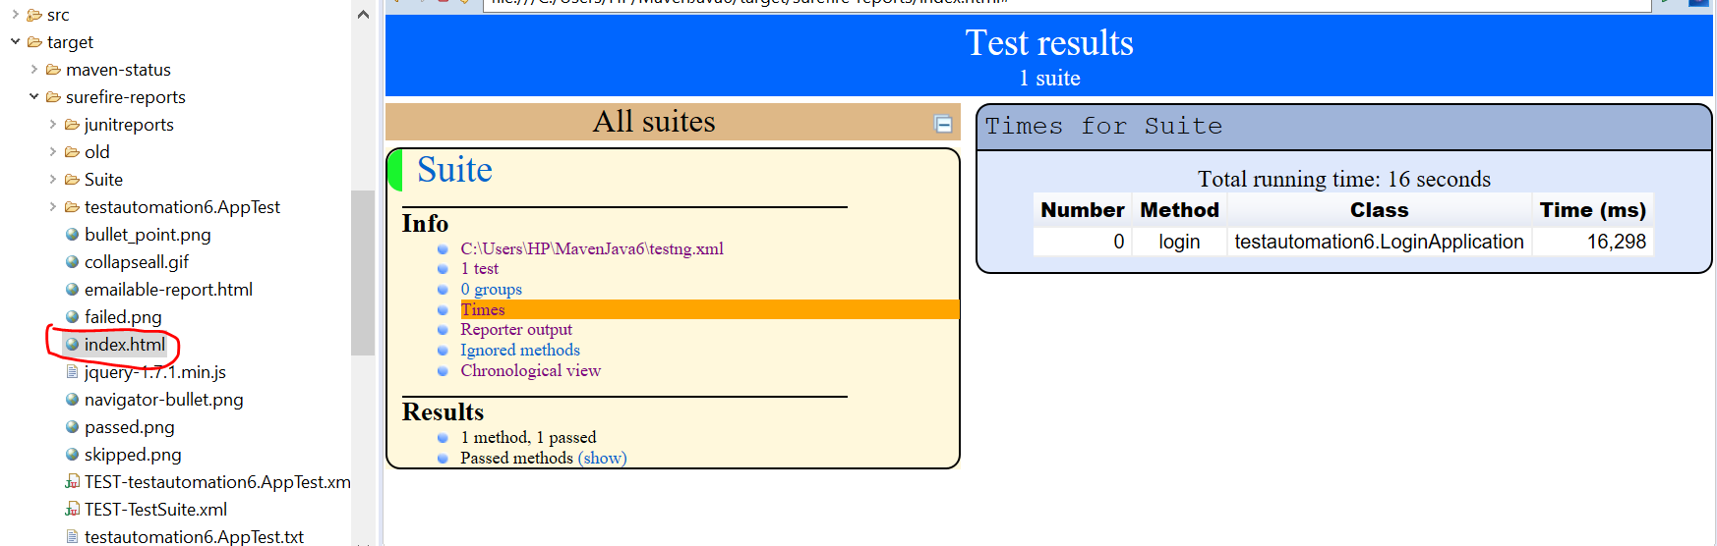
Maven Result in Eclipse
In Jenkins-> goto PlugIn Manager-> Install “TestNG Results” Plugin
After installing the above plugin. Run the build and user can see the “TestNG Results” in Jenkins build

Slide 33
Create a Maven Project from Eclipse
Add dependencies such as “Selenium Java”, “SeleniumWebDriver Manager” from Maven repository
Create “SeleniumTest” class file in the test package
https://github.com/bonigarcia/webdrivermanager
WebDriverManager.chromedriver().setup(); -> for Chrome browser
WebDriverManager.firefoxdriver().setup(); -> for FireFox browser
Log4J class from apache
https://logging.apache.org/log4j/2.x/maven-artifacts.html#Using_Log4j_in_your_Apache_Maven_build
Jenkins
Goto Build-> and select “Execute Windows batch command”. Enter the following line inside the window
E:
cd E:\eclipse-workspace\SeleniumWebDriverManager
mvn clean test
Notes:
http://localhost:8080/job/GuruSchool1/configure

Slide 34
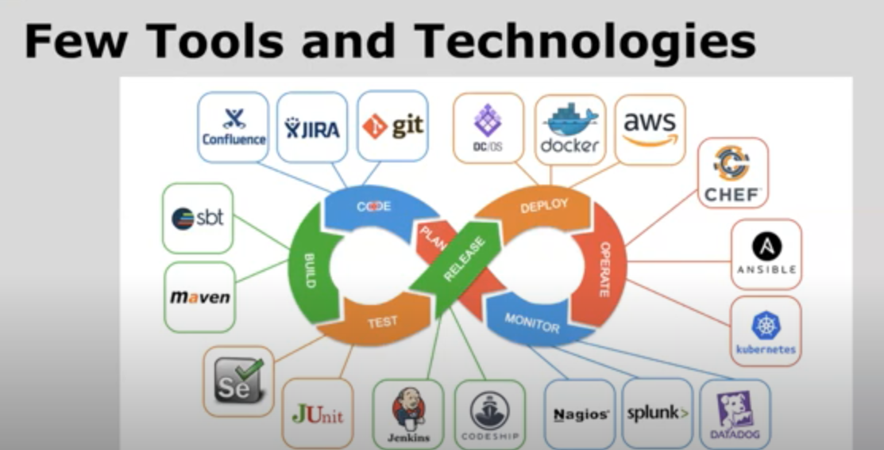

Slide 35
