Slide 1


Modeling Diabetic Patient Mortality
Ian Wittler

Slide 2
Outline
What is Diabetes Mellitus?
Objectives
Feature Engineering
Convolutional Neural Network
Results
Additional Research
Conclusion

Slide 3
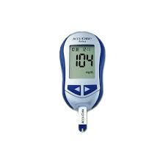
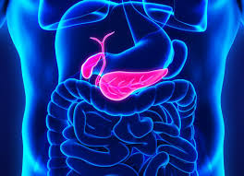
About Diabetes Mellitus
A disease where complications arise in producing and using insulin
100 million plus U.S. adults live with diabetes or prediabetes
There are 3 main classifications:
Type 1
Type 2
Gestational

Slide 4
Goals and Objectives
1. Develop a model that utilizes glucose measurements to predict diabetic patient outcomes.
2. Explore additional modeling applications for diabetes-related predictions.

Slide 5
Feature Exploration and Visualization
Source (MIMIC III)
Query
Visualize

Slide 6
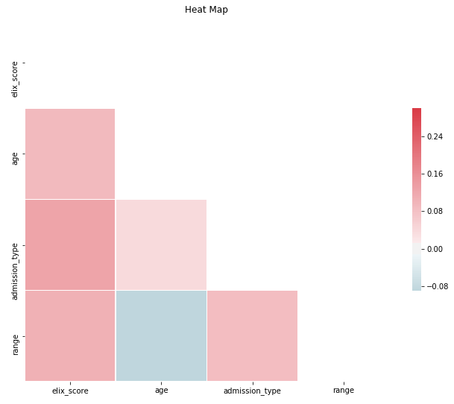
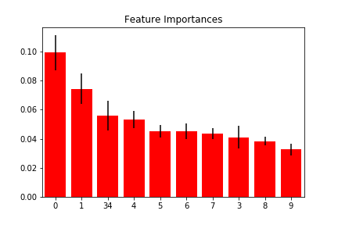
More Feature Exploration
Associated Number | Feature
0 | Exhauster Score
1 | Age
2 | Admission Type
3-33 | Glucose Measurements
34 | Glucose Range

Slide 7
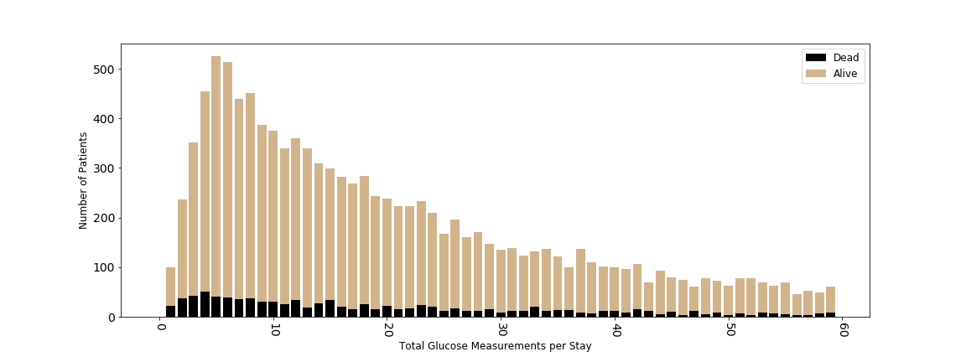
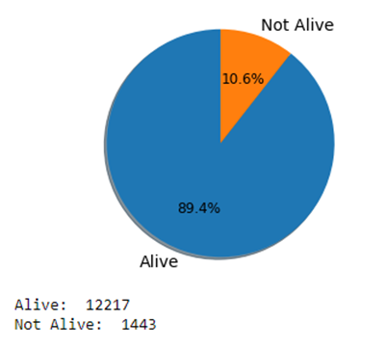
Feature Engineering
Feature Reduction
Data Distribution

Slide 8
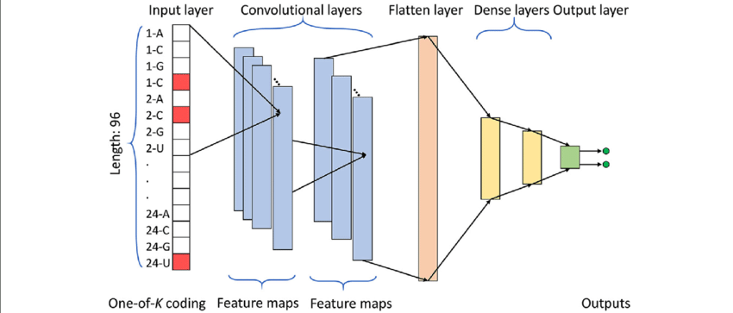
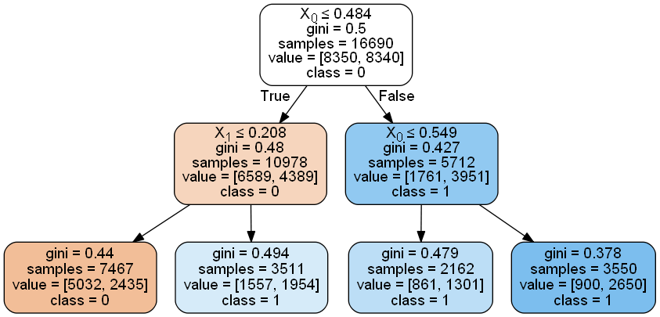
Baseline Models
Decision Tree
Accuracy: 0.693
AUC: 0.685
Random Forest
Accuracy: 0.773
AUC: 0.761
Simple Neural Network
Accuracy: 0.771
AUC: 0.791

Slide 9
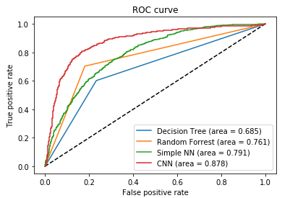
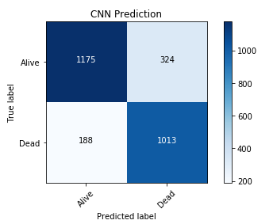
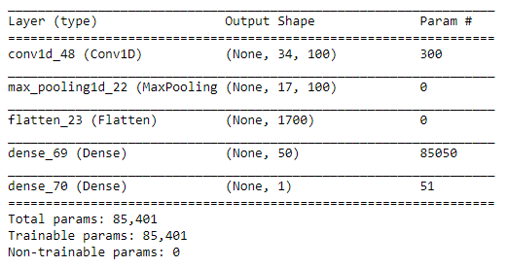
Convolutional Neural Network Results

Slide 10
Other Topics Investigated During Research
The relationship of different variables (ex. ICD9 codes) for patients who have diabetes
The use of medical notes to predict diabetes code
The consistency of ICD9 coding of individual diabetic patients over time

Slide 11
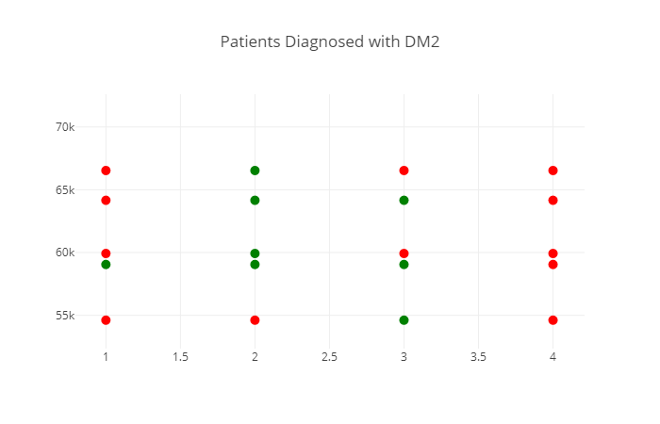
DM2 ICD9 Coding Consistency Research

Slide 12
Conclusion
Predictions models can beneficial to assist medical experts in decision making
With the vast amount of data currently available, data analysis and prediction to improve personalized health has a lot of room for growth.
Future work
Further NLP (Natural Language Processing) on the medical text of patients as additional features

Slide 13
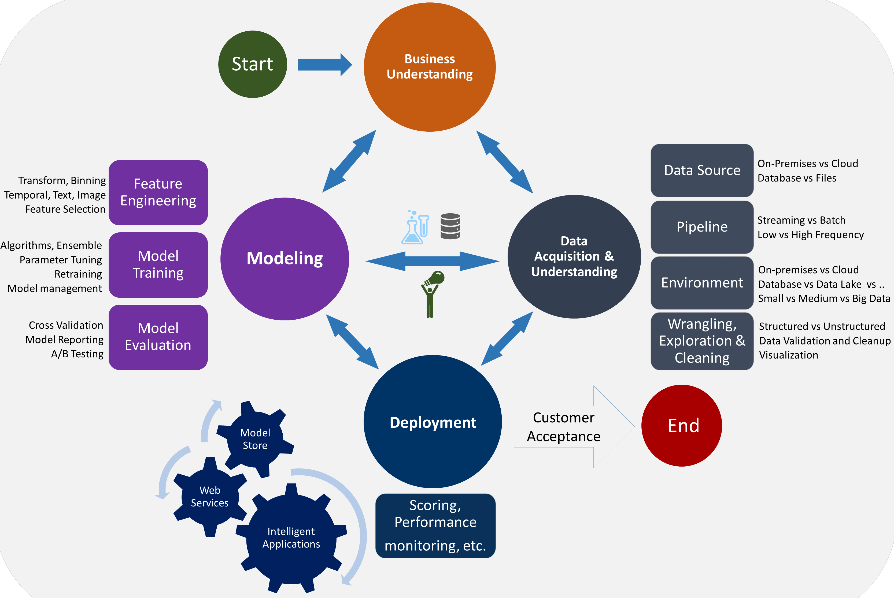
The Data Science Lifecycle

