Slide 1

Modeling Diabetic Patient Mortality
Ian Wittler

Slide 2
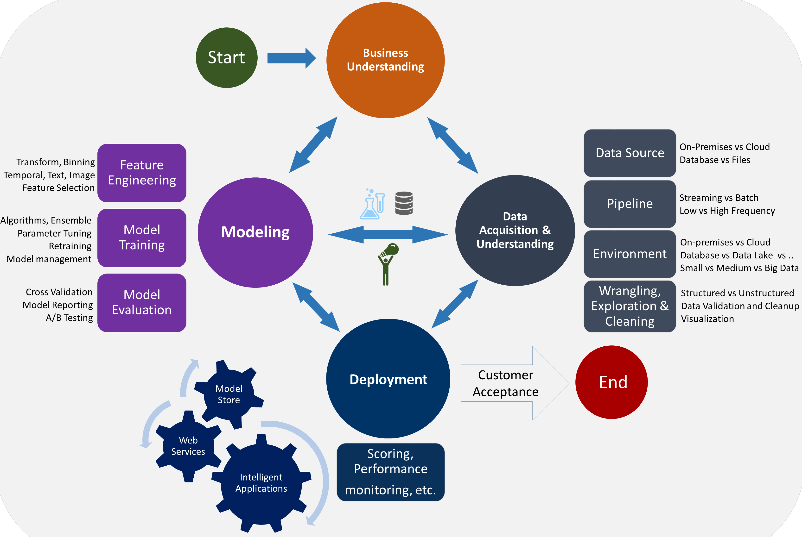
The Data Science Lifecycle

Slide 3
Outline
What is Diabetes Mellitus?
Objectives
Feature Engineering
Convolutional Neural Network
Results
Additional Research
Conclusion/Discussion

Slide 4
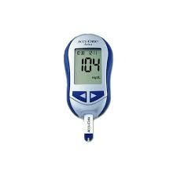
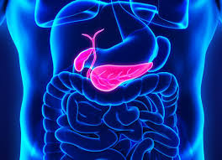
About Diabetes Mellitus
A disease where complications arise in producing and using insulin
100 million plus U.S. adults live with diabetes or prediabetes
There are 3 main classifications:
Type 1
Type 2
Gestational

Slide 5
Goals and Objectives
1. Develop a model that utilizes glucose measurements to predict diabetic patient outcome.
2. Explore other features that can be used for diabetes prediction algorithms.

Slide 6
Feature Exploration and Visualization
Source (MIMIC III)
Query
Visualize

Slide 7

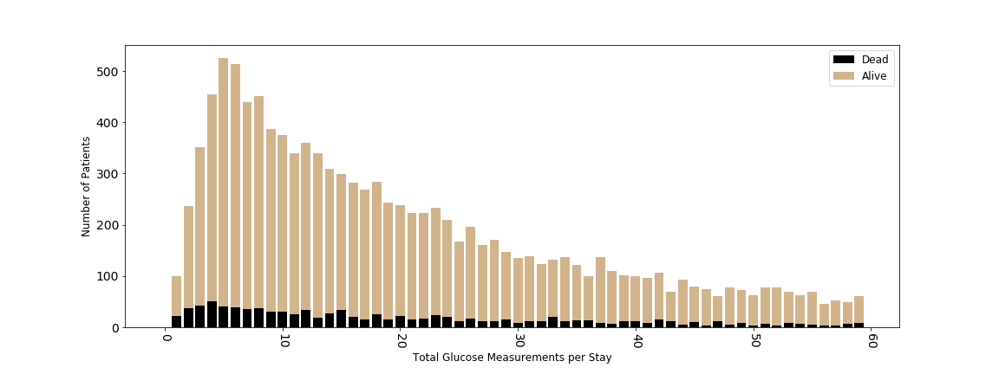
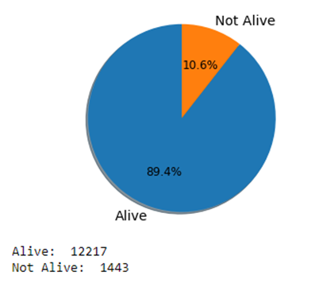
Feature Engineering
Feature Reduction
Data Distribution

Slide 8
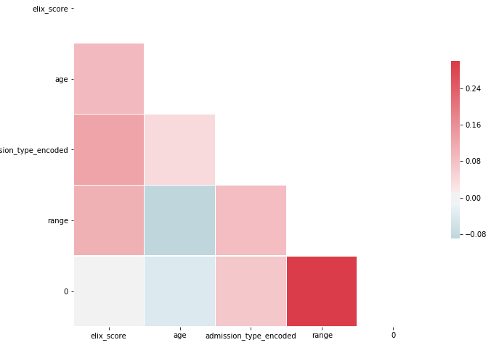
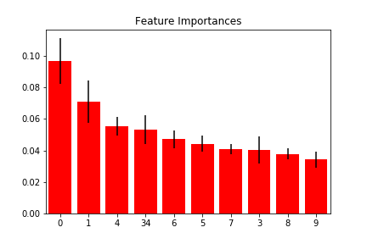
More Feature Exploration
0 – Exhauster Score (3-33) – Glucose Measurements
1 – Age 34 – Glucose Range
2 – Admission Type

Slide 9
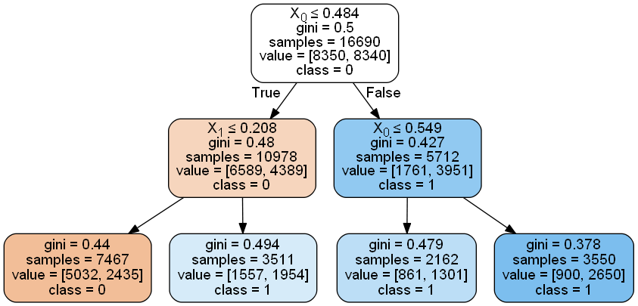
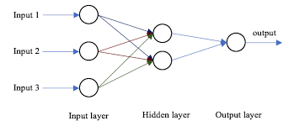
Baseline Models
Decision Tree
Accuracy: 0.693
AUC: 0.685
Random Forest
Accuracy: 0.773
AUC: 0.761
Simple Neural Network
Accuracy: 0.771
AUC: 0.791

Slide 10
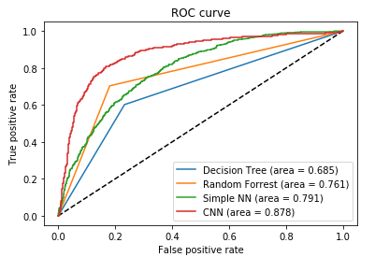
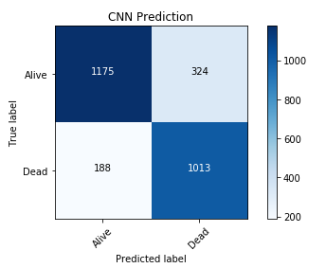
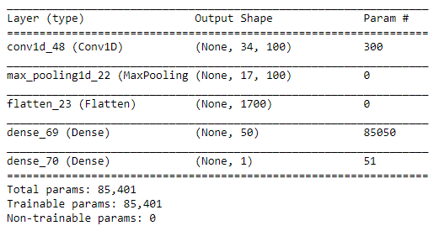
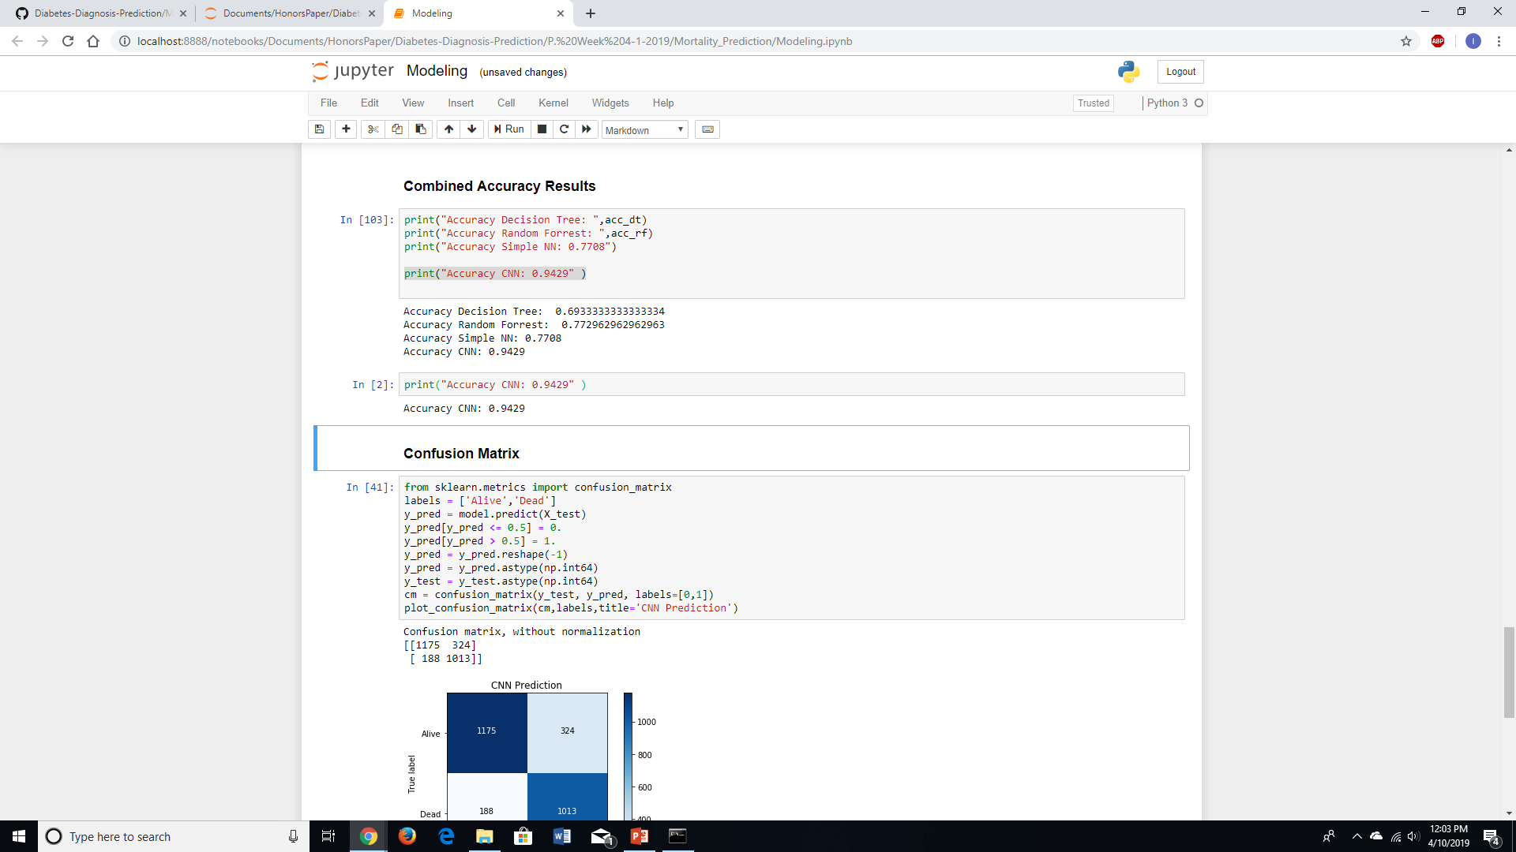
Convolutional Neural Network Results

Slide 11
Other Topics Investigated During Research
The relationship of different variables (ex. ICD9 codes) for patients who have diabetes
The use of medical notes to predict diabetes code
The consistency of ICD9 coding of individual diabetic patients over time

Slide 12
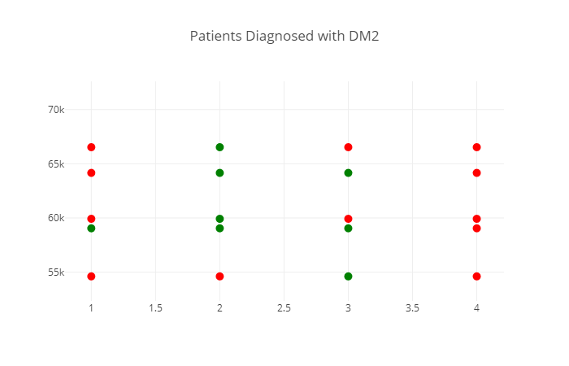
DM2 ICD9 Coding Consistency Research

Slide 13
Conclusion and Discussion
These types of models are beneficial to assist medical experts with decision making
Understanding the data improves the quality of results
Future work
Further NLP (Natural Language Processing) on the medical text of patients

