Slide 1

Modeling Diabetic Patient Mortality
Ian Wittler

Slide 2
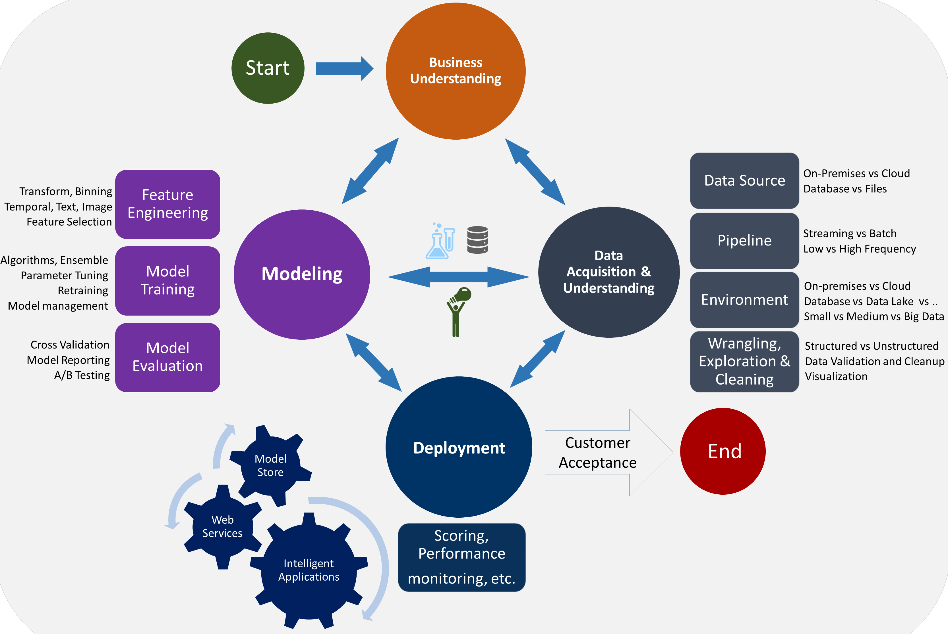
The Data Science Lifecycle

Slide 3
Outline
What is Diabetes Mellitus?
Objectives
Feature Exploration and Engineering
Neural Network
Results
Conclusion/Discussion

Slide 4
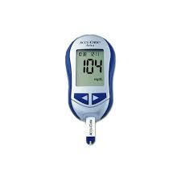
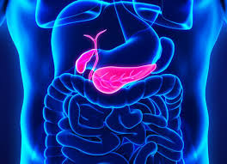
About Diabetes Mellitus
A disease where complications arise in producing and using insulin
100 million plus U.S. adults live with diabetes or prediabetes
There are 3 main classifications:
Type 1
Type 2
Gestational

Slide 5
Goals and Objectives
1. Develop a model that utilizes glucose measurements to predict diabetic patient outcome.
2. Determine how care management of diabetic patients effects patient outcome.

Slide 6
Feature Exploration and Visualization
Source
Query
Visualize

Slide 7
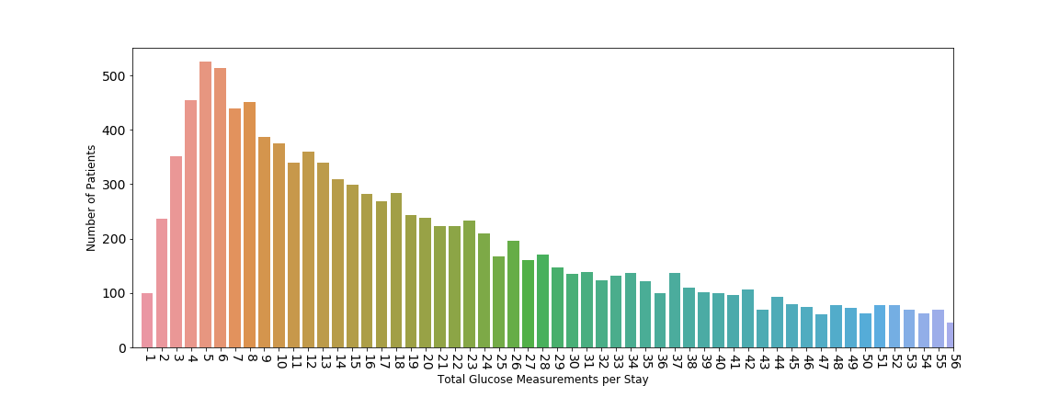
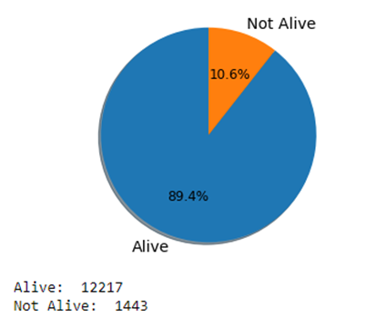
Glucose Measurement and Outcome Distributions
Feature Reduction
Imbalanced Data

Slide 8
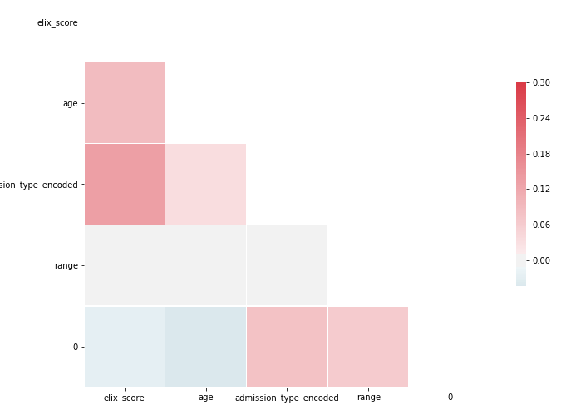
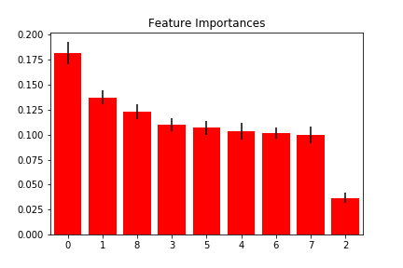
Feature Exploration
0 – Exhauster Score (3-7) – Glucose Measurements
1 – Age 8 – Glucose Range
2 – Admission Type

Slide 9
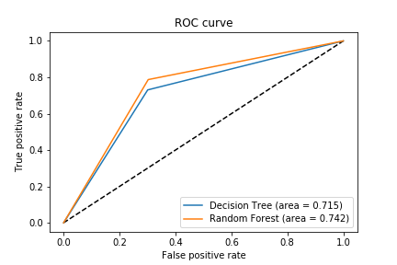
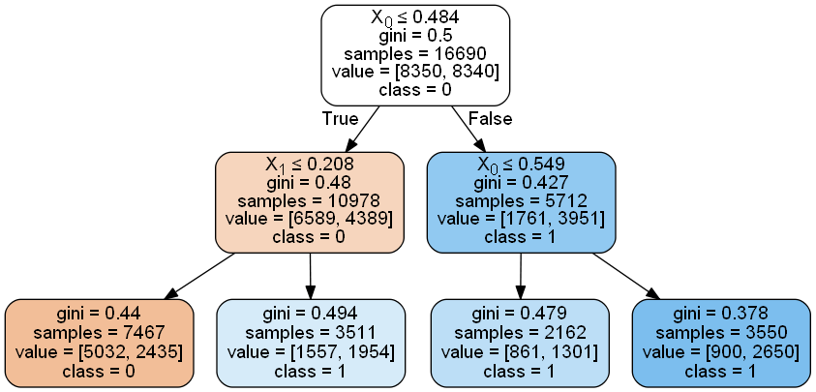
Baseline Methods
Baseline Models
Decision Tree
Random Forest
AUC and Accuracy
Decision Tree Acc: 71.5%
Random Forest Acc: 74.2%

Slide 10
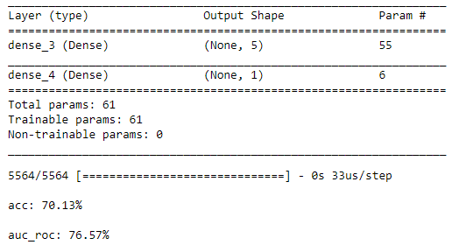
Neural Network
Model Summary
Tuning Model Adjustments:
Mean vs Glucose Readings
Hidden Layer Kernel Sizes
Optimizers
Activation Functions

Slide 11
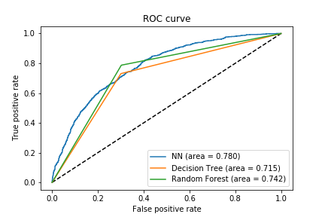
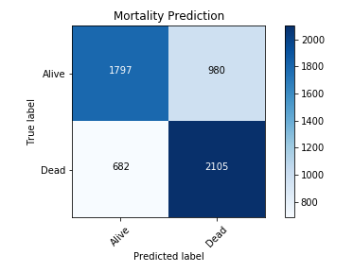
Neural Network Results

Slide 12
Other Topics Investigated During Research
The relationship of different variables (ex. ICD9 codes) for patients who have diabetes
The use of medical notes to predict diabetes code
The consistency of ICD9 coding of individual diabetic patients over time

Slide 13
Conclusion and Discussion
These types of models are beneficial to assist medical experts with decision making
Understanding the data improves the quality of results
Future work
Further NLP (Natural Language Processing) on the medical text of patients

