Slide 1


Modeling Diabetic Patient’s Mortality
Ian Wittler

Slide 2
Outline
What is Diabetes Mellitus?
Objectives
Data Exploration
Modeling
Results
Conclusions

Slide 3
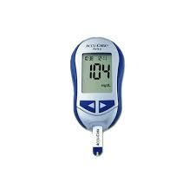

About Diabetes Mellitus
A disease where complications arise in producing and using insulin
100 million plus U.S. adults live with diabetes or prediabetes
There are 3 main classifications:
Type 1
Type 2
Gestational

Slide 4
Goals and Objectives
1. Develop a model that utilizes glucose measurements to predict diabetic patient outcomes.
2. Explore additional modeling applications for diabetes-related predictions.

Slide 5
Glucose Measurement Visualization
Source (MIMIC III)
Query
Visualize
Mimic III
Over 40,000 patients
40-50GB of space
Demographics, Vital Sign Measurements, Lab Results, Procedures, Medication, Medical Notes, Mortality
11,820 diabetic patients with 591,117 glucose measurements recorded

Slide 6
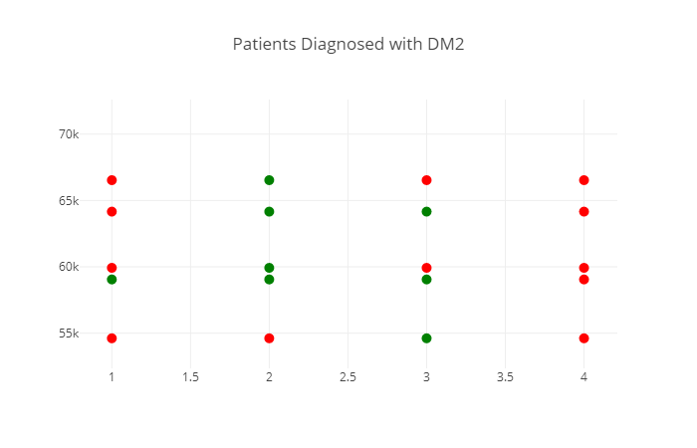
ICD9 Coding Consistency

Slide 7
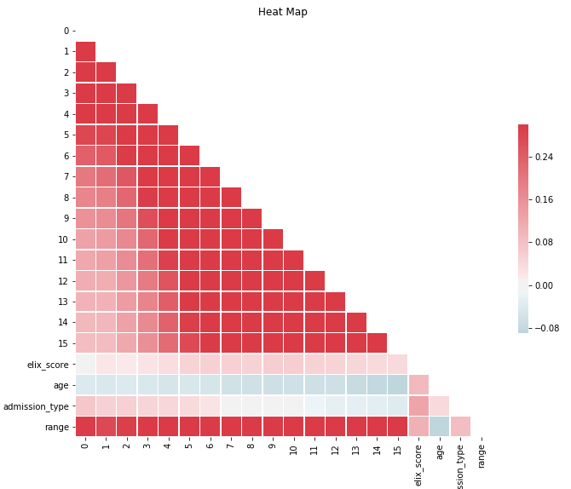
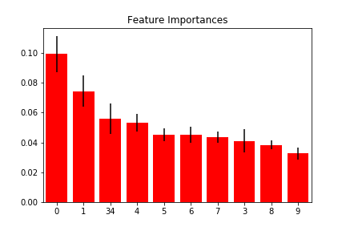
Data Exploration
Associated Number | Feature
0 | Exhauster Score
1 | Age
2 | Admission Type
3-33 | Glucose Measurements
34 | Glucose Range

Slide 8
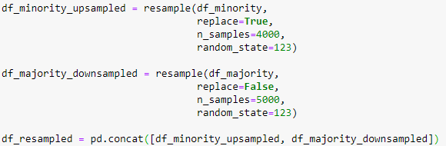
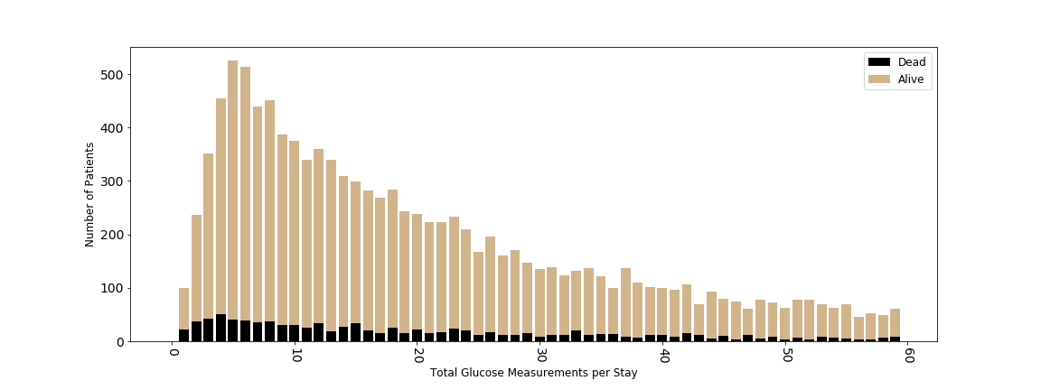
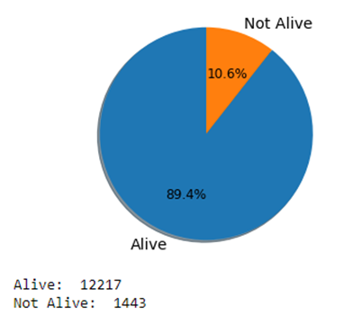
Data Exploration
Feature Reduction
Data Distribution

Slide 9
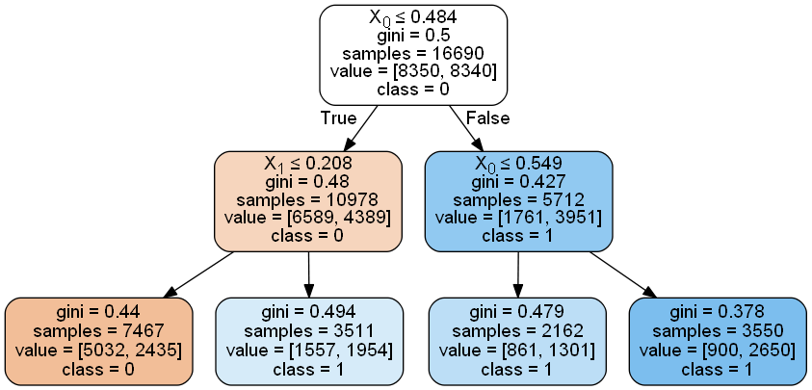
Baseline Models
Trained Decision Tree
Accuracy: 0.693
AUC: 0.685
Trained Random Forest
Accuracy: 0.773
AUC: 0.761
Feed Forward Neural Network
Accuracy: 0.771
AUC: 0.791

Slide 10
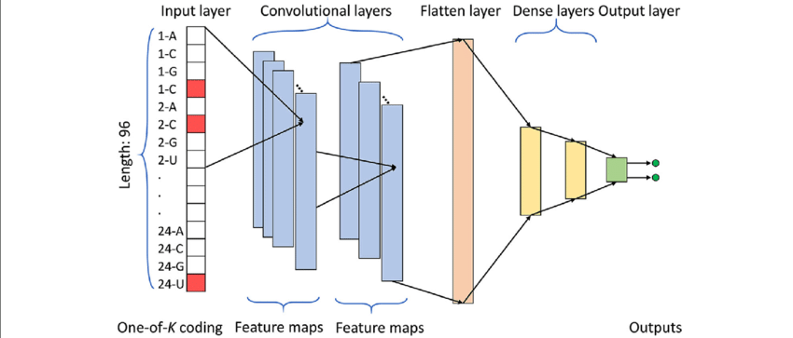
Convolutional Neural Network

Slide 11
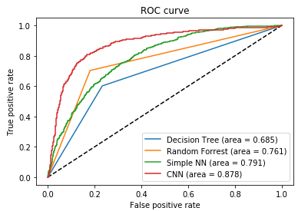
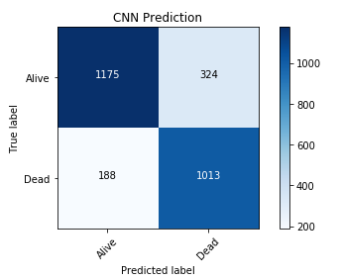
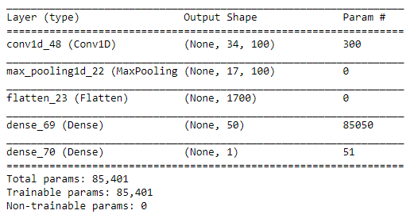
Final Results

Slide 12
Conclusion
Prediction models can be beneficial in assisting medical experts in decision making.
With the vast amount of data currently available, data analysis and prediction to improve personalized health has a lot of room for growth.
Future work
Further investigation into mortality results in correlation to how strictly a patient’s glucose levels are monitored.

Slide 13
Acknowledgments
Id like to thank the following people for there assistance in this project:
Dr. Liu
Dr. Dong
Dr. Kennedy
Dr. Darby
Dr. Campbell

Slide 14
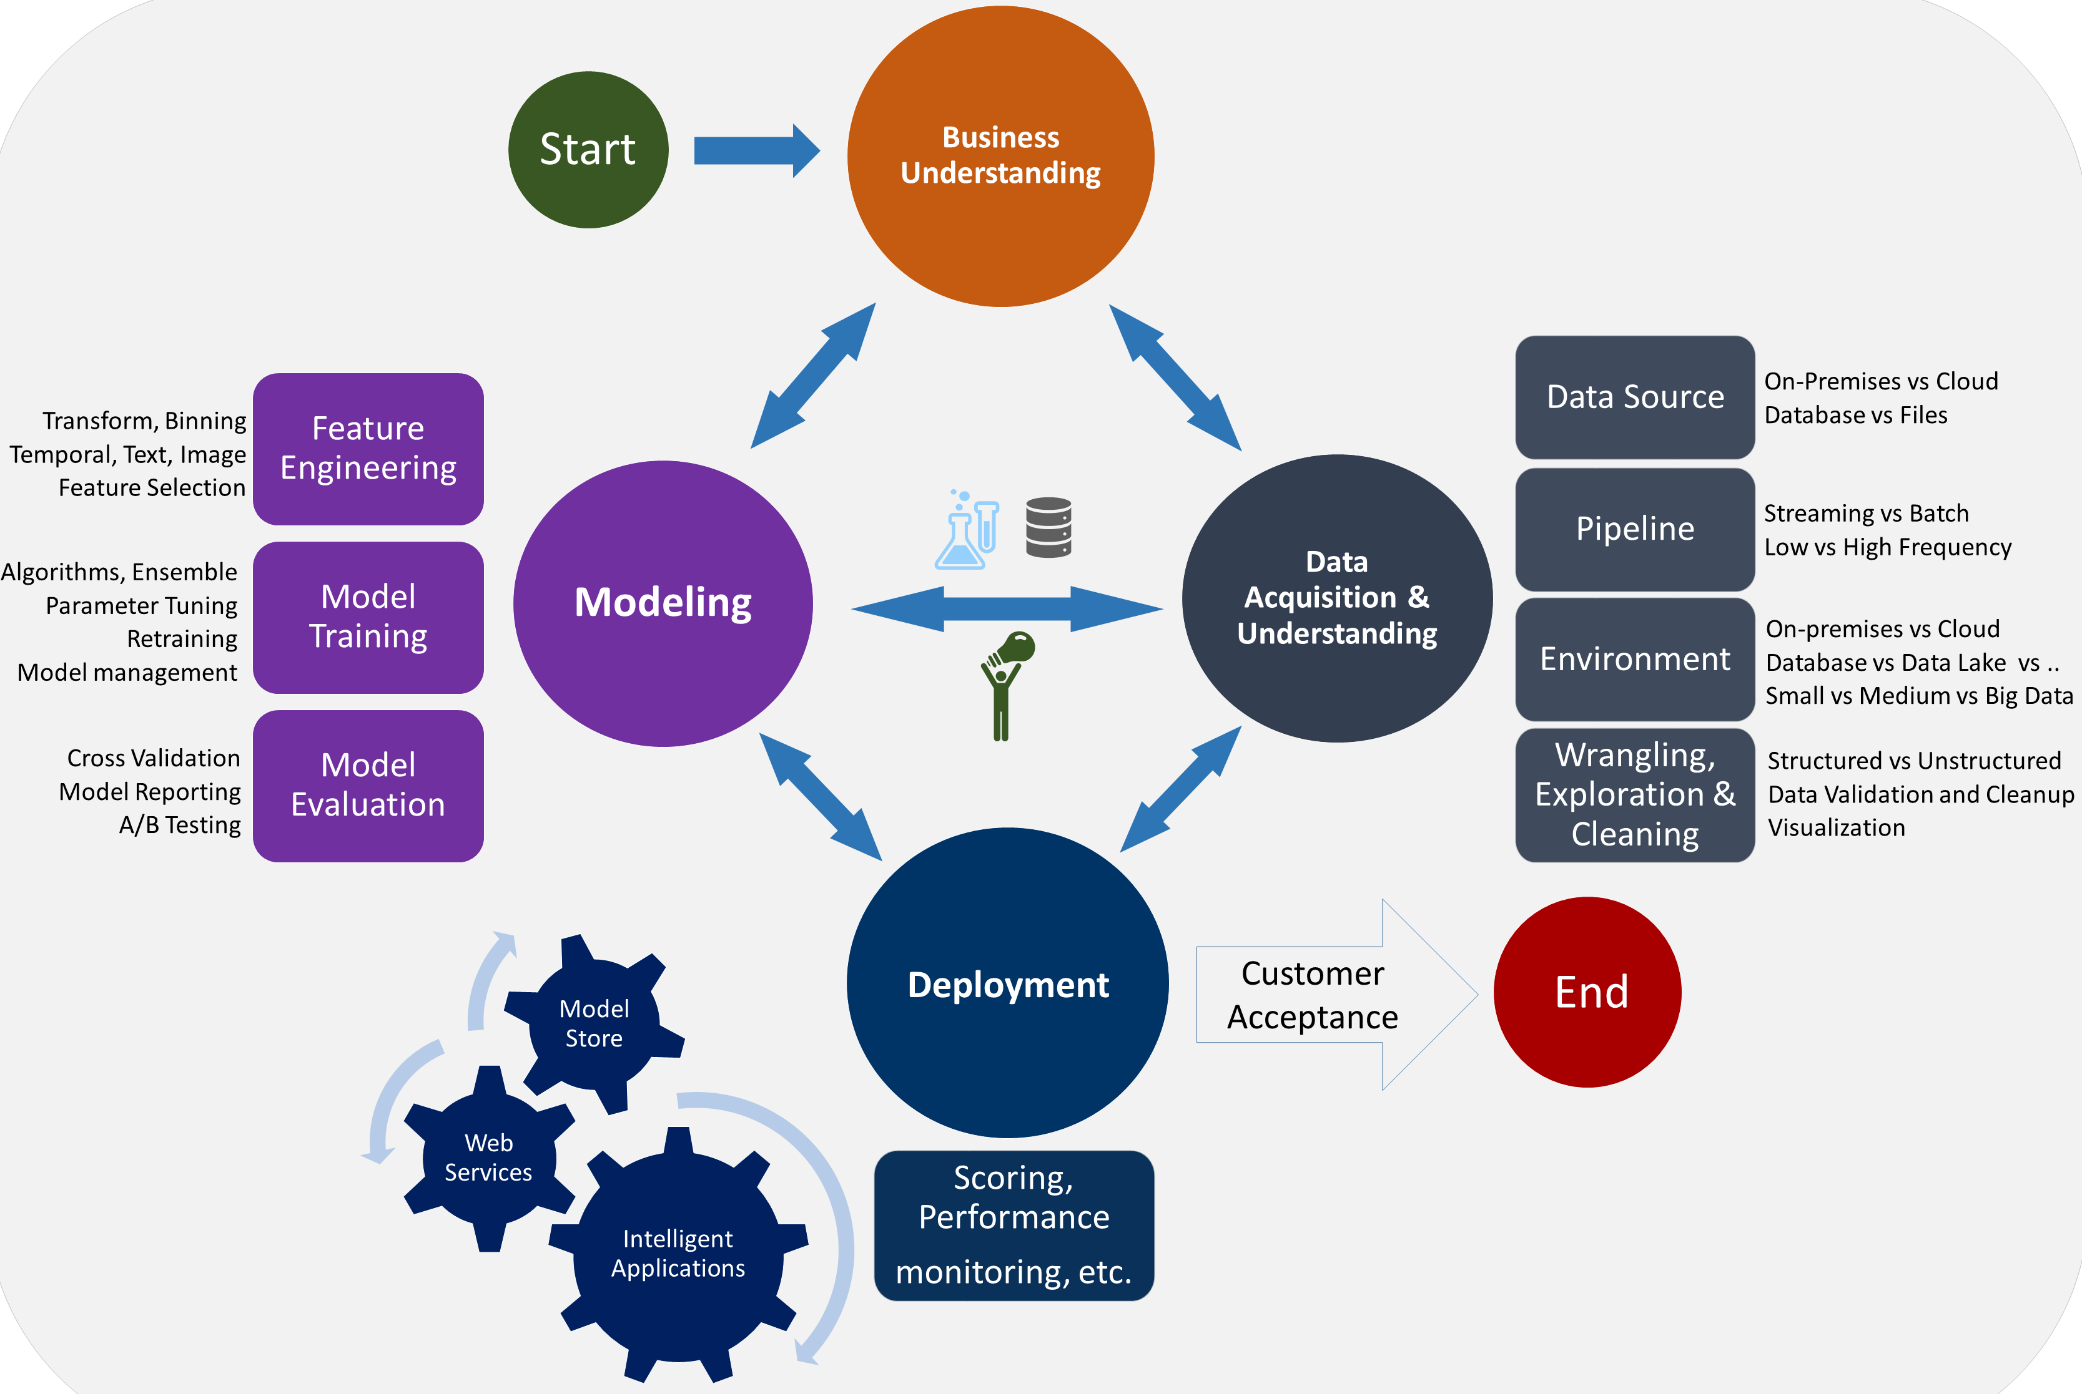
The Data Science Lifecycle

Slide 15
Other Topics Investigated During Research
The relationship of different variables (ex. ICD9 codes) for patients who have diabetes
The use of medical notes to predict diabetes code
The consistency of ICD9 coding of individual diabetic patients over time

