Slide 1

Modeling Diabetic Patient Mortality
Ian Wittler

Slide 2
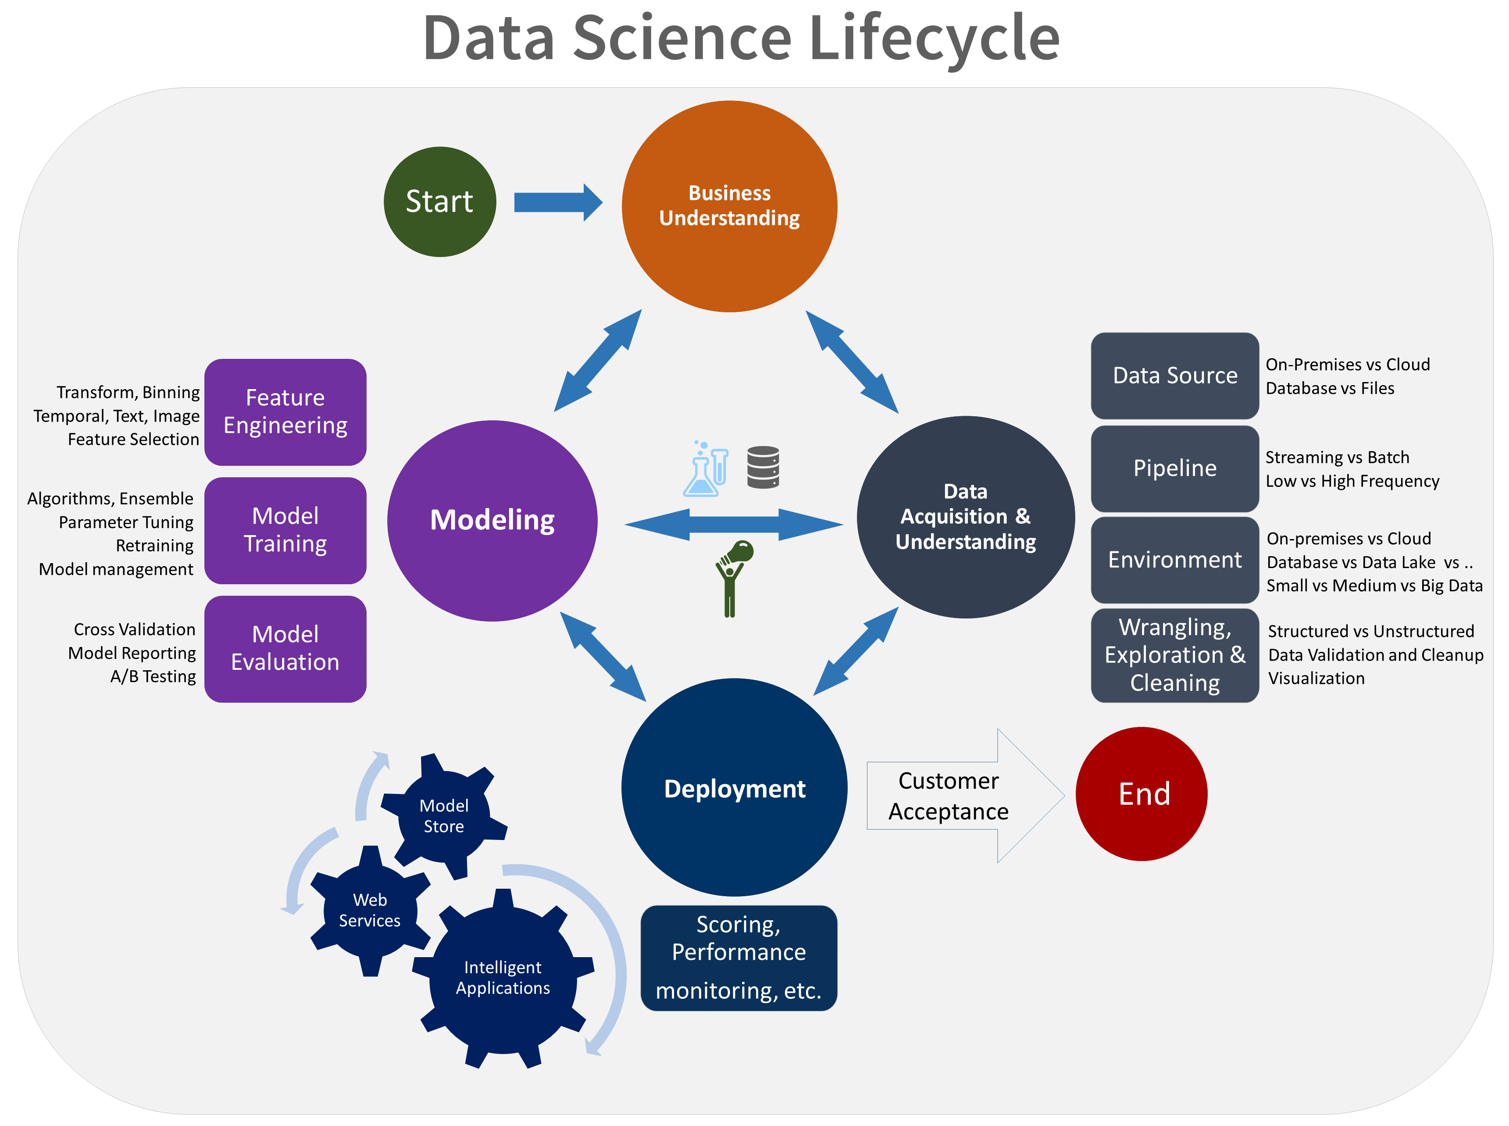
The Data Science Process

Slide 3
Outline
What is Diabetes Mellitus?
Objectives
Data Mining
Feature Exploration
Neural Network
Results
Conclusion/Discussion

Slide 4
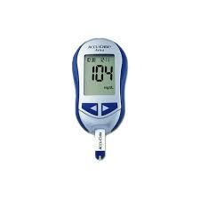
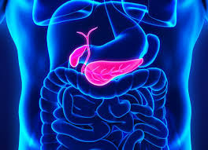
About Diabetes Mellitus
A disease where complications arise in producing and using insulin
100 million plus U.S. adults live with diabetes or prediabetes
There are 3 main classifications:
Type 1
Type 2
Gestational

Slide 5
Goals and Objectives
1. Develop a model that utilizes glucose measurements to predict diabetic patient outcome.
2. Determine how care management of diabetic patients effects patient outcome.

Slide 6
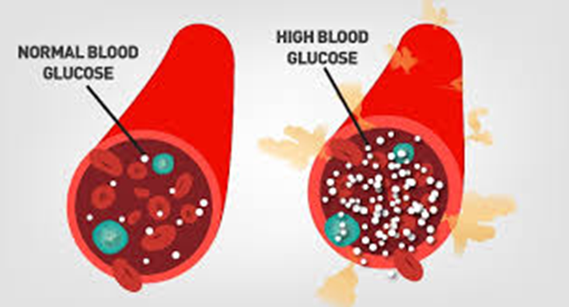
Data Mining and Visualization
Source
Query
Visualize

Slide 7
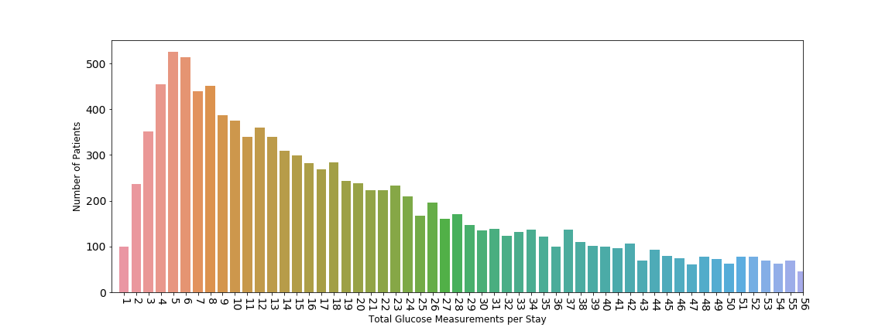
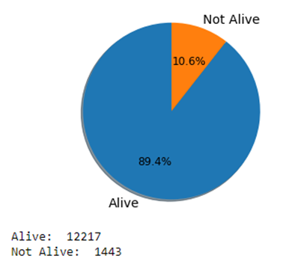
Glucose Measurement Distribution Feature Reduction
Outcome Distribution
Oversampling

Slide 8
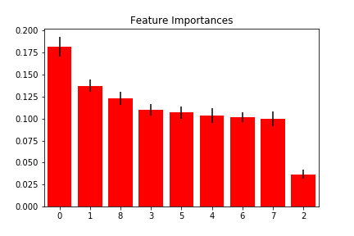
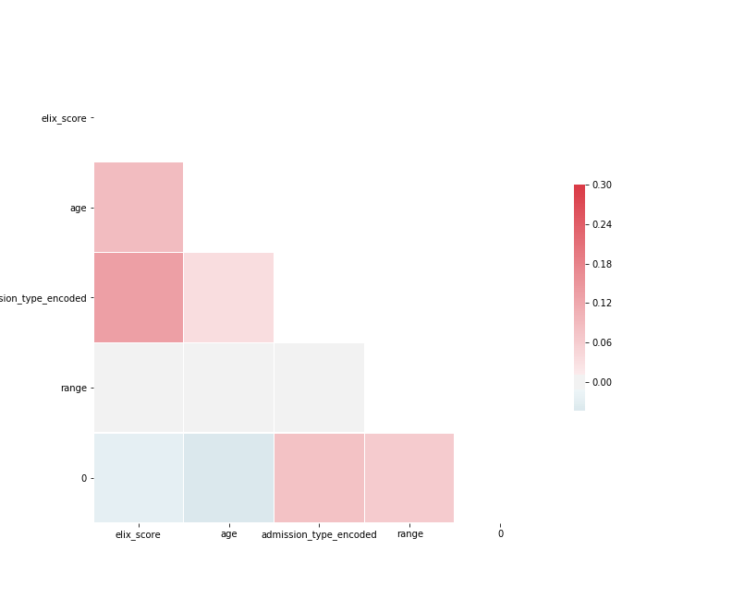
Feature Exploration
0 – Exhauster Score
1 – Age
2 – Admission Type
(3-7) – Glucose Measurements
8 – Glucose Range

Slide 9
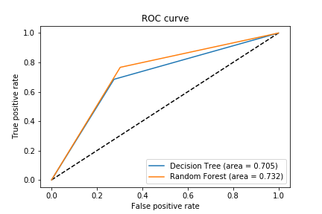
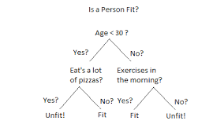
Baseline Methods
Baseline Models
Decision Tree
Random Forest
AUC and Accuracy
Decision Tree Accuracy: 70.5%
Random Forest Accuracy: 73.2%

Slide 10
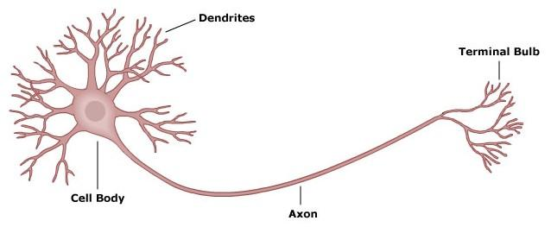
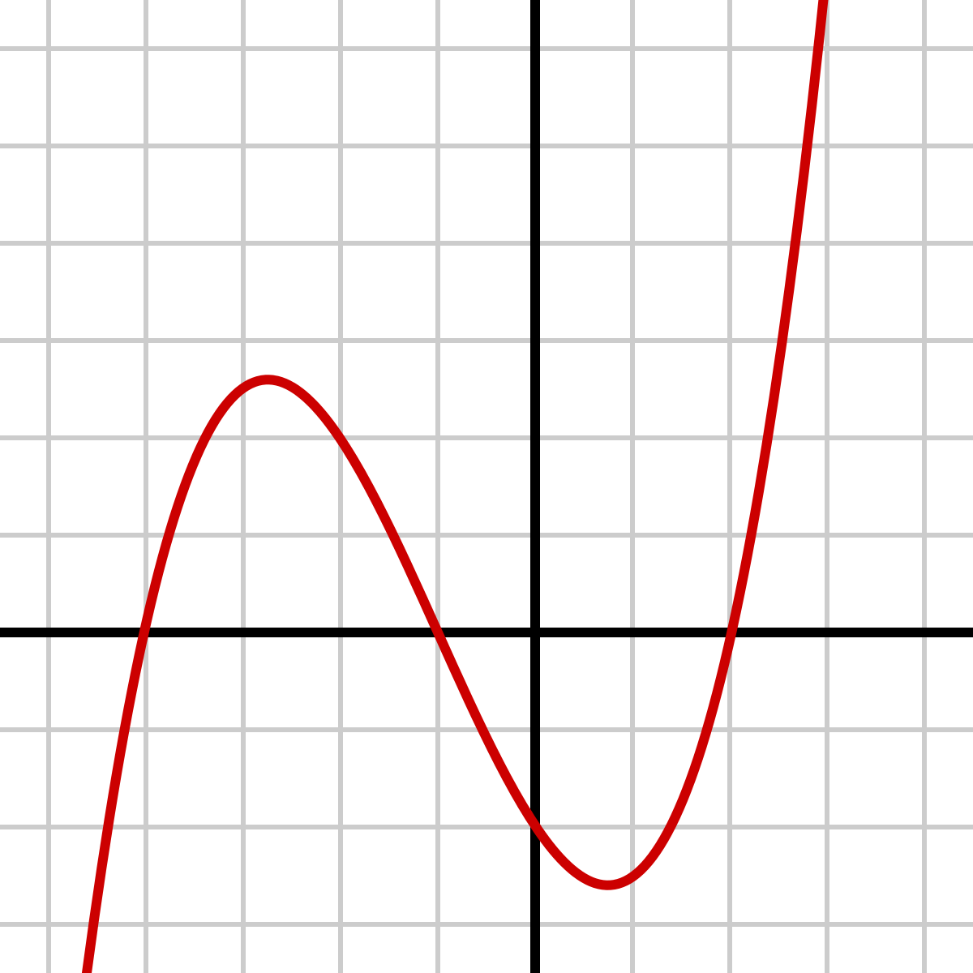
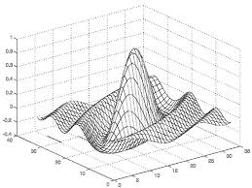
Neural Networks
Add my architecture here

Slide 11
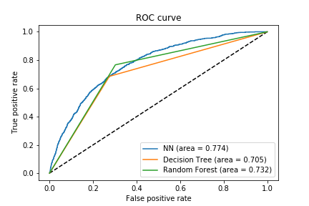
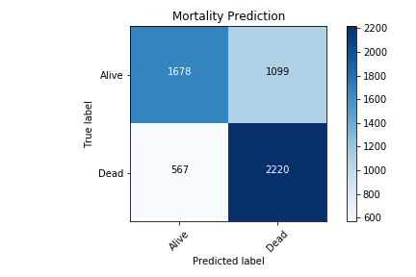
Neural Network Results

Slide 12
Other Task Investigated During Research
The relationship of different variables(ex. ICD9 codes) for patients who have diabetes
The use of medical notes to predict diabetes code
The consistency of ICD9 coding of individual diabetic patients over time

Slide 13
Conclusion and Discussion
Data mining’s impact in the medical field
Predictive mortality model results
Future work
Incorporating subgroup models
Further NLP on the medical text of patients

