Slide 1

Modeling Diabetic Patient Mortality
Ian Wittler

Slide 2
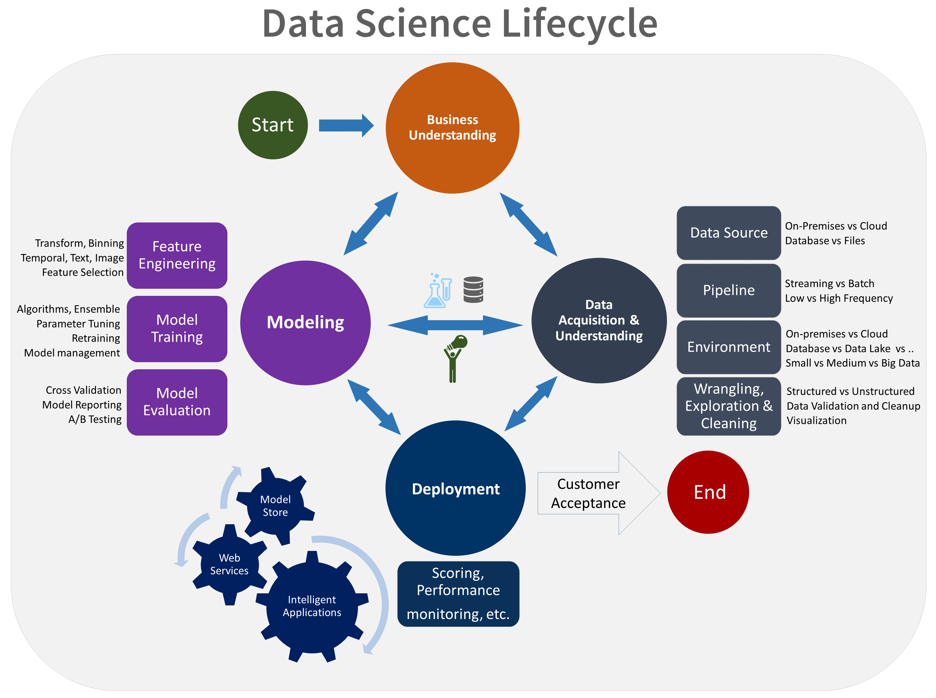
The Data Science Process

Slide 3
Outline
What is Diabetes Mellitus?
Objectives
Data Mining
Feature Exploration
Neural Network
Results
Conclusion/Discussion

Slide 4
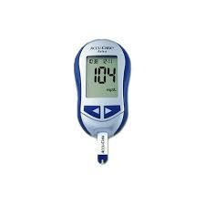
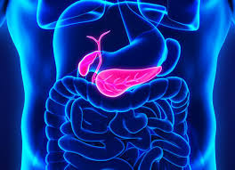
About Diabetes Mellitus
A disease where complications arise in producing and using insulin
100 million plus U.S. adults live with diabetes or prediabetes
There are 3 main classifications:
Type 1
Type 2
Gestational

Slide 5
Goals and Objectives
1. Develop a model that utilizes glucose measurements to predict diabetic patient outcome.
2. Determine how care management of diabetic patients effects patient outcome.

Slide 6
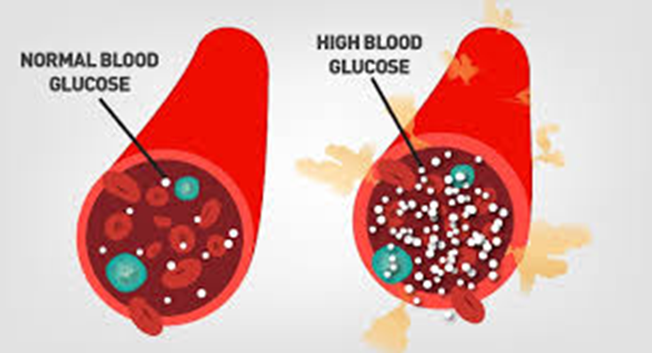
Data Mining and Visualization
Source
Query
Visualize

Slide 7
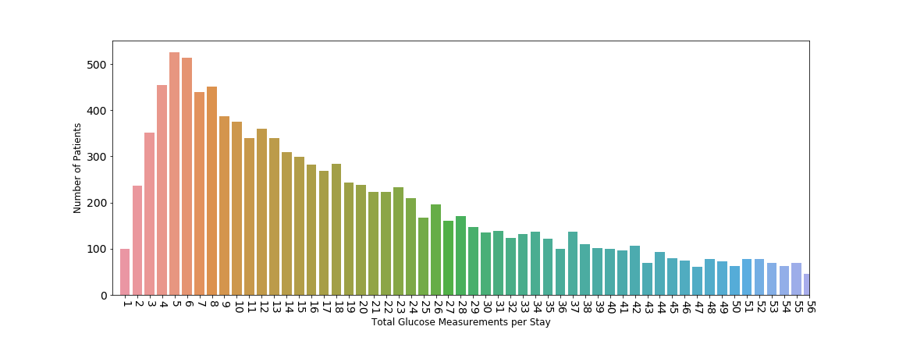
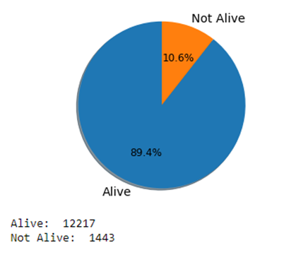
Glucose Measurement Distribution Feature Reduction
Outcome Distribution
Oversampling

Slide 8
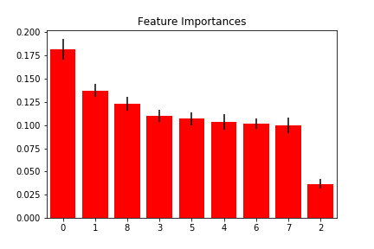
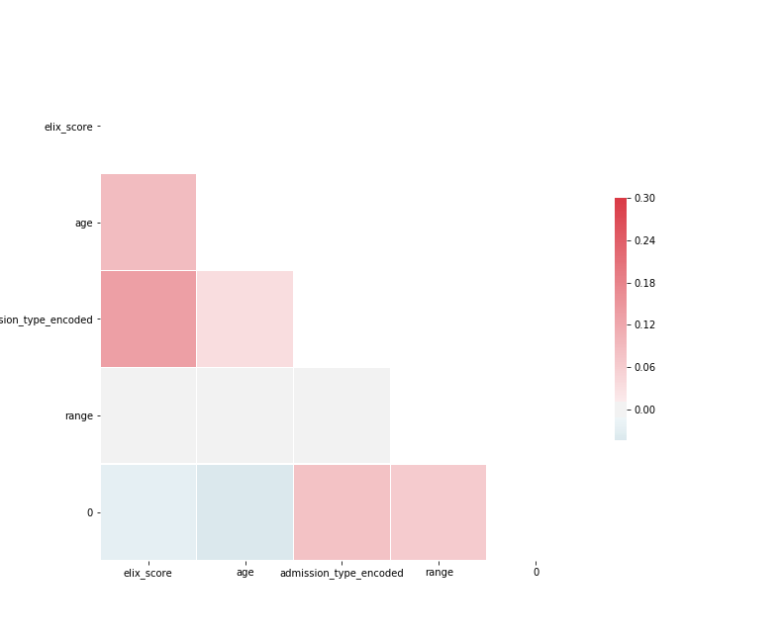
Feature Exploration
0 – Exhauster Score
1 – Age
2 – Admission Type
(3-7) – Glucose Measurements
8 – Glucose Range

Slide 9
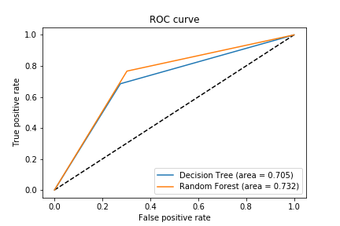
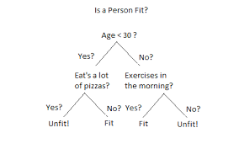
Baseline Methods
Baseline Models
Decision Tree
Random Forest
AUC and Accuracy
Decision Tree Accuracy: 70.5%
Random Forest Accuracy: 73.2%

Slide 10
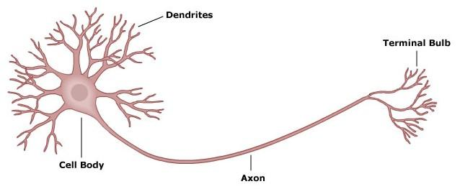
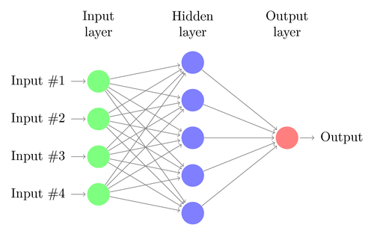
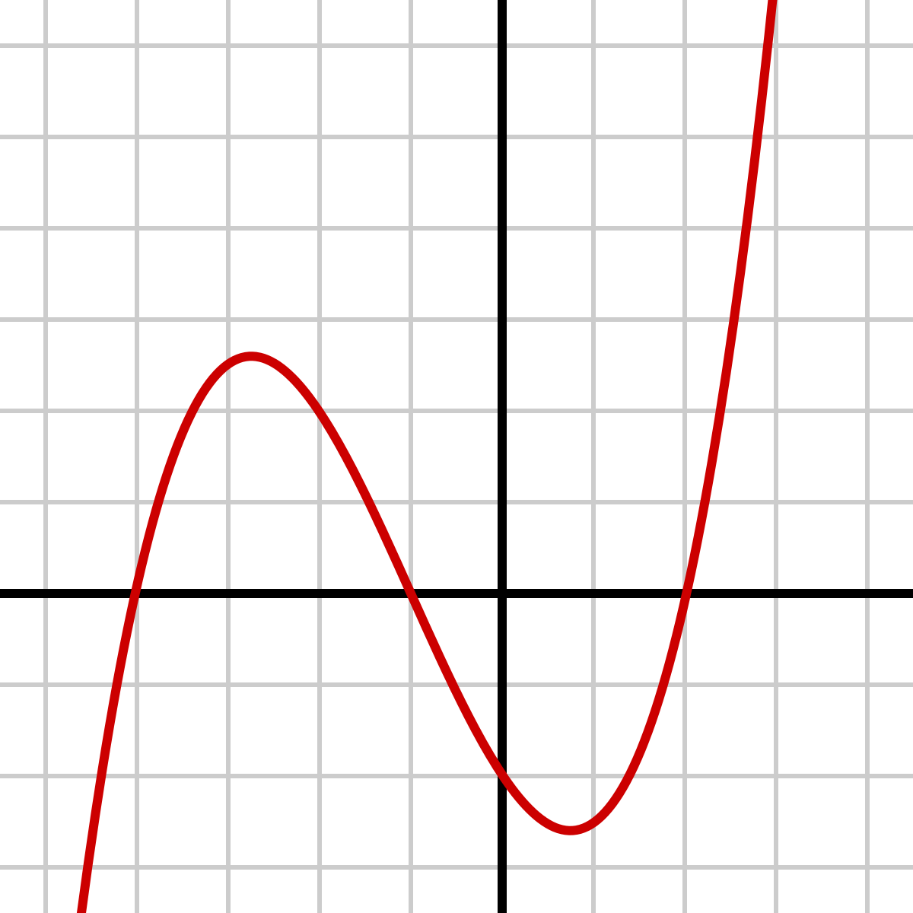
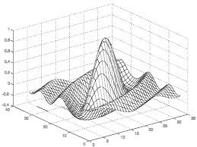
Neural Networks

Slide 11
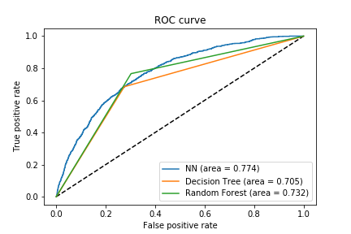
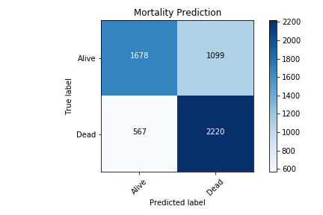
Neural Network Results

Slide 12
Conclusion
Data Mining in the Medical Field
Mortality Relationship with Different Variables
Future Work – NLP on Medical Notes

