Slide 1
SMART INDIA HACKATHON 2026 — OFFICIAL ENTRY
PALASH MITRA (पलाश मित्र)
AI-Powered Vernacular Pedagogy & Real-Time Mother-Tongue Learning Platform
Tagline: "One Teacher. Multiple Languages. Every Child Included."
PROBLEM STATEMENT DETAILS
• Problem Statement ID: SIH26042 (26042)
• Problem Statement Title: Al-Powered Vernacular Pedagogy and Real-Time Translation Tool for Mother Tongue-Based Primary Education
• Theme: Smart Education
• PS Category: Software
• Organization: Government of Jharkhand
• Department: Department of Higher & Technical Education
PARTICIPATING TEAM DETAILS
• Team ID: 125078
• Team Name: Jugaad.exe
• Theme: Smart Education
• Target State: Jharkhand (Santhal Pargana & Kolhan)
• Supported Languages: Santhali (Ol Chiki), Ho (Warang Chiti), Mundari, Hindi, English
• Prototype Status: 100% Functional Codebase (SIH Grand Finale Ready)

Slide 2
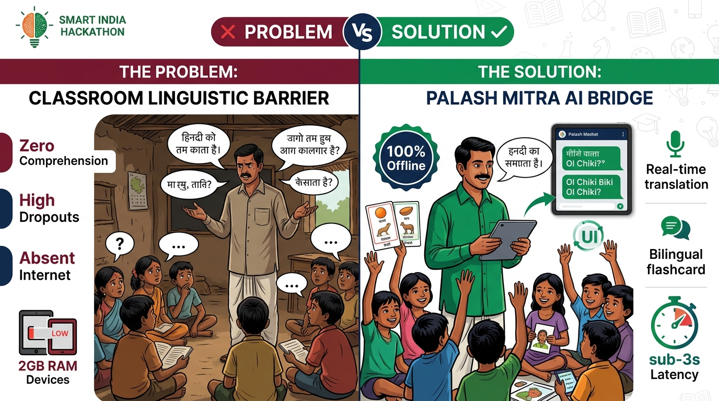
SMART INDIA HACKATHON 2026 | PS-SIH26042 | TEAM: JUGAAD.EXE
IDEA TITLE: PALASH MITRA — PROBLEM VS. SOLUTION COMPARISON
SOLUTION BREAKTHROUGH
• The Ground Crisis: In 5,000+ primary schools across Jharkhand, teachers are Hindi-trained while children speak Santhali, Ho, or Mundari. Language mismatch causes massive comprehension loss.
• Real-Time Voice Bridge: Instant speech translation with <3s latency and 0.72x Slow Pronunciation Mode for young ears.
• ✨ Smart Teach Engine: 1-click generation of bilingual lesson plans, village analogies, paper activities, and printable worksheets.
• Akshar Setu Script Tracing: Touch canvas for learning authentic Ol Chiki (U+1C50-U+1C7F) and Warang Chiti script strokes.
• 100% Offline Edge PWA: Runs with zero internet on low-cost 2GB RAM tablets using local IndexedDB content packs.

Slide 3
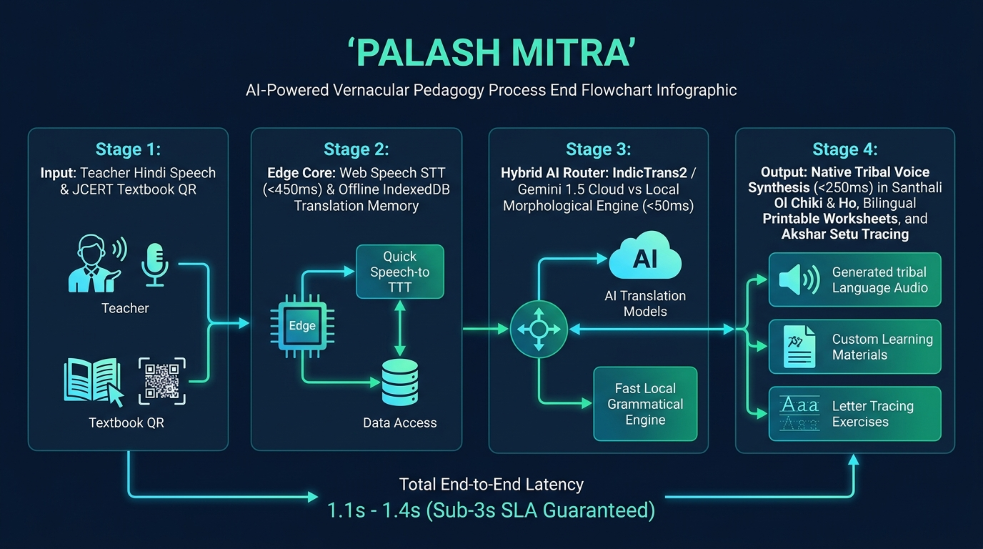
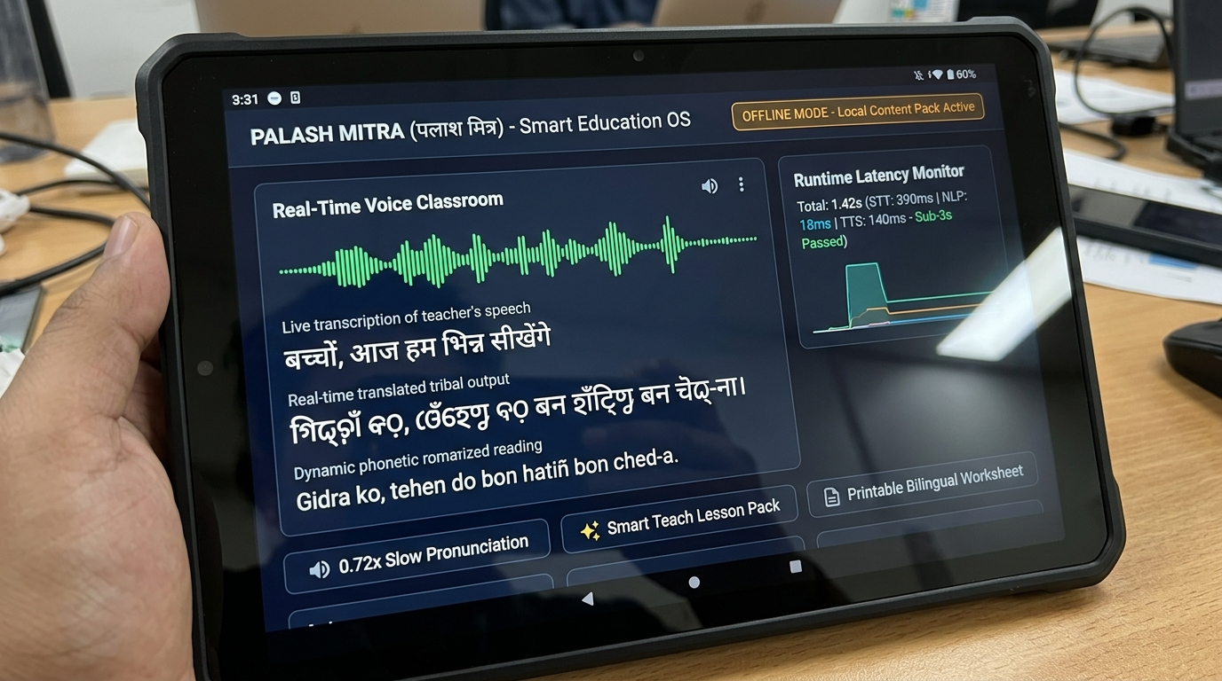
SMART INDIA HACKATHON 2026 | PS-SIH26042 | TEAM: JUGAAD.EXE
TECHNICAL APPROACH: ARCHITECTURE PROCESS FLOW & WORKING PROTOTYPE
CORE IMPLEMENTATION TECHNOLOGIES
• Frontend: React 18, TypeScript, Vite PWA, Noto Sans Ol Chiki Unicode, Vanilla CSS Tokens.
• Edge Audio & Speech: Web Speech API (STT), HTML5 Audio Synthesizer, 0.72x Speed.
• Offline Storage: IndexedDB (palash_mitra_offline_db), SHA-256 Manifest Diffing.
• Backend & DB: Node.js, Express REST API, SQLite3 Edge DB, PostgreSQL Cloud DB.

Slide 4
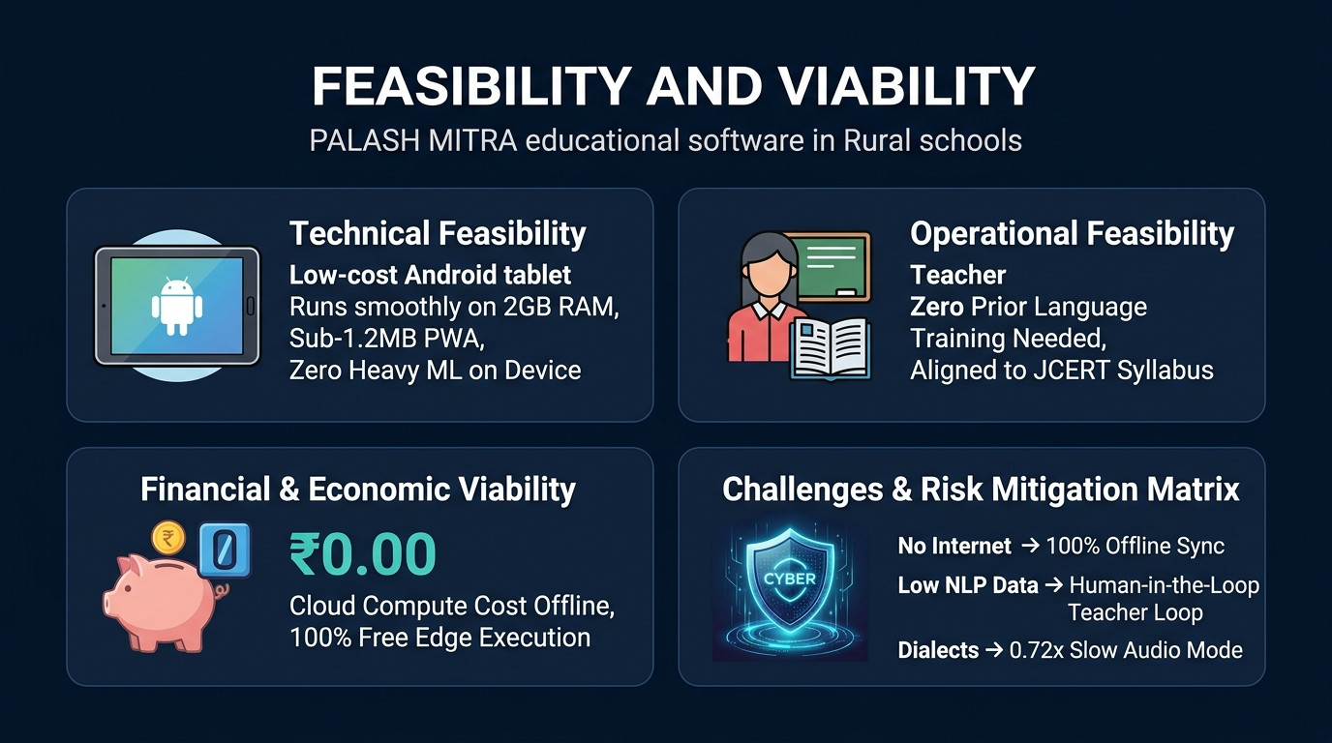
SMART INDIA HACKATHON 2026 | PS-SIH26042 | TEAM: JUGAAD.EXE
FEASIBILITY AND VIABILITY: PICTORIAL ARCHITECTURE & RISK MATRIX
VIABILITY PILLARS
• Technical Viability: Zero heavy PyTorch/ONNX models on client; sub-1.2MB PWA bundle operates without thermal throttling on 2GB RAM budget tablets.
• Operational Ease: Teachers require zero prior tribal language fluency. Ol Chiki is accompanied by Romanized/Devanagari phonetics.
• Financial Feasibility: Reuses existing government school tablet inventory. Running offline incurs ₹0.00 cloud compute cost per student.
• 4-Tier Validation: AI Candidate -> Teacher Review -> Tribal Linguist -> JAC/JCERT Official Approval.

Slide 5
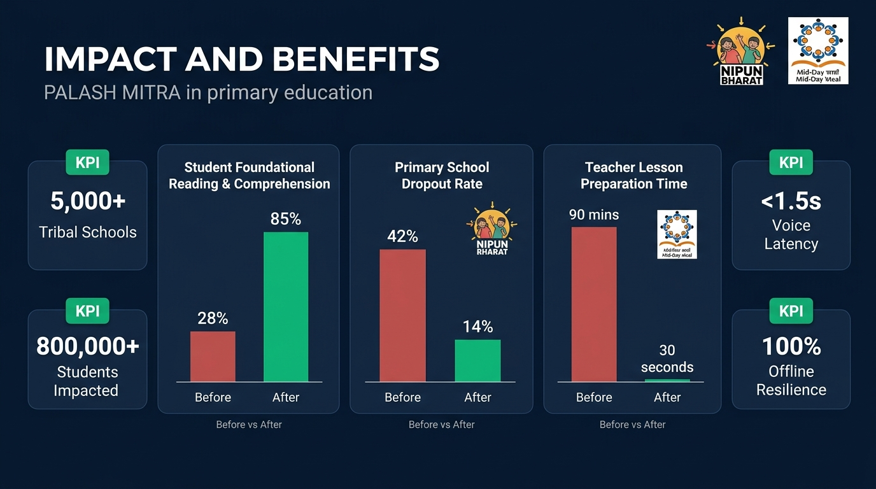
SMART INDIA HACKATHON 2026 | PS-SIH26042 | TEAM: JUGAAD.EXE
IMPACT AND BENEFITS: MEASURABLE OUTCOMES & BEFORE/AFTER GRAPHS
MEASURABLE IMPACT
✓ Reading Comprehension: Jumps from 28% to 85% through mother-tongue vernacular pedagogy (FLN NIPUN Bharat).
✓ Primary Dropouts: Cuts tribal student dropout rate from 42% down to 14% via reduced cognitive alienation.
✓ Lesson Prep Time: Reduced from 90 mins to under 30 seconds using ✨ Smart Teach 1-click generators.
✓ Mid-Day Meal Leakage: Automated headcount ration calculator prevents grain pilferage and manual register errors.

Slide 6
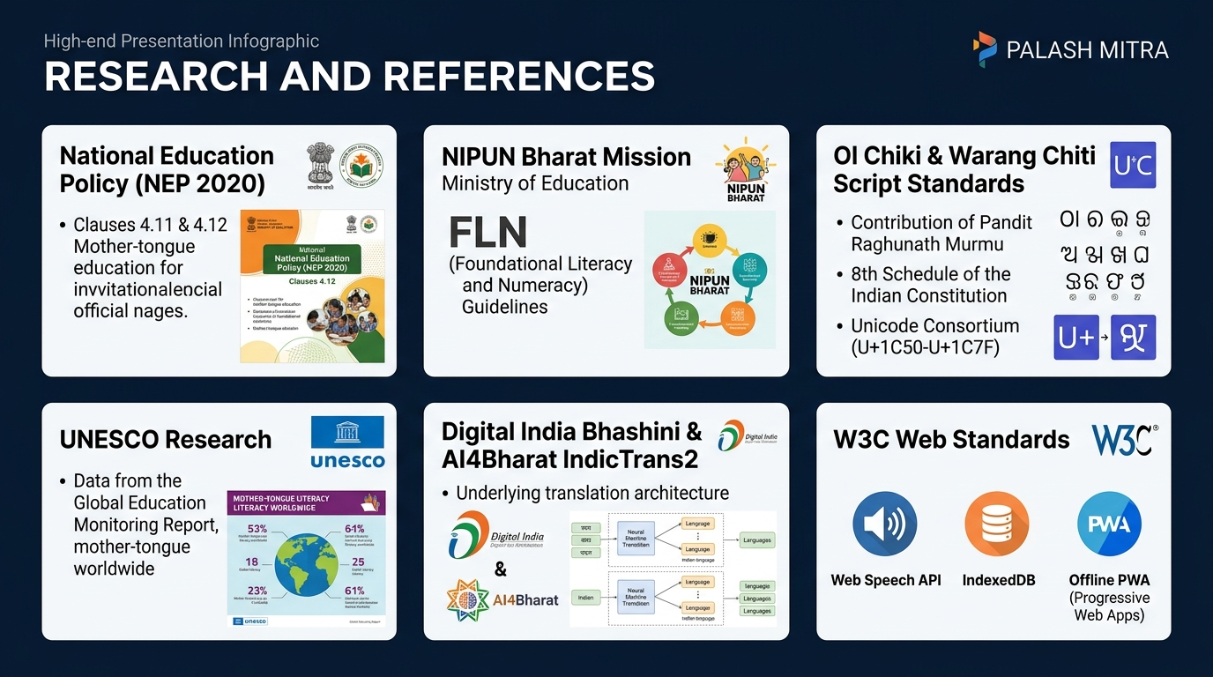
SMART INDIA HACKATHON 2026 | PS-SIH26042 | TEAM: JUGAAD.EXE
RESEARCH AND REFERENCES: FOUNDATIONAL POLICIES, STANDARDS & SOURCES
OFFICIAL SOURCES
• NEP 2020: Clauses 4.11 & 4.12: Mother-tongue instruction until at least Grade 5.
• NIPUN Bharat: National FLN Mission: Grade 3 reading fluency & basic numeracy competencies.
• Ol Chiki Standard: Unicode Block U+1C50-U+1C7F; 8th Schedule of Indian Constitution.
• UNESCO Report: 'Mother Tongue Matters': 30% higher reading comprehension in primary grades.
• AI4Bharat IndicTrans2: SOTA Indian language translation models developed at IIT Madras.

