Slide 1
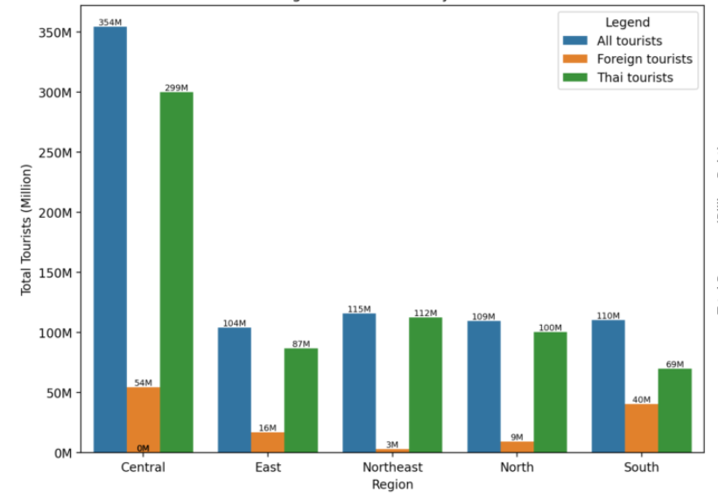
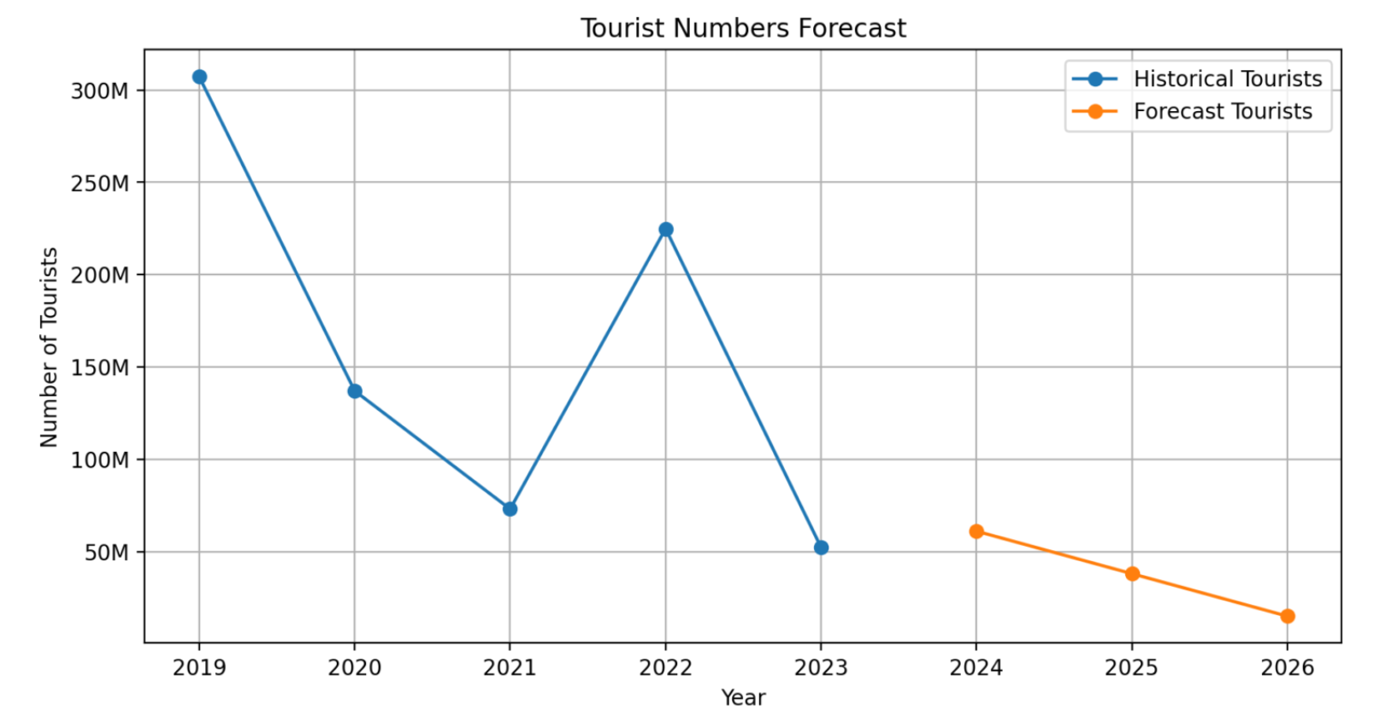
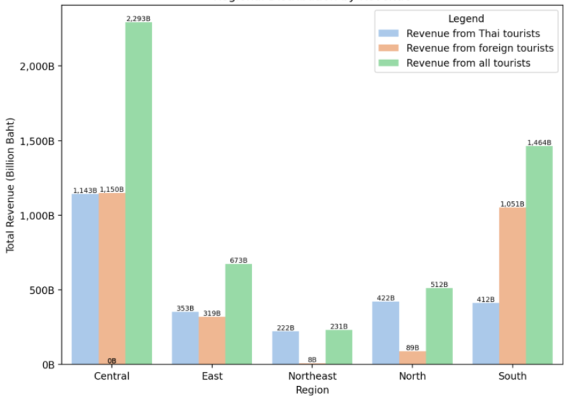
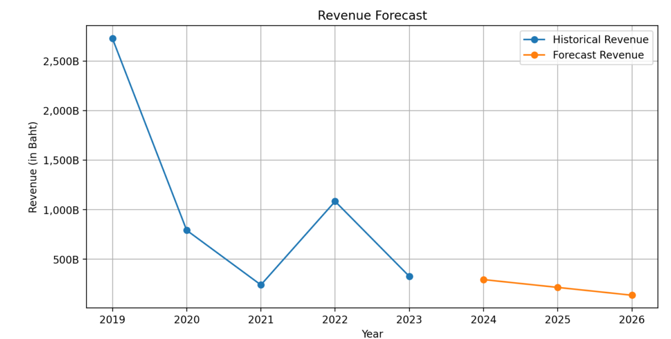
Thailand Domestic Tourism Analysis (2019-2022)
Overview
Key Insights
OpenAI Integration
This project aims to analyze domestic tourism statistics in Thailand from January 2019 to February 2023 using data science techniques. This project will explore insights related to the number of tourists, occupancy rates, and profits generated by tourism across different provinces. Additionally, we will categorize the data by the nationality of tourists, differentiating between Thai and foreign visitors.
The COVID-19 pandemic caused a significant drop in tourist numbers and revenue in 2020 and 2021.
A recovery trend is observed starting from 2022, with varying rates across regions.
Some regions have shown faster recovery rates than others, potentially due to domestic tourism preferences or local policies.
The top provinces by tourist numbers in the latest year may indicate shifting travel patterns post-pandemic.
Overall, the tourism industry has not yet fully recovered to pre-pandemic levels, but shows signs of improvement.
Prompt
Analyze the following tourism data and provide insights: Total tourists by region: {tourists_by_region.to_dict()} Total revenue by region: {revenue_by_region.to_dict()} Yearly tourist numbers: {yearly_data['no_tourist_all'].to_dict()}
Regional Distribution
AI-Powered Insights
Regional distribution by tourists
The central region of Thailand attracts the highest number of tourists, with over 354 million visitors. This region also generates the highest revenue, totaling over 2.29 trillion baht. This indicates that the central region is a key tourism hub in Thailand.
The east and south regions also attract a significant number of tourists, with over 104 million and 110 million visitors respectively. However, the south region generates much higher revenue compared to the east region. This could be due to the popularity of beach destinations in the south such as Phuket and Krabi.
The east-northeast region attracts a moderate number of tourists, but its revenue is relatively low compared to other regions. This suggests that there may be untapped potential for growth in this region, and efforts could be made to promote and develop tourism infrastructure to increase revenue.
The tourism industry in Thailand experienced a significant drop in tourist numbers in 2020, likely due to the impact of the COVID
Covid Recovery: Tourism Trends and Forecast
Uses Exponential Smoothing for accurate time-series forecasting.
Tourist Numbers Forecast
Regional distribution by revenue
Recommendations
Focus on promoting domestic tourism in regions with slower recovery rates.
Investigate successful strategies employed by fast-recovering regions and provinces.
Develop targeted marketing campaigns for top-performing provinces to maintain their appeal.
Implement safety measures and communicate them effectively to boost traveler confidence.
Consider developing new tourism products or experiences that cater to changed traveler preferences post-pandemic.
Shows a declining trend for 2024–2026 after a partial recovery in 2023.
Revenue Forecast
Insights
There's a significant gap between the central region and others in terms of tourist attraction and revenue generation, indication potential for development in other regions..
Team Member: Apinya Utapala (6620422001)
Repository: https://github.com/imyajaii/dads5001-tourism-ai
Reflects similar dynamics, with revenues stabilizing at lower levels compared to pre-pandemic highs.

