Slide 1

UE25CS251A
DIGITAL LOGIC AND COMPUTER DESIGN
TEAM DLCD
Department of CSE and CSE (AI & ML)

Slide 2

DIGITAL LOGIC AND COMPUTER DESIGN
Sequential Building Blocks
TEAM DLCD
Department of CSE and CSE (AI & ML)

Slide 3

DIGITAL LOGIC & COMPUTER DESIGN
TOPICS
Counters
Shift Registers

Slide 4
DIGITAL LOGIC & COMPUTER DESIGN
Sequential Building Blocks
Sequential building blocks are digital circuits that store information and change their state in response to a clock.
Unlike combinational circuits, whose outputs depend only on their current inputs, sequential circuits have memory. This memory is generally implemented using flip-flops.
Two important sequential building blocks discussed in this section are:
1. Counters
A counter stores a binary value and changes that value according to a fixed counting sequence. A binary counter normally increments its stored value by 1 on every rising edge of the clock.
2. Shift Registers
A shift register stores multiple bits and moves the stored bits from one flip-flop to another on every clock edge.
Applications
Counters → timing, event counting, frequency division
Shift registers → serial/parallel data conversion and digital testing

Slide 5
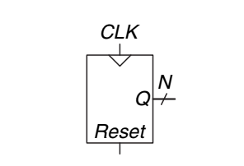
DIGITAL LOGIC & COMPUTER DESIGN
N-bit Binary Counter
What is a Counter?
An N-bit binary counter is a sequential arithmetic circuit with:
A clock input
A reset input
An N-bit output Q
When reset is asserted, the counter is initialized to zero. After reset is released, the counter increments by 1 at every rising edge of the clock.
General operation: Q_{next}=Q+1
Therefore, if the current value is: Q=0101, then at the next rising clock edge: Q=0110
The counter continues this process until it reaches its maximum value and then wraps around to zero.

Slide 6
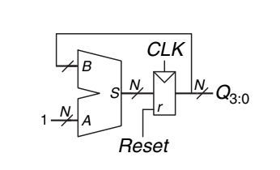
DIGITAL LOGIC & COMPUTER DESIGN
N-bit Binary Counter
Figure here, shows an N-bit counter composed of an adder and a resettable register.
On each cycle, the counter adds 1 to the value stored in the register.

Slide 7
DIGITAL LOGIC & COMPUTER DESIGN
Number of States in an N-bit Counter
How many values can an N-bit counter represent?
An N-bit binary number can represent: 2^N different combinations.
Therefore, an N-bit counter has: 2^N possible states
The values range from: 0 to 2^(N−1)
Example: 3-bit counter
Since: 2^3=8
the counter has 8 states:
000 → 001 → 010 → 011
↑ ↓
111 ← 110 ← 101 ← 100
After 111, the next value is: 000 because the counter has exhausted all 8 possible 3-bit combinations.

Slide 8
DIGITAL LOGIC & COMPUTER DESIGN
Number of States in an N-bit Counter
Example: 8-bit counter
2^8=256
So an 8-bit counter counts from: 0 to 255, before returning to 0.

Slide 9
DIGITAL LOGIC & COMPUTER DESIGN
Reset and Clock
The N-bit binary counter has:
Clock input
Reset input
N-bit output Q
Reset
Reset initializes the output to 0.
Clock
The counter increments on the:
rising edge/falling edge of the clock
Thus: Reset→Q=0 and subsequently, on each rising edge: Q→Q+1

Slide 10
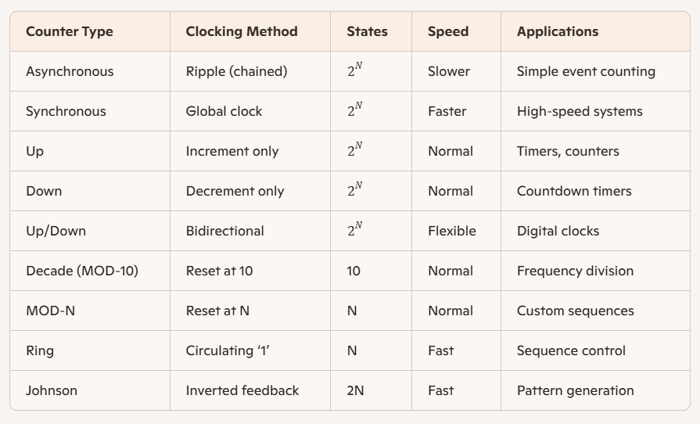
DIGITAL LOGIC & COMPUTER DESIGN
Types of counters
Asynchronous Counter(Ripple Counter)
Synchronous Counter

Slide 11
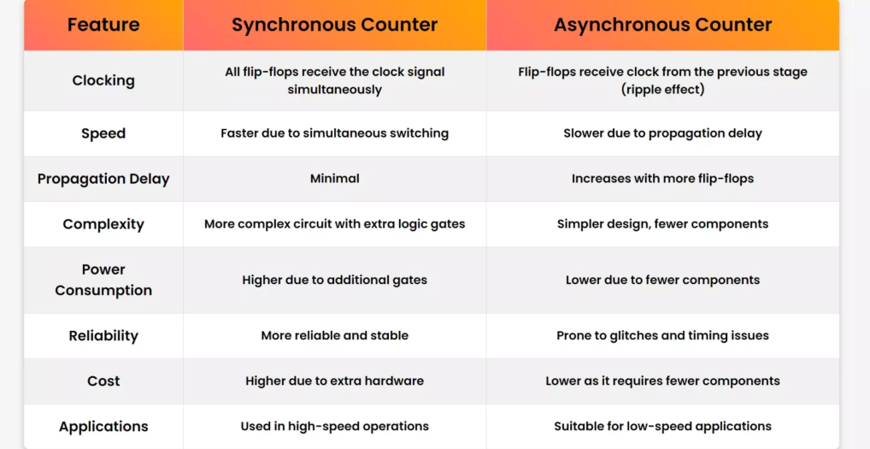
DIGITAL LOGIC & COMPUTER DESIGN
Types of counters-Differences
Asynchronous Counter(Ripple Counter)
Synchronous Counter

Slide 12
DIGITAL LOGIC & COMPUTER DESIGN
Types of counters-Differences
Why T and JK Flip-Flops Are Preferred
T Flip-Flop (Toggle Flip-Flop)
  Has a single input (T).
  When T = 1, the output toggles on each clock edge.
  This directly divides the clock frequency by 2, making it ideal for counters and frequency dividers.
  Simple design, minimal logic required.
JK Flip-Flop
  More versatile: can perform Set, Reset, Hold, and Toggle depending on J and K inputs.
  When J = K = 1, it behaves exactly like a T flip-flop (toggle mode).
  Eliminates the invalid state problem of SR flip-flops.
  Widely used in counters because of flexibility and reliability.

Slide 13
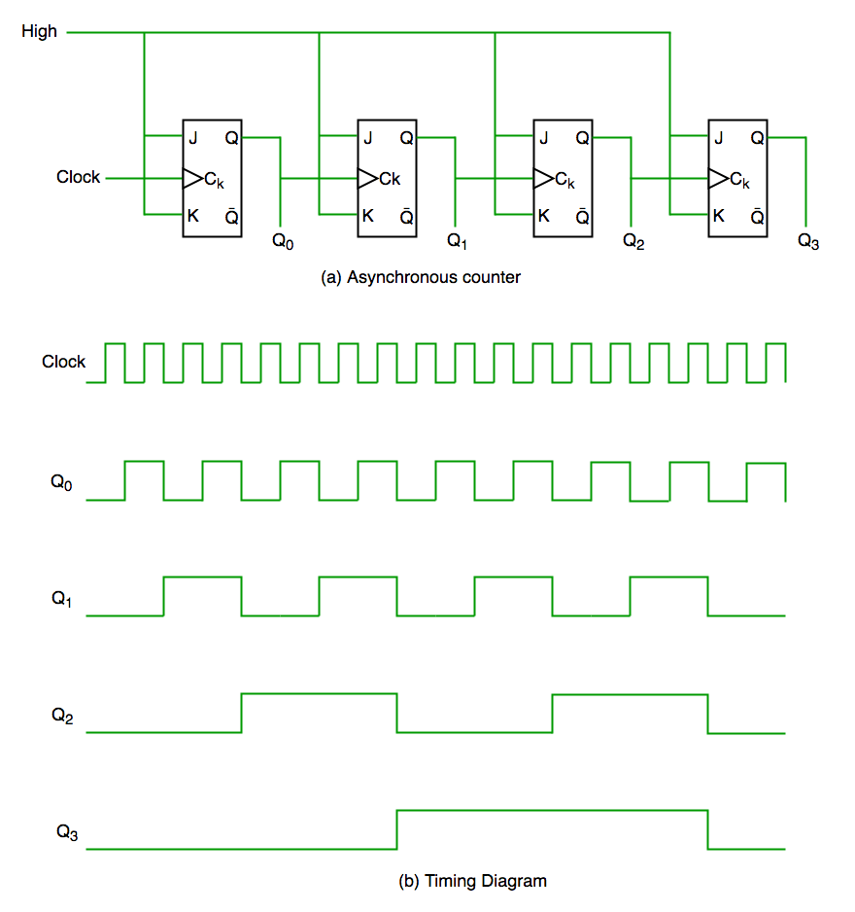
DIGITAL LOGIC & COMPUTER DESIGN
Types of counters-Asynchronous Counter
Asynchronous Counter (4 BIT RIPPLE / MOD 4 COUNTER)
In an asynchronous counter, there is no common (universal) clock for all flip-flops; only the first flip-flop is driven by the main clock, and each subsequent flip-flop is triggered by the output of the previous one, causing the count to ripple through the circuit.
From the timing diagram,
Q0 changes immediately at the falling edge of the clock,
Q1 changes at the falling edge of Q0, and the same pattern continues for Q2 and Q3.
This step-by-step change creates a ripple effect through the flip-flops, which is why it is called a ripple counter or serial counter. A ripple counter is a cascade of flip-flops where the output of one flip-flop acts as the clock input for the next.

Slide 14
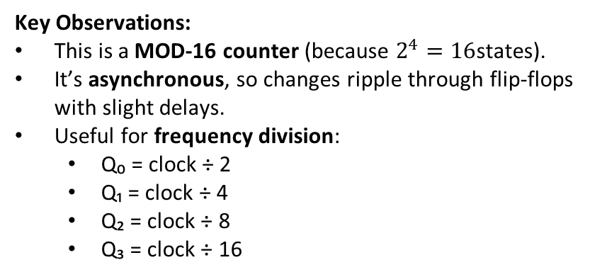
DIGITAL LOGIC & COMPUTER DESIGN
Asynchronous Counter-MOD-4
Clock Pulse | Q₃ | Q₂ | Q₁ | Q₀ | Decimal Value
Reset | 0 | 0 | 0 | 0 | 0
1 | 0 | 0 | 0 | 1 | 1
2 | 0 | 0 | 1 | 0 | 2
3 | 0 | 0 | 1 | 1 | 3
4 | 0 | 1 | 0 | 0 | 4
5 | 0 | 1 | 0 | 1 | 5
6 | 0 | 1 | 1 | 0 | 6
7 | 0 | 1 | 1 | 1 | 7
8 | 1 | 0 | 0 | 0 | 8
… | … | … | … | … | …
15 | 1 | 1 | 1 | 1 | 15
16 | 0 | 0 | 0 | 0 | 0 (wraps)
Timing Diagram (as in the image)
Clock: square wave pulses.
Q₀: toggles every pulse.
Q₁: toggles every 2 pulses.
Q₂: toggles every 4 pulses.
Q₃: toggles every 8 pulses.
Together, they form a binary count sequence from 0 → 15.

Slide 15
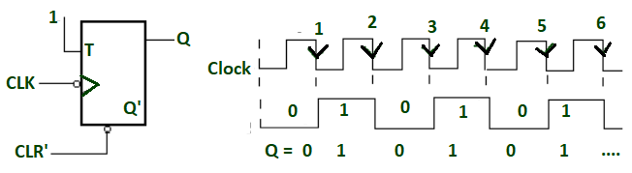
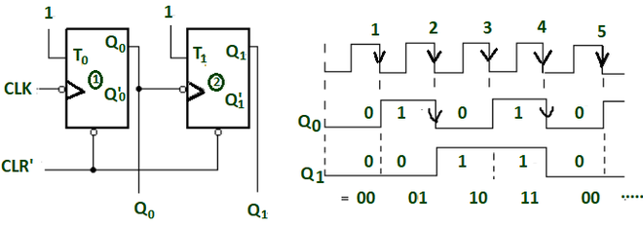
DIGITAL LOGIC & COMPUTER DESIGN
Asynchronous Counters -Examples
MOD-2 COUNTER(1-BIT)
When -ve edge clock pulse is applied and input is given to FF logic 1 then the output state of FF will toggle for every falling edge. The output frequency will be f/2 (If f is clock frequency).
It is known as binary or mod -2 counter or bit ripple counter.
It has 2 unique output states (0 and 1).
MOD 4 COUNTER(2-BIT)
When two FFs are connected in series and output of one FF is act as clock for 2nd FF. So the state of 2nd FF will change only when output and 1st FF is logic 1 and falling edge occur. The output frequency of Q₁ is f/4(if f is clock frequency).
It can generate 4 different unique states. This is known as divide by 4 circuits or mod 4 ripple counter.
Here output is taken as Q₁(MSB) Q₀(LSB).

Slide 16
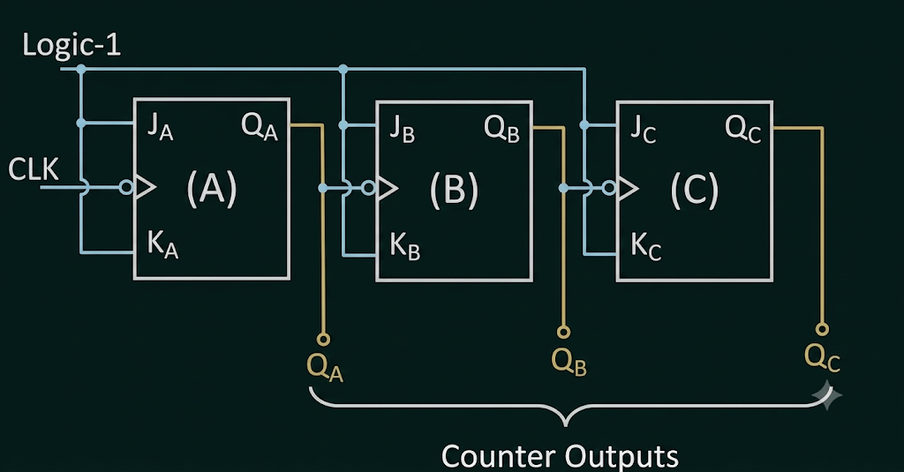
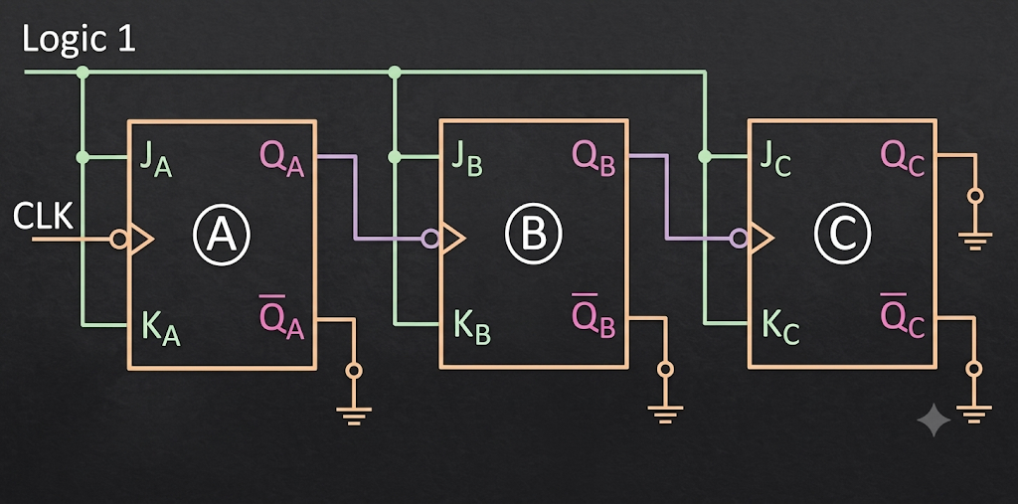
DIGITAL LOGIC & COMPUTER DESIGN
Asynchronous Counters - Examples
3 Bit-UP COUNTER 3 Bit-DOWN COUNTER
Counter State | Q_{C} | Q_{B} | Q_{A}
0 | 0 | 0 | 0
1 | 0 | 0 | 1
2 | 0 | 1 | 0
3 | 0 | 1 | 1
4 | 1 | 0 | 0
5 | 1 | 0 | 1
6 | 1 | 1 | 0
7 | 1 | 1 | 1
Counter State | Q’_{C} | Q’_{B} | Q’_{A}
7 | 1 | 1 | 1
6 | 1 | 1 | 0
5 | 1 | 0 | 1
4 | 1 | 0 | 0
3 | 0 | 1 | 1
2 | 0 | 1 | 0
1 | 0 | 0 | 1
0 | 0 | 0 | 0

Slide 17
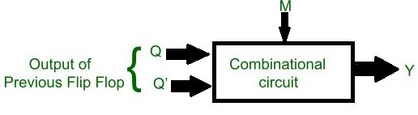
DIGITAL LOGIC & COMPUTER DESIGN
Asynchronous Counters -Examples
Design of 3 Bit Asynchronous UP/DOWN Counter
It is used more than separate up or down counter.
In this a mode control input (say M) is used for selecting up and down mode.
A combinational circuit is required between each pair of flip-flop to decide whether to do up or do down counting.
Step 1 : Decision for Mode control input -
Decision for mode control input
When M = 0, then Y= Q, therefore it will perform Up counting (As discussed above).
When M = 1, then Y= Q' therefore it will perform Down counting (As discussed above).
Combinational circuit is required for deciding mode control(i.e., whether counter will perform Up counting or Down counting).
So the all possible combinations are -

Slide 18
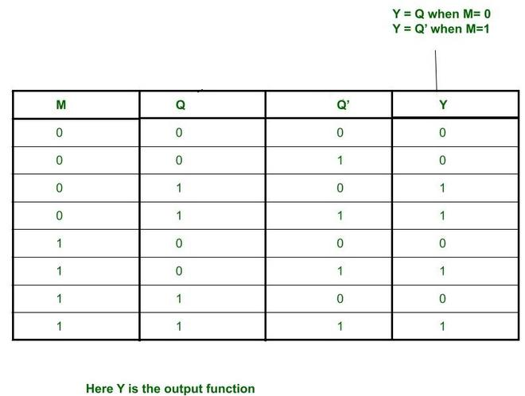
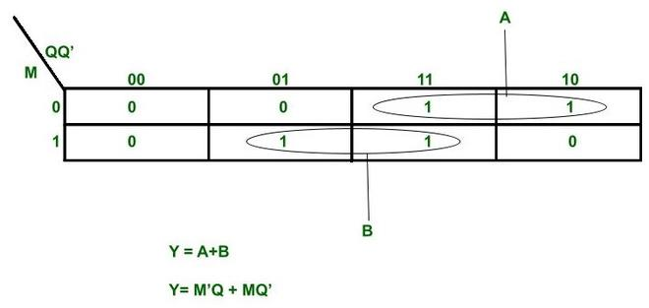
DIGITAL LOGIC & COMPUTER DESIGN
Asynchronous Counters -Examples

Slide 19
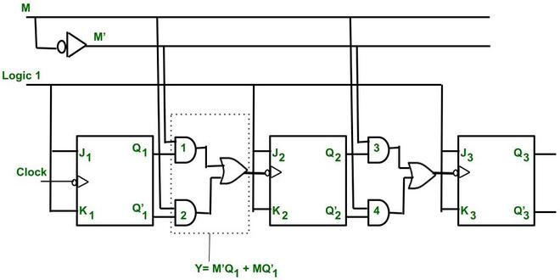
DIGITAL LOGIC & COMPUTER DESIGN
Asynchronous Counters -Examples
Insertion of Combinational logic between every pair of FFs -

Slide 20
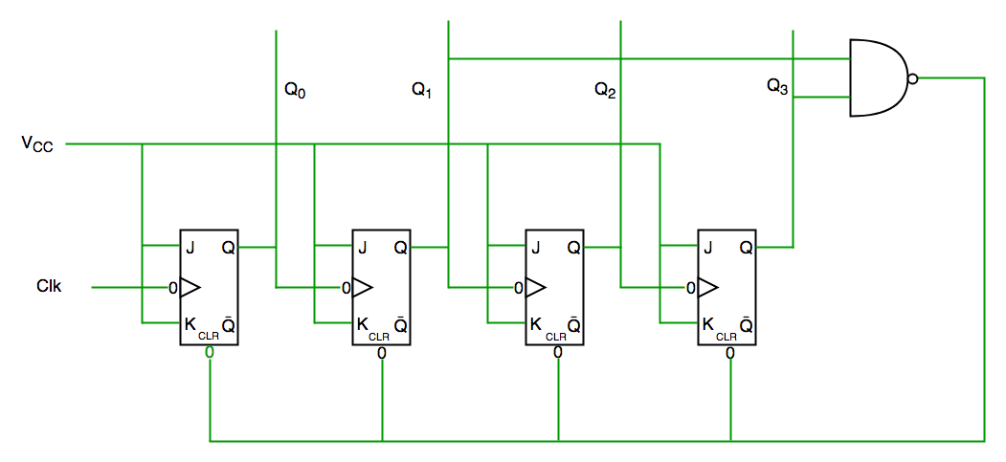
DIGITAL LOGIC & COMPUTER DESIGN
Asynchronous Counters -Examples
Decade Counter
Counts ten states and then resets to its initial state. The most common decade counter counts from 0 to 9, but it can also be designed to count any ten states within 0 to 15 in a 4-bit counter before resetting.
Clock pulse | Q3 | Q2 | Q1 | Q0
0 | 0 | 0 | 0 | 0
1 | 0 | 0 | 0 | 1
2 | 0 | 0 | 1 | 0
3 | 0 | 0 | 1 | 1
4 | 0 | 1 | 0 | 0
5 | 0 | 1 | 0 | 1
6 | 0 | 1 | 1 | 0
7 | 0 | 1 | 1 | 1
8 | 1 | 0 | 0 | 0
9 | 1 | 0 | 0 | 1
10 | 0 | 0 | 0 | 0
From the circuit diagram, a NAND gate is connected to Q3 and Q1 and its output is fed to the clear input because the binary representation of 10 is 1010. When Q3 and Q1 both become 1, the NAND gate output goes low, activating the clear input, so the counter resets at 10 and starts counting again from 0.

Slide 21
DIGITAL LOGIC & COMPUTER DESIGN
Synchronous Counters
Synchronous Counter
Unlike an asynchronous counter, a synchronous counter uses a single global clock that drives all flip-flops simultaneously, so all outputs change in parallel. Its main advantage is that it can operate at higher frequencies because it does not suffer from cumulative delay, as the same clock is applied to every flip-flop. Hence, it is also called a parallel counter.

Slide 22

DIGITAL LOGIC & COMPUTER DESIGN
Synchronous Counters -Examples
Steps to design Synchronous Counters

Slide 23
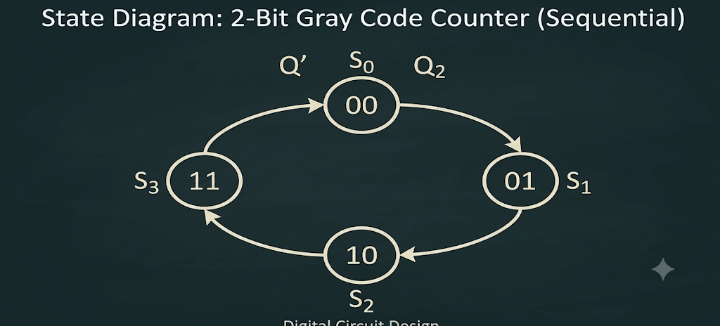
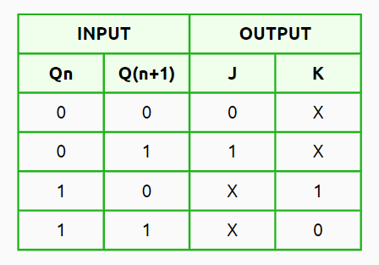
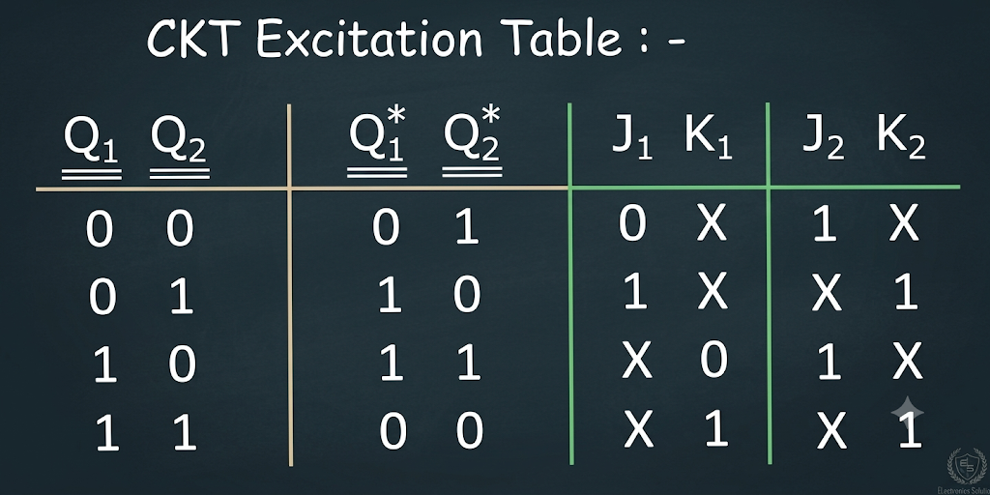
DIGITAL LOGIC & COMPUTER DESIGN
Synchronous Counters -Examples
Design 2 bit Synchronous Up Counter
Step3: State Diagram & Circuit ET
Step1: Decide the number of Flipflops – 2 (JK)
Step2: Excitation table of JK FF

Slide 24
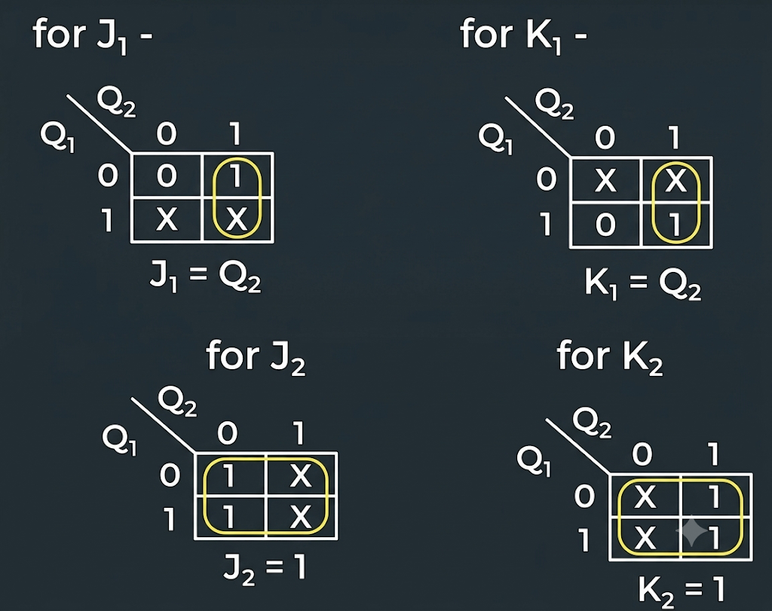
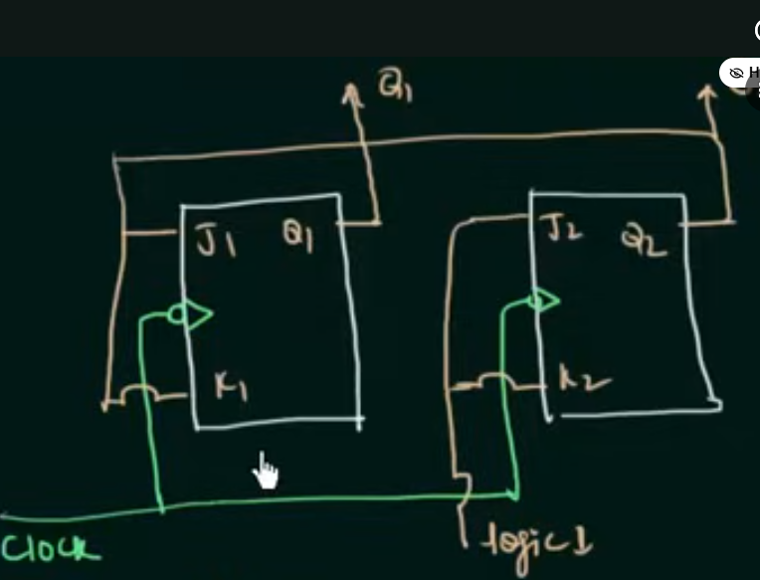
DIGITAL LOGIC & COMPUTER DESIGN
Synchronous Counters -Examples
Step 4: Solve for J1 K1 J2 K2 USING K MAPS
Step 5: Draw the logic diagram

Slide 25
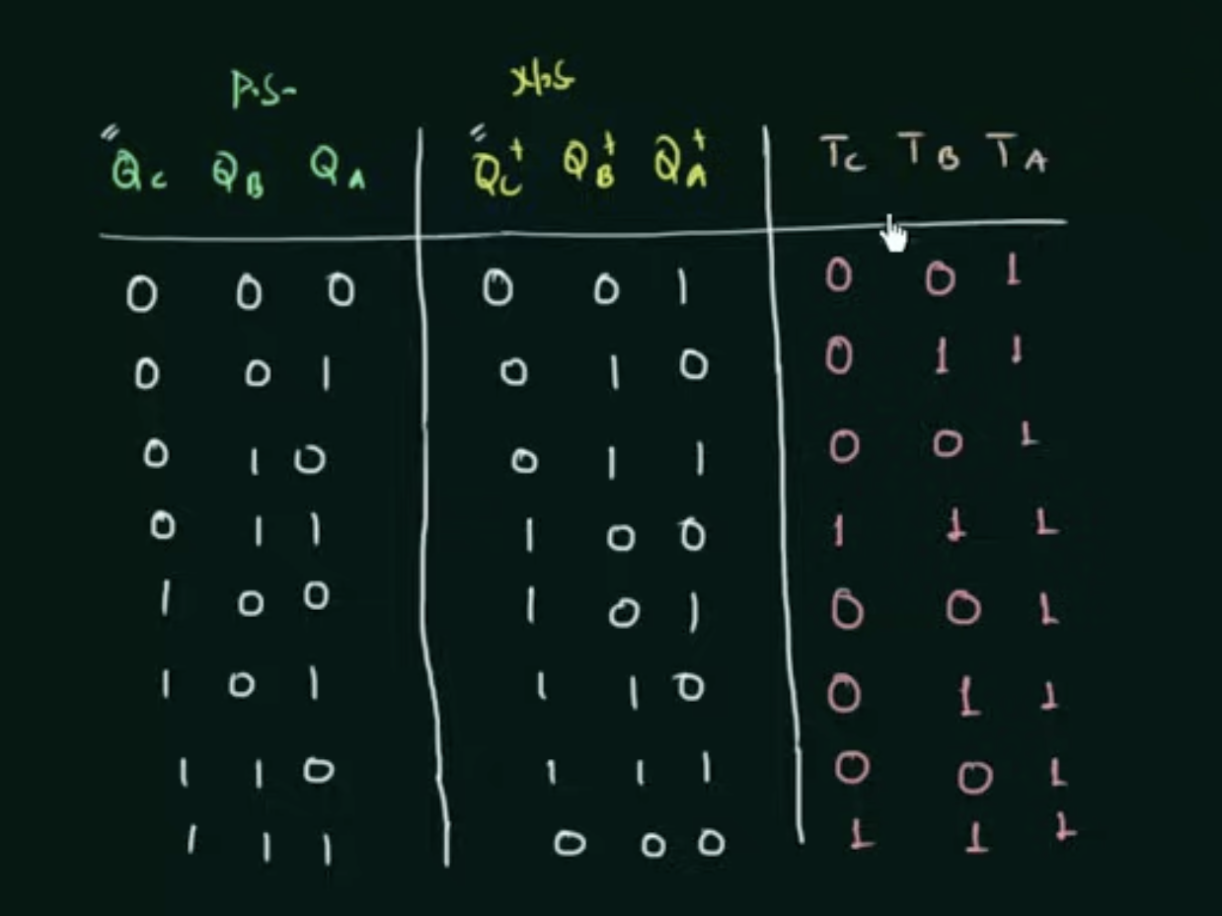
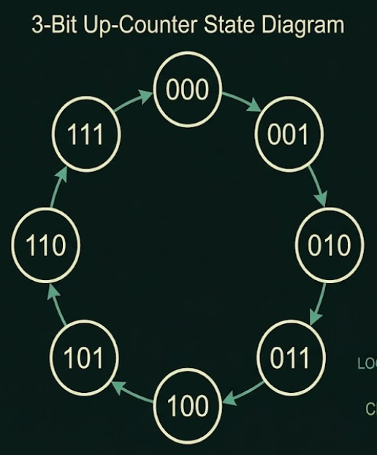
DIGITAL LOGIC & COMPUTER DESIGN
Synchronous Counters -Examples
Design 3 bit Synchronous Up Counter using T FF
Step3: State Diagram & Circuit ET
Step1: Decide the number of Flipflops – 3 (T FF)
Step2: Excitation table of T FF
INPUT |  | OUTPUT
Qn | Qn+1 | T
0 | 0 | 0
0 | 1 | 1
1 | 0 | 1
1 | 1 | 0

Slide 26
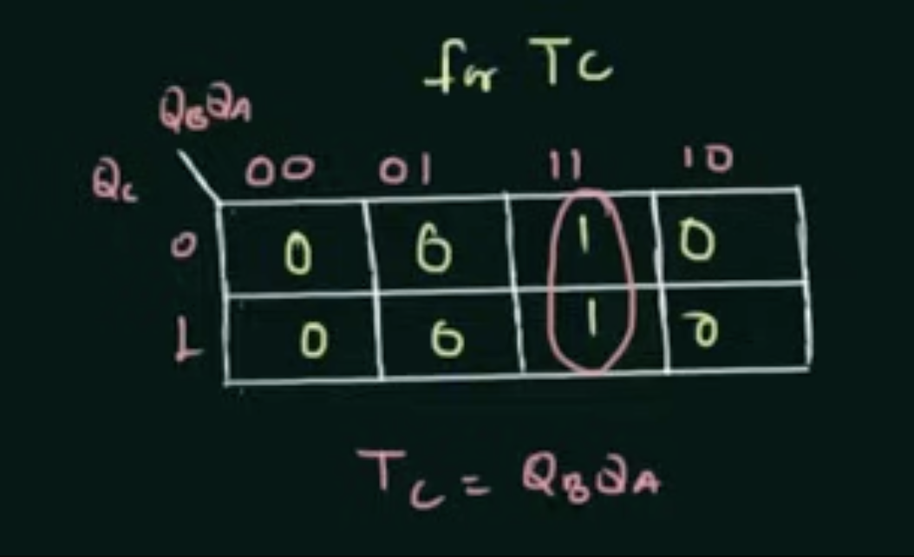
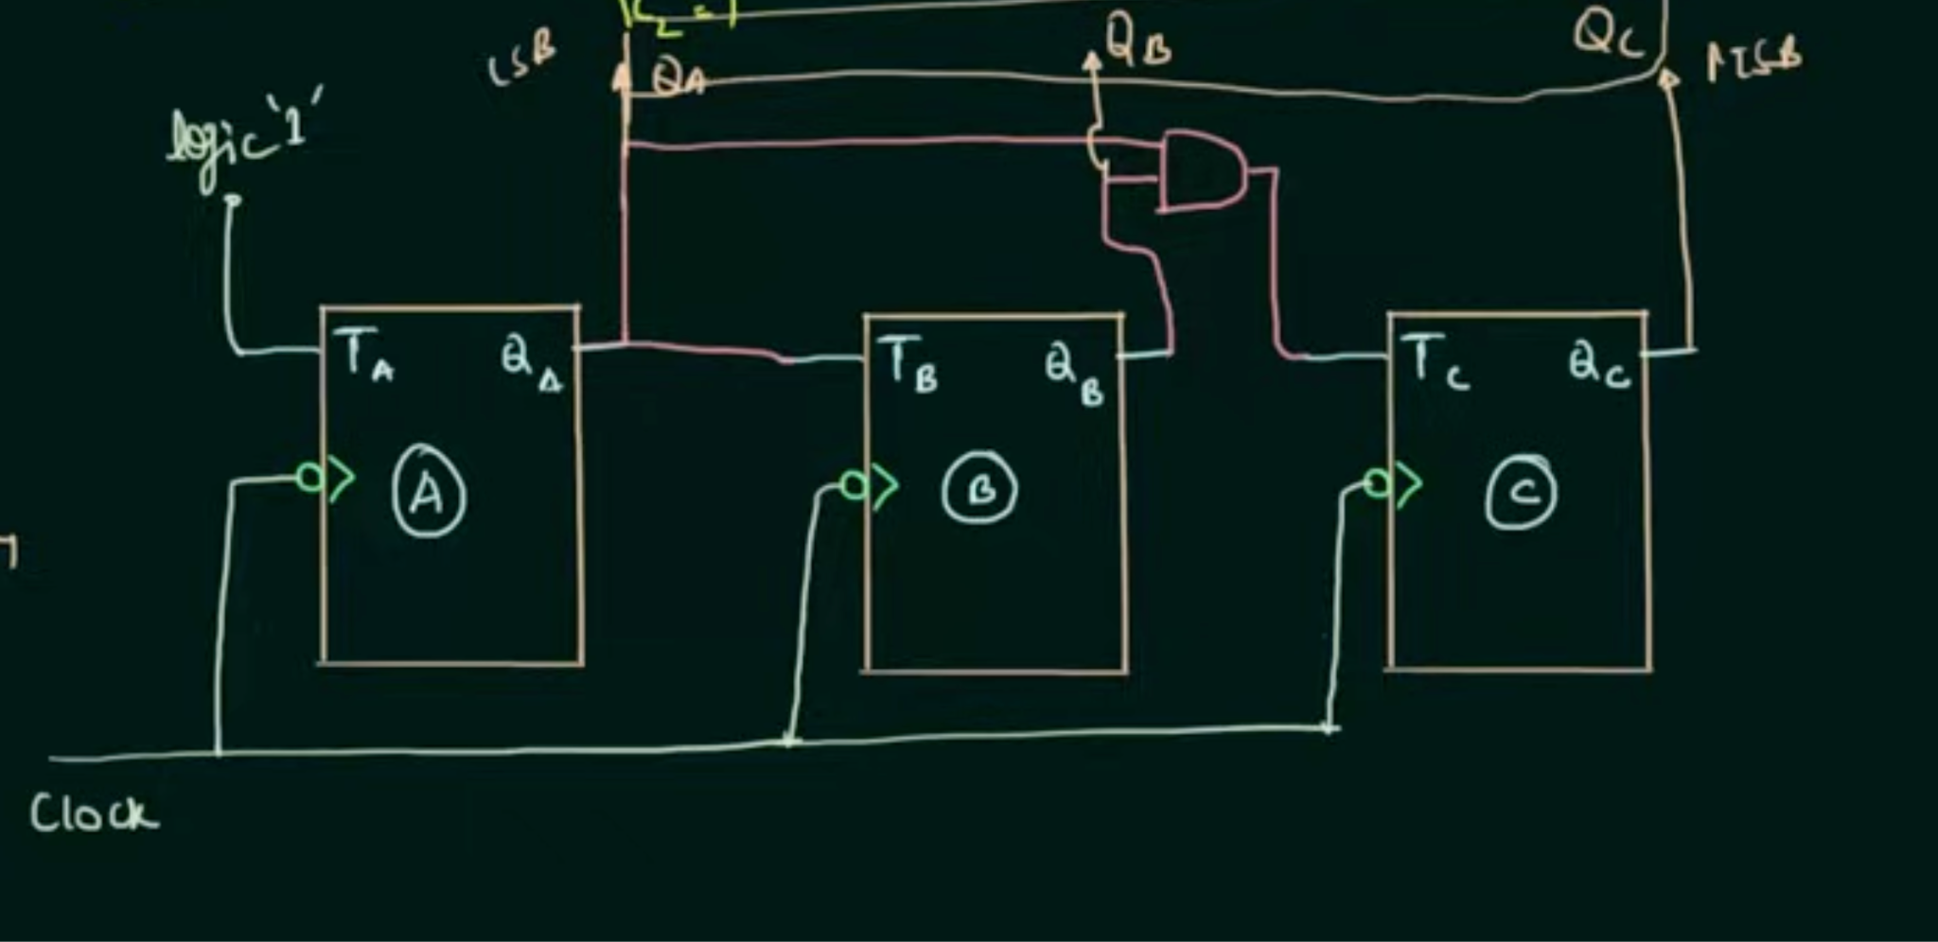
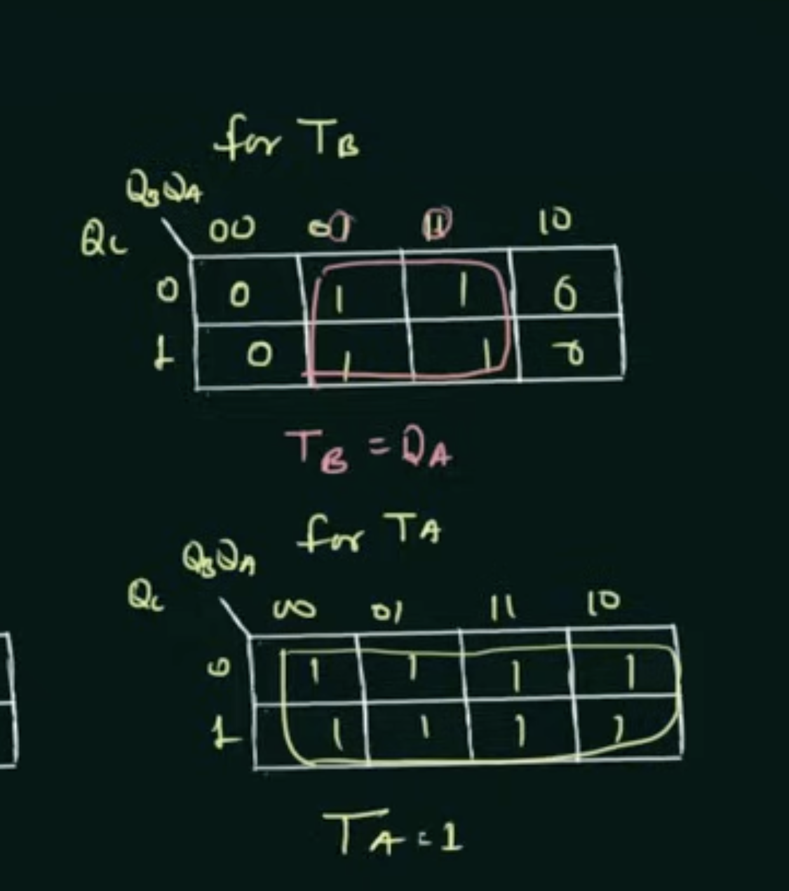
DIGITAL LOGIC & COMPUTER DESIGN
Synchronous Counters -Examples
Step 4: Solve for T1 T2 T3 USING K MAPS
Step 5: Draw the logic diagram

Slide 27
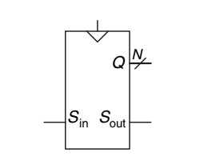
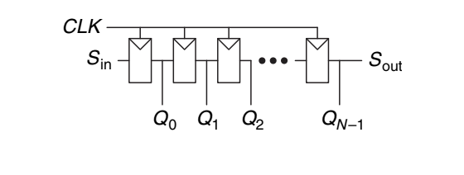
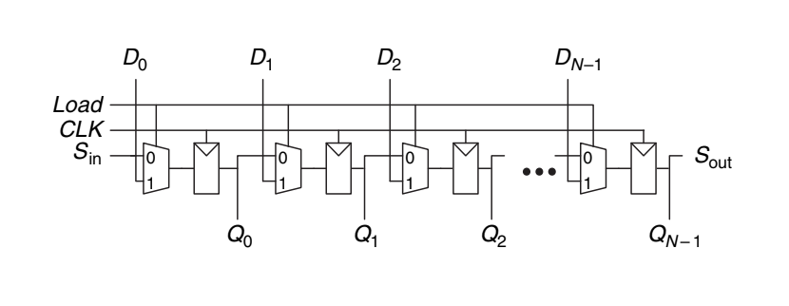
DIGITAL LOGIC & COMPUTER DESIGN
What Is a Shift Register?
A chain of flip-flops sharing one clock.
On each clock edge, a new bit enters at Sin; every stored bit moves forward one position.
The oldest bit exits at Sout.
After N cycles, all N bits sit together on parallel outputs Q0...QN-1.
Function: converts a serial (one-bit-at-a-time) stream into a parallel N-bit word.
Shift register symbol
Shift register schematic
Shift register with parallel load

Slide 28
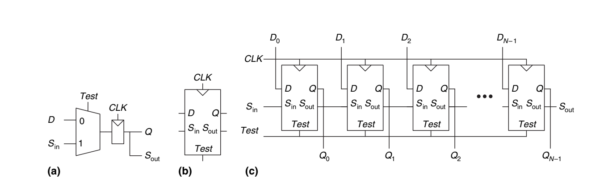
DIGITAL LOGIC & COMPUTER DESIGN
Shift Registers
Scannable flip-flop: (a) schematic, (b) symbol, and (c) N-bit scannable register

Slide 29
DIGITAL LOGIC & COMPUTER DESIGN
Shift Register
Internal structure:
Built from N flip-flops connected in series.
Each flip-flop's output feeds the next flip-flop's input.
All flip-flops share the same clock signal.
Some designs add a reset signal to clear all flip-flops to 0.
Adding Parallel Load:
Basic shift register only does serial-to-parallel.
Add a parallel data input D(N-1:0) and a control signal Load to also support parallel-to-serial.
When Load = 1: all flip-flops load directly from D (parallel load, one cycle).
When Load = 0: register shifts normally (Sin feeds in, bits move forward).

Slide 30
DIGITAL LOGIC & COMPUTER DESIGN
HDL Description
always @(posedge clk or posedge rst)
if (rst) q <= 0;
else if (load) q <= data_in; // parallel load
else q <= {q[N-2:0], sin}; // shift in sin
assign sout = q[N-1];
rst clears everything, highest priority.
load loads the full word from data_in in one cycle.
Otherwise, bits shift up and sin fills the empty slot.
sout is always the top bit of the register.

Slide 31
DIGITAL LOGIC & COMPUTER DESIGN
Why Test Sequential Circuits Differently ?
Combinational circuits: easy to test, apply input, check output.
Sequential circuits: hard since the output depends on internal state.
Example: to verify bit 31 of a 32-bit counter flips 0→1, naively need to reset then apply ~2 billion clock pulses.
Problem: too many flip-flops to give each one its own test pin.
Scan Chains: The Solution
Connect all flip-flops in the system into one long shift register called a scan chain.
Normal mode: each flip-flop loads from its regular D input; scan connections ignored.
Test mode: flip-flops shift data serially in/out via Sin/Sout — internal state can be read out or overwritten directly.
The mux for switching modes is usually built into the flip-flop itself, forming a "scannable flip-flop."

Slide 32
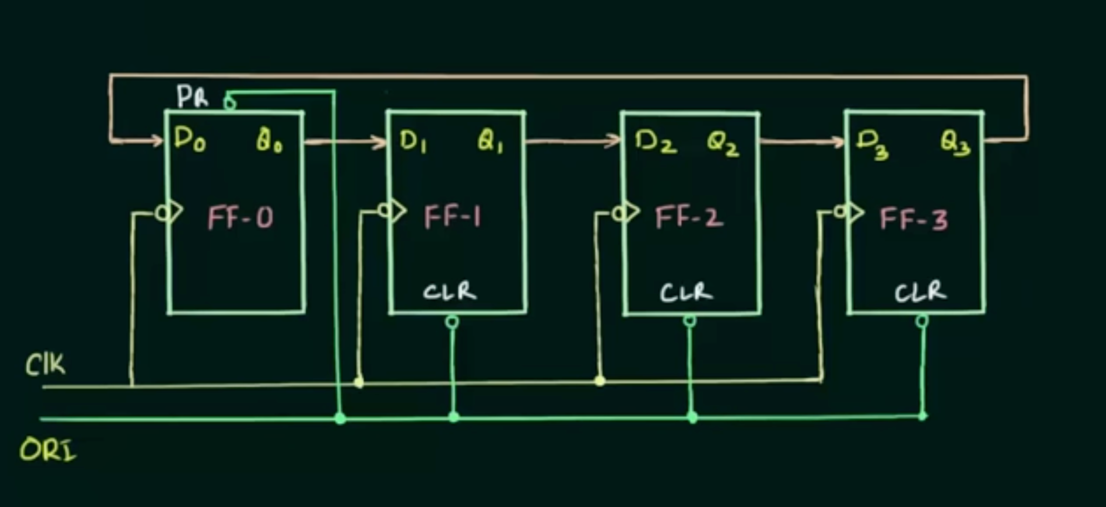
DIGITAL LOGIC & COMPUTER DESIGN
Type of counters - Ring counters
Definition
A ring counter is a shift-register-based counter in which the output of the last flip-flop is fed back to the first.
It consists of n flip-flops connected in a circular manner.
A single 1 circulates through the flip-flops with each clock pulse.
Example: 4-bit Ring Counter
1000 → 0100 → 0010 → 0001 → 1000 → …
Key Point:
For n flip-flops → n valid states → MOD-n counter
ORI means overriding input: If PR(preset) = 0 then Q=1
If Clr = 0 then Q=0
It is used to initialize counters as 1 0 0 0
It is used to initialize (preset) the ring counter to a valid starting state.

Slide 33
DIGITAL LOGIC & COMPUTER DESIGN
Type of counters - Ring counters
Circuit & Working
4-Bit Ring Counter
Four flip-flops are connected as a shift register.
All flip-flops receive a common clock.
The output of the last flip-flop is connected back to the input of the first.
The counter must be initialized with a single 1.
Working: Q0 → Q1 → Q2 → Q3 → Q0
At every clock pulse, the 1 shifts to the next flip-flop.
ORI is an initialization/reset-type control signal. It forces the ring counter into its starting state, usually 1000, before normal counting begins.
So remember:
ORI = Overriding Input
ORI = 0 → initialize the counter
ORI = 1 → normal ring-counter operation
One important point: ORI is not the clock. It is an overriding control used to establish the initial 1 in the ring.

Slide 34
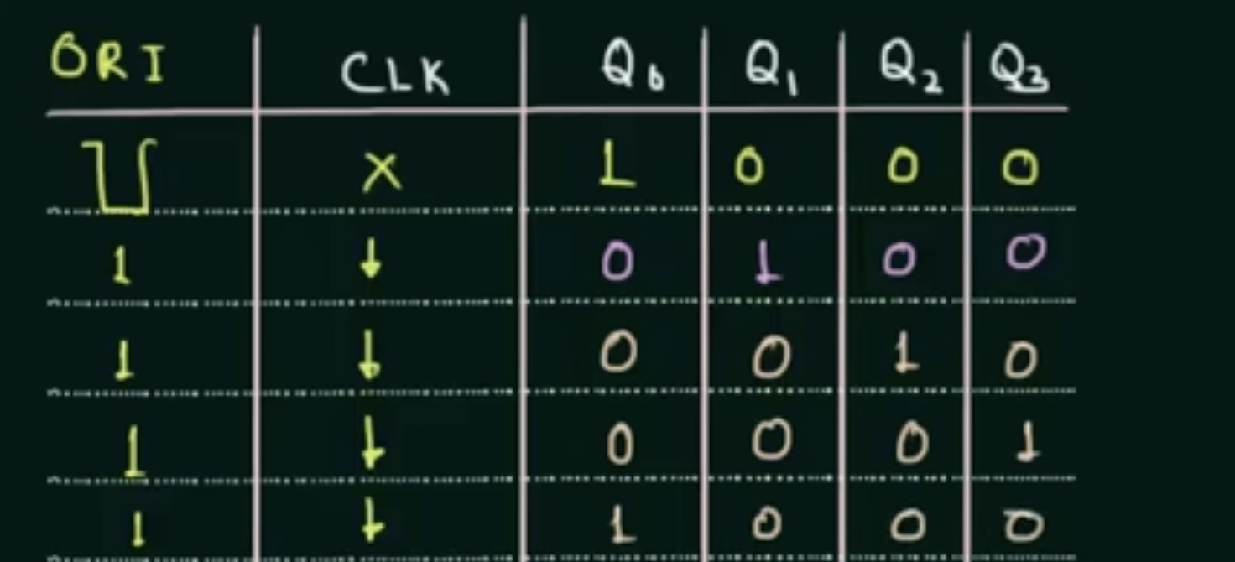
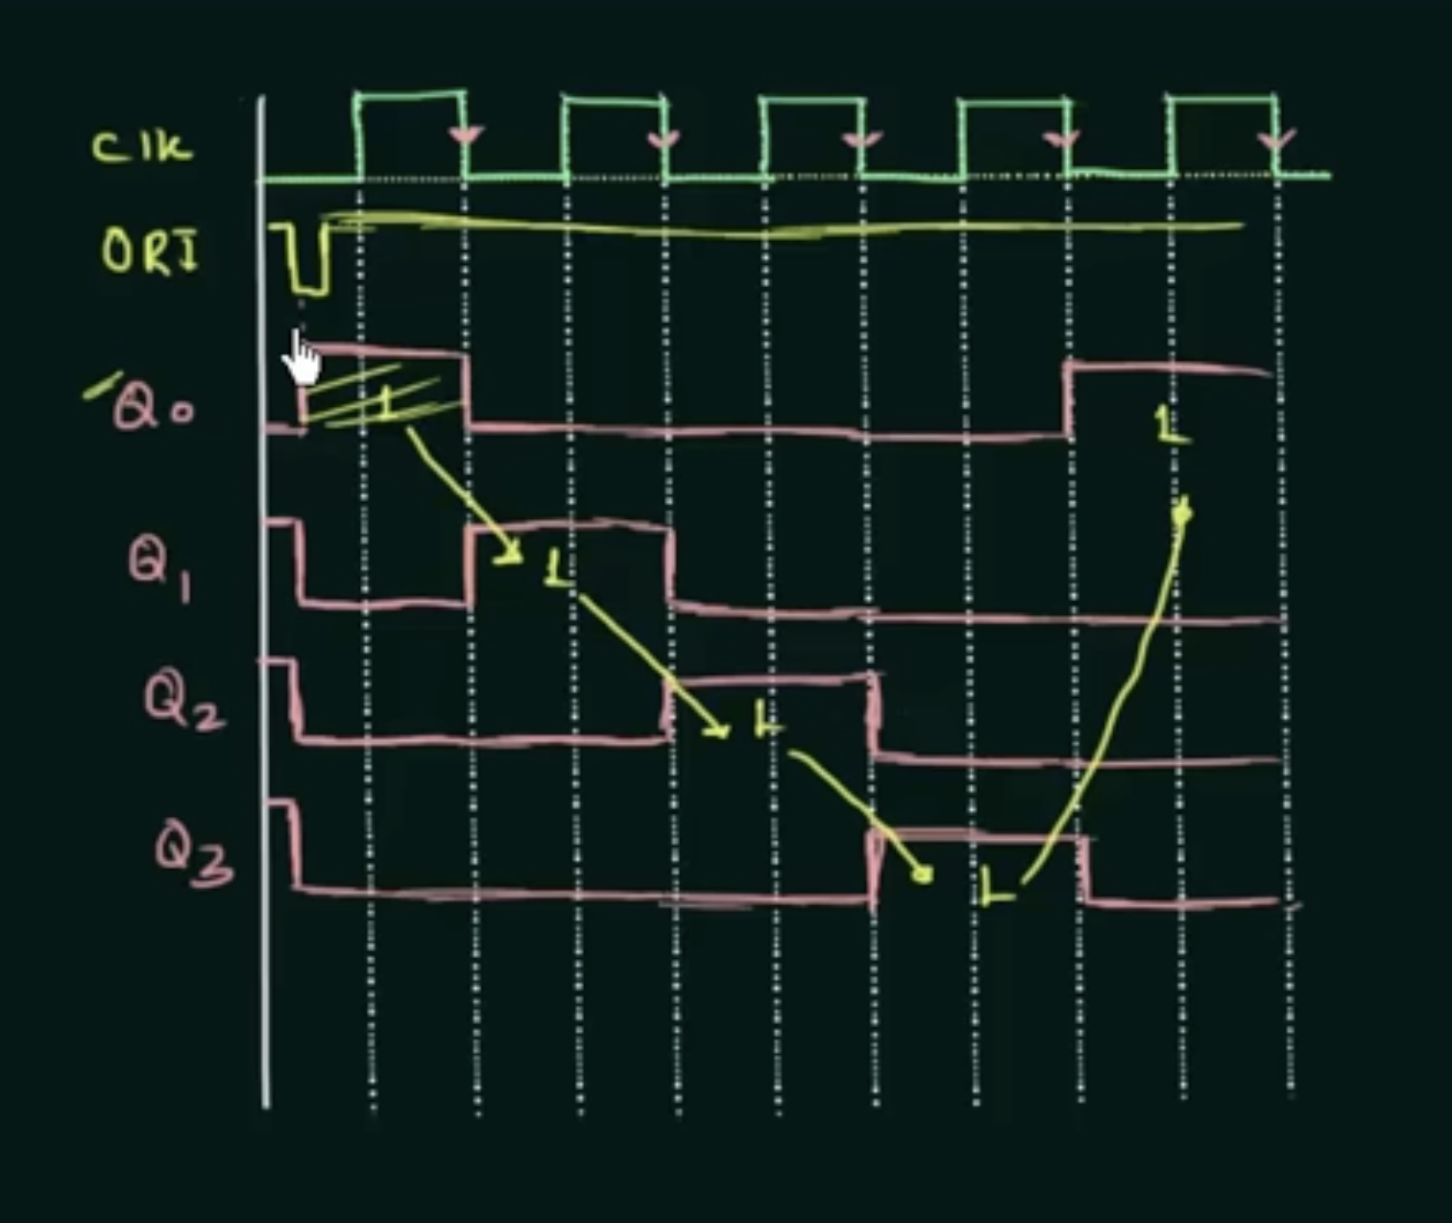
DIGITAL LOGIC & COMPUTER DESIGN
Type of counters - Ring counters
Ring Counter Timing/State Table

Slide 35
DIGITAL LOGIC & COMPUTER DESIGN
Type of counters - Ring counters
Advantages
Simple circuit design
Fast operation
Directly provides decoded outputs
No additional decoding logic required
Limitations
Requires n flip-flops for n states
More hardware compared with binary counters
Requires proper initialization
0000 is an invalid/stuck state
Applications
Sequence generation
Timing and control circuits
Stepper motor control
Digital control systems
Timing signal generation
A ring counter circulates a single HIGH bit through a series of flip-flops to generate a repeating sequence of states.

Slide 36
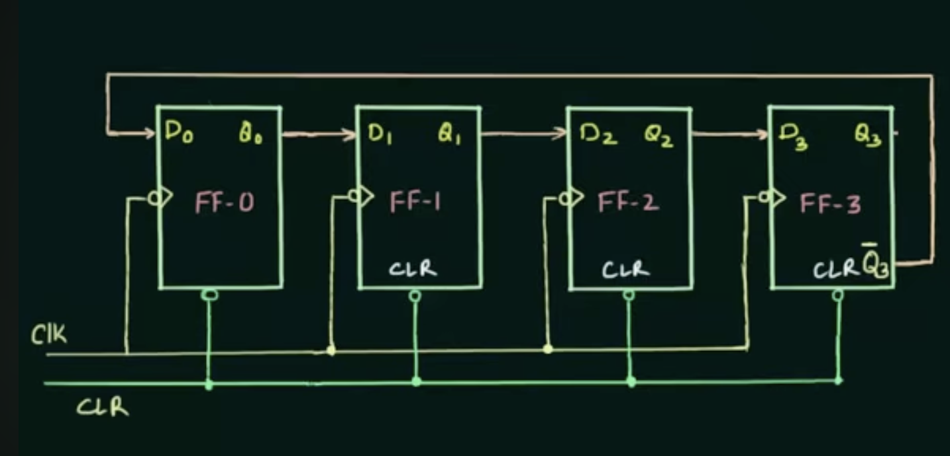
DIGITAL LOGIC & COMPUTER DESIGN
Type of counters - Johnson counters
A Johnson counter is a modified shift-register counter.
It is also called a Twisted Ring Counter or Switch-Tail Ring Counter.
The complement of the last flip-flop output is fed back to the input of the first flip-flop.
For n flip-flops, a Johnson counter has 2n valid states.
Example:
4-bit Johnson Counter → 8 states

Slide 37
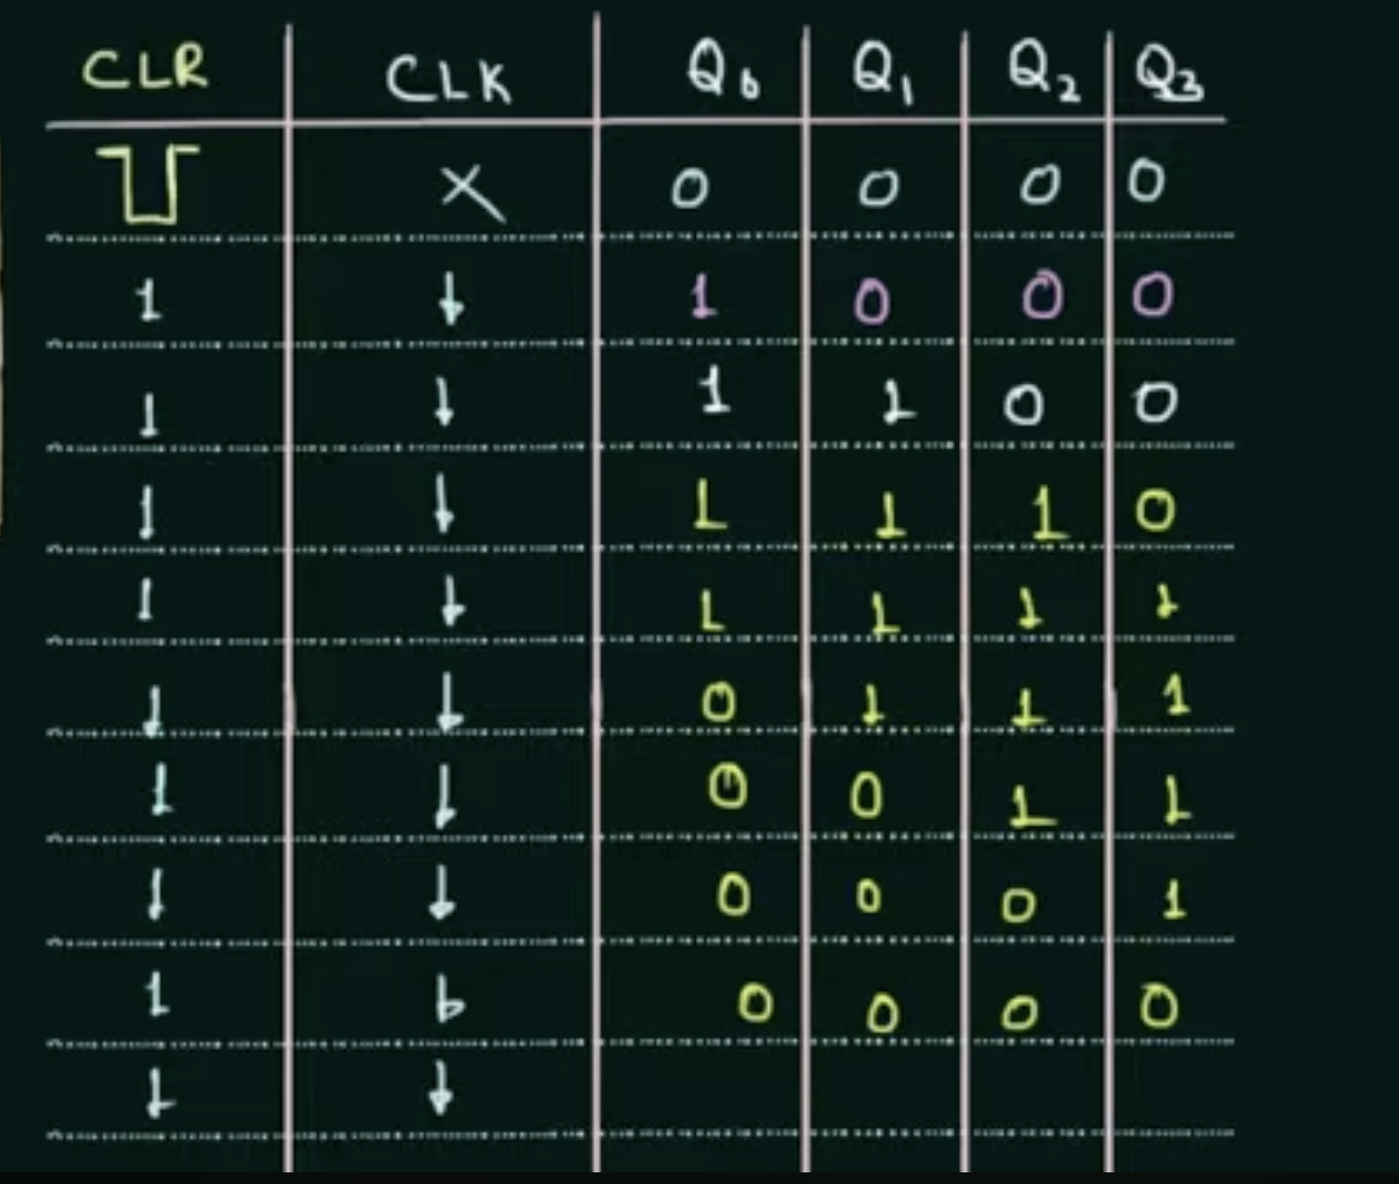
DIGITAL LOGIC & COMPUTER DESIGN
Type of counters - Johnson counters
4-Bit Johnson Counter
The complemented output of the last flip-flop is fed back to the first.
Feedback:
D₀ = Q₃^(-)
At every clock pulse, the contents shift by one position.
Starting from 0000:
0000 → 1000 → 1100 → 1110 → 1111 → 0111 → 0011 → 0001 → 0000
Thus, the sequence repeats after 8 clock pulses.

Slide 38
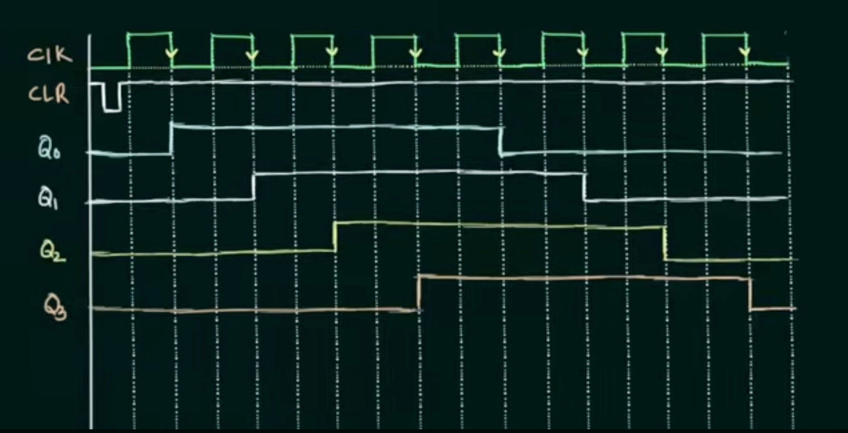
DIGITAL LOGIC & COMPUTER DESIGN
Type of counters - Johnson counters
Timing Waveforms of a 4-Bit Johnson (Twisted Ring) Counter

Slide 39
DIGITAL LOGIC & COMPUTER DESIGN
Worked Example: Testing a 32-bit Counter
Goal: confirm the counter correctly increments.
Step 1: Shift in test pattern 0111...111 (32 bits) - 32 cycles.
Step 2: Switch to normal mode, run 1 clock cycle (counter increments).
Step 3: Shift the result out - 32 cycles , verify it reads 1000...000.
Total: 65 cycles, instead of ~2 billion.

Slide 40
DIGITAL LOGIC & COMPUTER DESIGN
Questions
1. An N-bit binary counter with reset advances through how many distinct output values before repeating?
A) N
B) N²
C) 2N
D) 2^N
2. In the counter design built from an adder and a resettable register, what value is added to the register's contents on every clock cycle?
A) 0
B) 1
C) N
D) Reset value

Slide 41
DIGITAL LOGIC & COMPUTER DESIGN
Questions
1. An N-bit binary counter with reset advances through how many distinct output values before repeating?
A) N
B) N²
C) 2N
D) 2^N
Answer: D
2. In the counter design built from an adder and a resettable register, what value is added to the register's contents on every clock cycle?
A) 0
B) 1
C) N
D) Reset value
Answer: B

Slide 42
DIGITAL LOGIC & COMPUTER DESIGN
Questions
3. In the counter HDL, what has priority when both reset and the clock edge occur?
A) The increment (q <= q + 1)
B) Reset (q <= 0)
C) Neither - output is undefined
D) Load
4. What is the key structural difference between a plain shift register and a shift register with parallel load?
A) The plain version has no clock input
B) The parallel-load version adds a D input and Load control with a mux before each flip-flop
C) The plain version uses combinational logic only
D) The parallel-load version removes Sout

Slide 43
DIGITAL LOGIC & COMPUTER DESIGN
Questions
3. In the counter HDL, what has priority when both reset and the clock edge occur?
A) The increment (q <= q + 1)
B) Reset (q <= 0)
C) Neither - output is undefined
D) Load
Answer: B
4. What is the key structural difference between a plain shift register and a shift register with parallel load?
A) The plain version has no clock input
B) The parallel-load version adds a D input and Load control with a mux before each flip-flop
C) The plain version uses combinational logic only
D) The parallel-load version removes Sout
Answer: B

Slide 44
DIGITAL LOGIC & COMPUTER DESIGN
Questions
5. Why is testing sequential circuits harder than testing combinational circuits?
A) Sequential circuits have no outputs
B) Sequential circuits' outputs depend on internal state reached over many cycles, not just current inputs
C) Sequential circuits cannot be clocked
D) Sequential circuits use more transistors
6. In a scan chain, how does a flip-flop behave in normal (non-test) mode?
A) It loads from its usual D input; scan connections are ignored
B) It always loads from Sin
C) It shifts one position per cycle regardless of mode
D) It resets every cycle

Slide 45
DIGITAL LOGIC & COMPUTER DESIGN
Questions
5. Why is testing sequential circuits harder than testing combinational circuits?
A) Sequential circuits have no outputs
B) Sequential circuits' outputs depend on internal state reached over many cycles, not just current inputs
C) Sequential circuits cannot be clocked
D) Sequential circuits use more transistors
Answer: B
6. In a scan chain, how does a flip-flop behave in normal (non-test) mode?
A) It loads from its usual D input; scan connections are ignored
B) It always loads from Sin
C) It shifts one position per cycle regardless of mode
D) It resets every cycle
Answer: A

Slide 46
DIGITAL LOGIC & COMPUTER DESIGN
Questions
7. For the 32-bit counter scan-chain test example, what is the total number of cycles needed (shift in + 1 count cycle + shift out)?
A) 32
B) 33
C) 64
D) 65

Slide 47
DIGITAL LOGIC & COMPUTER DESIGN
Questions
7. For the 32-bit counter scan-chain test example, what is the total number of cycles needed (shift in + 1 count cycle + shift out)?
A) 32
B) 33
C) 64
D) 65
Answer: D

Slide 48
THANK YOU
Team DLCD
Department of CSE and CSE(AI & ML)

