Slide 1

DIGITAL LOGIC AND
COMPUTER DESIGN
TEAM DLCD
Department of CSE and CSE (AI & ML)

Slide 2

DIGITAL LOGIC AND COMPUTER DESIGN
ARCHITECTURE-Programming
TEAM DDCO
Department of CSE and CSE (AI & ML)

Slide 3

DIGITAL LOGIC AND COMPUTER DESIGN
TOPICS
Arithmetic/Logical Instructions
Branching
Conditional Statements.
Getting Loopy
Arrays
Function Calls.
© Elsevier, Digital Design and Computer Architecture, 2nd Ed., 2012.

Slide 4
DIGITAL LOGIC AND COMPUTER DESIGN
Programming
High–level languages:
e.g., C, Java, Python
Written at higher level of abstraction
Common high–level software constructs:
if/else statements for loops
while loops
Arrays, function calls
In this section, we explore how to translate these high-level constructs into MIPS assembly code.
© Elsevier, Digital Design and Computer Architecture, 2nd Ed., 2012.

Slide 5
DIGITAL LOGIC AND COMPUTER DESIGN
Arithmetic/Logical Instructions
MIPS provides a variety of arithmetic and logical instructions that are used to implement higher-level programming constructs. Most arithmetic instructions operate on values stored in registers.
Arithmetic instructions
add $t0, $s1, $s2 # $t0 = $s1 + $s2
sub $t0, $t3, $t5 # $t0 = $t3 - $t5
addi $t0, $s3, -12 # $t0 = $s3 - 12
For example, if $s1 = 25 and $s2 = 10:
add $t0,$s1,$s2 ⇒ $t0=35
MIPS also provides separate instructions for multiplication and division, which use the special hi and lo registers.
© Elsevier, Digital Design and Computer Architecture, 2nd Ed., 2012.

Slide 6
DIGITAL LOGIC AND COMPUTER DESIGN
Arithmetic/Logical Instructions
MIPS provides four basic logical operations: AND, OR, XOR and NOR. These are R-type instructions and operate bit-by-bit on two source registers.
For example, consider:
$s1 = 0xFFFF0000
$s2 = 0x46A1F0B7
The results are:
and $s3, $s1, $s2 # $s3 = 0x46A10000
or $s4, $s1, $s2 # $s4 = 0xFFFFF0B7
xor $s5, $s1, $s2 # $s5 = 0xB95EF0B7
nor $s6, $s1, $s2 # $s6 = 0x00000F48
AND is useful for masking bits because it can force selected bits to 0. OR can combine bits from two values.
MIPS does not provide a separate NOT instruction. Instead,
NOT A=A NOR $0
© Elsevier, Digital Design and Computer Architecture, 2nd Ed., 2012.

Slide 7
DIGITAL LOGIC AND COMPUTER DESIGN
Logical Instructions: What to Remember
AND
Mask bits
(keep only selected 1s)
OR
Set / combine bits
XOR
Show differences
between bits
NOR
OR first, then invert
(NOR with $0 = NOT)
• andi, ori, and xori zero-extend the 16-bit immediate before the operation.
• Use and for masking,
or for merging fields,
xor for bit comparison,
nor for inversion tricks.
© Elsevier, Digital Design and Computer Architecture, 2nd Ed., 2012.

Slide 8
DIGITAL LOGIC AND COMPUTER DESIGN
Logical Instructions: Example 1
Source Registers
$s1
$s2
1111 | 1111 | 1111 | 1111 | 0000 | 0000 | 0000 | 0000
0100 | 0110 | 1010 | 0001 | 1111 | 0000 | 1011 | 0111
Assembly Code
and $s3, $s1, $s2 $s3
^{or $s4, $s1, $s2} $s4 xor $s5, $s1, $s2 $s5 ^{nor $s6, $s1, $s2} $s6
Result
© Elsevier, Digital Design and Computer Architecture, 2nd Ed., 2012.

Slide 9
DIGITAL LOGIC AND COMPUTER DESIGN
Logical Instructions: Example 1
Source Registers
$s1
$s2
1111 | 1111 | 1111 | 1111 | 0000 | 0000 | 0000 | 0000
0100 | 0110 | 1010 | 0001 | 1111 | 0000 | 1011 | 0111
Assembly Code
and $s3, $s1, $s2 $s3
^{or $s4, $s1, $s2} $s4 xor $s5, $s1, $s2 $s5 nor $s6, $s1, $s2 $s6
Result
0100 | 0110 | 1010 | 0001 | 0000 | 0000 | 0000 | 0000
1111 | 1111 | 1111 | 1111 | 1111 | 0000 | 1011 | 0111
1011 | 1001 | 0101 | 1110 | 1111 | 0000 | 1011 | 0111
0000 | 0000 | 0000 | 0000 | 0000 | 1111 | 0100 | 1000
© Elsevier, Digital Design and Computer Architecture, 2nd Ed., 2012.

Slide 10


DIGITAL LOGIC AND COMPUTER DESIGN
Logical Instructions: Example 2
Logical operations can also operate on immediates. These I-type instructions are andi, ori, and xori.
nori is not provided, because the same functionality can be easily implemented using the other instructions.
Because these instructions operate on a 32-bit value from a register and a 16-bit immediate, they first zero-extend the immediate to 32 bits.
Source Values
$s1
imm
0000 | 0000 | 0000 | 0000 | 0000 | 0000 | 1111 | 1111
0000 | 0000 | 0000 | 0000 | 1111 | 1010 | 0011 | 0100
Assembly Code
andi $s2, $s1, 0xFA34 ori $s3, $s1, 0xFA34
xori $s4, $s1, 0xFA34
zero-extended
Result
$s2
$s3
$s4
© Elsevier, Digital Design and Computer Architecture, 2nd Ed., 2012.

Slide 11


DIGITAL LOGIC AND COMPUTER DESIGN
Logical Instructions: Example 2
Source Values
$s1
imm
0000 | 0000 | 0000 | 0000 | 0000 | 0000 | 1111 | 1111
0000 | 0000 | 0000 | 0000 | 1111 | 1010 | 0011 | 0100
Assembly Code
andi $s2, $s1, 0xFA34 ori $s3, $s1, 0xFA34
xori $s4, $s1, 0xFA34
zero-extended
Result
$s2
$s3
$s4
0000 | 0000 | 0000 | 0000 | 0000 | 0000 | 0011 | 0100
0000 | 0000 | 0000 | 0000 | 1111 | 1010 | 1111 | 1111
0000 | 0000 | 0000 | 0000 | 1111 | 1010 | 1100 | 1011
© Elsevier, Digital Design and Computer Architecture, 2nd Ed., 2012.

Slide 12
DIGITAL LOGIC AND COMPUTER DESIGN
Think About It
MIPS instruction set has an or instruction as well as a nor instruction, and also an ori instruction, but no nori instruction.
Why?
How can nori functionality be implemented?
© Elsevier, Digital Design and Computer Architecture, 2nd Ed., 2012.

Slide 13
DIGITAL LOGIC AND COMPUTER DESIGN
Think About It: Why is there no nori?
• MIPS avoids adding instructions whose behavior can already be built using existing ones.
• nori would mean: destination = NOT(rs OR immediate).
• That behavior is already easy to create in two instructions.
ori $t0, $s1, 0x00FF
nor $t0, $t0, $zero
Result:
$t0 = ~( $s1 | 0x00FF )
Key idea: nor with $zero works like bitwise NOT, so a dedicated nori instruction is unnecessary.
© Elsevier, Digital Design and Computer Architecture, 2nd Ed., 2012.

Slide 14
DIGITAL LOGIC AND COMPUTER DESIGN
Shift Instructions
Shift instructions shift the value in a register left or right by up to 31 bits.
Shift operations multiply or divide by powers of two.
MIPS shift operations are sll (shift left logical), srl (shift right logical), and sra (shift right arithmetic).
© Elsevier, Digital Design and Computer Architecture, 2nd Ed., 2012.

Slide 15
DIGITAL LOGIC AND COMPUTER DESIGN
Shift Instructions
Left shifts always fill the least significant bits with 0’s.
However, right shifts can be either logical (0’s shift into the most significant bits) or arithmetic (the sign bit shifts into the most significant bits).
Figure shows the machine code for the R–type instructions sll, srl, and sra.
rt (i.e., $s1) holds the 32–bit value to be shifted, and shamt gives the amount by which to shift (4).
The shifted result is placed in rd.
© Elsevier, Digital Design and Computer Architecture, 2nd Ed., 2012.

Slide 16
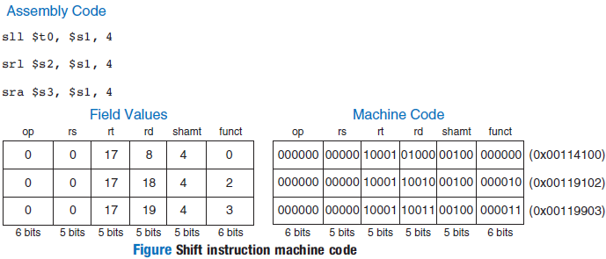
DIGITAL LOGIC AND COMPUTER DESIGN
Shift Instructions: Example
© Elsevier, Digital Design and Computer Architecture, 2nd Ed., 2012.

Slide 17
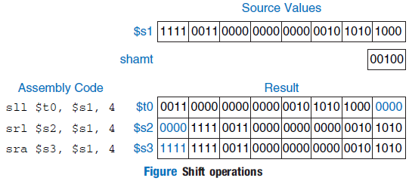
DIGITAL LOGIC AND COMPUTER DESIGN
Shift Instructions: Example
Figure shows the register values for the shift instructions sll, srl, and sra.
Shifting a value left by N is equivalent to multiplying it by 2^{N}.
Likewise, arithmetically shifting a value right by N is equivalent to dividing it by 2^{N},
© Elsevier, Digital Design and Computer Architecture, 2nd Ed., 2012.

Slide 18
DIGITAL LOGIC AND COMPUTER DESIGN
Shift Instructions: sll vs srl vs sra
Instruction | What it does | Bits filled in | Typical use
sll | Shift left logical | 0s on the right | Multiply by 2^n (if no overflow)
srl | Shift right logical | 0s on the left | Unsigned values / bit extraction
sra | Shift right arithmetic | Copies sign bit | Signed divide by 2^n
Example value:
10010000
srl by 2 → 00100100
sra by 2 → 11100100
shamt stores the fixed shift amount (0–31).
© Elsevier, Digital Design and Computer Architecture, 2nd Ed., 2012.

Slide 19
DIGITAL LOGIC AND COMPUTER DESIGN
Variable Shift Instructions
MIPS also has variable–shift instructions: sllv (shift left logical variable), srlv (shift right logical variable), and srav (shift right arithmetic variable).
Figure shows the machine code for these instructions.
Variable–shift assembly instructions are of the form sllv rd, rt, rs.
The order of rt and rs is reversed from most R–type instructions.
rt ($s1) holds the value to be shifted, and the five least significant bits of rs ($s2) give the amount to shift.
The shifted result is placed in rd, as before.
© Elsevier, Digital Design and Computer Architecture, 2nd Ed., 2012.

Slide 20
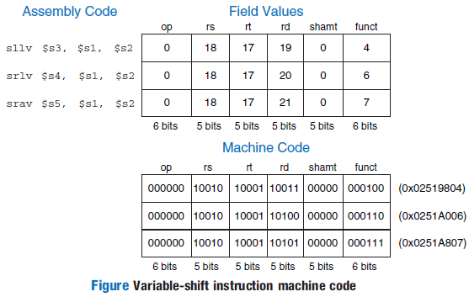
DIGITAL LOGIC AND COMPUTER DESIGN
Variable Shift Instructions: Example
© Elsevier, Digital Design and Computer Architecture, 2nd Ed., 2012.

Slide 21
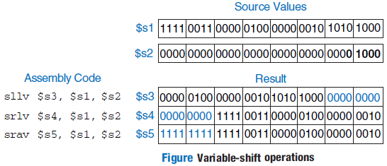
DIGITAL LOGIC AND COMPUTER DESIGN
Variable Shift Instructions: Example
The shamt field is ignored and should be all 0’s.
Figure shows register values for each type of variable–shift instruction.
© Elsevier, Digital Design and Computer Architecture, 2nd Ed., 2012.

Slide 22
DIGITAL LOGIC AND COMPUTER DESIGN
Variable Shift: Why rs and rt seem reversed
• Syntax is sllv rd, rt, rs (and similarly srlv, srav).
• rt contains the value that will be shifted.
• The lower 5 bits of rs give the shift amount.
• rd stores the final result.
• shamt is ignored because the amount now comes from a register.
rs
shift amount
rt
value to shift
rd
result
Easy memory tip: the variable amount comes from a register, not from the instruction bits.
© Elsevier, Digital Design and Computer Architecture, 2nd Ed., 2012.

Slide 23

DIGITAL LOGIC AND COMPUTER DESIGN
Generating Constants
The addi instruction can be used to assign a 16-bit constant to a register.
For example, to implement:
int a = 0x4F3C;
MIPS uses:
addi $s0, $0, 0x4F3C
Since $0 always contains zero:
$s0=0+0x4F3C
Therefore:
$s0 = 0x00004F3C
For a 32-bit constant, a single immediate instruction is not sufficient. MIPS uses lui followed by ori.
© Elsevier, Digital Design and Computer Architecture, 2nd Ed., 2012.

Slide 24
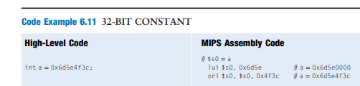
DIGITAL LOGIC AND COMPUTER DESIGN
Generating a 32-bit Constant
To implement:
int a = 0x6D5E4F3C;
MIPS divides the constant into two 16-bit parts:
Upper 16 bits = 0x6D5E
Lower 16 bits = 0x4F3C
First, lui loads the upper half: lui $s0, 0x6D5E
giving: $s0 = 0x6D5E0000
Then ori inserts the lower half: ori $s0, $s0, 0x4F3C
giving: $s0 = 0x6D5E4F3C
Thus:
lui+ori⇒32-bit constant
© Elsevier, Digital Design and Computer Architecture, 2nd Ed., 2012.

Slide 25
DIGITAL LOGIC AND COMPUTER DESIGN
Multiplication and Division
Multiplication and division differ from the other arithmetic operations because they can produce more than one 32-bit result.
Multiplying two 32-bit numbers produces a 64-bit product. MIPS stores this result in two special-purpose registers:
hi → upper 32 bits
lo → lower 32 bits
mult $s0, $s1
For division: div $s0, $s1
the results are:
lo → quotient
hi → remainder
The results can be moved to general-purpose registers using: mflo $t0; mfhi $t1
© Elsevier, Digital Design and Computer Architecture, 2nd Ed., 2012.

Slide 26
DIGITAL LOGIC AND COMPUTER DESIGN
Multiplication and Division: Numerical
MIPS uses the special HI and LO registers for multiplication and division. For division, LO stores the quotient and HI stores the remainder. For example, if: $s0=20,$s1=6
div $s0, $s1
mflo $t0 # $t0 = 3 (quotient)
mfhi $t1 # $t1 = 2 (remainder)
because: 20÷6=3 remainder 2
For multiplication, two 32-bit numbers produce a 64-bit product. HI stores the upper 32 bits and LO stores the lower 32 bits.
mult $s0, $s1
mflo $t0 # lower 32 bits
mfhi $t1 # upper 32 bits
MIPS also provides mul, which produces a 32-bit result directly in a general-purpose register:
mul $s1, $s2, $s3 # $s1 = $s2 × $s3
Remember: div → LO = quotient, HI = remainder; mult → HI:LO = 64-bit product.
© Elsevier, Digital Design and Computer Architecture, 2nd Ed., 2012.

Slide 27
DIGITAL LOGIC AND COMPUTER DESIGN
Branching
Executing Instructions Out of Sequence
Modern processors improve performance by changing the normal order of execution when a branch instruction occurs.
Types of Branch Instructions:
Conditional Branches
Execution jumps only if a specified condition is true.
beq (Branch if Equal): Branches when two registers contain the same value.
bne (Branch if Not Equal): Branches when two registers contain different values.
© Elsevier, Digital Design and Computer Architecture, 2nd Ed., 2012.

Slide 28
DIGITAL LOGIC AND COMPUTER DESIGN
Branching
Unconditional Branches
Execution always transfers control to another location.
j (Jump): Unconditionally jumps to a specified target address.
jr (Jump Register): Jumps to the address stored in a register (commonly used for function returns).
jal (Jump and Link): Jumps to a function and saves the return address in the $ra (return address) register.
© Elsevier, Digital Design and Computer Architecture, 2nd Ed., 2012.

Slide 29
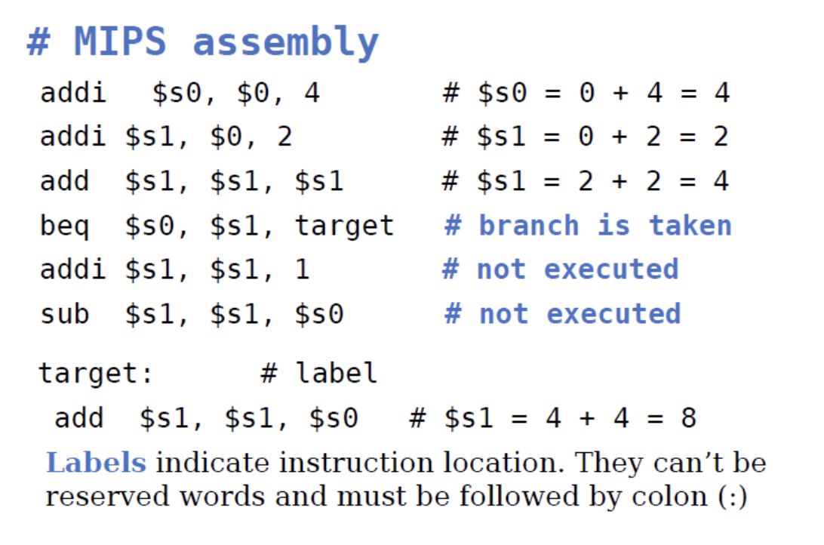
DIGITAL LOGIC AND COMPUTER DESIGN
Conditional branching (BEQ):
Branch if Equal (beq):
Compares the values stored in two registers.
If the values are equal, control transfers to the specified label.
If the values are not equal, execution continues with the next sequential instruction.
Syntax:
beq $rs, $rt, label
Example Explanation:
$s0 is initialized to 4.
$s1 is initialized to 2, then doubled to become 4.
Since $s0 == $s1, the condition is true.
The processor branches to the label target.
The instructions between beq and target are skipped.
Execution resumes at target, where $s1 becomes 8 (4 + 4).
© Elsevier, Digital Design and Computer Architecture, 2nd Ed., 2012.

Slide 30
DIGITAL LOGIC AND COMPUTER DESIGN
Conditional branching (BEQ):
Labels:
A label identifies the address of an instruction.
It acts as the branch destination.
Labels must end with a colon (:) and cannot be reserved keywords.
Key Takeaway: beq changes the program flow only when the two register values are equal; otherwise, execution proceeds with the next instruction.
© Elsevier, Digital Design and Computer Architecture, 2nd Ed., 2012.

Slide 31
DIGITAL LOGIC AND COMPUTER DESIGN
The branch not take (BNE)
Branch if Not Equal (bne):
Compares the values stored in two registers.
Branches to the specified label only if the register values are not equal.
If the values are equal, execution continues with the next sequential instruction.
Syntax:
bne $rs, $rt, label
Example Explanation
$s0 is initialized to 4.
$s1 is initialized to 2, then doubled to become 4.
Since $s0 == $s1, the condition for bne (not equal) is false.
The branch is not taken, so execution continues with the next instructions.
addi updates $s1 from **4 → 5, and subupdates$s1 from **5 → 1.
Execution eventually reaches the target label, where $s1 becomes 5 (1 + 4).
© Elsevier, Digital Design and Computer Architecture, 2nd Ed., 2012.

Slide 32
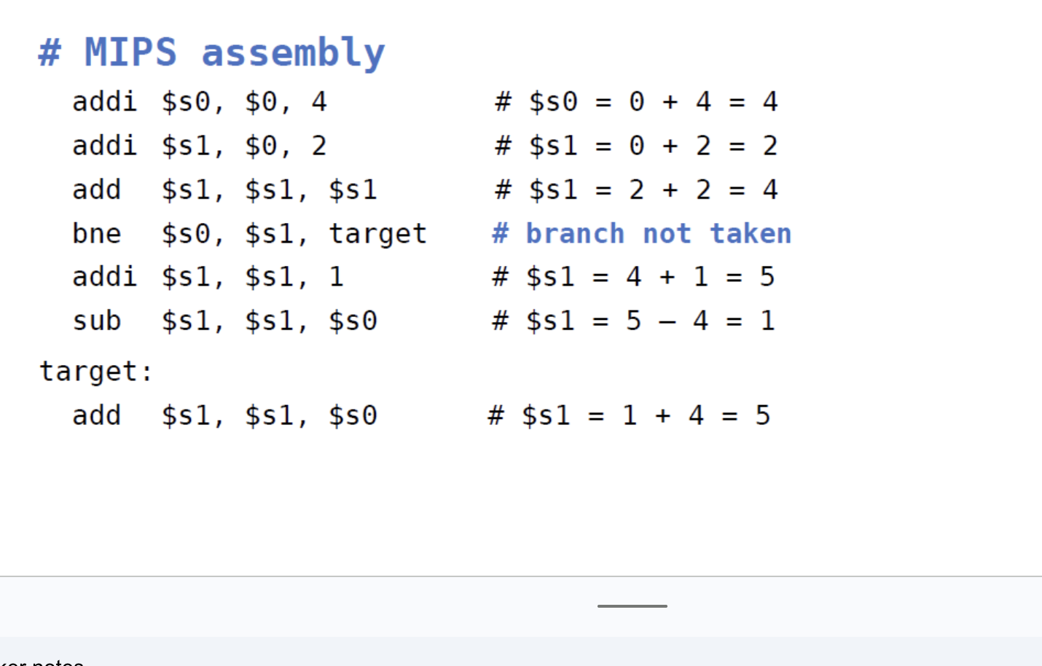
DIGITAL LOGIC AND COMPUTER DESIGN
The branch not take (BNE)
Key Takeaway: bne transfers control only when the compared register values are different. If they are equal, execution continues sequentially with the next instruction.
This matches the beq slide in style while clearly highlighting the difference:
beq → Branch when Equal.
bne → Branch when Not Equal.
© Elsevier, Digital Design and Computer Architecture, 2nd Ed., 2012.

Slide 33
DIGITAL LOGIC AND COMPUTER DESIGN
Unconditional Branching (J)
Jump (j)
An unconditional branch transfers control to another instruction without checking any condition.
The processor always jumps to the specified target label.
Instructions between the j instruction and the target label are skipped.
Syntax:
j label
Example Explanation
$s0 is initialized to 4.
$s1 is initialized to 1.
The instruction j target immediately transfers control to the label target.
The instructions sra, addi, and sub are not executed.
Execution resumes at target, where $s1 becomes 5 (1 + 4).
© Elsevier, Digital Design and Computer Architecture, 2nd Ed., 2012.

Slide 34
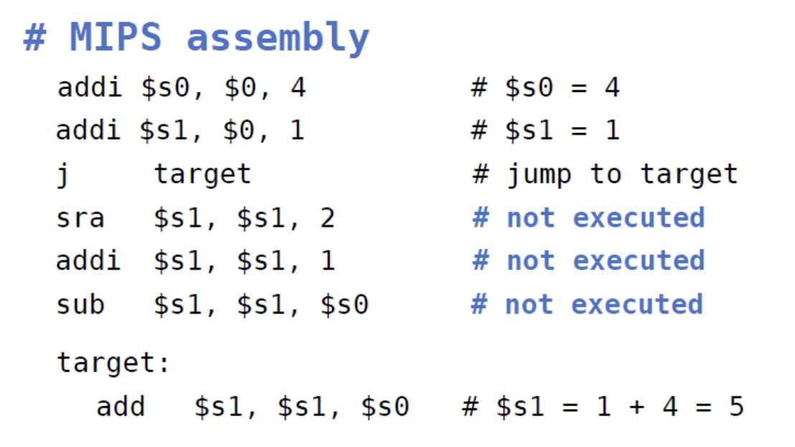
DIGITAL LOGIC AND COMPUTER DESIGN
Unconditional Branching (J)
Applications of j
Skipping a block of instructions.
Implementing loops.
Transferring control to another section of a program.
Key Takeaway: The j instruction always transfers execution to the specified label, regardless of any condition, causing all intermediate instructions to be skipped.
© Elsevier, Digital Design and Computer Architecture, 2nd Ed., 2012.

Slide 35
DIGITAL LOGIC AND COMPUTER DESIGN
Unconditional Branching (Jr)
Jump Register (jr)
Transfers control to the address stored in a register.
The target address is determined at run time, not encoded in the instruction.
Unlike j, jr uses a register operand instead of a label.
jr is an R-type instruction in the MIPS instruction set.
Syntax:
jr $rs
Example Explanation
addi $s0, $0, 0x2010 loads the address 0x00002010 into register $s0.
jr $s0 immediately jumps to the address stored in $s0.
The instructions at 0x00002008 and 0x0000200C are skipped.
Execution resumes at 0x00002010, where lw $s3, 44($s1) is executed.
© Elsevier, Digital Design and Computer Architecture, 2nd Ed., 2012.

Slide 36
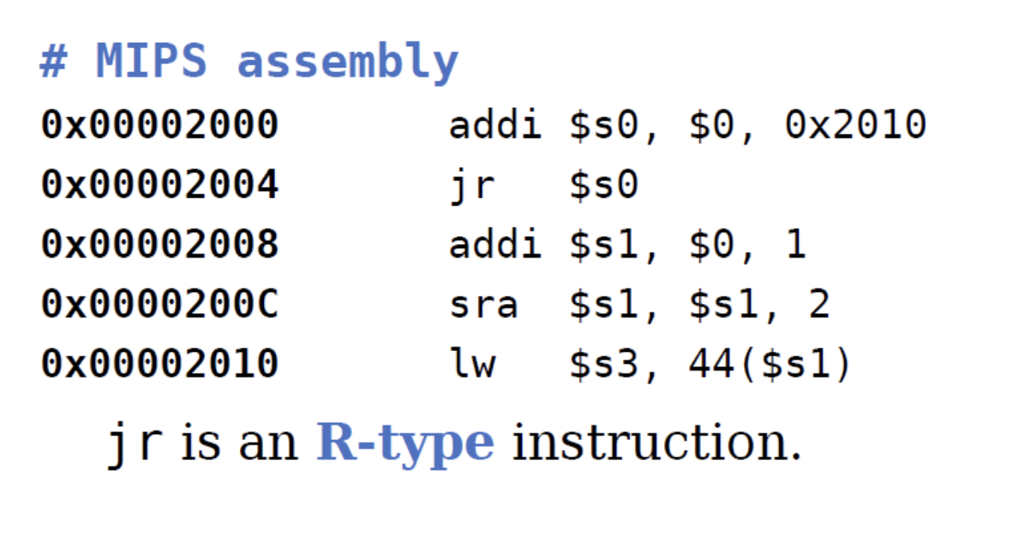
DIGITAL LOGIC AND COMPUTER DESIGN
Unconditional Branching (Jr)
Applications of jr
Returning from functions using jr $ra.
Jumping to addresses computed during program execution.
Supporting indirect control transfer.
Key Takeaway: jr transfers control to the address contained in a register, enabling indirect jumps and function returns in MIPS programs.
© Elsevier, Digital Design and Computer Architecture, 2nd Ed., 2012.

Slide 37
DIGITAL LOGIC AND COMPUTER DESIGN
Conditional statements
Conditional statements such as if, if/else, and switch/case execute a block of code only when a specified condition is satisfied.
In MIPS, these high-level constructs are implemented using conditional branch instructions and labels.
© Elsevier, Digital Design and Computer Architecture, 2nd Ed., 2012.

Slide 38
DIGITAL LOGIC AND COMPUTER DESIGN
IF statement
How an if Statement Works
An if statement executes a block of code only when a specified condition is true.
In MIPS, this is implemented using conditional branch instructions.
The branch instruction checks the opposite condition to skip the if block when the condition is false.
Example Explanation
C Code:
if (i == j)
f = g + h;
f = f - i;
© Elsevier, Digital Design and Computer Architecture, 2nd Ed., 2012.

Slide 39
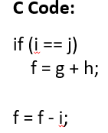
DIGITAL LOGIC AND COMPUTER DESIGN
IF statement
Equivalent MIPS Code:
bne $s3, $s4, L1
add $s0, $s1, $s2
L1: sub $s0, $s0, $s3
bne checks whether i and j are not equal.
If i != j, control jumps to L1, skipping f = g + h.
If i == j, the branch is not taken, and f = g + h is executed.
After the if block, execution continues with f = f - i.
Why use bne instead of beq?
Assembly often tests the opposite condition so that it can skip the if block when the condition is false, resulting in simpler and more efficient code.
© Elsevier, Digital Design and Computer Architecture, 2nd Ed., 2012.

Slide 40
DIGITAL LOGIC AND COMPUTER DESIGN
IF/ELSE statement
How an if-else Statement Works
An if-else statement executes one of two blocks based on a condition.
In MIPS, this is implemented using a conditional branch and an unconditional jump.
The conditional branch selects the appropriate block, while the unconditional jump skips the other block after execution.
Example Explanation
C Code:
if (i == j)
f = g + h;
else
f = f - i;
© Elsevier, Digital Design and Computer Architecture, 2nd Ed., 2012.

Slide 41
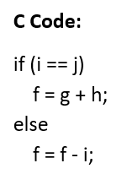
DIGITAL LOGIC AND COMPUTER DESIGN
IF/ELSE statement
Equivalent MIPS Code:
bne $s3, $s4, L1
add $s0, $s1, $s2
j done
L1: sub $s0, $s0, $s3
done:
bne checks whether i and j are not equal.
If i == j, the branch is not taken, and f = g + h is executed.
The j done instruction skips the else block.
If i != j, control branches directly to L1, where f = f - i is executed.
Execution continues from the label done after either block.
Key Takeaway: An if-else statement is implemented using a conditional branch to choose the correct block and an unconditional jump to avoid executing the alternate block.
© Elsevier, Digital Design and Computer Architecture, 2nd Ed., 2012.

Slide 42
DIGITAL LOGIC AND COMPUTER DESIGN
Switch/Case statement
A switch/case selects one of several blocks based on a value.
In MIPS, it can be implemented as a series of conditional tests, equivalent to nested if/else statements.
If none of the cases match, the default block is executed.
© Elsevier, Digital Design and Computer Architecture, 2nd Ed., 2012.

Slide 43
DIGITAL LOGIC AND COMPUTER DESIGN
Getting Loopy
Loops repeatedly execute a block of code as long as a condition is satisfied.
Common high-level loop constructs are while and for loops.
In MIPS, loops are implemented using comparison, branch, and jump instructions.
© Elsevier, Digital Design and Computer Architecture, 2nd Ed., 2012.

Slide 44
DIGITAL LOGIC AND COMPUTER DESIGN
While statement
How a while Loop Works
A while loop repeatedly executes a block of code as long as the specified condition is true.
In MIPS, the loop is implemented using a conditional branch to exit the loop and an unconditional jump to repeat it.
The loop condition is evaluated before each iteration.
Example Explanation
C Code
while (pow != 128) {
pow = pow * 2;
x = x + 1; }
© Elsevier, Digital Design and Computer Architecture, 2nd Ed., 2012.

Slide 45
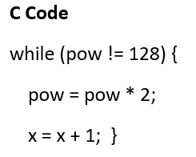
DIGITAL LOGIC AND COMPUTER DESIGN
While statement
Equivalent MIPS Code
while: beq $s0, $t0, done
sll $s0, $s0, 1
addi $s1, $s1, 1
j while
done:
beq checks whether pow == 128.
If the condition is true, control branches to done, terminating the loop.
If the condition is false, the loop body executes:
  sll $s0, $s0, 1 multiplies pow by 2 (left shift by 1 bit).
  addi $s1, $s1, 1 increments x.
j while returns control to the beginning of the loop to evaluate the condition again.
© Elsevier, Digital Design and Computer Architecture, 2nd Ed., 2012.

Slide 46
DIGITAL LOGIC AND COMPUTER DESIGN
While statement
Why use beq?
The original C condition is pow != 128, but the assembly tests the opposite condition (pow == 128) to determine when to exit the loop. This simplifies the loop control.
Key Takeaway: A while loop in MIPS uses a conditional branch to exit the loop and an unconditional jump to repeat the loop until the termination condition is met.
© Elsevier, Digital Design and Computer Architecture, 2nd Ed., 2012.

Slide 47
DIGITAL LOGIC AND COMPUTER DESIGN
For loop
A for loop is used to repeatedly execute a block of code when the number of iterations is known or controlled by a loop variable.
Syntax
for (initialization; condition; loop operation)
statement;
Components of a for Loop
Initialization: Executes once before the loop begins.
Condition: Evaluated at the start of each iteration. The loop continues while the condition is true.
Statement: The block of code executed during each iteration.
Loop Operation (Update): Executes at the end of each iteration before the condition is checked again.
© Elsevier, Digital Design and Computer Architecture, 2nd Ed., 2012.

Slide 48
DIGITAL LOGIC AND COMPUTER DESIGN
For loop
Execution Flow
Initialization → Condition → Statement → Loop Operation → Condition → … → Exit
Key Takeaway: A for loop combines initialization, condition checking, and update into a single statement, making it ideal for count-controlled iterations.
© Elsevier, Digital Design and Computer Architecture, 2nd Ed., 2012.

Slide 49
DIGITAL LOGIC AND COMPUTER DESIGN
For loop in MIPS
How a for Loop Works
A for loop performs initialization, checks a condition, executes the loop body, updates the loop variable, and repeats until the condition becomes false.
In MIPS, it is implemented using initialization instructions, a conditional branch, an update instruction, and an unconditional jump.
Example Explanation
C Code:
for (i = 0; i != 10; i++) {
sum = sum + i;
}
© Elsevier, Digital Design and Computer Architecture, 2nd Ed., 2012.

Slide 50
DIGITAL LOGIC AND COMPUTER DESIGN
For loop in MIPS
Equivalent MIPS Code:
addi $s1, $0, 0 # sum = 0
add $s0, $0, $0 # i = 0
addi $t0, $0, 10 # loop limit
for: beq $s0, $t0, done
add $s1, $s1, $s0
addi $s0, $s0, 1
j for
done:
addi instructions initialize sum, i, and the loop limit (10).
beq checks whether i == 10.
If the condition is true, control branches to done, terminating the loop.
Otherwise, the loop body adds the current value of i to sum.
addi $s0, $s0, 1 increments the loop variable.
© Elsevier, Digital Design and Computer Architecture, 2nd Ed., 2012.

Slide 51
DIGITAL LOGIC AND COMPUTER DESIGN
For loop in MIPS
j for returns control to the beginning of the loop for the next iteration.
Key Takeaway: A for loop in MIPS consists of initialization, condition checking, loop body execution, loop variable update, and an unconditional jump to repeat the loop until the termination condition is met.
© Elsevier, Digital Design and Computer Architecture, 2nd Ed., 2012.

Slide 52
DIGITAL LOGIC AND COMPUTER DESIGN
Magnitude Comparison Using slt
The beq and bne instructions compare whether two values are equal or unequal. For magnitude comparisons, MIPS provides the Set Less Than (slt) instruction.
slt $t1, $s0, $s1
The instruction sets $t1 to 1 when $s0 < $s1, otherwise it sets $t1 to 0.
For example:
$s0 = 5
$s1 = 8
slt $t1, $s0, $s1
gives:
5<8⇒$t1=1
This can then be combined with beq or bne to implement conditions such as less than, greater than, less than or equal to, and greater than or equal to.
© Elsevier, Digital Design and Computer Architecture, 2nd Ed., 2012.

Slide 53
DIGITAL LOGIC AND COMPUTER DESIGN
Loop Using slt : Numerical
The textbook example adds powers of 2 from 1 to 100:
C code:
int sum = 0;
for (i = 1; i < 101; i = i * 2)
sum = sum + i;
MIPS equivalent:
addi $s1, $0, 0 # sum = 0
addi $s0, $0, 1 # i = 1
addi $t0, $0, 101
loop:
slt $t1, $s0, $t0 # $t1 = 1 if i < 101
beq $t1, $0, done # if i >= 101, exit
add $s1, $s1, $s0 # sum = sum + i
© Elsevier, Digital Design and Computer Architecture, 2nd Ed., 2012.

Slide 54
DIGITAL LOGIC AND COMPUTER DESIGN
Loop Using slt : Numerical
sll $s0, $s0, 1 # i = i * 2
j loop
done:
The values added are:
1+2+4+8+16+32+64=1271+2+4+8+16+32+64=127
Therefore:
sum=127
Key idea: slt converts a magnitude comparison into a 1/0 result, which can then be tested using a branch instruction.
© Elsevier, Digital Design and Computer Architecture, 2nd Ed., 2012.

Slide 55
DIGITAL LOGIC AND COMPUTER DESIGN
Arrays and Array Indexing
An array stores multiple elements of the same type in sequential memory locations. Each element is identified by an index, starting from 0. The address of the first element, array[0], is called the base address.
For a 32-bit integer array, each element occupies 4 bytes. Therefore:
Address of array[i]=Base Address+4i
For example, if the base address is 0x10007000:
array[0] → 0x10007000
array[1] → 0x10007004
array[2] → 0x10007008
To access an element, MIPS uses the base address and an offset:
lw $t1, 4($s0) # loads array[1]; where $s0 contains the base address.
© Elsevier, Digital Design and Computer Architecture, 2nd Ed., 2012.

Slide 56
DIGITAL LOGIC AND COMPUTER DESIGN
Accessing an Array in MIPS
Consider: int array[5];
array[0] = array[0] * 8;
array[1] = array[1] * 8;
If the base address is 0x10007000, MIPS first loads this address into $s0:
lui $s0, 0x1000
ori $s0, $s0, 0x7000
Then the elements are accessed using their byte offsets:
lw $t1, 0($s0) # array[0]
sll $t1, $t1, 3 # multiply by 8
sw $t1, 0($s0)
lw $t1, 4($s0) # array[1]
sll $t1, $t1, 3 # multiply by 8
sw $t1, 4($s0)
Since each integer occupies 4 bytes, array[1] is located 4 bytes after array[0].
© Elsevier, Digital Design and Computer Architecture, 2nd Ed., 2012.

Slide 57
DIGITAL LOGIC AND COMPUTER DESIGN
Array Access Using a for Loop
For a large array, the same instructions should not be repeated for every element. The index can be used to calculate the address of each element.
For a 1000-element integer array:
for (i = 0; i < 1000; i++)
array[i] = array[i] * 8;
MIPS calculates the address using:
sll $t0, $s1, 2 # $t0 = i × 4
add $t0, $t0, $s0 # address of array[i]
lw $t1, 0($t0)
sll $t1, $t1, 3 # array[i] × 8
sw $t1, 0($t0)
Here, $s0 contains the base address and $s1 contains i.
Byte offset=i×4
The shift sll $t0,$s1,2 is used because: i×4=i×2^2
© Elsevier, Digital Design and Computer Architecture, 2nd Ed., 2012.

Slide 58
DIGITAL LOGIC AND COMPUTER DESIGN
Byte Arrays and Characters
Characters can be stored in a single byte instead of a 32-bit word. MIPS provides special instructions for accessing byte data:
lbu # Load Byte Unsigned
lb # Load Byte
sb # Store Byte
lbu zero-extends the loaded byte to 32 bits, while lb sign-extends it. sb stores only the least significant byte of a register into memory.
For byte arrays, consecutive elements are only 1 byte apart:
Address of chararray[i]=Base Address+i
This differs from an integer array, where the offset is 4i.
© Elsevier, Digital Design and Computer Architecture, 2nd Ed., 2012.

Slide 59
DIGITAL LOGIC AND COMPUTER DESIGN
Character Array: Lowercase to Uppercase Numerical
Question:
Convert the following C code into MIPS assembly language:
char chararray[10];
int i;
for (i = 0; i != 10; i = i + 1)
chararray[i] = chararray[i] - 32;
Assume that $s0 already contains the base address of chararray.
Solution
addi $s1, $0, 0 # i = 0
addi $t0, $0, 10 # $t0 = 10
© Elsevier, Digital Design and Computer Architecture, 2nd Ed., 2012.

Slide 60
DIGITAL LOGIC AND COMPUTER DESIGN
Character Array Numerical
loop:
beq $t0, $s1, done # if i == 10, exit
add $t1, $s1, $s0 # address of chararray[i]
lb $t2, 0($t1) # load chararray[i]
addi $t2, $t2, -32 # convert lowercase to uppercase
sb $t2, 0($t1) # store result
addi $s1, $s1, 1 # i = i + 1
j loop
done:
© Elsevier, Digital Design and Computer Architecture, 2nd Ed., 2012.

Slide 61
DIGITAL LOGIC AND COMPUTER DESIGN
Character Array Numerical
Why add $t1, $s1, $s0?
Each character occupies 1 byte, so the address of chararray[i] is:
Base Address+i
For ASCII characters:
′a′=0x61, 0x61−0x20=0x41=′A′
Thus, subtracting 32 (0x20) converts a lowercase English letter to its corresponding uppercase letter.
© Elsevier, Digital Design and Computer Architecture, 2nd Ed., 2012.

Slide 62
DIGITAL LOGIC AND COMPUTER DESIGN
Function Calls and Returns
Functions allow frequently used code to be reused, making programs more modular and readable. A function receives arguments and produces a return value.
MIPS follows a convention for communication between the caller and callee:
$a0−$a3→input arguments; $v0−$v1→return value
The function is called using jal, which stores the return address in $ra and jumps to the function. The function returns using jr $ra.
jal simple # call function
...
simple:
jr $ra # return to caller
For example, if jal is at 0x00400200, the next instruction is at 0x00400204. Therefore: $ra=0x00400204\boxed{\$ra=0x00400204}
© Elsevier, Digital Design and Computer Architecture, 2nd Ed., 2012.

Slide 63
DIGITAL LOGIC AND COMPUTER DESIGN
Function Call with Arguments
Consider the function:
int diffofsums(int f, int g, int h, int i) {
int result;
result = (f + g) - (h + i);
return result;
}
The caller places the four arguments in $a0–$a3:
addi $a0, $0, 2
addi $a1, $0, 3
addi $a2, $0, 4
addi $a3, $0, 5
© Elsevier, Digital Design and Computer Architecture, 2nd Ed., 2012.

Slide 64
DIGITAL LOGIC AND COMPUTER DESIGN
Function Call with Arguments
jal diffofsums
add $s0, $v0, $0
The callee performs the calculation and places the result in $v0:
add $t0, $a0, $a1
add $t1, $a2, $a3
sub $s0, $t0, $t1
add $v0, $s0, $0
jr $ra
Numerically:
(2+3)−(4+5)=5−9=−4(2+3)-(4+5)=5-9=\boxed{-4}
Therefore, the function returns −4 in $v0.
© Elsevier, Digital Design and Computer Architecture, 2nd Ed., 2012.

Slide 65
DIGITAL LOGIC AND COMPUTER DESIGN
Stack in Function Calls
The stack is a LIFO memory structure used to store temporary data and local variables during function execution. The MIPS stack grows toward lower memory addresses.
$sp is the stack pointer and points to the top of the stack.
If: $sp=0x7FFFFFFC and a function needs two additional words:
addi $sp, $sp, -8
then: $sp=0x7FFFFFF4
because each word occupies 4 bytes.
A function follows five basic steps when saving registers:
Allocate stack space.
Store registers on the stack.
Execute the function.
Restore the registers.
Deallocate the stack space.
© Elsevier, Digital Design and Computer Architecture, 2nd Ed., 2012.

Slide 66
DIGITAL LOGIC AND COMPUTER DESIGN
Saving Registers on the Stack
A function must preserve registers that the caller depends on. The stack can temporarily store these registers while the function executes.
For diffofsums, three registers are saved:
addi $sp, $sp, -12 # space for 3 words
sw $s0, 8($sp)
sw $t0, 4($sp)
sw $t1, 0($sp)
# function operations
lw $t1, 0($sp)
lw $t0, 4($sp)
lw $s0, 8($sp)
© Elsevier, Digital Design and Computer Architecture, 2nd Ed., 2012.

Slide 67
DIGITAL LOGIC AND COMPUTER DESIGN
Saving Registers on the Stack
addi $sp, $sp, 12
jr $ra
Since each register requires one word: 3×4=12 bytes
The stack space allocated by a function is called its stack frame.
© Elsevier, Digital Design and Computer Architecture, 2nd Ed., 2012.

Slide 68
DIGITAL LOGIC AND COMPUTER DESIGN
Preserved and Nonpreserved Registers
MIPS divides registers into preserved and nonpreserved registers.
Preserved | Nonpreserved
$s0–$s7 | $t0–$t9
$ra | $a0–$a3
$sp | $v0–$v1
A callee must save and restore preserved registers that it modifies. Nonpreserved registers may be changed by the callee.
Therefore, in the improved diffofsums, only $s0 needs to be saved:
addi $sp, $sp, -4
sw $s0, 0($sp)
# function operations
© Elsevier, Digital Design and Computer Architecture, 2nd Ed., 2012.

Slide 69
DIGITAL LOGIC AND COMPUTER DESIGN
Preserved and Nonpreserved Registers
lw $s0, 0($sp)
addi $sp, $sp, 4
jr $ra
Thus, the stack frame requires only:
1×4=4 bytes​
© Elsevier, Digital Design and Computer Architecture, 2nd Ed., 2012.

Slide 70
DIGITAL LOGIC AND COMPUTER DESIGN
Recursive Function Calls
A leaf function does not call another function, whereas a nonleaf function calls another function. A recursive function is a nonleaf function that calls itself.
Consider factorial:
int factorial(int n) {
if (n <= 1)
return 1;
else
return n * factorial(n - 1); }
The recursive relationship is: factorial(n)=n×factorial(n−1)
with the base case: factorial(1)=1
For n=3: 3!=3×2×1=6
Each recursive call creates its own stack frame to preserve $a0 and $ra.
© Elsevier, Digital Design and Computer Architecture, 2nd Ed., 2012.

Slide 71
DIGITAL LOGIC AND COMPUTER DESIGN
Recursive Factorial in MIPS
The textbook implementation saves $a0 and $ra before making the recursive call:
factorial:
addi $sp, $sp, -8
sw $a0, 4($sp)
sw $ra, 0($sp)
addi $t0, $0, 2
slt $t0, $a0, $t0
beq $t0, $0, else
addi $v0, $0, 1
addi $sp, $sp, 8
jr $ra
else:
addi $a0, $a0, -1
jal factorial
© Elsevier, Digital Design and Computer Architecture, 2nd Ed., 2012.

Slide 72
DIGITAL LOGIC AND COMPUTER DESIGN
Recursive Factorial in MIPS
lw $ra, 0($sp)
lw $a0, 4($sp)
addi $sp, $sp, 8
mul $v0, $a0, $v0
jr $ra
For factorial(3):
3→2→1
Then the calls return:
1→2×1=2→3×2=6
Each invocation allocates 8 bytes for $a0 and $ra.
© Elsevier, Digital Design and Computer Architecture, 2nd Ed., 2012.

Slide 73
DIGITAL LOGIC AND COMPUTER DESIGN
Additional Arguments and Local Variables
MIPS provides registers $a0–$a3 for the first four input arguments. If a function requires more than four arguments, the additional arguments are passed through the stack.
First 4 arguments → $a0–$a3
Additional arguments → Stack
The caller expands its stack to make room for the additional arguments. A function may also use the stack for local variables and local arrays.
The callee's stack frame can contain:
Local variables / arrays
$s0–$s7 (if needed)
$a0–$a3 (if needed)
Return address
Additional arguments
An important exception is that when a function has more than four arguments, the callee may access the additional arguments in the caller's stack frame.Key MIPS Function-Call Flow: Arguments→jal→Callee→Return value→jr $ra​
© Elsevier, Digital Design and Computer Architecture, 2nd Ed., 2012.

Slide 74
DIGITAL LOGIC AND COMPUTER DESIGN
Think About It
Assume that register $s1 contains 7 and register $s2 contains 4. Consider the following instruction sequence (the first register is the destination, and the not instruction inverts each bit):
nor $s3, $s0, $s2
addi $s3, $s2, 1
add $s3, $s1, $s2
What value gets stored in $s3? What arithmetic operation do above instructions perform on $s1 and $s2 contents?
© Elsevier, Digital Design and Computer Architecture, 2nd Ed., 2012.

Slide 75
DIGITAL LOGIC AND COMPUTER DESIGN
MCQ
Q1. What is the primary role of the Program Counter (PC)?
A) Store arithmetic results
B) Hold the address of the next instruction to be executed
C) Store data values temporarily
D) Decode machine instructions
© Elsevier, Digital Design and Computer Architecture, 2nd Ed., 2012.

Slide 76
DIGITAL LOGIC AND COMPUTER DESIGN
MCQ
Q2. Which statement correctly distinguishes assembly code from machine code?
A) Assembly code is executed directly by the CPU.
B) Machine code uses mnemonics such as add and lw.
C) Assembly code is human-readable and must be translated into machine code.
D) Both are identical representations of a program.
© Elsevier, Digital Design and Computer Architecture, 2nd Ed., 2012.

Slide 77
DIGITAL LOGIC AND COMPUTER DESIGN
MCQ
Q3. Which MIPS instruction transfers control only when two register values are equal?
A) bne
B) j
C) beq
D) jr
© Elsevier, Digital Design and Computer Architecture, 2nd Ed., 2012.

Slide 78
DIGITAL LOGIC AND COMPUTER DESIGN
MCQ
Q4. Which instruction is commonly used to return from a function in MIPS?
A) beq
B) j
C) jal
D) jr
© Elsevier, Digital Design and Computer Architecture, 2nd Ed., 2012.

Slide 79
DIGITAL LOGIC AND COMPUTER DESIGN
MCQ
Q5. In the MIPS implementation of an if-else statement, why is the instruction j done used?
A) To initialize variables before execution
B) To skip the else block after executing the if block
C) To compare two registers
D) To terminate the program
© Elsevier, Digital Design and Computer Architecture, 2nd Ed., 2012.

Slide 80
DIGITAL LOGIC AND COMPUTER DESIGN
MCQ
Q6. In a MIPS while loop, which instruction causes the loop to repeat?
A) beq
B) addi
C) j while
D) sub
© Elsevier, Digital Design and Computer Architecture, 2nd Ed., 2012.

Slide 81
DIGITAL LOGIC AND COMPUTER DESIGN
MCQ
Q7. Which sequence correctly represents the execution order of a for loop?
A) Statement → Initialization → Condition → Update
B) Initialization → Condition → Statement → Update
C) Condition → Initialization → Update → Statement
D) Initialization → Statement → Update → Condition
© Elsevier, Digital Design and Computer Architecture, 2nd Ed., 2012.

Slide 82
DIGITAL LOGIC AND COMPUTER DESIGN
MCQ
Q8. An integer array has base address 0x10007000. What address does the following MIPS code access?
Assume $s0 = 0x10007000.
A. 0x10007006
B. 0x10007018
C. 0x10007024
D. 0x10007028
© Elsevier, Digital Design and Computer Architecture, 2nd Ed., 2012.

Slide 83
DIGITAL LOGIC AND COMPUTER DESIGN
MCQ
Q9. Consider the following function call:
addi $a0, $0, 2
addi $a1, $0, 3
addi $a2, $0, 4
addi $a3, $0, 5
jal diffofsums
where the function computes: result = (f + g) - (h + i);
What value should be returned in $v0?
A. -4
B. 0
C. 4
D. 14
© Elsevier, Digital Design and Computer Architecture, 2nd Ed., 2012.

Slide 84
DIGITAL LOGIC AND COMPUTER DESIGN
MCQ
ANSWER KEY:
Q1: B Q2: C Q3: C Q4: D Q5: B Q6: C Q7: B Q8: B Q9: A
© Elsevier, Digital Design and Computer Architecture, 2nd Ed., 2012.

Slide 85
THANK YOU
Team DLCD
Department of CSE and CSE(AI & ML)

