Slide 1

UE25CS251A
DIGITAL LOGIC AND COMPUTER DESIGN
TEAM DLCD
Department of CSE and CSE (AI & ML)

Slide 2

DIGITAL LOGIC AND COMPUTER DESIGN
Lights, Camera, Action: Compiling, Assembling, and Loading
TEAM DLCD
Department of CSE and CSE (AI & ML)

Slide 3

DIGITAL LOGIC & COMPUTER DESIGN
TOPICS
Lights, Camera, Action: Compiling, Assembling, and Loading

Slide 4
DIGITAL LOGIC & COMPUTER DESIGN
Lights, Camera, Action: Compiling, Assembling, and Loading
Until now: translating short high-level snippets into assembly and machine code.
This section: compiling and assembling a complete program, and loading it into memory for execution.
We will study about the MIPS memory map (where code, data and stack live) and the steps of code execution for a sample program in this section.

Slide 5
DIGITAL LOGIC & COMPUTER DESIGN
The MIPS Memory Map
32-bit addresses → address space = 2³² bytes = 4 GB.
Word addresses are divisible by 4, ranging from 0 to 0xFFFFFFFC.
Four segments: text, global data, dynamic data, reserved.
Address range | Segment
0x00000000 – 0x003FFFFC | Reserved
0x00400000 – 0x0FFFFFFC | Text (PC starts at 0x00400000)
0x10000000 – 0x1000FFFC | Global data ($gp = 0x10008000)
0x10010000 – 0x7FFFFFFC | Dynamic data: heap (bottom) and stack (top, $sp = 0x7FFFFFFC)
0x80000000 – 0xFFFFFFFC | Reserved

Slide 6
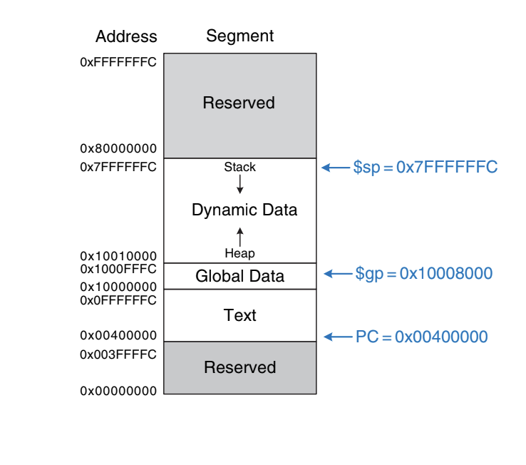
DIGITAL LOGIC & COMPUTER DESIGN
The MIPS Memory Map
MIPS memory map

Slide 7
DIGITAL LOGIC & COMPUTER DESIGN
Text Segment
Stores the machine language program.
Large enough for almost 256 MB of code.
The top 4 bits of every text address are all 0, so the j instruction can jump directly to any address in the program.
Analogy: The text segment is the recipe book. The PC is your finger on the line you are currently following. The book is read-only reference material that tells the CPU what to do.

Slide 8
DIGITAL LOGIC & COMPUTER DESIGN
Global Data Segment
Stores global variables, which, unlike local variables, can be seen by all functions.
These are defined at start-up, before the program begins executing.
These variables are declared outside main in C and accessible by any function.
Large enough for 64 KB of globals.
Accessing Globals with $gp: Global variables are accessed using the global pointer ($gp), which is initialized to 0x100080000. Unlike the stack pointer ($sp), $gp does not change during program execution. Any global variable can be accessed with a 16-bit positive or negative offset from $gp. The offset is known at assembly time, so the variables can be efficiently accessed using base addressing mode with constant offsets.
Analogy: Global variables are the noticeboard in a shared office, readable and writable by everyone. Local variables are notes on your own desk.

Slide 9
DIGITAL LOGIC & COMPUTER DESIGN
Dynamic Data Segment (Stack and Heap)
Holds the stack and the heap.
Data is not known at start-up; it is allocated and deallocated during execution.
This is the largest segment, spanning almost 2 GB.
 | Stack | Heap
Use | Save/restore registers used by functions; hold local variables such as arrays | Data allocated at runtime
Allocation | LIFO stack frames | malloc in C; new in C++ and Java
Direction | Grows downward from the top (0x7FFFFFFC) | Grows upward from the bottom
Order | Last-in-first-out | Used and discarded in any order
If stack and heap grow into each other, program data can be corrupted. The memory allocator prevents this by returning an out-of-memory error when space is insufficient.

Slide 10
DIGITAL LOGIC & COMPUTER DESIGN
Reserved Segments
Used by the operating system; cannot be used directly by the program.
Part of the reserved memory is used for interrupts and memory-mapped I/O (to be discussed in depth in future lectures).

Slide 11
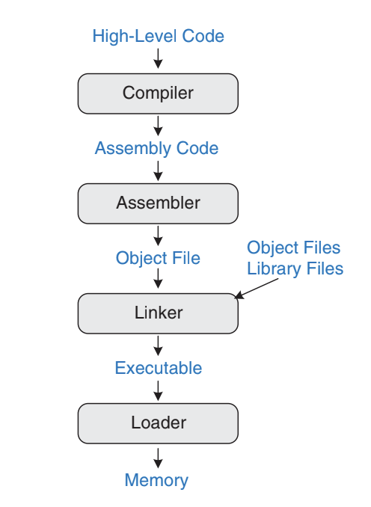
DIGITAL LOGIC & COMPUTER DESIGN
Translating and Starting a Program (Overview)
High-level code → Compiler → Assembly code → Assembler → Object file → Linker (+ object files and library files) → Executable → Loader → Memory
Compile: high-level code → assembly code.
Assemble: assembly → machine code in an object file.
Link: combine machine code with library/other object code → complete executable.
Load: loader puts the program in memory and starts execution.
In practice, most compilers perform compiling, assembling and linking together.
Steps for translating and starting a program

Slide 12
DIGITAL LOGIC & COMPUTER DESIGN
Translating and Starting a Program: Step 1 - Compilation
A compiler translates high-level code into assembly.
Example:
High-Level Code (C language):
int f, g, y; // global variables
int main(void) {
f = 2;
g = 3;
y = sum(f, g);
return y; }
int sum(int a, int b) {
return (a + b); }
MIPS assembly:
.data
f:
g:
y:
.text
main:
addi $sp, $sp, -4 # make stack frame
sw $ra, 0($sp) # store $ra on stack
addi $a0, $0, 2 # $a0 = 2
sw $a0, f # f = 2
addi $a1, $0, 3 # $a1 = 3
sw $a1, g # g = 3
jal sum # call sum function
sw $v0, y # y = sum(f, g)
lw $ra, 0($sp) # restore $ra from stack
addi $sp, $sp, 4 # restore stack pointer
jr $ra # return to operating system
sum:
add $v0, $a0, $a1 # $v0 = a+b
jr $ra # return to caller

Slide 13
DIGITAL LOGIC & COMPUTER DESIGN
Translating and Starting a Program: Step 1 - Compilation
.data and .text are assembler directives marking where the data and text segments begin.
Labels f, g, y name the globals. Their storage locations are decided by the assembler; for now they stay as symbols.

Slide 14
DIGITAL LOGIC & COMPUTER DESIGN
Translating and Starting a Program: Step 2 - Assembling (Pass 1)
The assembler converts assembly into an object file containing machine code.
It makes two passes.
Pass 1: assign instruction addresses and find all symbols (labels, global variable names).
Address | Instruction
0x00400000 | main: addi $sp, $sp, -4
0x00400004 | sw $ra, 0($sp)
0x00400008 | addi $a0, $0, 2
0x0040000C | sw $a0, f
0x00400010 | addi $a1, $0, 3
0x00400014 | sw $a1, g
0x00400018 | jal sum

Slide 15
DIGITAL LOGIC & COMPUTER DESIGN
Translating and Starting a Program: Step 2 - Assembling (Pass 1)
0x0040001C | sw $v0, y
0x00400020 | lw $ra, 0($sp)
0x00400024 | addi $sp, $sp, 4
0x00400028 | jr $ra
0x0040002C | sum: add $v0, $a0, $a1
0x00400030 | jr $ra

Slide 16
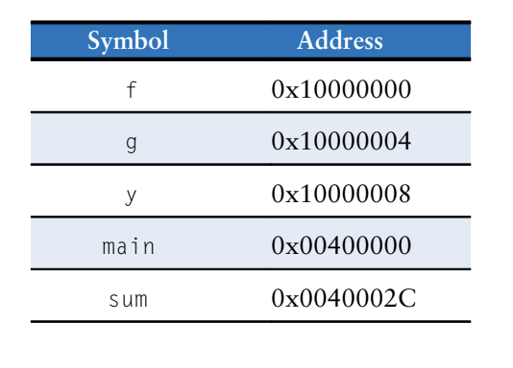
DIGITAL LOGIC & COMPUTER DESIGN
Translating and Starting a Program: Step 2 - Assembling (Symbol
Table and Pass 2)
Names and addresses of symbols are kept in the symbol table as shown in the table; addresses are filled in after Pass 1, when label addresses are known.
Global variables are assigned storage in the global data segment starting at 0x10000000.
Pass 2: the assembler produces machine code, taking addresses of globals and labels from the symbol table.
The machine code and symbol table are stored in the object file.
Symbol table

Slide 17
DIGITAL LOGIC & COMPUTER DESIGN
Translating and Starting a Program: Step 3 - Linking
Why link?
Large programs have many files. If only one changes, recompiling and reassembling the others is wasteful.
Library files almost never change.
If a high-level file is unchanged, its object file need not be updated.
What the linker does
Combines all object files into one machine-language file: the executable.
Relocates data and instructions so they are not all on top of each other.
Uses the symbol tables to adjust addresses of relocated globals and labels.
In our example there is one object file, so no relocation is needed.

Slide 18
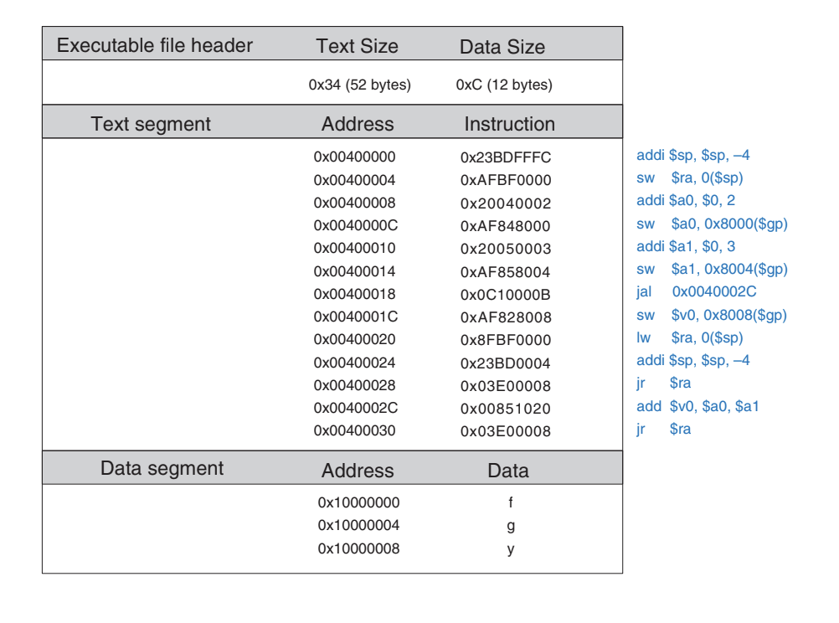
DIGITAL LOGIC & COMPUTER DESIGN
Translating and Starting a Program: The Executable
Executable has three sections: header, text segment, data segment.
Header: text size = 0x34 (52 bytes) (13 instructions × 4), data size = 0xC (12 bytes) (3 words).
Text segment: instructions in the order stored in memory.
Data segment: address of each global variable.
The figure shows readable instructions beside the machine code for convenience; the real file has only machine instructions.

Slide 19
DIGITAL LOGIC & COMPUTER DESIGN
Translating and Starting a Program: The Executable
Example (first store): sw $a0, 0x8000($gp) stores 2 into global f at 0x10000000.
0x8000 is a 16-bit signed offset, sign-extended to 0xFFFF8000, then added to $gp:
$gp + 0x8000 = 0x10008000 + 0xFFFF8000 = 0x10000000 (address of f)

Slide 20
DIGITAL LOGIC & COMPUTER DESIGN
Translating and Starting a Program: Step 4 - Loading
The OS loads the program by:
Reading the text segment of the executable from storage (usually the hard disk) into the text segment of memory.
Setting $gp = 0x10008000 (middle of the global data segment).
Setting $sp = 0x7FFFFFFC (top of the dynamic data segment).
Performing jal 0x00400000 to jump to the start of the program.
Memory at start of execution (Figure 6.34):
Text segment from 0x00400000 holds the 13 instructions (0x23BDFFFC … 0x03E00008).
f, g, y at 0x10000000–0x10000008 (global data).
Stack at the top (0x7FFFFFFC), heap at the bottom of the dynamic segment (0x10010000).
PC = 0x00400000.

Slide 21
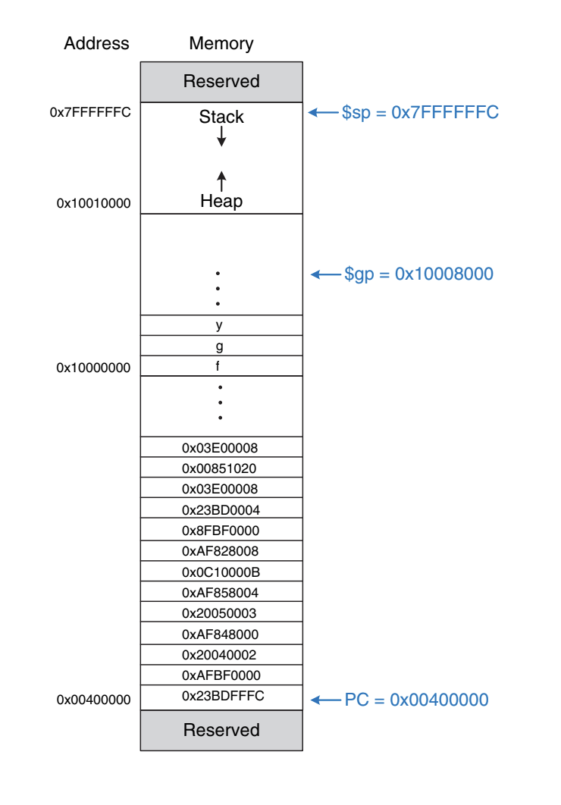
DIGITAL LOGIC & COMPUTER DESIGN
Translating and Starting a Program: Step 4 - Loading
Executable loaded in memory

Slide 22
DIGITAL LOGIC & COMPUTER DESIGN
MCQ
Q1. Which segment does the MIPS j instruction rely on being addressable directly, and why?
A. Stack, because it starts at 0x7FFFFFFC
B. Text, because the top 4 bits of its addresses are all 0
C. Heap, because it grows upward
D. Global data, because $gp is fixed
Q2. What is the value of $gp at program start, and what does it point to?
A. 0x10000000, the start of global data
B. 0x7FFFFFFC, the top of the stack
C. 0x10008000, the middle of the global data segment
D. 0x00400000, the start of the text segment

Slide 23
DIGITAL LOGIC & COMPUTER DESIGN
MCQ
Q3. Why can any global variable be reached efficiently using $gp?
A. Globals are always stored in registers
B. The 16-bit signed offset from $gp is known at assembly time, so base addressing with a constant offset works
C. $gp changes with each function call to track the current variable
D. The linker converts all globals into immediate values
Q4. Which statement about the dynamic data segment is correct?
A. The heap grows downward from 0x7FFFFFFC and the stack grows upward
B. The stack grows downward from 0x7FFFFFFC and the heap grows upward from the bottom
C. Both grow downward, with the heap above the stack
D. It is reserved for the OS and the program cannot use it

Slide 24
DIGITAL LOGIC & COMPUTER DESIGN
MCQ
Q5. What does the assembler do on its first pass?
A. Produces the final machine code
B. Relocates instructions from library files
C. Assigns instruction addresses and finds all symbols (labels and global variable names)
D. Loads the program into memory
Q6. In the example, sw $a0, 0x8000($gp) stores to which address?
A. 0x10008000 + 0x8000 = 0x10010000
B. 0x10008000 + 0xFFFF8000 = 0x10000000
C. 0x00008000
D. 0x7FFF8000
Q7. Which is the correct order of the steps that translate and start a program?
A. Assemble → Compile → Link → Load
B. Compile → Link → Assemble → Load
C. Compile → Assemble → Link → Load
D. Link → Compile → Assemble → Load

Slide 25
DIGITAL LOGIC & COMPUTER DESIGN
Answer key
Q | Ans | Why
1 | B | Top 4 bits of text addresses are 0, so j can jump to any program address.
2 | C | The OS sets $gp to 0x10008000, the middle of the global data segment.
3 | B | The offset is a signed 16-bit constant known at assembly time, so globals are accessed with base addressing.
4 | B | The stack grows down from 0x7FFFFFFC, and the heap grows up from the bottom.
5 | C | Pass 1 builds the symbol table. Pass 2 produces machine code.
6 | B | The 0x8000 offset is sign-extended to 0xFFFF8000. Adding it to $gp gives 0x10000000, the address of f.
7 | C | The pipeline is compiler → assembler → linker → loader.

Slide 26
THANK YOU
Team DLCD
Department of CSE and CSE(AI & ML)

