Slide 1

UE25CS251A
DIGITAL LOGIC AND COMPUTER DESIGN
TEAM DLCD
Department of CSE and CSE (AI & ML)

Slide 2

DIGITAL LOGIC AND COMPUTER DESIGN
ARCHITECTURE-Parallelism
TEAM DLCD
Department of CSE and CSE (AI & ML)

Slide 3

DIGITAL LOGIC & COMPUTER DESIGN
TOPICS
Parallelism

Slide 4
DIGITAL LOGIC & COMPUTER DESIGN
Parallelism
Parallelism is the technique of performing multiple operations simultaneously to improve the overall performance of a computer system. Instead of processing one task completely before starting the next, several tasks are executed at the same time using additional hardware resources or by overlapping different stages of execution.
The primary objective of parallelism is to increase system throughput without significantly affecting the latency of an individual task.
Executes multiple tasks simultaneously.
Improves processor performance.
Makes better use of available hardware resources.
Widely used in modern processors, GPUs, and multicore systems.
Definition: Parallelism is the simultaneous execution of multiple tasks to increase the amount of work completed in a given period.

Slide 5
DIGITAL LOGIC & COMPUTER DESIGN
Why Parallelism?
Modern computer systems must process a large number of tasks efficiently. Simply increasing the processor clock frequency is no longer sufficient because it leads to higher power consumption and heat generation.
Parallelism improves performance by executing multiple tasks simultaneously or by overlapping their execution.
Benefits
Increases overall system throughput.
Makes efficient use of available hardware.
Enables higher performance without relying only on faster clocks.
Widely used in multicore processors and GPUs.
Key Point: Parallelism mainly improves throughput rather than reducing latency.

Slide 6
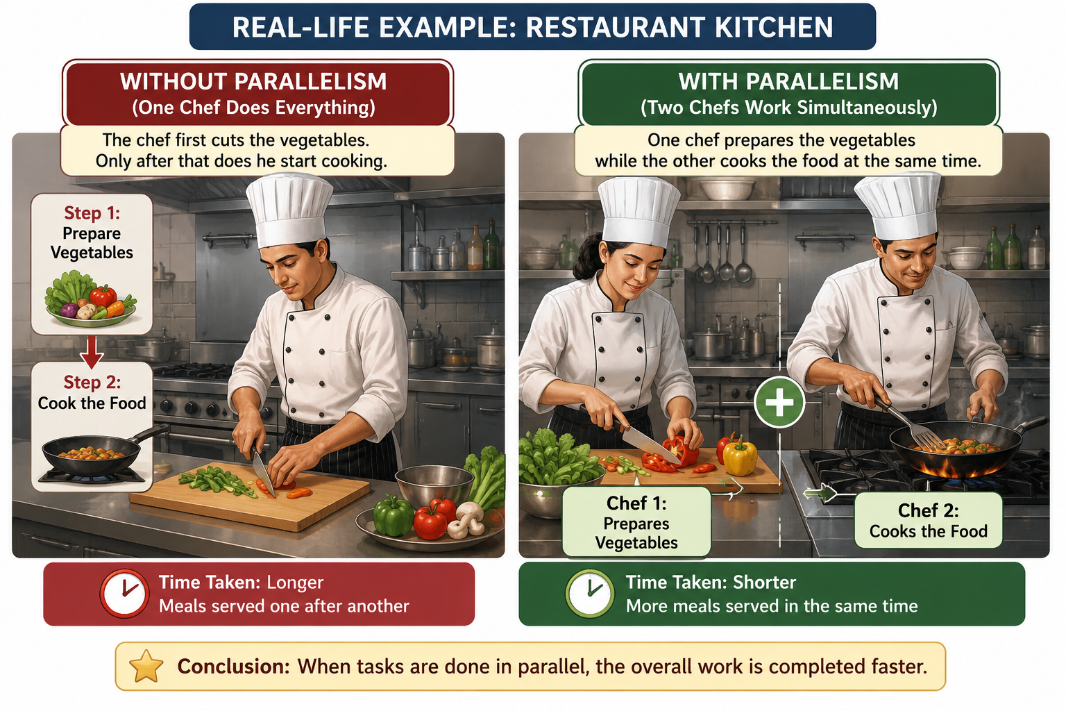
DIGITAL LOGIC & COMPUTER DESIGN
Parallelism
Example: Imagine a restaurant kitchen where one chef prepares vegetables while another cooks food. Since both tasks occur simultaneously, meals are prepared faster than if only one chef performed every task.

Slide 7
DIGITAL LOGIC & COMPUTER DESIGN
Performance Metrics – Latency and Throughput
Before studying parallelism, it is important to understand two performance metrics used to evaluate a computer system.
1. Latency
Latency is the time required for a single task (token) to travel from input to output.
It measures how long one operation takes to complete.
Formula
Latency=Time required for one task
​2. Throughput
Throughput is the number of tasks completed per unit time.
Higher throughput means the processor finishes more work every second.

Slide 8
DIGITAL LOGIC & COMPUTER DESIGN
Performance Metrics – Latency and Throughput
Formula
Throughput=Number of completed tasks / Unit Time
For a non-parallel system,
Throughput=1 / Latency
Latency vs Throughput
Latency is the time taken to complete a single task from start to finish. Lower latency means faster response for an individual task.
Throughput is the number of tasks completed in a given amount of time. Higher throughput means the system can process more work overall.
Key Point: A system can achieve high throughput by processing many tasks simultaneously, but the time taken for each individual task (latency) may still remain the same, or even increase. Therefore, improving throughput does not always reduce latency.

Slide 9
DIGITAL LOGIC & COMPUTER DESIGN
Example – Cookie Throughput and Latency (Textbook Numerical)
Problem: Ben is baking cookies.
Rolling cookies = 5 minutes
Baking cookies = 15 minutes
After one tray finishes baking, only then does he start preparing the next tray. Find latency and throughput
Solution: Step 1: Latency
Total time for one tray
5+15=20 minutes =1/3 hour
Therefore, Latency=20 minutes​

Slide 10
DIGITAL LOGIC & COMPUTER DESIGN
Example – Cookie Throughput and Latency (Textbook Numerical)
Step 2: Throughput
One tray is completed every 20 minutes.
In one hour,
60/20=3
Hence,
Throughput=3 trays / hour
Observation:
Although each tray requires 20 minutes, only three trays can be produced every hour because no tasks overlap.

Slide 11
DIGITAL LOGIC & COMPUTER DESIGN
Types of Parallelism
Parallelism is broadly classified into two categories.
1. Spatial Parallelism
Spatial parallelism improves performance by adding multiple copies of hardware. Each hardware unit performs a different task simultaneously.
Examples:
Multiple processors
Multiple ALUs
Multicore CPUs
Advantages:
Higher throughput
True simultaneous execution
Disadvantage:
Higher hardware cost

Slide 12
DIGITAL LOGIC & COMPUTER DESIGN
Types of Parallelism
2. Temporal Parallelism (Pipelining)
Temporal parallelism divides one task into multiple stages.
Different tasks occupy different stages simultaneously, just like an assembly line.
Example
Instruction Fetch -> Instruction Decode -> Execute -> Memory -> Write Back
Advantages
Better hardware utilization
Lower hardware cost than spatial parallelism

Slide 13
DIGITAL LOGIC & COMPUTER DESIGN
Types of Parallelism
Spatial Parallelism
Executes multiple operations simultaneously by duplicating hardware resources.
Requires additional hardware, such as multiple processors or multiple functional units.
Provides high performance but comes with higher implementation cost.
Temporal Parallelism
Improves performance by dividing a task into sequential pipeline stages.
Reuses the same hardware across different stages over time.
Requires less additional hardware, making it more cost-effective.
Commonly implemented using pipelining in processors.
Key Point: Spatial parallelism increases performance by adding more hardware, whereas temporal parallelism increases performance by overlapping different stages of execution using the same hardware.

Slide 14
DIGITAL LOGIC & COMPUTER DESIGN
Cookie Parallelism (Textbook Numerical)
Ben wants to bake cookies faster.
Case 1: Spatial Parallelism
Ben asks Alyssa to help. Now, Both bake simultaneously.
Latency = 20 minutes
Each person produces : 3 trays/hour
Therefore, Throughput = 3+3 = 6 = 6 trays/hour
Case 2: Temporal Parallelism
Ben buys another tray. While Tray 1 is baking, he prepares Tray 2. Still, latency = 20 minutes
One tray enters oven every 15 minutes
Therefore, Throughput = 60 / 15=4 trays/hour​

Slide 15
DIGITAL LOGIC & COMPUTER DESIGN
Cookie Parallelism (Textbook Numerical)
Case 3: Spatial + Temporal
Two people. Two trays. Result,
Latency = 20 minutes
Throughput = 8 trays/hour
Conclusion:
Parallelism improves throughput but does not reduce latency.

Slide 16
DIGITAL LOGIC & COMPUTER DESIGN
Mathematical Model of Parallelism
Consider a task having latency L.
Without Parallelism
Throughput=1 / L
Spatial Parallelism
Suppose N hardware units exist. Then
Throughput=N / L​​
Temporal Parallelism
Suppose, Task divided into N equal stages. Then
Throughput=N / L

Slide 17
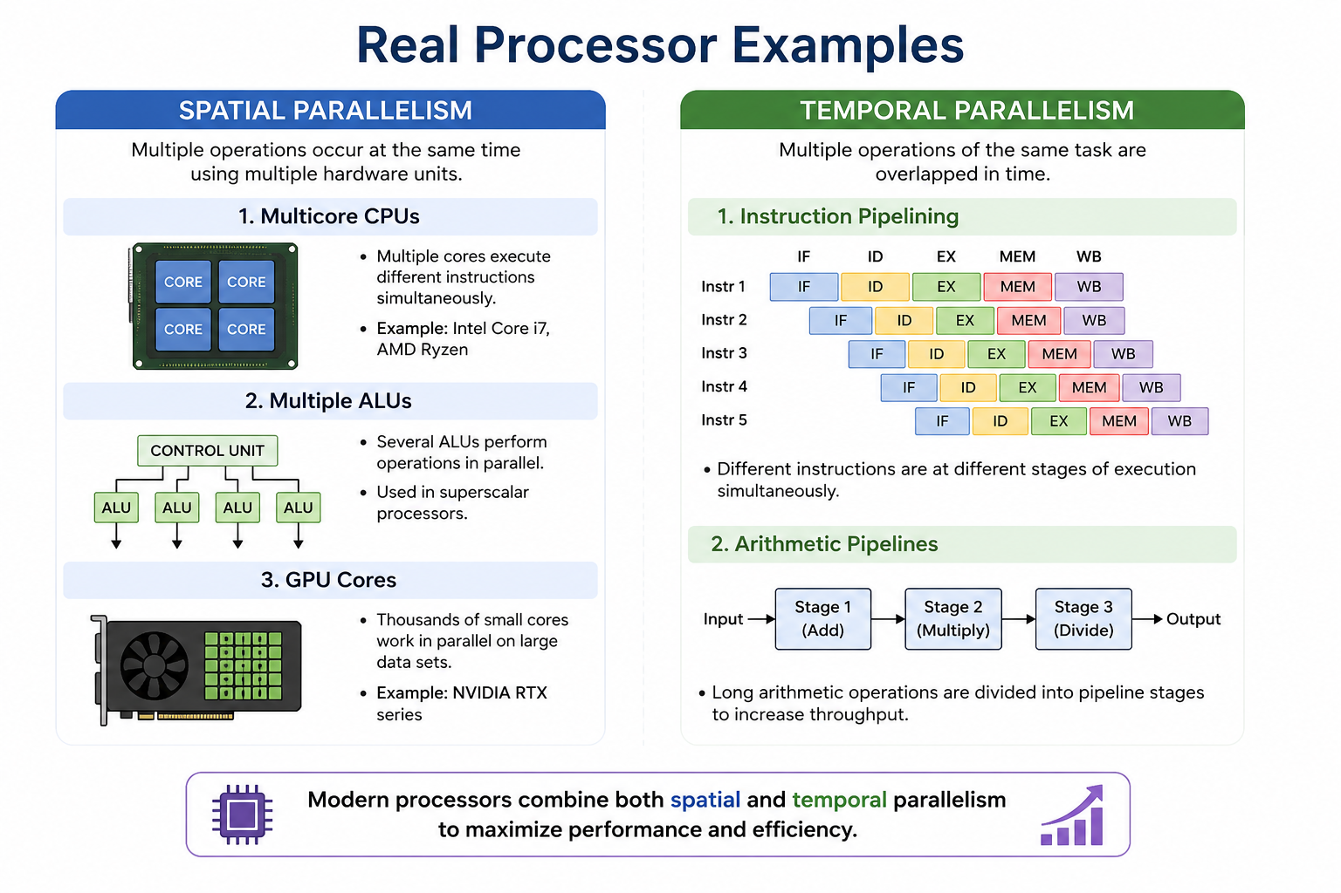
DIGITAL LOGIC & COMPUTER DESIGN
Mathematical Model of Parallelism

Slide 18
DIGITAL LOGIC & COMPUTER DESIGN
Mathematical Model of Parallelism
If stages are unequal, the longest stage determines speed. If longest stage latency is L1, then
Throughput=1 / L1​​
Key Observation:
Increasing the number of stages increases throughput only if the workload is evenly balanced.

Slide 19
DIGITAL LOGIC & COMPUTER DESIGN
Pipelining Example (Textbook Numerical)
Circuit Without Pipeline
Given Clock-to-Q delay is 0.3 ns, Logic blocks are 3 ns, 2 ns, 4 ns, Setup time is 0.2 ns
Step 1: Cycle Time, TC=0.3+3+2+4+0.2=9.5ns
Step 2: Latency = 9.5ns
Step 3: Throughput = 1 / 9.5ns = 105MHz

Slide 20
DIGITAL LOGIC & COMPUTER DESIGN
Two-Stage Pipeline (Textbook Numerical)
Now insert one register after Block 3.
Stage 1: 0.3+3+2+0.2 = 5.5ns
Stage 2: 0.3+4+0.2 = 4.5ns
Clock period equals longest stage.
Therefore, TC = 5.5ns
Throughput = 1 / 5.5ns = 182MHz
Performance Comparison
Without Pipelining
Clock Cycle Time: 9.5 ns
Maximum Throughput: 105 MHz
The entire task is completed in a single long cycle, resulting in a lower operating frequency.

Slide 21
DIGITAL LOGIC & COMPUTER DESIGN
Two-Stage Pipeline (Textbook Numerical)
With Two-Stage Pipelining
Clock Cycle Time: 5.5 ns
Maximum Throughput: 182 MHz
Dividing the circuit into two stages reduces the critical path delay, allowing the processor to run at a higher clock frequency.
Observation:
By introducing pipelining, the clock cycle time decreases from 9.5 ns to 5.5 ns, increasing the maximum operating frequency from 105 MHz to 182 MHz. This significantly improves throughput, while the latency of an individual task remains nearly unchanged.

Slide 22
DIGITAL LOGIC & COMPUTER DESIGN
Why Pipeline is Attractive
Pipelining is one of the most effective forms of temporal parallelism.
Advantages
Does not require duplicate hardware.
Divides long combinational logic into shorter stages.
Enables a shorter clock period.
Improves throughput significantly.
Makes efficient use of hardware resources.
Important Note
Pipeline registers isolate consecutive stages, preventing one token from interfering with another.

Slide 23
DIGITAL LOGIC & COMPUTER DESIGN
Advantages, Limitations & Applications
Advantages
Increases throughput.
Improves processor utilization.
Enables higher clock frequencies.
Forms the basis of modern pipelined processors.
Essential in multicore CPUs and GPUs.
Limitations
Spatial parallelism requires additional hardware.
Pipelining introduces pipeline registers and control complexity.
Unequal pipeline stages reduce efficiency.
Data hazards and control hazards may reduce performance.

Slide 24
DIGITAL LOGIC & COMPUTER DESIGN
Advantages, Limitations & Applications
Applications
Multicore processors
Graphics Processing Units (GPUs)
Supercomputers
Digital Signal Processors (DSPs)
Machine Learning accelerators
Key Takeaways
Latency measures the time taken to complete one task.
Throughput measures the number of tasks completed per unit time.
Spatial Parallelism uses multiple hardware units.
Temporal Parallelism overlaps task execution through pipelining.
Parallelism mainly improves throughput, while latency often remains unchanged.
Pipelining is one of the most effective and widely used forms of temporal parallelism in modern computer architecture.

Slide 25
DIGITAL LOGIC & COMPUTER DESIGN
Advantages, Limitations & Applications
Pipeline Hazards
Pipeline hazards are conditions that prevent instructions from executing smoothly through the pipeline. They introduce stalls (bubbles), reducing the overall throughput.
1. Data Hazard
Occurs when an instruction requires data that is still being produced by a previous instruction.
The dependent instruction must wait until the data is available.
2. Control Hazard
Caused by branch or jump instructions.
The processor may fetch incorrect instructions until the branch decision is known.
3. Structural Hazard
Occurs when multiple instructions need the same hardware resource simultaneously.
One instruction must wait until the resource becomes available.

Slide 26
DIGITAL LOGIC & COMPUTER DESIGN
Advantages, Limitations & Applications
Question:
The circuit in the textbook is divided into a three-stage pipeline. The three pipeline stages have delays of 3.5 ns, 2.5 ns, and 4.5 ns, respectively. Determine:
The clock cycle time
The latency of the circuit
The throughput
Answer
The clock must be slow enough for the slowest pipeline stage.
Tc=max⁡(3.5,2.5,4.5); Tc=4.5 ns
Latency:
There are 3 pipeline stages.
Latency = 3Tc = 3(4.5)=13.5 ns

Slide 27
DIGITAL LOGIC & COMPUTER DESIGN
Advantages, Limitations & Applications
Throughput:
Throughput = 1/Tc
= 14.5×10^-9
≈ 222 MHz
Final Answer:
Cycle time = 4.5 ns
Latency = 13.5 ns
Throughput = 222 MHz

Slide 28
DIGITAL LOGIC & COMPUTER DESIGN
MCQ
Parallelism primarily aims to improve:
A) Memory capacity
B) Throughput
C) Register size
D) Cache size

Slide 29
DIGITAL LOGIC & COMPUTER DESIGN
MCQ
A token in a parallel system refers to:
A) A processor core
B) A unit of work moving through the system
C) A clock pulse
D) A memory address

Slide 30
DIGITAL LOGIC & COMPUTER DESIGN
MCQ
Which type of parallelism increases performance by using multiple hardware units?
A) Temporal Parallelism
B) Spatial Parallelism
C) Instruction Parallelism
D) Data Compression

Slide 31
DIGITAL LOGIC & COMPUTER DESIGN
MCQ
Pipeline registers are inserted to:
A) Increase memory size
B) Divide combinational logic into stages
C) Reduce cache misses
D) Store operating system data

Slide 32
DIGITAL LOGIC & COMPUTER DESIGN
MCQ
Modern processors achieve high performance by combining:
A) Only higher clock frequencies
B) Only larger memories
C) Spatial and temporal parallelism
D) Only single-cycle execution

Slide 33
DIGITAL LOGIC & COMPUTER DESIGN
MCQ
Increasing the number of pipeline stages generally:
A) Improves throughput but may increase latency
B) Reduces throughput significantly
C) Eliminates pipeline hazards completely
D) Makes the processor slower in all cases

Slide 34
DIGITAL LOGIC & COMPUTER DESIGN
MCQ
Which metric indicates how much useful work a system completes over time?
A) Latency
B) Throughput
C) Clock Period
D) Register Width

Slide 35
DIGITAL LOGIC & COMPUTER DESIGN
MCQ
Which of the following is a real-world example of temporal parallelism?
A) Two cashiers serving customers simultaneously
B) An assembly line where different workers perform different stages on different products
C) Two printers printing the same document
D) Two CPUs installed on a motherboard without coordination

Slide 36
DIGITAL LOGIC & COMPUTER DESIGN
MCQ
Answer Key
Q1: B Q2: B Q3: B Q4: B Q5: C Q6: B Q7: B Q8: B

Slide 37
THANK YOU
Team DLCD
Department of CSE and CSE(AI & ML)

