Slide 1

DIGITAL LOGIC AND COMPUTER DESIGN
TEAM DLCD
Department of CSE and CSE (AI & ML)

Slide 2

DIGITAL LOGIC AND COMPUTER DESIGN
Sequential Building Blocks
TEAM DLCD
Department of CSE and CSE (AI & ML)

Slide 3
DIGITAL LOGIC & COMPUTER DESIGN
Exercise problems: 5.43
Exercise 5.43: Build a 32-bit synchronous Up/Down counter. The inputs are Reset and Up. When Reset is 1, the outputs are all 0. Otherwise, when Up = 1, the circuit counts up, and when Up = 0, the circuit counts down.
Given
Inputs: Reset, Up, CLK
Output: Q[31:0]
If Reset = 1 → Q = 0
If Reset = 0 and Up = 1 → count up
If Reset = 0 and Up = 0 → count down
Design
Use:
32-bit register
32-bit adder/subtractor
MUX
Constant 1

Slide 4
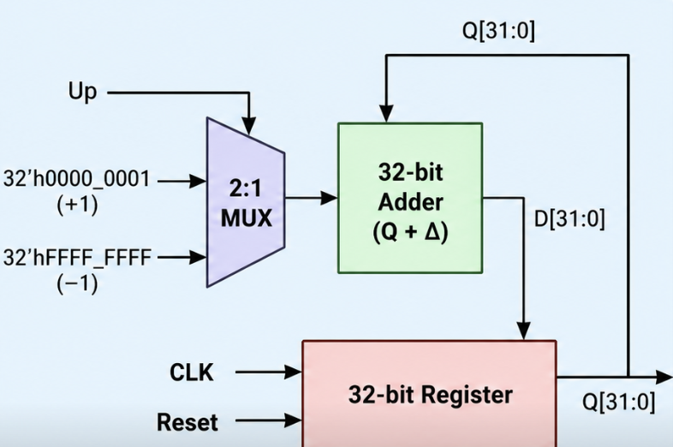
DIGITAL LOGIC & COMPUTER DESIGN
Exercise problems: 5.43
The next-state equation is:
Q+= { 0 Reset=1
Q+1 Reset=0, Up=1
Q−1 Reset=0, Up=0}
A convenient implementation is: Q^(+) = Q + (2Up-1)
or, more practically, use an adder/subtractor controlled by Up.
Reset here is synchronous - it overrides D on the clock edge, not an immediate async clear.

Slide 5
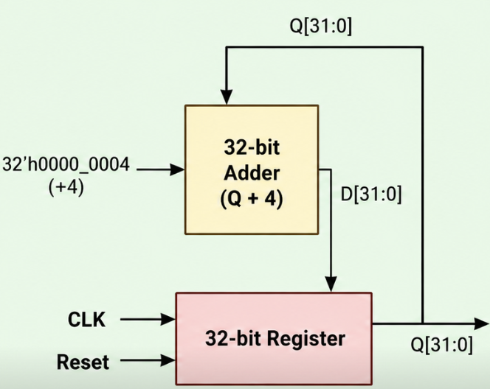
DIGITAL LOGIC & COMPUTER DESIGN
Exercise problems: 5.44
Exercise 5.44 Design a 32-bit counter that adds 4 at each clock edge. The counter has reset and clock inputs. Upon reset, the counter output is all 0.
Given
Inputs: Reset, CLK
Output: Q[31:0]
Reset → Q = 0
Every clock edge:
Q^(+) = Q+4
Design
Use:
32-bit register
32-bit adder
Constant 4

Slide 6
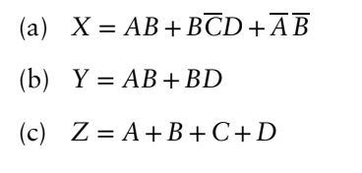
DIGITAL LOGIC & COMPUTER DESIGN
Exercise problems: 5.51
Implement the following functions using a single 16 × 3 ROM. Use dot notation to indicate the ROM contents.
Given:
A 16 × 3 ROM has:
4 address inputs: A,B,C,D since 2^(4)=16 addresses
3 data outputs: X,Y,Z
Step 1: Determine the ROM contents

Slide 7
DIGITAL LOGIC & COMPUTER DESIGN
Exercise problems: 5.51
Address | A B C D | X | Y | Z | ROM Data (XYZ)
0 | 0000 | 1 | 0 | 0 | 100
1 | 0001 | 1 | 0 | 1 | 101
2 | 0010 | 1 | 0 | 1 | 101
3 | 0011 | 1 | 0 | 1 | 101
4 | 0100 | 0 | 0 | 1 | 001
5 | 0101 | 0 | 1 | 1 | 011
6 | 0110 | 0 | 0 | 1 | 001
7 | 0111 | 0 | 1 | 1 | 011
8 | 1000 | 0 | 0 | 1 | 001
9 | 1001 | 0 | 0 | 1 | 001
10 | 1010 | 1 | 0 | 1 | 101

Slide 8
DIGITAL LOGIC & COMPUTER DESIGN
Exercise problems: 5.51
11 | 1011 | 0 | 0 | 1 | 001
12 | 1100 | 1 | 1 | 1 | 111
13 | 1101 | 1 | 1 | 1 | 111
14 | 1110 | 1 | 1 | 1 | 111
15 | 1111 | 1 | 1 | 1 | 111
Step 2: ROM contents
Therefore, the 16 × 3 ROM stores:
100, 101, 101, 101, 001, 011, 001, 011, 001, 001, 101, 001, 111, 111, 111, 111​

Slide 9
DIGITAL LOGIC & COMPUTER DESIGN
Exercise problems: 5.51
Dot Notation
In dot notation, place a dot at the intersection of an address row and output column wherever the ROM stores a 1.
Address ABCDABCD | X | Y | Z
0000 | ●
0001 | ● |  | ●
0010 | ● |  | ●
0011 | ● |  | ●
0100 |  |  | ●
0101 |  | ● | ●
0110 |  |  | ●
0111 |  | ● | ●

Slide 10
DIGITAL LOGIC & COMPUTER DESIGN
Exercise problems: 5.51
1000 |  |  | ●
1001 |  |  | ●
1010 | ● |  | ●
1011 |  |  | ●
1100 | ● | ● | ●
1101 | ● | ● | ●
1110 | ● | ● | ●
1111 | ● | ● | ●

Slide 11
DIGITAL LOGIC & COMPUTER DESIGN
Exercise problems: 6.3
Exercise 6.3: Consider memory storage of a 32-bit word stored at memory word 42 in a byte-addressable memory. (a) What is the byte address of memory word 42? (b) What are the byte addresses that memory word 42 spans? (c) Draw the number 0xFF223344 stored at word 42 in both big-endian and little-endian machines. Your drawing should be similar to Figure 6.4. Clearly label the byte address corresponding to each data byte value.
Given
Memory word = 42
Word size = 32 bits = 4 bytes
Memory is byte-addressable
Data = 0xFF223344
(a) Byte address of memory word 42
Since each word occupies 4 bytes: Byte address=Word number×4=42×4=168
Convert 168 to hexadecimal: 0xA8
Answer:0xA8. So, word 42 starts at byte address 0xA8.

Slide 12
DIGITAL LOGIC & COMPUTER DESIGN
Exercise problems: 6.3
(b) Byte addresses that word 42 spans
A 32-bit word contains 4 bytes.
Starting at 0xA8, the four bytes occupy consecutive addresses:
Byte | Address
Byte 0 | 0xA8
Byte 1 | 0xA9
Byte 2 | 0xAA
Byte 3 | 0xAB
Answer: 0xA8, 0xA9, 0xAA, 0xAB​

Slide 13
DIGITAL LOGIC & COMPUTER DESIGN
Exercise problems: 6.3
(c) Store 0xFF223344
First divide the 32-bit number into its four bytes: FF 22 33 44, where:
FF = Most Significant Byte (MSB)
44 = Least Significant Byte (LSB)
The textbook explains that in big-endian, the MSB is stored at the lower byte address, while in little-endian, the LSB is stored at the lower byte address.
Big-Endian
MSB goes to the lowest address. Therefore:
FF → 0xA8
22 → 0xA9
33 → 0xAA
44 → 0xAB

Slide 14
DIGITAL LOGIC & COMPUTER DESIGN
Exercise problems: 6.3
Little-Endian
LSB goes to the lowest address.
Therefore:
44 → 0xA8
33 → 0xA9
22 → 0xAA
FF → 0xAB
Finally,
Big-endian | A8:FF, A9:22, AA:33, AB:44
Little-endian | A8:44, A9:33, AA:22, AB:FF

Slide 15
DIGITAL LOGIC & COMPUTER DESIGN
Exercise problems: 6.4
Exercise 6.4: Repeat Exercise 6.3 for memory storage of a 32-bit word stored at memory word 15 in a byte-addressable memory.
(a) Byte address of memory word 15
Byte Address=15×4=60= 0x3C (in hexadecimal)
(b) Byte addresses that memory word 15 spans
A 32-bit word = 4 bytes, so it spans:
0x3C, 0x3D, 0x3E, 0x3F
(c) Store 0xFF223344
Endian Type | Byte Address : Data
Big-endian | 3C:FF, 3D:22, 3E:33, 3F:44
Little-endian | 3C:44, 3D:33, 3E:22, 3F:FF

Slide 16
THANK YOU
Team DLCD
Department of CSE and CSE(AI & ML)

