Slide 1

UE25CS251A
DIGITAL LOGIC AND COMPUTER DESIGN
TEAM DLCD
Department of CSE and CSE (AI & ML)

Slide 2

DIGITAL LOGIC AND COMPUTER DESIGN
Memory Arrays
TEAM DLCD
Department of CSE and CSE (AI & ML)

Slide 3

DIGITAL LOGIC & COMPUTER DESIGN
TOPICS
5.5 Memory Arrays
5.5.1 Overview
5.5.2 Dynamic Random Access Memory (DRAM)
5.5.3 Static Random Access Memory (SRAM)
5.5.4 Area and Delay
5.5.5 Register Files
5.5.6 Read Only Memory
5.5.7 Logic Using Memory Arrays
5.5.8 Memory HDL

Slide 4
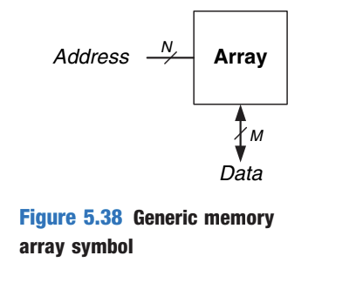
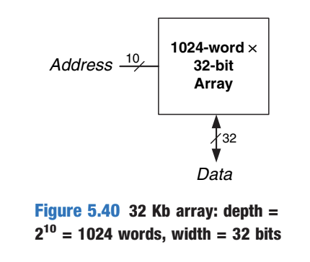
DIGITAL LOGIC & COMPUTER DESIGN
5.5 Memory Arrays — Overview
A memory array stores many words using a 2-D array of 1-bit cells.
• N address bits select one of 2^N words.
• Each word contains M data bits.
• Size = depth × width = 2^N × M bits.
• Memories are specified by size and by the number/type of ports.
Example: 10 address bits + 32-bit data
→ 2^10 = 1024 words
→ 1024 × 32 = 32 Kb
Each bit cell connects to a wordline and a bitline. A decoder activates one wordline for the selected address.
© Elsevier, Digital Design and Computer Architecture, 2nd Ed., 2012.

Slide 5
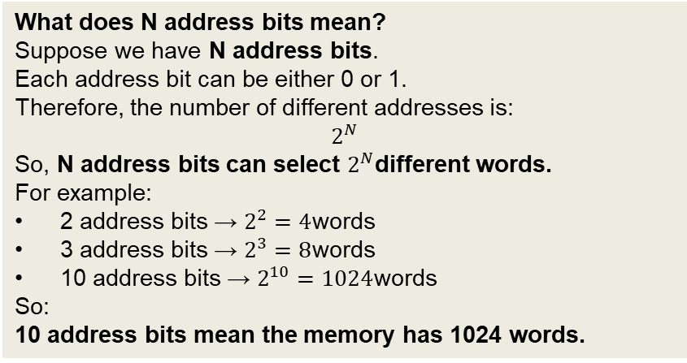
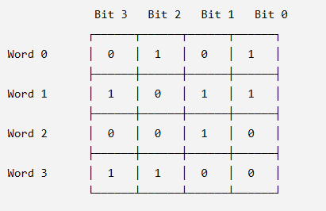
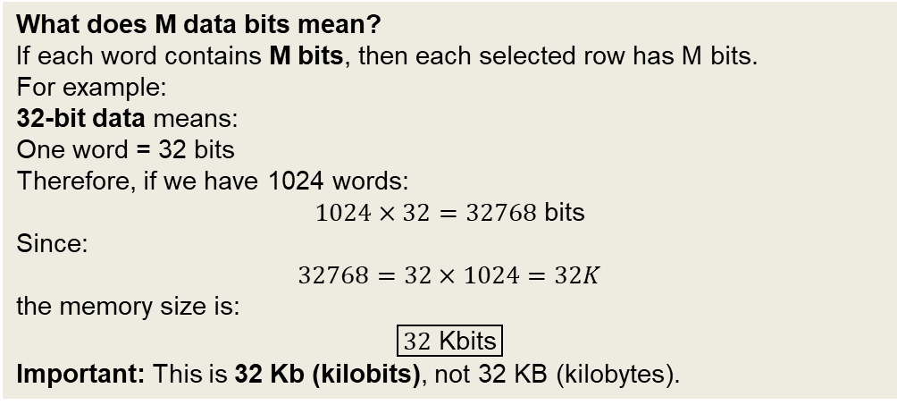
DIGITAL LOGIC & COMPUTER DESIGN
5.5 Memory Arrays — Overview
What is a memory array?
A memory is made up of many tiny 1-bit storage cells arranged in rows and columns.
Think of it like a spreadsheet:
Each row = one word
Each column = one bit
A collection of bits in one row forms a word
For example, if each word is 4 bits:
© Elsevier, Digital Design and Computer Architecture, 2nd Ed., 2012.

Slide 6
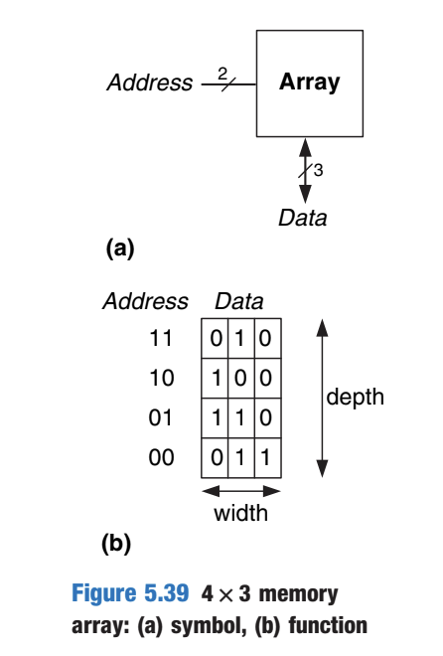
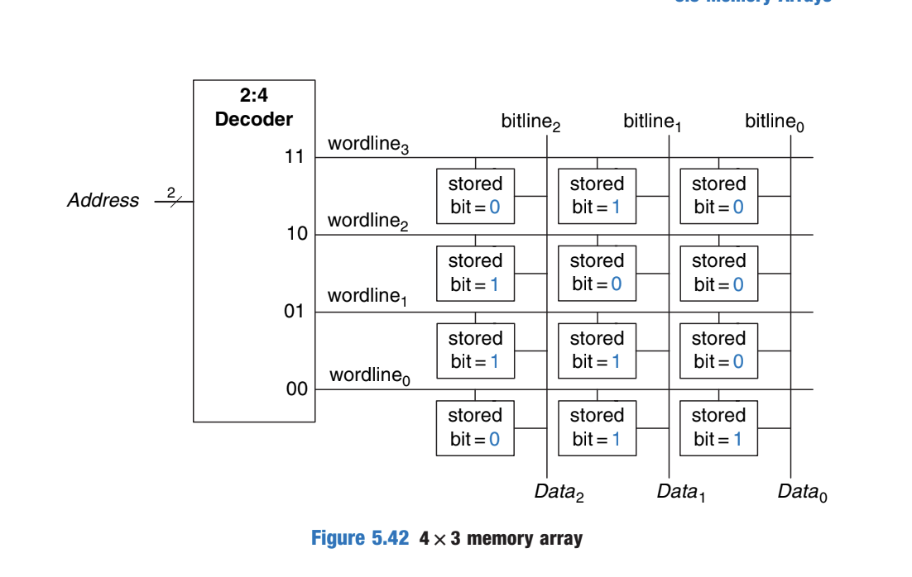
DIGITAL LOGIC & COMPUTER DESIGN
5.5 Memory Arrays — Overview
© Elsevier, Digital Design and Computer Architecture, 2nd Ed., 2012.

Slide 7
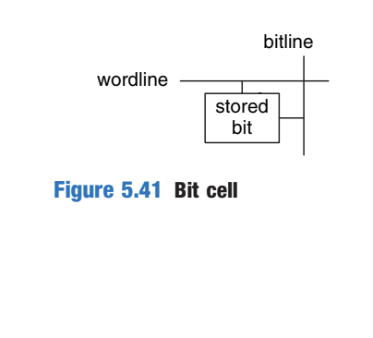
DIGITAL LOGIC & COMPUTER DESIGN
Memory Array: Bit Cell Organization
Memory Bit Cell
A memory array is built as an array of bit cells, where each bit cell stores 1 bit.
Each bit cell is connected to:
  Wordline – selects the bit cell.
  Bitline – transfers data to or from the bit cell.
For each combination of address bits, one wordline is activated.
When the wordline is HIGH, the selected bit cells are connected to their bitlines.
When the wordline is LOW, the bitline is disconnected from the bit cell.
The circuitry used to store the bit depends on the type of memory.
Wordline = Selects the row
Bitline = Carries the data
© Elsevier, Digital Design and Computer Architecture, 2nd Ed., 2012.

Slide 8
DIGITAL LOGIC & COMPUTER DESIGN
Reading and Writing a Bit Cell
Read Operation
Bitline is initially left floating (Z).
The wordline is turned ON.
The stored bit drives the bitline to 0 or 1.
Bit Cell→Bitline
Write Operation
Bitline is strongly driven to the desired value.
The wordline is turned ON.
The strongly driven bitline overpowers the existing bit.
The desired value is stored in the bit cell.
Bitline→Bit Cell​
© Elsevier, Digital Design and Computer Architecture, 2nd Ed., 2012.

Slide 9
DIGITAL LOGIC & COMPUTER DESIGN
Memory Array Organization
Internal Organization of a 4 × 3 Memory Array
A 4 × 3 memory array contains:
  4 words (rows)
  3 bits per word
Practical memories are much larger, but their operation can be understood using this smaller array.
A decoder selects one wordline based on the given address.
The selected row of bit cells is connected to the Data bitlines.
Read Operation
Wordline is asserted.
The selected row of bit cells drives the bitlines HIGH or LOW.
The resulting values appear on the Data bitlines.
Write Operation
Data bitlines are first driven to the required values.
The appropriate wordline is then asserted.
The bitline values are stored in the selected row.
© Elsevier, Digital Design and Computer Architecture, 2nd Ed., 2012.

Slide 10
DIGITAL LOGIC & COMPUTER DESIGN
Memory Array Organization
Reading Address 10
Address = 10
Decoder asserts wordline₂.
Bitlines are initially left floating.
The selected row contains 100.
Therefore, 100 appears on the Data bitlines.
10→Wordline2→100
Writing 001 to Address 11
Address = 11
Data bitlines are driven to 001.
Decoder asserts wordline₃.
The value 001 is stored in that row.
11+001→Wordline3→001 stored
READ: Wordline ON→Stored data drives bitlines
WRITE: Drive bitlines→Wordline ON→Store data
© Elsevier, Digital Design and Computer Architecture, 2nd Ed., 2012.

Slide 11
DIGITAL LOGIC & COMPUTER DESIGN
Memory Array: Depth, Width(Word size)
Depth, width and bit cells
• Depth = number of words (rows).
• Width = number of bits per word (columns).
Example: 4 × 3 memory
• 2 address bits select 1 of 4 words.
• Each word contains 3 bits.
• Total storage = 4 × 3 = 12 bits.
© Elsevier, Digital Design and Computer Architecture, 2nd Ed., 2012.

Slide 12
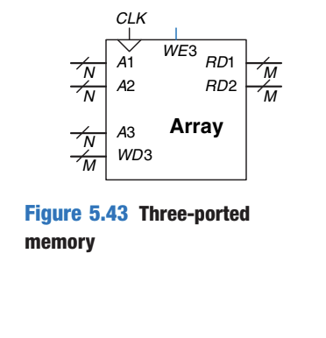
DIGITAL LOGIC & COMPUTER DESIGN
Memory Ports & Read/Write Example
A memory port provides access to one memory address. Memories may be single-ported or multiported.
Example: three-port memory
• Two read ports can read addresses A1 and A2 simultaneously.
• One write port writes WD3 to address A3 when WD3 is asserted on the rising clock edge.
Practical example — register file:
A processor may read two source registers while writing one destination register in the same cycle.
© Elsevier, Digital Design and Computer Architecture, 2nd Ed., 2012.

Slide 13
DIGITAL LOGIC & COMPUTER DESIGN
Memory Array Classification
Memory arrays are specified by:
Size: Depth × Width
Number of ports
Type of ports
All memory arrays store data using an array of bit cells, but they differ in how the bits are stored.
RAM vs ROM: The broadest classification of memory is:
RAM | ROM
Random Access Memory | Read Only Memory
Volatile | Nonvolatile
Loses data when power is turned OFF | Retains data without power
Historically associated with read/write memory | Historically associated with read-only memory
Both RAM and ROM can be randomly accessed. Modern ROMs can also be written in various ways.
© Elsevier, Digital Design and Computer Architecture, 2nd Ed., 2012.

Slide 14
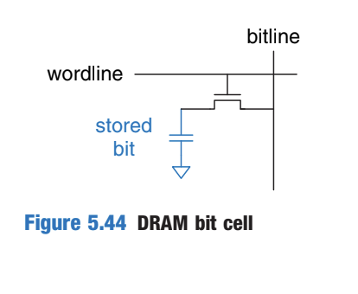
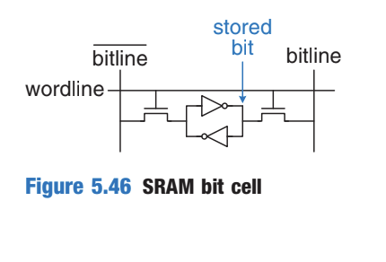
DIGITAL LOGIC & COMPUTER DESIGN
DRAM vs SRAM
There are two major types of RAM:
DRAM (Dynamic RAM)
• Stores each bit as charge on a capacitor.
• Charge leaks away, so periodic refresh is required.
• Reading disturbs/destroys the capacitor value, so the data is restored after a read.
• The simplified cell uses about 1 transistor per bit → very dense.
SRAM (Static RAM)
• Stores the bit using cross-coupled inverters.
• No periodic refresh is required while power is applied.
• The cross-coupled inverters restore the value if noise disturbs it.
• A typical SRAM bit cell uses 6 transistors → larger than DRAM but faster.
Book comparison: flip-flop ≈ 20 transistors/bit, SRAM ≈ 6, DRAM ≈ 1.
© Elsevier, Digital Design and Computer Architecture, 2nd Ed., 2012.

Slide 15
DIGITAL LOGIC & COMPUTER DESIGN
DRAM vs SRAM
1. Why is DRAM called "Dynamic"?
A DRAM cell stores a bit as electrical charge on a capacitor.
Charged capacitor → 1
Discharged capacitor → 0
But the capacitor gradually leaks its charge.
So:
Stored charge → leaks with time → data may be lost → refresh is required
That's why it is Dynamic: the stored value needs to be periodically refreshed.
2. Why is SRAM called "Static"?
SRAM uses cross-coupled inverters.
The two inverters continuously reinforce each other's state:
┌──────────┐
Q ──►│ Inverter │──► Q̅
└──────────┘
▲ │
│ ▼
┌──────────┐
Q̅ ──►│ Inverter │──► Q
└──────────┘
If Q = 1, the feedback keeps Q = 1 and Q̅ = 0.
If Q = 0, the feedback keeps Q = 0 and Q̅ = 1.
Therefore, as long as power is supplied, SRAM does not need periodic refresh.
3. Why is SRAM faster than DRAM?
The important difference is:
DRAM → charge must be sensed from a capacitor
SRAM → logic state is already maintained by the transistor circuit
So SRAM can generally be accessed faster, but its cell requires more transistors and therefore occupies more chip area.
© Elsevier, Digital Design and Computer Architecture, 2nd Ed., 2012.

Slide 16
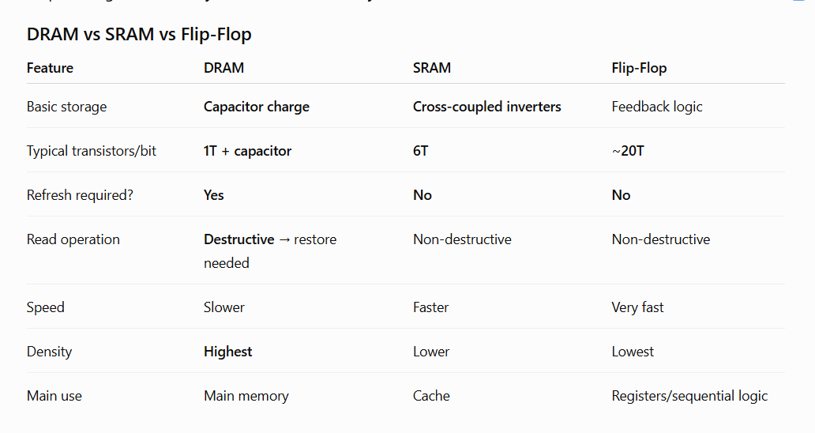
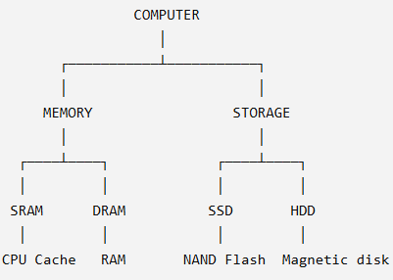
DIGITAL LOGIC & COMPUTER DESIGN
DRAM vs SRAM
© Elsevier, Digital Design and Computer Architecture, 2nd Ed., 2012.

Slide 17
DIGITAL LOGIC & COMPUTER DESIGN
Volatile Memory - Area & Delay
Flip-flops, SRAM, and DRAM are all volatile memories, but they differ in area, latency, and throughput.
Memory | Transistors/Bit | Relative Latency | Key characteristic
Flip-flop | ~20 | Fast | Output available immediately
SRAM | 6 | Medium | Faster access than DRAM
DRAM | 1 | Slow | High density
Why?
More transistors generally mean more area, power, and cost.
Flip-flops: data is immediately available at the output, but require at least ~20 transistors.
SRAM: uses 6 transistors per bit.
DRAM: uses only 1 transistor per bit, making it more area-efficient.
© Elsevier, Digital Design and Computer Architecture, 2nd Ed., 2012.

Slide 18
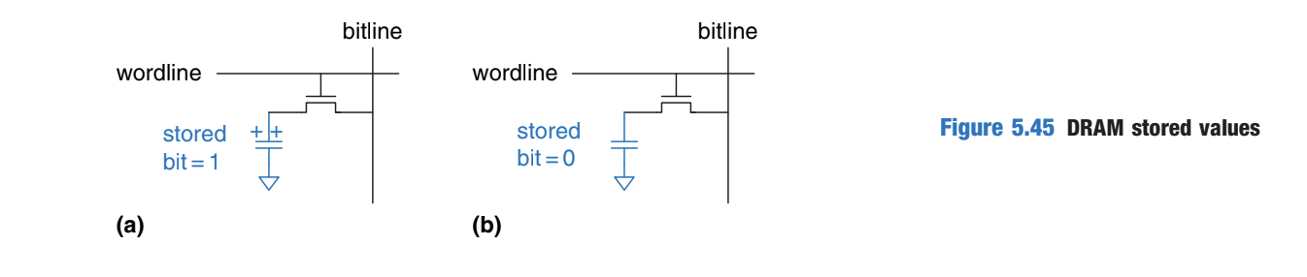
DIGITAL LOGIC & COMPUTER DESIGN
Why is DRAM Slower?
DRAM stores a bit as charge on a capacitor.
As shown in Figure 5.45(a), when the capacitor is charged to VDD, the stored bit is 1; when it is discharged to GND (Figure 5.45(b)), the stored bit is 0.
During a read:
Charge moves from the capacitor → bitline.
The bitline is not actively driven by a transistor.
Charge movement is relatively slow.
Therefore, DRAM has higher latency than SRAM.
DRAM also has lower throughput
DRAM must:
Periodically refresh its stored data.
Refresh the data after a read.
Therefore, its throughput is fundamentally lower than SRAM.
© Elsevier, Digital Design and Computer Architecture, 2nd Ed., 2012.

Slide 19
DIGITAL LOGIC & COMPUTER DESIGN
SDRAM & DDR SDRAM
Technologies were developed to improve DRAM throughput:
SDRAM - Synchronous DRAM
Uses a clock
Pipelines memory accesses
DDR SDRAM - Double Data Rate SDRAM
Transfers/accesses data on both rising and falling edges of the clock.
Therefore, it can double the throughput for a given clock speed.
It should be noted that DDR was first standardized in 2000, initially operating at 100–200 MHz. Later standards such as DDR2, DDR3, and DDR4 increased clock speeds.
Important take away DRAM → lower area per bit, but higher latency and lower throughput.
SRAM → faster, but uses more transistors.
Flip-flop → fastest, but largest per-bit implementation.
Also remember: Larger memories tend to be slower than smaller memories, assuming other factors are the same. The appropriate memory type depends on the design's speed, cost, and power constraints.
© Elsevier, Digital Design and Computer Architecture, 2nd Ed., 2012.

Slide 20
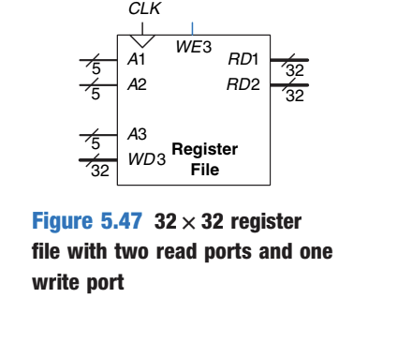
DIGITAL LOGIC & COMPUTER DESIGN
Register Files
Register file = a group of registers used to store temporary variables in a digital system.
Usually implemented as a small, multi-ported SRAM array
More compact than building the same registers using an array of flip-flops
A register file can allow multiple registers to be accessed simultaneously.
Example: 32 × 32 Three-Ported Register File
The textbook's Figure 5.47 shows a 32-register × 32-bit register file with:
2 read ports:
  A1 → RD1
  A2 → RD2
1 write port:
  A3 → WD3
CLK controls the write operation.
Each address is 5 bits, because: 2^5 = 32
© Elsevier, Digital Design and Computer Architecture, 2nd Ed., 2012.

Slide 21
DIGITAL LOGIC & COMPUTER DESIGN
Register Files
Therefore:
Two registers can be read and one register can be written simultaneously.
Numerical
For a 32 × 32 register file:
Number of registers=32
Bits per register=32
Address bits=log⁡2(32)=5
Total storage:
32×32=1024 bits
Register File → Small multi-ported SRAM → Temporary storage → Multiple simultaneous accesses
© Elsevier, Digital Design and Computer Architecture, 2nd Ed., 2012.

Slide 22
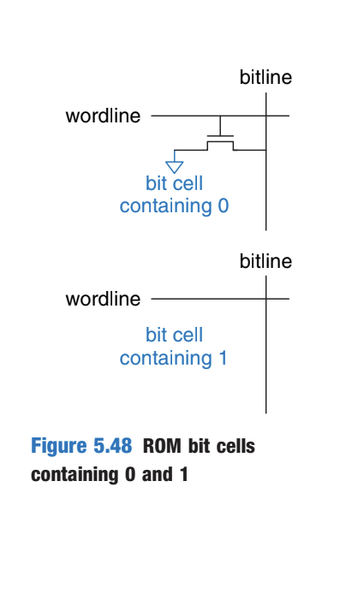
DIGITAL LOGIC & COMPUTER DESIGN
Read-Only Memory (ROM)
ROM stores each bit based on the presence or absence of a transistor.
How a ROM bit cell works
The bitline is weakly pulled HIGH.
The wordline is turned ON.
If a transistor is present → it pulls the bitline LOW → stored bit = 0.
If a transistor is absent → bitline remains HIGH → stored bit = 1.
Key point
ROM is non volatile because its bit cell is a combinational circuit and has no state that is lost when power is removed.
© Elsevier, Digital Design and Computer Architecture, 2nd Ed., 2012.

Slide 23
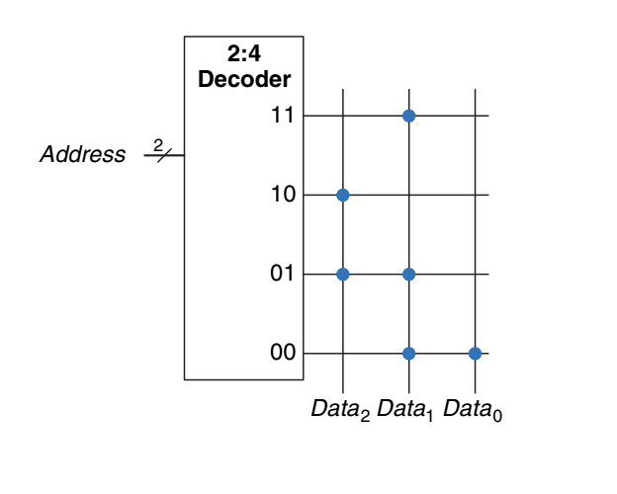
DIGITAL LOGIC & COMPUTER DESIGN
ROM Dot Notation
ROM contents can be represented using dot notation.
Rows → Wordlines / Addresses
Columns → Bitlines / Data bits
Dot at an intersection → stored bit = 1
No dot → stored bit = 0
Example: 4 × 3 ROM
A 4-word × 3-bit ROM has: 2^2=4 words
and each word contains:3 bits
So the total storage is:
4×3=12 bits
For the example shown in Figure 5.49, the top wordline has a dot only on Data1, so the corresponding stored word is 010.
© Elsevier, Digital Design and Computer Architecture, 2nd Ed., 2012.

Slide 24
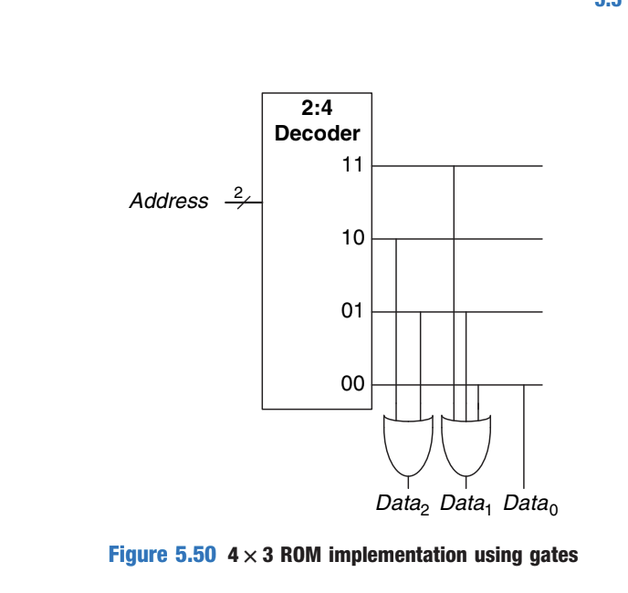
DIGITAL LOGIC & COMPUTER DESIGN
ROM
© Elsevier, Digital Design and Computer Architecture, 2nd Ed., 2012.

Slide 25
DIGITAL LOGIC & COMPUTER DESIGN
ROM as Logic
A ROM can also be viewed as a two-level logic circuit:
AND gates → OR gates
First level: AND gates
Generate all possible minterms
Therefore, they function as a decoder
Second level: OR gates
Combine selected minterms
Produce the required output functions
So conceptually: Address → Decoder → OR gates → Data
Important point: A ROM can implement any two-level logic function.
In practice, ROMs use transistors instead of logic gates to reduce size and cost.
© Elsevier, Digital Design and Computer Architecture, 2nd Ed., 2012.

Slide 26
DIGITAL LOGIC & COMPUTER DESIGN
Types of ROM
ROMs differ mainly in how their contents are programmed and erased.
1. Mask ROM
Contents are specified during manufacturing
A transistor is either present or absent in each bit cell.
Cannot be changed by the user.
2. PROM - Programmable ROM
Transistors are initially present.
User can program the memory.
In the fuse-programmable version, programming selectively blows fuses.
Once programmed, it cannot be reversed.
PROM = One-Time Programmable ROM (OTP)
© Elsevier, Digital Design and Computer Architecture, 2nd Ed., 2012.

Slide 27
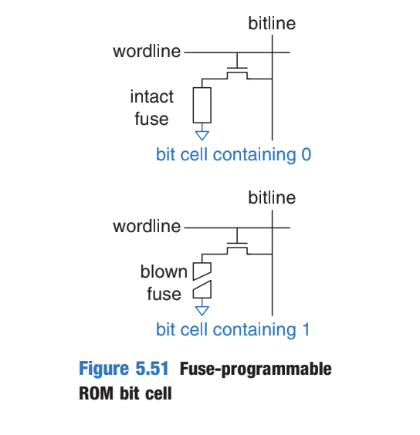
DIGITAL LOGIC & COMPUTER DESIGN
Fuse-Programmable ROM
Programming operation
Fuse intact:
Transistor connected to GND
Cell stores 0
Fuse blown:
Transistor disconnected from GND
Cell stores 1
A high voltage is applied to selectively blow the required fuses.
Because a blown fuse cannot be repaired:
PROM is one-time programmable​
© Elsevier, Digital Design and Computer Architecture, 2nd Ed., 2012.

Slide 28
DIGITAL LOGIC & COMPUTER DESIGN
Reprogrammable ROM
EPROM — Erasable Programmable ROM
Uses a floating-gate transistor.
Programming:
High voltage causes electrons to move onto the floating gate.
This changes the transistor's state.
Erasing:
Exposed to intense UV light.
UV light removes the electrons from the floating gate.
So:
EPROM → Program electrically → Erase using UV light
© Elsevier, Digital Design and Computer Architecture, 2nd Ed., 2012.

Slide 29
DIGITAL LOGIC & COMPUTER DESIGN
EEPROM & Flash Memory
EEPROM
Electrically Erasable Programmable ROM
Can be programmed electrically.
Can also be erased electrically.
Individual bits/cells can be erased.
No UV light required.
Flash Memory
Uses similar principles to EEPROM.
Erases larger blocks of bits rather than individual cells.
Requires fewer erasing circuits.
Therefore, it is cheaper than EEPROM.
© Elsevier, Digital Design and Computer Architecture, 2nd Ed., 2012.

Slide 30
DIGITAL LOGIC & COMPUTER DESIGN
Comparison
Type | Programmable? | Erasable? | Erasing method
Mask ROM | During manufacturing | No | —
PROM | Once | No | —
EPROM | Yes | Yes | UV light
EEPROM | Yes | Yes | Electrical
Flash | Yes | Yes | Electrical, block-wise
© Elsevier, Digital Design and Computer Architecture, 2nd Ed., 2012.

Slide 31
DIGITAL LOGIC & COMPUTER DESIGN
Memory Arrays as Logic
Memory arrays are primarily used for data storage, but they can also implement combinational logic functions.
For a memory of: 2^N-words×M-bits
it can implement any combinational function with:
N inputs
M outputs
Why?
The N inputs are used as the address.
Each possible input combination corresponds to one memory row.
The M data bits stored in that row represent the outputs.
So:
Inputs → Address → Memory Array → Data Outputs
© Elsevier, Digital Design and Computer Architecture, 2nd Ed., 2012.

Slide 32
DIGITAL LOGIC & COMPUTER DESIGN
Example — ROM as Combinational Logic
The 4 × 3 ROM from Figure 5.49 has:
4 words → 2^2, so 2 inputs
3-bit data → 3 outputs
Therefore, it implements: 3 functions of 2 inputs
For this particular ROM:
Data2 = XOR of the two address inputs
Data0 = NOR of the two address inputs
Data1 is another combinational function determined by the stored ROM contents.
Key idea
The ROM contents essentially represent the truth table of the desired logic functions.
© Elsevier, Digital Design and Computer Architecture, 2nd Ed., 2012.

Slide 33
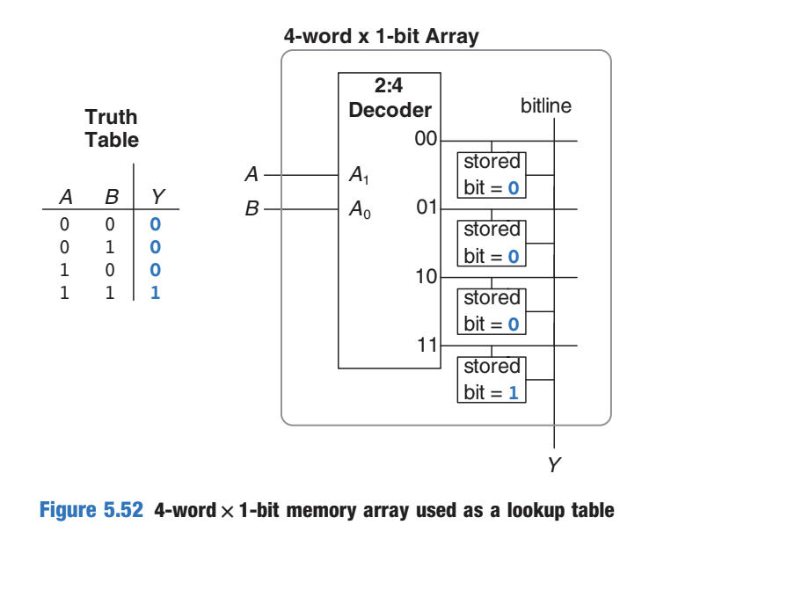
DIGITAL LOGIC & COMPUTER DESIGN
Lookup Tables (LUTs)
A memory array used to perform logic is called a:
Lookup Table (LUT)
Instead of constructing a function using individual logic gates, we store the output values in memory.
How a LUT works
Inputs are applied as an address.
The address selects a particular row.
The stored data in that row gives the output.
Input combination → Address → Selected row → Output
© Elsevier, Digital Design and Computer Architecture, 2nd Ed., 2012.

Slide 34
DIGITAL LOGIC & COMPUTER DESIGN
Example — LUT for Y=AB
Lets uses a 4-word × 1-bit memory to implement: Y=AB
Since there are 2 inputs:2^2=4 possible input combinations
A | B | Address | Y = AB
0 | 0 | 00 | 0
0 | 1 | 01 | 0
1 | 0 | 10 | 0
1 | 1 | 11 | 1
The LUT simply stores: 0, 0, 0, 1
For N inputs and M outputs: LUT size=2N×M
© Elsevier, Digital Design and Computer Architecture, 2nd Ed., 2012.

Slide 35
DIGITAL LOGIC & COMPUTER DESIGN
MCQ
Q1. An N-bit binary counter has how many possible states?
A. N
B. 2N
C. N²
D. 2^N
Q2. What happens to a binary counter on each rising clock edge after reset is released?
A. Q remains constant
B. Q decreases by 1
C. Q increases by 1
D. Q becomes all 1s

Slide 36
DIGITAL LOGIC & COMPUTER DESIGN
MCQ
Q3. A shift register with N flip-flops can act as which converter?
A. Serial-to-parallel
B. Analog-to-digital only
C. Frequency-to-voltage
D. Decimal-to-BCD only
Q4. In a shift register with parallel load, what happens when Load = 1?
A. The register is cleared
B. D inputs are loaded into the flip-flops
C. The clock is disabled permanently
D. The register shifts without loading D

Slide 37
DIGITAL LOGIC & COMPUTER DESIGN
MCQ
Q5. A memory has 10 address bits and 8 data bits. What is its organization?
A. 10 × 8 bits
B. 100 × 8 bits
C. 1024 × 8 bits
D. 2048 × 10 bits
Q6. During a memory read, what does the decoder primarily do?
A. Adds two data words
B. Activates the wordline for the selected address
C. Refreshes every bit cell
D. Converts binary to decimal

Slide 38
DIGITAL LOGIC & COMPUTER DESIGN
MCQ
Q7. Which statement about DRAM is correct?
A. It stores data in cross-coupled inverters and never needs refresh
B. It stores charge on a capacitor and requires refresh
C. It is nonvolatile
D. It uses more transistors per bit than a flip-flop
Q8. Which statement about SRAM is correct?
A. It requires periodic refresh like DRAM
B. It stores the bit using cross-coupled inverters
C. A read always destroys the stored bit
D. It is nonvolatile

Slide 39
DIGITAL LOGIC & COMPUTER DESIGN
MCQ
Q9. A typical processor register file in the textbook has which port arrangement?
A. One read port and no write port
B. Two read ports and one write port
C. Three write ports and no read ports
D. One read/write port only
Q10. A 2^N-word × M-bit memory used as a LUT has:
A. N input/address bits and M output bits
B. M input bits and N output bits
C. N output bits only
D. One fixed output bit
© Elsevier, Digital Design and Computer Architecture, 2nd Ed., 2012.

Slide 40
DIGITAL LOGIC & COMPUTER DESIGN
MCQ
Answer Key:
Q1: D Q2: C Q3: A Q4: B Q5: C Q6: B
Q7: B Q8: B Q9: B Q10: A

Slide 41
THANK YOU
Team DLCD
Department of CSE and CSE(AI & ML)

