Slide 1

UE25CS251A
DIGITAL LOGIC AND COMPUTER DESIGN
TEAM DLCD
Department of CSE and CSE (AI & ML)

Slide 2

DIGITAL LOGIC AND COMPUTER DESIGN
ARCHITECTURE-Introduction
TEAM DLCD
Department of CSE and CSE (AI & ML)

Slide 3

DIGITAL LOGIC & COMPUTER DESIGN
TOPICS
Introduction
Assembly Language
Machine Language
Programming
Addressing modes
Parallelism

Slide 4
DIGITAL LOGIC & COMPUTER DESIGN
Introduction
What is Computer Architecture
Computer Architecture is the programmer's view of a computer. It defines how software communicates with hardware by specifying:
  Instruction Set Architecture (ISA)
  Operand locations (Registers and Memory)
  Data representation and instruction formats
Why Study Computer Architecture?
  Bridges the gap between hardware and software.
  Determines how programs are executed by the processor.
  Helps design efficient, compatible, and high-performance computer systems.
  Provides a foundation for understanding processor organization and programming.

Slide 5
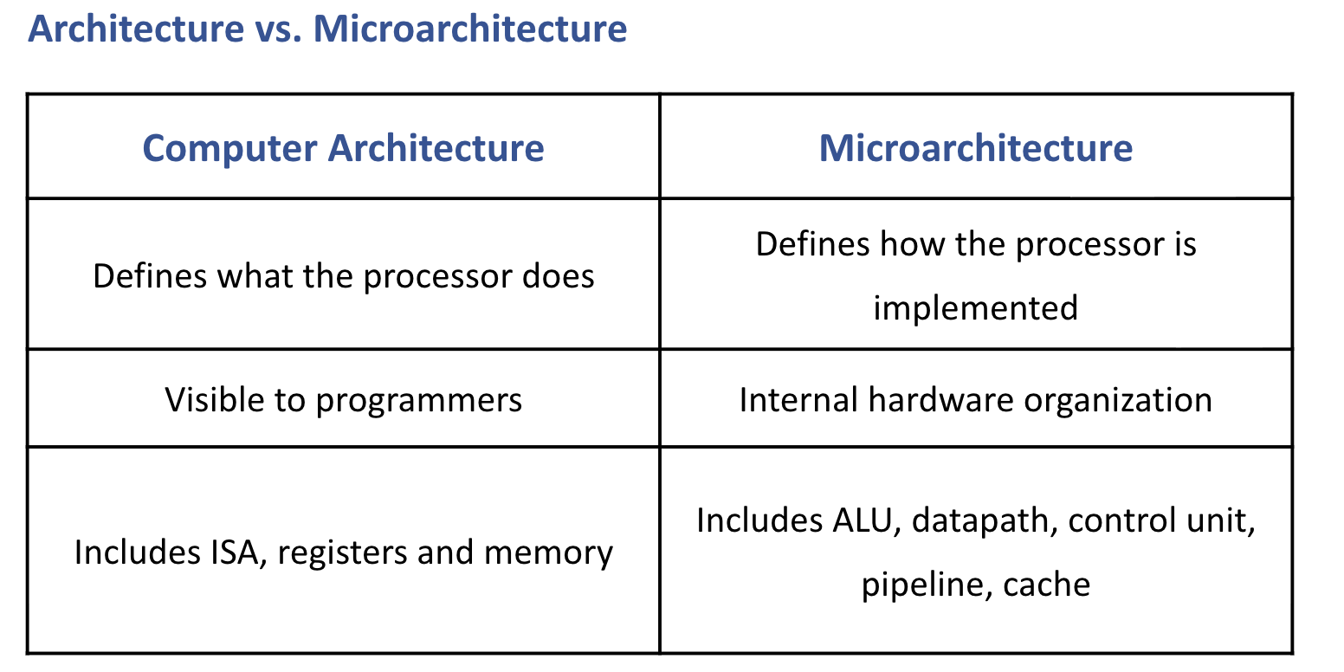
DIGITAL LOGIC & COMPUTER DESIGN
Introduction

Slide 6
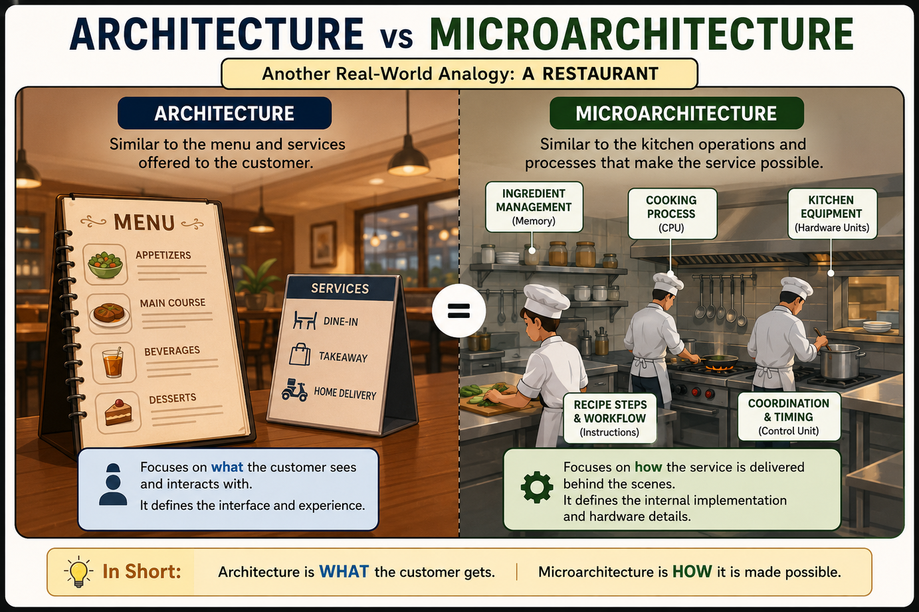
DIGITAL LOGIC & COMPUTER DESIGN
Introduction

Slide 7
DIGITAL LOGIC & COMPUTER DESIGN
Introduction
  Many Architectures Exist: e.g. x86, MIPS, SPARC, and PowerPC
    Each architecture defines its own instruction set
  Instruction Sets Are Like Dialects: once you learn one, learning another is fairly straightforward
  Instructions: the words of a computer’s language; even complex applications compile down to simple instructions like add, subtract, and jump

Slide 8
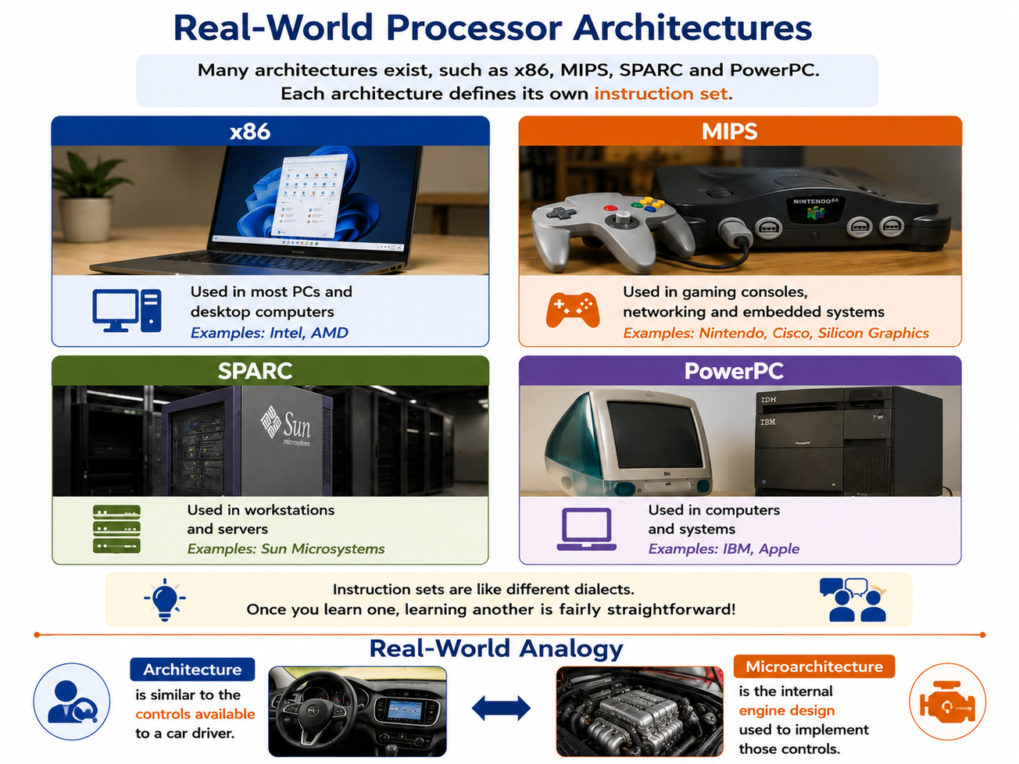
DIGITAL LOGIC & COMPUTER DESIGN
Introduction

Slide 9
DIGITAL LOGIC & COMPUTER DESIGN
MCQ
  Q1. What is “architecture” as defined in this chapter?
    The programmer’s view of a computer, defined by the instruction set and operand locations
    The physical arrangement of transistors on a chip
    The way registers are wired to the ALU
    A hardware description language

Slide 10
DIGITAL LOGIC & COMPUTER DESIGN
MCQ
  Q2. Which of the following is the human-readable form of instructions?
    Machine language
    Assembly language
    Binary code
    Microcode

Slide 11
DIGITAL LOGIC & COMPUTER DESIGN
MCQ
  Q3. Machine language instructions are ultimately encoded as:
    Decimal numbers
    ASCII characters
    Binary (1’s and 0’s)
    Hexadecimal strings only

Slide 12
DIGITAL LOGIC & COMPUTER DESIGN
MCQ
  Q4. Who developed the MIPS architecture, and where?
    John Hennessy and colleagues at Stanford
    Dennis Ritchie at Bell Labs
    Gordon Moore at Intel
    Alan Turing at Cambridge

Slide 13
DIGITAL LOGIC & COMPUTER DESIGN
MCQ
  Answer Key
  Q1: A Q2: B Q3: C Q4: A

Slide 14
THANK YOU
Team DLCD
Department of CSE and CSE(AI & ML)

