Slide 1

UE25CS251A
DIGITAL LOGIC AND COMPUTER DESIGN
TEAM DLCD
Department of CSE and CSE (AI & ML)

Slide 2

DIGITAL LOGIC AND COMPUTER DESIGN
ARCHITECTURE-Assembly Language
TEAM DLCD
Department of CSE and CSE (AI & ML)

Slide 3

DIGITAL LOGIC & COMPUTER DESIGN
TOPICS
Instructions
Operands: Registers, Memory, and Constants

Slide 4
DIGITAL LOGIC & COMPUTER DESIGN
Assembly language
  Instructions: commands in a computer’s language
    Assembly language: human–readable format of instructions
    Machine language: computer–readable format (1’s and 0’s)
  MIPS architecture:
    MIPS (Microprocessor without Interlocked Pipelined Stages) is a family of reduced instruction set computer (RISC), instruction set architectures (ISA) developed by MIPS Computer Systems, now MIPS Technologies, based in United States.
    Developed by John Hennessy and his colleagues at Stanford, in 1980’s.
    Used in many commercial systems, including Silicon Graphics, Nintendo and Cisco
    Once you’ve learnt one architecture, it’s easy to learn others
© Elsevier, Digital Design and Computer Architecture, 2nd Ed., 2012.

Slide 5
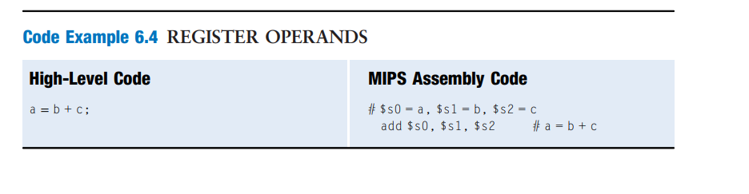
DIGITAL LOGIC & COMPUTER DESIGN
MIPS Instruction: Addition
C Code
a = b + c;
MIPS assembly code
add a, b, c
add: mnemonic indicates operation to perform (here it is addition).
b, c: source operands (on which the operation is performed).
a: destination operand (to which the result is written).
© Elsevier, Digital Design and Computer Architecture, 2nd Ed., 2012.

Slide 6
DIGITAL LOGIC & COMPUTER DESIGN
MIPS Instruction: Subtraction
C Code
a = b - c;
MIPS assembly code
sub a, b, c
sub: mnemonic indicates operation to perform (here it is subtraction).
b, c: source operands (on which the operation is performed).
a: destination operand (to which the result is written).
© Elsevier, Digital Design and Computer Architecture, 2nd Ed., 2012.

Slide 7
DIGITAL LOGIC & COMPUTER DESIGN
Architecture Design Principles
Computer architectures are designed using a set of fundamental principles that improve performance, simplicity, and efficiency.
1. Simplicity Favors Regularity
  Simple and uniform instruction formats simplify hardware design.
  Regular structures are easier to implement, test, and optimize.
2. Make the Common Case Fast
  Frequently executed operations should be optimized.
  Improves overall system performance since common tasks dominate execution time.
3. Smaller is Faster
  Smaller hardware structures, such as registers and caches, have lower access time.
  Faster access leads to improved processor performance.
4. Good Design Demands Good Compromises
  Every design involves trade-offs between performance, cost, power, and complexity.
  An efficient architecture balances these factors instead of optimizing only one.
© Elsevier, Digital Design and Computer Architecture, 2nd Ed., 2012.

Slide 8
DIGITAL LOGIC & COMPUTER DESIGN
Design Principle – 1
Simplicity Favors Regularity
  MIPS uses a consistent and uniform instruction format for most instructions.
  Arithmetic instructions follow the format:
    Two source operands
    One destination operand
  Uniform instruction formats simplify instruction encoding, decoding, and hardware implementation.
  Regular designs reduce hardware complexity, making processors faster, more reliable, and easier to design.
Example: add $s0, $s1, $s2
sub $t0, $t1, $t2
Both instructions follow the same format:
Destination = Source1 OP Source2
© Elsevier, Digital Design and Computer Architecture, 2nd Ed., 2012.

Slide 9
DIGITAL LOGIC & COMPUTER DESIGN
Design Principle – 2
Make the Common Case Fast
  Processor performance is improved by optimizing the operations that are executed most frequently.
  MIPS includes a small set of simple, commonly used instructions that can be decoded and executed quickly.
  Simple instructions enable smaller, faster, and more efficient hardware.
  Complex operations are implemented by combining multiple simple instructions, rather than using a single complex instruction.
  MIPS follows the Reduced Instruction Set Computer (RISC) philosophy, emphasizing simplicity and speed.
  In contrast, architectures such as Intel x86 follow the Complex Instruction Set Computer (CISC) approach, where individual instructions perform more complex tasks.
© Elsevier, Digital Design and Computer Architecture, 2nd Ed., 2012.

Slide 10
DIGITAL LOGIC & COMPUTER DESIGN
Design Principle – 2
Feature | RISC (e.g., MIPS, ARM, RISC-V) | CISC (e.g., x86, VAX)
Instruction Set Size | Small, simple set (≈ 30–100 instructions) | Large, complex set (hundreds to thousands)
Instruction Length | Fixed (commonly 32 bits) | Variable (1–15 bytes in x86)
Execution Time | Most instructions complete in 1 clock cycle | Instructions may take multiple cycles
Complexity Location | Complexity shifted to compiler/software | Complexity handled by hardware/microcode
Memory Access | Load/Store architecture (only load/store access memory; ALU ops use registers) | ALU operations can directly access memory (read-modify-write)
Registers | Many general-purpose registers (e.g., 32 in ARM/RISC-V) | Fewer registers (e.g., 16 in x86-64)
Pipelining | Easy and efficient due to uniform instruction size | Harder due to variable-length instructions
Code Density | Larger program size (more instructions for complex tasks) | Smaller program size (complex tasks in fewer instructions)
Instruction Decoding | Simple, fast decoding | Complex, slower decoding
Hardware Complexity | Low — simpler control logic, fewer transistors | High — microcode, wide decoders, more transistors
Performance Strategy | Reduce cycles per instruction (CPI) | Reduce instructions per program
Power Consumption | Lower (efficient per watt, common in mobile/embedded systems) | Higher (desktop/server CPUs with more power budget)
Examples | ARM, RISC-V, MIPS, SPARC | Intel x86, AMD64, VAX

Slide 11
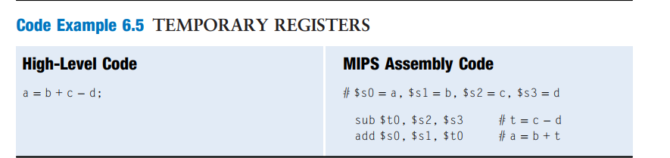
DIGITAL LOGIC & COMPUTER DESIGN
Multiple Instructions
  More complex code is handled by multiple MIPS instructions.
MIPS assembly code
C Code
a = b + c - d;
add t, b, c sub a, t, d
# t = b + c # a = t - d
A RISC architecture minimizes the hardware complexity and the necessary instruction encoding by keeping the set of distinct instructions small.
For example, an instruction set with 64 simple instructions would need log₂64 = 6 bits to encode the operation.
An instruction set with 256 complex instructions would need log₂256 = 8 bits of encoding per instruction.
In a CISC machine, even though the complex instructions may be used only rarely, they add overhead to all instructions, even the simple ones.

Slide 12
DIGITAL LOGIC & COMPUTER DESIGN
Operands: Locations
Every instruction performs an operation on one or more operands. An operand is the data used by an instruction, and it can be stored in different locations within a computer.
The three operand locations in the MIPS architecture are:
  Registers – High-speed storage locations inside the CPU used for frequently accessed data.
  Memory – Stores large amounts of program instructions and data that cannot fit in registers.
  Constants (Immediates) – Fixed values encoded directly within the instruction.
Example: addi $t0, $t1, 10.
$t0 → Destination Register
$t1 → Source Register
10 → Immediate (Constant)

Slide 13
DIGITAL LOGIC & COMPUTER DESIGN
Operands: Registers
  Registers are small, high-speed storage locations inside the CPU used to hold operands and intermediate results.
  MIPS provides 32 general-purpose registers, each 32 bits wide.
  Registers can be accessed much faster than main memory, reducing instruction execution time.
  MIPS is called a 32-bit architecture because its registers and ALU operate on 32-bit data.
  Frequently used variables are stored in registers, while less frequently used data is stored in memory.
© Elsevier, Digital Design and Computer Architecture, 2nd Ed., 2012.

Slide 14
DIGITAL LOGIC & COMPUTER DESIGN
Design Principle – 3
Smaller is Faster
  Smaller hardware structures generally have lower access time and can operate at higher speeds.
  MIPS includes 32 general-purpose registers, providing a balance between performance and hardware complexity.
  A smaller register file allows faster access, reducing instruction execution time.
  Frequently accessed data is stored in registers, while larger amounts of data are kept in main memory.
  This design improves overall processor performance by minimizing slower memory accesses.
Example:
  Accessing data from a register takes significantly less time than accessing the same data from main memory.
  Therefore, compilers try to keep frequently used variables in registers whenever possible.
© Elsevier, Digital Design and Computer Architecture, 2nd Ed., 2012.

Slide 15
DIGITAL LOGIC & COMPUTER DESIGN
MIPS Register Set
Name | Register Number | Usage
$0 | 0 | the constant value 0
$at | 1 | assembler temporary
$v0–$v1 | 2–3 | function return values
$a0–$a3 | 4–7 | function arguments
$t0–$t7 | 8–15 | temporaries
$s0–$s7 | 16–23 | saved variables
$t8–$t9 | 24–25 | more temporaries
$k0–$k1 | 26–27 | OS temporaries
$gp | 28 | global pointer
$sp | 29 | stack pointer
$fp | 30 | frame pointer
$ra | 31 | function return address
© Elsevier, Digital Design and Computer Architecture, 2nd Ed., 2012.

Slide 16
DIGITAL LOGIC & COMPUTER DESIGN
Operands: Registers
MIPS Register Naming Convention
In MIPS, every register name is prefixed with a '$' symbol.
Example: $0 (read as register zero or dollar zero).
Registers are assigned specific roles to simplify programming and improve code organization.
Commonly Used Registers
$0 (Register Zero): Always stores the constant value 0.
$s0 – $s7 (Saved Registers): Used to store variables whose values must be preserved across function calls.
$t0 – $t9 (Temporary Registers): Used to store intermediate results during calculations; their contents need not be preserved.
$a0 – $a3 (Argument Registers): Used to pass arguments to functions.
$v0 – $v1 (Value Registers): Used to store function return values.
© Elsevier, Digital Design and Computer Architecture, 2nd Ed., 2012.

Slide 17
DIGITAL LOGIC & COMPUTER DESIGN
Operands: Registers
Example:
add $t0, $s1, $s2
  $s1, $s2 → Source operands (saved registers)
  $t0 → Destination operand (temporary register)
Note: Other special-purpose registers such as $sp (Stack Pointer), $fp (Frame Pointer), and $ra (Return Address) will be discussed later during function calls and stack management.
© Elsevier, Digital Design and Computer Architecture, 2nd Ed., 2012.

Slide 18
DIGITAL LOGIC & COMPUTER DESIGN
Operands: Memory
The 32 registers in MIPS are insufficient to store all program data.
Main memory is used to store additional data and program instructions.
Memory provides large storage capacity, but it is slower to access than registers.
Frequently accessed variables are kept in registers, while less frequently used data is stored in memory.
Data is transferred between memory and registers using load (lw) and store (sw) instructions.
Key Point:
Registers provide fast access for frequently used data, while memory provides large storage for the rest of the program.

Slide 19
DIGITAL LOGIC & COMPUTER DESIGN
Memory organization
Memories are organized as an array of data words.
The MIPS architecture uses 32-bit memory addresses and 32-bit data words.
MIPS uses a byte-addressable memory.
That is, each byte in memory has a unique address.
However, for explanation purposes only, we first introduce a word-addressable memory, and afterward describe the MIPS byte-addressable memory.

Slide 20
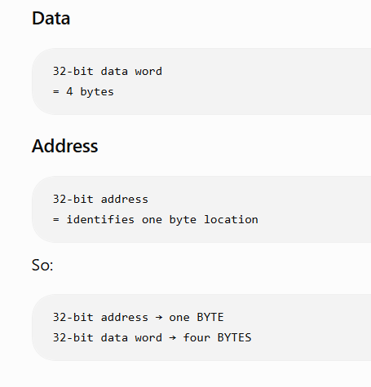
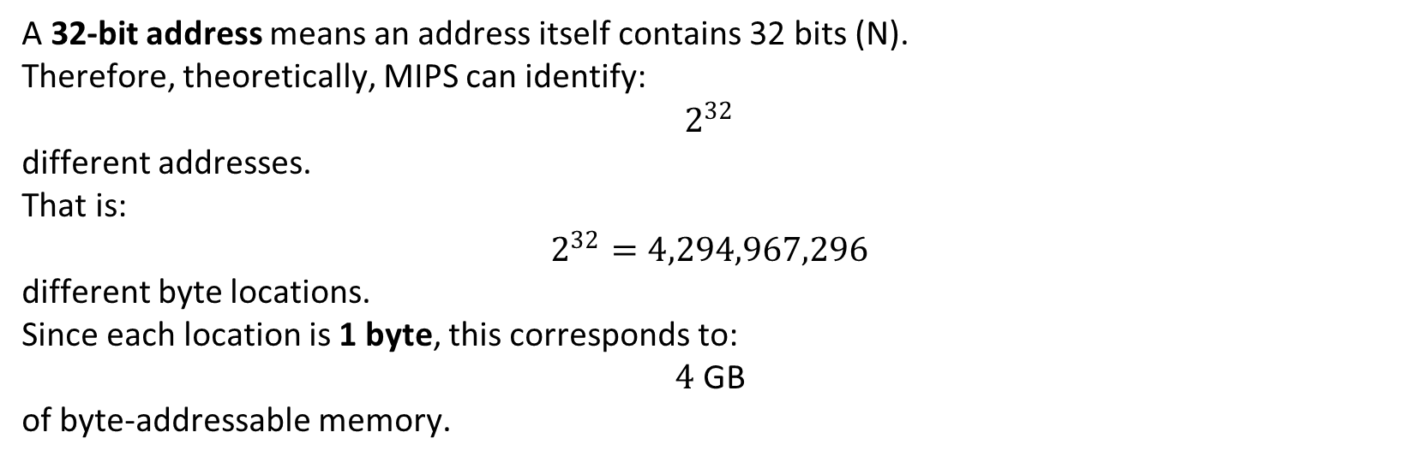
DIGITAL LOGIC & COMPUTER DESIGN
Memory organization
A 32-bit address means an address itself contains 32 bits (N).
Therefore, theoretically, MIPS can identify:
$$2^{32}$$
different addresses.
That is:
$$2^{32}=4,294,967,296$$
different byte locations.
Since each location is 1 byte, this corresponds to:
$$4\text{ GB}$$
of byte-addressable memory.

Slide 21
DIGITAL LOGIC & COMPUTER DESIGN
Memory organization
Let's take a real example
Suppose memory contains:
Address Data
------- ----
1000 AA
1001 BB
1002 CC
1003 DD
These four bytes together form one 32-bit word:
AA BB CC DD
Therefore:
Address 1000 ─┐
Address 1001 │
Address 1002 ├──→ one 32-bit word
Address 1003 ─┘
The next 32-bit word starts at address:
1004
This is why MIPS addresses often increase by 4
Suppose you have an array of 32-bit integers:
int A[0]
int A[1]
int A[2]
int A[3]……..int A[31]
Each integer is 4 bytes.
Therefore:
A[0] → address 0
A[1] → address 4
A[2] → address 8
A[3] → address 12
Notice:
0 → 4 → 8 → 12
not
0 → 1 → 2 → 3
because each integer occupies 4 bytes.

Slide 22
DIGITAL LOGIC & COMPUTER DESIGN
Memory organization: Word-Addressable Memory
Word-Addressable Memory: A word-addressable memory is a memory organization in which each memory address refers to one complete word. A word is the natural unit of data processed by the processor.
For a 32-bit processor:
1 Word = 32 bits = 4 Bytes
Each address stores one complete 32-bit word.
Memory addresses increase by 1 word.
Characteristics
One address points to one entire word.
Efficient for processors that mainly operate on full words.
Individual bytes cannot be directly addressed.

Slide 23
DIGITAL LOGIC & COMPUTER DESIGN
Memory organization: Word-Addressable Memory
Example:
Address | Stored data
0 | Word 0
1 | Word 1
2 | Word 2
Key Point: In word-addressable memory, Address 2 means the third word, not the third byte.

Slide 24
DIGITAL LOGIC & COMPUTER DESIGN
Reading Word-Addressable Memory
Reading data from memory is called a Load operation.
MIPS uses the instruction:
lw destination, offset(base)
where:
lw → Load Word
destination → Register that receives the data
base → Starting memory address
offset → Displacement added to the base address
Address Calculation:
Effective Address=Base Register+Offset

Slide 25
DIGITAL LOGIC & COMPUTER DESIGN
Reading Word-Addressable Memory
Example:
lw $s0, 5($t1)
If, $t1 = 20
Then, Address = 20 + 5 = 25
The word stored at address 25 is loaded into $s0.

Slide 26
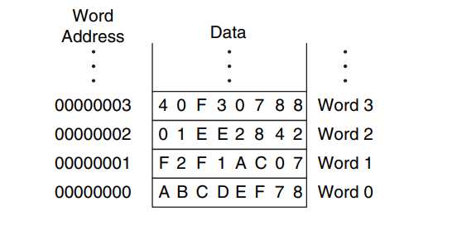
DIGITAL LOGIC & COMPUTER DESIGN
Reading Word-Addressable Memory: Example
Example:
lw $s3, 1($0)
Step 1: Base Register, $0 = 0
Step 2: Offset: 1
Step 3: Effective Address, 0 + 1 = 1
Step 4: The processor reads the contents of Memory Word 1.
$s3 = 0xF2F1AC07
Observation:
Only one instruction is needed to transfer an entire 32-bit word from memory to a register.

Slide 27
DIGITAL LOGIC & COMPUTER DESIGN
Writing Word-Addressable Memory
Writing data into memory is called a Store operation.
MIPS uses the instruction:
sw source, offset(base)
where:
sw → Store Word
source → Register containing data
base → Base memory address
offset → Address displacement
Address Calculation:
Effective Address=Base Register+Offset
The value from the register is copied into the calculated memory location.

Slide 28
DIGITAL LOGIC & COMPUTER DESIGN
Writing Word-Addressable Memory: Example
Example:
sw $t4, 0x7($0) #write the value in $t4 to memory word 7
Step 1: Base Address, $0 = 0
Step 2: Offset, 0x7 = 7
Step 3: Effective Address, 0 + 7 = 7
Result:
The value stored in $t4 is written into Memory Word 7.

Slide 29
DIGITAL LOGIC & COMPUTER DESIGN
Memory Organization: Byte-Addressable Memory
Byte-Addressable Memory: A byte-addressable memory is a memory organization in which each memory address refers to one byte (8 bits) of data.
For a 32-bit processor:
1 Byte = 8 bits
1 Word = 32 bits = 4 Bytes
Therefore, one 32-bit word occupies four consecutive byte addresses.
Characteristics:
• Each address identifies exactly one byte.
• Memory addresses increase by 1 byte at a time.
• MIPS uses byte-addressable memory.

Slide 30
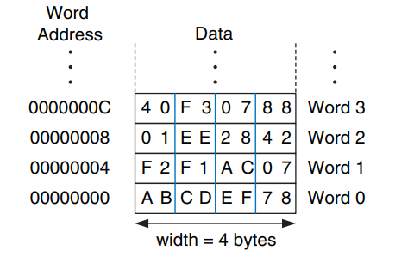
DIGITAL LOGIC & COMPUTER DESIGN
Memory Organization: Byte-Addressable Memory
A 32-bit word consists of four 8-bit bytes. So each word address is a multiple of 4, as shown in Figure 6.2. Again, both the 32-bit word address and the data value are given in hexadecimal.

Slide 31
DIGITAL LOGIC & COMPUTER DESIGN
Byte-Addressable Memory: Example
Example:
Suppose one 32-bit word contains 0xF2F1AC07.
In byte-addressable memory, this word occupies four consecutive byte addresses.
Byte Address | Meaning
0x04 – 0x07 | Four bytes belonging to one 32-bit word (0xF2F1AC07)
0x08 | Starting byte address of the next word
0x0C | Starting byte address of the following word
Key Point: The next 32-bit word begins at address 0x08, because each word occupies 4 bytes.

Slide 32
DIGITAL LOGIC & COMPUTER DESIGN
Reading Byte-Addressable Memory
Example:
lw $s3, 4($0)
Step 1: Base register, $0 = 0
Step 2: Offset = 4
Step 3: Effective address = 0 + 4 = 4
Step 4: The processor reads the four bytes stored at addresses 4, 5, 6, and 7.
Result: The four bytes are combined to form one 32-bit word and loaded into $s3.
Observation: In MIPS, the offset in lw and sw is measured in bytes, not in words.

Slide 33
DIGITAL LOGIC & COMPUTER DESIGN
Word-Addressable vs Byte-Addressable Memory
Comparison:
• In word-addressable memory, one address refers to one complete word.
• In byte-addressable memory, one address refers to exactly one byte.
• In a 32-bit system, one word occupies 1 address in word-addressable memory but 4 consecutive addresses in byte-addressable memory.
• Word addresses increase by 1 word, whereas byte addresses increase by 1 byte.
• Byte-addressable memory is more flexible because individual bytes can also be accessed independently.
Key Point: MIPS uses byte-addressable memory, so consecutive 32-bit words begin at addresses such as 0, 4, 8, 12.
"A MIPS word is 32 bits or 4 bytes, but MIPS assigns an address to every byte, not every word. Therefore, one 32-bit word occupies four consecutive memory addresses."

Slide 34

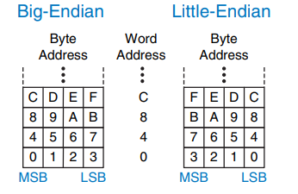
DIGITAL LOGIC & COMPUTER DESIGN
Big–Endian & Little–Endian Example
• How to number bytes within a word?
• Little-endian: byte numbers start at the little (least significant) end
• Big-endian: byte numbers start at the big (most significant) end
• Word address is the same for big- or little-endian
Big-Endian

Slide 35
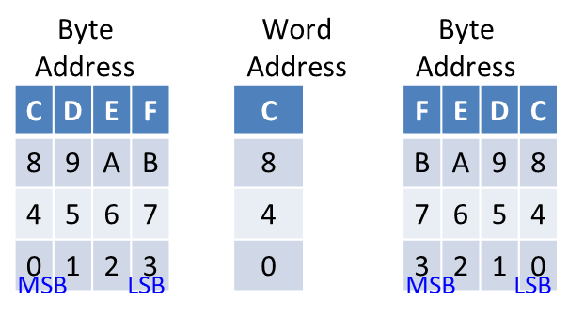
DIGITAL LOGIC & COMPUTER DESIGN
Big–Endian & Little–Endian Example
• Jonathan Swift’s Gulliver’s Travels: the Little-Endians broke their eggs on the little end of the egg and the Big-Endians broke their eggs on the big end.
• It doesn’t really matter which addressing type is used – except when the two systems need to share data!
Big-Endian

Slide 36
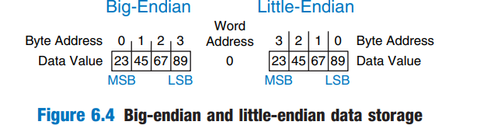
DIGITAL LOGIC & COMPUTER DESIGN
Big–Endian & Little–Endian Example
Suppose $t0 initially contains 0x23456789
After following code runs on big–endian system, what value is in $s0?
In a little–endian system?
sw $t0, 0($0) // It stores the entire 32-bit value 0x23456789 starting at byte address 0.
lb $s0, 1($0)
Big–endian: 0x00000045
Little–endian: 0x00000067

Slide 37
DIGITAL LOGIC & COMPUTER DESIGN
Design principle - 4
Good Design Demands Good Compromises
  Processor design involves balancing performance, cost, power consumption, and hardware complexity.
  Improving one aspect of a system often requires sacrificing another; therefore, practical designs rely on carefully chosen trade-offs.
  MIPS adopts a Reduced Instruction Set Computer (RISC) architecture by using a small set of simple instructions instead of many complex ones.
  This simplifies hardware implementation, improves execution speed, and reduces power consumption.
  An effective computer architecture achieves the best overall balance rather than optimizing a single parameter.

Slide 38
DIGITAL LOGIC & COMPUTER DESIGN
Design principle - 4
Example
RISC (MIPS):
    Simple instructions
    Faster execution
    Simpler hardware
CISC (x86):
    Complex instructions
    More hardware complexity
    Fewer instructions per program

Slide 39
DIGITAL LOGIC & COMPUTER DESIGN
Operands: Constant (Immediate)
Immediate Operands
Constants are values embedded directly within the instruction, so they are immediately available during execution.
MIPS uses a 16-bit signed (two's complement) field to represent immediate values.
Immediate operands eliminate the need to load small constants from memory, reducing the number of instructions.
Immediate Instructions
addi (Add Immediate): Adds a constant directly to the value in a register.
andi, ori, xori: Perform bitwise operations using immediate constants.

Slide 40
DIGITAL LOGIC &COMPUTER DESIGN
Operands: Constant (Immediate)
Why is there no subi instruction?
MIPS does not require a separate subi instruction because subtraction can be performed by adding a negative immediate.
Example:
addi $s1, $s0, -12
This instruction is equivalent to:
b = a - 12;
Key Point
Immediate instructions improve efficiency by encoding small constants directly in the instruction, avoiding an extra memory access or register for the constant.

Slide 41
DIGITAL LOGIC & COMPUTER DESIGN
Operands: Constant (Immediate)
C Code: MIPS Assembly code:
# $s0 = a, $s1 = b
a = a + 4; addi $s0, $s0, 4
b = a – 12; addi $s1, $s0, –12
Instruction Explanation:
addi $s0, $s0, 4 #Adds the immediate value 4 to $s0.
  Result: $s0 = $s0 + 4 (a = a + 4)
addi $s1, $s0, -12 #Adds −12 to $s0 and stores the result in $s1.
  Result: $s1 = $s0 - 12 (b = a - 12)
Note: addi uses a 16-bit signed immediate, so subtraction is performed by adding a negative value.

Slide 42
DIGITAL LOGIC & COMPUTER DESIGN
Think About It - 1
Example 6.1 TRANSLATING HIGH-LEVEL CODE TO ASSEMBLY LANGUAGE Translate the following high-level code into assembly language. Assume variables a–c are held in registers $s0–$s2 and f–j are in $s3–$s7.
a = b – c;
f = (g + h) − (i + j);
© Elsevier, Digital Design and Computer Architecture, 2nd Ed., 2012.

Slide 43
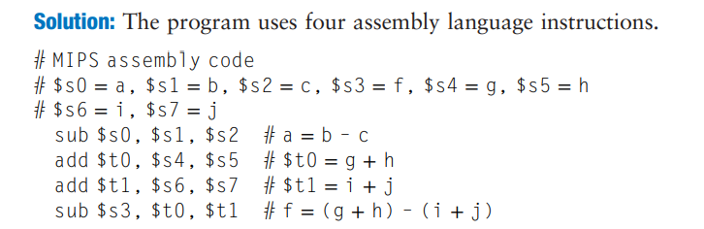
DIGITAL LOGIC & COMPUTER DESIGN
Think About It - 1
Example 6.1 TRANSLATING HIGH-LEVEL CODE TO ASSEMBLY LANGUAGE Translate the following high-level code into assembly language. Assume variables a–c are held in registers $s0–$s2 and f–j are in $s3–$s7.
a = b – c;
f = (g + h) − (i + j);
© Elsevier, Digital Design and Computer Architecture, 2nd Ed., 2012.

Slide 44
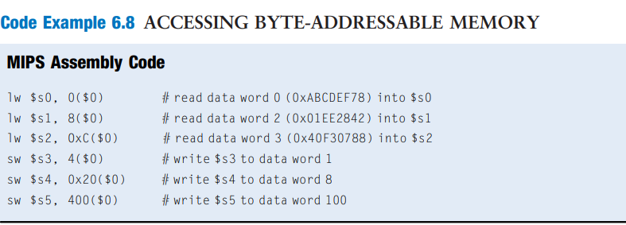
DIGITAL LOGIC & COMPUTER DESIGN
Think About It - 2
The code shows how to read and write words in the MIPS byte-addressable memory. The word address is four times the word number. The MIPS assembly code reads words 0, 2, and 3 and writes words 1, 8, and 100. The offset can be written in decimal or hexadecimal.
© Elsevier, Digital Design and Computer Architecture, 2nd Ed., 2012.

Slide 45
DIGITAL LOGIC & COMPUTER DESIGN
Think About It - 3
Using the instructions learnt so far (add and sub), can you write a program (sequence of instructions) that would left shift a number (stored in some register) by three bit positions? How many registers do you need?
© Elsevier, Digital Design and Computer Architecture, 2nd Ed., 2012.

Slide 46
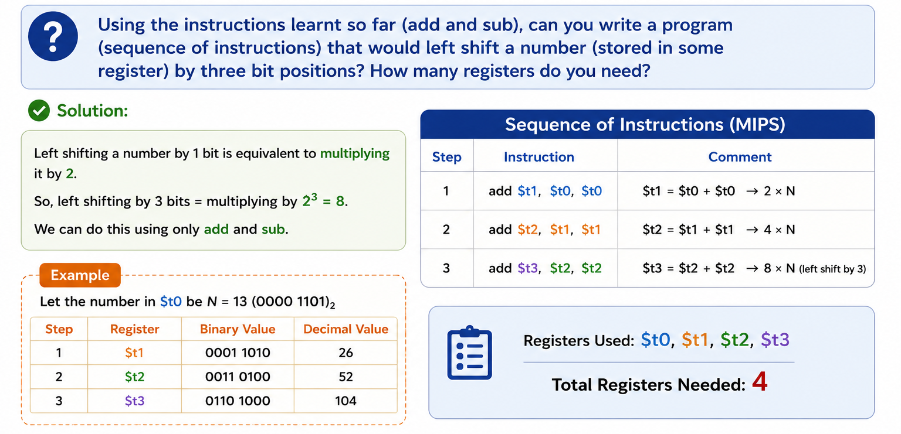
DIGITAL LOGIC & COMPUTER DESIGN
Think About It - 3
© Elsevier, Digital Design and Computer Architecture, 2nd Ed., 2012.

Slide 47
DIGITAL LOGIC & COMPUTER DESIGN
Think about it - 4
By writing just an assembly language program, can you determine if the processor it is running on is Big–Endian or Little–Endian?
What if the processor has no load byte and store byte instructions?

Slide 48
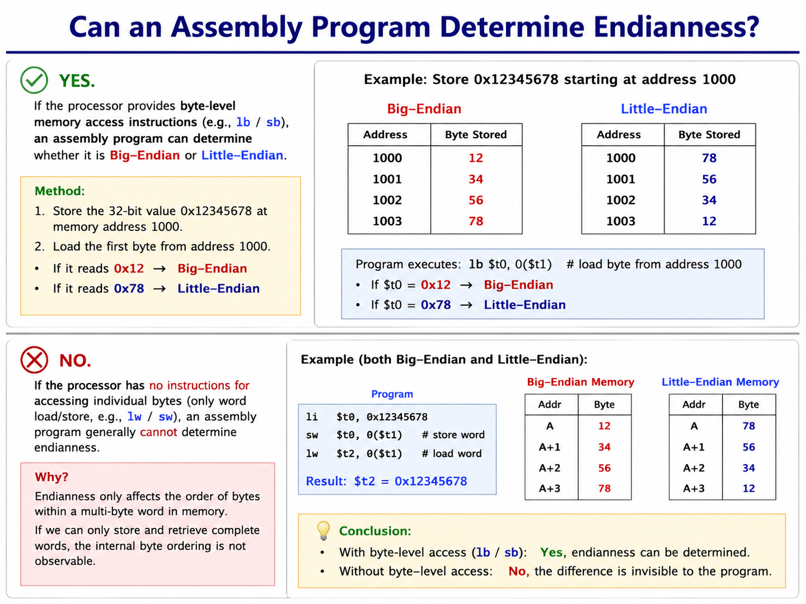
DIGITAL LOGIC & COMPUTER DESIGN
Think about it - 4

Slide 49
DIGITAL LOGIC & COMPUTER DESIGN
MCQ
  Q1.An operand stored in memory is accessed using which instructions in MIPS?
A) add and sub
B) lw and sw
C) beq and j
D) and and or

Slide 50
DIGITAL LOGIC & COMPUTER DESIGN
MCQ
  Q2. Memory is primarily used to store:
A) Frequently used temporary values only
B) Large amounts of data and programs
C) CPU clock signals
D) ALU outputs only

Slide 51
DIGITAL LOGIC & COMPUTER DESIGN
MCQ
  Q3. In byte-addressable memory, each memory address represents:
A) One bit
B) One byte
C) One word
D) Eight bytes

Slide 52
DIGITAL LOGIC & COMPUTER DESIGN
MCQ
  Q4. In word-addressable memory, each memory address represents:
A) One bit
B) One byte
C) One word
D) Eight bytes

Slide 53
DIGITAL LOGIC & COMPUTER DESIGN
MCQ
  Q5. An operand that is directly specified within an instruction is called a:
A) Memory operand
B) Register operand
C) Constant (Immediate) operand
D) Address operand

Slide 54
DIGITAL LOGIC & COMPUTER DESIGN
MCQ
  Q6. Which statement correctly distinguishes word-addressable and byte-addressable memory?
A) Both assign one address per word.
B) Both assign one address per byte.
C) Word-addressable memory assigns one address per word, while byte-addressable memory assigns one address per byte.
D) Byte-addressable memory cannot store words.

Slide 55
DIGITAL LOGIC & COMPUTER DESIGN
MCQ
Answer Key
Q1: B Q2: B Q3: B Q4: C Q5: C Q6: C

Slide 56
THANK YOU
Team DLCD
Department of CSE and CSE(AI & ML)

