Slide 1

UE25CS251A
DIGITAL LOGIC AND COMPUTER DESIGN
TEAM DLCD
Department of CSE and CSE (AI & ML)

Slide 2

DIGITAL LOGIC AND COMPUTER DESIGN
ARCHITECTURE-Machine Language
TEAM DLCD
Department of CSE and CSE (AI & ML)

Slide 3

DIGITAL LOGIC AND COMPUTER DESIGN
TOPICS
Machine Language
R, I & J-Type Instructions
Instruction Formats
Logical Instructions
Shift Instructions
Stored Program
Machine Code Interpretation
Programming
© Elsevier, Digital Design and Computer Architecture, 2nd Ed., 2012.

Slide 4
DIGITAL LOGIC AND COMPUTER DESIGN
Machine Language
Binary representation of instructions
Computers only understand 1’s and 0’s
32–bit instructions
  Simplicity favors regularity: 32–bit data & instructions
3 instruction formats:
R – Type: register operands
I – Type: immediate operands
J – Type: for jumping (discuss later)
© Elsevier, Digital Design and Computer Architecture, 2nd Ed., 2012.

Slide 5
DIGITAL LOGIC AND COMPUTER DESIGN
Machine Language: Big Picture
• A MIPS instruction is a 32-bit binary pattern stored in memory.
• The processor does not see add or lw; it only sees fields inside those 32 bits.
• Always read the opcode first, then decide whether the instruction is R-type, I-type, or J-type.
• The remaining fields tell the CPU which registers, constant, or address to use.
• TA shortcut: format first, meaning next.
32-bit
instruction
Split into
fields
CPU
acts
Example: 001000 ... → opcode = addi →
interpret remaining bits as rs, rt, imm c
(I-type) instruction
© Elsevier, Digital Design and Computer Architecture, 2nd Ed., 2012.

Slide 6
DIGITAL LOGIC AND COMPUTER DESIGN
Instruction Formats at a Glance
Format | Used for | Important fields | Quick memory rule
R-type | Register-register ALU ops | rs, rt, rd, funct | No immediate; funct decides exact op
I-type | Immediate, load/store, branch | rs, rt, imm | 16-bit immediate/offset is present
J-type | Jump instructions | addr | 26-bit jump target
Fast decoding order: opcode → format → field meaning → final assembly instruction
© Elsevier, Digital Design and Computer Architecture, 2nd Ed., 2012.

Slide 7
DIGITAL LOGIC AND COMPUTER DESIGN
R-Type: Decode in 4 Steps
• R-type is used when the operands are mainly registers.
• If opcode = 000000, the instruction is R-type.
• rs and rt are usually the source registers; rd is the destination.
• funct chooses the exact ALU action such as add, sub, and, or, or shift.
op
rs
rt
rd
shamt
funct
Example: add $s0, $s1, $s2
rs = $s1, rt = $s2, rd = $s0, funct = 100000
Memory tip: destination comes first in assembly, but is stored in rd.
© Elsevier, Digital Design and Computer Architecture, 2nd Ed., 2012.

Slide 8
DIGITAL LOGIC AND COMPUTER DESIGN
R – Type
Register – type
3 register operands
rs, rt: source registers
rd: destination register
Other fields:
op: the operation code or the opcode (0 for R–type instructions)
funct: the function with opcode tells computer what operation to perform
shamt: the shift amount for shift instructions, otherwise 0.
Eg:For example, the opcode and funct fields for the add instruction are 0 (000000₂) and 32 (100000₂), respectively. Similarly, the sub instruction has an opcode and funct field of 0 and 34.
R–Type
op | rs | rt | rd | shamt | funct
6 bits
5 bits
5 bits
5 bits
5 bits
6 bits
© Elsevier, Digital Design and Computer Architecture, 2nd Ed., 2012.

Slide 9
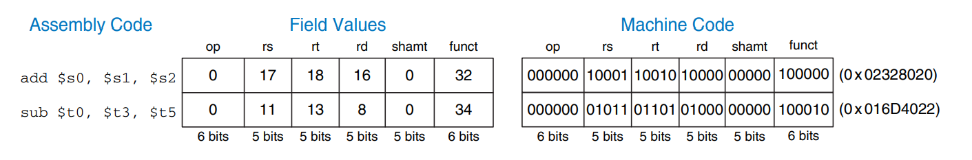
DIGITAL LOGIC AND COMPUTER DESIGN
R – Type Examples
The machine code for the R-type instructions add and sub.
Notice that the destination is the first register in an assembly language instruction,
but it is the third register field (rd) in the machine language instruction.
For example, the assembly instruction add $s0, $s1, $s2 has
rs = $s1 (17),
rt = $s2 (18),
rd = $s0 (16).
© Elsevier, Digital Design and Computer Architecture, 2nd Ed., 2012.

Slide 10
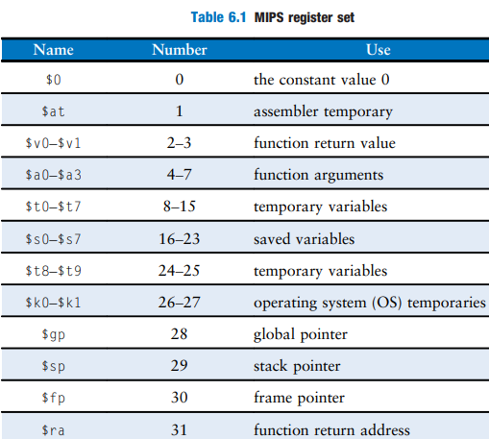
DIGITAL LOGIC AND COMPUTER DESIGN
R – Type Examples
Example 6.3 TRANSLATING ASSEMBLY LANGUAGE TO MACHINE LANGUAGE Translate the following assembly language statement into machine language. \
add $t0, $s4, $s5
Solution: According to Table 6.1, $t0, $s4, and $s5 are registers 8, 20, and 21.
According to Tables B.1 and B.2, add has an opcode of 0 and a funct code of 32.
The easiest way to write the machine language in hexadecimal is to first write it in binary, then look at consecutive groups of four bits, which correspond to hexadecimal digits (indicated in blue). Hence, the machine language instruction is 0x02954020.
© Elsevier, Digital Design and Computer Architecture, 2nd Ed., 2012.

Slide 11
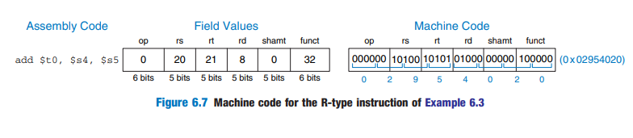
DIGITAL LOGIC AND COMPUTER DESIGN
R – Type Examples
Example 6.3 TRANSLATING ASSEMBLY LANGUAGE TO MACHINE LANGUAGE Translate the following assembly language statement into machine language.
add $t0, $s4, $s5
© Elsevier, Digital Design and Computer Architecture, 2nd Ed., 2012.

Slide 12
DIGITAL LOGIC AND COMPUTER DESIGN
I – Type
Immediate – type
2 register & 1 immediate (constant) operands
rs, rt: register operands
imm: 16–bit immediate for +ve number and 2’s complement for –ve number
Other fields:
op: the operation code or the opcode
Simplicity favors regularity: all instructions have opcode.
Operation is completely determined by opcode.
rs and imm are always used as source operands.
rt is used as a destination for some instructions (such as addi and lw) but as another source for others (such as sw).
I-Type
op | rs | rt | imm
6 bits
5 bits
5 bits
16 bits
© Elsevier, Digital Design and Computer Architecture, 2nd Ed., 2012.

Slide 13
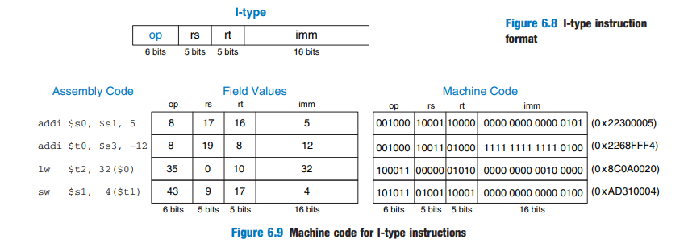
DIGITAL LOGIC AND COMPUTER DESIGN
I – Type Examples
© Elsevier, Digital Design and Computer Architecture, 2nd Ed., 2012.

Slide 14
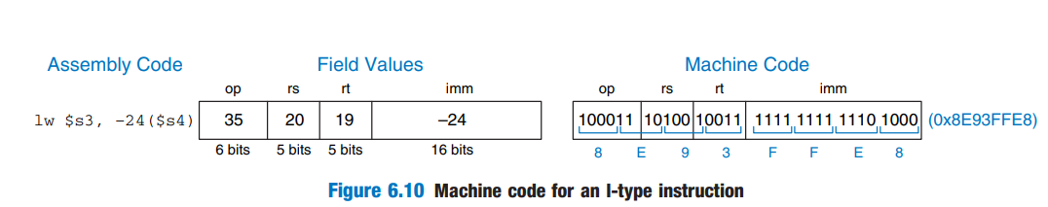
DIGITAL LOGIC AND COMPUTER DESIGN
I – Type Examples
Translate the following I-type instruction into machine code.
lw $s3, −24($s4)
Solution: According to Table 6.1, $s3 and $s4 are registers 19 and 20, respectively. Table B.1 indicates that lw has an opcode of 35.
rs specifies the base address, $s4,
and rt specifies the destination register, $s3.
The immediate, imm, encodes the 16-bit offset, −24. The fields and machine code are given in Figure 6.10.
© Elsevier, Digital Design and Computer Architecture, 2nd Ed., 2012.

Slide 15
DIGITAL LOGIC AND COMPUTER DESIGN
I – Type Examples
NOTE: I-type instructions have a 16-bit immediate field, but the immediates are used in 32-bit operations. For example, lw adds a 16-bit offset to a 32-bit base register.
What should go in the upper half of the 32 bits?
For positive immediates, the upper half should be all 0’s,
but for negative immediates, the upper half should be all 1’s.
© Elsevier, Digital Design and Computer Architecture, 2nd Ed., 2012.

Slide 16
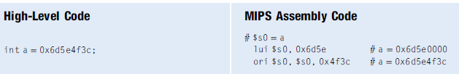
DIGITAL LOGIC AND COMPUTER DESIGN
I – Type Examples
The addi instruction is helpful for assigning 16–bit constants.
To assign 32–bit constants, use a load upper immediate instruction (lui) followed by an or immediate (ori) instruction as shown in code.
© Elsevier, Digital Design and Computer Architecture, 2nd Ed., 2012.

Slide 17
DIGITAL LOGIC AND COMPUTER DESIGN
I-Type: Immediate, Load/Store, and Branch
• Format: op | rs | rt | imm
• imm is a 16-bit constant or address offset.
• For addi and lw, rt is usually the destination register.
• For sw, rt is the value that will be stored to memory.
• addi/lw/sw use sign extension; andi/ori/xori use zero extension.
Instruction | Read it as
addi $s0, $s1, 5 | $s0 = $s1 + 5
lw $t2, 32($0) | $t2 = Memory[$0 + 32]
sw $s1, 4($t1) | Memory[$t1 + 4] = $s1
Exam check: in load/store, rs = base register, imm = offset.
© Elsevier, Digital Design and Computer Architecture, 2nd Ed., 2012.

Slide 18
DIGITAL LOGIC AND COMPUTER DESIGN
J – Type
Jump – type
26–bit address operand (addr)
Used for jump instructions (j)
J -Type
op
addr
6 bits
26 bits
© Elsevier, Digital Design and Computer Architecture, 2nd Ed., 2012.

Slide 19
DIGITAL LOGIC AND COMPUTER DESIGN
Review: Instruction Formats
R-Type
op | rs | rt | rd | shamt | funct
6 bits
5 bits
^{5 bits 5 bits} 5 bits
I-Type
6 bits
op | rs | rt | imm
6 bits
5 bits
5 bits
16 bits
J -Type
op
addr
6 bits
26 bits
© Elsevier, Digital Design and Computer Architecture, 2nd Ed., 2012.

Slide 20
DIGITAL LOGIC AND COMPUTER DESIGN
Interpreting Machine Code
To interpret machine language, one must decipher the fields of each 32-bit instruction word.
Different instructions use different formats, but all formats start with a 6-bit opcode field.
Thus, the best place to begin is to look at the opcode. If it is 0, the instruction is R-type.
otherwise it is I-type or J-type.
© Elsevier, Digital Design and Computer Architecture, 2nd Ed., 2012.

Slide 21
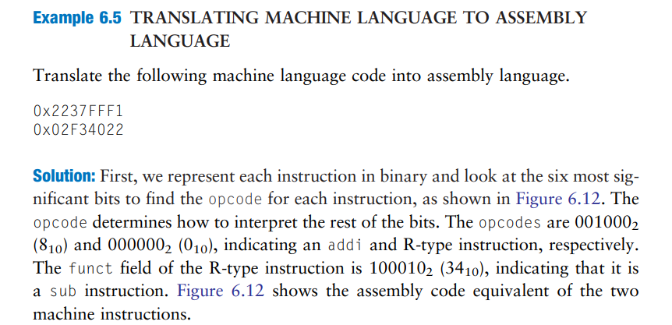
DIGITAL LOGIC AND COMPUTER DESIGN
Interpreting Machine Code
© Elsevier, Digital Design and Computer Architecture, 2nd Ed., 2012.

Slide 22
DIGITAL LOGIC AND COMPUTER DESIGN
Machine Code Decoding Strategy
• Step 1: Read the opcode.
• Step 2: If opcode = 0, treat it as R-type and inspect funct.
• Step 3: Otherwise, use the opcode itself to identify the I-type or J-type instruction.
• Step 4: Convert register numbers carefully to register names.
• Step 5: Interpret the immediate as signed or unsigned based on the instruction.
Worked example: 001000 10001 10111 1111111111110001
Field | Value | Meaning
opcode | 001000 | addi
rs | 10001 | $s1
rt | 10111 | $s7
imm | 1111...0001 | -15
Final answer: addi $s7, $s1, -15
© Elsevier, Digital Design and Computer Architecture, 2nd Ed., 2012.

Slide 23
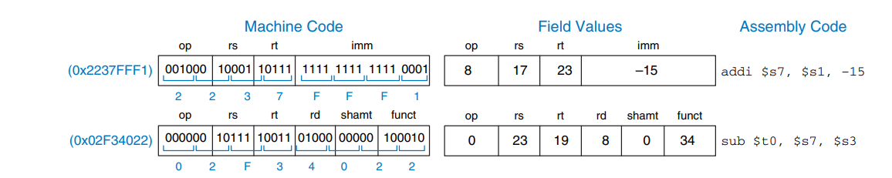
DIGITAL LOGIC AND COMPUTER DESIGN
Interpreting Machine Code
© Elsevier, Digital Design and Computer Architecture, 2nd Ed., 2012.

Slide 24
DIGITAL LOGIC AND COMPUTER DESIGN
Review: The Stored Program Concept
What is a Stored Program?
A program is stored in main memory as machine code (binary instructions).
Each instruction occupies a unique memory address.
The processor executes instructions one at a time in sequence.
Machine Code:
Executed directly by the CPU.
Represented in binary or hexadecimal format.
Difficult for humans to read and write.
Example: 0x8C0A0020
© Elsevier, Digital Design and Computer Architecture, 2nd Ed., 2012.

Slide 25
DIGITAL LOGIC AND COMPUTER DESIGN
Review: The Stored Program Concept
Assembly Code:
Human-readable representation of machine instructions.
Uses mnemonics (e.g., lw, add, sub) instead of binary.
Easier to write, understand, and debug.
Example: lw $t2, 32($0)
Program Counter (PC):
The Program Counter (PC) is a special register that stores the address of the next instruction to be executed.
After an instruction is fetched, the PC is normally incremented by 4 bytes (for MIPS 32-bit instructions).
Branch and jump instructions modify the PC to execute instructions from a different location.
Key point: A stored-program computer keeps both instructions and data in memory. The CPU uses the Program Counter (PC) to fetch and execute instructions sequentially unless a branch or jump changes the execution flow.
© Elsevier, Digital Design and Computer Architecture, 2nd Ed., 2012.

Slide 26
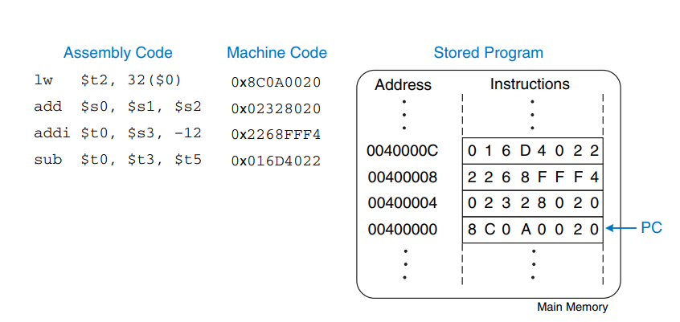
DIGITAL LOGIC AND COMPUTER DESIGN
Review: The Stored Program Concept
© Elsevier, Digital Design and Computer Architecture, 2nd Ed., 2012.
Main Memory

Slide 27
DIGITAL LOGIC AND COMPUTER DESIGN
MCQ
• Q1. An operand stored in memory is accessed using which instructions in MIPS?
A) add and sub
B) lw and sw
C) beq and j
D) and and or
© Elsevier, Digital Design and Computer Architecture, 2nd Ed., 2012.

Slide 28
DIGITAL LOGIC AND COMPUTER DESIGN
MCQ
• Q2. In an R-type instruction, which field identifies the exact ALU operation when opcode = 0?
A) imm
B) funct
C) shamt
D) addr
© Elsevier, Digital Design and Computer Architecture, 2nd Ed., 2012.

Slide 29
DIGITAL LOGIC AND COMPUTER DESIGN
MCQ
• Q3. Which set of immediate instructions uses zero extension?
A) addi, lw, sw
B) andi, ori, xori
C) beq, bne
D) j
© Elsevier, Digital Design and Computer Architecture, 2nd Ed., 2012.

Slide 30
DIGITAL LOGIC AND COMPUTER DESIGN
MCQ
• Q4. In sra, the new most significant bits are filled using:
A) 0s
B) sign bit
C) funct bits
D) shamt bits
© Elsevier, Digital Design and Computer Architecture, 2nd Ed., 2012.

Slide 31
DIGITAL LOGIC AND COMPUTER DESIGN
MCQ
• Q5. In sllv rd, rt, rs, the shift amount comes from:
A) shamt field
B) lower 5 bits of rs
C) lower 5 bits of rt
D) opcode
© Elsevier, Digital Design and Computer Architecture, 2nd Ed., 2012.

Slide 32
DIGITAL LOGIC AND COMPUTER DESIGN
MCQ
• Q6. Which instruction format is used by j?
A) R-type
B) I-type
C) J-type
D) depends on funct
© Elsevier, Digital Design and Computer Architecture, 2nd Ed., 2012.

Slide 33
DIGITAL LOGIC AND COMPUTER DESIGN
MCQ
Answer Key
Q1: B Q2: B Q3: B Q4: B Q5: B Q6: C
© Elsevier, Digital Design and Computer Architecture, 2nd Ed., 2012.

Slide 34

THANK YOU
Team DLCD
Department of CSE and CSE(AI & ML)

