Slide 1

Stack Application: Expression Conversion and Evaluation
Data Structures and its Applications
N S Kumar
Professor
Department of Computer Science & Engineering (AI & ML)
B.TECH » DEPARTMENT OF COMPUTER SCIENCE & ENGINEERING (AI & ML) » DATA STRUCTURES AND ITS APPLICATIONS » UE25CS252A » UNIT 1 » STACK APPLICATION: EXPRESSION CONVERSION AND EVALUATION » CLASS 10/11
© Confidential Information of PES University. All Rights Reserved - 2026
1 / 23

Slide 2
Stack Application: Expression Conversion and Evaluation
Quiz 1: Stack Application: expression conversion and evaluation
a = b = c
The equivalent expression in postfix is
a) a b = c =
b) a b c = =
c) c b = a =
d) c b a = =
B.TECH » DEPARTMENT OF COMPUTER SCIENCE & ENGINEERING (AI & ML) » DATA STRUCTURES AND ITS APPLICATIONS » UE25CS252A » UNIT 1 » STACK APPLICATION: EXPRESSION CONVERSION AND EVALUATION » CLASS 10/11
© Confidential Information of PES University. All Rights Reserved - 2026
2 / 23

Slide 3
Stack Application: Expression Conversion and Evaluation
Quiz 1: Stack Application: expression conversion and evaluation
a = b = c
The equivalent expression in postfix is
a) a b = c =
b) a b c = =
c) c b = a =
d) c b a = =
B.TECH » DEPARTMENT OF COMPUTER SCIENCE & ENGINEERING (AI & ML) » DATA STRUCTURES AND ITS APPLICATIONS » UE25CS252A » UNIT 1 » STACK APPLICATION: EXPRESSION CONVERSION AND EVALUATION » CLASS 10/11
© Confidential Information of PES University. All Rights Reserved - 2026
3 / 23

Slide 4
Stack Application: Expression Conversion and Evaluation
Quiz 2: Stack Application: expression conversion and evaluation
While evaluating an expression in postfix, we require
a) a stack of operators
b) a stack of operands
c) Stacks of operator and operands
d) None of these
B.TECH » DEPARTMENT OF COMPUTER SCIENCE & ENGINEERING (AI & ML) » DATA STRUCTURES AND ITS APPLICATIONS » UE25CS252A » UNIT 1 » STACK APPLICATION: EXPRESSION CONVERSION AND EVALUATION » CLASS 10/11
© Confidential Information of PES University. All Rights Reserved - 2026
4 / 23

Slide 5
Stack Application: Expression Conversion and Evaluation
Quiz 2: Stack Application: expression conversion and evaluation
While evaluating an expression in postfix, we require
a) a stack of operators
b) a stack of operands
c) Stacks of operator and operands
d) None of these
B.TECH » DEPARTMENT OF COMPUTER SCIENCE & ENGINEERING (AI & ML) » DATA STRUCTURES AND ITS APPLICATIONS » UE25CS252A » UNIT 1 » STACK APPLICATION: EXPRESSION CONVERSION AND EVALUATION » CLASS 10/11
© Confidential Information of PES University. All Rights Reserved - 2026
5 / 23

Slide 6
Stack Application: Expression Conversion and Evaluation
Quiz 3: Stack Application: expression conversion and evaluation
In a postfix expression,
a) Left parenthesis has the highest precedence
b) Right parenthesis has the highest precedence
c) There are no parentheses
d) None of these
B.TECH » DEPARTMENT OF COMPUTER SCIENCE & ENGINEERING (AI & ML) » DATA STRUCTURES AND ITS APPLICATIONS » UE25CS252A » UNIT 1 » STACK APPLICATION: EXPRESSION CONVERSION AND EVALUATION » CLASS 10/11
© Confidential Information of PES University. All Rights Reserved - 2026
6 / 23

Slide 7
Stack Application: Expression Conversion and Evaluation
Quiz 3: Stack Application: expression conversion and evaluation
In a postfix expression,
a) Left parenthesis has the highest precedence
b) Right parenthesis has the highest precedence
c) There are no parentheses
d) None of these
B.TECH » DEPARTMENT OF COMPUTER SCIENCE & ENGINEERING (AI & ML) » DATA STRUCTURES AND ITS APPLICATIONS » UE25CS252A » UNIT 1 » STACK APPLICATION: EXPRESSION CONVERSION AND EVALUATION » CLASS 10/11
© Confidential Information of PES University. All Rights Reserved - 2026
7 / 23

Slide 8
Stack Application: Expression Conversion and Evaluation
Quiz 4: Stack Application: expression conversion and evaluation
While converting an expression from infix to postfix,
a) Left parenthesis has the highest precedence in the input string
b) Left parenthesis has the highest precedence in the stack
c) Precedence of parentheses is same in the input string as well as in the stack
d) None of these
B.TECH » DEPARTMENT OF COMPUTER SCIENCE & ENGINEERING (AI & ML) » DATA STRUCTURES AND ITS APPLICATIONS » UE25CS252A » UNIT 1 » STACK APPLICATION: EXPRESSION CONVERSION AND EVALUATION » CLASS 10/11
© Confidential Information of PES University. All Rights Reserved - 2026
8 / 23

Slide 9
Stack Application: Expression Conversion and Evaluation
Quiz 4: Stack Application: expression conversion and evaluation
While converting an expression from infix to postfix,
a) Left parenthesis has the highest precedence in the input string
b) Left parenthesis has the highest precedence in the stack
c) Precedence of parentheses is same in the input string as well as in the stack
d) None of these
B.TECH » DEPARTMENT OF COMPUTER SCIENCE & ENGINEERING (AI & ML) » DATA STRUCTURES AND ITS APPLICATIONS » UE25CS252A » UNIT 1 » STACK APPLICATION: EXPRESSION CONVERSION AND EVALUATION » CLASS 10/11
© Confidential Information of PES University. All Rights Reserved - 2026
9 / 23

Slide 10
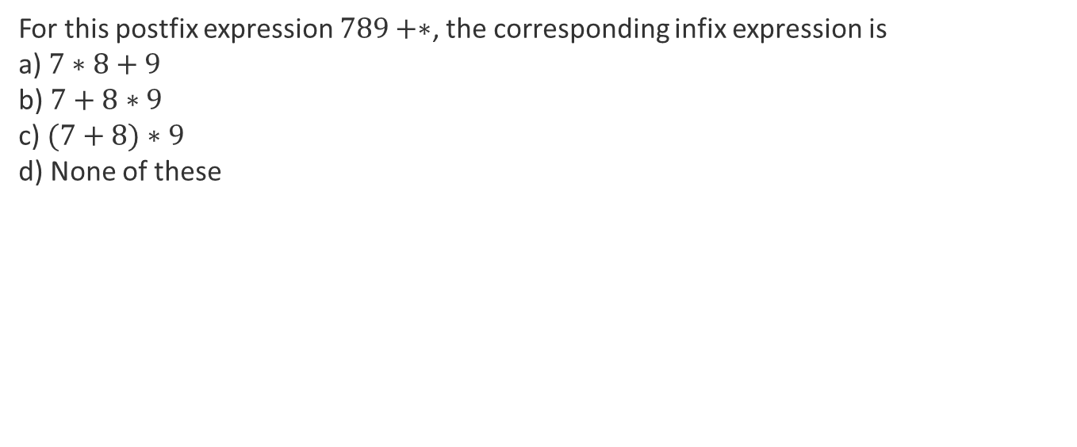
Stack Application: Expression Conversion and Evaluation
Quiz 5: Stack Application: expression conversion and evaluation
For this postfix expression $789+∗$, the corresponding infix expression is
a) $7∗8+9$
b) $7+8∗9$
c) $(7+8)∗9$
d) None of these
B.TECH » DEPARTMENT OF COMPUTER SCIENCE & ENGINEERING (AI & ML) » DATA STRUCTURES AND ITS APPLICATIONS » UE25CS252A » UNIT 1 » STACK APPLICATION: EXPRESSION CONVERSION AND EVALUATION » CLASS 10/11
© Confidential Information of PES University. All Rights Reserved - 2026
10 / 23

Slide 11
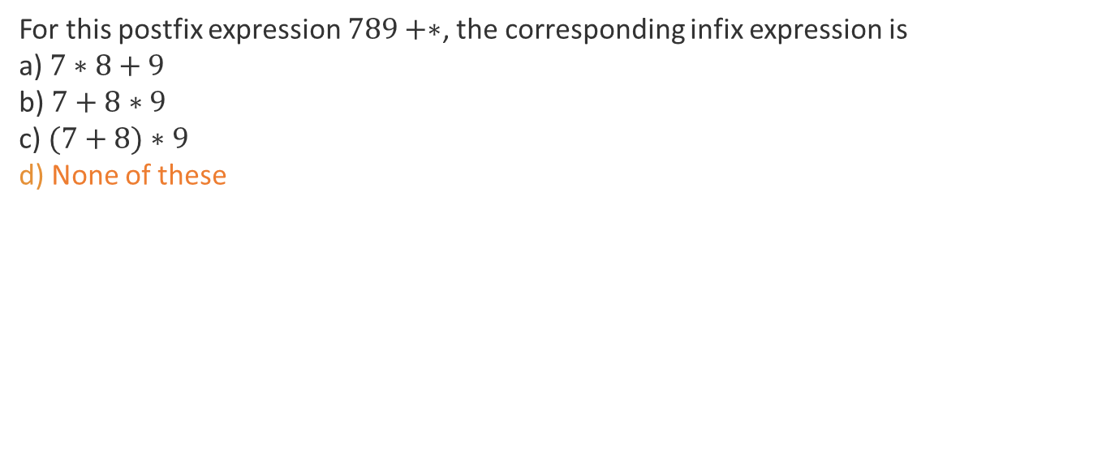
Stack Application: Expression Conversion and Evaluation
Quiz 5: Stack Application: expression conversion and evaluation
For this postfix expression $789+∗$, the corresponding infix expression is
a) $7∗8+9$
b) $7+8∗9$
c) $(7+8)∗9$
d) None of these
B.TECH » DEPARTMENT OF COMPUTER SCIENCE & ENGINEERING (AI & ML) » DATA STRUCTURES AND ITS APPLICATIONS » UE25CS252A » UNIT 1 » STACK APPLICATION: EXPRESSION CONVERSION AND EVALUATION » CLASS 10/11
© Confidential Information of PES University. All Rights Reserved - 2026
11 / 23

Slide 12
Stack Application: Expression Conversion and Evaluation
stack
Arithmetic expressions are easy for humans to write
parsing them in a program can be complicated.
Infix notation uses operators between operands: 3 + 4.
Postfix notation puts operators after operands: 3 4 +.
A stack makes postfix evaluation straightforward.
B.TECH » DEPARTMENT OF COMPUTER SCIENCE & ENGINEERING (AI & ML) » DATA STRUCTURES AND ITS APPLICATIONS » UE25CS252A » UNIT 1 » STACK APPLICATION: EXPRESSION CONVERSION AND EVALUATION » CLASS 10/11
© Confidential Information of PES University. All Rights Reserved - 2026
12 / 23

Slide 13
Stack Application: Expression Conversion and Evaluation
Why Expression Evaluation Is Complicated
BODMAS gives a familiar order: Brackets, Orders, Division, Multiplication, Addition, Subtraction.
Programming languages add many precedence levels and associativity rules.
Parentheses introduce nesting.
A useful alternative is a notation in which operators can be processed as soon as they are encountered.
B.TECH » DEPARTMENT OF COMPUTER SCIENCE & ENGINEERING (AI & ML) » DATA STRUCTURES AND ITS APPLICATIONS » UE25CS252A » UNIT 1 » STACK APPLICATION: EXPRESSION CONVERSION AND EVALUATION » CLASS 10/11
© Confidential Information of PES University. All Rights Reserved - 2026
13 / 23

Slide 14
Stack Application: Expression Conversion and Evaluation
Infix and postfix expressions
3 + 4 => 3 4 +
5 * 6 + 7 => 5 6 * 7 +
5 + 6 * 7 => 5 6 7 * +
(3 + 4) * (5 + 6) => 3 4 + 5 6 + *
Observe : no parentheses in postfix expression
B.TECH » DEPARTMENT OF COMPUTER SCIENCE & ENGINEERING (AI & ML) » DATA STRUCTURES AND ITS APPLICATIONS » UE25CS252A » UNIT 1 » STACK APPLICATION: EXPRESSION CONVERSION AND EVALUATION » CLASS 10/11
© Confidential Information of PES University. All Rights Reserved - 2026
14 / 23

Slide 15
Stack Application: Expression Conversion and Evaluation
Postfix Evaluation Using a Stack
Create a stack of operands.
Read the postfix expression from left to right.
Operand → push it onto the stack.
Operator → pop the required operands, perform the operation,
and push the result.
After the complete expression is processed, the stack contains
exactly one value: the result.
B.TECH » DEPARTMENT OF COMPUTER SCIENCE & ENGINEERING (AI & ML) » DATA STRUCTURES AND ITS APPLICATIONS » UE25CS252A » UNIT 1 » STACK APPLICATION: EXPRESSION CONVERSION AND EVALUATION » CLASS 10/11
© Confidential Information of PES University. All Rights Reserved - 2026
15 / 23

Slide 16
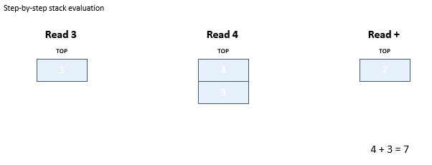
Stack Application: Expression Conversion and Evaluation
Example: 3 4 +
Final result = 7
B.TECH » DEPARTMENT OF COMPUTER SCIENCE & ENGINEERING (AI & ML) » DATA STRUCTURES AND ITS APPLICATIONS » UE25CS252A » UNIT 1 » STACK APPLICATION: EXPRESSION CONVERSION AND EVALUATION » CLASS 10/11
© Confidential Information of PES University. All Rights Reserved - 2026
16 / 23

Slide 17
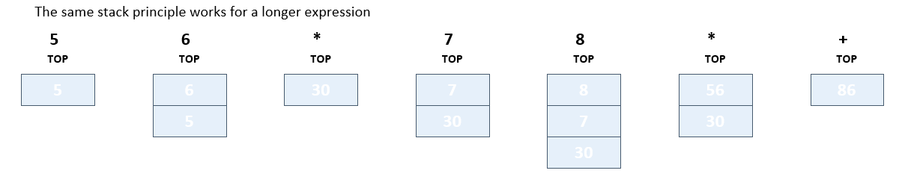
Stack Application: Expression Conversion and Evaluation
Example: 5 6 7 8 +
30 + 56 = 86 → Final result = 86
B.TECH » DEPARTMENT OF COMPUTER SCIENCE & ENGINEERING (AI & ML) » DATA STRUCTURES AND ITS APPLICATIONS » UE25CS252A » UNIT 1 » STACK APPLICATION: EXPRESSION CONVERSION AND EVALUATION » CLASS 10/11
© Confidential Information of PES University. All Rights Reserved - 2026
17 / 23

Slide 18
Stack Application: Expression Conversion and Evaluation
Postfix Evaluation: Algorithm
Read the postfix expression.
Create and initialize a stack of integers.
For each token:
if token is an operand:
push(token)
else if token is an operator:
val2 = pop()
val1 = pop()
result = val1 operator val2
push(result)
At the end:
result = pop()
the stack should now be empty.
B.TECH » DEPARTMENT OF COMPUTER SCIENCE & ENGINEERING (AI & ML) » DATA STRUCTURES AND ITS APPLICATIONS » UE25CS252A » UNIT 1 » STACK APPLICATION: EXPRESSION CONVERSION AND EVALUATION » CLASS 10/11
© Confidential Information of PES University. All Rights Reserved - 2026
18 / 23

Slide 19
Stack Application: Expression Conversion and Evaluation
Postfix Evaluation: order of evaluation
For + and *, operand order does not affect the result.
For – and /, it matters.
If the postfix expression is: 8 3 –
First pop gives val2 = 3; second pop gives val1 = 8.
Compute val1 – val2 = 8 – 3 = 5.
Never compute 3 – 8
B.TECH » DEPARTMENT OF COMPUTER SCIENCE & ENGINEERING (AI & ML) » DATA STRUCTURES AND ITS APPLICATIONS » UE25CS252A » UNIT 1 » STACK APPLICATION: EXPRESSION CONVERSION AND EVALUATION » CLASS 10/11
© Confidential Information of PES University. All Rights Reserved - 2026
19 / 23

Slide 20
Stack Application: Expression Conversion and Evaluation
Conversion from infix to postfix
Example: 5 * 6 + 7 * 8
Postfix form: 5 6 * 7 8 * +
Operands are sent directly to the output.
Relative positions of the operands is never changed
A stack of operators is required
Operators are temporarily stored on a stack.
The stack allows operators to be delayed
until their precedence requires them to be output
B.TECH » DEPARTMENT OF COMPUTER SCIENCE & ENGINEERING (AI & ML) » DATA STRUCTURES AND ITS APPLICATIONS » UE25CS252A » UNIT 1 » STACK APPLICATION: EXPRESSION CONVERSION AND EVALUATION » CLASS 10/11
© Confidential Information of PES University. All Rights Reserved - 2026
20 / 23

Slide 21
Stack Application: Expression Conversion and Evaluation
Conversion from infix to postfix
Associate a precedence value with each operator
Higher the precedence, higher the value
When an operator is encountered, we compare the precedence value of the operator in the string with that of the operator in the top of the stack
While the first one is higher, push the operator into the stack
Otherwise pop the operator from the stack and push the operator
in the string on to the stack
When the input string is completely processed, pop all the operators from the stack
B.TECH » DEPARTMENT OF COMPUTER SCIENCE & ENGINEERING (AI & ML) » DATA STRUCTURES AND ITS APPLICATIONS » UE25CS252A » UNIT 1 » STACK APPLICATION: EXPRESSION CONVERSION AND EVALUATION » CLASS 10/11
© Confidential Information of PES University. All Rights Reserved - 2026
21 / 23

Slide 22
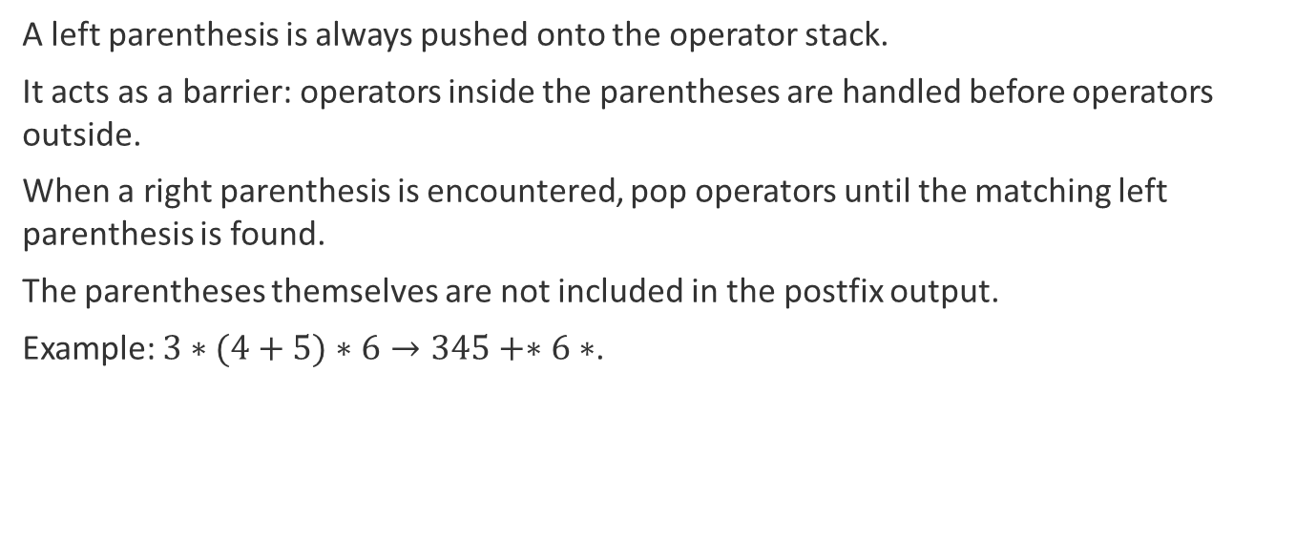
Stack Application: Expression Conversion and Evaluation
Conversion from infix to postfix: Parentheses During Infix → Postfix
A left parenthesis is always pushed onto the operator stack.
It acts as a barrier: operators inside the parentheses are handled before operators outside.
When a right parenthesis is encountered, pop operators until the matching left parenthesis is found.
The parentheses themselves are not included in the postfix output.
Example: $3∗(4+5)∗6→345+∗6∗$.
B.TECH » DEPARTMENT OF COMPUTER SCIENCE & ENGINEERING (AI & ML) » DATA STRUCTURES AND ITS APPLICATIONS » UE25CS252A » UNIT 1 » STACK APPLICATION: EXPRESSION CONVERSION AND EVALUATION » CLASS 10/11
© Confidential Information of PES University. All Rights Reserved - 2026
22 / 23

Slide 23
Stack Application: Expression Conversion and Evaluation
Summary
Postfix notation removes the need for precedence rules during evaluation.
A stack of operands is sufficient for postfix evaluation.
Operators pop operands, compute, and push the result.
Infix-to-postfix conversion uses a stack of operators.
Precedence, associativity, and parentheses determine when operators are popped.
The stack can be used through its interface without knowing whether it is implemented with an array or a list.
B.TECH » DEPARTMENT OF COMPUTER SCIENCE & ENGINEERING (AI & ML) » DATA STRUCTURES AND ITS APPLICATIONS » UE25CS252A » UNIT 1 » STACK APPLICATION: EXPRESSION CONVERSION AND EVALUATION » CLASS 10/11
© Confidential Information of PES University. All Rights Reserved - 2026
23 / 23

Slide 24
THANK YOU
N S Kumar
Professor
Department of Computer Science & Engineering (AI & ML)

