Slide 1

Introduction
Tree
Data Structures and its Applications (UE25CS52A)
N S Kumar
Professor
Department of Computer Science & Engineering (AI & ML)
B.TECH » DEPARTMENT OF COMPUTER SCIENCE & ENGINEERING (AI & ML) » DATA STRUCTURES AND ITS APPLICATIONS » UE25CS252A » UNIT 2 » INTRODUCTION AND REVISION » CLASS 11/11
© Confidential Information of PES University. All Rights Reserved - 2026
1 / 6

Slide 2
Tree
Quiz : Tree
1. The number of edges in a tree having n nodes
Depends whether the tree is a binary tree or not
Is always n - 1
Is 2n as each node has 2 pointers
Can vary from 1 to n
B. SCIENCE & ENGINEERING (AI & ML) » DATA STRUCTURES AND ITS APPLICATIONS » UE25CS252A » UNIT 1 » ARRAYS » CLASS 3/12
© Confidential Information of PES University. All Rights Reserved - 2026
2 / 9

Slide 3
Tree
Quiz : Tree
1. The number of nodes in a tree having n nodes
Depends whether the tree is a binary tree or not
Is always n - 1
Is 2n as each node has 2 pointers
Can vary from 1 to n
B. SCIENCE & ENGINEERING (AI & ML) » DATA STRUCTURES AND ITS APPLICATIONS » UE25CS252A » UNIT 1 » ARRAYS » CLASS 3/12
© Confidential Information of PES University. All Rights Reserved - 2026
2 / 9

Slide 4
Tree
Quiz : Tree
2. The longest path from the root to the leaf in any binary tree of n nodes has the length
n-1
log(n, 2)
n
n/2
B. SCIENCE & ENGINEERING (AI & ML) » DATA STRUCTURES AND ITS APPLICATIONS » UE25CS252A » UNIT 1 » ARRAYS » CLASS 3/12
© Confidential Information of PES University. All Rights Reserved - 2026
2 / 9

Slide 5
Tree
Quiz : Tree
2. The longest path from the root to the leaf in any binary tree of n nodes has the length
n-1
log(n, 2)
n
n/2
B. SCIENCE & ENGINEERING (AI & ML) » DATA STRUCTURES AND ITS APPLICATIONS » UE25CS252A » UNIT 1 » ARRAYS » CLASS 3/12
© Confidential Information of PES University. All Rights Reserved - 2026
2 / 9

Slide 6
Tree
Quiz : Tree
3. The max number of leaves in a binary tree of n nodes is
n-1
log(n, 2)
Floor(n/2) + 1
Floor((n +1)/2)
B. SCIENCE & ENGINEERING (AI & ML) » DATA STRUCTURES AND ITS APPLICATIONS » UE25CS252A » UNIT 1 » ARRAYS » CLASS 3/12
© Confidential Information of PES University. All Rights Reserved - 2026
2 / 9

Slide 7
Tree
Quiz : Tree
3. The max number of leaves in a binary tree of n nodes is
n-1
log(n, 2)
Floor(n/2) + 1
Floor((n +1)/2)
B. SCIENCE & ENGINEERING (AI & ML) » DATA STRUCTURES AND ITS APPLICATIONS » UE25CS252A » UNIT 1 » ARRAYS » CLASS 3/12
© Confidential Information of PES University. All Rights Reserved - 2026
2 / 9

Slide 8
Tree
Quiz : Tree
4. In a binary search tree (key less than the root on the left), the node with the least key
Will be a leaf
Will not have a left sub tree
Will not have a right sub tree
Can have both left and right sub trees
B. SCIENCE & ENGINEERING (AI & ML) » DATA STRUCTURES AND ITS APPLICATIONS » UE25CS252A » UNIT 1 » ARRAYS » CLASS 3/12
© Confidential Information of PES University. All Rights Reserved - 2026
2 / 9

Slide 9
Tree
Quiz : Tree
4. In a binary search tree (key less than the root on the left), the node with the least key
Will be a leaf
Will not have a left sub tree
Will not have a right sub tree
Can have both left and right sub trees
B. SCIENCE & ENGINEERING (AI & ML) » DATA STRUCTURES AND ITS APPLICATIONS » UE25CS252A » UNIT 1 » ARRAYS » CLASS 3/12
© Confidential Information of PES University. All Rights Reserved - 2026
2 / 9

Slide 10
Tree
Quiz : Tree
5. The number of comparisons while searching a binary search tree of n nodes in the worst case will be
n
n/2
Log(n, 2)
1
B. SCIENCE & ENGINEERING (AI & ML) » DATA STRUCTURES AND ITS APPLICATIONS » UE25CS252A » UNIT 1 » ARRAYS » CLASS 3/12
© Confidential Information of PES University. All Rights Reserved - 2026
2 / 9

Slide 11
Tree
Quiz : Tree
5. The number of comparisons while searching a binary search tree of n nodes in the worst case will be
n
n/2
Log(n, 2)
1
B. SCIENCE & ENGINEERING (AI & ML) » DATA STRUCTURES AND ITS APPLICATIONS » UE25CS252A » UNIT 1 » ARRAYS » CLASS 3/12
© Confidential Information of PES University. All Rights Reserved - 2026
2 / 9

Slide 13
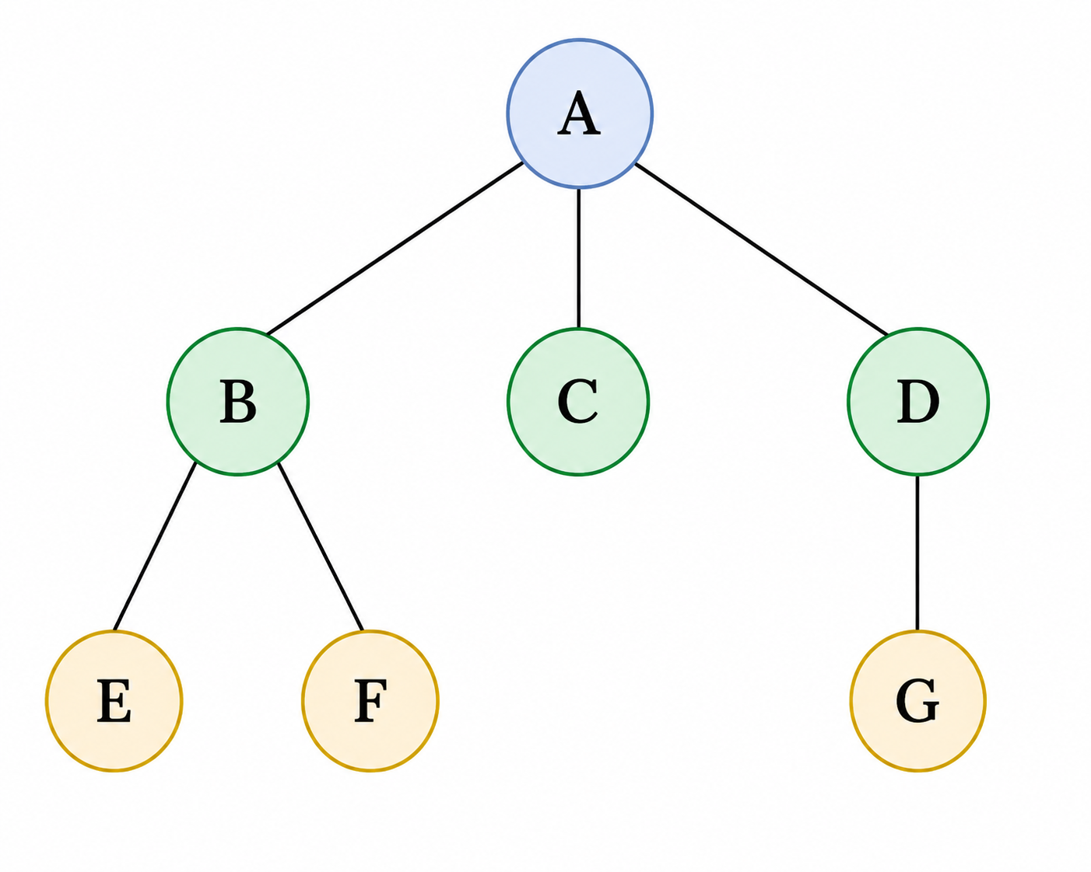
General Tree
Definition and Properties
A tree
  is a non-linear data structure used to represent hierarchical relationships
  organizes elements in a parent–child structure.
B.TECH » DEPARTMENT OF COMPUTER SCIENCE & ENGINEERING (AI & ML) » DATA STRUCTURES AND ITS APPLICATIONS » UE25CS252A » UNIT 1 » ARRAYS » CLASS 3/12
© Confidential Information of PES University. All Rights Reserved - 2026
2 / 9

Slide 14
General Tree
Terminology from genealogy:
Parent
Child
Siblings
Ancestor
Descendant
Uncle
B.TECH » DEPARTMENT OF COMPUTER SCIENCE & ENGINEERING (AI & ML) » DATA STRUCTURES AND ITS APPLICATIONS » UE25CS252A » UNIT 1 » ARRAYS » CLASS 3/12
© Confidential Information of PES University. All Rights Reserved - 2026
2 / 9

Slide 15
General Tree
Terminology from botany:
Root
Nodes
Leaves
Internal nodes
External nodes
Branch
B.TECH » DEPARTMENT OF COMPUTER SCIENCE & ENGINEERING (AI & ML) » DATA STRUCTURES AND ITS APPLICATIONS » UE25CS252A » UNIT 1 » ARRAYS » CLASS 3/12
© Confidential Information of PES University. All Rights Reserved - 2026
2 / 9

Slide 16
General Tree
Definition
A Tree
  Is either empty
  Has a root followed by number of trees
    Called subtrees
Some more terms
  Path
  Level
  height
B.TECH » DEPARTMENT OF COMPUTER SCIENCE & ENGINEERING (AI & ML) » DATA STRUCTURES AND ITS APPLICATIONS » UE25CS252A » UNIT 1 » ARRAYS » CLASS 3/12
© Confidential Information of PES University. All Rights Reserved - 2026
2 / 9

Slide 17
General Tree
Important properties of trees:
Acyclic : Can not start from a node, traverse and come back to the same node
Connected. Any two nodes are connected by a path which may go through the root
A tree of n nodes has n – 1 edges – neither more not less.
Add an edge, we will have a cycle. Remove an edge, we will have more than one tree.
B.TECH » DEPARTMENT OF COMPUTER SCIENCE & ENGINEERING (AI & ML) » DATA STRUCTURES AND ITS APPLICATIONS » UE25CS252A » UNIT 1 » ARRAYS » CLASS 3/12
© Confidential Information of PES University. All Rights Reserved - 2026
2 / 9

Slide 18
General Tree
A possible ADT for a general tree :
Create a tree
Destroy the tree
Check empty
Check full
Add a node
Remove a node
Traverse a tree
Find root
Find children
Check whether leaf
Find height of the tree
Find the path from the root to a given node
B.TECH » DEPARTMENT OF COMPUTER SCIENCE & ENGINEERING (AI & ML) » DATA STRUCTURES AND ITS APPLICATIONS » UE25CS252A » UNIT 1 » ARRAYS » CLASS 3/12
© Confidential Information of PES University. All Rights Reserved - 2026
2 / 9

Slide 19
General Tree
Applications of the tree
File System Structure:
Search Trees:
Databases, indexing and B-trees:
Expression Evaluation:
Compiler design:
Document representation
Heap Tree and priority queue:
Process structure:
Organization structure
Decision Trees in AI
…
B.TECH » DEPARTMENT OF COMPUTER SCIENCE & ENGINEERING (AI & ML) » DATA STRUCTURES AND ITS APPLICATIONS » UE25CS252A » UNIT 1 » ARRAYS » CLASS 3/12
© Confidential Information of PES University. All Rights Reserved - 2026
2 / 9

Slide 20
General Tree
Applications of the tree
File System Structure:
Search Trees:
Databases, indexing and B-trees:
Expression Evaluation:
Compiler design:
Document representation
Heap Tree and priority queue:
Process structure:
Organization structure
Decision Trees in AI
…
B.TECH » DEPARTMENT OF COMPUTER SCIENCE & ENGINEERING (AI & ML) » DATA STRUCTURES AND ITS APPLICATIONS » UE25CS252A » UNIT 1 » ARRAYS » CLASS 3/12
© Confidential Information of PES University. All Rights Reserved - 2026
2 / 9

Slide 21
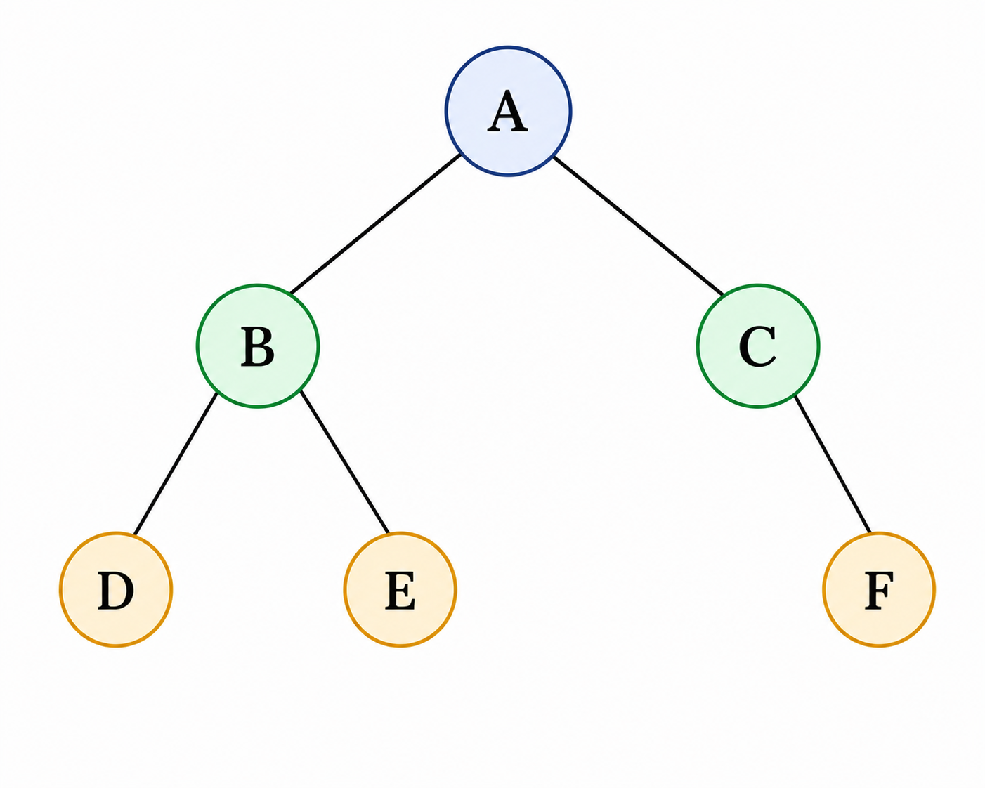
Binary Tree
Definitiion
A binary tree is a tree in which every node has at most two children.
The two children are distinguished as the
left child and right child.
A binary tree is either:
  An empty tree, or
  A root node together with
  two disjoint binary trees called its:
    left subtree
    right subtree
B.TECH » DEPARTMENT OF COMPUTER SCIENCE & ENGINEERING (AI & ML) » DATA STRUCTURES AND ITS APPLICATIONS » UE25CS252A » UNIT 1 » ARRAYS » CLASS 3/12
© Confidential Information of PES University. All Rights Reserved - 2026
2 / 9

Slide 22
Binary Tree
Inorder traversal of the binary tree
If tree is not empty
  Visit the left subtree
  Visit the root
  Visit the right subtree
Inorder traversal of this tree:
D B E A C F
B.TECH » DEPARTMENT OF COMPUTER SCIENCE & ENGINEERING (AI & ML) » DATA STRUCTURES AND ITS APPLICATIONS » UE25CS252A » UNIT 1 » ARRAYS » CLASS 3/12
© Confidential Information of PES University. All Rights Reserved - 2026
2 / 9

Slide 23
Binary Tree
Binary representation of any general tree
Root of general tree becomes root of the binary tree
Child of a node in general tree appears to the left of the node in the binary tree
Sibling of a node in general tree will appear to the right of the node in the binary tree
B.TECH » DEPARTMENT OF COMPUTER SCIENCE & ENGINEERING (AI & ML) » DATA STRUCTURES AND ITS APPLICATIONS » UE25CS252A » UNIT 1 » ARRAYS » CLASS 3/12
© Confidential Information of PES University. All Rights Reserved - 2026
2 / 9

Slide 24
Binary Tree
Binary Search Tree
Every node has a key
Nodes are inserted based on the key
If the key of a node is less than that of the root, it will be inserted in the left subtree
Otherwise, it will be inserted in the right subtree
B.TECH » DEPARTMENT OF COMPUTER SCIENCE & ENGINEERING (AI & ML) » DATA STRUCTURES AND ITS APPLICATIONS » UE25CS252A » UNIT 1 » ARRAYS » CLASS 3/12
© Confidential Information of PES University. All Rights Reserved - 2026
2 / 9

Slide 25
Binary Tree
Binary Search Tree : simple and small interface
Create a tree
Destroy the tree
Insert the key
Display the tree in inorder
Find the number of nodes
Find the number of leaves
B.TECH » DEPARTMENT OF COMPUTER SCIENCE & ENGINEERING (AI & ML) » DATA STRUCTURES AND ITS APPLICATIONS » UE25CS252A » UNIT 1 » ARRAYS » CLASS 3/12
© Confidential Information of PES University. All Rights Reserved - 2026
2 / 9

Slide 26
Binary Tree
Binary Search Tree : structure of the functions
Recursive on nodes and not on tree
Model for recursive routine :
  Empty tree
  Tree with left and right subtrees
B.TECH » DEPARTMENT OF COMPUTER SCIENCE & ENGINEERING (AI & ML) » DATA STRUCTURES AND ITS APPLICATIONS » UE25CS252A » UNIT 1 » ARRAYS » CLASS 3/12
© Confidential Information of PES University. All Rights Reserved - 2026
2 / 9

Slide 27
THANK YOU
N S Kumar
Professor
Department of Computer Science & Engineering (AI & ML)

