Slide 1

Introduction
Tree
Data Structures and its Applications (UE25CS52A)
N S Kumar
Professor
Department of Computer Science & Engineering (AI & ML)
B.TECH » DEPARTMENT OF COMPUTER SCIENCE & ENGINEERING (AI & ML) » DATA STRUCTURES AND ITS APPLICATIONS » UE25CS252A » UNIT 2 » INTRODUCTION AND REVISION » CLASS 11/11
© Confidential Information of PES University. All Rights Reserved - 2026
1 / 6

Slide 2
Splay Tree
Splay Tree:
A Splay Tree is a self-adjusting Binary Search Tree (BST)
Whenever a node is accessed, move that node to the root
This operation is called splaying
B. SCIENCE & ENGINEERING (AI & ML) » DATA STRUCTURES AND ITS APPLICATIONS » UE25CS252A » UNIT 1 » ARRAYS » CLASS 3/12
© Confidential Information of PES University. All Rights Reserved - 2026
2 / 9

Slide 3
Splay Tree
Splay Tree: salient features
No Extra Metadata: They require no balance accounting data (like color bits in red-black trees or height numbers in AVL trees), saving memory.
Locality of Reference: If we access a piece of data once, it moves to the top, making subsequent lookups of the same data instantaneous.
Efficiency: While a single worst-case operation can take time proportional to the number of elements, a sequence of m operations is guaranteed to run in time proportional to m * log(n, 2).
Dynamic Adaptation: The tree structure continuously morphs to fit the actual access pattern of the workload rather than enforcing a rigid shape.
B. SCIENCE & ENGINEERING (AI & ML) » DATA STRUCTURES AND ITS APPLICATIONS » UE25CS252A » UNIT 1 » ARRAYS » CLASS 3/12
© Confidential Information of PES University. All Rights Reserved - 2026
2 / 9

Slide 4
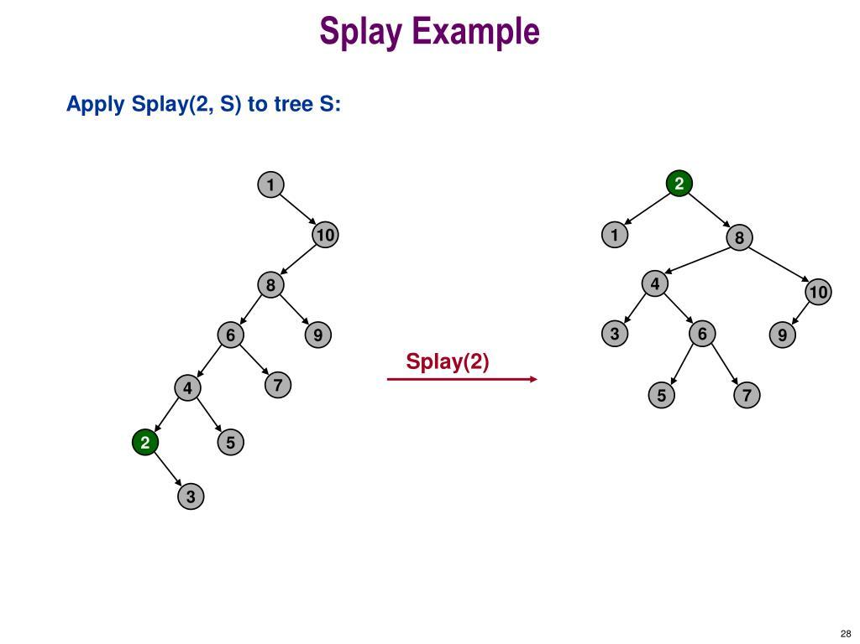
Splay Tree
B. SCIENCE & ENGINEERING (AI & ML) » DATA STRUCTURES AND ITS APPLICATIONS » UE25CS252A » UNIT 1 » ARRAYS » CLASS 3/12
© Confidential Information of PES University. All Rights Reserved - 2026
2 / 9

Slide 5
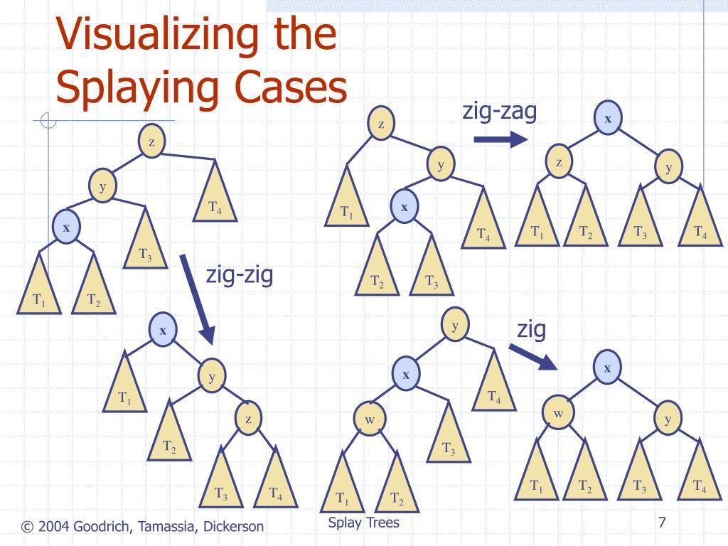
Splay Tree
B. SCIENCE & ENGINEERING (AI & ML) » DATA STRUCTURES AND ITS APPLICATIONS » UE25CS252A » UNIT 1 » ARRAYS » CLASS 3/12
© Confidential Information of PES University. All Rights Reserved - 2026
2 / 9

Slide 6
Splay Tree
Splay Tree: operations
Zig
Zig-Zig
Zig-Zag
B. SCIENCE & ENGINEERING (AI & ML) » DATA STRUCTURES AND ITS APPLICATIONS » UE25CS252A » UNIT 1 » ARRAYS » CLASS 3/12
© Confidential Information of PES University. All Rights Reserved - 2026
2 / 9

Slide 7
Splay Tree
Splay Tree: ZIG
Node accessed is the child of the root
Suppose we access 30:
50
/
30
Perform a right rotation:
30
\
50
Suppose we access 70
50
\
70
perform a left rotation:
70
/
50
Zig rule
Node is child of root
↓
Perform one rotation
↓
Node becomes root
B. SCIENCE & ENGINEERING (AI & ML) » DATA STRUCTURES AND ITS APPLICATIONS » UE25CS252A » UNIT 1 » ARRAYS » CLASS 3/12
© Confidential Information of PES University. All Rights Reserved - 2026
2 / 9

Slide 8
Splay Tree
Splay Tree: ZIG-ZIG (LL case)
node and its parent are both on the same side
First rotation
Rotate 50 right:
30
/ \
20 50
Second rotation
Rotate 30 right:
20
\
30
\
50
Zig-ZIG rule
LL => two right rotations
50
/
30
/
20
We want to access 20.
Here:
20 is the left child of 30
30 is the left child of 50
So this is Left-Left (LL).
B. SCIENCE & ENGINEERING (AI & ML) » DATA STRUCTURES AND ITS APPLICATIONS » UE25CS252A » UNIT 1 » ARRAYS » CLASS 3/12
© Confidential Information of PES University. All Rights Reserved - 2026
2 / 9

Slide 9
Splay Tree
Splay Tree: ZIG-ZIG (RR case)
node and its parent are both on the same side
First rotation
Rotate 30 left:
30
/ \
20 50
Second rotation
Rotate 50 left:
50
/
30
/
20
Zig-ZIG rule
LL => two right rotations
RR => two left rotations
20
\
30
\
50
Access 50.
50 is the right child of 30
30 is the right child of 20
So this is RR case
B. SCIENCE & ENGINEERING (AI & ML) » DATA STRUCTURES AND ITS APPLICATIONS » UE25CS252A » UNIT 1 » ARRAYS » CLASS 3/12
© Confidential Information of PES University. All Rights Reserved - 2026
2 / 9

Slide 10
Splay Tree
Splay Tree: ZIG-ZAG
node and its parent are both on the opposite side
First rotation
Rotate 20 left:
50
/
30
/
20
Second rotation
Rotate 50 right:
30
/ \
20 50
So 30 becomes the root.
Zig-Zag rule
LR => one left; one right
Consider:
50
/
20
\
30
30 is the right child of 20
20 is the left child of 50
Therefore:
Left-Right (LR) configuration.
B. SCIENCE & ENGINEERING (AI & ML) » DATA STRUCTURES AND ITS APPLICATIONS » UE25CS252A » UNIT 1 » ARRAYS » CLASS 3/12
© Confidential Information of PES University. All Rights Reserved - 2026
2 / 9

Slide 11
THANK YOU
N S Kumar
Professor
Department of Computer Science & Engineering (AI & ML)

