Slide 1

Introduction
Tree
Data Structures and its Applications (UE25CS52A)
N S Kumar
Professor
Department of Computer Science & Engineering (AI & ML)
B.TECH » DEPARTMENT OF COMPUTER SCIENCE & ENGINEERING (AI & ML) » DATA STRUCTURES AND ITS APPLICATIONS » UE25CS252A » UNIT 2 » INTRODUCTION AND REVISION » CLASS 11/11
© Confidential Information of PES University. All Rights Reserved - 2026
1 / 6

Slide 2
Tree
Quiz : Tree
1. Search on a binary search tree in the worst case will do
n comparisons
n/2 comparisons
Log(n) to base 2 comparisons
Log(n) to base e comparisons
B. SCIENCE & ENGINEERING (AI & ML) » DATA STRUCTURES AND ITS APPLICATIONS » UE25CS252A » UNIT 1 » ARRAYS » CLASS 3/12
© Confidential Information of PES University. All Rights Reserved - 2026
2 / 9

Slide 3
Tree
Quiz : Tree
1. Search on a binary search tree in the worst case will do
n comparisons
n/2 comparisons
Log(n) to base 2 comparisons
Log(n) to base e comparisons
B. SCIENCE & ENGINEERING (AI & ML) » DATA STRUCTURES AND ITS APPLICATIONS » UE25CS252A » UNIT 1 » ARRAYS » CLASS 3/12
© Confidential Information of PES University. All Rights Reserved - 2026
2 / 9

Slide 4
Tree
Quiz : Tree
2. The smallest key in a binary search tree will
Always be a leaf in the left subtree
Always be a leaf in the right subtree
Could be an internal node with no left subtree
Could be an internal node with no right subtree
B. SCIENCE & ENGINEERING (AI & ML) » DATA STRUCTURES AND ITS APPLICATIONS » UE25CS252A » UNIT 1 » ARRAYS » CLASS 3/12
© Confidential Information of PES University. All Rights Reserved - 2026
2 / 9

Slide 5
Tree
Quiz : Tree
2. The smallest key in a binary search tree will
Always be a leaf in the left subtree
Always be a leaf in the right subtree
Could be an internal node with no left subtree
Could be an internal node with no right subtree
B. SCIENCE & ENGINEERING (AI & ML) » DATA STRUCTURES AND ITS APPLICATIONS » UE25CS252A » UNIT 1 » ARRAYS » CLASS 3/12
© Confidential Information of PES University. All Rights Reserved - 2026
2 / 9

Slide 6
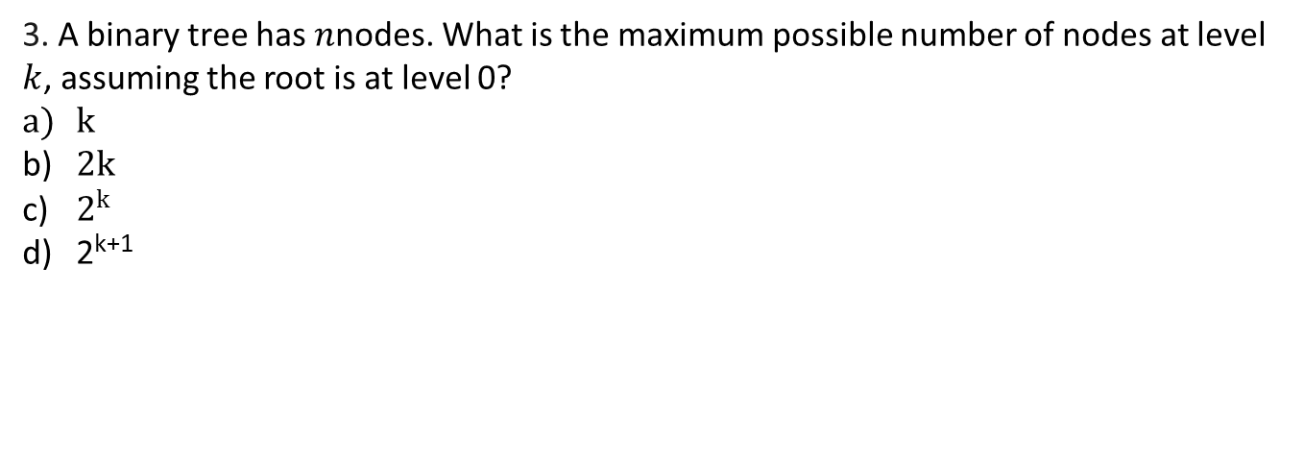
Tree
Quiz : Tree
3. A binary tree has $n$nodes. What is the maximum possible number of nodes at level $k$, assuming the root is at level 0?
$k$
$2k$
$2^{k}$
2^{k+1}
B. SCIENCE & ENGINEERING (AI & ML) » DATA STRUCTURES AND ITS APPLICATIONS » UE25CS252A » UNIT 1 » ARRAYS » CLASS 3/12
© Confidential Information of PES University. All Rights Reserved - 2026
2 / 9

Slide 7
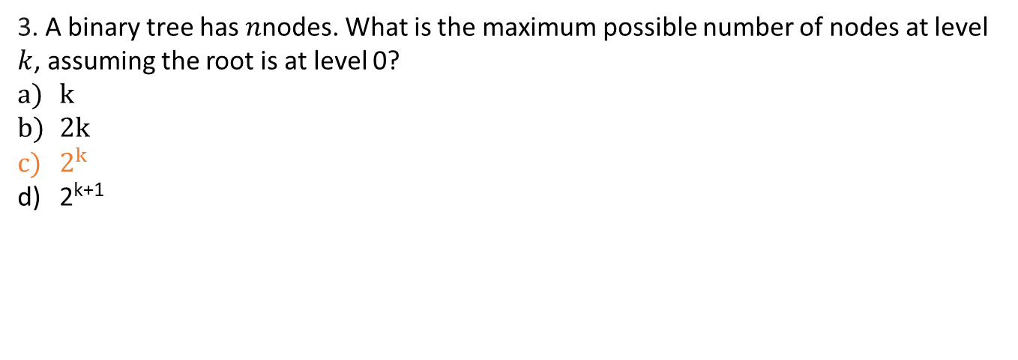
Tree
Quiz : Tree
3. A binary tree has $n$nodes. What is the maximum possible number of nodes at level $k$, assuming the root is at level 0?
$k$
$2k$
$2^{k}$
2^{k+1}
B. SCIENCE & ENGINEERING (AI & ML) » DATA STRUCTURES AND ITS APPLICATIONS » UE25CS252A » UNIT 1 » ARRAYS » CLASS 3/12
© Confidential Information of PES University. All Rights Reserved - 2026
2 / 9

Slide 8
Tree
Quiz : Tree
4. A binary tree contains 15 nodes. What is the minimum possible height of the tree, where the height of a single-node tree is 0?
2
3
4
14
B. SCIENCE & ENGINEERING (AI & ML) » DATA STRUCTURES AND ITS APPLICATIONS » UE25CS252A » UNIT 1 » ARRAYS » CLASS 3/12
© Confidential Information of PES University. All Rights Reserved - 2026
2 / 9

Slide 9
Tree
Quiz : Tree
4. A binary tree contains 15 nodes. What is the minimum possible height of the tree, where the height of a single-node tree is 0?
2
3
4
14
B. SCIENCE & ENGINEERING (AI & ML) » DATA STRUCTURES AND ITS APPLICATIONS » UE25CS252A » UNIT 1 » ARRAYS » CLASS 3/12
© Confidential Information of PES University. All Rights Reserved - 2026
2 / 9

Slide 10
Tree
Quiz : Tree
5. Which statement is always true for a binary tree?
Every node has exactly two children
Every leaf has two children
A node can have at most two children
Every internal node has two children
B. SCIENCE & ENGINEERING (AI & ML) » DATA STRUCTURES AND ITS APPLICATIONS » UE25CS252A » UNIT 1 » ARRAYS » CLASS 3/12
© Confidential Information of PES University. All Rights Reserved - 2026
2 / 9

Slide 11
Tree
Quiz : Tree
5. Which statement is always true for a binary tree?
Every node has exactly two children
Every leaf has two children
A node can have at most two children
Every internal node has two children
B. SCIENCE & ENGINEERING (AI & ML) » DATA STRUCTURES AND ITS APPLICATIONS » UE25CS252A » UNIT 1 » ARRAYS » CLASS 3/12
© Confidential Information of PES University. All Rights Reserved - 2026
2 / 9

Slide 13
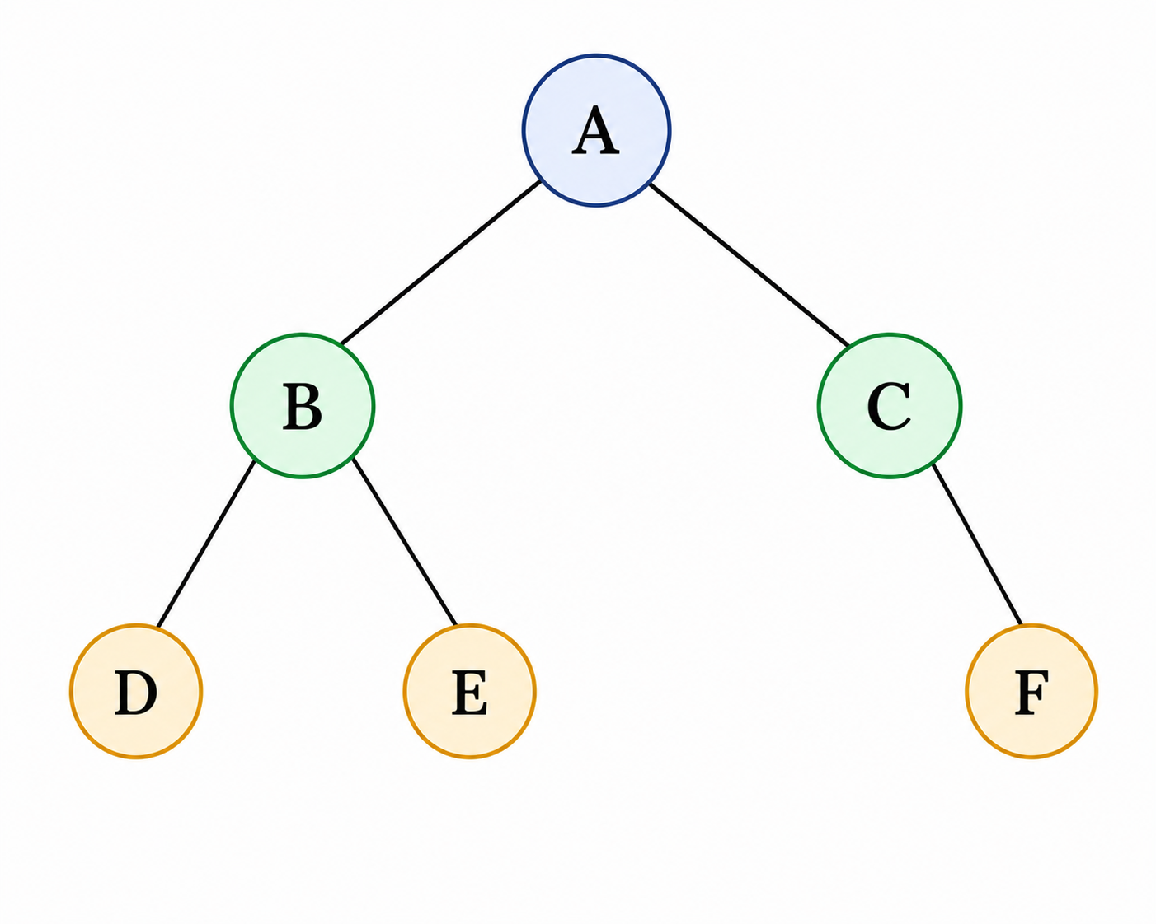
Binary Tree
Definitiion
A binary tree is a tree in which every node has at most two children.
The two children are distinguished as the
left child and right child.
A binary tree is either:
  An empty tree, or
  A root node together with
  two disjoint binary trees called its:
    left subtree
    right subtree
B.TECH » DEPARTMENT OF COMPUTER SCIENCE & ENGINEERING (AI & ML) » DATA STRUCTURES AND ITS APPLICATIONS » UE25CS252A » UNIT 1 » ARRAYS » CLASS 3/12
© Confidential Information of PES University. All Rights Reserved - 2026
2 / 9

Slide 14
Binary Tree
Inorder traversal of the binary tree
If tree is not empty
  Visit the left subtree in inorder
  Visit the root
  Visit the right subtree in inorder
Inorder traversal of this tree:
D B E A C F
B.TECH » DEPARTMENT OF COMPUTER SCIENCE & ENGINEERING (AI & ML) » DATA STRUCTURES AND ITS APPLICATIONS » UE25CS252A » UNIT 1 » ARRAYS » CLASS 3/12
© Confidential Information of PES University. All Rights Reserved - 2026
2 / 9

Slide 15
Binary Tree
preorder traversal of the binary tree
If tree is not empty
  Visit the root
  Visit the left subtree in preorder
  Visit the right subtree in preorder
preorder traversal of this tree:
A B D E C F
B.TECH » DEPARTMENT OF COMPUTER SCIENCE & ENGINEERING (AI & ML) » DATA STRUCTURES AND ITS APPLICATIONS » UE25CS252A » UNIT 1 » ARRAYS » CLASS 3/12
© Confidential Information of PES University. All Rights Reserved - 2026
2 / 9

Slide 16
Binary Tree
postorder traversal of the binary tree
If tree is not empty
  Visit the left subtree in postorder
  Visit the right subtree in postorder
  Visit the root
postorder traversal of this tree:
D E B F C A
B.TECH » DEPARTMENT OF COMPUTER SCIENCE & ENGINEERING (AI & ML) » DATA STRUCTURES AND ITS APPLICATIONS » UE25CS252A » UNIT 1 » ARRAYS » CLASS 3/12
© Confidential Information of PES University. All Rights Reserved - 2026
2 / 9

Slide 17
Binary Tree
Binary Search Tree
Every node has a key
Nodes are inserted based on the key
If the key of a node is less than that of the root, it will be inserted in the left subtree
Otherwise, it will be inserted in the right subtree
B.TECH » DEPARTMENT OF COMPUTER SCIENCE & ENGINEERING (AI & ML) » DATA STRUCTURES AND ITS APPLICATIONS » UE25CS252A » UNIT 1 » ARRAYS » CLASS 3/12
© Confidential Information of PES University. All Rights Reserved - 2026
2 / 9

Slide 18
Binary Tree
Binary Search Tree : simple and small interface
Create a tree
Destroy the tree
Insert the key
Display the tree in inorder
Find the number of nodes
Find the number of leaves
B.TECH » DEPARTMENT OF COMPUTER SCIENCE & ENGINEERING (AI & ML) » DATA STRUCTURES AND ITS APPLICATIONS » UE25CS252A » UNIT 1 » ARRAYS » CLASS 3/12
© Confidential Information of PES University. All Rights Reserved - 2026
2 / 9

Slide 19
Binary Tree
Binary Search Tree : structure of the functions
Recursive on nodes and not on tree
Model for recursive routine :
  Empty tree
  Tree with left and right subtrees
B.TECH » DEPARTMENT OF COMPUTER SCIENCE & ENGINEERING (AI & ML) » DATA STRUCTURES AND ITS APPLICATIONS » UE25CS252A » UNIT 1 » ARRAYS » CLASS 3/12
© Confidential Information of PES University. All Rights Reserved - 2026
2 / 9

Slide 20
Binary Tree
Binary Search Tree : interface
void init(tree_t *ptr_tree);
  Ground the root.
void deinit(tree_t *ptr_tree);
  Walk through the tree
  Remove the left subtree
  Remove the right subtree
  Remove the root
void disp(tree_t *ptr_tree);
// This is inorder traversal of the tree
  If the tree is not empty
    Display the left subtree
    Display the root
    Display the right subtree
void insert(tree_t *ptr_tree, int key);
  If the tree is empty, make this the root
  Otherwise compare the keys
  Decide to insert in the left subtree or the right subtree
B.TECH » DEPARTMENT OF COMPUTER SCIENCE & ENGINEERING (AI & ML) » DATA STRUCTURES AND ITS APPLICATIONS » UE25CS252A » UNIT 1 » ARRAYS » CLASS 3/12
© Confidential Information of PES University. All Rights Reserved - 2026
2 / 9

Slide 21
Binary Tree
Binary Search Tree : insert
// on the tree; non recursive
void insert(tree_t *ptr_tree, int key)
{
node_t *temp = (node_t*)malloc(sizeof(node_t));
temp->key_ = key;
temp->left_ = temp->right_ = NULL;
ptr_tree->root_ = insert_recursive(ptr_tree->root_, temp);
}
B.TECH » DEPARTMENT OF COMPUTER SCIENCE & ENGINEERING (AI & ML) » DATA STRUCTURES AND ITS APPLICATIONS » UE25CS252A » UNIT 1 » ARRAYS » CLASS 3/12
© Confidential Information of PES University. All Rights Reserved - 2026
2 / 9

Slide 22
Binary Tree
Binary Search Tree : insert
// on the node; recursive; observe the assignment to the root
static node_t* insert_recursive(node_t* root, node_t* temp)
{
if(root == NULL)
{
root = temp;
}
else if(root->key_ > temp->key_)
{
root->left_ = insert_recursive(root->left_, temp);
}
else
{
root->right_ = insert_recursive(root->right_, temp);
}
return root;
}
B.TECH » DEPARTMENT OF COMPUTER SCIENCE & ENGINEERING (AI & ML) » DATA STRUCTURES AND ITS APPLICATIONS » UE25CS252A » UNIT 1 » ARRAYS » CLASS 3/12
© Confidential Information of PES University. All Rights Reserved - 2026
2 / 9

Slide 23
Binary Tree
Binary Tree : some recursive algorithms on the node
Count the number of nodes
int number_of_nodes_recursive(node_t* temp)
{
if(temp == NULL)
{
return 0;
}
else
{
return 1 + number_of_nodes_recursive(temp->left_)
+ number_of_nodes_recursive(temp->right_);
}
}
B.TECH » DEPARTMENT OF COMPUTER SCIENCE & ENGINEERING (AI & ML) » DATA STRUCTURES AND ITS APPLICATIONS » UE25CS252A » UNIT 1 » ARRAYS » CLASS 3/12
© Confidential Information of PES University. All Rights Reserved - 2026
2 / 9

Slide 24
Binary Tree
Binary Tree : some recursive algorithms on the node
2. Count the number of leaves
int number_of_leaves_recursive(node_t* temp)
{
if(temp == NULL)
{
return 0;
}
else if(temp->left_ == NULL && temp->right_ == NULL)
{
return 1;
}
else
{
return number_of_leaves_recursive(temp->left_)
+ number_of_leaves_recursive(temp->right_);
}
}
B.TECH » DEPARTMENT OF COMPUTER SCIENCE & ENGINEERING (AI & ML) » DATA STRUCTURES AND ITS APPLICATIONS » UE25CS252A » UNIT 1 » ARRAYS » CLASS 3/12
© Confidential Information of PES University. All Rights Reserved - 2026
2 / 9

Slide 25
Binary Tree
Binary Tree : some recursive algorithms on the node
3. Compare two trees
int are_same_recursive(node_t* root1, node_t* root2)
{
if(root1 == NULL && root2 == NULL)
return 1;
else if(root1 == NULL || root2 == NULL)
return 0;
else
return root1->key_ == root2->key_ &&
are_same_recursive(root1->left_, root2->left_) &&
are_same_recursive(root1->right_, root2->right_);
}
B.TECH » DEPARTMENT OF COMPUTER SCIENCE & ENGINEERING (AI & ML) » DATA STRUCTURES AND ITS APPLICATIONS » UE25CS252A » UNIT 1 » ARRAYS » CLASS 3/12
© Confidential Information of PES University. All Rights Reserved - 2026
2 / 9

Slide 26
Binary Tree
Binary Tree : some recursive algorithms on the node
4. Copy tree
node_t* copy_recursive(node_t* ptr_src)
{
node_t *temp;
if(ptr_src != NULL)
{
temp = (node_t*)malloc(sizeof(node_t));
temp->key_ = ptr_src->key_;
temp->left_ = copy_recursive(ptr_src->left_);
temp->right_ = copy_recursive(ptr_src->right_);
return temp;
}
else
{
return NULL;
}
}
B.TECH » DEPARTMENT OF COMPUTER SCIENCE & ENGINEERING (AI & ML) » DATA STRUCTURES AND ITS APPLICATIONS » UE25CS252A » UNIT 1 » ARRAYS » CLASS 3/12
© Confidential Information of PES University. All Rights Reserved - 2026
2 / 9

Slide 27
Binary Tree
Binary search Tree : some recursive algorithms on the node
5. search
node_t* search_recursive(node_t* root, int key)
{
if(root == NULL)
return NULL;
else if(key == root->key_)
return root;
else if(key < root->key_)
return search_recursive(root->left_, key);
else
return search_recursive(root->right_, key);
}
B.TECH » DEPARTMENT OF COMPUTER SCIENCE & ENGINEERING (AI & ML) » DATA STRUCTURES AND ITS APPLICATIONS » UE25CS252A » UNIT 1 » ARRAYS » CLASS 3/12
© Confidential Information of PES University. All Rights Reserved - 2026
2 / 9

Slide 28
Binary Tree
Binary search Tree : some recursive algorithms on the node
6. Inorder successor if the argument is the right subtree of a given node
node_t* inorder_successor(node_t* root)
{
node_t* temp = root;
while(temp->left_ != NULL)
temp = temp->left_;
return temp;
}
B.TECH » DEPARTMENT OF COMPUTER SCIENCE & ENGINEERING (AI & ML) » DATA STRUCTURES AND ITS APPLICATIONS » UE25CS252A » UNIT 1 » ARRAYS » CLASS 3/12
© Confidential Information of PES University. All Rights Reserved - 2026
2 / 9

Slide 29
Binary Tree
Binary search Tree : some recursive algorithms on the node
7. Delete based on key
node_t* delete_key_recursive(node_t* root, int key)
{
if(root == NULL) // empty tree
{
return NULL;
}
else if(key < root->key_) // search in left subtree
{
root->left_ = delete_key_recursive(root->left_, key);
}
else if (key > root->key_) // search in right subtree
{
root->right_ = delete_key_recursive(root->right_, key);
}
else // match found; action of deletion should start
B.TECH » DEPARTMENT OF COMPUTER SCIENCE & ENGINEERING (AI & ML) » DATA STRUCTURES AND ITS APPLICATIONS » UE25CS252A » UNIT 1 » ARRAYS » CLASS 3/12
© Confidential Information of PES University. All Rights Reserved - 2026
2 / 9

Slide 30
Binary Tree
Binary search Tree : some recursive algorithms on the node
7. Delete based on key continued
if(root->left_ == NULL && root->right_ == NULL) // 1 leaf
{
free(root); return NULL;
}
else if(root->left_ == NULL) // 2. no left
{
node_t* temp = root->right_; free(root);
return temp;
}
else if(root->right_ == NULL) // 3. no right
{
node_t* temp = root->left_; free(root);
return temp;
}
B.TECH » DEPARTMENT OF COMPUTER SCIENCE & ENGINEERING (AI & ML) » DATA STRUCTURES AND ITS APPLICATIONS » UE25CS252A » UNIT 1 » ARRAYS » CLASS 3/12
© Confidential Information of PES University. All Rights Reserved - 2026
2 / 9

Slide 31
Binary Tree
Binary search Tree : some recursive algorithms on the node
7. Delete based on key continued; we have found a match
// 4. has both left and right
// find the inorder successor
else
{
node_t* temp = inorder_successor(root->right_);
root->key_ = temp->key_; // replace
// search with the new key in the right subtree
root->right_ = delete_key_recursive(root->right_, temp->key_);
}
}
return root;
}
B.TECH » DEPARTMENT OF COMPUTER SCIENCE & ENGINEERING (AI & ML) » DATA STRUCTURES AND ITS APPLICATIONS » UE25CS252A » UNIT 1 » ARRAYS » CLASS 3/12
© Confidential Information of PES University. All Rights Reserved - 2026
2 / 9

Slide 32
Binary Tree
Binary Tree : persistence
A single traversal will not define the tree uniquely
An inorder and a postorder traversal combined define a tree uniquely
Rightmost node in the postorder traversal will be the root of the tree
This node in the order traversal divides the tree in left subtree and the right subtree
Repeating traversal from right to left of post order traversal and locating the node
to divide the inorder traversal to left and right subtrees
will recreate the tree
B.TECH » DEPARTMENT OF COMPUTER SCIENCE & ENGINEERING (AI & ML) » DATA STRUCTURES AND ITS APPLICATIONS » UE25CS252A » UNIT 1 » ARRAYS » CLASS 3/12
© Confidential Information of PES University. All Rights Reserved - 2026
2 / 9

Slide 33
THANK YOU
N S Kumar
Professor
Department of Computer Science & Engineering (AI & ML)

