Slide 1

Introduction
Tree
Data Structures and its Applications (UE25CS52A)
N S Kumar
Professor
Department of Computer Science & Engineering (AI & ML)
B.TECH » DEPARTMENT OF COMPUTER SCIENCE & ENGINEERING (AI & ML) » DATA STRUCTURES AND ITS APPLICATIONS » UE25CS252A » UNIT 2 » INTRODUCTION AND REVISION » CLASS 11/11
© Confidential Information of PES University. All Rights Reserved - 2026
1 / 6

Slide 2
Tree
Quiz : Tree implemented as an array
1. In 0 based indexing , mapping the root i to its left child is
trunc(i/2)
2*i
2*i+1
Round(i/2)
B. SCIENCE & ENGINEERING (AI & ML) » DATA STRUCTURES AND ITS APPLICATIONS » UE25CS252A » UNIT 1 » ARRAYS » CLASS 3/12
© Confidential Information of PES University. All Rights Reserved - 2026
2 / 9

Slide 3
Tree
Quiz : Tree implemented as an array
1. In 0 based indexing , mapping the root i to its left child is
trunc(i/2)
2*i
2*i+1
Round(i/2)
B. SCIENCE & ENGINEERING (AI & ML) » DATA STRUCTURES AND ITS APPLICATIONS » UE25CS252A » UNIT 1 » ARRAYS » CLASS 3/12
© Confidential Information of PES University. All Rights Reserved - 2026
2 / 9

Slide 4
Tree
Quiz : Tree implemented as an array
2. In node based array representation of a tree, a leaf is identified when its
left = -1 and right = -1
left = 0 and right = 0
Left = -1 is sufficient
Left = 0 is sufficient
B. SCIENCE & ENGINEERING (AI & ML) » DATA STRUCTURES AND ITS APPLICATIONS » UE25CS252A » UNIT 1 » ARRAYS » CLASS 3/12
© Confidential Information of PES University. All Rights Reserved - 2026
2 / 9

Slide 5
Tree
Quiz : Tree implemented as an array
2. In node based array representation of a tree, a leaf is identified when its
left = -1 and right = -1
left = 0 and right = 0
Left = -1 is sufficient
Left = 0 is sufficient
B. SCIENCE & ENGINEERING (AI & ML) » DATA STRUCTURES AND ITS APPLICATIONS » UE25CS252A » UNIT 1 » ARRAYS » CLASS 3/12
© Confidential Information of PES University. All Rights Reserved - 2026
2 / 9

Slide 6
Tree
Quiz : Tree implemented as an array
3. In 1 based indexing , the highest index in the array representation of a complete binary tree of n nodes is
n
n - 1
Log(n, 2)
n + 1
B. SCIENCE & ENGINEERING (AI & ML) » DATA STRUCTURES AND ITS APPLICATIONS » UE25CS252A » UNIT 1 » ARRAYS » CLASS 3/12
© Confidential Information of PES University. All Rights Reserved - 2026
2 / 9

Slide 7
Tree
Quiz : Tree implemented as an array
3. In 1 based indexing , the highest index in the array representation of a complete binary tree of n nodes is
n
n - 1
Log(n, 2)
n + 1
B. SCIENCE & ENGINEERING (AI & ML) » DATA STRUCTURES AND ITS APPLICATIONS » UE25CS252A » UNIT 1 » ARRAYS » CLASS 3/12
© Confidential Information of PES University. All Rights Reserved - 2026
2 / 9

Slide 8
Tree
Quiz : Tree implemented as an array
4. In 1 based indexing , the leaf node i in the array representation of a complete binary tree of n nodes will satisfy the following property
i > n
2i > n
2i >= n
i > 2n
B. SCIENCE & ENGINEERING (AI & ML) » DATA STRUCTURES AND ITS APPLICATIONS » UE25CS252A » UNIT 1 » ARRAYS » CLASS 3/12
© Confidential Information of PES University. All Rights Reserved - 2026
2 / 9

Slide 9
Tree
Quiz : Tree implemented as an array
4. In 1 based indexing , the leaf node i in the array representation of a complete binary tree of n nodes will satisfy the following property
i > n
2i > n
2i >= n
i > 2n
B. SCIENCE & ENGINEERING (AI & ML) » DATA STRUCTURES AND ITS APPLICATIONS » UE25CS252A » UNIT 1 » ARRAYS » CLASS 3/12
© Confidential Information of PES University. All Rights Reserved - 2026
2 / 9

Slide 10
Tree
Quiz : Tree implemented as an array
5. In 1 based indexing , a tree of n nodes which is not a complete tree may have a node stored at the highest index
n
2^n -1
2*n
2^n
B. SCIENCE & ENGINEERING (AI & ML) » DATA STRUCTURES AND ITS APPLICATIONS » UE25CS252A » UNIT 1 » ARRAYS » CLASS 3/12
© Confidential Information of PES University. All Rights Reserved - 2026
2 / 9

Slide 11
Tree
Quiz : Tree implemented as an array
5. In 1 based indexing , a tree of n nodes which is not a complete tree may have a node stored at the highest index
n
2^n -1
2*n
2^n
B. SCIENCE & ENGINEERING (AI & ML) » DATA STRUCTURES AND ITS APPLICATIONS » UE25CS252A » UNIT 1 » ARRAYS » CLASS 3/12
© Confidential Information of PES University. All Rights Reserved - 2026
2 / 9

Slide 12
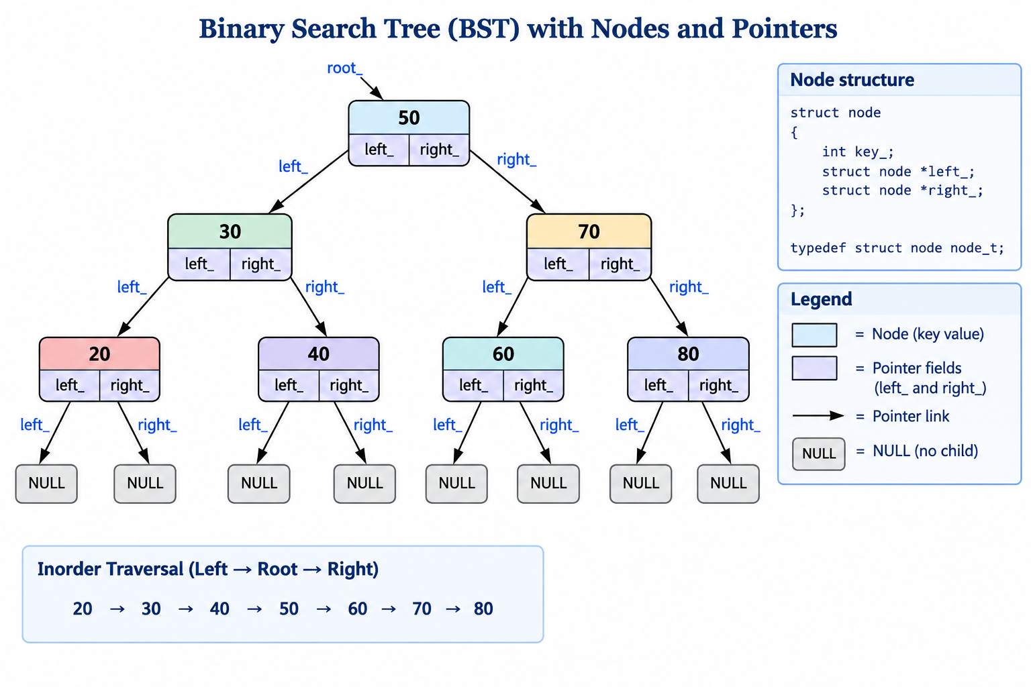
Binary Tree : Array representation
B.TECH » DEPARTMENT OF COMPUTER SCIENCE & ENGINEERING (AI & ML) » DATA STRUCTURES AND ITS APPLICATIONS » UE25CS252A » UNIT 1 » ARRAYS » CLASS 3/12
© Confidential Information of PES University. All Rights Reserved - 2026
2 / 9

Slide 13
Binary Tree : Array representation
1. Based on relative position of parent and children
a)
0 index based mapping:
Parent : i , left child : 2i + 1; right child : 2i + 2
b)
1 index based mapping :
Parent : i , left child : 2i ; right child : 2i + 1
Points:
Compact representation if the tree is a complete tree
If not complete, we should know which slots are not filled
Might require a dummy value
index | key
0
1 | 50
2 | 30
3 | 70
4 | 20
5 | 40
6 | 60
7 | 80
B.TECH » DEPARTMENT OF COMPUTER SCIENCE & ENGINEERING (AI & ML) » DATA STRUCTURES AND ITS APPLICATIONS » UE25CS252A » UNIT 1 » ARRAYS » CLASS 3/12
© Confidential Information of PES University. All Rights Reserved - 2026
2 / 9

Slide 14
Binary Tree : Array representation
2. Array implementation of binary tree with the node structure
Each node has element, left and right
Left and right are indices
Points:
Require a memory manager to allocate and deallocate a free slot
Otherwise insertion limited by the size of the array and not on available slots free on deletion
index | left | key | right
0 | 1 | 50 | 2
1 | 3 | 30 | 4
2 | 5 | 70 | 6
3 | -1 | 20 | -1
4 | -1 | 40 | -1
5 | -1 | 60 | -1
6 | -1 | 80 | -1
B.TECH » DEPARTMENT OF COMPUTER SCIENCE & ENGINEERING (AI & ML) » DATA STRUCTURES AND ITS APPLICATIONS » UE25CS252A » UNIT 1 » ARRAYS » CLASS 3/12
© Confidential Information of PES University. All Rights Reserved - 2026
2 / 9

Slide 15
Binary Tree : Array representation
2. Array implementation of binary tree with the node structure
Structure
#define MAXSIZE 200
struct node
{
int key_;
int left_;
int right_;
};
typedef struct node node_t;
Count is used to indicate the next slot to insert as there is memory manager
struct tree
{
int root_;
int count_;
node_t elem_[MAXSIZE];
};
typedef struct tree tree_t;
B.TECH » DEPARTMENT OF COMPUTER SCIENCE & ENGINEERING (AI & ML) » DATA STRUCTURES AND ITS APPLICATIONS » UE25CS252A » UNIT 1 » ARRAYS » CLASS 3/12
© Confidential Information of PES University. All Rights Reserved - 2026
2 / 9

Slide 16
Binary Tree : Array representation
2. Array implementation of binary tree with the node structure
Interface: no change
void init(tree_t *ptr_tree);
void deinit(tree_t *ptr_tree);
void disp(tree_t *ptr_tree);
void insert(tree_t *ptr_tree, int key);
B.TECH » DEPARTMENT OF COMPUTER SCIENCE & ENGINEERING (AI & ML) » DATA STRUCTURES AND ITS APPLICATIONS » UE25CS252A » UNIT 1 » ARRAYS » CLASS 3/12
© Confidential Information of PES University. All Rights Reserved - 2026
2 / 9

Slide 17
Binary Tree : Array representation
2. Array implementation of binary tree with the node structure
Initialize :
void init(tree_t *ptr_tree)
{
ptr_tree->root_ = -1; // index of the first element; invalid to start
ptr_tree->count_ = 0; // # of elem or slot to insert
}
B.TECH » DEPARTMENT OF COMPUTER SCIENCE & ENGINEERING (AI & ML) » DATA STRUCTURES AND ITS APPLICATIONS » UE25CS252A » UNIT 1 » ARRAYS » CLASS 3/12
© Confidential Information of PES University. All Rights Reserved - 2026
2 / 9

Slide 18
Binary Tree : Array representation
2. Array implementation of binary tree with the node structure
insert :
void insert(tree_t *ptr_tree, int key)
{
// no space; exit
if(ptr_tree->count_ == MAXSIZE)
{
printf("tree full\n");
exit(1);
}
// count : empty slot at which key, left and right
// can be populated
// increment count to indicate the number of elem
// new node is always a leaf
int temp = ptr_tree->count_++;
ptr_tree->elem_[temp].key_ = key;
ptr_tree->elem_[temp].left_ =
ptr_tree->elem_[temp].right_ = -1;
// call recursive to make the right connections
ptr_tree->root_ = insert_recursive(ptr_tree->elem_,
ptr_tree->root_, temp);
}
B.TECH » DEPARTMENT OF COMPUTER SCIENCE & ENGINEERING (AI & ML) » DATA STRUCTURES AND ITS APPLICATIONS » UE25CS252A » UNIT 1 » ARRAYS » CLASS 3/12
© Confidential Information of PES University. All Rights Reserved - 2026
2 / 9

Slide 19
Binary Tree : Array representation
2. Array implementation of binary tree with the node structure
Recursive insert :
static int insert_recursive(node_t elem[], int root, int temp)
{
if(root == -1)
{
root = temp;
}
else if(elem[root].key_ > elem[temp].key_)
{
elem[root].left_ = insert_recursive(elem, elem[root].left_, temp);
}
else
{
elem[root].right_ = insert_recursive(elem, elem[root].right_, temp);
}
return root;
}
B.TECH » DEPARTMENT OF COMPUTER SCIENCE & ENGINEERING (AI & ML) » DATA STRUCTURES AND ITS APPLICATIONS » UE25CS252A » UNIT 1 » ARRAYS » CLASS 3/12
© Confidential Information of PES University. All Rights Reserved - 2026
2 / 9

Slide 20
Binary Tree : Array representation
2. Array implementation of binary tree with the node structure
Display:
void disp(tree_t *ptr_tree)
{
printf("Tree : ");
disp_recursive(ptr_tree->elem_, ptr_tree->root_);
printf("\n");
}
static void disp_recursive(node_t elem[], int temp)
{
if(temp != -1)
{
disp_recursive(elem, elem[temp].left_);
printf("%d ", elem[temp].key_);
disp_recursive(elem, elem[temp].right_);
}
}
B.TECH » DEPARTMENT OF COMPUTER SCIENCE & ENGINEERING (AI & ML) » DATA STRUCTURES AND ITS APPLICATIONS » UE25CS252A » UNIT 1 » ARRAYS » CLASS 3/12
© Confidential Information of PES University. All Rights Reserved - 2026
2 / 9

Slide 21
Binary Tree : Array representation
2. Array implementation of binary tree with the node structure
# of nodes
int number_of_nodes(tree_t *ptr_tree)
{
return number_of_nodes_recursive( ptr_tree->elem_,
ptr_tree->root_);
}
int number_of_nodes_recursive(node_t elem[], int temp)
{
if(temp == -1)
{
return 0;
}
else
{
return 1 + number_of_nodes_recursive(elem, elem[temp].left_) + number_of_nodes_recursive(elem, elem[temp].right_);
}
}
B.TECH » DEPARTMENT OF COMPUTER SCIENCE & ENGINEERING (AI & ML) » DATA STRUCTURES AND ITS APPLICATIONS » UE25CS252A » UNIT 1 » ARRAYS » CLASS 3/12
© Confidential Information of PES University. All Rights Reserved - 2026
2 / 9

Slide 22
Binary Tree : Array representation
2. Array implementation of binary tree with the node structure
# of leaves
int number_of_leaves(tree_t *ptr_tree)
{
return number_of_leaves_recursive
(ptr_tree->elem_,
ptr_tree->root_);
}
int number_of_leaves_recursive(node_t elem[], int temp)
{
if(temp == -1)
{
return 0;
}
else if(elem[temp].left_ == -1 && elem[temp].right_ == -1)
{
return 1;
}
else
{
return number_of_leaves_recursive(
elem, elem[temp].left_) + number_of_leaves_recursive(
elem, elem[temp].right_);
}
}
B.TECH » DEPARTMENT OF COMPUTER SCIENCE & ENGINEERING (AI & ML) » DATA STRUCTURES AND ITS APPLICATIONS » UE25CS252A » UNIT 1 » ARRAYS » CLASS 3/12
© Confidential Information of PES University. All Rights Reserved - 2026
2 / 9

Slide 23
Binary Tree : Array representation
2. Array implementation of binary tree with the node structure
Other functions:
Traversals :
  Inorder
  Preorder
  Postorder
Compare two trees
Copy tree
B.TECH » DEPARTMENT OF COMPUTER SCIENCE & ENGINEERING (AI & ML) » DATA STRUCTURES AND ITS APPLICATIONS » UE25CS252A » UNIT 1 » ARRAYS » CLASS 3/12
© Confidential Information of PES University. All Rights Reserved - 2026
2 / 9

Slide 24
THANK YOU
N S Kumar
Professor
Department of Computer Science & Engineering (AI & ML)

