Slide 1

Introduction
Tree
Data Structures and its Applications (UE25CS52A)
N S Kumar
Professor
Department of Computer Science & Engineering (AI & ML)
B.TECH » DEPARTMENT OF COMPUTER SCIENCE & ENGINEERING (AI & ML) » DATA STRUCTURES AND ITS APPLICATIONS » UE25CS252A » UNIT 2 » INTRODUCTION AND REVISION » CLASS 11/11
© Confidential Information of PES University. All Rights Reserved - 2026
1 / 6

Slide 2
Threaded Binary Tree
Quiz : Threaded Binary Tree
1. The number of pointers grounded in a tree of n nodes is
n + 1
n - 1
n
2n
B. SCIENCE & ENGINEERING (AI & ML) » DATA STRUCTURES AND ITS APPLICATIONS » UE25CS252A » UNIT 1 » ARRAYS » CLASS 3/12
© Confidential Information of PES University. All Rights Reserved - 2026
2 / 9

Slide 3
Threaded Binary Tree
Quiz : Threaded Binary Tree
1. The number of pointers grounded in a tree of n nodes is
n + 1
n - 1
n
2n
B. SCIENCE & ENGINEERING (AI & ML) » DATA STRUCTURES AND ITS APPLICATIONS » UE25CS252A » UNIT 1 » ARRAYS » CLASS 3/12
© Confidential Information of PES University. All Rights Reserved - 2026
2 / 9

Slide 4
Threaded Binary Tree
Quiz : Threaded Binary Tree
2. Left of new node inserted in a threaded binary search tree(for inorder traversal)
Is always a structural pointer
Is a thread and gets the value of left of parent
Is a thread and gets the value of right of parent
Is always grounded
B. SCIENCE & ENGINEERING (AI & ML) » DATA STRUCTURES AND ITS APPLICATIONS » UE25CS252A » UNIT 1 » ARRAYS » CLASS 3/12
© Confidential Information of PES University. All Rights Reserved - 2026
2 / 9

Slide 5
Threaded Binary Tree
Quiz : Threaded Binary Tree
2. Left of new node inserted in a threaded binary search tree(for inorder traversal)
Is always a structural pointer
Is a thread and gets the value of left of parent
Is a thread and gets the value of right of parent
Is always grounded
B. SCIENCE & ENGINEERING (AI & ML) » DATA STRUCTURES AND ITS APPLICATIONS » UE25CS252A » UNIT 1 » ARRAYS » CLASS 3/12
© Confidential Information of PES University. All Rights Reserved - 2026
2 / 9

Slide 6
Threaded Binary Tree
Quiz : Threaded Binary Tree
3. Lthread = 1 implies that the left is a thread. Rthread = 1 implies that the right is a thread. Initializing lthread and rthread of a new node
to 0 is preferred as left and right pointers of a new node are always structural
to 1 is preferred as left and right pointers of a new node are always threads
to 0 is preferred as left and right pointers of a new node are always threads
to 1 is preferred as left and right pointers of a new node are always structural
B. SCIENCE & ENGINEERING (AI & ML) » DATA STRUCTURES AND ITS APPLICATIONS » UE25CS252A » UNIT 1 » ARRAYS » CLASS 3/12
© Confidential Information of PES University. All Rights Reserved - 2026
2 / 9

Slide 7
Threaded Binary Tree
Quiz : Threaded Binary Tree
3. Lthread = 1 implies that the left is a thread. Rthread = 1 implies that the right is a thread. Initializing lthread and rthread of a new node
to 0 is preferred as left and right pointers of a new node are always structural
to 1 is preferred as left and right pointers of a new node are always threads
to 0 is preferred as left and right pointers of a new node are always threads
to 1 is preferred as left and right pointers of a new node are always structural
B. SCIENCE & ENGINEERING (AI & ML) » DATA STRUCTURES AND ITS APPLICATIONS » UE25CS252A » UNIT 1 » ARRAYS » CLASS 3/12
© Confidential Information of PES University. All Rights Reserved - 2026
2 / 9

Slide 8
Threaded Binary Tree
Quiz : Threaded Binary Tree
4. Lthread = 1 and Rthread = 1 implies that
the node is a leaf
the node is an internal node
The node should be the root
Nothing can be said about the node
B. SCIENCE & ENGINEERING (AI & ML) » DATA STRUCTURES AND ITS APPLICATIONS » UE25CS252A » UNIT 1 » ARRAYS » CLASS 3/12
© Confidential Information of PES University. All Rights Reserved - 2026
2 / 9

Slide 9
Threaded Binary Tree
Quiz : Threaded Binary Tree
4. Lthread = 1 and Rthread = 1 implies that
the node is a leaf
the node is an internal node
The node should be the root
Nothing can be said about the node
B. SCIENCE & ENGINEERING (AI & ML) » DATA STRUCTURES AND ITS APPLICATIONS » UE25CS252A » UNIT 1 » ARRAYS » CLASS 3/12
© Confidential Information of PES University. All Rights Reserved - 2026
2 / 9

Slide 10
Threaded Binary Tree
Quiz : Threaded Binary Tree
5. When a new is added, the right of the node
Is a thread and refers to its parent
Is structural and refers to its parent
Is a thread and refers to itself
Is structural and refers to itself
B. SCIENCE & ENGINEERING (AI & ML) » DATA STRUCTURES AND ITS APPLICATIONS » UE25CS252A » UNIT 1 » ARRAYS » CLASS 3/12
© Confidential Information of PES University. All Rights Reserved - 2026
2 / 9

Slide 11
Threaded Binary Tree
Quiz : Threaded Binary Tree
5. When a new is added, the right of the node
Is a thread and refers to its parent
Is structural and refers to its parent
Is a thread and refers to itself
Is structural and refers to itself
B. SCIENCE & ENGINEERING (AI & ML) » DATA STRUCTURES AND ITS APPLICATIONS » UE25CS252A » UNIT 1 » ARRAYS » CLASS 3/12
© Confidential Information of PES University. All Rights Reserved - 2026
2 / 9

Slide 13
Threaded Binary Tree
In a binary tree of n nodes, there are 2n pointers
A tree has n-1 edges.
n + 1 pointers are grounded
Make the right pointers which are normally grounded to point the successor in some traversal
Make the left pointers which are normally grounded
to point the predecessor in some traversal
Avoid recursive calls while traversing – so efficient in time
Requires extra space to indicate whether a pointer is a structural pointer or a thread
Inorder traversal selected in our discussion
B.TECH » DEPARTMENT OF COMPUTER SCIENCE & ENGINEERING (AI & ML) » DATA STRUCTURES AND ITS APPLICATIONS » UE25CS252A » UNIT 1 » ARRAYS » CLASS 3/12
© Confidential Information of PES University. All Rights Reserved - 2026
2 / 9

Slide 14
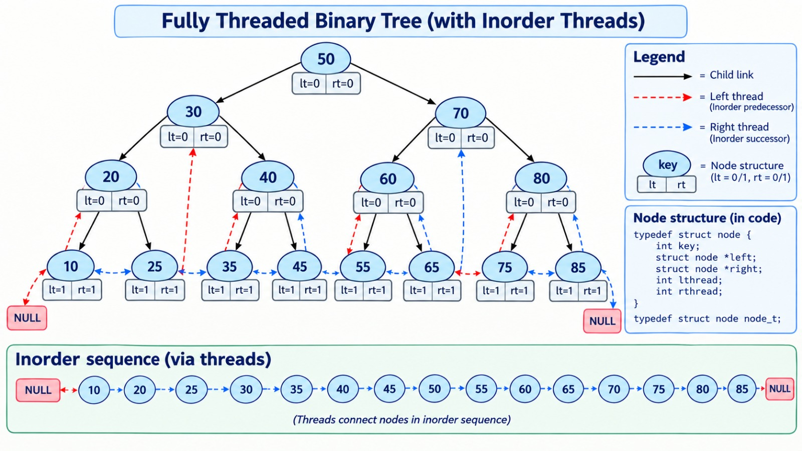
Threaded Binary Tree
B.TECH » DEPARTMENT OF COMPUTER SCIENCE & ENGINEERING (AI & ML) » DATA STRUCTURES AND ITS APPLICATIONS » UE25CS252A » UNIT 1 » ARRAYS » CLASS 3/12
© Confidential Information of PES University. All Rights Reserved - 2026
2 / 9

Slide 15
Threaded Binary Tree
Structure:
struct node
{
int key_;
struct node *left_;
struct node *right_;
int lthread_; // 1 if left_ is a thread
int rthread_; // 1 if right_ is a thread
};
typedef struct node node_t;
struct tree
{
node_t *root_;
};
typedef struct tree tree_t;
B.TECH » DEPARTMENT OF COMPUTER SCIENCE & ENGINEERING (AI & ML) » DATA STRUCTURES AND ITS APPLICATIONS » UE25CS252A » UNIT 1 » ARRAYS » CLASS 3/12
© Confidential Information of PES University. All Rights Reserved - 2026
2 / 9

Slide 16
Threaded Binary Tree
interface:
void init(tree_t *ptr_tree);
void deinit(tree_t *ptr_tree);
void disp(tree_t *ptr_tree);
void insert(tree_t *ptr_tree, int key);
B.TECH » DEPARTMENT OF COMPUTER SCIENCE & ENGINEERING (AI & ML) » DATA STRUCTURES AND ITS APPLICATIONS » UE25CS252A » UNIT 1 » ARRAYS » CLASS 3/12
© Confidential Information of PES University. All Rights Reserved - 2026
2 / 9

Slide 17
Threaded Binary Tree
initialize:
void init(tree_t *ptr_tree)
{
ptr_tree->root_ = NULL;
}
B.TECH » DEPARTMENT OF COMPUTER SCIENCE & ENGINEERING (AI & ML) » DATA STRUCTURES AND ITS APPLICATIONS » UE25CS252A » UNIT 1 » ARRAYS » CLASS 3/12
© Confidential Information of PES University. All Rights Reserved - 2026
2 / 9

Slide 18
Threaded Binary Tree
insert: helper function
static node_t* create_node(int key)
{
node_t *temp = (node_t*)malloc(sizeof(node_t));
if(temp == NULL)
{
printf("no more memory\n"); exit(1);
}
temp->key_ = key;
temp->left_ = temp->right_ = NULL; // should be changed on insertion
temp->lthread_ = temp->rthread_ = 1; // should be threads
return temp;
}
B.TECH » DEPARTMENT OF COMPUTER SCIENCE & ENGINEERING (AI & ML) » DATA STRUCTURES AND ITS APPLICATIONS » UE25CS252A » UNIT 1 » ARRAYS » CLASS 3/12
© Confidential Information of PES University. All Rights Reserved - 2026
2 / 9

Slide 19
Threaded Binary Tree
insert:
Insert_key is not available to the client
This knows the node structure.
void insert(tree_t *ptr_tree, int key)
{
ptr_tree->root_ = insert_key(ptr_tree->root_, key);
}
B.TECH » DEPARTMENT OF COMPUTER SCIENCE & ENGINEERING (AI & ML) » DATA STRUCTURES AND ITS APPLICATIONS » UE25CS252A » UNIT 1 » ARRAYS » CLASS 3/12
© Confidential Information of PES University. All Rights Reserved - 2026
2 / 9

Slide 20
Threaded Binary Tree
insert:
static node_t* insert_key(node_t* root, int key)
{
node_t *temp = create_node(key);
node_t *parent = NULL;
node_t *curr = root;
while (curr != NULL)
{
parent = curr;
if (key < curr->key_)
{
if (curr->lthread_ == 0)
curr = curr->left_;
else
break;
}
else
{
if (curr->rthread_ == 0)
curr = curr->right_;
else
break;
}
} // of while
if key is less than that of the root move left until there is left subtree. Lthread = 1 => no left subtree
If key is not less than that of the root move right until
There is no right subtree. Rthread = 1 => no right subtree
B.TECH » DEPARTMENT OF COMPUTER SCIENCE & ENGINEERING (AI & ML) » DATA STRUCTURES AND ITS APPLICATIONS » UE25CS252A » UNIT 1 » ARRAYS » CLASS 3/12
© Confidential Information of PES University. All Rights Reserved - 2026
2 / 9

Slide 21
Threaded Binary Tree
insert: continued
if (parent == NULL)
{
return temp; // empty tree case
}
/* Insert as left child */
if (key < parent->key_)
{
temp->left_ = parent->left_;
temp->right_ = parent;
parent->left_ = temp;
parent->lthread_ = 0;
}
temp->right_ is a thread and refer to its parent.
parent->left_ refers to temp and is no more a thread.
/* Insert as right child */
else
{
temp->right_ = parent->right_;
temp->left_ = parent;
parent->right_ = temp;
parent->rthread_ = 0;
}
return root;
}
Insertion on the right subtree is similar.
B.TECH » DEPARTMENT OF COMPUTER SCIENCE & ENGINEERING (AI & ML) » DATA STRUCTURES AND ITS APPLICATIONS » UE25CS252A » UNIT 1 » ARRAYS » CLASS 3/12
© Confidential Information of PES University. All Rights Reserved - 2026
2 / 9

Slide 22
Threaded Binary Tree
Inorder traversal :
void disp(tree_t *ptr_tree)
{
printf("Tree : ");
inorder(ptr_tree->root_);
printf("\n");
}
Helper function:
// returns the node with no left subtree
static node_t *leftmost(node_t *temp)
{
if (temp == NULL)
return NULL;
while (temp->lthread_ == 0)
temp = temp->left_;
return temp;
}
static void inorder(node_t *root)
{
// start from the leftmost node in the tree
node_t *temp = leftmost(root);
while (temp != NULL)
{
printf("%d ", temp->key_);
// find the inorder successor
// follow the right thread if the pointer is a thread
if (temp->rthread_ == 1)
temp = temp->right_;
else
// otherwise find the leftmost of its right subtree
temp = leftmost(temp->right_);
}
}
B.TECH » DEPARTMENT OF COMPUTER SCIENCE & ENGINEERING (AI & ML) » DATA STRUCTURES AND ITS APPLICATIONS » UE25CS252A » UNIT 1 » ARRAYS » CLASS 3/12
© Confidential Information of PES University. All Rights Reserved - 2026
2 / 9

Slide 23
THANK YOU
N S Kumar
Professor
Department of Computer Science & Engineering (AI & ML)

