Slide 1

Introduction
Tree
Data Structures and its Applications (UE25CS52A)
N S Kumar
Professor
Department of Computer Science & Engineering (AI & ML)
B.TECH » DEPARTMENT OF COMPUTER SCIENCE & ENGINEERING (AI & ML) » DATA STRUCTURES AND ITS APPLICATIONS » UE25CS252A » UNIT 2 » INTRODUCTION AND REVISION » CLASS 11/11
© Confidential Information of PES University. All Rights Reserved - 2026
1 / 6

Slide 2
AVL tree
AVL tree: height balanced binary search tree
Searching in a binary search tree may require n comparisons
The tree could become skewed – degenerate to a list
AVL tree gives a solution to this problem
Each node has a balance factor
  Height(left subtree) – Height(right subtree)
Difference is maintained within 1 (-1, 0, 1)
Rotate the tree to keep the balance
B. SCIENCE & ENGINEERING (AI & ML) » DATA STRUCTURES AND ITS APPLICATIONS » UE25CS252A » UNIT 1 » ARRAYS » CLASS 3/12
© Confidential Information of PES University. All Rights Reserved - 2026
2 / 9

Slide 3
AVL tree
AVL tree: rotations
Case | Configuration | Rotation
LL | Left-Left | Right rotation
RR | Right-Right | Left rotation
LR | Left-Right | Left rotation + Right rotation
RL | Right-Left | Right rotation + Left rotation
Same direction → single rotation
Opposite directions → double rotation
B. SCIENCE & ENGINEERING (AI & ML) » DATA STRUCTURES AND ITS APPLICATIONS » UE25CS252A » UNIT 1 » ARRAYS » CLASS 3/12
© Confidential Information of PES University. All Rights Reserved - 2026
2 / 9

Slide 4
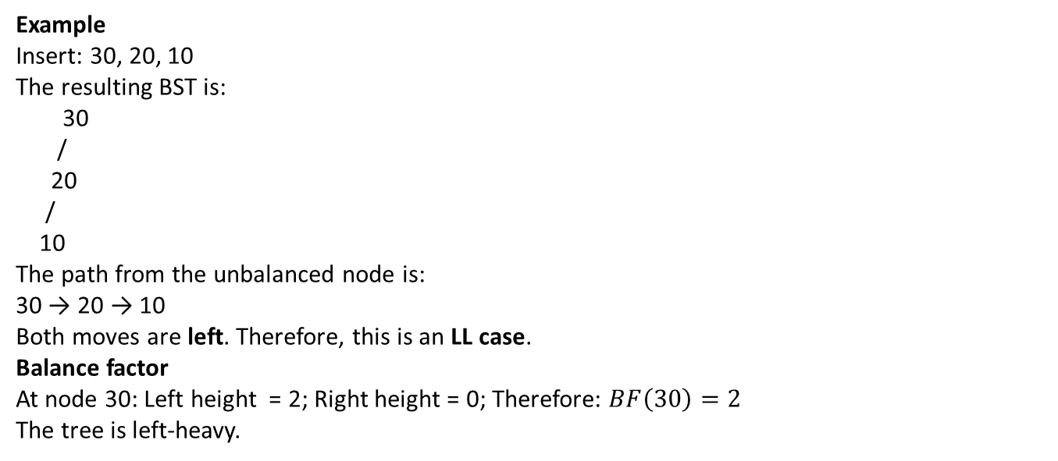
AVL tree
AVL tree: LL Rotation
Example
Insert: 30, 20, 10
The resulting BST is:
30
/
20
/
10
The path from the unbalanced node is:
30 → 20 → 10
Both moves are left. Therefore, this is an LL case.
Balance factor
At node 30: Left height = 2; Right height = 0; Therefore: $BF\left(30\right)=2$
The tree is left-heavy.
B. SCIENCE & ENGINEERING (AI & ML) » DATA STRUCTURES AND ITS APPLICATIONS » UE25CS252A » UNIT 1 » ARRAYS » CLASS 3/12
© Confidential Information of PES University. All Rights Reserved - 2026
2 / 9

Slide 5
AVL tree
AVL tree: LL Rotation
Solution: Right Rotation : Rotate right around 30:
30
/
20
/
10
↓
20
/ \
10 30
The tree is now balanced.
LL rule : LL → Right Rotation
B. SCIENCE & ENGINEERING (AI & ML) » DATA STRUCTURES AND ITS APPLICATIONS » UE25CS252A » UNIT 1 » ARRAYS » CLASS 3/12
© Confidential Information of PES University. All Rights Reserved - 2026
2 / 9

Slide 6
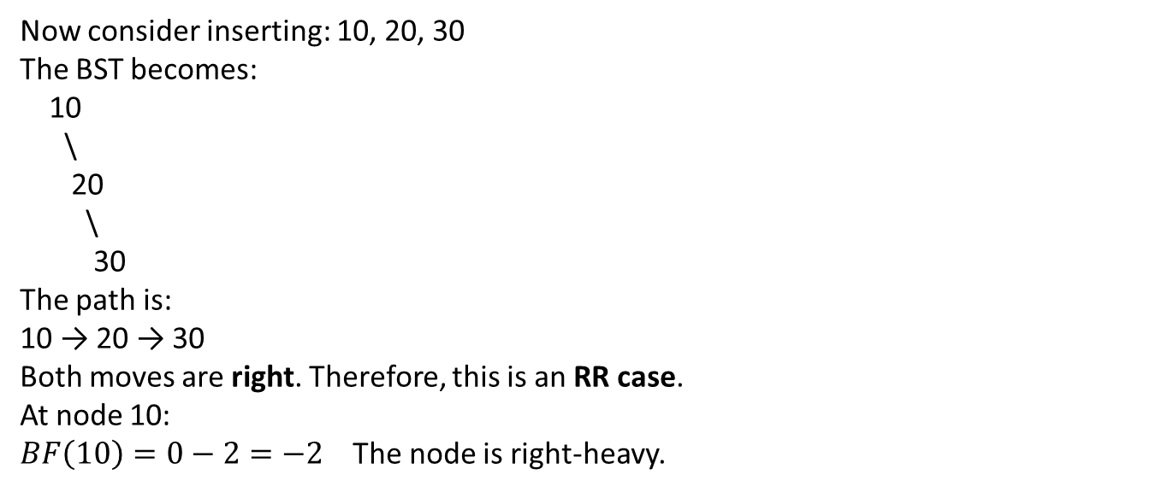
AVL tree
AVL tree: RR Rotation
Now consider inserting: 10, 20, 30
The BST becomes:
10
\
20
\
30
The path is:
10 → 20 → 30
Both moves are right. Therefore, this is an RR case.
At node 10:
$BF\left(10\right)=0−2=−2$ The node is right-heavy.
B. SCIENCE & ENGINEERING (AI & ML) » DATA STRUCTURES AND ITS APPLICATIONS » UE25CS252A » UNIT 1 » ARRAYS » CLASS 3/12
© Confidential Information of PES University. All Rights Reserved - 2026
2 / 9

Slide 7
AVL tree
AVL tree: RR Rotation
Solution: Solution: Left Rotation; Rotate left around 10:
10
\
20
\
30
↓
20
/ \
10 30
RR rule
RR → Left Rotation
B. SCIENCE & ENGINEERING (AI & ML) » DATA STRUCTURES AND ITS APPLICATIONS » UE25CS252A » UNIT 1 » ARRAYS » CLASS 3/12
© Confidential Information of PES University. All Rights Reserved - 2026
2 / 9

Slide 8
AVL tree
AVL tree: LR Rotation
Insert: 30, 10, 20
The BST becomes:
30
/
10
\
20
The path is:
30 → 10 → 20
The first move is left, but the second is right. Therefore:
Left → Right
This is an LR case. (requires double rotation)
.
B. SCIENCE & ENGINEERING (AI & ML) » DATA STRUCTURES AND ITS APPLICATIONS » UE25CS252A » UNIT 1 » ARRAYS » CLASS 3/12
© Confidential Information of PES University. All Rights Reserved - 2026
2 / 9

Slide 9
AVL tree
AVL tree: LR Rotation
Step 1 : Left rotation : First rotate the subtree rooted at 10 to the left.
30
/
10
\
20
becomes:
30
/
20
/
10 Now the tree has become an LL configuration.
B. SCIENCE & ENGINEERING (AI & ML) » DATA STRUCTURES AND ITS APPLICATIONS » UE25CS252A » UNIT 1 » ARRAYS » CLASS 3/12
© Confidential Information of PES University. All Rights Reserved - 2026
2 / 9

Slide 10
AVL tree
AVL tree: LR Rotation
Step 2: Right rotation : Rotate right around 30:
30
/
20
/
10
↓
20
/ \
10 30 The tree is balanced.
LR rule : LR → Left Rotation followed by Right Rotation
B. SCIENCE & ENGINEERING (AI & ML) » DATA STRUCTURES AND ITS APPLICATIONS » UE25CS252A » UNIT 1 » ARRAYS » CLASS 3/12
© Confidential Information of PES University. All Rights Reserved - 2026
2 / 9

Slide 11
AVL tree
AVL tree: RL Rotation
Now consider:
10, 30, 20
The BST becomes:
10
\
30
/
20
The path is:
10 → 30 → 20
The first move is right, followed by left.
Therefore, this is an RL case. (requires double rotation)
.
B. SCIENCE & ENGINEERING (AI & ML) » DATA STRUCTURES AND ITS APPLICATIONS » UE25CS252A » UNIT 1 » ARRAYS » CLASS 3/12
© Confidential Information of PES University. All Rights Reserved - 2026
2 / 9

Slide 12
AVL tree
AVL tree: RL Rotation
Step 1: Right rotation : Rotate right around 30:
10
\
30
/
20
becomes:
10
\
20
\
30 Now we have an RR configuration.
B. SCIENCE & ENGINEERING (AI & ML) » DATA STRUCTURES AND ITS APPLICATIONS » UE25CS252A » UNIT 1 » ARRAYS » CLASS 3/12
© Confidential Information of PES University. All Rights Reserved - 2026
2 / 9

Slide 13
AVL tree
AVL tree: RL Rotation
Step 2: Left rotation : Rotate left around 10:
10
\
20
\
30
↓
20
/ \
10 30 The tree is balanced.
RL rule : RL → Right Rotation followed by Left Rotation
B. SCIENCE & ENGINEERING (AI & ML) » DATA STRUCTURES AND ITS APPLICATIONS » UE25CS252A » UNIT 1 » ARRAYS » CLASS 3/12
© Confidential Information of PES University. All Rights Reserved - 2026
2 / 9

Slide 14
THANK YOU
N S Kumar
Professor
Department of Computer Science & Engineering (AI & ML)

