Slide 1

OPERATING SYSTEMS
UE25CS242A
Memory Management
Pavan A C and Nivedita Kasturi
Department of Computer Science & Engineering

Slide 2
OPERATING SYSTEMS
Slides Credits for all the PPTs of this course
The slides/diagrams in this course are an adaptation, combination, and enhancement of material from the following resources and persons:
Slides of Operating System Concepts, Abraham Silberschatz, Peter Baer Galvin, Greg Gagne - 9th edition 2013 and some slides from 10th edition 2018
Some conceptual text and diagram from Operating Systems - Internals and Design Principles, William Stallings, 9th edition 2018
Some presentation transcripts from A. Frank – P. Weisberg
Some conceptual text from Operating Systems: Three Easy Pieces, Remzi Arpaci-Dusseau, Andrea Arpaci Dusseau

Slide 3
OPERATING SYSTEMS
Main Memory:
Hardware and control structures, OS support, Address translation
Pavan A C and Nivedita Kasturi
Department of Computer Science & Engineering

Slide 4
OPERATING SYSTEMS
Background
What is a memory?
  Memory consists of a large array of bytes, each with its own address.
Execution of an instruction,
  Fetch an Instruction from memory, Decode the instruction, operands are fetched(from memory or registers)
  After the instruction is executed, results are stored back.
The memory unit(MU) sees the stream of addresses.
Memory unit does not know how these addresses are generated.
We will learn how the addresses are generated by the running program.

Slide 5
OPERATING SYSTEMS
Basic Hardware
Program must be brought (from disk) into memory and placed within a ready queue it to be run
Main memory and registers are only storage CPU can access directly
The data required for CPU must be made available in the registers.
  Register access in one CPU clock (or less)
Main memory can take many cycles, causing a stall
Cache sits between main memory and CPU registers
  Speeds up memory access without any OS control
Protection of memory required to ensure correct operation

Slide 6
OPERATING SYSTEMS
Multi-Programming
Protection of OS from its access by user processes is needed
On multiuser systems user processes must be protected from each other.
This protection must be provided by the hardware because the operating system doesn’t usually intervene between the CPU and its memory accesses.
Several hardware protection methods will be discussed.
Protection by using two registers, usually a base and a limit.

Slide 7
OPERATING SYSTEMS
Multi-Programming
Protection of OS from its access by user processes is needed
On multiuser systems user processes must be protected from each other.
This protection must be provided by the hardware because the operating system doesn’t usually intervene between the CPU and its memory accesses.
Several hardware protection methods will be discussed.
Protection by using two registers, usually a base and a limit.

Slide 8
OPERATING SYSTEMS
Protection vs. Translation
Protection - preventing access to private memory of other processes
Translation - converting virtual addresses to physical ones to provide a uniform memory view

Slide 9
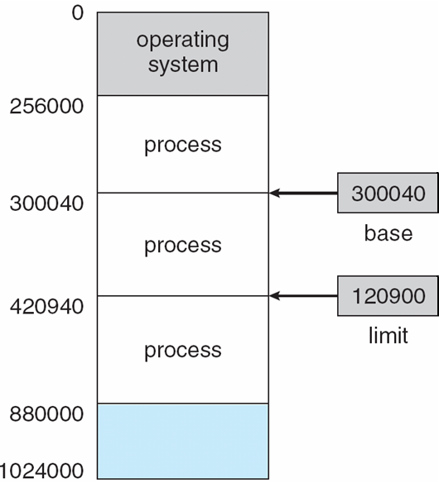
OPERATING SYSTEMS
Basic Hardware
A pair of base and limit registers define the logical address space
CPU must check every memory access generated in user mode to be sure it is between base and limit for that user
Notes:
The base register holds the smallest legal physical address.
The limit register specifies the size of the range of legal addresses that the process may access.

Slide 10
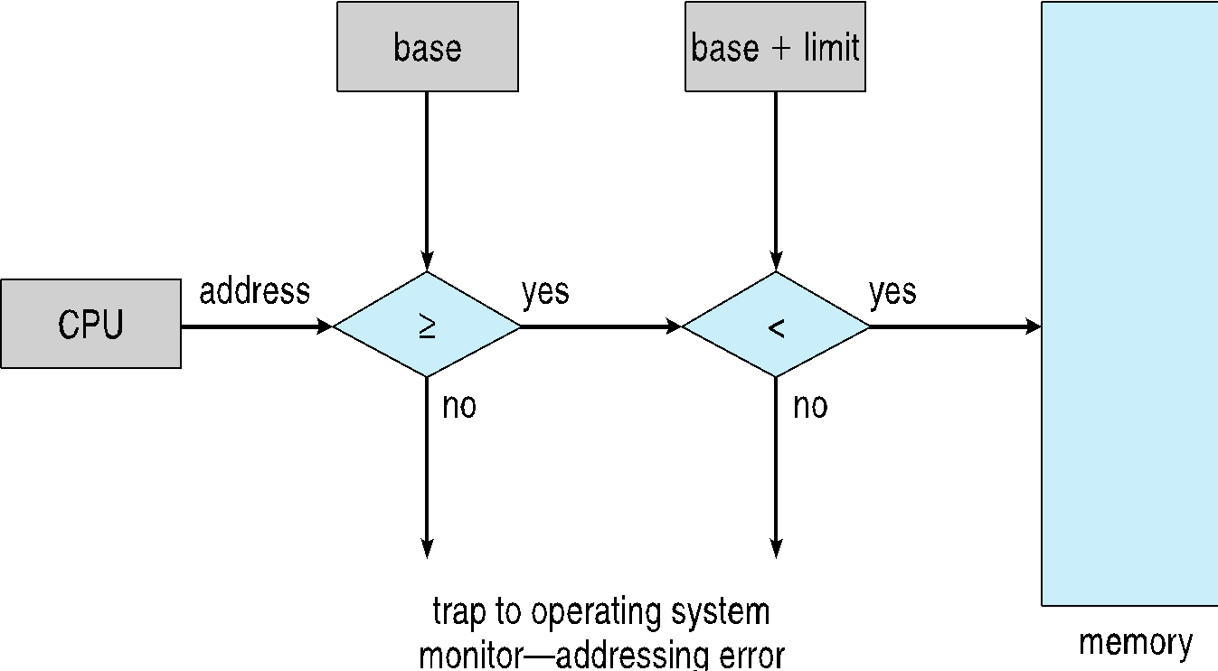
OPERATING SYSTEMS
Hardware Address Protection
CPU must check every memory access generated in user mode to be sure it is between base and limit for that user
prevents a user program from modifying the code or data structures of either the operating system or other users.

Slide 11
OPERATING SYSTEMS
Basic Hardware
The base and limit registers can be loaded only by the operating system.
  Using special privileged instruction.
  privileged instructions can be executed only in kernel mode.
  OS runs in the kernel mode. Only OS can change the register values.
  This prevents other user programs to modify the register values.
Notes:
The base register holds the smallest legal physical address.
The limit register specifies the size of the range of legal addresses that the process may access.

Slide 12
OPERATING SYSTEMS
Address Binding
Programs on disk as binary executable and are brought to main memory for execution
Processes may be moved between the disk and memory during execution.
What are the steps involved in the program execution?
Most systems allow a user process to reside in any part of the physical memory.
The address space of the computer may start at 00000 but the first address of the user process need not be 00000
Addresses in the source program are generally symbolic (Ex. variable count).

Slide 13
OPERATING SYSTEMS
Address Binding
A compiler typically binds these symbolic addresses to relocatable addresses
  “14 bytes from the beginning of this module”
The linkage editor or loader in turn binds the relocatable addresses to absolute addresses
  Ex. 74014
Each binding is a mapping from one address space to another.

Slide 14
OPERATING SYSTEMS
Memory-Management Unit (Cont.)
Base-register scheme for address mapping
The base register also referred to as a relocation register.
The value in the relocation register is added to every address generated by a user process at the time the address is sent to memory .
Example, if the base is at 14000, then an attempt by the user to address location 0 is dynamically relocated to location 14000;
An access to location 346 is mapped to location 14346.
The user program deals with logical addresses; it never sees the real physical addresses
  Execution-time binding occurs when reference is made to location in memory
  Logical address bound to physical addresses

Slide 15
OPERATING SYSTEMS
Memory-Management Unit (Cont.)
The binding of instructions and data to memory addresses
Compile time. If you know at compile time where the process will reside in memory, then absolute code can be generated.
  If the start address changes, it is necessary to recompile once again
  The MS-DOS .COM-format programs are bound at compile time.
Load time. If it is not known at compile time where the process will reside in memory, then the compiler must generate relocatable code.
  final binding is delayed until load time.
  If the starting address changes, we need only reload the user code to incorporate this changed value.
Execution time. If the process can be moved during its execution from one memory segment to another, then binding must be delayed until run time.
  Special hardware must be available for this scheme to work

Slide 16
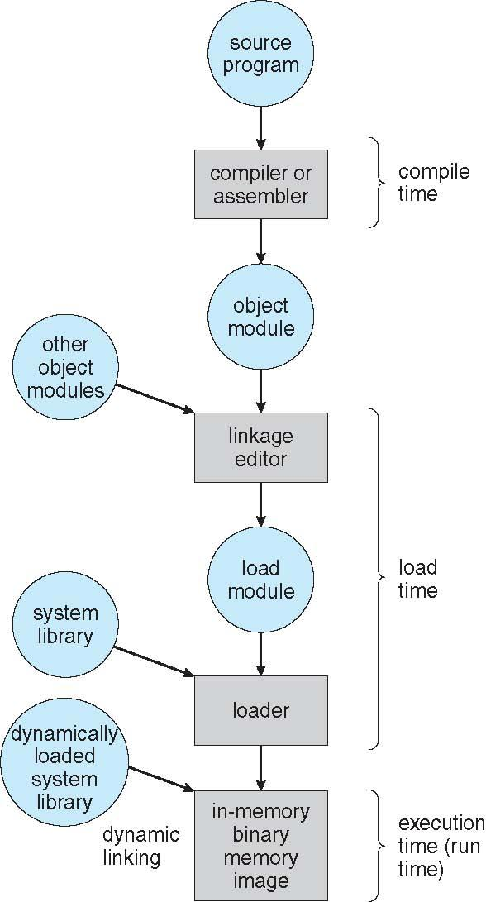
OPERATING SYSTEMS
Multistep Processing of a User Program
Notes:
A user program goes through several steps—some of which may be optional—before being. Addresses may be represented
in different ways during these steps. Addresses in the source program are generally symbolic (such as the variable count).
A compiler typically binds these symbolic addresses to relocatable addresses (such as “14 bytes from the beginning of this module”).
The linker or loader in turn binds the relocatable addresses to absolute addresses (such as 74014).
Each binding is a mapping from one address space to another. Classically, the binding of instructions and data to memory addresses can
be done at any step along the way:

Slide 17
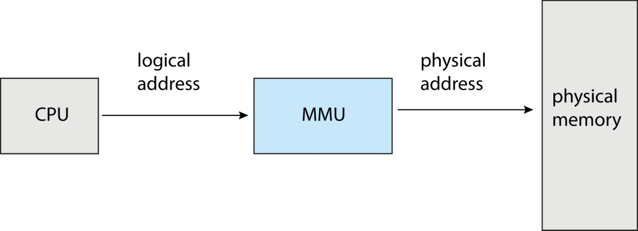
OPERATING SYSTEMS
Memory-Management Unit (MMU)
Hardware device that at run time maps virtual to physical address
Many methods possible to accomplish this mapping, will be discussed in the next few lectures.

Slide 18
OPERATING SYSTEMS
Logical vs. Physical Address Space
The concept of a logical address space that is bound to a separate physical address space is central to proper memory management
  Logical address – generated by the CPU; also referred to as virtual address
  Physical address – address seen by the memory unit
Logical and physical addresses are the same in compile-time and load-time address-binding schemes; logical (virtual) and physical addresses differ in execution-time address-binding scheme
Logical address space is the set of all logical addresses generated by a program
Physical address space is the set of all physical addresses generated by a program

Slide 19
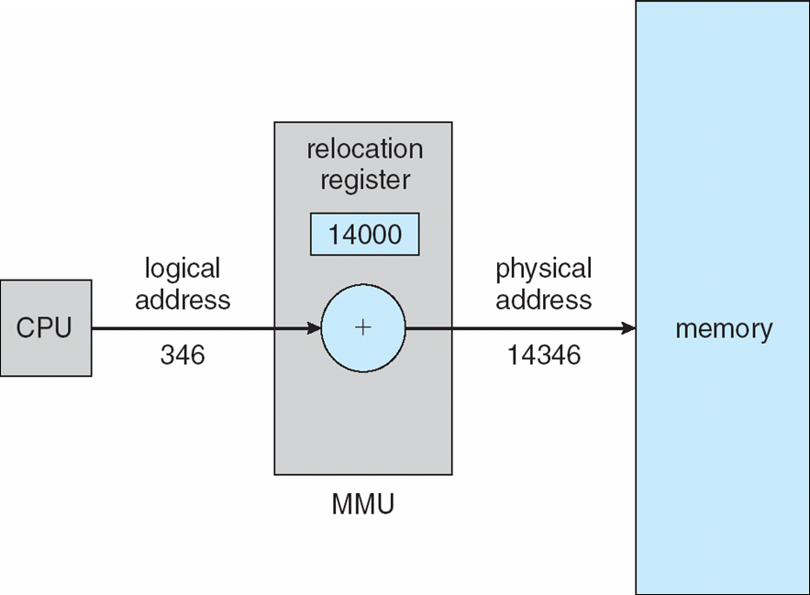
OPERATING SYSTEMS
Dynamic relocation using a relocation register
Routine is not loaded until it is called
Better memory-space utilization; unused routine is never loaded
All routines kept on disk in relocatable load format
Useful when large amounts of code are needed to handle infrequently occurring cases
No special support from the operating system is required
  Implemented through program design
  OS can help by providing libraries to implement dynamic loading

Slide 20
OPERATING SYSTEMS
Dynamic Linking
Static linking – system libraries and program code combined by the loader into the binary program image
Dynamic linking –linking postponed until execution time
Small piece of code, stub, used to locate the appropriate memory-resident library routine
Stub replaces itself with the address of the routine, and executes the routine
Operating system checks if routine is in processes’ memory address
  If not in address space, add to address space
Dynamic linking is particularly useful for libraries
Other programs linked before the new library was installed will continue using the older library
This System also known as shared libraries
Consider applicability to patching system libraries
  Versioning may be needed

Slide 21
OPERATING SYSTEMS
Static and Dynamic Linking
A program whose necessary library functions are embedded directly in the program’s executable binary file is statically linked to its libraries
The main disadvantage of static linkage is that every program generated must contain copies of exactly the same common system library functions
Dynamic linking is more efficient in terms of both physical memory and disk-space usage because it loads the system libraries into memory only once
Notes:
Linux implements dynamic linking in user mode through a special linker library.
Every dynamically linked program contains small, statically linked function that is called when the program starts
This static function maps the link library into memory and runs the code that the function contains.
Link library determines dynamic libraries required by the program and the names of the variables and functions needed
Maps libraries into middle of virtual memory and resolves references to symbols contained in the libraries
Shared libraries compiled to be position-independent code (PIC) so can be loaded anywhere

Slide 22
OPERATING SYSTEMS
Memory-Mapped Files (mmap)
Mapping file contents directly into the process virtual address space.Access disk files via memory pointers (ptr[i]) instead of standard I/O system calls.Eliminate data duplication between kernel buffers and user space.
How It Works:
Address Translation: OS allocates a virtual address range to the file without loading it into physical RAM.
OS Support & Page Faults: Reading an address triggers a hardware page fault; the OS then pages the disk content into Main Memory.
Dynamic Shared Libraries: Uses the same mechanism as shared libraries to allow multiple processes to share memory safely.
Two Core Modes
Shared Mapping (MAP_SHARED): Writes modify the actual file on disk and are instantly visible to other processes.
Private Mapping (MAP_PRIVATE): Utilizes Copy-on-Write (CoW); modifications stay in memory and never change the disk file.
Advantages
High Performance: Bypasses overhead from read() and write() system calls.
Zero-Copy I/O: Transfers data directly from disk cache to user space.
Efficient IPC: Enables lightning-fast Inter-Process Communication via shared physical pages.
Notes:
We can use standard system calls like read(), seek(), open(), and so on to perform a sequential read of a file present on the disk.
Thus, to access a file from the disk we need system calls and disk access.
Memory mapping is a technique that allows a part of the virtual address space to be associated with a file logically.
This technique of memory mapping leads to a significant increase in performance.
Memory-mapped files simply reuse the OS paging mechanisms to map file contents directly into a process's virtual address space.

Slide 23
OPERATING SYSTEMS
Memory-Mapped Files- Life cycle of the Mapped Pages
1. First access:A demand-paging fault occurs; a page-sized chunk of the file is read from disk into a physical page.
2. Subsequent access:Reads and writes to the file are handled as ordinary memory accesses — no read()/write() system call overhead.
3. Deferred write-back:Modified pages aren't written to disk immediately; under memory pressure they're paged to swap space instead of being lost.
4. On close:All memory-mapped data is written back to secondary storage and unmapped from the process's virtual memory.
Solaris Example:
mmap(): File is mapped directly into the process's address space.
open() / read() / write(): File is still memory-mapped — but into kernel address space.
Net effect: All file I/O goes through the efficient memory subsystem, avoiding traditional system-call overhead.
Notes:
Some OSes memory-map only via an explicit call; others (like Solaris) memory-map every file regardless of how it was opened.

Slide 24
OPERATING SYSTEMS
Memory-Mapped Files: Advantages and Sharing Memory
Faster file access
The file can be accessed directly through memory addresses.
This can be faster than repeatedly using read() and write() system calls.
Less data copying
The operating system can map file pages directly into the process's address space.
This reduces unnecessary copying of data between kernel buffers and user-space buffers.
Random access is easy
Any part of the file can be accessed directly using an address.
There is no need to sequentially read the file to reach a particular location.
Efficient for large files
The entire file does not necessarily need to be loaded into RAM.
The OS loads required pages into memory when they are accessed using demand paging.
Easy programming
After mapping, the file can be accessed using normal pointer/array operations.
For example:
data[100]
can access data at a particular location in the mapped file.
Sharing between processes
Multiple processes can map the same file and potentially share the same physical memory pages.
This can be useful for IPC and shared data.
Changes can be reflected in the file
With a shared mapping (MAP_SHARED), modifications to the mapped memory can be written back to the underlying file.

Slide 25
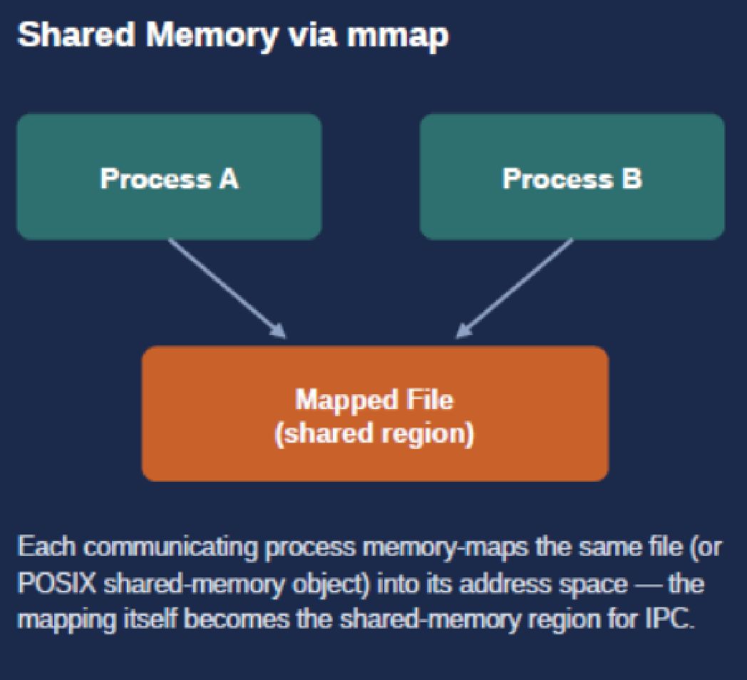
OPERATING SYSTEMS
Memory-Mapped Files: Advantages and Sharing Memory
Concurrent access, copy-on-write, and shared memory
Concurrent Sharing
Multiple processes can map the same file at once. Each process's virtual memory map points to the same physical page — the page holding the disk block — so writes by one process are immediately visible to all others.
Copy-on-Write
Mapping calls can support copy-on-write: processes share a file read-only, but any process that modifies data gets its own private copy of just that data.
Coordinating Access
Since the memory is shared, processes typically use a mutual-exclusion mechanism to coordinate access to the shared data.
Shared Memory via mmap (diagram box)
Process A → Mapped File (shared region)
Process B → Mapped File (shared region)
Each communicating process memory-maps the same file (or POSIX shared-memory object) into its address space — the mapping itself becomes the shared-memory region for IPC.

Slide 26
OPERATING SYSTEMS
Memory-Mapped Files: Example

Slide 27
OPERATING SYSTEMS
Memory-Mapped Files: Example
For Complete Example refer to Lecture_30_Write Program _mmap_shared_guide.docx
Lecture_30_mmap_reader_and_ipc_guide.docx

Slide 28
OPERATING SYSTEMS
Questions
Q1: Why must memory protection checks (like base and limit) be implemented in hardware rather than by the OS software?
Q2: What happens if a user process attempts to access a memory address that is greater than its limit register?
Q3: Can a user process modify its own base and limit registers to access more memory? Why or why not?
Q5: What is the primary disadvantage of static linking?
Q6: What is a "stub" in the context of dynamic linking?
Q7: Explain the concept of "Execution-time address binding.”
Q8: If a system uses a relocation (base) register set to 14000, what physical address is accessed if the program requests logical address 346?
Notes:
7: It is a scheme where the final physical address of a variable or instruction is not determined until the program is actually running and making the memory reference. This requires hardware support like an MMU to translate the logical address on the fly.

Slide 29
OPERATING SYSTEMS
Questions
Question 1: Explain the difference between MAP_SHARED and MAP_PRIVATE flags when used with the mmap() system call. What happens to modifications made on disk in each case?
Question 2: In the code segment map[0] = 'Z';, how does the operating system handle writing this modification back to storage without a standard write() system call?
Question 3: Why is it necessary to open the file with O_RDWR if you plan to use PROT_WRITE inside mmap()?
Question 4: Suppose two independent processes use MAP_SHARED to map the exact same file region. If Process A changes map[0] to 'Z', how does Process B find out about the change? Does it require an explicit message-passing mechanism? Explain your answer.
Question 5: What would happen if you ran the mmap_write program shown on the slide, but the file data.txt did not exist or was completely empty (0 bytes) before execution?
Notes:
Question 1: Explain the difference between MAP_SHARED and MAP_PRIVATE flags when used with the mmap() system call. What happens to modifications made on disk in each case?
Answer:
MAP_SHARED: The memory mapping is shared among all processes mapping the same file region. Any changes written to the memory address space are visible to other processes immediately and are written back to the actual underlying disk file.
MAP_PRIVATE: This creates a private Copy-on-Write (COW) mapping. Any edits a process makes are local to its own virtual address space. The underlying disk file remains completely untouched, and changes are invisible to other applications.
Question 2: In the code segment map[0] = 'Z';, how does the operating system handle writing this modification back to storage without a standard write() system call?
Answer:
When the processor executes map[0] = 'Z';, it interacts directly with virtual memory via the Memory Management Unit (MMU).
The CPU marks that specific page in physical memory (RAM) as "dirty" (modified).
Because there is no explicit write() system call, the user process continues immediately without blocking.
The operating system's kernel page-flushing daemon (like pdflush or kswapd in Linux) periodically runs in the background. It finds dirty pages and asynchronously commits them back to disk storage. Alternatively, a developer can force it to sync immediately using the msync() system call.
Question 3: Why is it necessary to open the file with O_RDWR if you plan to use PROT_WRITE inside mmap()?
Answer:
The operating system enforces a strict permission matching rule between the file descriptor and the memory protection flags. If a file is opened as read-only (O_RDONLY), granting write protection (PROT_WRITE) in memory would break file system security boundaries. The system will reject this mismatch during the execution of the mmap() system call, failing immediately and returning MAP_FAILED (with errno set to EACCES or EPERM).
Question 4: Suppose two independent processes use MAP_SHARED to map the exact same file region. If Process A changes map[0] to 'Z', how does Process B find out about the change? Does it require an explicit message-passing mechanism? Explain your answer.
Answer:
No explicit message passing is required. When both processes execute mmap() with MAP_SHARED on the same file, the OS page tables of both Process A and Process B point directly to the exact same physical page frame in RAM (the kernel's page cache). When Process A edits map[0], it is changing physical RAM. Because Process B shares that exact physical RAM page, the update is instantly visible the next time Process B reads that memory address.
Question 5: What would happen if you ran the mmap_write program shown on the slide, but the file data.txt did not exist or was completely empty (0 bytes) before execution?
Answer:
If the file does not exist: The initial open("data.txt", O_RDWR) call will fail and return -1 because the O_CREAT flag was not passed. The program will print an error and exit.
If the file exists but is empty (0 bytes): The mmap() call will request a mapping of 0 bytes (or round up to a page). However, when the program attempts to execute map[0] = 'Z';, it is trying to access memory outside the valid file size allocation. This triggers a hardware fault, and the operating system will abruptly terminate the program with a SIGBUS (Bus Error) or SIGSEGV (Segmentation Fault).

Slide 30
THANK YOU
Pavan A C
Department of Computer Science and Engineering
pavanac@pes.edu

