Slide 1

OPERATING SYSTEMS
UE25CS242A
Swapping, Memory Allocation, Fragmentation
Prof. Pavan A C
Department of Computer Science & Engineering

Slide 2
OPERATING SYSTEMS
Slides Credits for all the PPTs of this course
The slides/diagrams in this course are an adaptation, combination, and enhancement of material from the following resources and persons:
Slides of Operating System Concepts, Abraham Silberschatz, Peter Baer Galvin, Greg Gagne - 9th edition 2013 and some slides from 10th edition 2018
Some conceptual text and diagram from Operating Systems - Internals and Design Principles, William Stallings, 9th edition 2018
Some presentation transcripts from A. Frank – P. Weisberg
Some conceptual text from Operating Systems: Three Easy Pieces, Remzi Arpaci-Dusseau, Andrea Arpaci Dusseau

Slide 3
OPERATING SYSTEMS
Swapping, Memory Allocation , Fragmentation
Prof. Pavan A C
Department of Computer Science & Engineering

Slide 4
OPERATING SYSTEMS
Swapping
A process can be swapped temporarily out of memory to a backing store, and then brought back into memory for continued execution
  Total physical memory space of processes can exceed physical memory
Backing store – fast disk large enough to accommodate copies of all memory images for all users; must provide direct access to these memory images
Roll out, roll in – swapping variant used for priority-based scheduling algorithms; lower-priority process is swapped out so higher-priority process can be loaded and executed
Major part of swap time is transfer time; total transfer time is directly proportional to the amount of memory swapped
System maintains a ready queue of ready-to-run processes which have memory images on disk

Slide 5
OPERATING SYSTEMS
Swapping (Cont.)
Does the swapped out process need to swap back in to same physical addresses?
Depends on address binding method
  Plus consider pending I/O to / from process memory space
Modified versions of swapping are found on many systems (i.e., UNIX, Linux, and Windows)
  Swapping normally disabled
  Started if more than threshold amount of memory allocated
  Disabled again once memory demand reduced below threshold

Slide 6
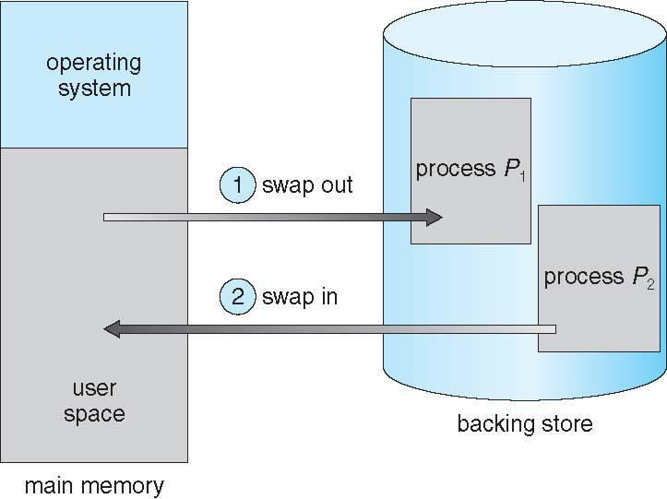
OPERATING SYSTEMS
Schematic View of Swapping
Notes:
Standard swapping involves moving entire processes between main memory and a backing store.
The advantage of standard swapping is that it allows physical memory to be oversubscribed, so that the system can accommodate
more processes than there is actual physical memory to store them.
Idle or mostly idle processes are good candidates for swapping; any memory that has been allocated to these inactive processes can then be
dedicated to active processes. If an inactive process that has been swapped out becomes active once again, it must then be swapped back in.

Slide 7
OPERATING SYSTEMS
Context Switch Time including Swapping
If next processes to be put on CPU is not in memory, need to swap out a process and swap in target process
Context switch time can then be very high
Let us consider a user process with size 100MB
hard disk transfer rate of 50MB/sec
  Swap out time=100MB/50MB per sec= 2 sec
  Swap in in time is same as swap out time
  Total context switch swapping component time = 4 seconds =swap in time + swap out time
What will be the swap time for process with size 3GB? – 60 secs
Is it right to swap complete process?
Can be reduced if size of memory to be swapped is reduced – by knowing how much memory really being used
  System calls to inform OS of memory use via request_memory() and release_memory()

Slide 8
OPERATING SYSTEMS
Context Switch Time and Swapping (Cont.)
Other constraints as well on swapping
  Pending I/O – can’t swap out as I/O would occur to wrong process
  Or always transfer I/O to kernel space, then to process memory space
    Known as double buffering, adds overhead
Standard swapping not used in modern operating systems
  But modified version common
    Swap only when free memory extremely low

Slide 9
OPERATING SYSTEMS
Contiguous Allocation
Main memory must accommodate both OS and user processes
Memory needs to be allocated efficiently
Contiguous allocation is one early method
Main memory usually into two partitions:
  Resident operating system, usually held in low memory with interrupt vector
  User processes then held in high memory
  Each process contained in single section of memory that is contiguous to the section containing the next process.
Notes:
An interrupt vector is the memory location of an interrupt handler.
The interrupt vector table is normally located in the first 1024 bytes of memory at addresses 000000H–0003FFH.
It contains 256 different interrupt vectors. Each vector is 4 bytes long and contains the starting address of the ISR.
This starting address consists of the segment and offset of the ISR.

Slide 10
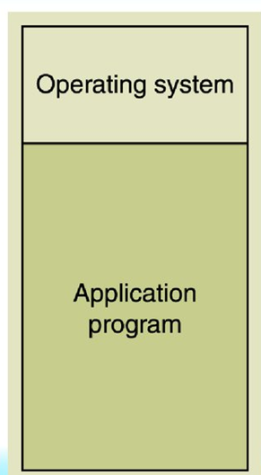
OPERATING SYSTEMS
Contiguous Allocation
Lower address
higher address

Slide 11
OPERATING SYSTEMS
Contiguous Allocation (Cont.)
Relocation registers used to protect user processes from each other, and from changing operating-system code and data
  Base register contains value of smallest physical address
  Limit register contains range of logical addresses – each logical address must be less than the limit register
  MMU maps logical address dynamically
  Can then allow actions such as kernel code being transient (it comes and goes as needed) and kernel/OS changing size during program execution.

Slide 12
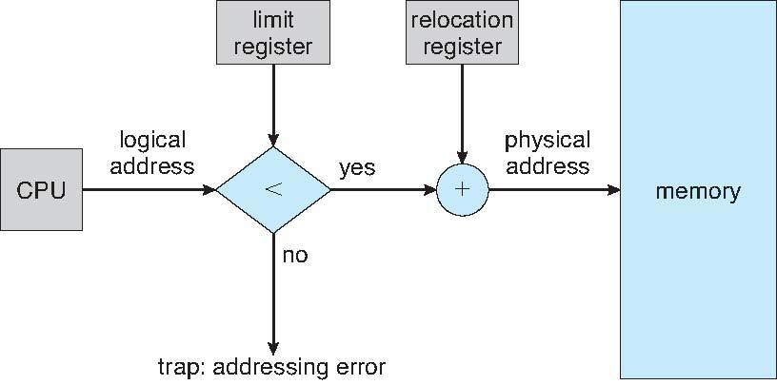
OPERATING SYSTEMS
Hardware Support for Relocation and Limit Registers
When the CPU scheduler selects a process for execution, the dispatcher loads the relocation and limit registers with the correct values as part of the context switch.

Slide 13
OPERATING SYSTEMS
Memory Protection
Every address generated by a CPU is checked against these registers, so possible to protect both the operating system and the other users’ programs and data from being modified by this running process .
The relocation-register scheme provides an effective way to allow the operating system’s size to change dynamically.
  This flexibility is desirable in many situations. For example, the operating system contains code and buffer space for device drivers. If a device driver is not currently in use, it makes little sense to keep it in memory; instead, it can be loaded into memory only when it is needed. Likewise, when the device driver is no longer needed, it can be removed and its memory allocated for other needs.

Slide 14
OPERATING SYSTEMS
Multiple-partition allocation
Multiple-partition allocation
  Divide memory into several fixed-size partitions.
    Each partition may contain exactly one process
    Degree of multiprogramming is bounded by number of partitions.
    when a partition is free, a process is selected from the input queue and is loaded into the free partition
    used by the IBM OS/360 operating system,but is no longer in use
  Variable-partition sizes for efficiency (sized to a given process’ needs)
    This scheme keeps a table indicating which parts of memory are available/occupied
  Hole – block of available memory; holes of various size are scattered throughout memory

Slide 15
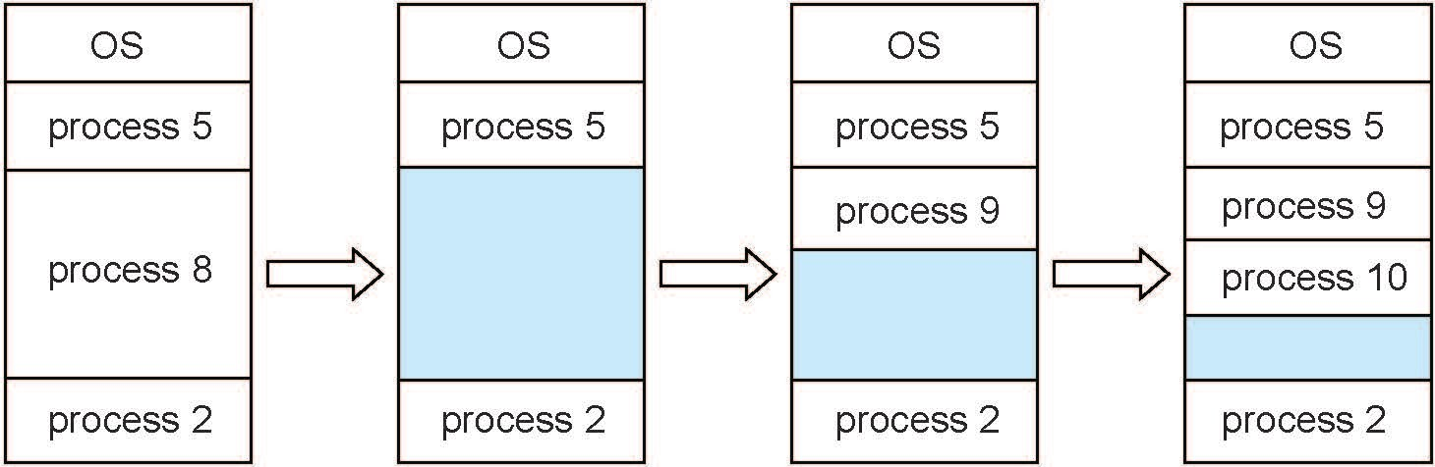
OPERATING SYSTEMS
Multiple-partition allocation (Cont.)
  When a process arrives, it is allocated memory from a hole large enough to accommodate it
  Process exiting frees its partition, adjacent free partitions combined
  Operating system maintains information about:
  a) allocated partitions b) free partitions (hole)
  Considering the size of process as,
  Process 5=100MB,Processes 8=400MB, Process 2=200MB,Process 9=200MB, process 10=100MB, can the process 11=200MB be accommodated after process 5 terminates?

Slide 16
OPERATING SYSTEMS
Partitions
Advantages
No Internal Fragmentation
No restriction on Degree of Multiprogramming
No Limitation on the size of the process
Disadvantages
  Causes External Fragmentation
  Difficult to implement

Slide 17
OPERATING SYSTEMS
Dynamic Storage-Allocation Problem and Strategies
How to satisfy a request of size n from a list of free holes?
First-fit: Allocate the first hole that is big enough (generally faster)
Best-fit: Allocate the smallest hole that is big enough; must search entire list, unless ordered by size
  Produces the smallest leftover hole
Worst-fit: Allocate the largest hole; must also search entire list
  Produces the largest leftover hole
First-fit and best-fit better than worst-fit in terms of speed and storage utilization

Slide 18
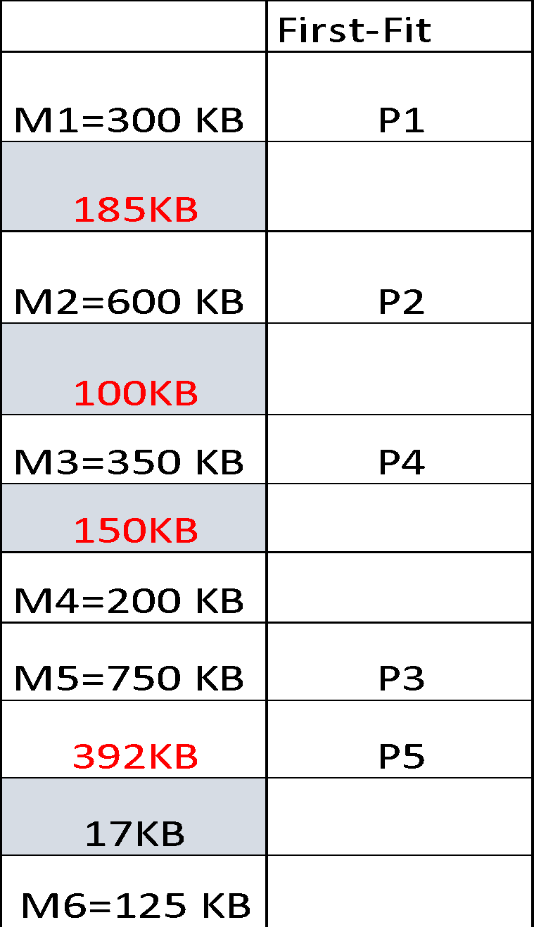
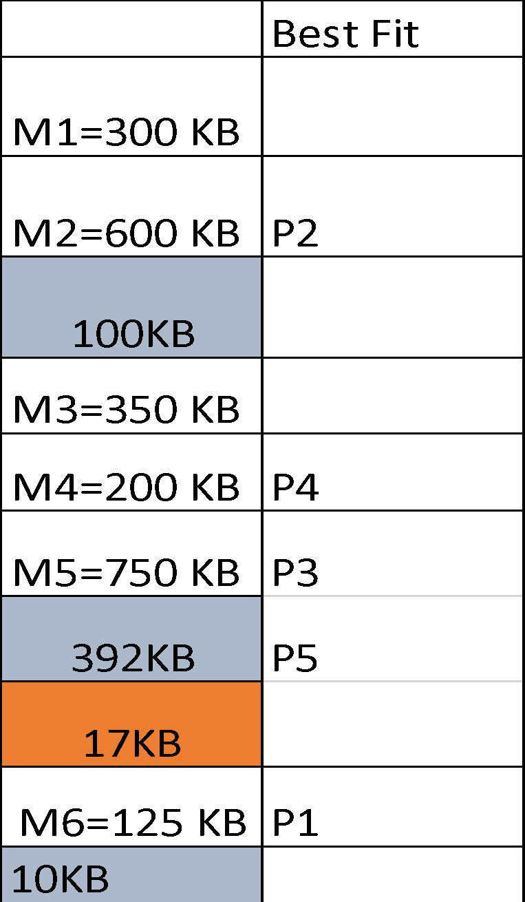
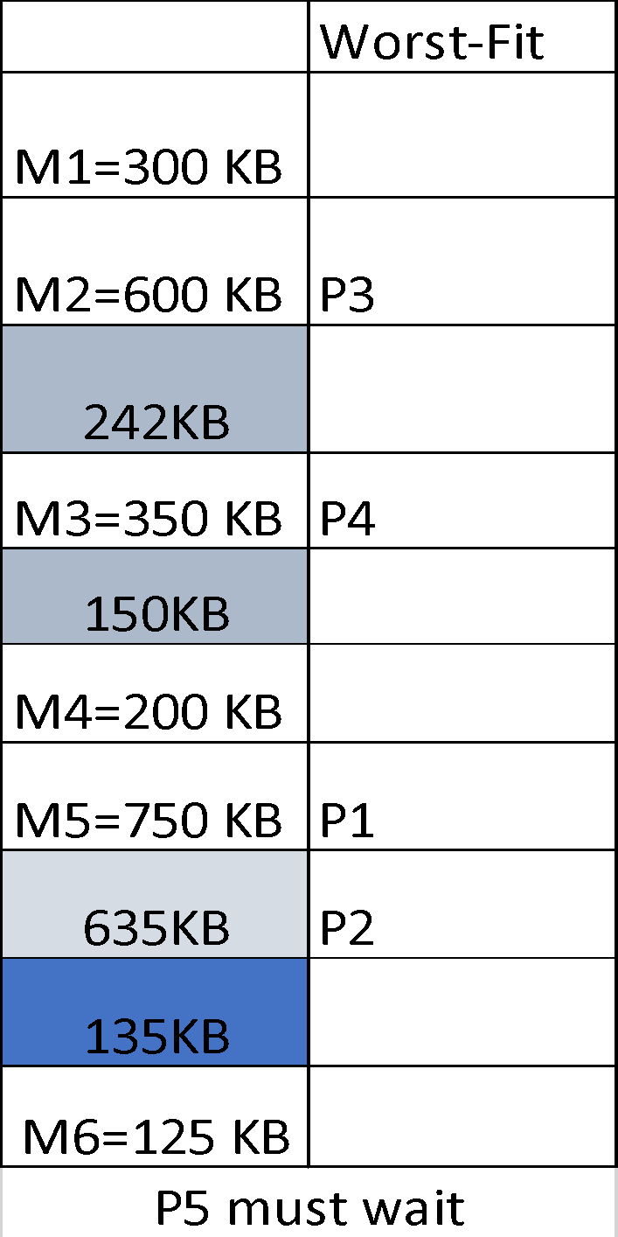
OPERATING SYSTEMS
Allocations strategies: Examples
Example: Given six memory partitions of 300 KB, 600 KB, 350 KB, 200 KB, 750 KB, and 125 KB (in order), how would the first-fit, best-fit, and worst-fit algorithms place processes of size 115 KB, 500 KB, 358 KB, 200 KB, and 375 KB (in order)? Rank the algorithms in terms of how efficiently they use memory.
Soln:
Partitions
Partitions
Partitions
Processes and their sizes
P1=115 KB P2=500 KB P3=358 KB P4=200 KB P5=375 KB
P5 must wait

Slide 19
OPERATING SYSTEMS
Fragmentation
Internal Fragmentation – allocated memory may be slightly larger than requested memory; this size difference is memory internal to a partition, but not being used
External Fragmentation – total memory space exists to satisfy a request, but it is not contiguous
  First fit statistical analysis reveals that given N allocated blocks (66% for example), another 0.5 N blocks (33% for example) lost to fragmentation
  1/3 of memory may be unusable -> 50-percent rule
    Unusable memory = (0.5N)/(N+0.5N)= 1/3
Notes:
For every N blocks allocated, 0.5N blocks are lost to fragmentation.
The rule states that, N blocks (66% for example) of memory may be allocated to processes and 0.5 N (33%) will likely end up as
fragmented memory space.
It does not end up that 50% of memory is fragmented, because that would require that 100% of memory is allocated (according to the ‘rule’ of 0.5 N). We don’t have 150% to allocate.

Slide 20
OPERATING SYSTEMS
Fragmentation (Cont.)
Reduce external fragmentation by compaction
  Shuffle memory contents to place all free memory together in one large block
  Compaction is possible only if relocation is dynamic, and is done at execution time
  I/O problem
    Latch job in memory while it is involved in I/O
    Do I/O only into OS buffers
Why don't we use compaction? imagine the CPU overhead of freezing a computer to physically copy 8 GB of RAM from one physical location to another.
Because contiguous allocation causes external fragmentation, and compaction is too slow, operating systems had to invent a way to allow processes to be mapped to non-contiguous physical memory.

Slide 21
OPERATING SYSTEMS
Questions
Q1: In early systems, standard swapping involved moving entire processes between main memory and a backing store. Why is this specific technique rarely used in modern operating systems like Linux?
Q2: What is the primary problem with swapping out a process that is currently waiting for an I/O operation to complete?
Q3: In contiguous memory allocation, what is the role of the Limit Register?
Q4: A process requests 400KB of memory, but the OS allocates a fixed 512KB partition for it. What specific type of problem does this cause?
Q5: A system has 500MB of total free memory, but a process requesting 300MB cannot be loaded. What is occurring here?

Slide 22
THANK YOU
Prof. Pavan A C
Department of Computer Science and Engineering
pavanac@pes.edu

