Slide 1

OPERATING SYSTEMS
UE25CS242A
Segmentation
Pavan A C
Department of Computer Science & Engineering

Slide 2
OPERATING SYSTEMS
Slides Credits for all the PPTs of this course
The slides/diagrams in this course are an adaptation, combination, and enhancement of material from the following resources and persons:
Slides of Operating System Concepts, Abraham Silberschatz, Peter Baer Galvin, Greg Gagne - 9th edition 2013 and some slides from 10th edition 2018
Some conceptual text and diagram from Operating Systems - Internals and Design Principles, William Stallings, 9th edition 2018
Some presentation transcripts from A. Frank – P. Weisberg
Some conceptual text from Operating Systems: Three Easy Pieces, Remzi Arpaci-Dusseau, Andrea Arpaci Dusseau

Slide 3
OPERATING SYSTEMS
Segmentation
Pavan A C
Department of Computer Science & Engineering

Slide 4
OPERATING SYSTEMS
Segmentation
Memory-management scheme that supports user view of memory
A program is a collection of segments
  A segment is a logical unit such as:
main program
procedure
function
method
object
local variables, global variables
common block
stack
symbol table
arrays
Notes:
Programmers don’t like to think of memory as a linear array of bytes, some containing instructions and others containing data.

Slide 5
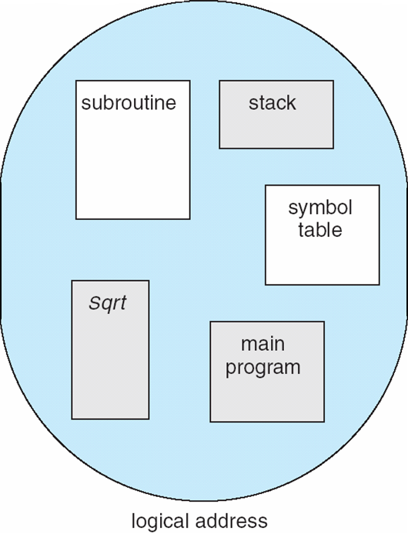
OPERATING SYSTEMS
User’s View of a Program
Segmentation is a memory-management scheme that supports this programmer view of memory
Each segment has a name and a length.
Addresses specify segment name + offset within the segment

Slide 6
OPERATING SYSTEMS
Logical View of Segmentation
1
1
4
2
3
4
2
3
user space
physical memory space
Notes:
A logical address space is a collection of segments.

Slide 7
OPERATING SYSTEMS
Segmentation Basics
Segmentation is a technique for breaking memory up into logical pieces
Each “piece” is a grouping of related information
  data segments for each process
  code segments for each process
  data segments for the OS
  etc.
Segmentation permits the physical address space of a process to be non-contiguous.

Slide 8
OPERATING SYSTEMS
Segmentation Architecture
Logical address consists of a two tuple:
<segment-number s, offset d>,
Segment table – maps two-dimensional physical addresses; each table entry has:
  Segment base – contains the starting physical address where the segments reside in memory
  Segment limit – specifies the length of the segment
Segment-table base register (STBR) points to the segment table’s location in memory
Segment-table length register (STLR) indicates number of segments used by a program;
segment number s is legal if s < STLR
Notes:
Programmer specifies each address by 2 quantities: a segment name and an offset
Compiler creates separate segments reflecting the input program.
Libraries (that are linked in during compile time) may be assigned separate segments.
Loader would assign segment numbers to all these segments.

Slide 9
OPERATING SYSTEMS
Segmentation Hardware
A logical address consists of two parts: a segment number, s, and an offset into that segment, d.
The segment number is used as an index to the segment table. The offset d of the logical address must be between 0 and the segment limit. If it is not, we trap to the operating system (logical addressing attempt beyond end of segment).
When an offset is legal, it is added to the segment base to produce the address in physical memory of the desired byte. The segment table is thus essentially an array of base–limit register pairs.
Notes:
The use of a segment table is shown in the diagram.

Slide 10
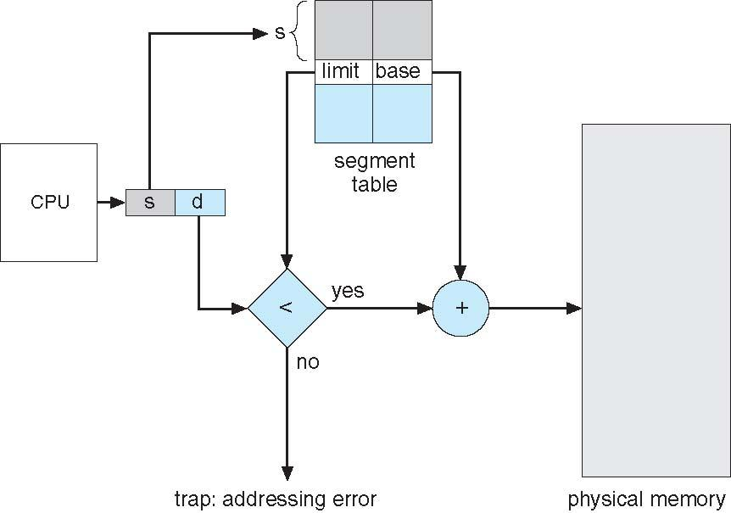
OPERATING SYSTEMS
Segmentation Hardware (Cont.)
Notes:
The use of a segment table is shown in the diagram.

Slide 11
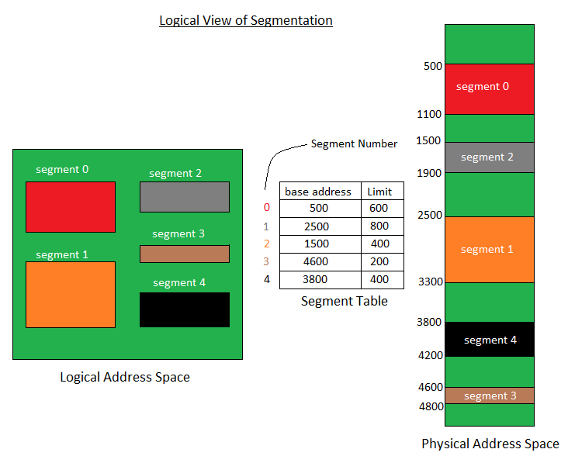
OPERATING SYSTEMS
Segmentation Example

Slide 12
OPERATING SYSTEMS
Segmentation Example (Cont.)
We have five segments numbered from 0 through 4. The segments are stored in physical memory as shown.
The segment table has a separate entry for each segment, giving the beginning address of the segment in physical memory (or base) and the length of that segment (or limit).

Slide 13
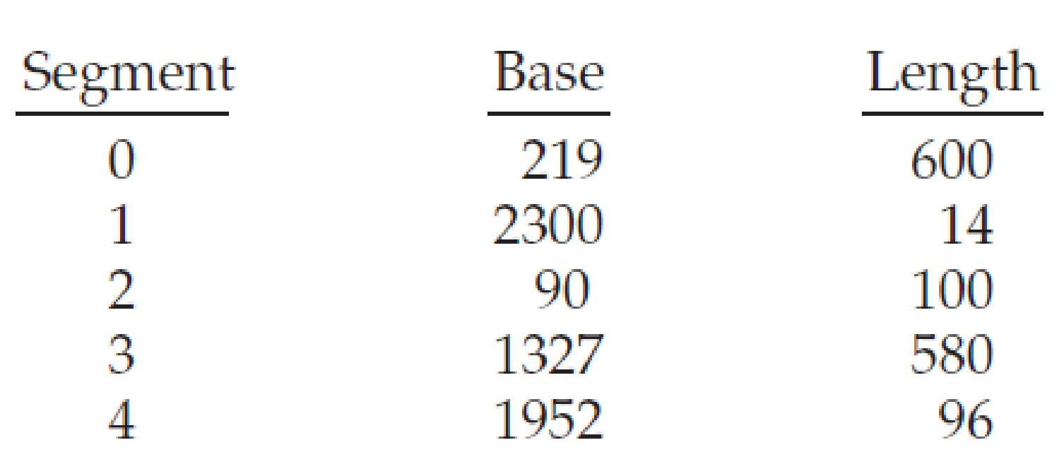
OPERATING SYSTEMS
Segmentation: Examples
Consider the following segment table:
What are the physical addresses for the following logical addresses?
a. 0,430
b. 1,10
c. 2,500
d. 3,400
e. 4,112

Slide 14
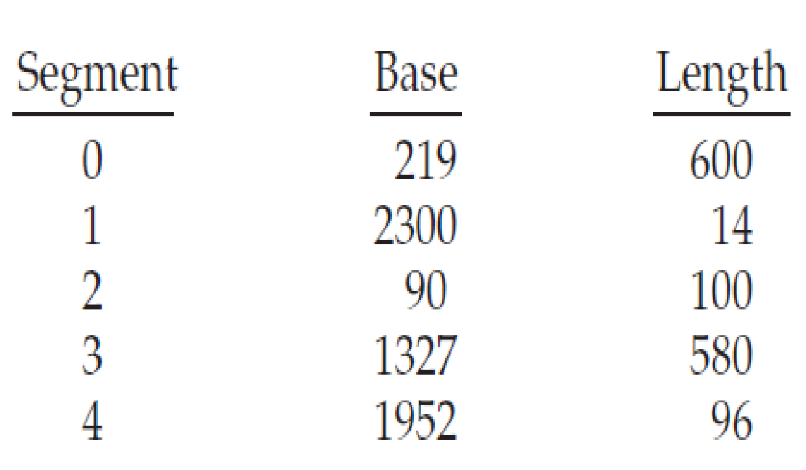
OPERATING SYSTEMS
Segmentation: Examples
Consider the following segment table:
What are the physical addresses for the following logical addresses?
a. 0,430
b. 1,10
c. 2,500
d. 3,400
e. 4,112
Solution:
0, 430 🡪219 + 430 = 649
1, 10 🡪2300 + 10 = 2310
2, 500 Illegal address since size of segment 2 is 100 and the offset in logical address is 500.
3, 400 🡪1327 + 400 = 1727
4, 112 Illegal address since size of segment 4 is 96 and the offset in logical address is 112.

Slide 15
OPERATING SYSTEMS
Shared Segments
How will you implement shared memory using segmentation?
Two processes may have segments with same base address 🡪 Segments will be mapped to both and hence shared.

Slide 16
OPERATING SYSTEMS
Linux Angle
The Legacy of x86: Classic Intel processors utilized explicit segmentation registers (CS for Code, DS for Data, SS for Stack).
Linux Flat Memory Model: Modern Linux on 64-bit systems essentially neutralizes segmentation. The kernel sets the base address of all segments to 0x00000000 and the limit to the maximum addressable space.
What would be most common disadvantage of Segmentation?
External Fragmentation
This leads us to the Paging mechanism

Slide 17
OPERATING SYSTEMS
Questions
Q1: In a segmented memory system, what two components make up a logical address?
Q2: When the CPU translates a logical address in a segmented system, what causes a "trap to the operating system" (a Segmentation Fault)?
Q3: Why is it advantageous to separate the Stack and the Code into different segments?
Q4: What is the "Flat Memory Model" used by modern Linux on x86-64 architectures?
Q5: During process execution, which hardware component performs the addition of the segment base and the logical offset?

Slide 18
THANK YOU
Pavan A C
Department of Computer Science and Engineering
pavanac@pes.edu

