Slide 1

OPERATING SYSTEMS
UE25CS242A
Memory Management
Pavan A C
Department of Computer Science & Engineering

Slide 2
OPERATING SYSTEMS
Slides Credits for all the PPTs of this course
The slides/diagrams in this course are an adaptation, combination, and enhancement of material from the following resources and persons:
Slides of Operating System Concepts, Abraham Silberschatz, Peter Baer Galvin, Greg Gagne - 9th edition 2013 and some slides from 10th edition 2018
Some conceptual text and diagram from Operating Systems - Internals and Design Principles, William Stallings, 9th edition 2018
Some presentation transcripts from A. Frank – P. Weisberg
Some conceptual text from Operating Systems: Three Easy Pieces, Remzi Arpaci-Dusseau, Andrea Arpaci Dusseau

Slide 3
OPERATING SYSTEMS
Paging
Pavan A C
Department of Computer Science & Engineering

Slide 4
OPERATING SYSTEMS
Paging
Segmentation permits Physical address space of a process can be noncontiguous
Paging is another memory-management scheme that offers this advantage.
  Avoids external fragmentation and need for compaction
  Solves the problem of fitting memory chunks of varying sizes onto the backing store.
The backing store also has the fragmentation problems

Slide 5
OPERATING SYSTEMS
Paging: Basic Method
Divide physical memory into fixed-sized blocks called frames
Divide logical memory into blocks of same size called pages
Page size and frame size are defined by the hardware
Keep track of all free frames
To run a program of size N pages, need to find N free frames and load program
Set up a page table to translate logical to physical addresses
Still have Internal fragmentation
Following command displays the page size supported in the system,
getconf PAGESIZE

Slide 6
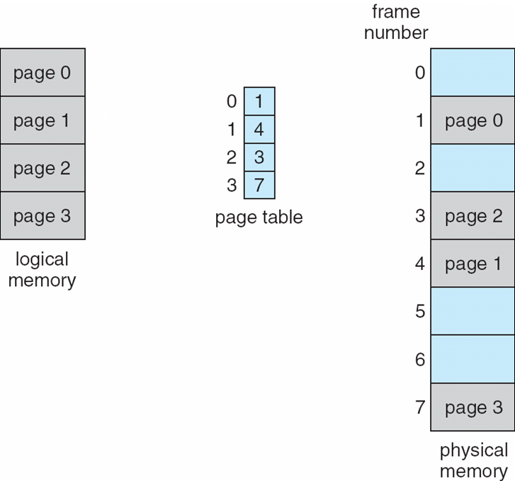
OPERATING SYSTEMS
Paging Model of Logical and Physical Memory

Slide 7
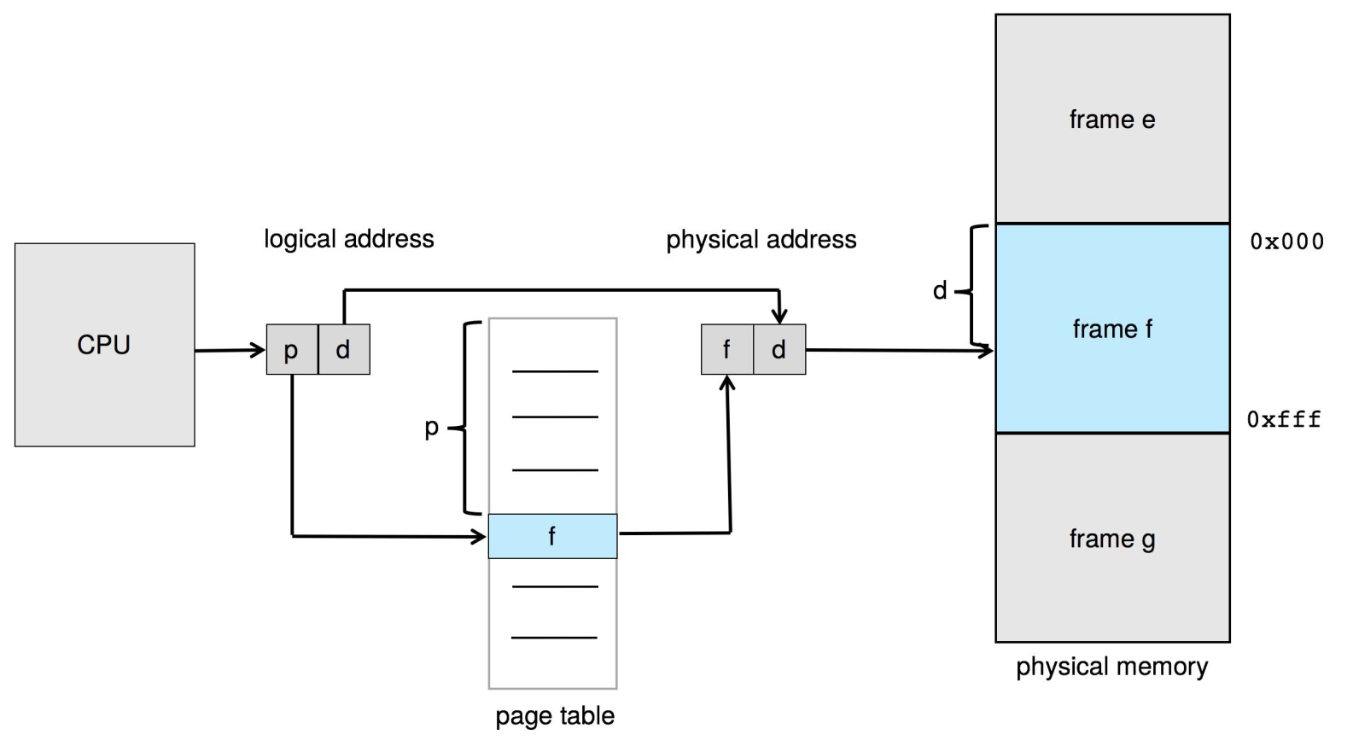
OPERATING SYSTEMS
Paging Hardware

Slide 8
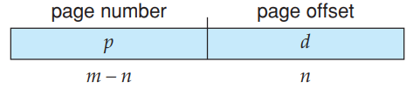
OPERATING SYSTEMS
Address Translation Scheme
Address generated by CPU is divided into:
  Page number (p) – used as an index into a page table which contains base address of each page in physical memory
  Page offset (d) – combined with base address to define the physical memory address that is sent to the memory unit
  Page size defined by hardware.
  Page size varies between 512 bytes and 1 GB per page
  The logical address space is 2^{m} and page size 2^{n}
  The high-order m − n bits of a logical address designate the page number, and the n low-order bits designate the page offset

Slide 9
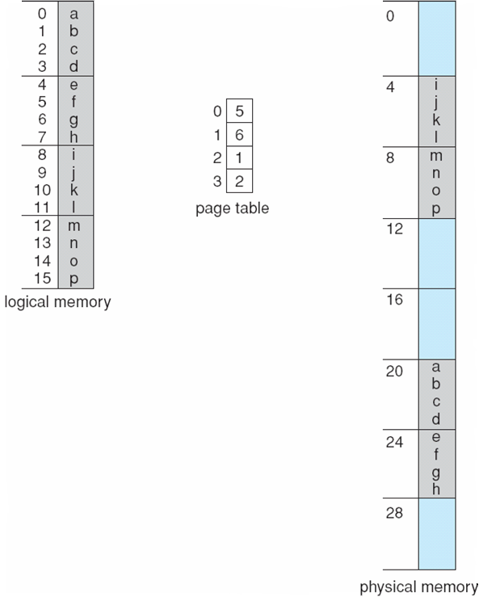
OPERATING SYSTEMS
Paging Example
Logical address: n = 2 and m = 4. Using a page size of 4 bytes and a physical memory of 32 bytes (8 pages)
Logical address space = 2^m
Page size = 2^n bytes
No external fragmentation, we may have internal fragmentation

Slide 10
OPERATING SYSTEMS
Paging Example

Slide 11
OPERATING SYSTEMS
Paging (Cont.)
Calculating internal fragmentation
  Page size = 2,048 bytes
  Process size = 72,766 bytes
  35 pages + 1,086 bytes
  Internal fragmentation of 2,048 - 1,086 = 962 bytes
  Worst case fragmentation = 1 frame – 1 byte
  So small frame sizes desirable?
  But each page table entry takes memory to track

Slide 12
OPERATING SYSTEMS
Paging (Cont.)
Worst case, a process would need n pages plus 1 byte.
  needs to be allocated n + 1 frames, resulting in internal fragmentation of almost an entire frame.
If the page size is smaller, an overhead is involved with each page table entry
The overhead can be reduced by increasing the page size
Page size are 4KB, 8KB
Some CPU and kernel support multiple page sizes.
Researchers are now developing support for variable on-the-fly page size.

Slide 13
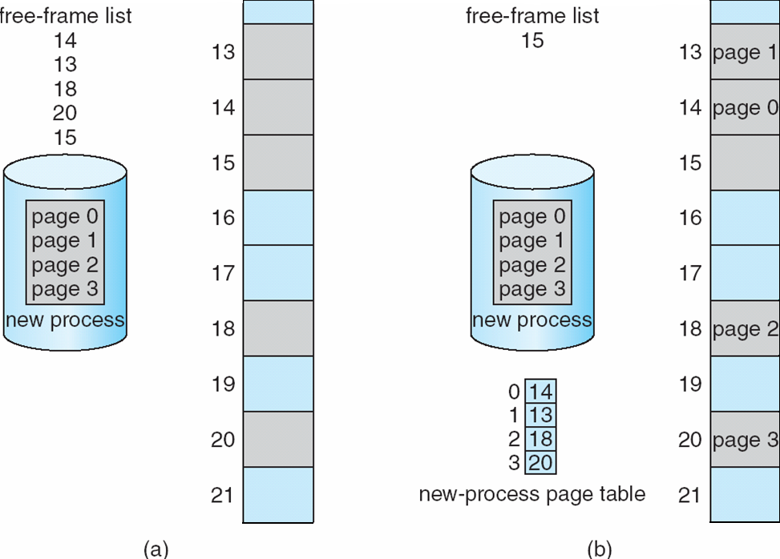
OPERATING SYSTEMS
Free Frames
Before allocation
After allocation

Slide 14
OPERATING SYSTEMS
Paging (Cont.)
OS manages physical memory, keeps track of which frames are free or allocated using frame table.
OS must be aware that user processes operate in user space, and all logical addresses must be mapped to produce physical addresses.
The operating system maintains a copy of the page table for each process.
It is used to translate logical addresses to physical addresses
It is also used by the CPU dispatcher to define the hardware page table when a process is to be allocated the CPU.
Paging therefore increases the context-switch time.
How to reduce the context-switch time?
  Using TLB

Slide 15
THANK YOU
Pavan A C
Department of Computer Science Engineering
pavanac@pes.edu

