Slide 1

OPERATING SYSTEMS
Memory Management
Pavan A C
Department of Computer Science & Engineering

Slide 2
OPERATING SYSTEMS
Slides Credits for all the PPTs of this course
The slides/diagrams in this course are an adaptation, combination, and enhancement of material from the following resources and persons:
Slides of Operating System Concepts, Abraham Silberschatz, Peter Baer Galvin, Greg Gagne - 9th edition 2013 and some slides from 10th edition 2018
Some conceptual text and diagram from Operating Systems - Internals and Design Principles, William Stallings, 9th edition 2018
Some presentation transcripts from A. Frank – P. Weisberg
Some conceptual text from Operating Systems: Three Easy Pieces, Remzi Arpaci-Dusseau, Andrea Arpaci Dusseau

Slide 3
OPERATING SYSTEMS
Structure of the page table
Pavan A C
Department of Computer Science & Engineering

Slide 4
OPERATING SYSTEMS
Hardware Support for Page Table
The hardware implementation of page table can be done by using dedicated registers.
But the usage of register for the page table is satisfactory only if page table is small.
If page table contain large number of entries then we can use TLB(translation Look-aside buffer), a special, small, fast look up hardware cache.

Slide 5
OPERATING SYSTEMS
Hardware Support for Page Table
Page table is kept in main memory
Page-table base register (PTBR) points to the page table
Page-table length register (PTLR) indicates size of the page table
In this scheme every data/instruction access requires two memory accesses
  One for the page table and one for the data / instruction
The two memory access problem can be solved by the use of a special fast-lookup hardware cache called associative memory or translation look-aside buffers (TLBs)

Slide 6
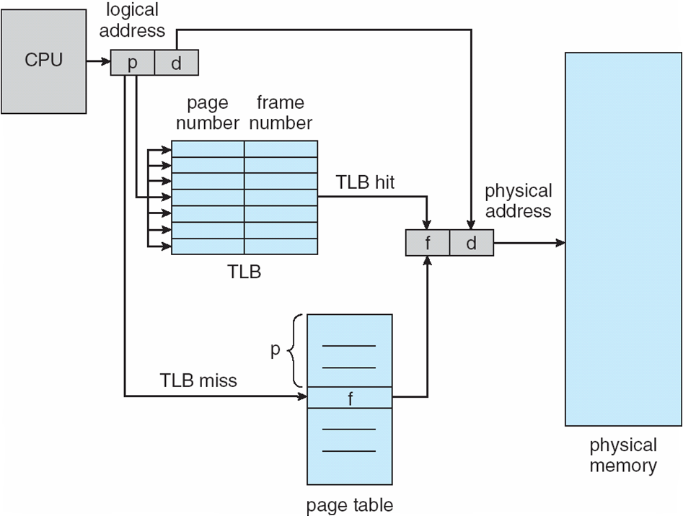
OPERATING SYSTEMS
Paging Hardware With TLB

Slide 7
OPERATING SYSTEMS
Effective Access Time
  Hit ratio – percentage of times that a page number is found in the TLB
An 80% hit ratio means that we find the desired page number in the TLB 80% of the time.
Suppose that 10 nanoseconds to access memory.
  If we find the desired page in TLB then a mapped-memory access take 10 ns
  Otherwise we need two memory access so it is 20 ns i.e. if we fail to find the page number in the TLB then we must first access memory for the page table and frame number (10 ns) and then access the desired byte in memory (10 nanoseconds), for a total of 20 ns (assuming that a page table lookup takes only one memory access).
Effective Access Time (EAT)
EAT = 0.80 x 10 + 0.20 x 20 = 12 nanoseconds
implying 20% slowdown in access time
Consider a more realistic hit ratio of 99%,
  EAT = 0.99 x 10 + 0.01 x 20 = 10.1ns
implying only 1% slowdown in access time.

Slide 8
OPERATING SYSTEMS
Translation Look-Aside Buffer
How TLB is different from CPU Cache
TLB is about ‘speeding up address translation for Virtual/logical memory’ so that page-table needn’t to be accessed for every address.
CPU Cache is about ‘speeding up main memory access latency’ so that RAM isn’t accessed always by CPU.
TLB operation comes at the time of address translation by MMU while CPU cache operation comes at the time of memory access by CPU.

Slide 9
OPERATING SYSTEMS
Memory Protection
Memory protection implemented by associating protection bit with each frame to indicate if read-only or read-write access is allowed
  Can also add more bits to indicate page execute-only, and so on
Valid-invalid bit attached to each entry in the page table:
  “valid” indicates that the associated page is in the process’ logical address space, and is thus a legal page
  “invalid” indicates that the page is not in the process’ logical address space
  Or use page-table length register (PTLR)
Any violations result in a trap to the kernel

Slide 10
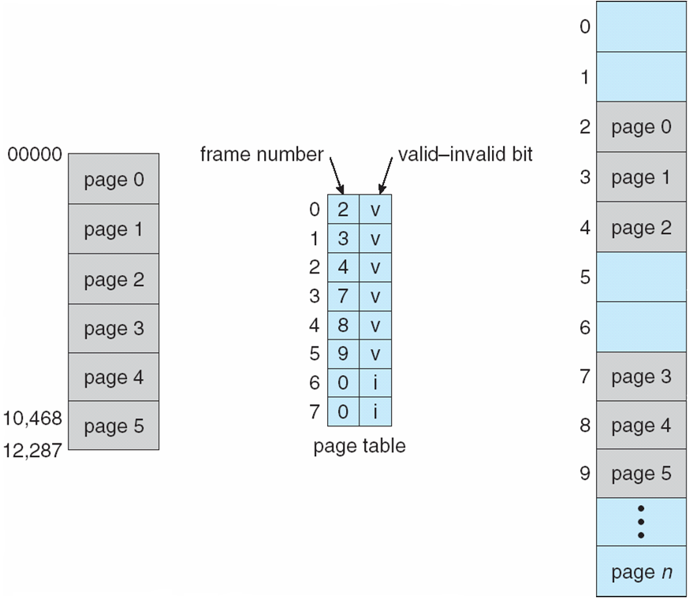
OPERATING SYSTEMS
Valid (v) or Invalid (i) Bit In A Page Table

Slide 11
OPERATING SYSTEMS
Valid (v) or Invalid (i) Bit In A Page Table
Demand Paging: If a page is marked "Invalid," the MMU throws a Page Fault trap. Modern OSes use this intentionally; they map memory as invalid so they don't have to allocate physical RAM until the exact time the program tries to use it.

Slide 12
OPERATING SYSTEMS
Shared Pages
An advantage of paging is the possibility of sharing common code.
  important in a time-sharing environment
Consider a system that supports 40 users, each of whom executes a text editor.
If the text editor consists of 150 KB of code and 50 KB of data space.
we need 8,000 KB(150 KBX40+50KB X40) to support the 40 users.
Can this memory space usage be reduced?
    YES
If the code is shared, then a total space required will be 2,150 KB

Slide 13
OPERATING SYSTEMS
Shared Pages
Shared code
  One copy of read-only (reentrant) code shared among processes (i.e., text editors, compilers, window systems)
  Reentrant (multi-instance) code is a reusable routine that multiple programs can invoke, interrupt, and reinvoke simultaneously.
  Reentrant code is non-self-modifying code: it never changes during execution.
  Similar to multiple threads sharing the same process space
  Also useful for interprocess communication if sharing of read-write pages is allowed
Private code and data
  Each process keeps a separate copy of the code and data
  The pages for the private code and data can appear anywhere in the logical address space

Slide 14
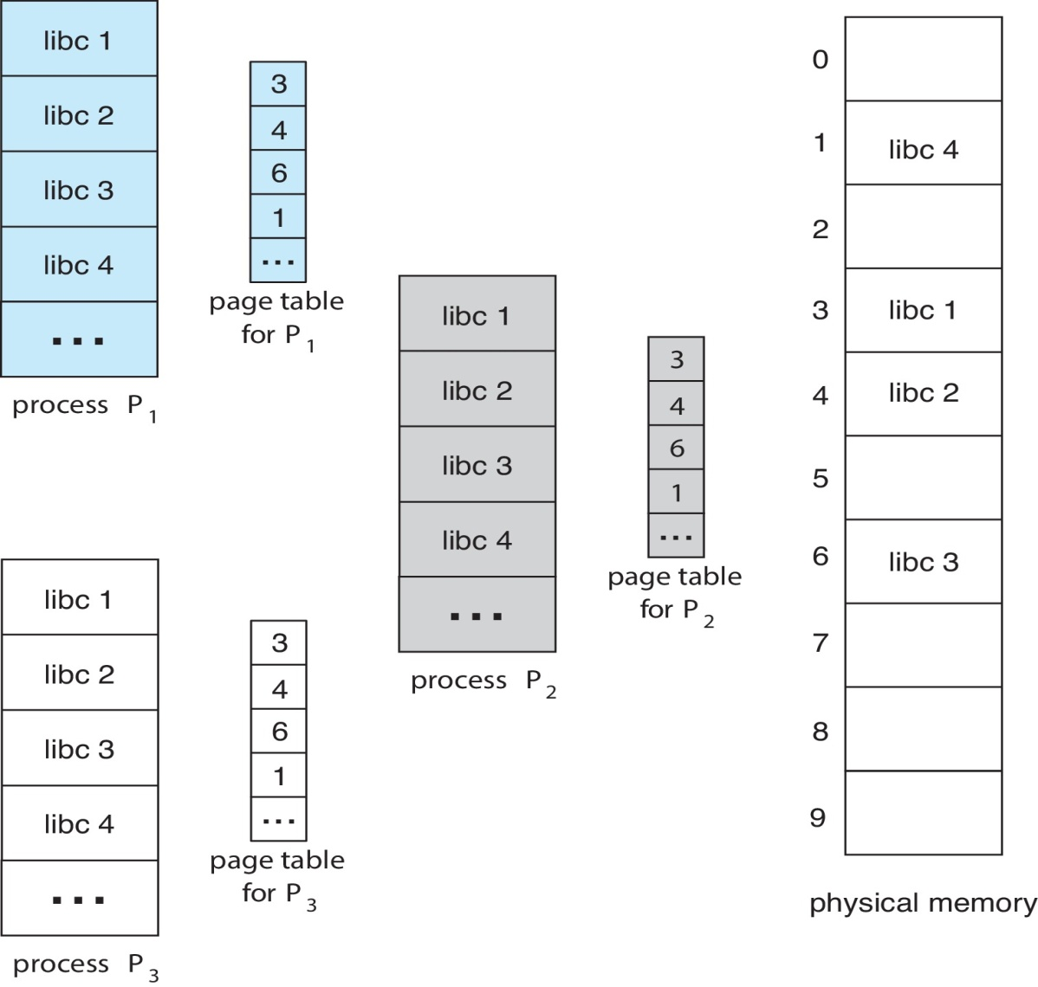
OPERATING SYSTEMS
Shared Pages Example

Slide 15
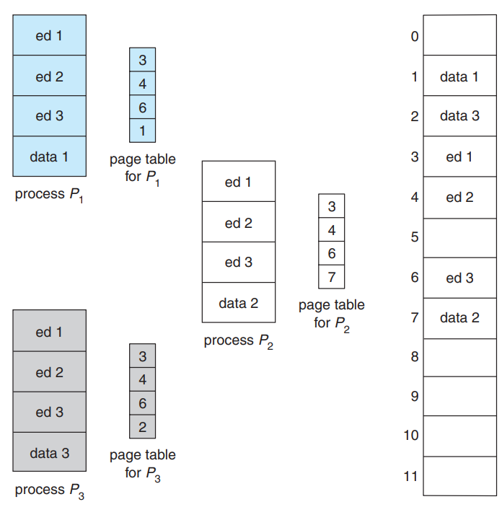
OPERATING SYSTEMS
Shared Pages Example

Slide 16
OPERATING SYSTEMS
Structure of the Page Table
Memory structures for paging can get huge using straight-forward methods
  Consider a 32-bit logical address space as on modern computers
  Page size of 4 KB (2¹²)
  Page table would have 1 million entries (2³² / 2¹²)
  If each entry is 4 bytes -> 4 MB of physical memory for page table alone
    That amount of memory used to cost a lot
    Don’t want to allocate that contiguously in main memory
we explore some of the most common techniques for structuring the page table, including hierarchical paging, hashed page tables, and inverted page tables

Slide 17
OPERATING SYSTEMS
Structures of the Page Table
Hierarchical Paging
Hashed Page Tables
Inverted Page Tables

Slide 18
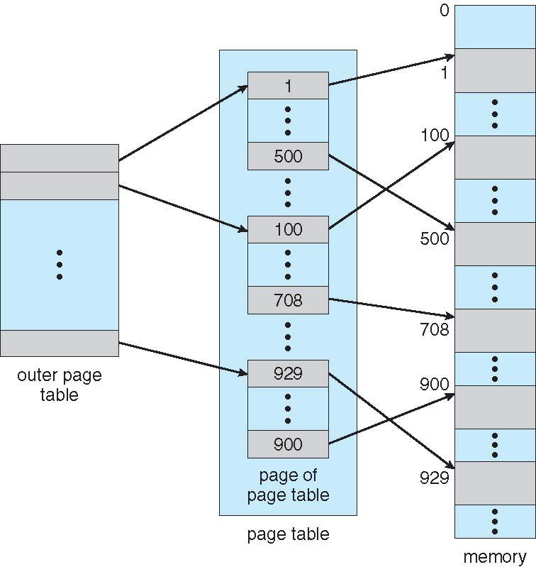
OPERATING SYSTEMS
Hierarchical Page Tables
Break up the logical address space into multiple page tables
A simple technique is a two-level page table
We then page the page table

Slide 19
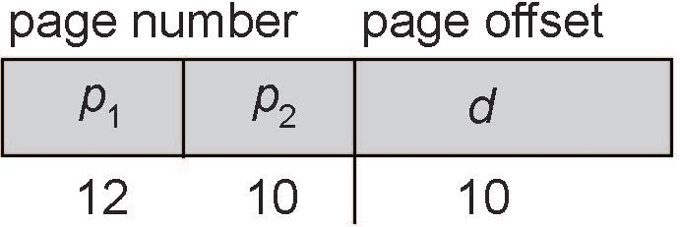
OPERATING SYSTEMS
Two-Level Paging Example
A logical address (on 32-bit machine with 1K page size) is divided into:
  a page number consisting of 22 bits
  a page offset consisting of 10 bits
Since the page table is paged, the page number is further divided into:
  a 12-bit page number
  a 10-bit page offset
Thus, a logical address is as follows:
  where p₁ is an index into the outer page table, and p₂ is the displacement within the page of the inner page table

Slide 20
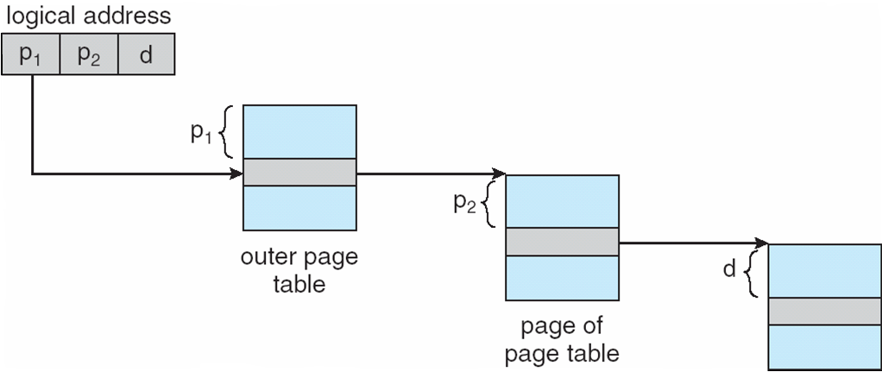
OPERATING SYSTEMS
Address-Translation Scheme
This scheme is known as forward-mapped page table as address translation works from the outer page table inward.

Slide 21
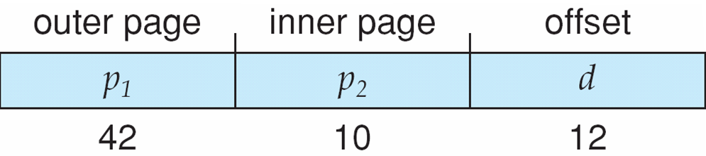
OPERATING SYSTEMS
64-bit Logical Address Space
Even two-level paging scheme not sufficient
If page size is 4 KB (2¹²)
  Then page table has 2⁵² entries
  If two level scheme, inner page tables could be 2¹⁰ 4-byte entries
  Address would look like
  Outer page table has 2⁴² entries or 2⁴⁴ bytes
  One solution is to add a 2nd outer page table

Slide 22
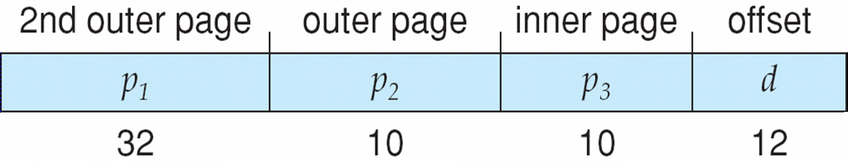
OPERATING SYSTEMS
Three-level Paging Scheme
We can divide the outer page table in various ways.
For example, we can page the outer page table, giving us a three-level paging scheme. Suppose that the outer page table is made up of standard-size pages (2¹⁰ entries, or 2¹² bytes).
In this case, a 64-bit address space is still daunting:
The next step would be a four-level paging scheme, where the second-level outer page table itself is also paged, and so forth.
Notes:
Linear page tables:
PTs are too large to be stored in main memory
Store PT in virtual memory
Very large page tables need more than 2 levels
22

Slide 23
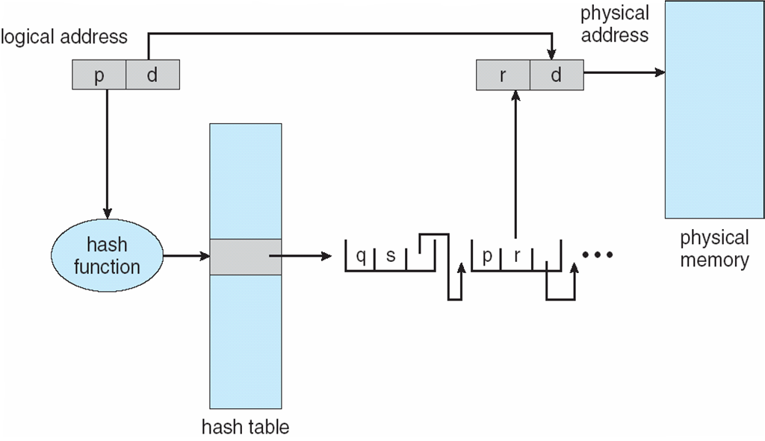
OPERATING SYSTEMS
Hashed Page Table
Notes:
23

Slide 24
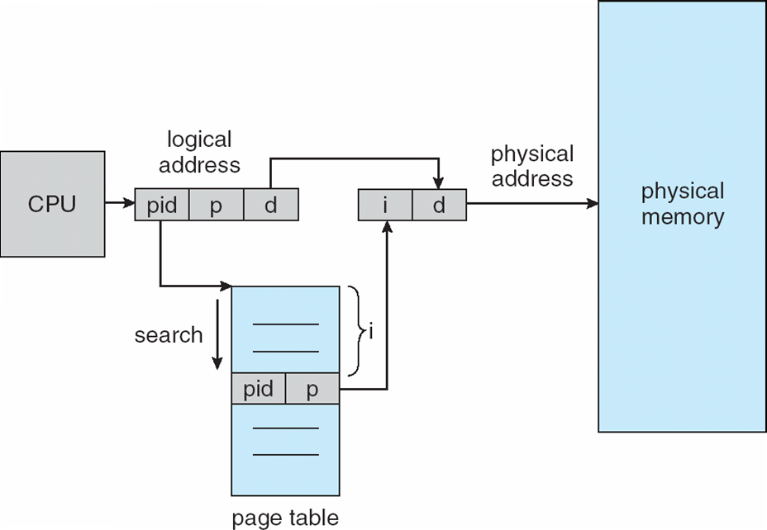
OPERATING SYSTEMS
Inverted Page Table Architecture

Slide 25
OPERATING SYSTEMS
Inverted Page Table
Rather than each process having a page table and keeping track of all possible logical pages, track all physical pages
One entry for each real page of memory
Entry consists of the virtual address of the page stored in that real memory location, with information about the process that owns that page
Decreases memory needed to store each page table, but increases time needed to search the table when a page reference occurs
Use hash table to limit the search to one — or at most a few — page-table entries
  TLB can accelerate access
But how to implement shared memory?
  One mapping of a virtual address to the shared physical address

Slide 26
OPERATING SYSTEMS
Inverted Page Table
Systems that use inverted page tables have difficulty in implementing shared memory.
Shared memory is usually implemented as multiple virtual addresses are mapped to one physical address.
There is only one virtual page entry for every physical page
One physical page cannot have two (or more) shared virtual addresses.
A simple technique for addressing this issue is to allow the page table to contain only one mapping of a virtual address to the shared physical address.
references to virtual addresses that are not mapped result in page faults

Slide 27
OPERATING SYSTEMS
Linux Angle
How does Linux handle the TLB bottleneck?
If a database needs 100GB of RAM, the TLB (with only 1024 entries of 4KB) will constantly miss.
Modern OSes allow processes to request "Huge Pages" (e.g., 2MB or 1GB blocks) so a single TLB entry can cover vastly more memory space.

Slide 28
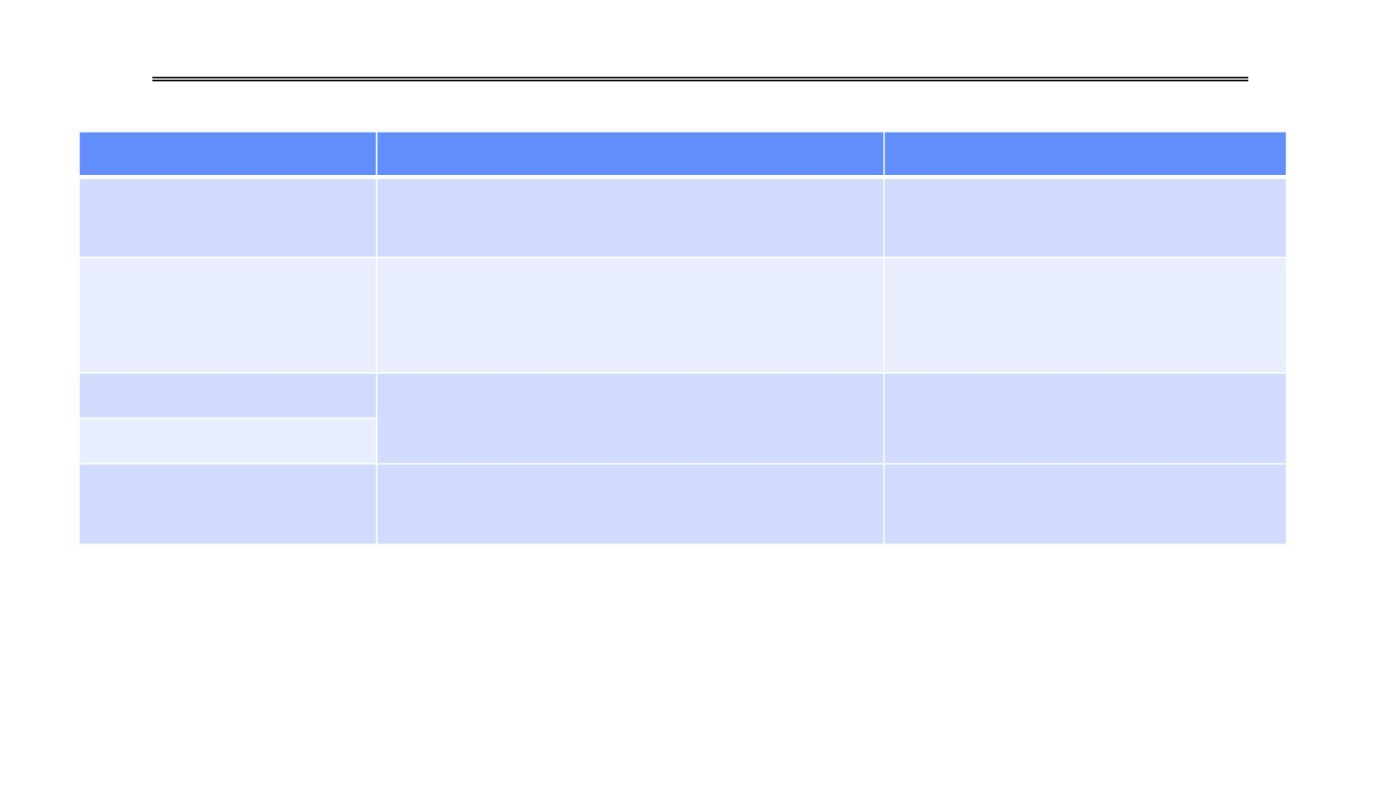
Address Translation Comparison
Advantages
Disadvantages
Fast context switching (segment map
maintained by CPU)
Simple Segmentation
Paging (Single-Level)
External fragmentation
Large table size (~ virtual
memo ry)
Internal fragmentation
No external fragmentation
Fast and easy allocation
Paged Segmentation
Multi-Level Paging
Table size ~ # of pages in virtual memor y Multiple memory references per
Fast and easy allocation
page access
Hash function more complex
No cache locality of page table
Inverted Page Table
Table size ~ # of pages in physical memory

Slide 29

OPERATING SYSTEMS
Summary: Segmentation & Paging
Segment Mapping
Segment registers reside directly within the processor for rapid translation.
Segment ID is associated with every memory access.
  Often extracted from a portion of the virtual address.
  Can instead be loaded directly from instruction bits (e.g., x86 architecture).
Each segment contains explicit base and limit info, adjusting offsets by adding the base.
Page Tables
Memory is divided into structured, fixed-sized chunks (pages and frames).
Virtual page numbers are systematically mapped to physical page numbers via the page table.
The offset of the virtual address remains identical in the physical address.
Large page tables can be dynamically placed inside virtual memory to save physical RAM.
Multi-Level Tables
The virtual address is mapped through a hierarchical series of nested lookup tables.
This multi-level structure permits sparse population of the process address space.
Avoids the massive memory overhead of maintaining large, contiguous single-level page tables for unused memory regions.

Slide 30
OPERATING SYSTEMS
Questions
Q1: In a paging system, what is the difference between a Page and a Frame?
Q2: Why is the page offset (d) not translated by the Memory Management Unit (MMU)?
Q3: What is the "two-memory-access problem" in a basic paging system?
Q4: What is the purpose of an ASID (Address-Space Identifier) in a TLB?
Q5: A system has a TLB hit rate of 90%. It takes 5ns to access the TLB, and 100ns to access main memory. What is the Effective Access Time (EAT)?
Q6: What specific type of fragmentation does Paging eliminate, and which type does it not?
Q7: How does a paging architecture implement shared memory (like sharing the C standard library)?
Q8: Why do modern 64-bit operating systems use hierarchical (multi-level) page tables rather than a single contiguous page table?
Q10: Why did Inverted Page Tables largely fall out of favour compared to Hierarchical Page Tables in modern computing?
Notes:
Answer: Hit: 5ns (TLB) + 100ns (Memory) = 105ns.
Miss: 5ns (TLB) + 100ns (Page Table) + 100ns (Memory) = 205ns. EAT = (0.90 * 105) + (0.10 * 205) = 94.5 + 20.5 = 115ns.

Slide 31
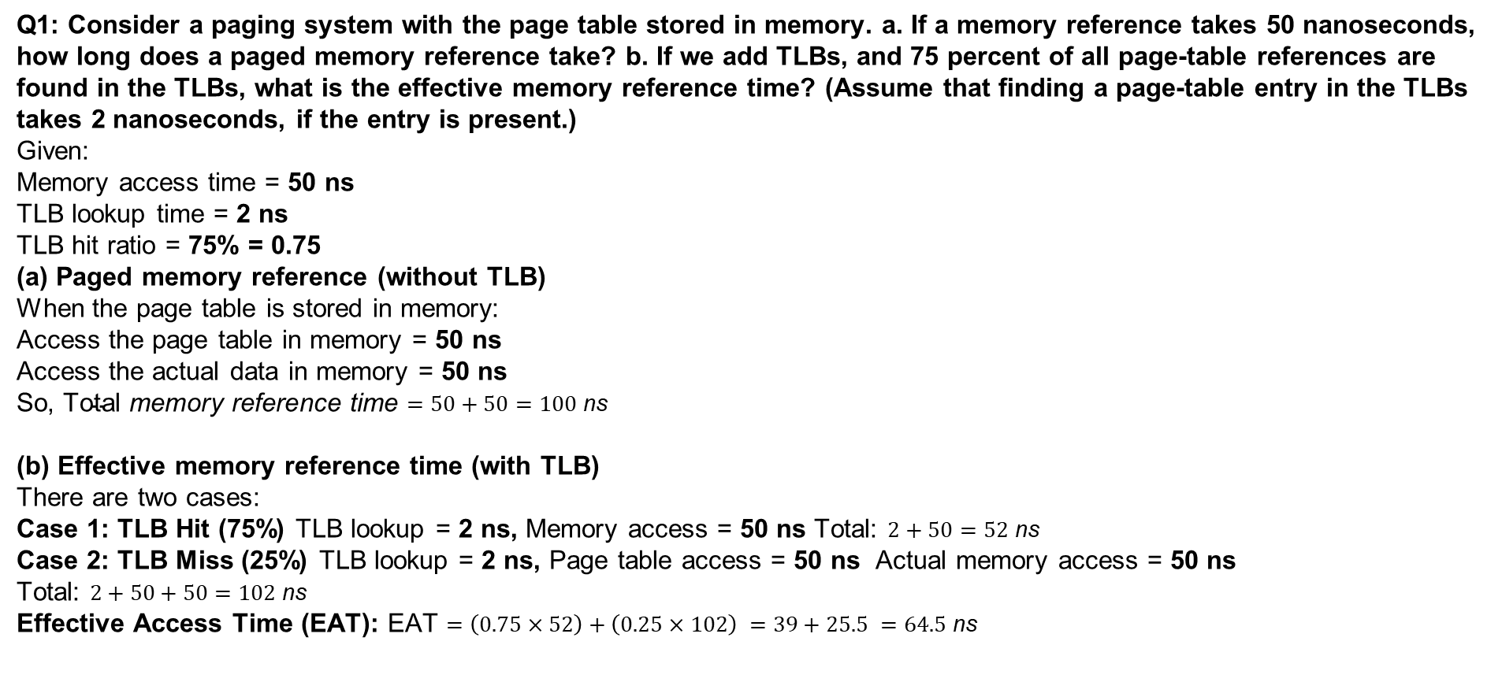
OPERATING SYSTEMS
Problems
Notes:
Answer: Hit: 5ns (TLB) + 100ns (Memory) = 105ns.
Miss: 5ns (TLB) + 100ns (Page Table) + 100ns (Memory) = 205ns. EAT = (0.90 * 105) + (0.10 * 205) = 94.5 + 20.5 = 115ns.

Slide 32
OPERATING SYSTEMS
Problems
Q1: Consider a paging system where the page table is stored in main memory.
Given:
A memory access takes 80 nanoseconds.
A TLB (Translation Lookaside Buffer) is added.
The TLB lookup time is 5 nanoseconds.
90% of page-table references are found in the TLB.
Answer the following:
a. If there is no TLB, how long does one paged memory reference take?
b. With the TLB, what is the effective memory access time (EAT)?
Notes:
Answer: Hit: 5ns (TLB) + 100ns (Memory) = 105ns.
Miss: 5ns (TLB) + 100ns (Page Table) + 100ns (Memory) = 205ns. EAT = (0.90 * 105) + (0.10 * 205) = 94.5 + 20.5 = 115ns.

Slide 33
OPERATING SYSTEMS
Problems
Notes:
Answer: Hit: 5ns (TLB) + 100ns (Memory) = 105ns.
Miss: 5ns (TLB) + 100ns (Page Table) + 100ns (Memory) = 205ns. EAT = (0.90 * 105) + (0.10 * 205) = 94.5 + 20.5 = 115ns.

Slide 34
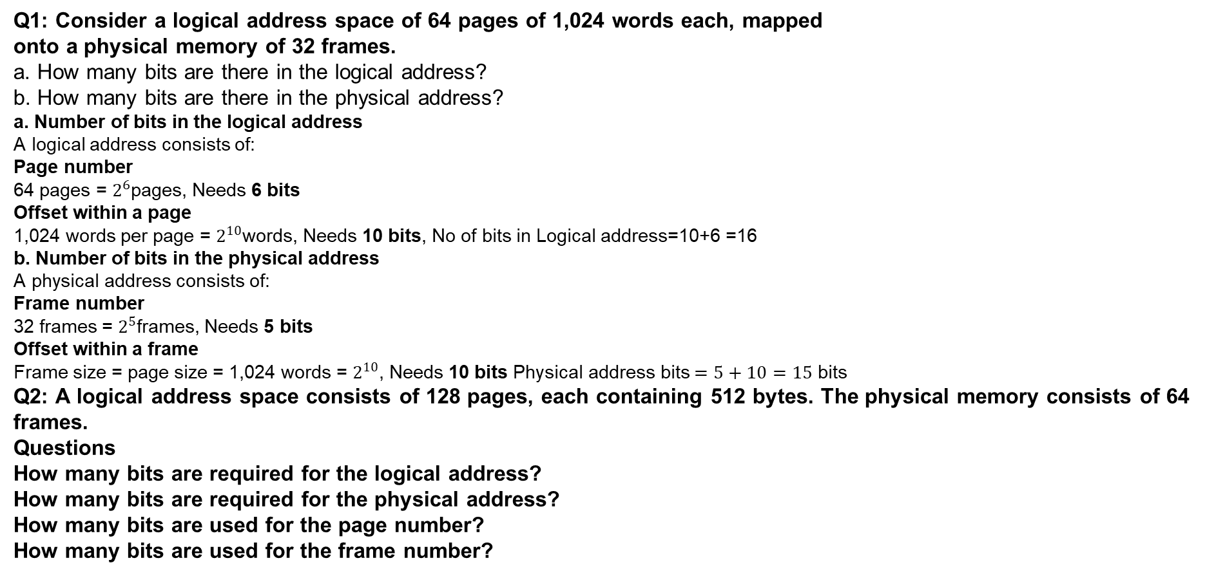
OPERATING SYSTEMS
Problems
Notes:
Answer: Hit: 5ns (TLB) + 100ns (Memory) = 105ns.
Miss: 5ns (TLB) + 100ns (Page Table) + 100ns (Memory) = 205ns. EAT = (0.90 * 105) + (0.10 * 205) = 94.5 + 20.5 = 115ns.

Slide 35
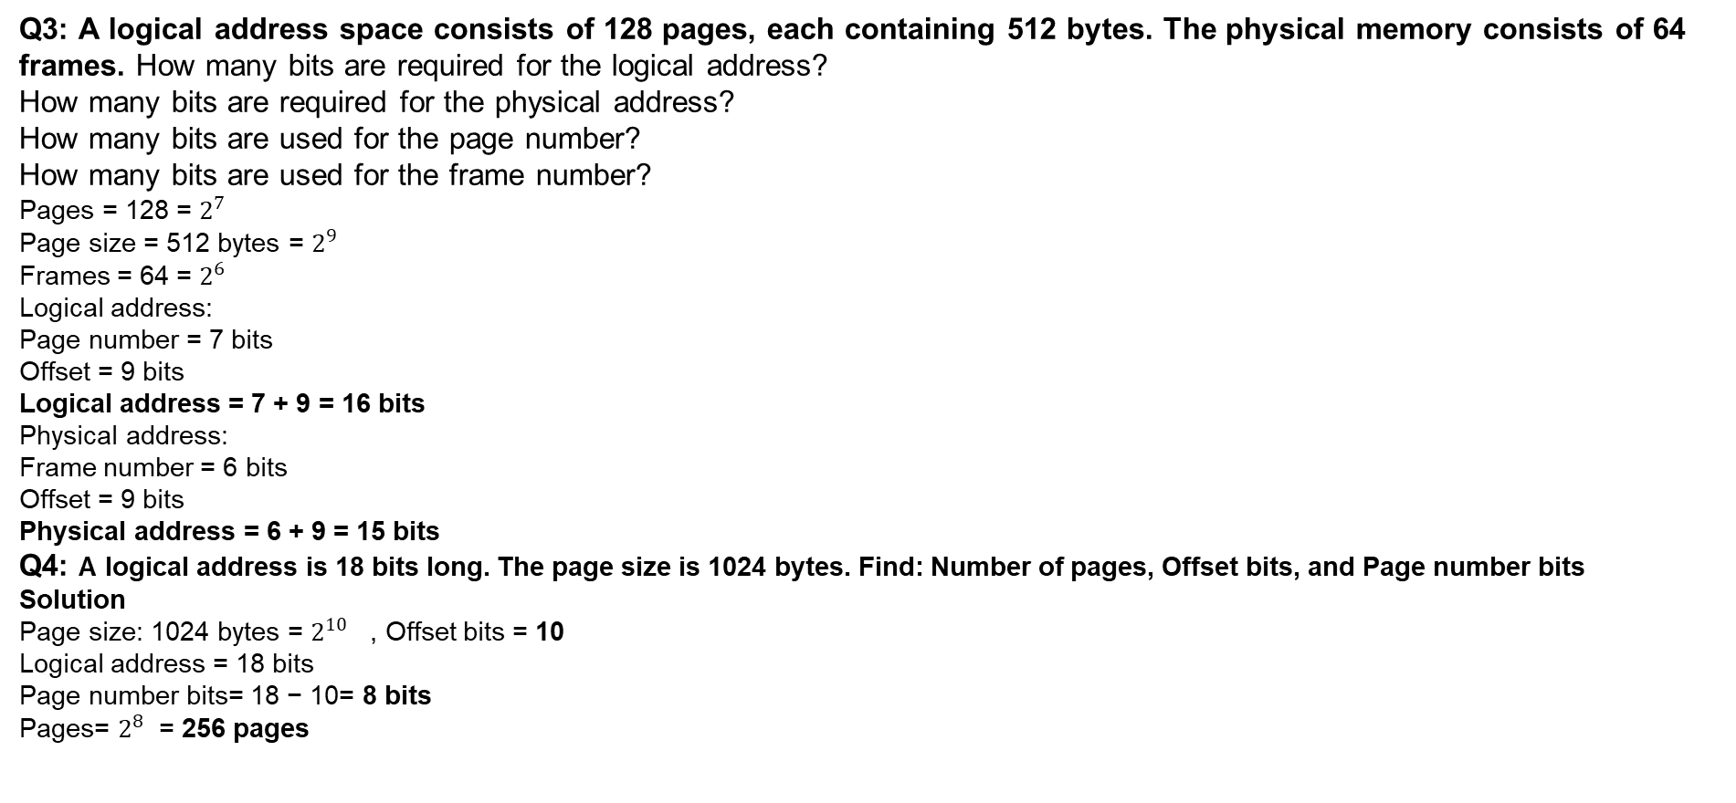
OPERATING SYSTEMS
Problems
Notes:
Answer: Hit: 5ns (TLB) + 100ns (Memory) = 105ns.
Miss: 5ns (TLB) + 100ns (Page Table) + 100ns (Memory) = 205ns. EAT = (0.90 * 105) + (0.10 * 205) = 94.5 + 20.5 = 115ns.

Slide 36
OPERATING SYSTEMS
Examples
Consider that the size of main memory (physical memory) is 512 MB and frame size of 4KB. Calculate(Assume logical address space 2GB)
Page offset(d)
Bits to address page number/Frame number
What will be the total number of frames
Number of level of paging
Notes:
36

Slide 37
OPERATING SYSTEMS
Page table example
Consider a computer system with a 32-bit logical address and 4-KB page
size. The system supports up to 512 MB of physical memory. How many
entries are there in each of the following?
a. A conventional single-level page table
b. An inverted page table

Slide 39
THANK YOU
Pavan A C
Department of Computer Science Engineering
pavanac@pes.edu

