Slide 1


OPERATING SYSTEMS
Memory Management
Pavan A C
Department of Computer Science & Engineering
Notes:
‹#›

Slide 2
OPERATING SYSTEMS
Slides Credits for all the PPTs of this course
The slides/diagrams in this course are an adaptation, combination, and enhancement of material from the following resources and persons:
Slides of Operating System Concepts, Abraham Silberschatz, Peter Baer Galvin, Greg Gagne - 9th edition 2013 and some slides from 10th edition 2018
Some conceptual text and diagram from Operating Systems - Internals and Design Principles, William Stallings, 9th edition 2018
Some presentation transcripts from A. Frank – P. Weisberg
Some conceptual text from Operating Systems: Three Easy Pieces, Remzi Arpaci-Dusseau, Andrea Arpaci Dusseau

Slide 3
OPERATING SYSTEMS
Virtual Memory
Pavan A C
Department of Computer Science & Engineering
Notes:
To describe the benefits of a virtual memory system
To explain the concepts of demand paging, page-replacement algorithms
To discuss the principle of the working-set model
To describe demand paging and page fault
‹#›

Slide 4
OPERATING SYSTEMS
Background (Cont.)
Virtual address space – logical view of how process is stored in memory
  Usually start at address 0, contiguous addresses until end of space
  Meanwhile, physical memory organized in page frames
  MMU must map logical to physical
Virtual memory can be implemented via:
  Demand paging
  Demand segmentation

Slide 5
OPERATING SYSTEMS
Background
Virtual memory allows programs larger than physical memory
Only part of program needs to be in memory
Logical memory separated from physical memory
More programs can run concurrently

Slide 6
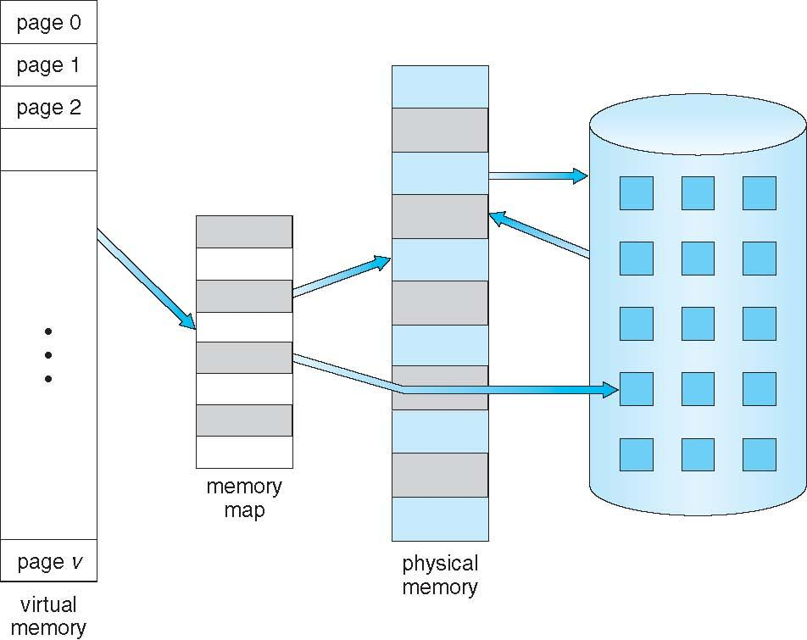
OPERATING SYSTEMS
Virtual Memory That is Larger Than Physical Memory

Slide 7
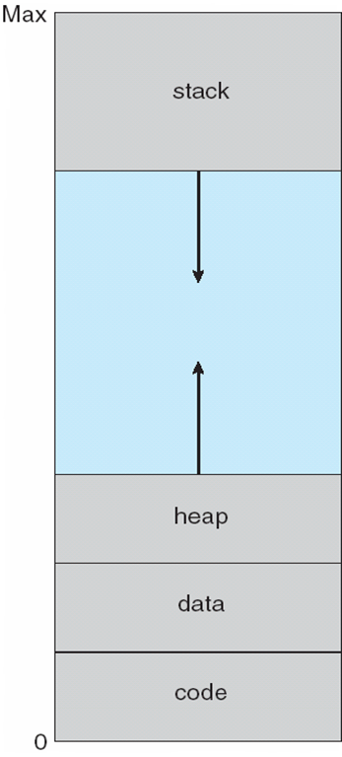
OPERATING SYSTEMS
Virtual-address Space
Usually design logical address space for stack to start at Max logical address and grow “down” while heap grows “up”
  Maximizes address space use
  Unused address space between the two is hole
    No physical memory needed until heap or stack grows to a given new page
Enables sparse address spaces with holes left for growth, dynamically linked libraries, etc
System libraries shared via mapping into virtual address space
Shared memory by mapping pages read-write into virtual address space
Pages can be shared during fork(), speeding process creation

Slide 8
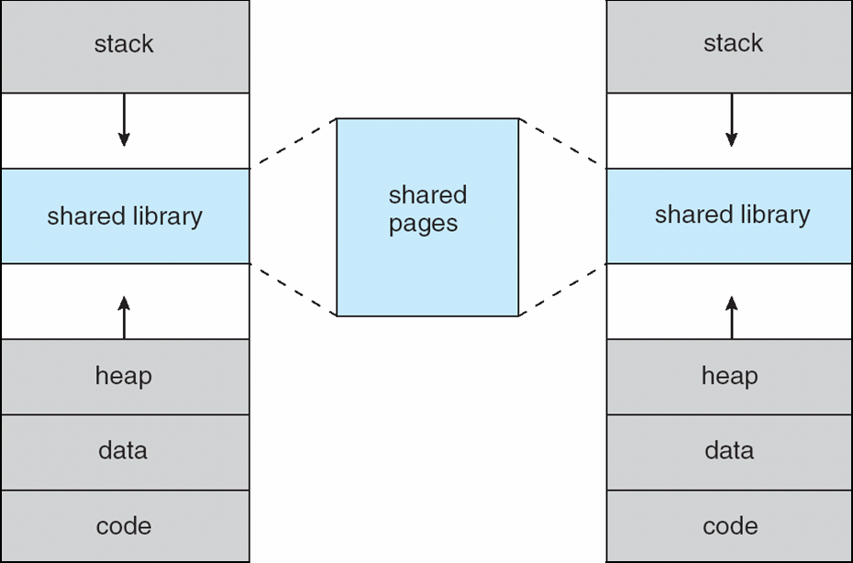
OPERATING SYSTEMS
Shared Library Using Virtual Memory

Slide 9
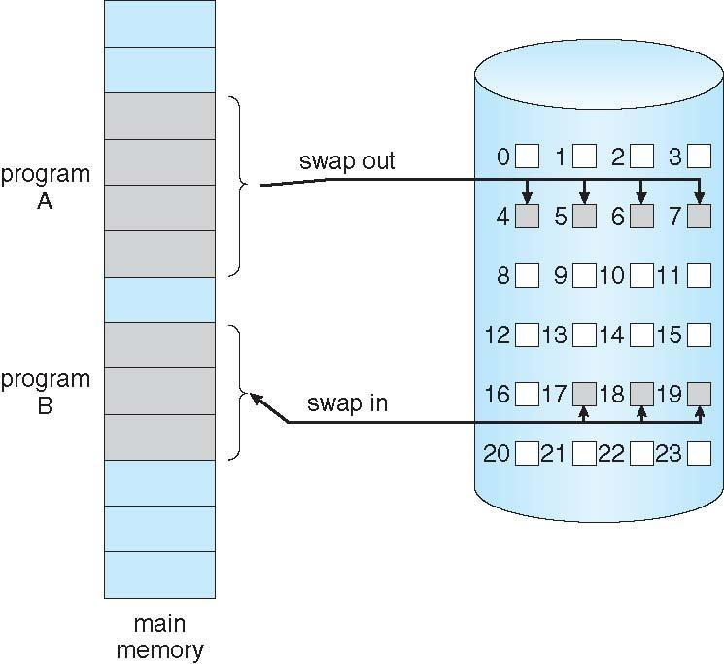
OPERATING SYSTEMS
Demand Paging
Could bring entire process into memory at load time
Or bring a page into memory only when it is needed
  Less I/O needed, no unnecessary I/O
  Less memory needed
  Faster response
  More users
Similar to paging system with swapping (diagram on right)
Page is needed ⇒ reference to it
  invalid reference ⇒ abort
  not-in-memory ⇒ bring to memory
Lazy swapper – never swaps a page into memory unless page will be needed
  Swapper that deals with pages is called a pager

Slide 10
OPERATING SYSTEMS
Demand Paging

Slide 11
OPERATING SYSTEMS
Demand Paging – Basic Concepts
With swapping, pager guesses which pages will be used before swapping out again
Instead, pager brings in only those pages into memory
How to determine that set of pages?
  Need new MMU functionality to implement demand paging
If pages needed are already memory resident
  No difference from non demand-paging
If page needed and not memory resident
  Need to detect and load the page into memory from storage
    Without changing program behavior
    Without programmer needing to change code

Slide 12
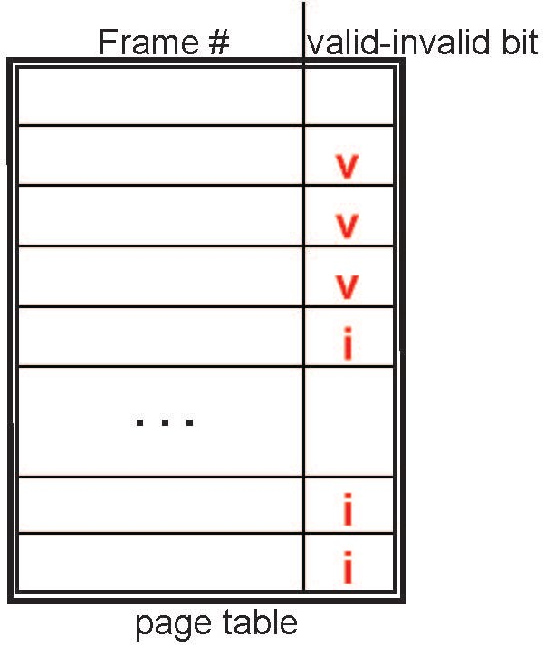
OPERATING SYSTEMS
Valid-Invalid Bit
With each page table entry a valid–invalid bit is associated
(v ⇒ in-memory – memory resident, i ⇒ not-in-memory)
Initially valid–invalid bit is set to i on all entries
Example of a page table snapshot:
During MMU address translation, if valid–invalid bit in page table entry is i ⇒ page fault

Slide 13
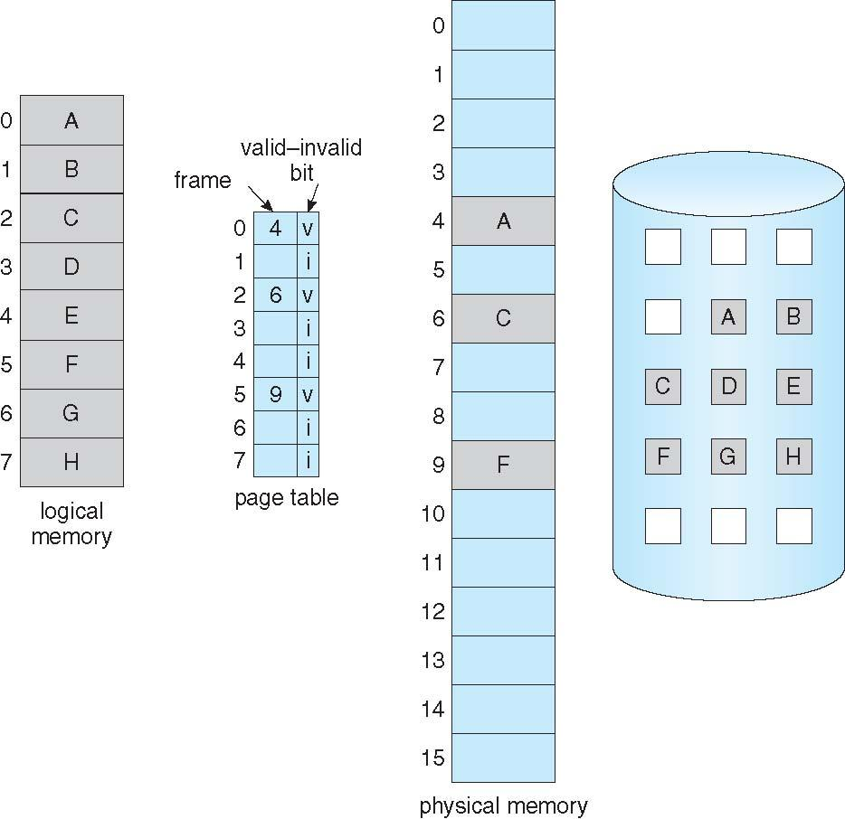
OPERATING SYSTEMS
Page Table When Some Pages Are Not in Main Memory

Slide 14
OPERATING SYSTEMS
Steps in Handling Page Fault
If there is a reference to a page, first reference to that page will trap to operating system
  Page fault
Operating system looks at another table to decide:
  Invalid reference ⇒ abort
  Just not in memory
Find free frame
Swap page into frame via scheduled disk operation
Reset tables to indicate page now in memory
Set validation bit = v
Restart the instruction that caused the page fault

Slide 15
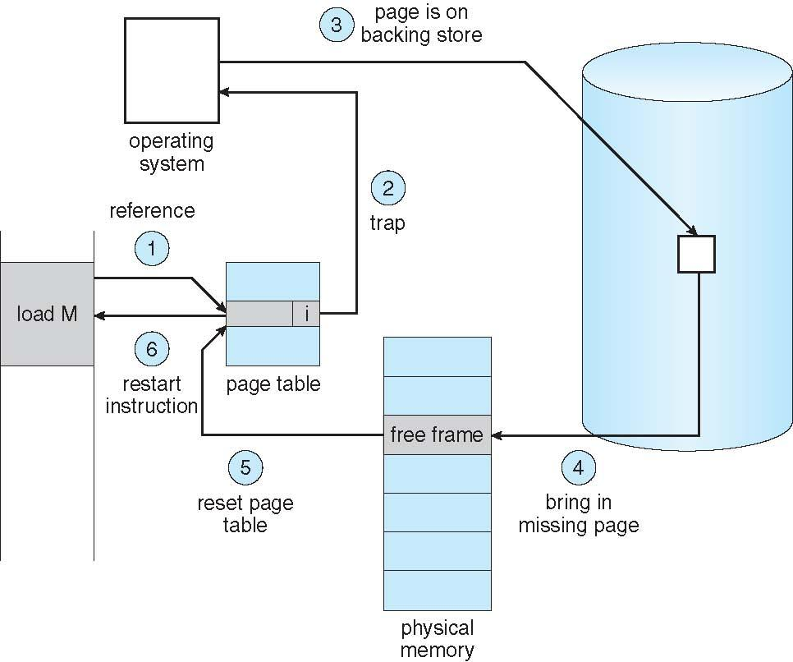
OPERATING SYSTEMS
Steps in Handling Page Fault (Cont.)

Slide 16
OPERATING SYSTEMS
Major vs Minor page faults
Major page fault: the page we want to reference exists only on the system disk, thus reading it will be an expensive operation. This type is also called “Hard Page Fault”.
Minor Page Fault: the required page is not stored on disk but in some other place in memory. An example for that is in the working set of another process. It is also sometimes called “Soft Page Fault”.

Slide 17
OPERATING SYSTEMS
Aspects of Demand Paging
Extreme case – start process with no pages in memory
  OS sets instruction pointer to first instruction of process, non-memory-resident -> page fault
  And for every other process pages on first access
  Pure demand paging
Actually, a given instruction could access multiple pages -> multiple page faults
  Consider fetch and decode of instruction which adds 2 numbers from memory and stores result back to memory
  Pain decreased because of locality of reference - Process migrates from one locality (i.e., a set of pages that are actively used together) to another
Hardware support needed for demand paging
  Page table with valid / invalid bit
  Secondary memory (swap device with swap space)
  Instruction restart

Slide 18
OPERATING SYSTEMS
Instruction Restart
Consider an instruction that could access several different locations (Ex: move some bytes from one location to another possibly overlapping location)
  Source and destination blocks overlap i.e straddle a page boundary
    Page fault might occur after the move is partially done
    Source block may have been modified so we cannot simply restart the instruction
    In one solution, the microcode computes and attempts to access both ends of both blocks.
      Page fault can occur before anything is modified
    The other solution uses temporary registers to hold the values of overwritten locations.
      If Page fault occurs, all the old values are written back into memory before the trap occurs
Notes:
A crucial requirement for demand paging is the ability to restart any instruction after a page fault. Because we save the state (registers, condition code, instruction counter) of the interrupted process when the page fault occurs, we must be able to restart the process in exactly the same place and state, except that the desired page is now in memory and is accessible. In most cases, this requirement is easy to meet.
A page fault may occur at any memory reference. If the page fault occurs on the instruction fetch, we can restart by
fetching the instruction again. If a page fault occurs while we are fetching an operand, we must fetch and decode the instruction again and then fetch the operand.
‹#›

Slide 19
OPERATING SYSTEMS
Performance of Demand Paging
Stages in Demand Paging (worse case)
Trap to the operating system
Save the user registers and process state
Determine that the interrupt was a page fault
Check that the page reference was legal and determine the location of the page on the disk
Issue a read from the disk to a free frame:
  Wait in a queue for this device until the read request is serviced
  Wait for the device seek and/or latency time
  Begin the transfer of the page to a free frame

Slide 20
OPERATING SYSTEMS
Performance of Demand Paging (Cont.)
While waiting, allocate the CPU to some other user
Receive an interrupt from the disk I/O subsystem (I/O completed)
Save the registers and process state for the other user
Determine that the interrupt was from the disk
Correct the page table and other tables to show page is now in memory
Wait for the CPU to be allocated to this process again
Restore the user registers, process state, and new page table, and then resume the interrupted instruction

Slide 21
OPERATING SYSTEMS
Performance of Demand Paging (Cont.)
Three major activities
  Service the interrupt – careful coding means just several hundred instructions needed
  Read the page – lots of time
  Restart the process – again just a small amount of time
Page Fault Rate 0 ≤ p ≤ 1 (p is the probability of a page fault)
  if p = 0 no page faults
  if p = 1, every reference is a fault
Effective Access Time (EAT)
EAT = (1 – p) x memory access
+ p x page-fault service time

Slide 22
OPERATING SYSTEMS
Demand Paging Example
Memory access time = 200 nanoseconds
Average page-fault service time = 8 milliseconds
EAT = (1 – p) x 200 + p (8 milliseconds)
= (1 – p) x 200 + p x 8,000,000
= 200 + p x 7,999,800
EAT is directly proportional to page-fault rate
If one access out of 1,000 causes a page fault i.e p = 0.001, then
EAT = 8200 ns or 8.2 microseconds.
This is a slowdown by a factor of 40!! (i.e. 8200/200)
If we want performance degradation < 10 percent
  220 > 200 + 7,999,800 x p
  20 > 7,999,800 x p
  p < .0000025
  < one page fault in every 400,000 memory accesses
Notes:
8 ms = 8 * 10^-3 = 8 * 10^-3 * (10^-6 / 10^-6) = 8 * 10^6 * 10^-9 = 8000000 ns
‹#›

Slide 23
OPERATING SYSTEMS
Demand Paging Optimizations (Cont.)
Still need to write to swap space
    Pages not associated with a file (like stack and heap) – anonymous memory
    Pages modified in memory but not yet written back to the file system
Mobile systems:
  Modern Android and macOS/iOS heavily use compressed memory (e.g., ZRAM).
  Instead of swapping to disk, the OS compresses the inactive page and leaves it in RAM, treating CPU cycles as cheaper than disk I/O.

Slide 24
OPERATING SYSTEMS
Copy-on-Write
Copy-on-Write (COW) allows both parent and child processes to initially share the same pages in memory
  If either process modifies a shared page, only then is the page copied
COW allows more efficient process creation as only modified pages are copied
In general, free pages are allocated from a pool of zero-fill-on-demand pages
  Pool should always have free frames for fast demand page execution
    Don’t want to have to free a frame as well as other processing on page fault
Hardware Enforcement: The OS marks the page table entries for both processes as Read-Only.
The Trap: If either process attempts to modify the data, the MMU triggers a hardware protection fault. The OS intercepts this trap, realizes it's a COW page, allocates a new physical frame, copies the data, updates the page table to Read/Write, and restarts the instruction.

Slide 25
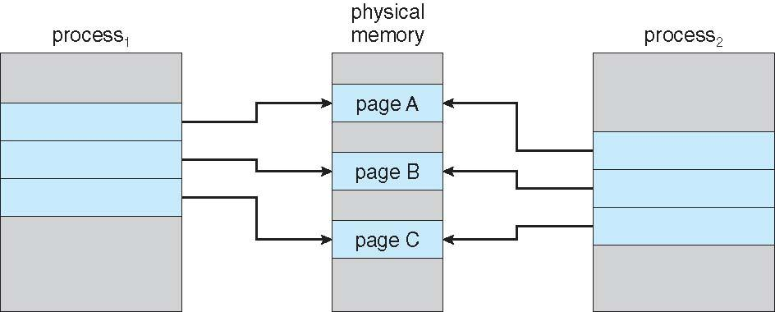
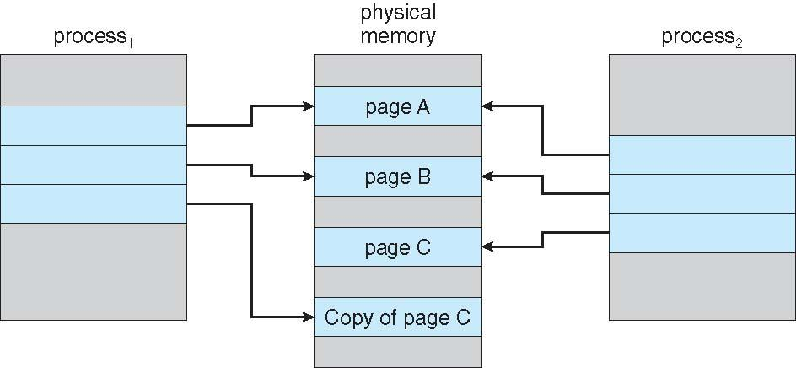
OPERATING SYSTEMS
Before and After Process 1 Modifies Page C

Slide 26
OPERATING SYSTEMS
What Happens if There is no Free Frame?
Used up by process pages
Also in demand from the kernel, I/O buffers, etc
How much to allocate to each?
Page replacement – find some page in memory, but not really in use, page it out
  Algorithm – terminate? swap out? replace the page?
  Performance – want an algorithm which will result in minimum number of page faults
Same page may be brought into memory several times

Slide 27
OPERATING SYSTEMS
Page Replacement
Prevent over-allocation of memory by modifying page-fault service routine to include page replacement (vs simply increasing degree of multiprogramming)
Use modify (dirty) bit to reduce overhead of page transfers – only modified pages are written to disk
Page replacement completes separation between logical memory and physical memory – large virtual memory can be provided on a smaller physical memory

Slide 28
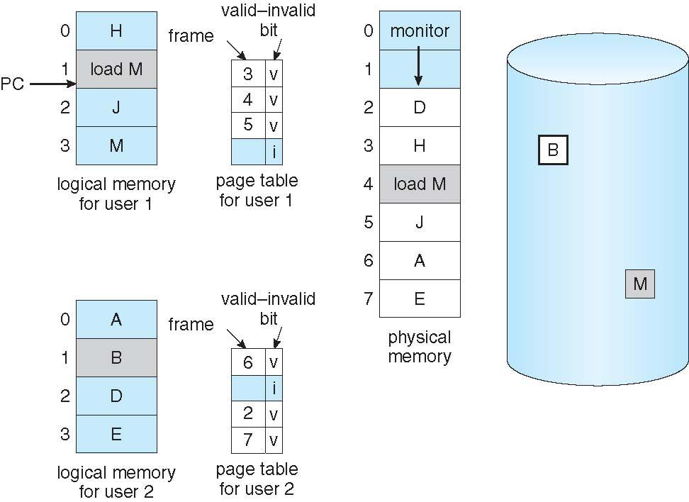
OPERATING SYSTEMS
Need For Page Replacement – Example 1

Slide 29
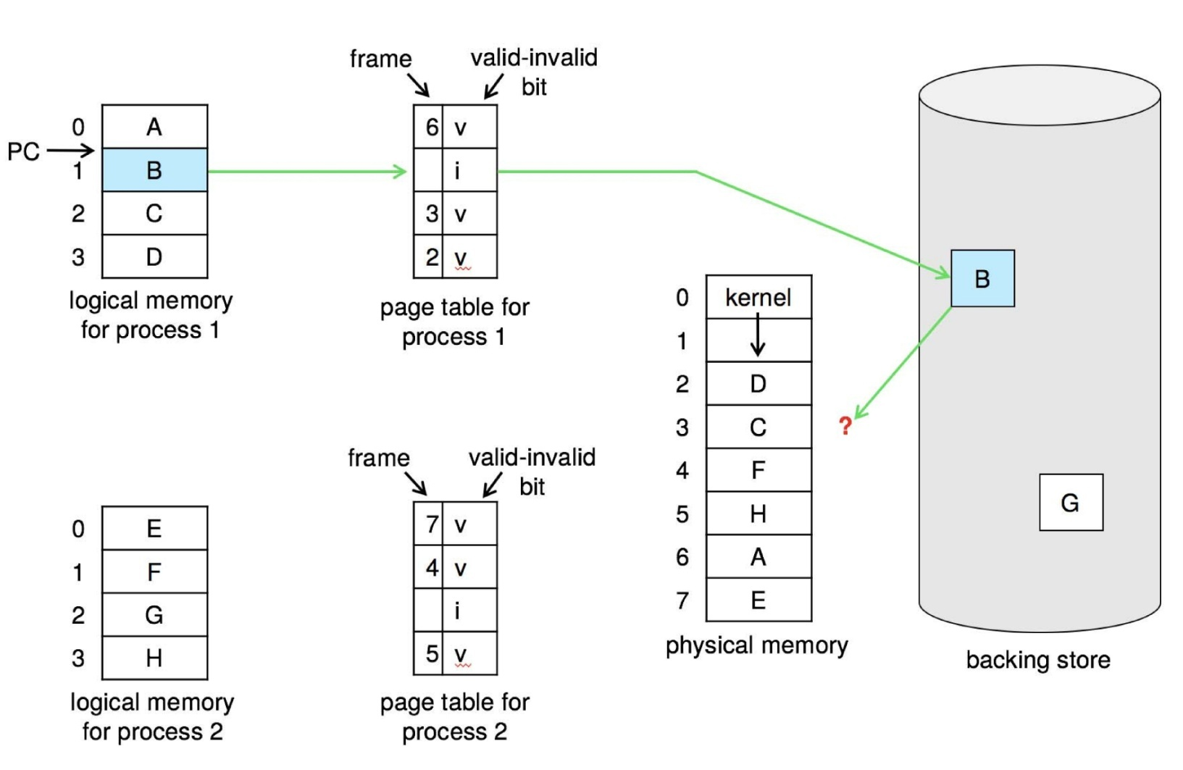
OPERATING SYSTEMS
Need For Page Replacement –Example 2

Slide 30
OPERATING SYSTEMS
Basic Page Replacement
Find the location of the desired page on disk
Find a free frame:
- If there is a free frame, use it
- If there is no free frame, use a page replacement algorithm to select a victim frame
- Write victim frame to disk if dirty
Bring the desired page into the (newly) free frame; update the page and frame tables
Continue the process by restarting the instruction that caused the trap
Note now potentially 2 page transfers for page fault – increasing EAT

Slide 31
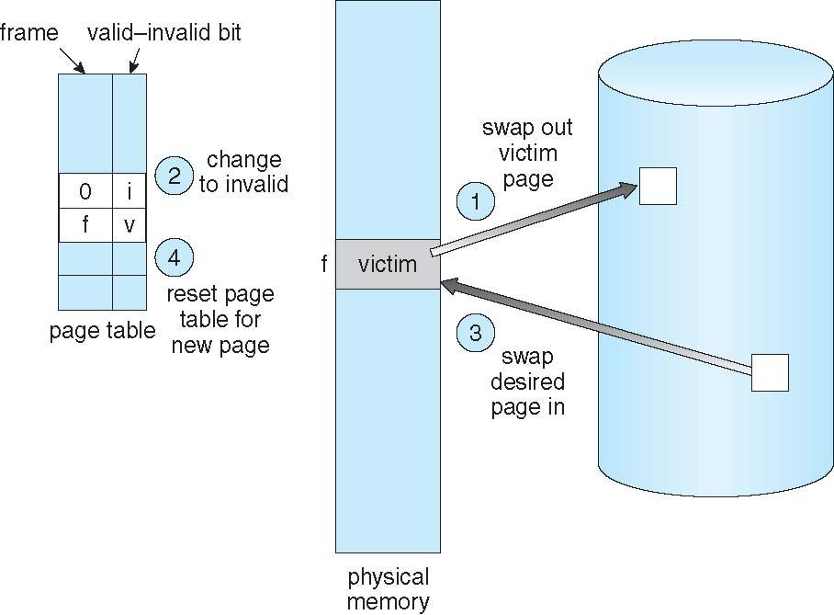
OPERATING SYSTEMS
Basic Page Replacement (Cont.)

Slide 32
OPERATING SYSTEMS
Linux Angle
The Synchronous Problem: Should OS wait till memory is 100% before invoking page replacement algorithms?.
The Linux Solution (kswapd): Linux does not wait for memory to hit 0 free frames.
Watermarks: OS maintains "high" and "low" watermarks. When free memory drops below the low watermark, kswapd wakes up in the background and proactively searches for inactive pages to evict, building up a pool of free frames so that programs rarely have to wait synchronously for a victim frame to be written to disk.

Slide 33
OPERATING SYSTEMS
Linux Angle
The Synchronous Problem: Should OS wait till memory is 100% before invoking page replacement algorithms?.
The Linux Solution (kswapd): Linux does not wait for memory to hit 0 free frames.
Watermarks: OS maintains "high" and "low" watermarks. When free memory drops below the low watermark, kswapd wakes up in the background and proactively searches for inactive pages to evict, building up a pool of free frames so that programs rarely have to wait synchronously for a victim frame to be written to disk.

Slide 34
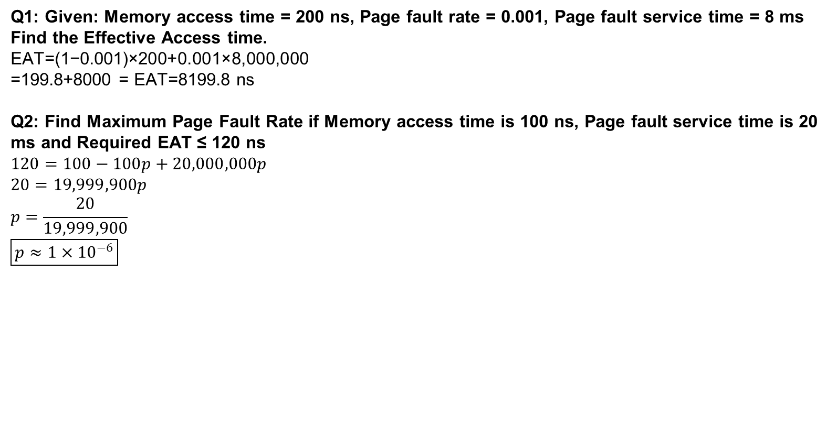
OPERATING SYSTEMS
Problems

Slide 35
OPERATING SYSTEMS
Questions
Q1: What is the fundamental definition of Virtual Memory?
Q2: In a virtual address space, why is it beneficial that the Stack and Heap grow towards each other from opposite ends?
Q3: What does the term "Pure Demand Paging" mean?
Q4: How does the Memory Management Unit (MMU) differentiate between a page that is in RAM and a page that is swapped to disk?
Q5: What is the immediate hardware response when a CPU attempts to access a page marked with an 'i' (invalid) bit?
Q6: Why is a "Minor Page Fault" much faster to resolve than a "Major Page Fault"?
Q7: Describe the architectural difficulty of "Instruction Restart" during a page fault.
Q8: What is the difference between File-backed memory and Anonymous memory?
Q9: Why do mobile operating systems (like iOS/Android) typically avoid traditional swapping to a disk partition?
Notes:
Answer: Flash storage on mobile devices degrades with constant write cycles, and I/O is slow. Instead, mobile OSes reclaim read-only pages (like code) and often use compressed memory in RAM to avoid disk writes entirely.

Slide 36
OPERATING SYSTEMS
Questions
Q1: In a Copy-on-Write (COW) system, what hardware permission does the OS apply to the shared pages immediately after a fork()?
Q2: What specific problem necessitates the use of a Page Replacement algorithm?
Q3: What is a "Victim Frame"?
Q4: What is the purpose of the "Dirty Bit" (Modify bit) in a page table entry?
Q5: Why does replacing a dirty victim page effectively double the page-fault service time?
Q6: What must the OS do to the page table of the process whose page was just evicted as a victim?
Q7: In modern systems like Linux, does the OS wait until there are exactly 0 free frames before executing page replacement?

Slide 37

THANK YOU
Pavan A C
Department of Computer Science and Engineering
pavanac@pes.edu

