Slide 1


OPERATING SYSTEMS
UE25CS242A
Memory Management
Pavan A C
Department of Computer Science & Engineering
Notes:
1

Slide 2
OPERATING SYSTEMS
Slides Credits for all the PPTs of this course
The slides/diagrams in this course are an adaptation, combination, and enhancement of material from the following resources and persons:
Slides of Operating System Concepts, Abraham Silberschatz, Peter Baer Galvin, Greg Gagne - 9th edition 2013 and some slides from 10th edition 2018
Some conceptual text and diagram from Operating Systems - Internals and Design Principles, William Stallings, 9th edition 2018
Some presentation transcripts from A. Frank – P. Weisberg
Some conceptual text from Operating Systems: Three Easy Pieces, Remzi Arpaci-Dusseau, Andrea Arpaci Dusseau

Slide 3
OPERATING SYSTEMS
Page replacement, Allocation of frames, Thrashing
Pavan A C
Department of Computer Science & Engineering
Notes:
3

Slide 4
OPERATING SYSTEMS
Page and Frame Replacement Algorithms
Frame-allocation algorithm determines
  How many frames to give each process
  Which frames to replace
Page-replacement algorithm
  Want lowest page-fault rate on both first access and re-access
Evaluate algorithm by running it on a particular string of memory references (reference string) and computing the number of page faults on that string
  String is just page numbers, not full addresses
  Repeated access to the same page does not cause a page fault
  Results depend on number of frames available
In all our examples, the reference string of referenced page numbers is
7,0,1,2,0,3,0,4,2,3,0,3,0,3,2,1,2,0,1,7,0,1

Slide 5
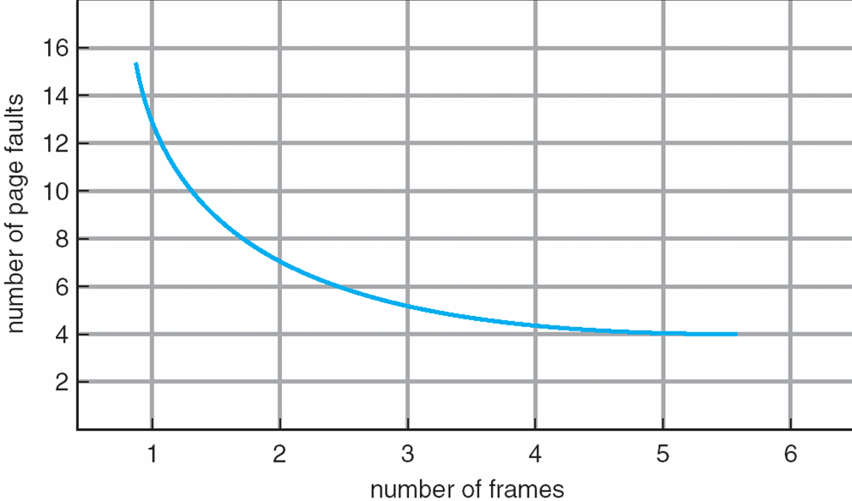
OPERATING SYSTEMS
Graph of Page Faults Versus The Number of Frames

Slide 6
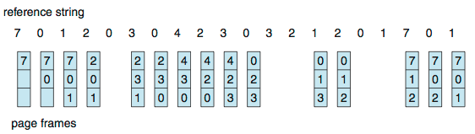
OPERATING SYSTEMS
First-In-First-Out (FIFO) Algorithm
Reference string: 7,0,1,2,0,3,0,4,2,3,0,3,2,1,2,0,1,7,0,1
3 frames (3 pages can be in memory at a time per process)

Slide 7
OPERATING SYSTEMS
First-In-First-Out (FIFO) Algorithm
Reference string: 7,0,1,2,0,3,0,4,2,3,0,3,2,1,2,0,1,7,0,1
3 frames (3 pages can be in memory at a time per process)
Can vary by reference string: consider 1,2,3,4,1,2,5,1,2,3,4,5
  Adding more frames can cause more page faults!
    Belady’s Anomaly
How to track ages of pages?
  Just use a FIFO queue

Slide 8
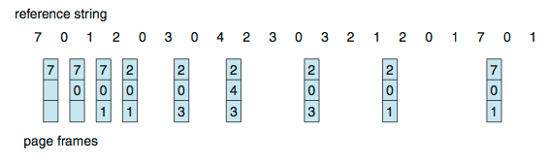
OPERATING SYSTEMS
Optimal Algorithm – Theoretical Best
Replace page that will not be used for longest period of time
  9 is optimal for the example

Slide 9
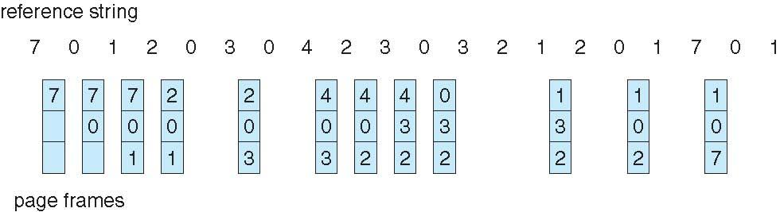
OPERATING SYSTEMS
Least Recently Used (LRU) Algorithm
Use past knowledge rather than future
Replace page that has not been used in the most amount of time
Associate time of last use with each page

Slide 10
OPERATING SYSTEMS
Least Recently Used (LRU) Algorithm
Use past knowledge rather than future
Replace page that has not been used in the most amount of time
Associate time of last use with each page
12 faults – better than FIFO but worse than OPT
Generally good algorithm and frequently used
But how to implement?

Slide 11

OPERATING SYSTEMS
LRU Algorithm (Cont.)
Counter implementation
  Every page entry has a counter; every time page is referenced through this entry, copy the clock into the counter
  When a page needs to be changed, look at the counters to find smallest value
    Search through table needed
Stack implementation
  Keep a stack of page numbers in a double link form:
  Page referenced:
    move it to the top
    requires 6 pointers to be changed
  But each update more expensive
  No search for replacement - bottom of the stack is our victim
LRU and OPT are cases of stack algorithms that don’t have Belady’s Anomaly

Slide 12
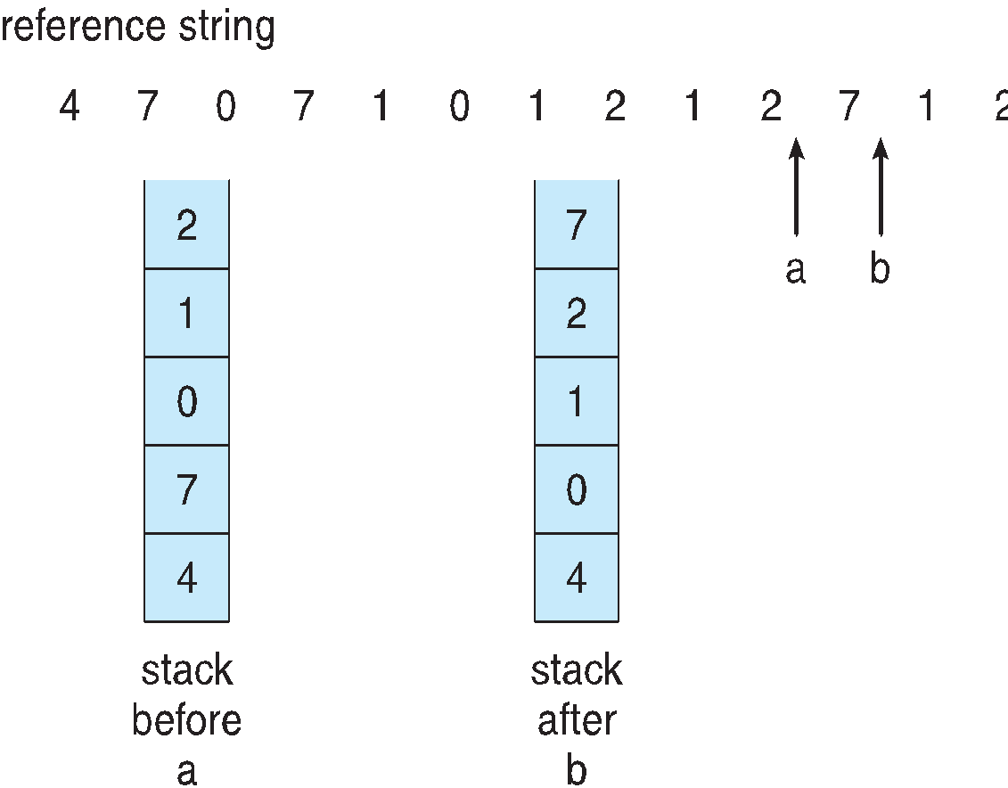
OPERATING SYSTEMS
Use Of A Stack to Record Most Recent Page References
LRU and OPT are cases of stack algorithms that don’t have Belady’s Anomaly
Use Of A Stack to Record Most Recent Page References

Slide 13
OPERATING SYSTEMS
Allocation of Frames
How do we allocate the fixed amount of free memory among the various processes?
Example:
Consider a single-user system with 128 KB of memory composed of pages 1 KB in size. Therefore, this system has 128 frames.
The operating system may take 35 KB, leaving 93 frames for the user process.
When a user process started execution, under pure demand paging, it would generate a sequence of page faults.
The first 93 page faults would all get free frames from the free-frame list.
When the free-frame list is exhausted, a page-replacement algorithm would be used.
When the process is terminated, the 93 frames would once again be placed on the free-frame list

Slide 14
OPERATING SYSTEMS
Allocation of Frames
Minimum number of frames:
One reason for allocating at least a minimum number of frames involves performance.
As the number of frames allocated to each process decreases, the page-fault rate increases, slowing process execution
When a page fault occurs before an executing instruction is complete, the instruction must be restarted. Consequently, we must have enough frames to hold all the different pages that any single instruction can reference
The minimum number of frames is defined by the computer architecture.
The maximum number is defined by the amount of available physical memory.
In between, we are still left with significant choice in frame allocation

Slide 15
OPERATING SYSTEMS
Frame Allocation Algorithms
Equal allocation:
The easiest way to split m frames among n processes is to give everyone an equal share, m/n frames (ignoring frames needed by the operating system)
Example:
        If there are 93 frames and 5 processes, each process will get 18 frames.
        The three leftover frames can be used as a free-frame buffer pool.

Slide 16
OPERATING SYSTEMS
Frame Allocation Algorithms
Proportional allocation:
Allocate available memory to each process according to its size
Let the size of the virtual memory for process p_{i} be s_{i} and define S = ∑ s_{i}
If the total number of available frames is m, allocate a_{i} frames to process p_{i} , where a_{i} is approximately a_{i} = s_{i} / S × m
Adjust each a_{i} to be an integer that is greater than the minimum number of frames required by the instruction set, with a sum not exceeding m
Example: To allocate 62 frames between two processes, one of 10 pages and one of 127 pages
    10/137 × 62 ≈ 4
    127/137 × 62 ≈ 57

Slide 17
OPERATING SYSTEMS
Global versus Local Allocation
Page-replacement algorithms can be classified into two broad categories: global replacement and local replacement
Global replacement allows a process to select a replacement frame from the set of all frames, even if that frame is currently allocated to some other process; that is, one process can take a frame from another.
Local replacement requires that each process select from only its own set of allocated frames.
Example: Consider a global replacement scheme wherein high-priority processes are allowed to select frames from low-priority processes for replacement.
A process can select a replacement from among its own frames or the frames of any lower-priority process. This approach allows a high-priority process to increase its frame allocation at the expense of a low-priority process
With a local replacement strategy, the number of frames allocated to a process does not change.
Global replacement generally results in greater system throughput and is therefore the more commonly used method.

Slide 18
OPERATING SYSTEMS
Thrashing
If a process does not have “enough” pages, the page-fault rate is very high
  Page fault to get page
  Replace existing frame
  But quickly need replaced frame back
  This leads to:
    Low CPU utilization
    Operating system thinking that it needs to increase the degree of multiprogramming
    Another process added to the system
Thrashing ≡ a process is busy swapping pages in and out

Slide 19
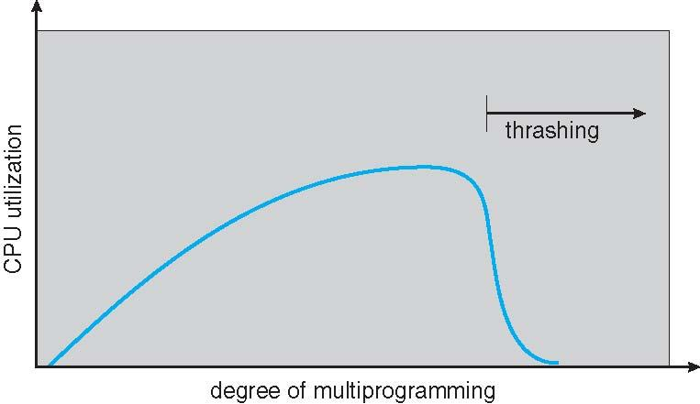
OPERATING SYSTEMS
Cause of Thrashing
Thrashing results in severe performance problems.
Consider the scenario of the paging systems performance.
As the degree of multiprogramming increases, CPU utilization also increases.
Why there is a decrease in the CPU Utilization when the degree of multiprogramming is increased?.
How this will be handled?

Slide 20

THANK YOU
Pavan A C
Department of Computer Science & Engineering

