Slide 1


OPERATING SYSTEMS
UE25CS242A
Memory Management
Pavan A C
Neha Sharma
Department of Computer Science & Engineering
Notes:
1

Slide 2
OPERATING SYSTEMS
Slides Credits for all the PPTs of this course
The slides/diagrams in this course are an adaptation, combination, and enhancement of material from the following resources and persons:
Slides of Operating System Concepts, Abraham Silberschatz, Peter Baer Galvin, Greg Gagne - 9th edition 2013 and some slides from 10th edition 2018
Some conceptual text and diagram from Operating Systems - Internals and Design Principles, William Stallings, 9th edition 2018
Some presentation transcripts from A. Frank – P. Weisberg
Some conceptual text from Operating Systems: Three Easy Pieces, Remzi Arpaci-Dusseau, Andrea Arpaci Dusseau

Slide 3
OPERATING SYSTEMS
NUMA (Non-Uniform Memory Access) Basics and Memory Locality, Clock Page Replacement.
Pavan A C
Neha Sharma
Department of Computer Science & Engineering
Notes:
3

Slide 4
OPERATING SYSTEMS
Non-uniform Memory Access
In systems with multiple CPUs, a given CPU can access some sections of main memory faster than it can access others.
These performance differences are caused by how CPUs and memory are interconnected in the system.
Systems in which memory access times vary significantly are known collectively as non-uniform memory access (NUMA) systems, and without exception, they are slower than systems in which memory and CPUs are located on the same motherboard
Managing which page frames are stored at which locations can significantly affect performance in NUMA systems. If we treat memory as uniform in such a system, CPUs may wait significantly longer for memory access than if we modify memory allocation algorithms to take NUMA into account.

Slide 5
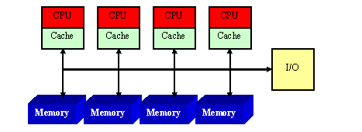
NUMA Architecture

Slide 6
Components of a NUMA System
Processors (CPUs): Execute processes and access both local and remote memory.
Local Memory: Memory directly connected to a processor with the lowest access latency.
Remote Memory: Memory connected to another processor; accessed through the interconnect.
High-Speed Interconnect: Transfers data between processors and memory nodes.
Memory Controller: Handles memory requests and manages data transfer.
Operating System: Schedules processes and allocates memory to improve memory locality.

Slide 7
OPERATING SYSTEMS
Memory locality
Memory locality refers to the tendency of a program to access the same memory locations or nearby memory locations repeatedly over a short period of time. The principle of locality is the basis for efficient memory hierarchy design (registers, cache, RAM and virtual memory). Memory locality improves system performance by:
      Reducing memory access time.
Increasing CPU cache hit rate.
Decreasing cache misses.
Improving virtual memory and paging efficiency.
Enhancing overall execution speed.

Slide 8
OPERATING SYSTEMS
Types of Memory locality
1. Temporal Locality (Locality in Time)
If a memory location is accessed, it is likely to be accessed again in the near future.
Applications:
CPU cache stores recently accessed data.
Frequently used instructions remain in the instruction cache.
2. Spatial Locality (Locality in Space)
If a memory location is accessed, nearby memory locations are likely to be accessed soon.
Applications:
Cache loads an entire cache block (cache line), not just one memory location.
Sequential file reading benefits from spatial locality.

Slide 9
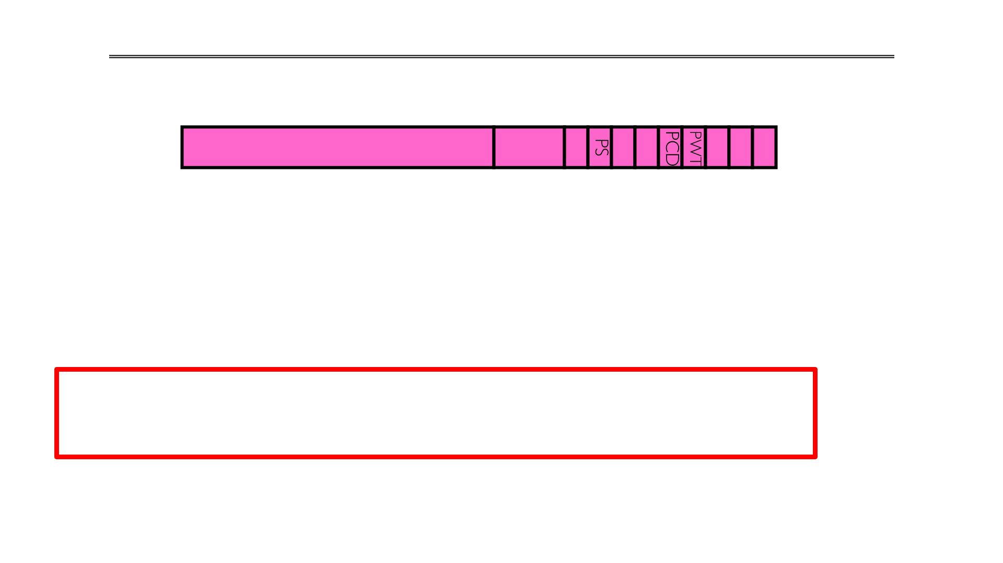
Approximating LRU: PTE bits
• Which bits of a PTE entry can help us approximate LRU?
Intel PTE:
PTE:
Page Frame Number
Free
(O S)
0
D A
U W P
(Physical Page Number)
31-12
11-9 8 7 6 5 4 3 2 1 0
– The “Present” bit (called “Valid” elsewhere):
» P==0: Page is invalid and a reference will cause page fault
» P==1: Page frame number is valid and MMU is allowed to proceed with translation
The “Accessed” bit (called “Use” elsewhere):
» A==0: Page has not been accessed (or used) since last time software set A→0
» A==1: Page has been accessed (or used) since last time software set A→0

Slide 10
Approximating LRU: PTE bits contd…
– The “Writable” bit (could have opposite sense and be called “Read-only”):
» W==0: Page is read-only and cannot be written.
» W==1: Page can be written
– The “Dirty” bit (called “Modified” elsewhere):
» D==0: Page has not been modified (written) since PTE was loaded
» D==1: Page has changed since PTE was loaded

Slide 11
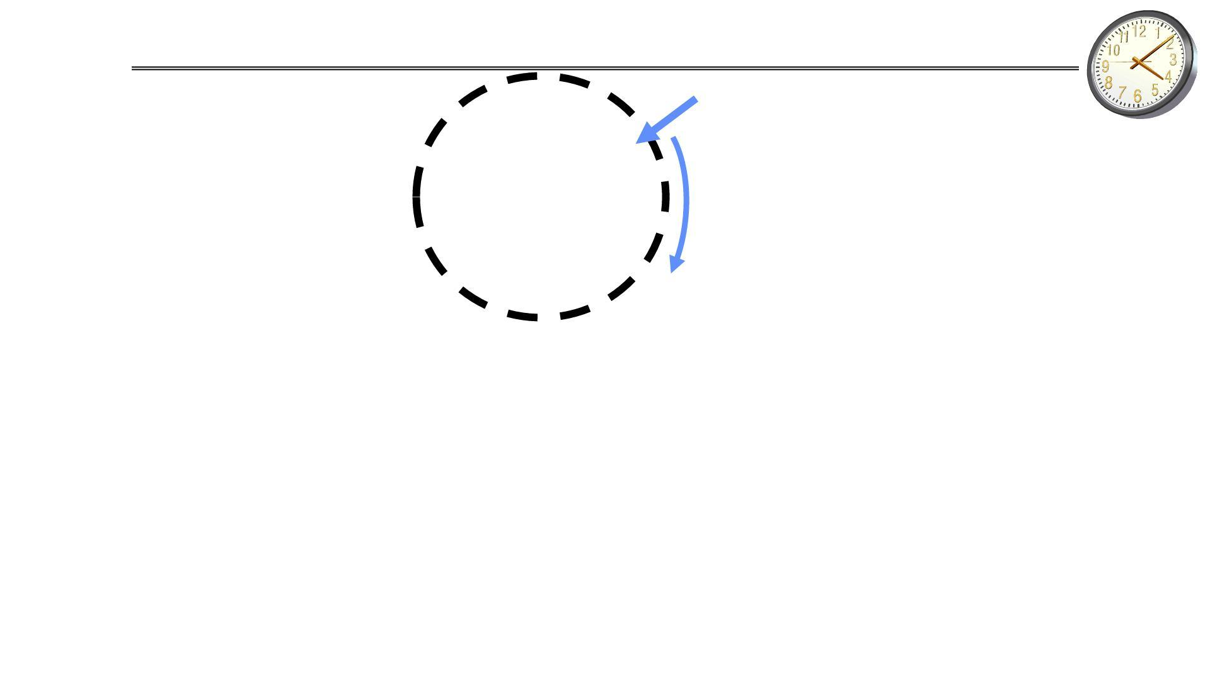
Approximating LRU: Clock Algorithm
Single Clock Hand:
Set of all pages
in Memory
Advances only on page fault
Check for pages not used recently
Mark pages as not used recently
• Clock Algorithm: Arrange physical pages in circle with single clock hand
– Approximate LRU
– Replace an old page, not the oldest page

Slide 12
Approximating LRU: Clock Algorithm
• Details:
– Hardware “use” bit per physical page (called “accessed” in Intel architecture):
» Hardware sets use bit on each reference
» If use bit isn’t set, means not referenced in a long time
– On page fault:
» Advance clock hand (not real time)
» Check use bit:
1→ used recently; clear and leave alone
0→ selected candidate for replacement

Slide 13
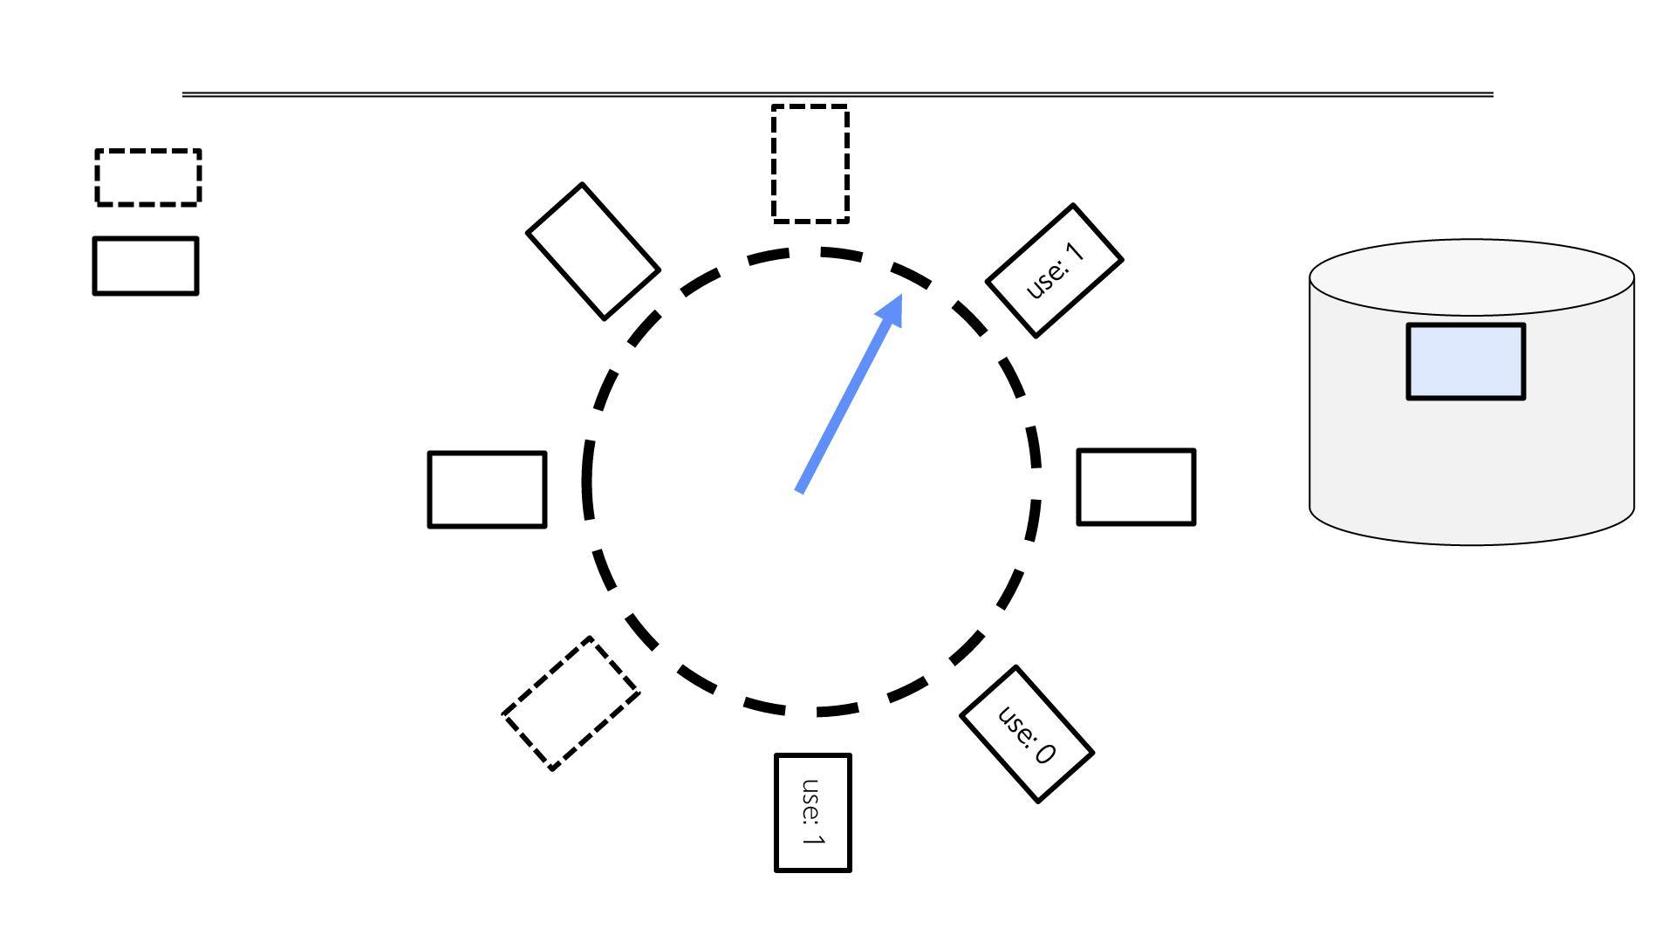
Clock Algorithm Example
Free frame
Page
use: 1

Slide 14
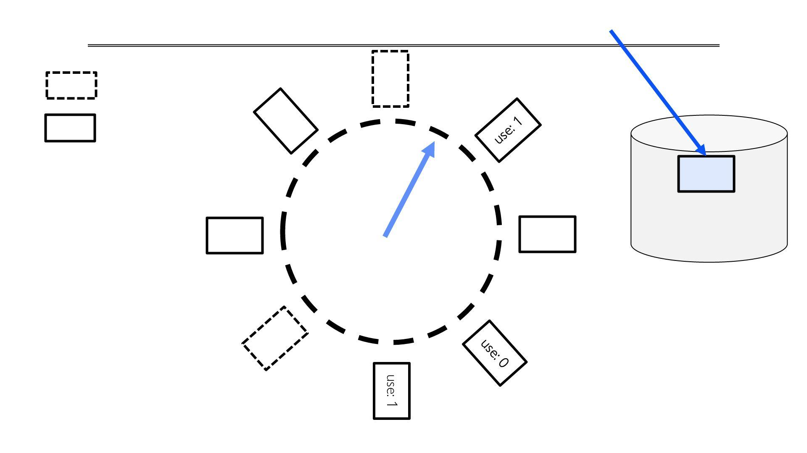
Clock Algorithm Example: Page Fault
Free frame
Page
use: 1

Slide 15
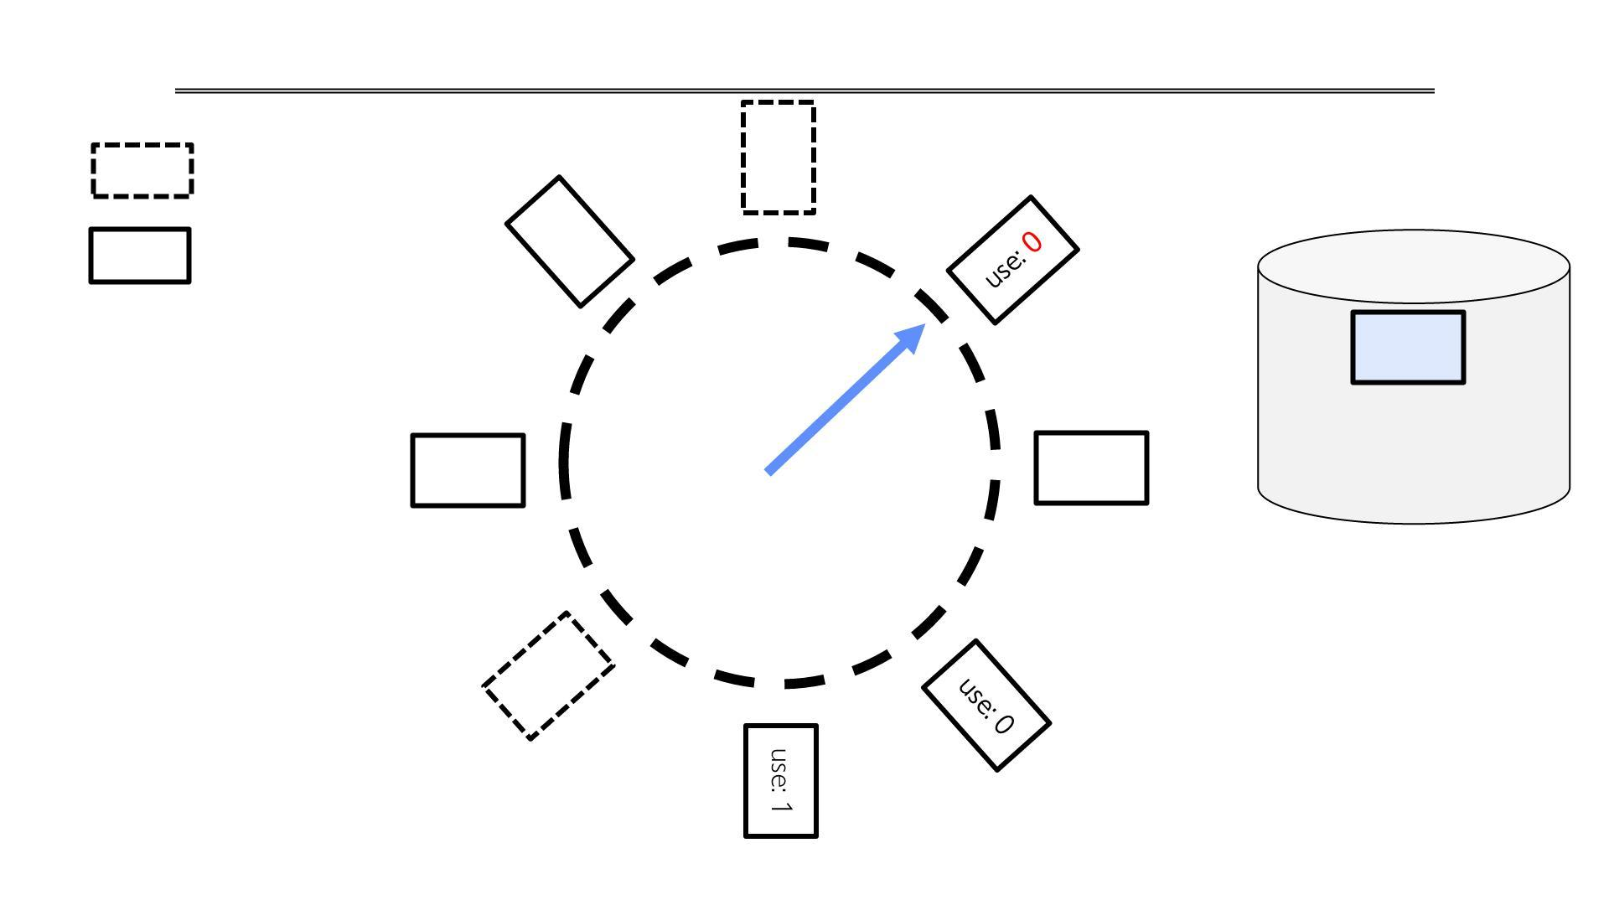
Clock Algorithm Example: Page Fault
Free frame
Page
use: 1

Slide 16
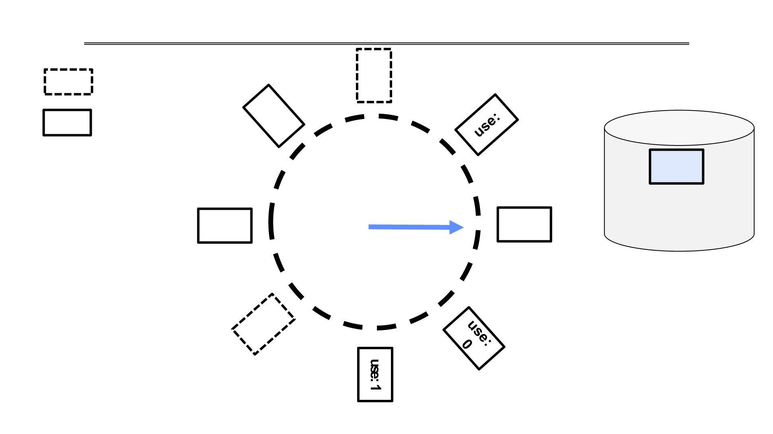
Clock Algorithm Example: Page Fault
Free frame
Page
use:0

Slide 17
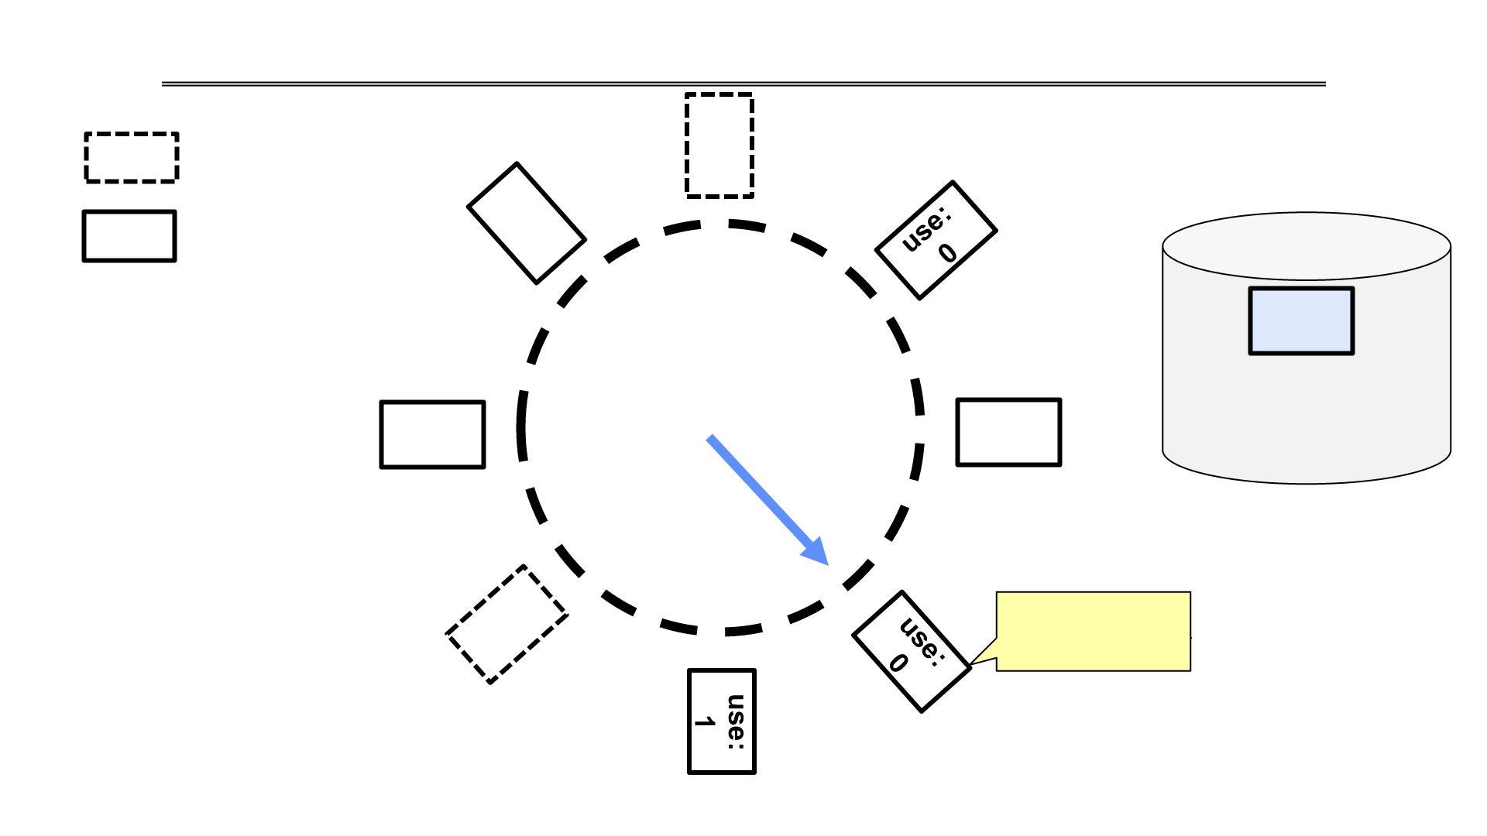
Clock Algorithm Example: Page Fault
Free frame
Page
use:
0
This is ”0”.
We can replace it!

Slide 18
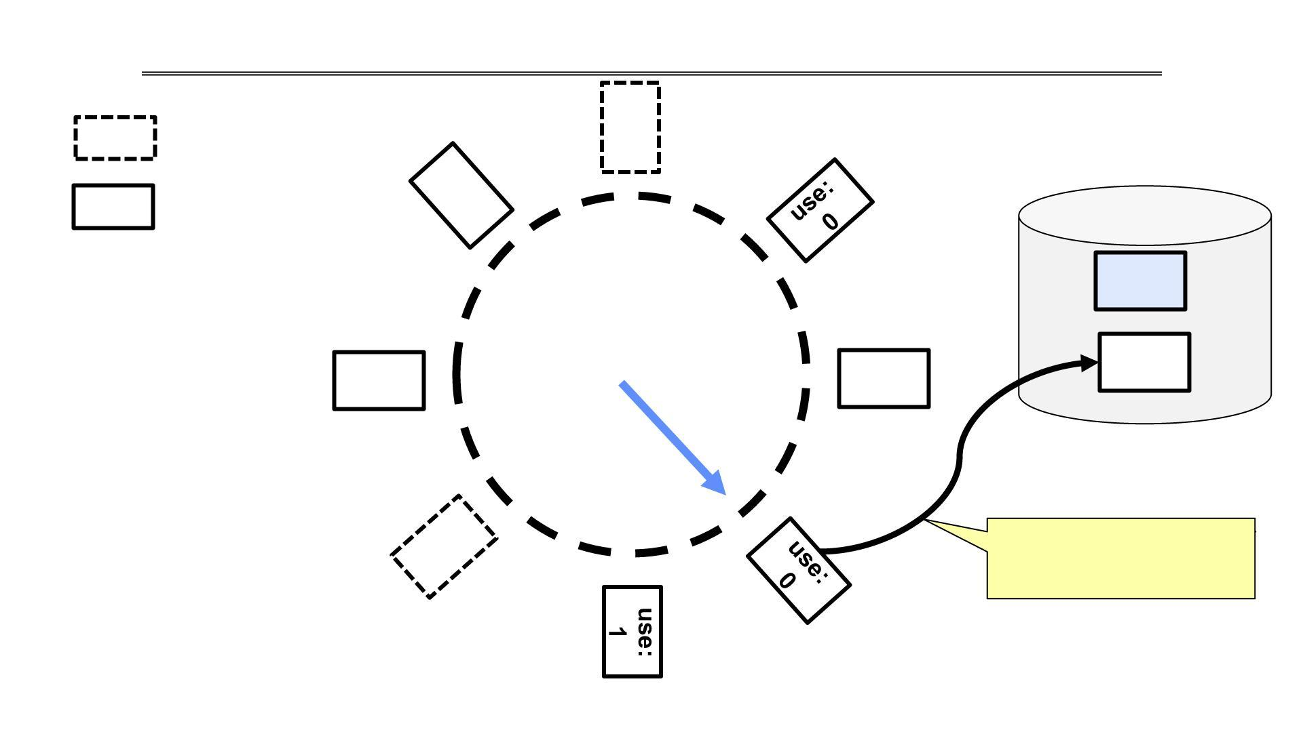
Clock Algorithm Example: Page Fault
Free frame
Page
use:
0
Save the page, if
“dirty”; invalidate
TLB and PTE

Slide 19
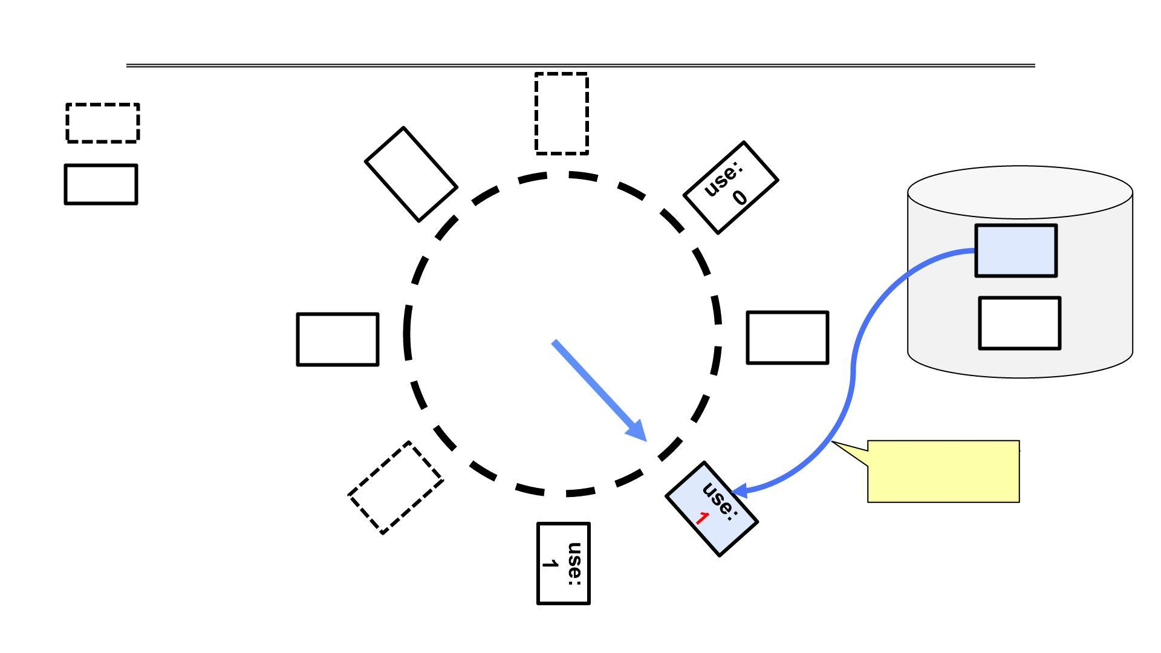
Clock Algorithm Example: Page Fault
Free frame
Page
use:
0
Load page;
update PTE

Slide 20
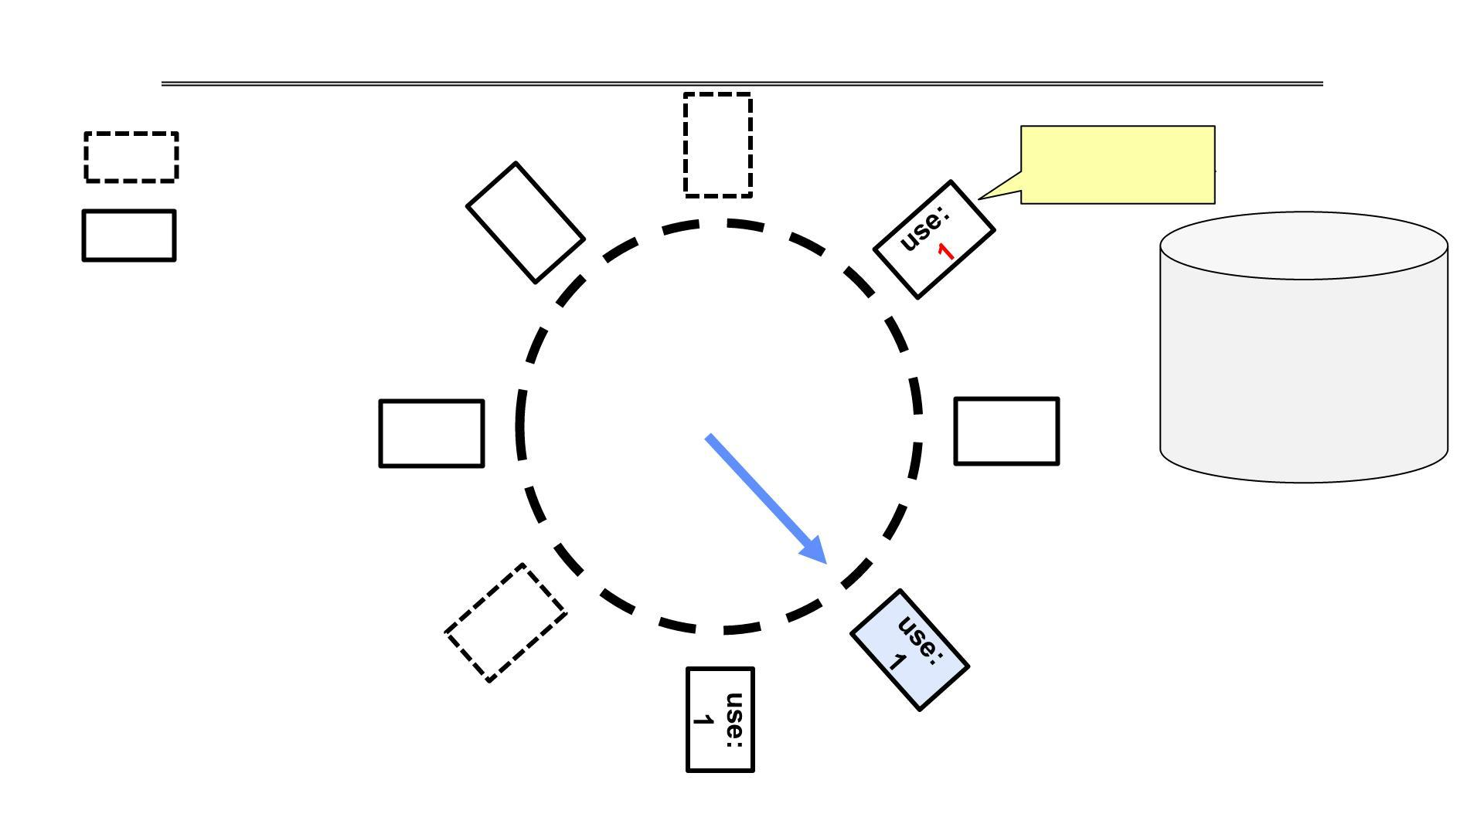
Clock Algorithm Example
Free frame
Page
Access page
(red or write)
use:
0

Slide 21
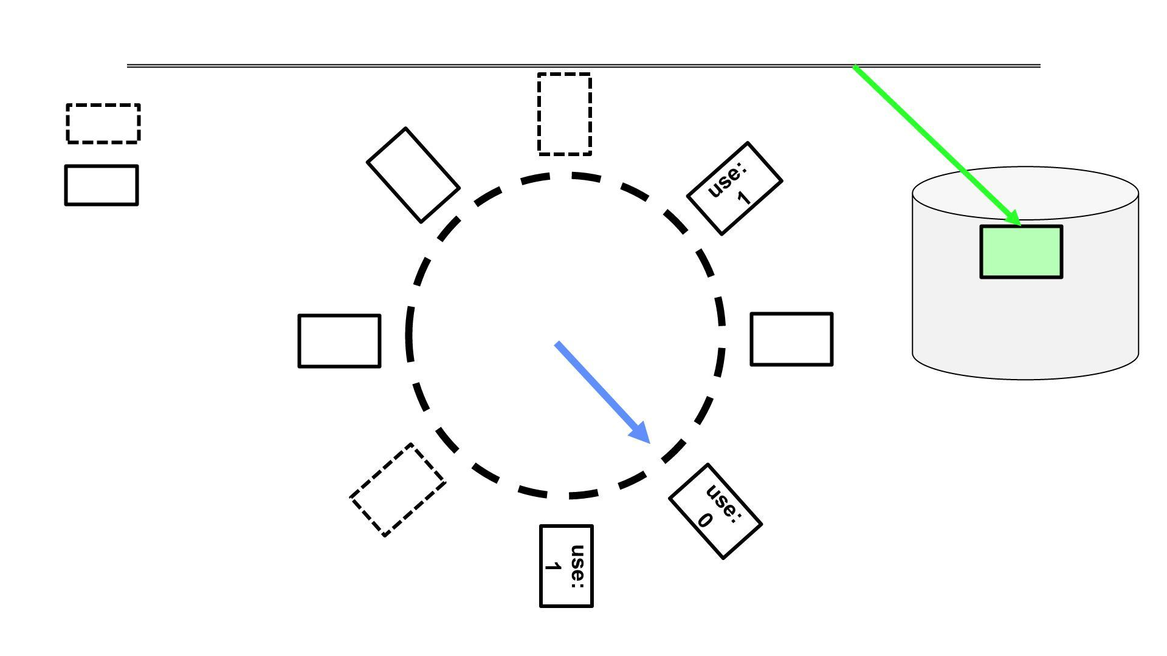
Clock Algorithm Example: Another Page Fault
Free frame
Page
use:
0
CS162 © UCB Fall 2025

Slide 22
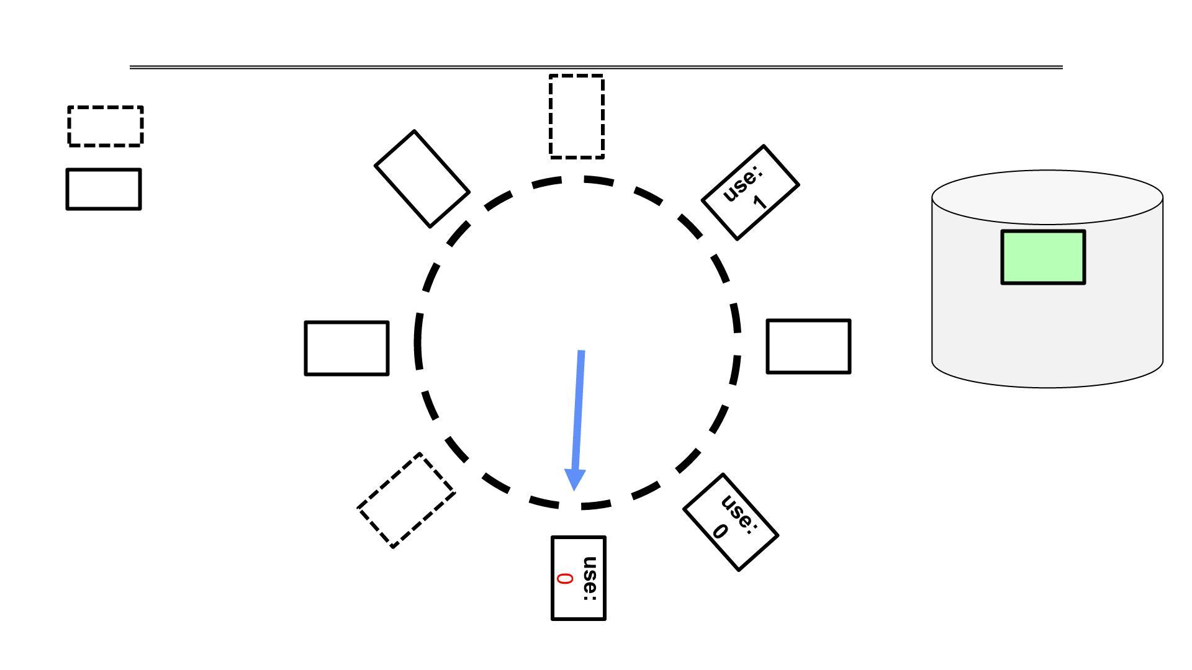
Clock Algorithm Example: Another Page Fault
Free frame
Page
use:
0

Slide 23
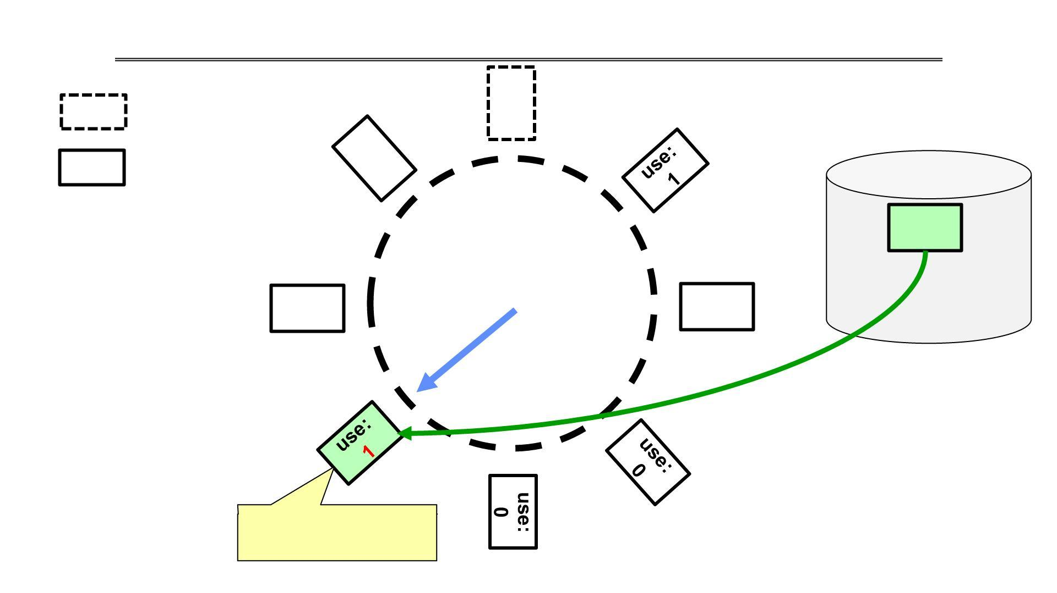
Clock Algorithm Example: Another Page Fault
Free frame
Page
use:
0
Free frame; Load
page; update PTE

Slide 24
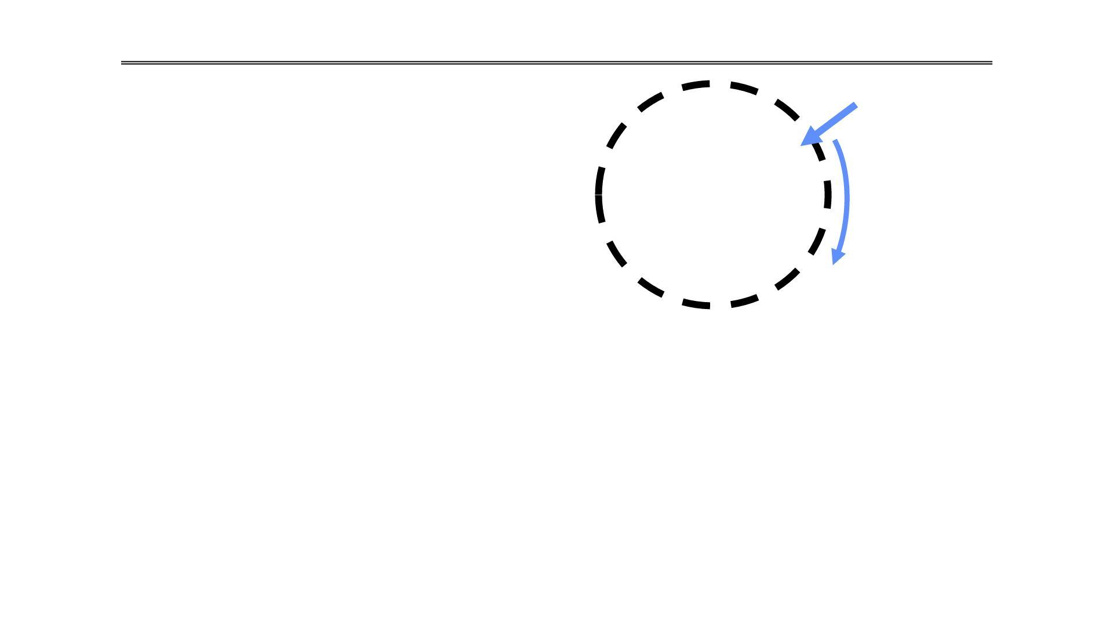
Clock Algorithm: More details
• Will always find a page or loop forever?
Single Clock Hand
– Even if all use bits set, will eventually loop
all the way around FIFO
Set of all pages
in Memory
• What if hand moving slowly?
– Good sign or bad sign?
» Not many page faults
» or find page quickly
• What if hand is moving quickly?
– Lots of page faults and/or lots of reference bits set
This provides a brilliant, low-overhead approximation of LRU that powers the operating systems today

Slide 25
Clock Algorithm problem
Consider the following page reference string:
1, 2, 3, 2, 4, 1
Assume that the system has 3-page frames. Apply the Clock Page Replacement Algorithm to the given reference string.
Tasks:
Show the contents of the page frames after each page reference.
Indicate whether each page reference results in a Page Hit or a Page Fault.
Determine the total number of page faults.
Draw the final state of the clock (circular queue) showing the page frames and the clock pointer.

Slide 26

THANK YOU
Pavan A C
Neha Sharma
Department of Computer Science and Engineering

