Slide 1

OPERATING SYSTEMS
UE25CS242A
File Management
Pavan A C
Department of Computer Science & Engineering

Slide 2
OPERATING SYSTEMS
File System
Pavan A C
Department of Computer Science & Engineering

Slide 3
OPERATING SYSTEMS
Slides Credits for all the PPTs of this course
The slides/diagrams in this course are an adaptation, combination, and enhancement of material from the following resources and persons:
Slides of Operating System Concepts, Abraham Silberschatz, Peter Baer Galvin, Greg Gagne - 9th edition 2013 and some slides from 10th edition 2018
Some conceptual text and diagram from Operating Systems - Internals and Design Principles, William Stallings, 9th edition 2018
Some presentation transcripts from A. Frank – P. Weisberg
Some conceptual text from Operating Systems: Three Easy Pieces, Remzi Arpaci-Dusseau, Andrea Arpaci Dusseau

Slide 4
OPERATING SYSTEMS
Directory Structure
A collection of nodes containing information about all files
Directory
Files
F 1
F 2
F 3
F 4
F n
Both the directory structure and the files reside on disk

Slide 5
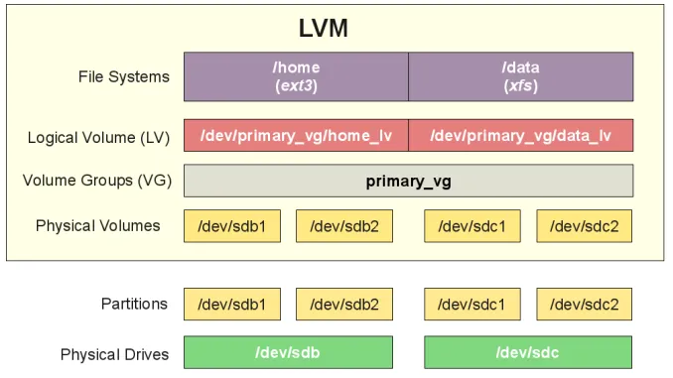
OPERATING SYSTEMS
Disk Structure
Disk can be subdivided into partitions
Disks or partitions can be RAID protected against failure
Disk or partition can be used raw – without a file system, or formatted with a file system
Partitions also known as minidisks, slices
Entity containing file system known as a volume
Each volume containing file system also tracks that file system’s info in device directory or volume table of contents
As well as general-purpose file systems there are many special-purpose file systems, frequently all within the same operating system or computer

Slide 6
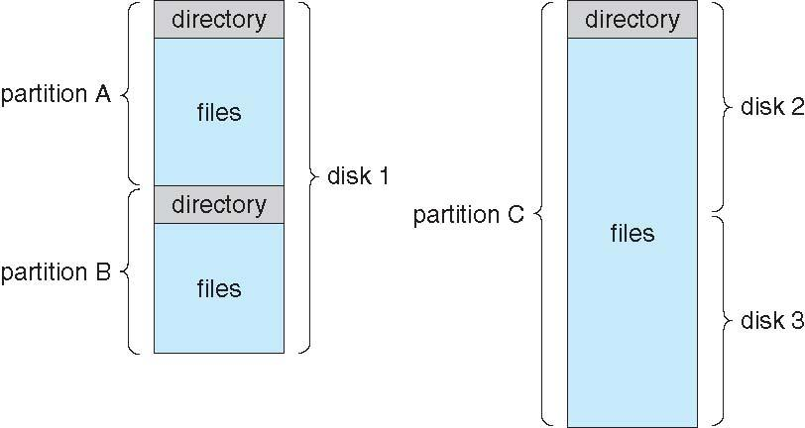
OPERATING SYSTEMS
A Typical File-system Organization

Slide 7
OPERATING SYSTEMS
Operations Performed on Directory
Search for a file
Create a file
Delete a file
List a directory
Rename a file
Traverse the file system

Slide 8
OPERATING SYSTEMS
Directory Organization
The directory is organized logically to obtain
Efficiency – locating a file quickly
Naming – convenient to users
  Two users can have same name for different files
  The same file can have several different names
Grouping – logical grouping of files by properties, (e.g., all Java programs, all games, …)

Slide 9
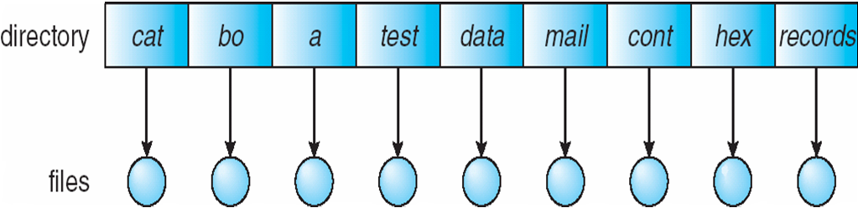
OPERATING SYSTEMS
Single-Level Directory
A single directory for all users
Naming problem
Grouping problem

Slide 10
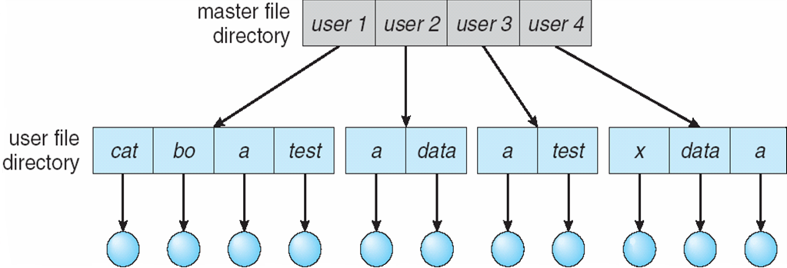
OPERATING SYSTEMS
Two-Level Directory
Separate directory for each user
Path name
Can have the same file name for different user
Efficient searching
No grouping capability

Slide 11
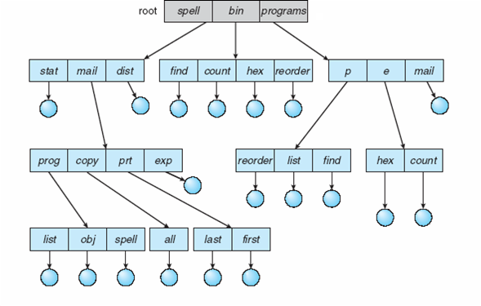
OPERATING SYSTEMS
Tree-Structured Directories
A tree structure is the most common directory structure.
The tree has a root directory, and every file in the system have a unique path.

Slide 12
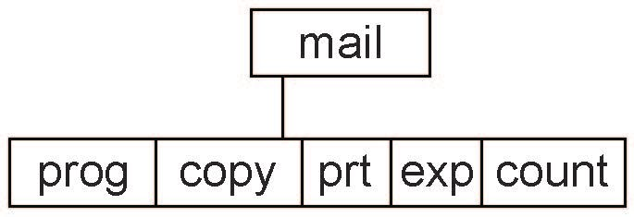
OPERATING SYSTEMS
Tree-Structured Directories (Cont.)
Efficient searching
Grouping Capability
Current directory (working directory)
  cd /spell/mail/prog
  type list
We cannot share files
Deleting “mail” ⇒ deleting the entire subtree rooted by “mail”

Slide 13
OPERATING SYSTEMS
Tree-Structured Directories (Cont.)
Absolute or relative path name
Creating a new file is done in current directory
Delete a file
rm <file-name>
Creating a new subdirectory is done in current directory
  mkdir <dir-name>
  Example: if in current directory /mail
  mkdir count
Deleting “mail” ⇒ deleting the entire subtree rooted by “mail”

Slide 14
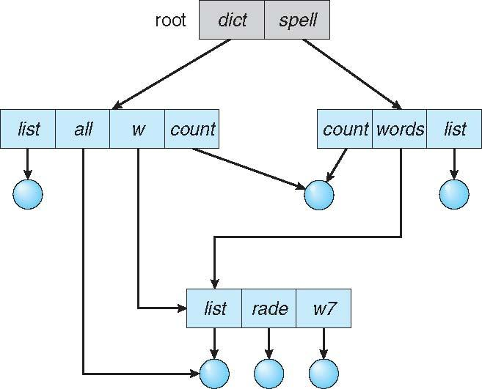
OPERATING SYSTEMS
Acyclic-Graph Directories
An acyclic graph is a graph with no cycle and allows to share subdirectories and files.
The same file or subdirectories may be in two different directories
It is used in a situation like when two programmers are working on a joint project and they need to access files.

Slide 15
OPERATING SYSTEMS
Acyclic-Graph Directories (Cont.)
Two different names (aliasing)
If dict deletes list ⇒ dangling pointer
Solutions:
  Backpointers, so we can delete all pointers
  Variable size records a problem
  Backpointers using a daisy chain organization
  Entry-hold-count solution
New directory entry type
  Link – another name (pointer) to an existing file
  Resolve the link – follow pointer to locate the file

Slide 16
OPERATING SYSTEMS
General Graph Directory
Advantages:
It allows cycles within a dir structure.
Multiple directories can be derived from more than one parent dir.
Disadvantages:
It is more costly than others.
It needs garbage collection (traversing the entire file system, marking everything that can be accessed)

Slide 17
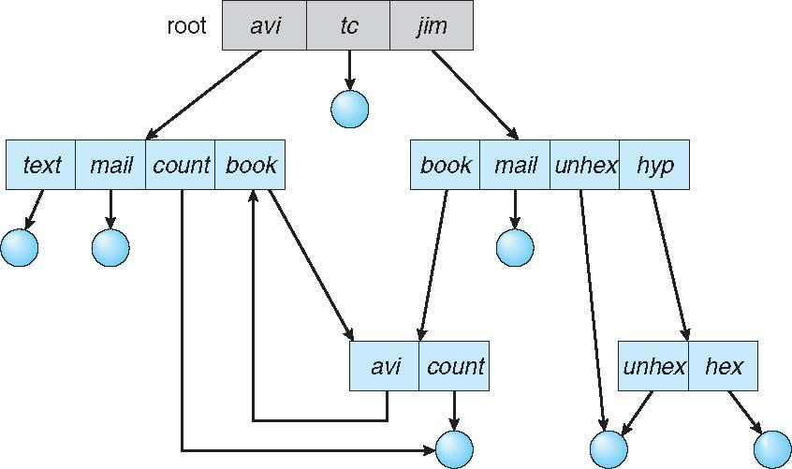
OPERATING SYSTEMS
General Graph Directory (Contd.)
How do we guarantee no cycles?
  Allow only links to file not subdirectories
  Garbage collection
  Every time a new link is added use a cycle detection algorithm to determine whether it is OK

Slide 18
THANK YOU
Pavan A C
Department of Computer Science & Engineering
pavanac@pes.edu

