Slide 1

OPERATING SYSTEMS
UE25CS242A
Storage Management
Pavan A C
Department of Computer Science & Engineering

Slide 2
OPERATING SYSTEMS
File System
Pavan A C
Department of Computer Science & Engineering
Notes:
To explain the function of file systems
To describe the interfaces to file systems
To discuss file-system design tradeoffs, including access methods, file sharing, file locking, and directory structures
To explore file-system protection

Slide 3
OPERATING SYSTEMS
Slides Credits for all the PPTs of this course
The slides/diagrams in this course are an adaptation, combination, and enhancement of material from the following resources and persons:
Slides of Operating System Concepts, Abraham Silberschatz, Peter Baer Galvin, Greg Gagne - 9th edition 2013 and some slides from 10th edition 2018
Some conceptual text and diagram from Operating Systems - Internals and Design Principles, William Stallings, 9th edition 2018
Some presentation transcripts from A. Frank – P. Weisberg
Some conceptual text from Operating Systems: Three Easy Pieces, Remzi Arpaci-Dusseau, Andrea Arpaci Dusseau

Slide 4
OPERATING SYSTEMS
File Concept
Computers can store information on various storage media, such as magnetic disks, magnetic tapes, and optical disks.
File is logical storage where as disks are physical storage unit
What is a File?
  Collection of related information
  Data cannot to be written to disk unless they are in files
  Data can be Numeric, alphabetic, alphanumeric, binary
A file is a sequence of bits, bytes, lines, or records, the meaning of which is defined by the file’s creator and user
Contents of file can be source or executable programs, numeric or text data, photos, music, video, and so on.

Slide 5
OPERATING SYSTEMS
File Attributes
Files are named and are referred by their names by the human users.
Attributes of files
Name – only information kept in human-readable form
Identifier – unique tag (number) identifies file within file system
Type – needed for systems that support different types
Location – pointer to file location on device
Size – current file size
Protection – controls who can do reading, writing, executing
Time, date, and user identification – data for protection, security, and usage monitoring
Information about files are kept in the directory structure, which is maintained on the disk.

Slide 6
OPERATING SYSTEMS
File Operations
File is an abstract data type.
File Operations
Create
Write – Use the system call to write to a file. A write pointer points to the location in the file, where the next write is to take place.
Read – – Use the system call to write to a file. A read pointer points to the location in the file from where the next read is to take place
Reposition within file - Repositioning within a file need not involve any actual I/O. It is done with system call lseek. Repositioning is also called seek to location in a file
Delete: Use the system call to delete/remove a file.
  File to be deleted is searched in the directory.
  Release the memory allocated after deletion

Slide 7
OPERATING SYSTEMS
File Operations
Truncate: The user may want to erase the contents of a file but keep its attributes.
  Instead of deleting the file and then recreating it, use the function that sets the size of file to zero.
Appending to the end of a existing file
Open a file – use a system call open()
  Open-file table: tracks open files
  File pointer: pointer to last read/write location, per process that has the file open
  File-open count: counter of number of times a file is open – to allow removal of data from open-file table when last processes closes it
Close: When a file is actively not used close it.

Slide 8
OPERATING SYSTEMS
File Operations
Several pieces of information are associated with an open file.
  File pointer
  File-open count.
  Disk location of the file.
  Access rights

Slide 9
OPERATING SYSTEMS
Open Files
Provided by some operating systems and file systems
  Similar to reader-writer locks
  Shared lock similar to reader lock – several processes can acquire concurrently
  Exclusive lock similar to writer lock
OS mediates access to a file
Mandatory or advisory:
  Mandatory – access is denied depending on locks held and requested
  Advisory – processes can find status of locks and decide what to do
Notes:
If a lock is mandatory, then once a process acquires an exclusive lock, the operating system will prevent any other process
from accessing the locked file i.e. OS ensures locking integrity.
For advisory locking, it is up to software developers to ensure that locks are appropriately acquired and released.
As a general rule, Windows operating systems adopt mandatory locking, and UNIX systems employ advisory locks.

Slide 10
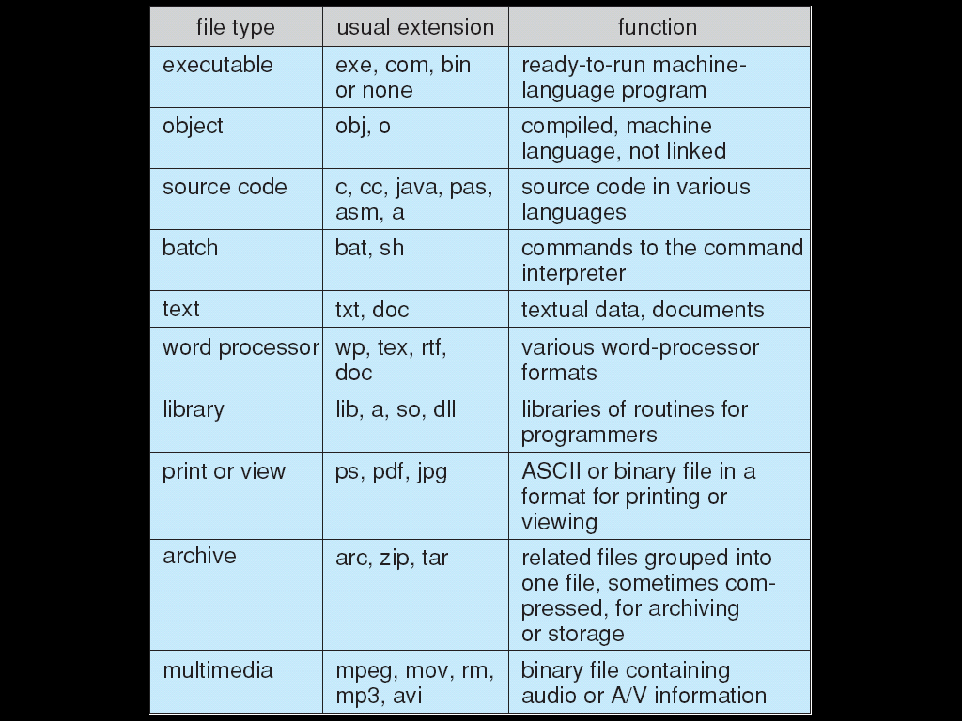
OPERATING SYSTEMS
File Types – Name, Extension

Slide 11
OPERATING SYSTEMS
File Structure
None - sequence of words, bytes
Simple record structure
  Lines
  Fixed length
  Variable length
Complex Structures
  Formatted document
  Relocatable load file
Can simulate last two with first method by inserting appropriate control characters
Who decides:
  Operating system
  Program

Slide 12
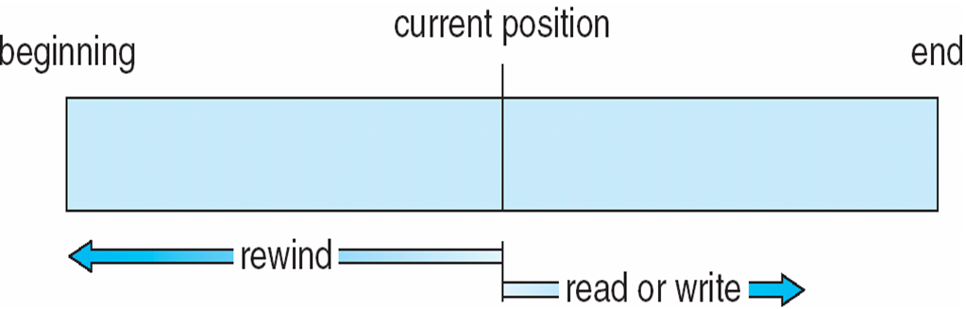
OPERATING SYSTEMS
Access Methods

Slide 13
OPERATING SYSTEMS
Sequential-access File
Sequential Access
read next
write next
reset
Direct Access (or relative access) – file is fixed length logical records
read n
write n
position to n
read next
write next
n = relative block number (i.e. index relative to the beginning of the file)
Relative block numbers allow OS to decide where file should be placed

Slide 14
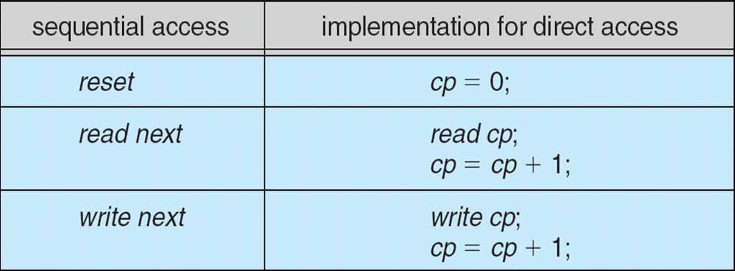
OPERATING SYSTEMS
Simulation of Sequential Access on Direct-access File
cp = current position
Some systems allow only sequential file access; others allow only direct access

Slide 15
THANK YOU
Pavan A C
Department of Computer Science & Engineering
pavanac@pes.edu

