Slide 1

OPERATING SYSTEMS
UE25CS242A
File Management
Pavan A C
Department of Computer Science & Engineering

Slide 2
OPERATING SYSTEMS
Access Matrix
Pavan A C
Department of Computer Science & Engineering

Slide 3
OPERATING SYSTEMS
Slides Credits for all PPTs of this course
The slides/diagrams in this course are an adaptation, combination, and enhancement of material from the following resources and persons:
Slides of Operating System Concepts, Abraham Silberschatz, Peter Baer Galvin, Greg Gagne - 9th edition 2013 and some slides from 10th edition 2018
Some conceptual text and diagram from Operating Systems - Internals and Design Principles, William Stallings, 9th edition 2018
Some presentation transcripts from A. Frank – P. Weisberg
Some conceptual text from Operating Systems: Three Easy Pieces, Remzi Arpaci-Dusseau, Andrea Arpaci Dusseau

Slide 4
OPERATING SYSTEMS
Access Matrix
Protection Model
The Access Matrix is a protection model used by an operating system to specify who can access what and what operations are permitted.
It represents access permissions between:
  Domains → Subjects/users/processes
  Objects → Resources such as files, printers, memory, etc.
Each cell contains the access rights allowed for a particular domain on an object.
Basic Structure
Rows → Domains
Columns → Objects
Cells → Access Rights
Example Rights - read (r), write (w), execute (x), print, delete

Slide 5
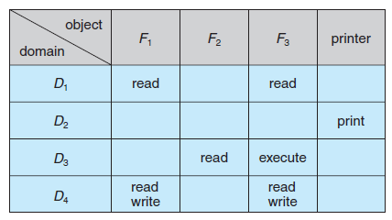
OPERATING SYSTEMS
Access Matrix example
Domains: D1, D2, D3, D4
Objects: F1, F2, F3, Printer
Key Points:
D1 → Read F1, F3
D4 → Same as D1 + Write F1, F3
D2 → Access Printer only

Slide 6
OPERATING SYSTEMS
Access Matrix
Ensures:
Only allowed access
Strict control of resources
OS decides:
Which domain a process runs in
What rights are given
Domain Switching
Domain is treated as an object
Switching = performing switch operation
Rule:
Process can switch from Di → Dj
only if ‘switch’ right exists

Slide 7
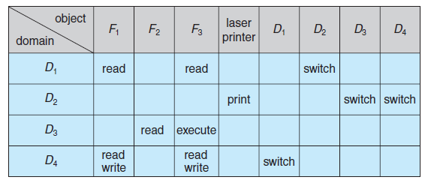
OPERATING SYSTEMS
Access Matrix – Domain switching
D2 → can switch to D3, D4
D4 → can switch to D1
D1 → can switch to D2
Additional Rights:
copy → duplicate access rights
owner → full control
control → modify rights

Slide 8
OPERATING SYSTEMS
Implementation of the Access Matrix
Why is Implementation Needed?
The Access Matrix provides a clear protection model, but a complete matrix can become very large.
Most entries in the matrix are usually empty.
Therefore, storing the entire matrix directly is not memory efficient.
Operating systems use different techniques to implement the Access Matrix.
Common Implementations
Global Table
Access List for Objects (ACL)
Capability List

Slide 9
OPERATING SYSTEMS
Implementation of the Access Matrix – Global table
A global table stores all non-empty access relationships in a single table.
Each entry is represented as: <Domain, Object, Rights>
How It Works
A process requests access to an object.
The OS searches the global table.
It looks for the corresponding Domain–Object entry.
The requested operation is checked against the stored rights.
Access is allowed or denied.
Limitations
Large table → inefficient use of memory
Slow lookup → searching may take time
Difficult to manage grouping of similar access rights

Slide 10
OPERATING SYSTEMS
Implementation of the Access Matrix – Access list for objects
In this approach, each object maintains a list of domains and their allowed rights.
The list answers: “Who can access this object, and what can they do?”
Format: Object → (Domain, Rights)
How it works
Process requests access to an object.
OS checks that object's access list.
It finds the requesting domain.
The requested operation is compared with the allowed rights.
Access is granted or denied.
Advantages
Easy to determine who can access an object.
Permissions can be easily modified.
Supports default permissions.
Limitation - Difficult to determine all objects accessible by a particular domain.
Domain | Rights
D1 | Read
D3 | Read, Write
D4 | Read, Write
So:
D1 → can read F1
D3 → can read and write F1
D4 → can read and write F1
D2 → has no access to F1

Slide 11
OPERATING SYSTEMS
Capability List
A capability list stores the access rights associated with a domain.
It answers: “What objects can this domain access, and what can it do?”
Format: Domain → (Object, Rights)
How it works
A process executes in a particular domain.
The OS checks that domain's capability list.
It finds the requested object.
The requested operation is checked against the stored rights.
Access is granted or denied.
Object | Rights
F1 | Read
F2 | Read, Write
Printer | Print
So D1 can:
Read F1
Read and Write F2
Print using the Printer

Slide 12
THANK YOU
Pavan A C
Department of Computer Science and Engineering
pavanac@pes.edu

