Slide 1

OPERATING SYSTEMS
UE25CS242A
File Management
Pavan A C
Department of Computer Science & Engineering

Slide 2
OPERATING SYSTEMS
Access Control, Revocation of Access Rights
Pavan A C
Department of Computer Science & Engineering

Slide 3
OPERATING SYSTEMS
Slides Credits for all PPTs of this course
The slides/diagrams in this course are an adaptation, combination, and enhancement of material from the following resources and persons:
Slides of Operating System Concepts, Abraham Silberschatz, Peter Baer Galvin, Greg Gagne - 9th edition 2013 and some slides from 10th edition 2018
Some conceptual text and diagram from Operating Systems - Internals and Design Principles, William Stallings, 9th edition 2018
Some presentation transcripts from A. Frank – P. Weisberg
Some conceptual text from Operating Systems: Three Easy Pieces, Remzi Arpaci-Dusseau, Andrea Arpaci Dusseau

Slide 4
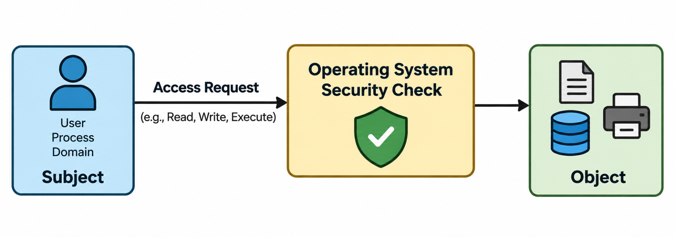
OPERATING SYSTEMS
Access Control
Access control determines who can access a resource and what operations they are allowed to perform.
The operating system uses protection mechanisms to control access to files, devices, and other objects.
Access rights may be assigned to users, domains, or roles.

Slide 5
OPERATING SYSTEMS
Revocation of Access Rights
Revocation means removing previously granted access rights.
It is required when access permissions need to be changed or withdrawn.
Revocation is important in dynamic protection systems, where access rights can change over time.
Example
Before:
Faculty → File F1 → Read + Write
After Revocation:
Faculty → File F1 → Read
→ The Write permission has been revoked.

Slide 6
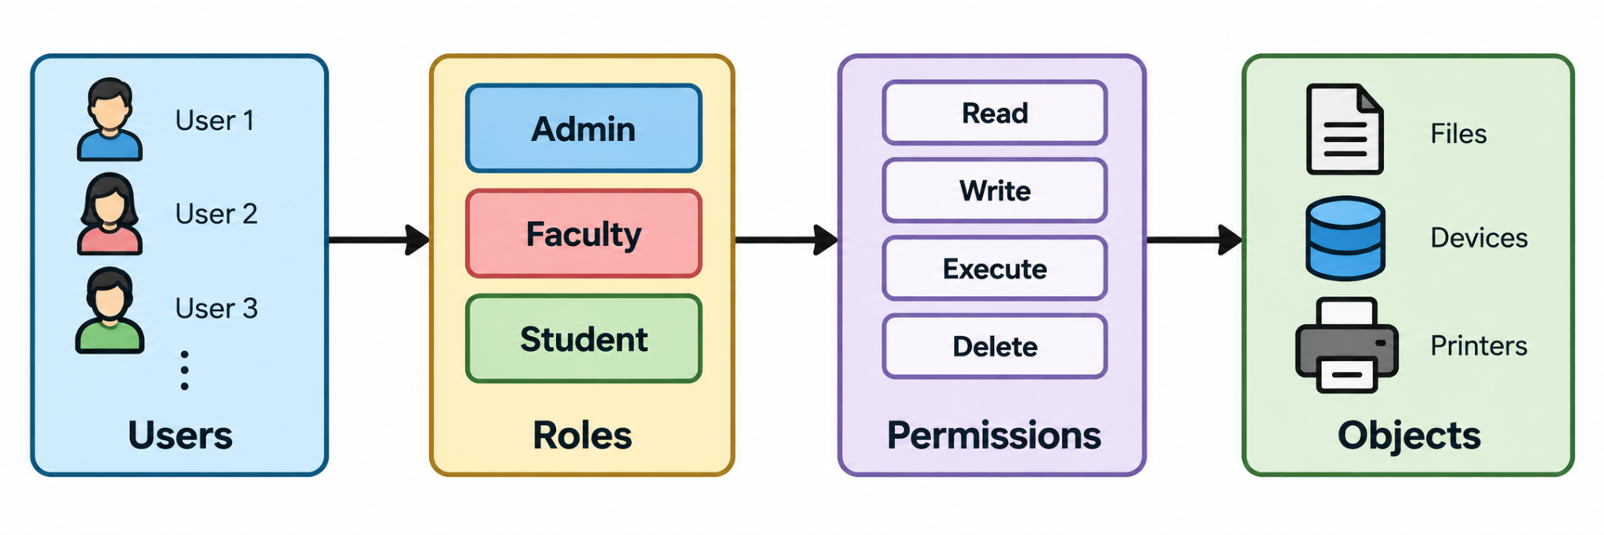
OPERATING SYSTEMS
Role-Based Access Control (RBAC)
In RBAC, permissions are assigned to roles, rather than directly to individual users.
A role represents a user's job or function in the system.
Users are assigned one or more appropriate roles.

Slide 7
OPERATING SYSTEMS
Why Revocation of Access Rights is Needed
Revocation
Revocation means removing previously granted access rights from a user or domain.
It is necessary because access requirements can change over time.
Revocation is an important part of a dynamic protection system.
Why is Revocation Required?
A user's role or responsibility changes.
A user no longer needs access to a resource.
A resource becomes more restricted.
Temporary access has expired.
An administrator needs to withdraw previously granted permissions.
Simple Example
Before: D1 → File F1 → Read + Write
After Revocation: D1 → File F1 → Read : The Write right has been removed, while Read is retained.

Slide 8
OPERATING SYSTEMS
Types of Revocation
Revocation can be classified based on when, how much, and for whom access is removed.
1. Immediate vs. Delayed
Immediate: Access is removed immediately.
Delayed: Revocation takes effect after a specified time or condition.
2. Selective vs. General
Selective: Remove access from a specific user/domain.
General: Remove access from all users/domains having that right.
3. Partial vs. Total
Partial: Remove some rights while keeping others.
Total: Remove all access rights to the object.
4. Temporary vs. Permanent
Temporary: Access is removed for a limited period or until a condition is met.
Permanent: Access is removed and does not automatically return.

Slide 9
OPERATING SYSTEMS
Revocation Using ACL and Capability List
Revocation with Access Control List (ACL)
In an ACL, each object maintains a list of domains/users and their access rights.
To revoke access, the OS can remove or modify the corresponding entry.
Therefore, revocation using ACL is relatively straightforward.
Revocation with Capability List
In a Capability List, access rights are associated with domains.
Capabilities may be distributed among different domains.
Therefore, revoking a particular capability can be more difficult.

Slide 10
OPERATING SYSTEMS
Revocation Techniques
When capabilities are distributed among domains, different techniques can be used to revoke access.
1. Reacquisition
Capabilities have a limited validity.
When they expire, the user/domain must request access again.
If access is revoked, the request is denied.
2. Back-Pointers
The system maintains pointers to all copies of a capability.
During revocation, these pointers are used to locate and modify/remove the capabilities.
3. Indirection
Access is managed through an intermediate/global table.
To revoke access, the corresponding entry in the table is deleted or invalidated.
4. Keys
A capability is associated with a key.
Changing or invalidating the key makes the old capability unusable.

Slide 11
OPERATING SYSTEMS
Access Matrix
Protection model represented as a matrix
Rows → Domains
Columns → Objects
Each cell contains access rights
access(i, j):
Operations allowed on object Oj by domain Di

Slide 12
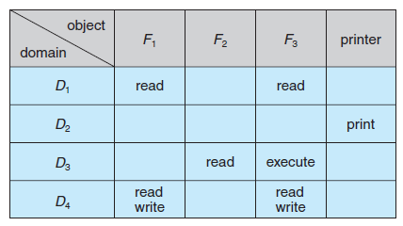
OPERATING SYSTEMS
Access Matrix example
Domains: D1, D2, D3, D4
Objects: F1, F2, F3, Printer
Key Points:
D1 → Read F1, F3
D4 → Same as D1 + Write F1, F3
D2 → Access Printer only

Slide 13
OPERATING SYSTEMS
Access Matrix
Ensures:
Only allowed access
Strict control of resources
OS decides:
Which domain a process runs in
What rights are given
Domain Switching
Domain is treated as an object
Switching = performing switch operation
Rule:
Process can switch from Di → Dj
only if ‘switch’ right exists

Slide 14
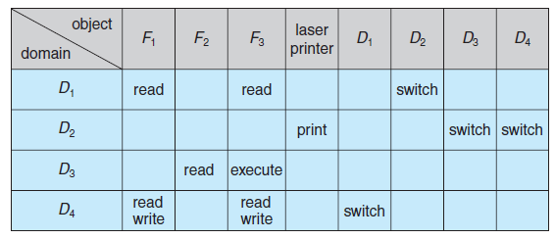
OPERATING SYSTEMS
Access Matrix – Domain switching
D2 → can switch to D3, D4
D4 → can switch to D1
D1 → can switch to D2
Additional Rights:
copy → duplicate access rights
owner → full control
control → modify rights

Slide 15
OPERATING SYSTEMS
Implementation of the Access Matrix – Global table
Represented as: <domain, object, rights>
System searches table to check permission
Drawbacks:
Large size → not memory efficient
Slow lookup (search required)
Difficult to manage grouping

Slide 16
OPERATING SYSTEMS
Implementation of the Access Matrix – Access list for objects
Each object has a list:
  (domain, rights)
Advantages:
Easy to check who can access object
Supports default permissions
Limitation:
Hard to know what a domain can access

Slide 17
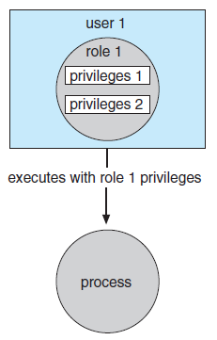
OPERATING SYSTEMS
Role based access control
Access permissions are assigned to roles, not directly to users
A role represents a job/function (e.g., Admin, Faculty, Student)
How it works:
Users → assigned to roles
Roles → assigned permissions
Users gain access through roles
Example:
Admin → read, write, delete
Faculty → read, write
Student → read only
If a user is assigned “Faculty” role → gets those permissions

Slide 18
OPERATING SYSTEMS
Role based access control
Advantages:
Reduces complexity in access management
Easy to update permissions (change role, not every user)
Improves security (no direct permission assignment)
Supports large systems efficiently
Limitation:
Requires proper role design
Too many roles → becomes complex

Slide 19
OPERATING SYSTEMS
Revocation of access rights
Revocation = Removing access rights from users/domains
Needed in dynamic protection systems
Types of Revocation:
Immediate / Delayed
  Instant removal vs later
Selective / General
  Specific users vs all users
Partial / Total
  Some rights vs all rights
Temporary / Permanent
  Can be regained vs removed forever

Slide 20
OPERATING SYSTEMS
Revocation of access rights
Access List (ACL):
Easy to revoke:
  Simply remove entry from list
Supports:
  All types (selective, partial, etc.)
Capability List:
Difficult to revoke:
  Capabilities are distributed across system

Slide 21
OPERATING SYSTEMS
Revocation of access rights
Revocation Techniques:
Reacquisition
  Capabilities expire → must request again
Back-pointers
  Track all capabilities → modify them
Indirection
  Use global table → delete entry
Keys
  Change key → invalidate all old access

Slide 22
THANK YOU
Pavan A C
Department of Computer Science and Engineering
pavanac@pes.edu

