Slide 1

OPERATING SYSTEMS
UE25CS242A
File Management
Pavan A C
Department of Computer Science & Engineering

Slide 2
OPERATING SYSTEMS
File System – File-System Mounting, File Sharing and File Protection
Pavan A C
Department of Computer Science & Engineering

Slide 3
OPERATING SYSTEMS
Slides Credits for all the PPTs of this course
The slides/diagrams in this course are an adaptation, combination, and enhancement of material from the following resources and persons:
Slides of Operating System Concepts, Abraham Silberschatz, Peter Baer Galvin, Greg Gagne - 9th edition 2013 and some slides from 10th edition 2018
Some conceptual text and diagram from Operating Systems - Internals and Design Principles, William Stallings, 9th edition 2018
Some presentation transcripts from A. Frank – P. Weisberg
Some conceptual text from Operating Systems: Three Easy Pieces, Remzi Arpaci-Dusseau, Andrea Arpaci Dusseau

Slide 4
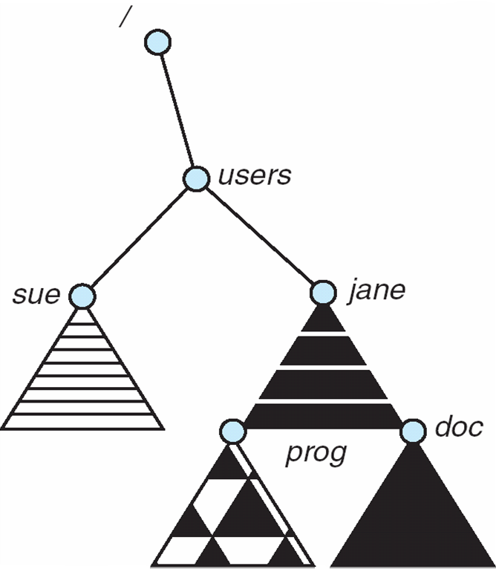
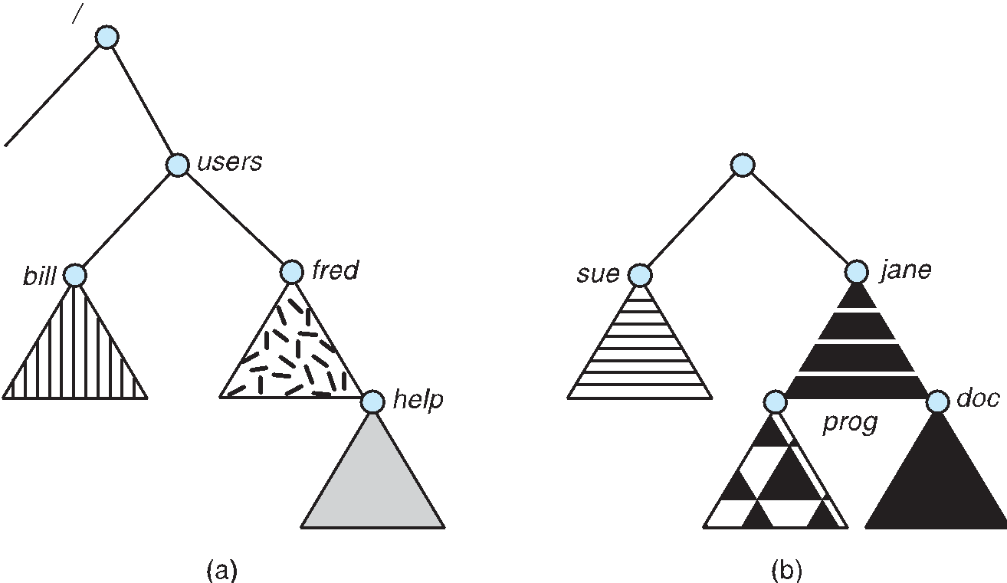
OPERATING SYSTEMS
File System Mounting
A file system must be mounted before it can be accessed
Fig (a) shows Existing File System
A unmounted file system (i.e., Fig. (b)) is mounted at a mount point
Fig (c) shows the effect of mounting
(c)

Slide 5
OPERATING SYSTEMS
File Sharing
Sharing of files on multi-user systems is desirable
Sharing may be done through a protection scheme
On distributed systems, files may be shared across a network
Network File System (NFS) is a common distributed file-sharing method
If multi-user system
  User IDs identify users, allowing permissions and protections to be per-user
  Group IDs allow users to be in groups, permitting group access rights
  Owner of a file / directory
  Group of a file / directory

Slide 6
OPERATING SYSTEMS
File Sharing – Remote File Systems
Uses networking to allow file system access between systems
  Manually via programs like FTP
  Automatically, seamlessly using distributed file systems
  Semi automatically via the world wide web

Slide 7
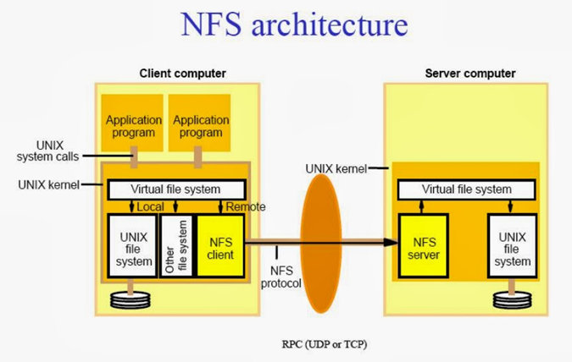
OPERATING SYSTEMS
File Sharing – Remote File Systems (Cont.)
Client-server model allows clients to mount remote file systems from servers
  Server can serve multiple clients
  Client and user-on-client identification is insecure or complicated
  NFS is standard UNIX client-server file sharing protocol
  CIFS is standard Windows protocol
  Standard operating system file calls are translated into remote calls
Distributed Information Systems (distributed naming services) such as LDAP, DNS, NIS, Active Directory implement unified access to information needed for remote computing
Notes:
CIFS – Common Internet file system – uses network information in conjunction with user authentication to create a network login
LDAP – Lightweight directory-access protocol

Slide 8
OPERATING SYSTEMS
Protection
File owner/creator should be able to control:
  what can be done
  by whom
Types of access
  Read
  Write
  Execute
  Append
  Delete
  List

Slide 9
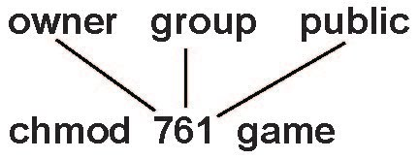
OPERATING SYSTEMS
Access Lists and Groups
Mode of access: read, write, execute
Three classes of users on Unix / Linux
RWX
a) owner access 7 ⇒ 1 1 1
RWX
b) group access 6 ⇒ 1 1 0
RWX
c) public access 1 ⇒ 0 0 1
Ask manager to create a group (unique name), say G, and add some users to the group.
For a particular file (say game) or subdirectory, define an appropriate access.
Attach a group to a file
chgrp G game

Slide 10
THANK YOU
Pavan A C
Department of Computer Science and Engineering
pavanac@pes.edu

