Slide 1

OPERATING SYSTEMS
UE25CS242A
File Management
Pavan A C
Department of Computer Science & Engineering

Slide 2
OPERATING SYSTEMS
Driver Development, Flash Drives , File system
implementation, Directory implementation
Pavan A C
Department of Computer Science & Engineering
Notes:
To describe the details of implementing local file systems and directory structures
To describe the implementation of remote file systems
To discuss block allocation and free-block algorithms and trade-offs

Slide 3
OPERATING SYSTEMS
Slides Credits for all the PPTs of this course
The slides/diagrams in this course are an adaptation, combination, and enhancement of material from the following resources and persons:
Slides of Operating System Concepts, Abraham Silberschatz, Peter Baer Galvin, Greg Gagne - 9th edition 2013 and some slides from 10th edition 2018
Some conceptual text and diagram from Operating Systems - Internals and Design Principles, William Stallings, 9th edition 2018
Some presentation transcripts from A. Frank – P. Weisberg
Some conceptual text from Operating Systems: Three Easy Pieces, Remzi Arpaci-Dusseau, Andrea Arpaci Dusseau

Slide 4
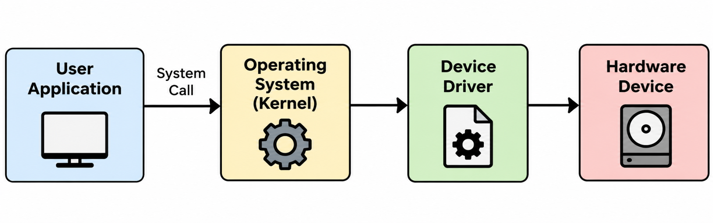
OPERATING SYSTEMS
Device Driver
A device driver is a specialized software component that enables the Operating System (OS) to communicate with and control a hardware device.
It acts as a translator between the OS and the hardware.
The OS does not need to understand the internal details of every hardware device.
The driver provides a standard interface through which the OS can access the device.
Examples - Keyboard Driver, Mouse Driver, Printer Driver, Disk/Storage Driver, Network Card Driver, USB Driver
Notes:
The file system is generally composed of many different levels

Slide 5
OPERATING SYSTEMS
Types of Device Drivers & Architecture
1. Character Device Drivers
Transfer data one character/byte at a time
Used for devices such as keyboards, mice, and serial ports
2. Block Device Drivers
Transfer data in fixed-size blocks
Used for storage devices such as HDDs, SSDs, and USB drives
3. Network Device Drivers
Enable communication between the OS and network hardware
Used for Ethernet cards and Wi-Fi adapters
Notes:
The file system is generally composed of many different levels

Slide 6
OPERATING SYSTEMS
How Does a Device Driver Work?
Device Driver Workflow
Application Request - A user application requests an operation such as read, write, or print.
System Call - The application uses a system call to request the service from the OS.
Kernel Processing - The OS kernel receives the request and determines which device and driver are required.
Device Driver - The driver converts the OS request into device-specific commands.
Hardware Operation - The hardware performs the requested operation.
Interrupt / Response
  The device may generate an interrupt when the operation is completed.
  The driver informs the OS, which then returns the result to the application.
Example
Application → read() → Kernel → Disk Driver → SSD/HDD → Interrupt → Kernel → Application
Notes:
The file system is generally composed of many different levels

Slide 7
OPERATING SYSTEMS
Driver Development in Linux
Driver development is the process of creating software that allows the OS to communicate with and control a specific hardware device.
In Linux, many device drivers run as part of the kernel.
Drivers can be built into the kernel or loaded dynamically as Kernel Modules.
Basic Linux Driver Development
1. Device Identification - Understand the hardware and its communication interface.
2. Driver Implementation - Write the driver using C and Linux Kernel APIs.
3. Driver Registration - Register the driver with the Linux kernel.
Notes:
The file system is generally composed of many different levels

Slide 8
OPERATING SYSTEMS
Driver Development in Linux
4. Device Communication - Implement operations such as open, read, write and close.
5. Testing & Debugging - Test communication between the driver and hardware.
Example
User Program → System Call → Linux Kernel → Device Driver → Hardware
Notes:
The file system is generally composed of many different levels

Slide 9
OPERATING SYSTEMS
Flash Drives & Flash Memory
What is Flash Storage?
Flash memory is a non-volatile memory that retains data even when power is turned off.
It is widely used in USB flash drives, SSDs, memory cards, and smartphones.
Flash storage has no moving mechanical parts, making it faster and more resistant to physical shock than HDDs.
NAND Flash
Most modern flash storage uses NAND flash memory.
Data is organized into Pages and Blocks.
Page: Smallest unit for read/write operations.
Block: Collection of pages; erase operations occur at block level.
Notes:
The file system is generally composed of many different levels

Slide 10
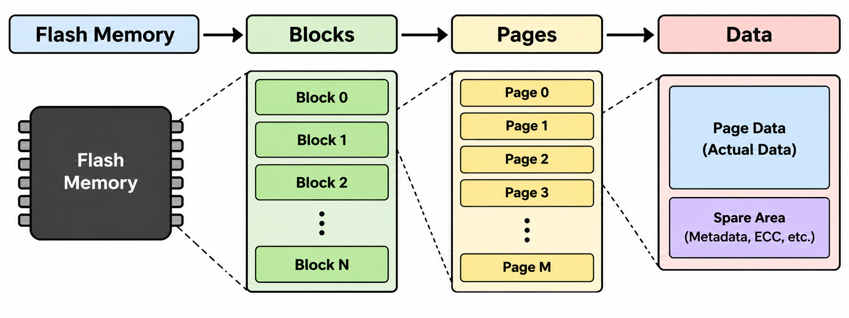
OPERATING SYSTEMS
Flash Drives & Flash Memory
What is Flash Storage?
Flash memory is a non-volatile memory that retains data even when power is turned off.
It is widely used in USB flash drives, SSDs, memory cards, and smartphones.
Flash storage has no moving mechanical parts, making it faster and more resistant to physical shock than HDDs.
Notes:
The file system is generally composed of many different levels

Slide 11
OPERATING SYSTEMS
NAND Flash
NAND Flash
Most modern flash storage uses NAND flash memory.
Data is organized into Pages and Blocks.
Page: Smallest unit for read/write operations.
Block: Collection of pages; erase operations occur at block level.
Types of NAND Flash
Type | Bits / Cell | Key Feature
SLC | 1 bit | Fast, reliable, high endurance
MLC | 2 bits | Higher capacity, moderate endurance
TLC | 3 bits | High capacity, widely used
QLC | 4 bits | Very high capacity, lower endurance
Notes:
The file system is generally composed of many different levels

Slide 12
OPERATING SYSTEMS
NAND Flash
Flash Organization
Page: Basic unit for read/write operations.
Block: Collection of pages; erase operation is performed at block level.
Multiple blocks form a Flash Memory Chip.
Important Concept
Read/Write → Page level
Erase → Block level
Example:
If a block contains 256 pages, data can be written to individual pages, but the entire block must be erased before its pages can be reused.
Notes:
The file system is generally composed of many different levels

Slide 13
OPERATING SYSTEMS
Flash Storage Management
Why is Flash Storage Management Required?
Flash memory has limitations:
A flash cell has a limited number of write/erase cycles.
Data cannot be overwritten directly like a magnetic disk.
Erasing is performed at the block level, while writing is performed at the page level.
Notes:
The file system is generally composed of many different levels

Slide 14
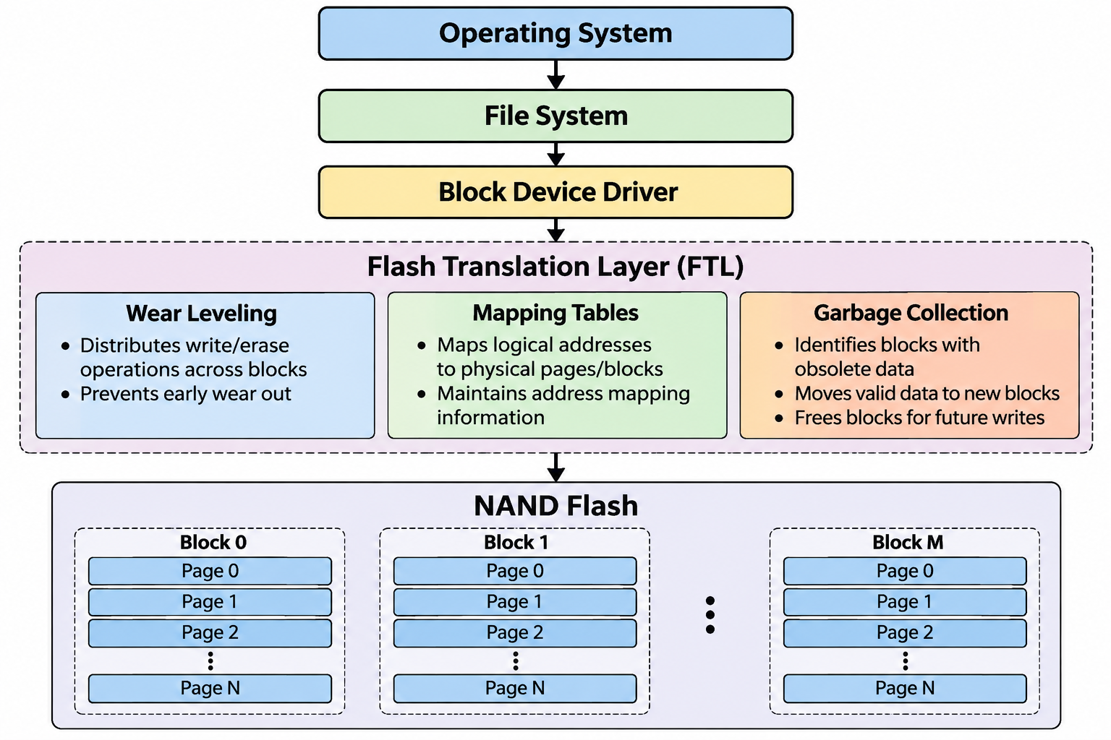
OPERATING SYSTEMS
Flash Storage Management
Key Management Techniques
1. Flash Translation Layer (FTL)
Maps logical addresses from the OS to physical locations in flash memory.
Hides the internal organization of flash from the OS.
2. Wear Leveling
Distributes write/erase operations across blocks.
Prevents some blocks from wearing out earlier than others.
3. Garbage Collection
Identifies blocks containing obsolete data.
Moves valid data and frees blocks for future writes.
4. Bad Block Management
Detects unusable flash blocks.
Prevents the system from storing data in damaged blocks.
Notes:
The file system is generally composed of many different levels

Slide 15
OPERATING SYSTEMS
Flash Storage and the Operating System
How Does the OS Interact with Flash Storage?
The OS views an SSD/flash drive as a block storage device.
The file system manages files and directories using logical block addresses.
The block device driver communicates with the storage device.
The Flash Translation Layer (FTL) converts logical addresses into physical flash locations.
Important Operations
Read - OS requests data → Driver → FTL → Flash page → Data returned
Write - OS sends data → FTL selects a suitable page → Data is written
Erase - Flash memory erases entire blocks, not individual pages.
TRIM - The OS informs the SSD that certain blocks/pages are no longer in use and also, helps the SSD perform garbage collection more efficiently.
Notes:
The file system is generally composed of many different levels

Slide 16
OPERATING SYSTEMS
Flash Storage and the Operating System
Feature | HDD | SSD / Flash
Moving Parts | Yes | No
Access Time | Higher | Lower
Noise | Mechanical | Silent
Shock Resistance | Lower | Higher
Erase Requirement | No | Yes
Notes:
The file system is generally composed of many different levels

Slide 17
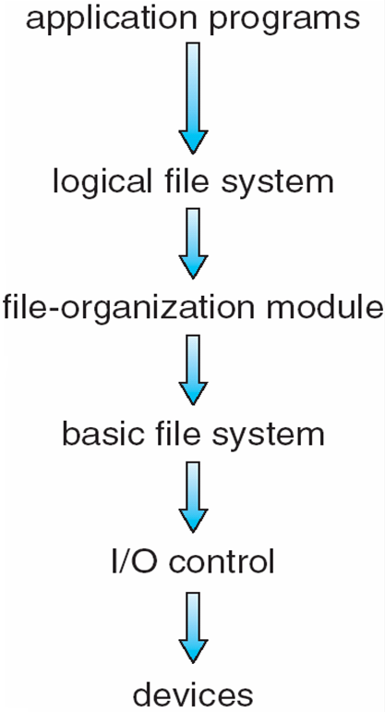
OPERATING SYSTEMS
Layered File System
Manages metadata information, and the dir structure to provide the file-org module. Also responsible for protection
Translates logical to physical block addresses
Issues generic commands to the device driver, manages mem buffers
Device drivers and interrupt handlers
Notes:
The file system is generally composed of many different levels

Slide 18
OPERATING SYSTEMS
File-System Structure
File structure
  Logical storage unit
  Collection of related information
File system resides on secondary storage (disks)
  Provided user interface to storage, mapping logical to physical
  Provides efficient and convenient access to disk by allowing data to be stored, located retrieved easily
File control block (FCB) – storage structure consisting of information about a file including ownership, permissions, and location of the file contents
Device driver controls the physical device
File system organized into layers

Slide 19
OPERATING SYSTEMS
File System Layers
Device drivers manage I/O devices at the I/O control layer
Basic file system given command like “retrieve block 123” translates to device driver
Also manages memory buffers and caches (allocation, freeing, replacement)
  Buffers hold data in transit
  Caches hold frequently used data

Slide 20
OPERATING SYSTEMS
File System Layers (Cont.)
File organization module understands files, logical address, and physical blocks
  Translates logical block # to physical block #
  Manages free space, disk allocation
Logical file system manages metadata information
  Translates file name into file number, file handle, location by maintaining file control blocks (inodes in UNIX)
  Directory management
  Protection

Slide 21
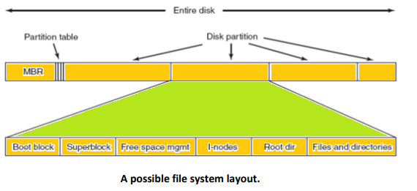
OPERATING SYSTEMS
File-System Implementation

Slide 22
OPERATING SYSTEMS
File-System Implementation
We have system calls at the API level, but how do we implement their functions?
  On-disk and in-memory structures
Boot control block contains info needed by system to boot OS from that volume
  Needed if volume contains OS, usually first block of volume
Volume control block (superblock, master file table) contains volume details
  Total # of blocks, # of free blocks, block size, free block pointers or array
Directory structure organizes the files
  Names and inode numbers, master file table
Notes:
A superblock is a record of the characteristics of a filesystem, including its size, the block size, the empty and the filled blocks and their respective counts, the size and location of the inode tables, the disk block map and usage information, and the size of the block groups.

Slide 23
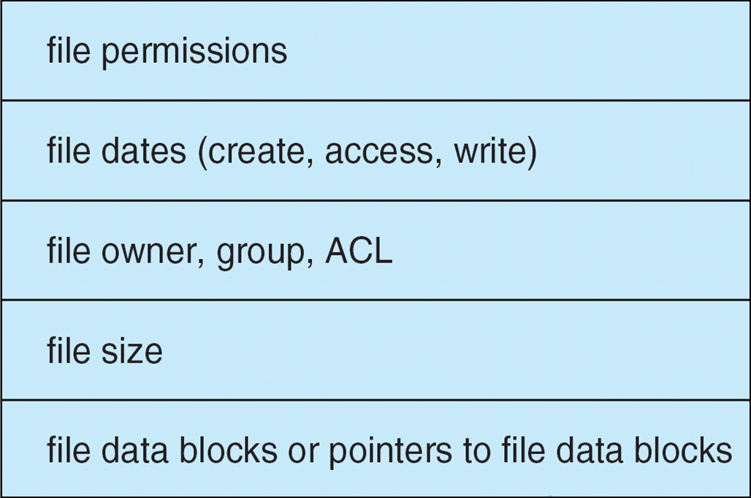
OPERATING SYSTEMS
File-System Implementation (Cont.)
Per-file File Control Block (FCB) contains many details about the file
  inode number, permissions, size, dates
  NFTS stores into in master file table using relational DB structures

Slide 24
OPERATING SYSTEMS
In-Memory File System Structures
Mount table storing file system mounts, mount points, file system types
The following figure illustrates the necessary file system structures provided by the operating systems
Figure (a) refers to opening a file
Figure (b) refers to reading a file
Plus buffers hold data blocks from secondary storage
Open returns a file handle for subsequent use
Data from read eventually copied to specified user process memory address

Slide 25
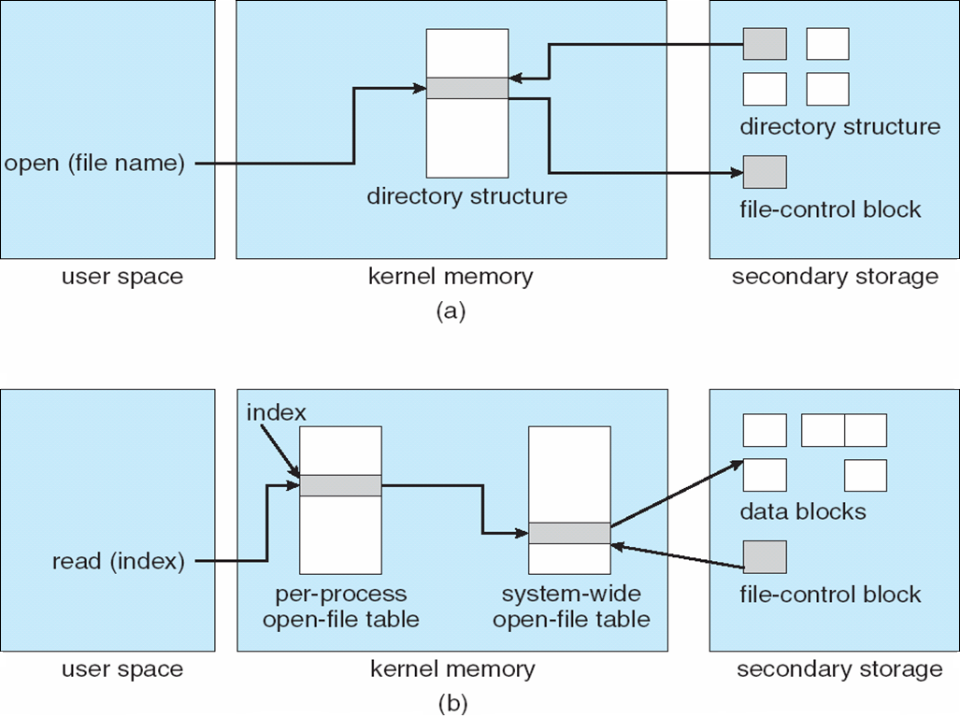
OPERATING SYSTEMS
In-Memory File System Structures

Slide 26
OPERATING SYSTEMS
Virtual File Systems
Virtual File Systems (VFS) on Unix provide an object-oriented way of implementing file systems
VFS allows the same system call interface (the API) to be used for different types of file systems
  Separates file-system generic operations from implementation details
  Implementation can be one of many file systems types, or network file system
    Implements vnodes which hold inodes or network file details
  Then dispatches operation to appropriate file system implementation routines

Slide 27
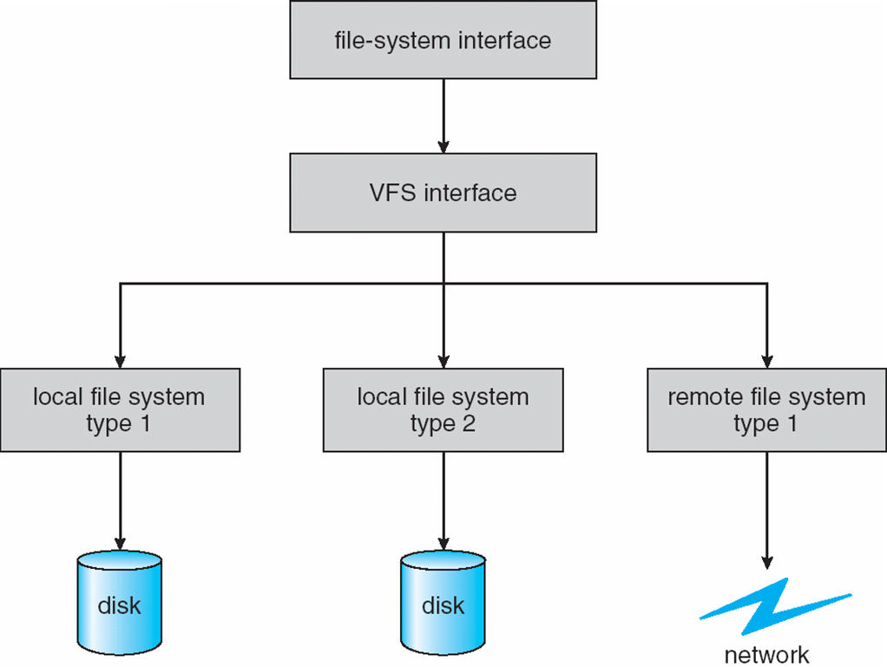
OPERATING SYSTEMS
Virtual File Systems
The API is to the VFS interface, rather than any specific type of file system (FS)
VFS provides a single set of commands for the kernel and developers to access all types of FSs
VFS software calls the specific device driver required to interface to various types of FSs
Device driver interprets the standard set of FS commands to a specific type of FS on the partition or logical volume

Slide 28
THANK YOU
Pavan A C
Department of Computer Science and Engineering
pavanac@pes.edu

