Slide 1

OPERATING SYSTEMS
UE25CS242A
File Management
Pavan A C
Department of Computer Science & Engineering

Slide 2
OPERATING SYSTEMS
Implementing File-Systems – Disk Space Allocation Methods
Pavan A C
Department of Computer Science & Engineering
Notes:
To describe the details of implementing local file systems and directory structures
To describe the implementation of remote file systems
To discuss block allocation and free-block algorithms and trade-offs

Slide 3
OPERATING SYSTEMS
Slides Credits for all the PPTs of this course
The slides/diagrams in this course are an adaptation, combination, and enhancement of material from the following resources and persons:
Slides of Operating System Concepts, Abraham Silberschatz, Peter Baer Galvin, Greg Gagne - 9th edition 2013 and some slides from 10th edition 2018
Some conceptual text and diagram from Operating Systems - Internals and Design Principles, William Stallings, 9th edition 2018
Some presentation transcripts from A. Frank – P. Weisberg
Some conceptual text from Operating Systems: Three Easy Pieces, Remzi Arpaci-Dusseau, Andrea Arpaci Dusseau

Slide 4
OPERATING SYSTEMS
Allocation Methods - Contiguous
An allocation method refers to how disk blocks are allocated for files:
Contiguous allocation – each file occupies set of contiguous blocks
  Best performance in most cases
  Simple – only starting location (block #) and length (number of blocks) are required
  Supports both sequential and direct access
  Problems include finding space for file, knowing file size, external fragmentation, need for compaction off-line (downtime) or on-line

Slide 5
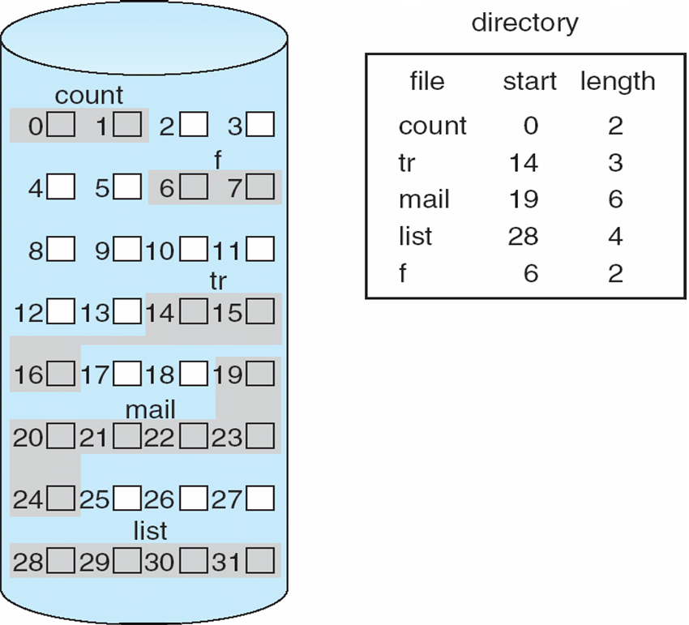
OPERATING SYSTEMS
Contiguous Allocation
Mapping from logical to physical
Q
LA/512
R
LA – Length of the area allocated for this file
Q = displacement into index table
Block to be accessed = Q + starting address
Displacement into block = R
Notes:
The directory entry for each file indicates the address of the starting block and the length of the area
allocated for this file

Slide 6
OPERATING SYSTEMS
Contiguous Allocation
Notes:
The directory entry for each file indicates the address of the starting block and the length of the area
allocated for this file

Slide 7
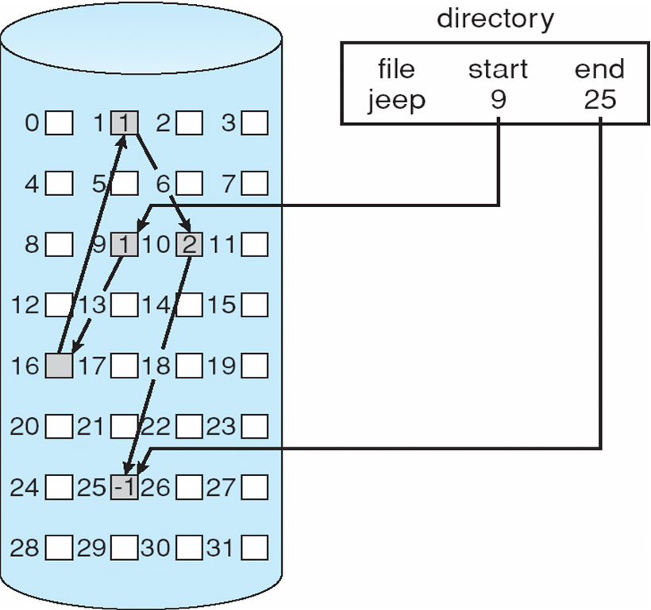
OPERATING SYSTEMS
Linked Allocation
Each block contains a pointer to the next block.
If each block is 512 bytes and a disk address (pointer) requires 4 bytes then the user sees blocks of 508 bytes (i.e. some disk space is wasted)
Collect blocks into multiples called clusters and allocate clusters rather than blocks

Slide 8
OPERATING SYSTEMS
Allocation Methods - Linked
Linked allocation – each file a linked list of blocks
  File ends with null pointer
  No external fragmentation
  Each block contains pointer to next block
  No compaction, external fragmentation
  Free space management system called when new block needed
  Improve efficiency by clustering blocks into groups but increases internal fragmentation
  Reliability can be a problem
  Locating a block can take many I/Os and disk seeks

Slide 9
OPERATING SYSTEMS
Allocation Methods – Linked (Cont.)
FAT (File Allocation Table) variation
  Beginning of volume has table, indexed by block number
  Much like a linked list, but faster on disk and cacheable
  New block allocation simple

Slide 10
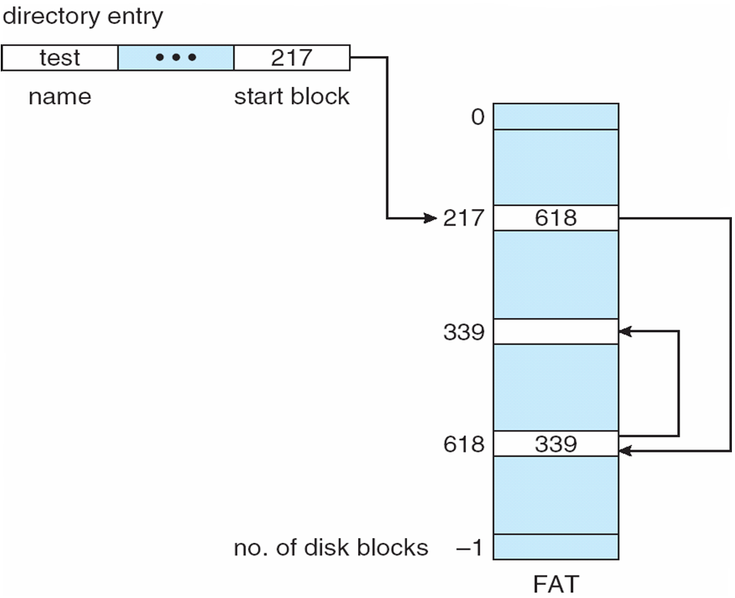
OPERATING SYSTEMS
File-Allocation Table (variation on linked allocation)
Unused block is indicated by a table value of 0
To allocate a new block to a file, find the first 0-valued table entry and replace the previous EOF value with the address of the new block.
Then replace 0 with EOF value

Slide 11
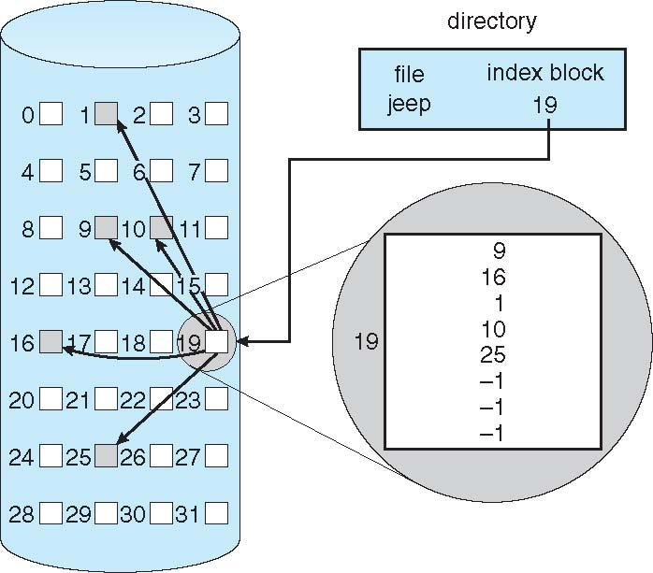
OPERATING SYSTEMS
Indexed Allocation
In this scheme, a special block known as the Index block contains the pointers to all the blocks occupied by a file.
Each file has its own index block. The ith entry in the index block contains the disk address of the ith file block.
The directory entry contains the address of the index block as shown in the figure.

Slide 12
OPERATING SYSTEMS
Allocation Methods – Indexed (Cont.)
Advantages:
This supports direct access to the blocks occupied by the file and therefore provides fast access to the file blocks.
It overcomes the problem of external fragmentation.
Disadvantages:
The pointer overhead for indexed allocation is greater than linked allocation.
For very small files, say files that expand only 2-3 blocks, the indexed allocation would keep one entire block (index block) for the pointers which is inefficient in terms of memory utilization. (Note: In linked allocation we lose the space of only 1 pointer per block.)

Slide 13
THANK YOU
Pavan A C
Department of Computer Science and Engineering
pavanac@pes.edu

