Slide 1

OPERATING SYSTEMS
UE25CS242A
File Management
Pavan A C
Department of Computer Science & Engineering

Slide 2
OPERATING SYSTEMS
File Management – Free space management, Efficiency and Performance
Pavan A C
Department of Computer Science & Engineering

Slide 3
OPERATING SYSTEMS
Slides Credits for all the PPTs of this course
The slides/diagrams in this course are an adaptation, combination, and enhancement of material from the following resources and persons:
Slides of Operating System Concepts, Abraham Silberschatz, Peter Baer Galvin, Greg Gagne - 9th edition 2013 and some slides from 10th edition 2018
Some conceptual text and diagram from Operating Systems - Internals and Design Principles, William Stallings, 9th edition 2018
Some presentation transcripts from A. Frank – P. Weisberg
Some conceptual text from Operating Systems: Three Easy Pieces, Remzi Arpaci-Dusseau, Andrea Arpaci Dusseau

Slide 4
OPERATING SYSTEMS
Free-Space Management
Need to reuse the disk space from deleted files for new files
To keep track of free disk space, the system maintains a free-space list
The free-space list records all free disk blocks
When a file is created, the free-space list is searched for the required amount of space and allocate that space to the new file. This space is then removed from the free-space list.
When a file is deleted, its disk space is added to the free-space list

Slide 5
OPERATING SYSTEMS
Bit Vector
The free-space list is implemented as a bit map or bit vector.
Each block is represented by 1 bit.
If the block is free, the bit is 1; if the block is allocated, the bit is 0
For example, consider a disk where blocks 2, 3, 4, 5, 8, 9, 10, 11, 12, 13, 17, 18, 25, 26, and 27 are free and the rest of the blocks are allocated.
The free-space bit map would be 001111001111110001100000011100000 ...
The main advantage of this approach is its relative simplicity and its efficiency in finding the first free block or n consecutive free blocks on the disk

Slide 6
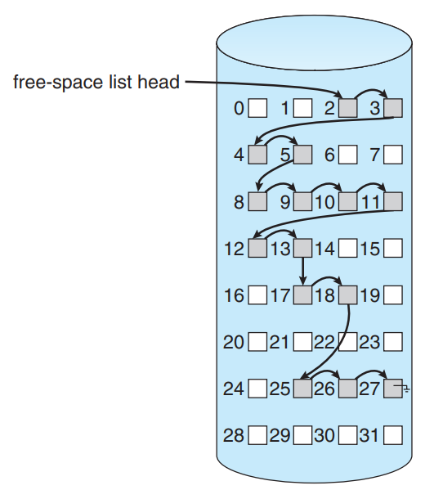
OPERATING SYSTEMS
Linked List
Link together all the free disk blocks, keeping a pointer to the first free block in a special location on the disk and caching it in memory.
The first free block contains a pointer to the next free disk block, and so on
Example: Consider blocks 2, 3, 4, 5, 8, 9, 10, 11, 12, 13, 17, 18, 25, 26, and 27 are free and the rest of the blocks are allocated.
The pointer would point to block 2 as the first free block. Block 2 would contain a pointer to block 3, which would point to block 4 and so on
This scheme is not efficient; to traverse the list, one must read each block, which requires substantial I/O time.

Slide 7
OPERATING SYSTEMS
Linked List

Slide 8
OPERATING SYSTEMS
Grouping
A modification of the free-list approach stores the addresses of n free blocks in the first free block.
The first n−1 of these blocks are actually free.
The last block contains the addresses of another n free blocks, and so on.
The addresses of a large number of free blocks can now be found quickly, unlike the situation when the standard linked-list approach is used.

Slide 9
OPERATING SYSTEMS
Counting
Generally, several contiguous blocks may be allocated or freed simultaneously, particularly when space is allocated with the contiguous-allocation algorithm or through clustering.
Rather than keeping a list of n free disk addresses, we can keep the address of the first free block and the number (n) of free contiguous blocks that follow the first block
Each entry in the free-space list then consists of a disk address and a count.
The entries can be stored in a balanced tree, rather than a linked list, for efficient lookup, insertion, and deletion.

Slide 10
OPERATING SYSTEMS
Efficiency and Performance
Efficiency dependent on:
  Disk allocation and directory algorithms
  Types of data kept in file’s directory entry
  Pre-allocation or as-needed allocation of metadata structures
  Fixed-size or varying-size data structures
Performance dependent on:
  Keeping data and metadata close together
  Buffer cache – separate section of main memory for frequently used blocks
  Free-behind and read-ahead – techniques to optimize sequential access
  Reads frequently slower than writes

Slide 11
OPERATING SYSTEMS
Page cache
Some systems maintain a separate section of main memory for a buffer cache, where blocks are kept under the assumption that they will be used again shortly.
Other systems cache file data using a page cache. The page cache uses virtual memory techniques to cache file data as pages rather than as file-system-oriented blocks.
Caching file data using virtual addresses is far more efficient than caching through physical disk blocks, as accesses interface with virtual memory rather than the file system.
Several systems—including Solaris, Linux, and Windows —use page caching to cache both process pages and file data. This is known as unified virtual memory.

Slide 12
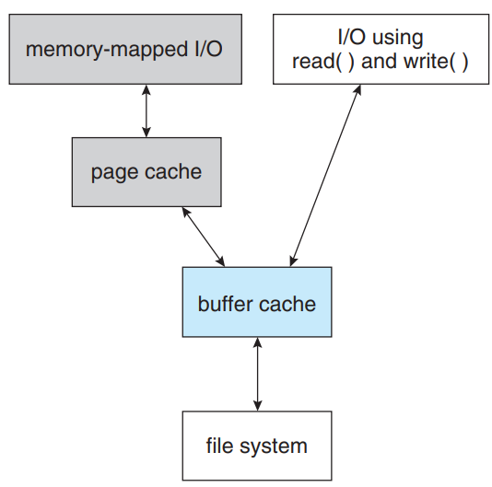
OPERATING SYSTEMS
I/O without a unified buffer cache
Consider standard system calls read() and write()
Without a unified buffer cache, the read() and write() system calls go through the buffer cache.
The memory-mapping call, requires two caches—the page cache and the buffer cache.
A memory mapping proceeds by reading in disk blocks from the file system and storing them in the buffer cache. Because the virtual memory system does not interface with the buffer cache, the contents of the file in the buffer cache must be copied into the page cache.
This situation, known as double caching, requires caching file-system data twice. Not only does it waste memory but it also wastes significant CPU and I/O cycles due to the extra data movement within system memory.

Slide 13
OPERATING SYSTEMS
I/O without a unified buffer cache

Slide 14
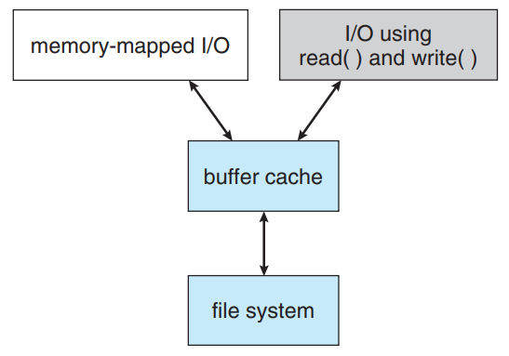
OPERATING SYSTEMS
I/O using a unified buffer cache

Slide 15
OPERATING SYSTEMS
I/O using a unified buffer cache
When a unified buffer cache is provided, both memory mapping and the read() and write() system calls use the same page cache.
This has the benefit of avoiding double caching, and it allows the virtual memory system to manage file-system data

Slide 16
OPERATING SYSTEMS
Page replacement
Sequential access can be optimized by techniques known as free-behind and read-ahead.
Free-behind removes a page from the buffer as soon as the next page is requested. The previous pages are not likely to be used again and waste buffer space.
With read-ahead, a requested page and several subsequent pages are read and cached. These pages are likely to be requested after the current page is processed.
Retrieving these data from the disk in one transfer and caching them saves a considerable amount of time

Slide 17
THANK YOU
Pavan A C
Department of Computer Science and Engineering
pavanac@pes.edu

