Slide 1

OPERATING SYSTEMS
UE25CS242A
File Management
Pavan A C
Department of Computer Science & Engineering

Slide 2
OPERATING SYSTEMS
Mass-Storage Structure
Pavan A C
Department of Computer Science & Engineering
Notes:
To describe the physical structure of secondary storage devices and its effects on the uses of the devices
To explain the performance characteristics of mass-storage devices
To evaluate disk scheduling algorithms
To discuss operating-system services provided for mass storage, including RAID

Slide 3
OPERATING SYSTEMS
Slides Credits for all PPTs of this course
The slides/diagrams in this course are an adaptation, combination, and enhancement of material from the following resources and persons:
Slides of Operating System Concepts, Abraham Silberschatz, Peter Baer Galvin, Greg Gagne - 9th edition 2013 and some slides from 10th edition 2018
Some conceptual text and diagram from Operating Systems - Internals and Design Principles, William Stallings, 9th edition 2018
Some presentation transcripts from A. Frank – P. Weisberg
Some conceptual text from Operating Systems: Three Easy Pieces, Remzi Arpaci-Dusseau, Andrea Arpaci Dusseau

Slide 4
OPERATING SYSTEMS
Overview of Mass Storage Structure
Magnetic disks provide bulk of secondary storage of modern computers.
Each disk platter has a flat circular shape, like a CD. Common platter diameters range from 1.8 to 3.5 inches.
The two surfaces of a platter are covered with a magnetic material.
The heads are attached to a disk arm that moves all the heads as a unit.
The surface of a platter is logically divided into circular tracks, which are subdivided into sectors.
The set of tracks that are at one arm position makes up a cylinder.

Slide 5
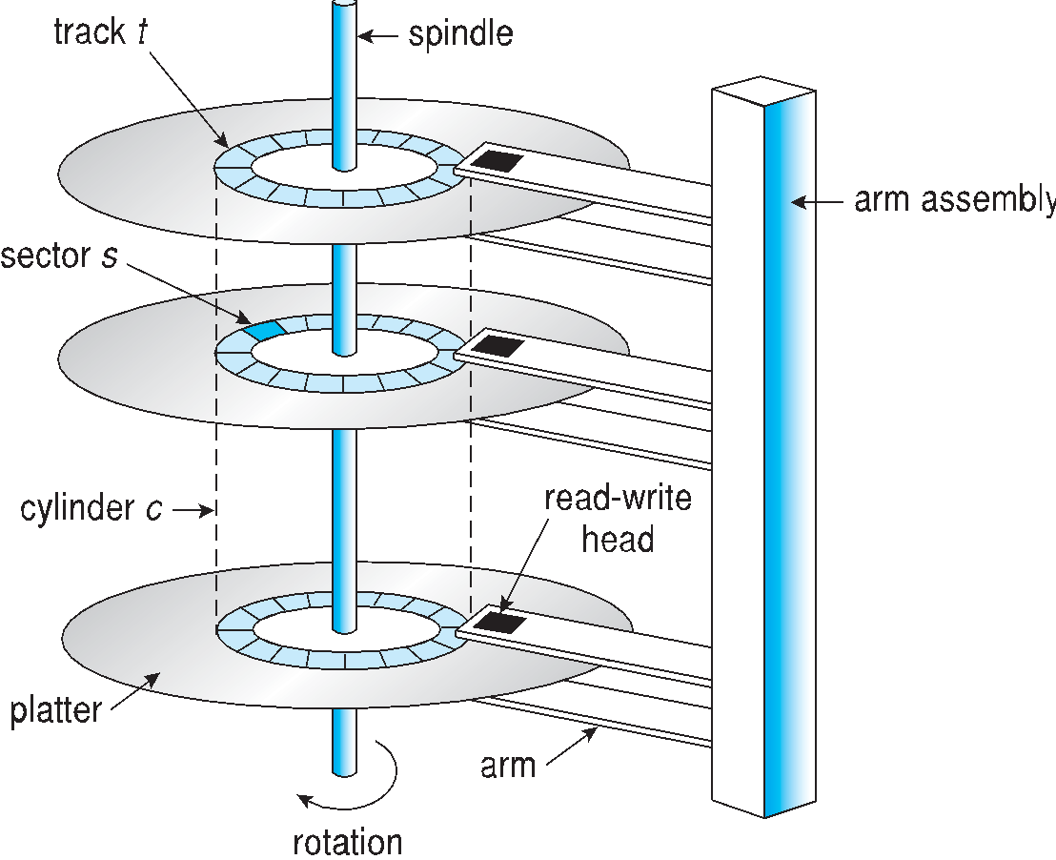
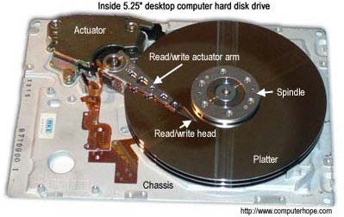
OPERATING SYSTEMS
Moving-head Disk Mechanism
Notes:
The set of tracks that are at one arm position makes up a cylinder.

Slide 6
OPERATING SYSTEMS
Overview of Mass Storage Structure
When the disk is in use, a drive motor spins it at high speed. Most drives rotate 60 to 250 times per second.
Disk speed has two parts.
The transfer rate is the rate at which data flow between the drive and the computer.
The positioning time, or random-access time, consists of two parts
  The time necessary to move the disk arm to the desired cylinder, called the seek time.
  the time necessary for the desired sector to rotate to the disk head, called the rotational latency.
Disk Latency = Seek time + Rotational latency + Transfer time

Slide 7
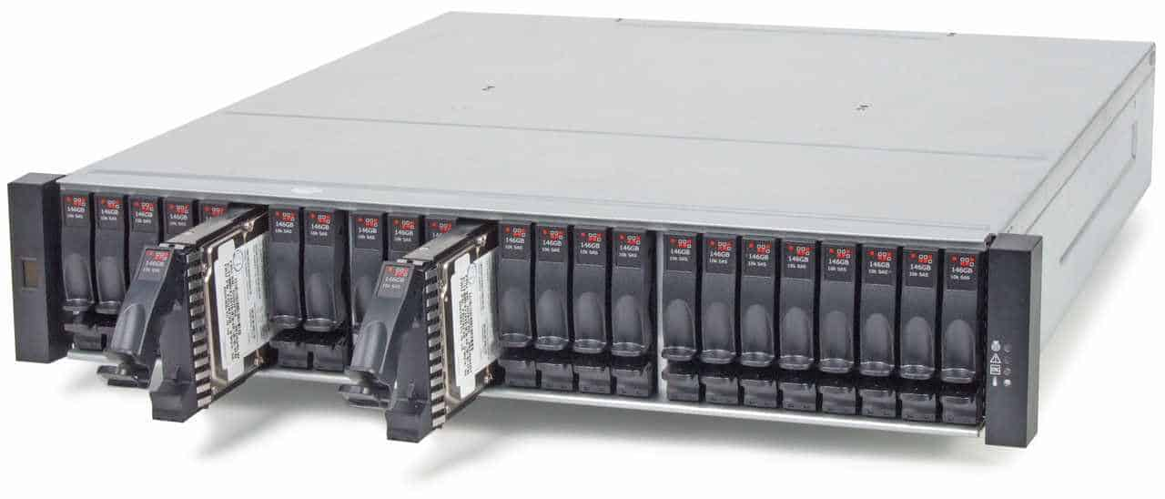
OPERATING SYSTEMS
Overview of Mass Storage Structure
Disk head flies on an extremely thin cushion of air.
Head will sometimes damage the magnetic surface when it makes contact with it.
  Head crash
  Not recoverable
A disk can be removable.
Removable magnetic disks generally consist of one platte
Examples CDs, DVDs, and Blu-ray discs as well as removable flash-memory

Slide 8
OPERATING SYSTEMS
Mass Storage Structure (Cont.)
Drive attached to computer via I/O bus
  Busses vary, including EIDE, ATA, SATA, USB, Fiber Channel, SCSI, SAS, Firewire
  Host controller in computer uses bus to talk to disk controller built into drive or storage array
Notes:
IDE – Integrated Drive Electronics
EIDE – Enhanced IDE
SATA is cheaper than IDE which is cheaper than SCSI
EIDE has 40 pin attachments, while SATA has 7 pin attachments.
PCI – Peripheral Component Interconnect
SAS – Serial Attached SCSI

Slide 9
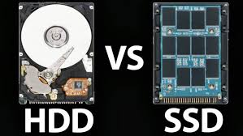
OPERATING SYSTEMS
Solid-State Disks
Nonvolatile memory used like a hard drive
Can be more reliable than HDDs
More expensive per MB
Maybe have shorter life span
Less capacity
But much faster
Standard Bus interfaces can be too slow -> connect directly to the system bus (PCI, for example)
No moving parts, so no seek time or rotational latency

Slide 10
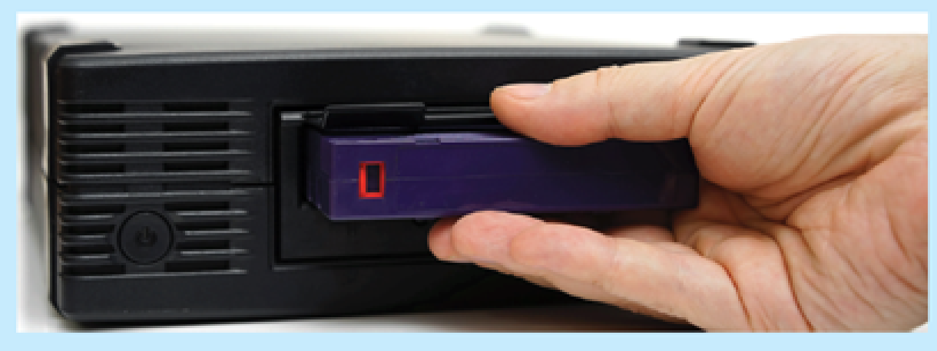
OPERATING SYSTEMS
Magnetic Tape
Was early secondary-storage medium
Relatively permanent and holds large quantities of data
Access time slow
Random access ~1000 times slower than disk
Mainly used for backup, storage of infrequently-used data, transfer medium between systems

Slide 11
THANK YOU
Pavan A C
Department of Computer Science and Engineering
pavanac@pes.edu

