Slide 1

OPERATING SYSTEMS
UE25CS242A
File Management
Pavan A C
Department of Computer Science & Engineering

Slide 2
OPERATING SYSTEMS
Mass-Storage Structure – Disk Scheduling
FCFS, SSTF, SCAN, C-SCAN, LOOK
Pavan A C
Department of Computer Science & Engineering

Slide 3
OPERATING SYSTEMS
Slides Credits for all PPTs of this course
The slides/diagrams in this course are an adaptation, combination, and enhancement of material from the following resources and persons:
Slides of Operating System Concepts, Abraham Silberschatz, Peter Baer Galvin, Greg Gagne - 9th edition 2013 and some slides from 10th edition 2018
Some conceptual text and diagram from Operating Systems - Internals and Design Principles, William Stallings, 9th edition 2018
Some presentation transcripts from A. Frank – P. Weisberg
Some conceptual text from Operating Systems: Three Easy Pieces, Remzi Arpaci-Dusseau, Andrea Arpaci Dusseau

Slide 4
OPERATING SYSTEMS
Disk Scheduling
The operating system is responsible for using hardware efficiently — for the disk drives, this means having a fast access time and disk bandwidth
Minimize seek time
Seek time ≈ seek distance
Disk bandwidth is the total number of bytes transferred, divided by the total time between the first request for service and the completion of the last transfer

Slide 5
OPERATING SYSTEMS
Disk Scheduling (Cont.)
There are many sources of disk I/O request
  OS
  System processes
  Users processes
I/O request includes input or output mode, disk address, memory address, number of sectors to transfer
OS maintains queue of requests, per disk or device
Idle disk can immediately work on I/O request, busy disk means work must queue
  Optimization algorithms only make sense when a queue exists

Slide 6
OPERATING SYSTEMS
Disk Scheduling (Cont.)
Note that drive controllers have small buffers and can manage a queue of I/O requests (of varying “depth”)
Several algorithms exist to schedule the servicing of disk I/O requests
The analysis is true for one or many platters
We illustrate scheduling algorithms with a request queue (0-199)
98, 183, 37, 122, 14, 124, 65, 67
Head pointer 53
Notes:
Varying depth – varying number of pending I/O requests

Slide 7
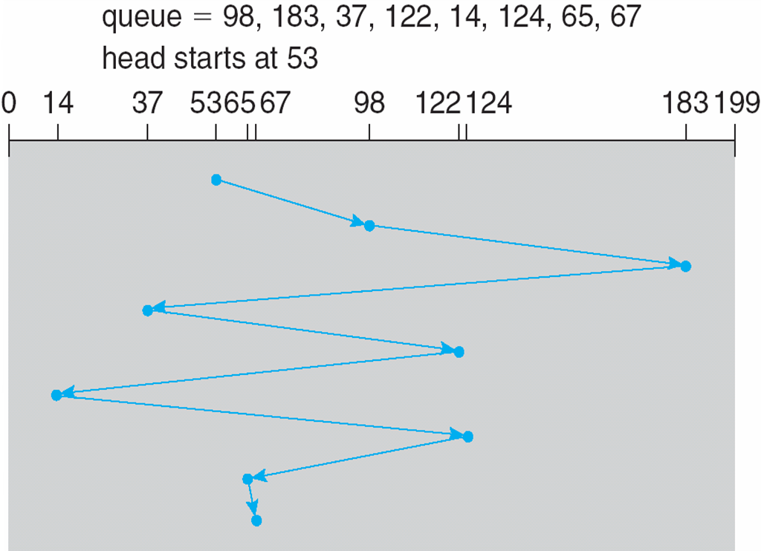
OPERATING SYSTEMS
FCFS
Illustration shows total head movement of 640 cylinders
45+85+146+85+108+110+59+2 = 640 cylinders

Slide 8
OPERATING SYSTEMS
FCFS
Illustration shows total head movement of 640 cylinders

Slide 9
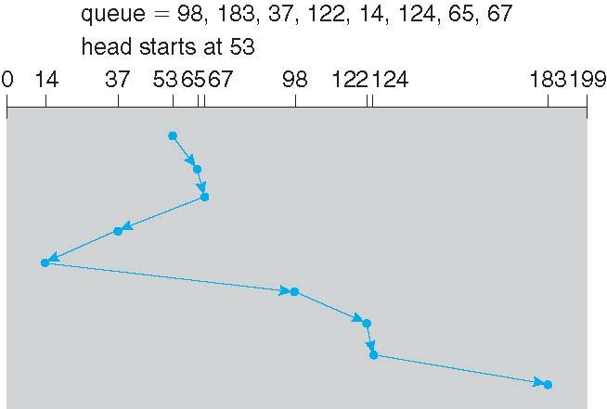
OPERATING SYSTEMS
SSTF
Shortest Seek Time First selects the request with the minimum seek time from the current head position
SSTF scheduling is a form of SJF scheduling; may cause starvation of some requests
Illustration shows total head movement of 236 cylinders
12+2+30+23+84+24+2+59 = 236 cylinders

Slide 10
OPERATING SYSTEMS
SSTF

Slide 11
OPERATING SYSTEMS
SCAN
The disk arm starts at one end of the disk, and moves toward the other end, servicing requests until it gets to the other end of the disk, where the head movement is reversed and servicing continues.
SCAN algorithm Sometimes called the elevator algorithm
But note that if requests are uniformly dense, largest density at other end of disk and those wait the longest

Slide 12
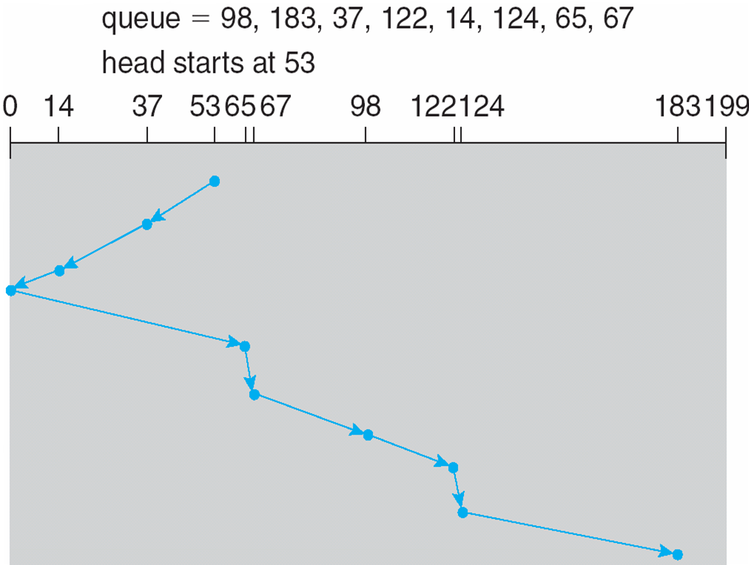
OPERATING SYSTEMS
SCAN (Cont.)
Number of cylinder moves= 16+23+79+2+31+24+2+59=236

Slide 13
OPERATING SYSTEMS
SCAN (Cont.)

Slide 14
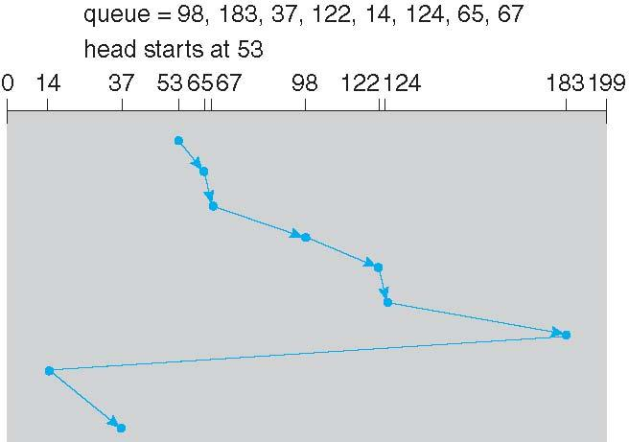
OPERATING SYSTEMS
C-LOOK (Cont.)
Notes:
12+2+31+24+2+59+169+23 = 322 cylinders

Slide 15
OPERATING SYSTEMS
C-SCAN
Provides a more uniform wait time than SCAN
The head moves from one end of the disk to the other, servicing requests as it goes
  When it reaches the other end, however, it immediately returns to the beginning of the disk, without servicing any requests on the return trip
Treats the cylinders as a circular list that wraps around from the last cylinder to the first one
Total number of cylinders?

Slide 16
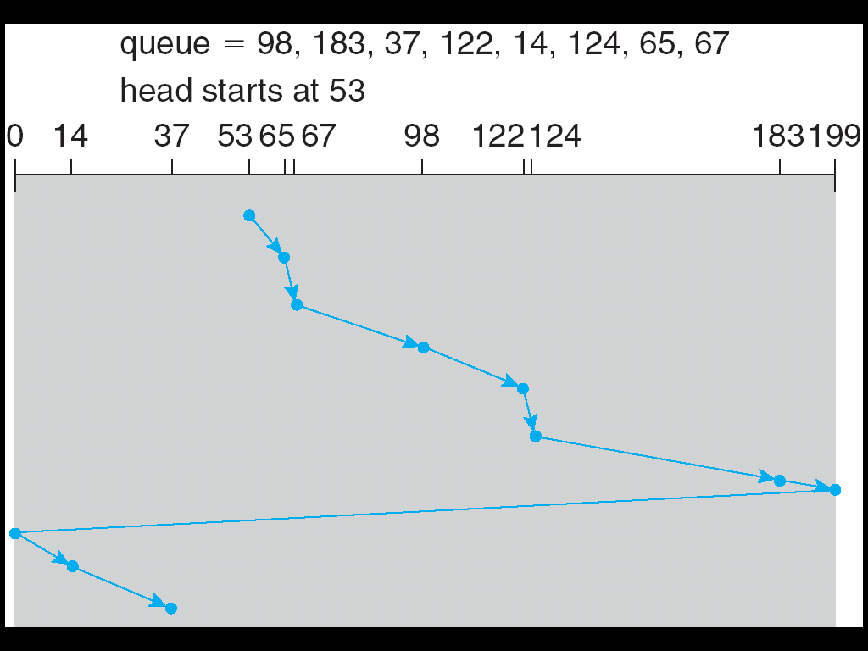
OPERATING SYSTEMS
C-SCAN (Cont.)

Slide 17
OPERATING SYSTEMS
C-SCAN (Cont.)
= (65-53)+(67-65)+(98-67)+(122-98)+(124-122)+(183-124)+(199-183)+(199-0)+(14-0)+(37-14)
=12+2+31+24+2+59+16+199+14+23
= 382

Slide 18
OPERATING SYSTEMS
LOOK & C-LOOK
LOOK a version of SCAN, C-LOOK a version of C-SCAN
Arm only goes as far as the last request in each direction, then reverses direction immediately, without first going all the way to the end of the disk
Total number of cylinders?
Notes:
The LOOK algorithm services request similarly as SCAN algorithm meanwhile it also “looks” ahead as if there are more tracks that are needed to be serviced in the same direction. If there are no pending requests in the moving direction the head reverses the direction and start servicing requests in the opposite direction.

Slide 19
OPERATING SYSTEMS
C-LOOK (Cont.)
Total head movements incurred while servicing these requests
= (65 – 53) + (67 – 65) + (98 – 67) + (122 – 98) + (124 – 122) + (183 – 124) + (183 – 14) + (37 – 14)
= 12 + 2 + 31 + 24 + 2 + 59 + 169 + 23
= 322
Notes:
12+2+31+24+2+59+169+23 = 322 cylinders

Slide 20
OPERATING SYSTEMS
Selecting a Disk-Scheduling Algorithm
SSTF is common and has a natural appeal
SCAN and C-SCAN perform better for systems that place a heavy load on the disk
  Less starvation
Performance depends on the number and types of requests
Requests for disk service can be influenced by the file-allocation method
  And metadata layout
The disk-scheduling algorithm should be written as a separate module of the operating system, allowing it to be replaced with a different algorithm if necessary
Either SSTF or LOOK is a reasonable choice for the default algorithm
Notes:
The disk-scheduling algorithms discussed so far focus primarily on minimizing the amount of disk head movement
in magnetic disk drives. SSDs—which do not contain moving disk heads—commonly use a simple FCFS policy.

Slide 21
OPERATING SYSTEMS
Selecting a Disk-Scheduling Algorithm (Cont.)
What about rotational latency?
  Difficult for OS to calculate
  The rotational latency can be nearly as large as the average seek time.
  It is difficult for the operating system to schedule for improved rotational latency, though, because modern disks do not disclose the physical location of logical blocks.
  Disk manufacturers have been alleviating this problem by implementing disk-scheduling algorithms in the controller hardware built into the disk drive.
How does disk-based queueing effect OS queue ordering efforts?
  If the OS sends a batch of requests to the controller, the controller can queue them and then schedule them to improve both the seek time and the rotational latency.
Notes:
Rotational latency (sometimes called rotational delay or just latency) is the delay waiting for the rotation of the disk to bring the required disk sector under the read-write head. It depends on the rotational speed of a disk (or spindle motor), measured in revolutions per minute (RPM).
The scheduling algorithms described till now consider only the seek distances. For modern disks, the rotational latency can be nearly
as large as the average seek time.

Slide 22
THANK YOU
Pavan A C
Department of Computer Science and Engineering
pavanac@pes.edu

