Slide 1

OPERATING SYSTEMS
UE25CS242A
File Management
Pavan A C
Department of Computer Science & Engineering

Slide 2
OPERATING SYSTEMS
RAID
Pavan A C
Department of Computer Science & Engineering

Slide 3
OPERATING SYSTEMS
Slides Credits for all PPTs of this course
The slides/diagrams in this course are an adaptation, combination, and enhancement of material from the following resources and persons:
Slides of Operating System Concepts, Abraham Silberschatz, Peter Baer Galvin, Greg Gagne - 9th edition 2013 and some slides from 10th edition 2018
Some conceptual text and diagram from Operating Systems - Internals and Design Principles, William Stallings, 9th edition 2018
Some presentation transcripts from A. Frank – P. Weisberg
Some conceptual text from Operating Systems: Three Easy Pieces, Remzi Arpaci-Dusseau, Andrea Arpaci Dusseau

Slide 4
OPERATING SYSTEMS
RAID Basics
RAID is a Disk Organization technique
  Addresses performance and reliability issues
  Multiple disk drives provide (or improve) reliability via redundancy
Many systems today need to store many terabytes of data
Don’t want to use single, large disk
  too expensive
  failures could be catastrophic
Would prefer to use many smaller disks
Redundant Array of Independent (inexpensive) Disks

Slide 5
OPERATING SYSTEMS
RAID Basics (Cont.)
Basic idea is to connect multiple disks together to provide
  large storage capacity
  faster access to reading data
  redundant data
Many different levels of RAID systems
  differing levels of redundancy, error checking, capacity, and cost

Slide 6
OPERATING SYSTEMS
Striping
Take file data and map it to different disks
Allows for reading data in parallel
Transfer rate is improved by striping data across the disks
  Bit-level striping and block-level striping (most common)
file data
block 0
block 1
block 2
block 3
Disk 0
Disk 1
Disk 2
Disk 3
Notes:
Striping alone does not include redundancy and therefore includes no protection against data loss.
Need to use Mirroring or parity alongside striping to ensure data security and availability.

Slide 7
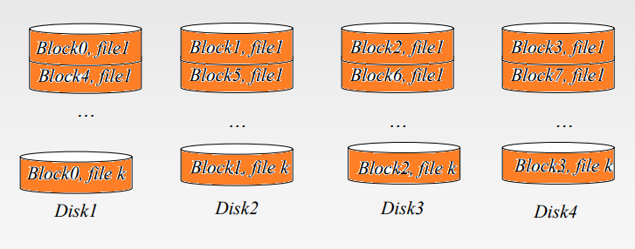
OPERATING SYSTEMS
Block-level Striping
  Requests for different blocks can run in parallel if the blocks reside on different disks
  A request for a long sequence of blocks can utilize all disks in parallel

Slide 8
OPERATING SYSTEMS
Mirroring
Keep two copies of data on two separate disks
Gives good error recovery
  if some data is lost, get it from the other source
Expensive
  requires twice as many disks
Write performance can be slow
  have to write data to two different spots
Read performance is enhanced
  can read data from file in parallel

Slide 9
OPERATING SYSTEMS
RAID Structure
Mean time to failure
  If MTTF of a single disk is 100,000 hours, MTTF of some disk in an array of 100 disks = 100000/100 = 1000 hours or 41.66 days
Mean time to repair – time taken to replace a failed disk and to restore the data on it
Mean time to data loss based on above factors
  If mirrored disks fail independently (i.e., not related to power failures and natural disasters), consider disk with MTTF of 100,000 hours and MTTR is 10 hours
Notes:
Reference: https://cs.stackexchange.com/questions/17933/why-is-the-mean-time-to-failure-of-multiple-disks-calculated-via-division-and-no

Slide 10
OPERATING SYSTEMS
RAID (Cont.)
Several improvements in disk-use techniques involve the use of multiple disks working cooperatively
Disk striping uses a group of disks as one storage unit
RAID is arranged into six different levels
RAID schemes improve performance and improve the reliability of the storage system by storing redundant data
  Mirroring or shadowing (RAID 1) keeps duplicate of each disk
  Striped mirrors (RAID 1+0) or mirrored stripes (RAID 0+1) provides high performance and high reliability
  Block interleaved parity (RAID 4, 5, 6) uses much less redundancy

Slide 11
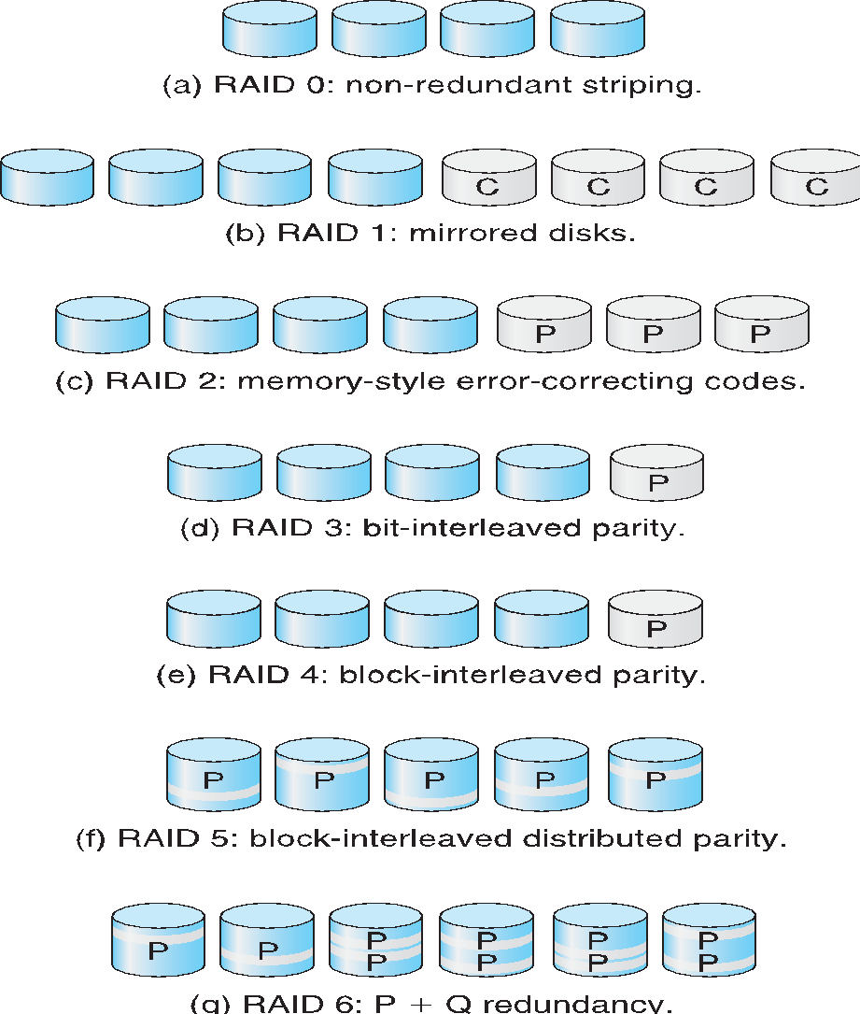
OPERATING SYSTEMS
RAID Levels
P indicates error-correcting bits
C indicates a second copy of the data
P + Q redundancy scheme uses 2 parity values P and Q

Slide 12


OPERATING SYSTEMS
RAID Levels 0 and 1
RAID level 0 refers to disk arrays with striping at the level of blocks
  No redundancy (such as mirroring or parity bits)
  lots of disks means low Mean Time To Failure (MTTF)
RAID level 1 refers to disk mirroring.
  A complete file is stored on a single disk
  A second disk contains an exact copy of the file
  Provides complete redundancy of data
  file data can be read in parallel
  must write the data out twice
  Most expensive RAID implementation
  requires twice as much storage space

Slide 13

OPERATING SYSTEMS
RAID Level-5
RAID level 5 stripes file data and checks data over all the disks
  no longer a single check disk
Consists of block-level striping with distributed parity.
  Unlike RAID 4, parity information is distributed among the drives
Drastically improves the performance of multiple writes
  they can now be done in parallel
read and write performance close to that of RAID Level-1

Slide 14
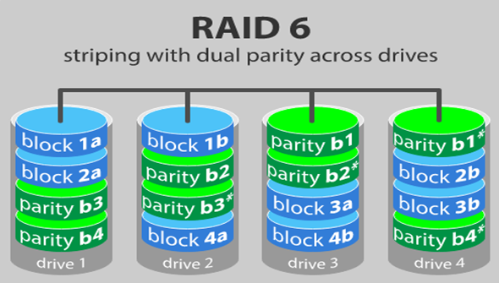

OPERATING SYSTEMS
RAID Level-6
RAID 6 is like RAID 5, but the parity data are written to two drives.
Write data transactions are slower than RAID 5 due to the additional parity data that have to be calculated.
Notes:
P and Q are 2 parity values used in RAID level 6

Slide 15
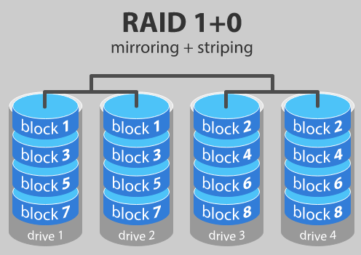
OPERATING SYSTEMS
RAID level 10 - combining RAID 1 and RAID 0
Provides security by mirroring all data on secondary drives while using striping across each set of drives to speed up data transfers.
Rebuild time is very fast
Half of the storage capacity goes to mirroring
  so compared to large RAID 5 or RAID 6 arrays, this is an expensive way to have redundancy.
Notes:
RAID levels 2, 3, 4 and 7 levels are not that common (RAID 3 is essentially like RAID 5 but with the parity data always written to the same drive).

Slide 16
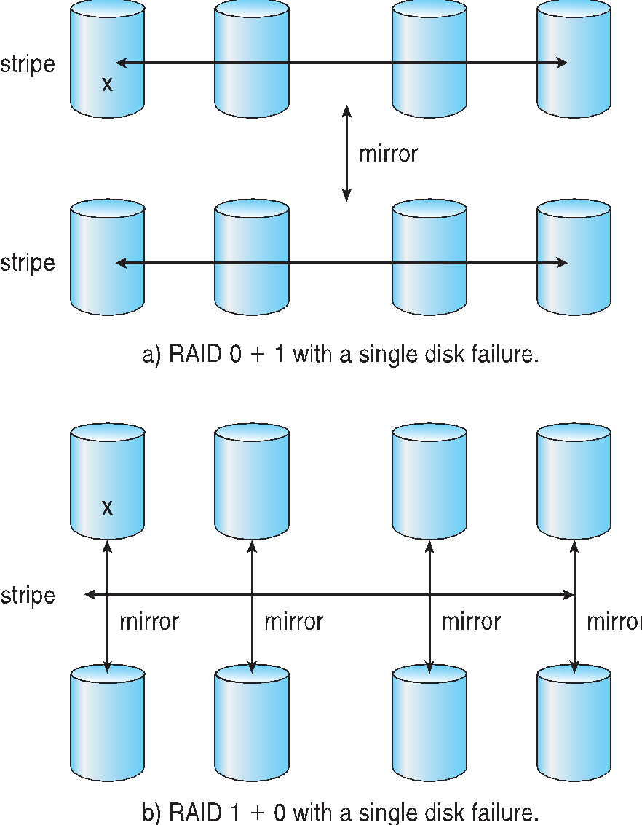
OPERATING SYSTEMS
RAID (0 + 1) and (1 + 0)
Disks are striped and then the stripe is mirrored to another, equivalent stripe. If a single disk fails, an entire stripe is inaccessible.
Disks are mirrored in pairs and then the resulting mirrored pairs are striped. This is better than 0+1 when a single disk fails

Slide 17
THANK YOU
Pavan A C
Department of Computer Science and Engineering
pavanac@pes.edu

