Slide 1





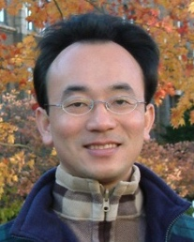



Sharing Teaching Experiences in EMI Courses and Project-based Learning (PBL)
Shih Hsin University
2023/5/22 (Monday) 13:00 - 15:00
Host: Prof. Yu-Chin Liu
Information Management, College of Management, Shih Hsin University (SHU)
2F, No. 111, Muzha Road, Section 1, Wenshan District, Taipei, Taiwan
Min-Yuh Day, Ph.D, Associate Professor
Institute of Information Management, National Taipei University
https://web.ntpu.edu.tw/~myday
2023-05-22

Slide 2









戴敏育 博士 Min-Yuh Day, Ph.D.
1
Associate Professor, Information Management, NTPU
Visiting Scholar, IIS, Academia Sinica
Ph.D., Information Management, NTU
Director, Intelligent Financial Innovation Technology, IFIT Lab, IM, NTPU
Associate Director, Fintech and Green Finance Center, NTPU
Publications Co-Chairs, IEEE/ACM International Conference on Advances in Social Networks Analysis and Mining (ASONAM 2013- )
Program Co-Chair, IEEE International Workshop on Empirical Methods for Recognizing Inference in TExt (IEEE EM-RITE 2012- )
Publications Chair, The IEEE International Conference on Information Reuse and Integration for Data Science (IEEE IRI 2007- )

Slide 3










生成式AI在永續發展的應用 Generative AI and ChatGPT for ESG and Sustainable Development
2023 NTPU 永續月 【SDGS永續沙龍】
Time: 2023.04.27 (Thu) 12:10-13:30
Place: USR HUB, Office of Sustainability, NTPU
Host: Office of Sustainability, NTPU
https://forms.gle/vYVvYBT6y1ik4RtN7
戴敏育 永續辦公室 社會責任組 組長
Min-Yuh Day, Ph.D, Associate Professor
Institute of Information Management, National Taipei University
https://web.ntpu.edu.tw/~myday
2023-04-27

Slide 4
Outline
EMI Teacher Community, AACSB, NTPU
Teaching Experiences Sharing
EMI Courses
Project-based Learning (PBL)

Slide 5
EMI Teacher Community II AACSB, NTPU 2022-2023

Slide 6
EMI Teacher Community Activities
1. 2022/05/05 (Thursday) 12:00 pm-13:00 pm, B302
Teaching Experiences Sharing of EMI Courses in AI for Business Applications
Min-Yuh Day, National Taipei University,
2. 2022/05/11 (Wednesday) 9:10 am - 12:00 pm, Google Meet ONLINE
Agile Principles Patterns and Practices in FinTech and Digital Transformation
Shihyu (Alex) Chu, Senior Industry Analyst/Program Manager, Market Intelligence & Consulting Institute (MIC)
3. 2022/05/11 (Wednesday) 12:10 pm - 13:00 pm, Google Meet ONLINE
Professional Business Presentations in English
Shihyu (Alex) Chu, Senior Industry Analyst/Program Manager, Market Intelligence & Consulting Institute (MIC)
4. 2022/05/18 (Wednesday) 12:10 pm - 13:00 pm, Google Meet ONLINE
Web 3: From DeFi to WoFi
Prof. Shih-wei Liao, National Taiwan University
5. 2022/05/27 (Friday) 12:00 pm - 13:00 pm, Google Meet ONLINE
Experiences Sharing of NTPU EMI Teaching Community II
Professors of EMI Teaching Community II, National Taipei University

Slide 7
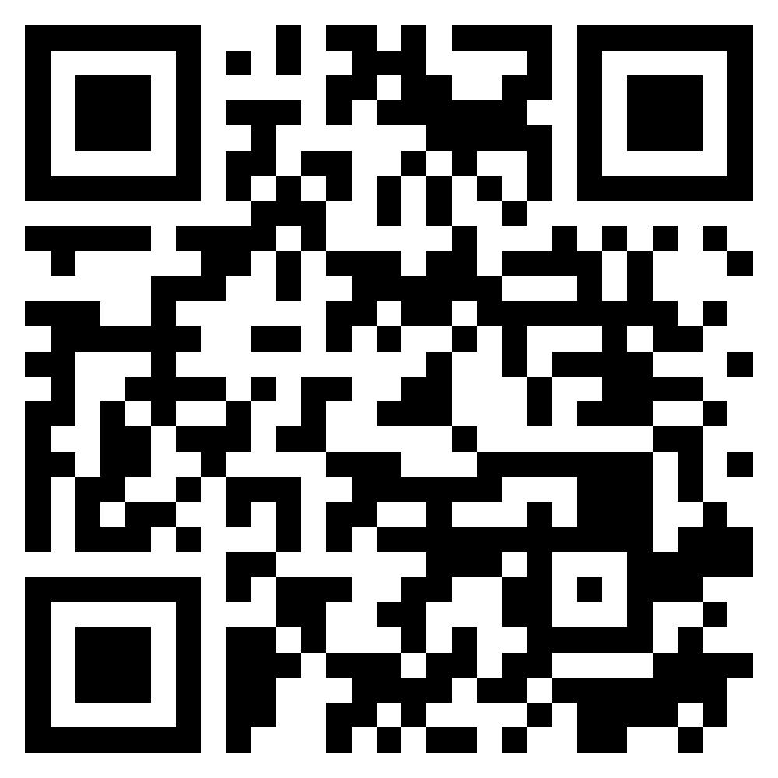

Teaching Experiences Sharing of EMI Courses in AI for Business Applications
EMI Teacher Community, AACSB, NTPU
1
Spring 2022
2022/5/5 (Thursday) 12:10 - 13:00
B302, AACSB, National Taipei University
Min-Yuh Day, Ph.D, Associate Professor
Institute of Information Management, National Taipei University
https://web.ntpu.edu.tw/~myday
https://meet.google.com/zuc-yyaw-mnt
2022-05-05

Slide 8
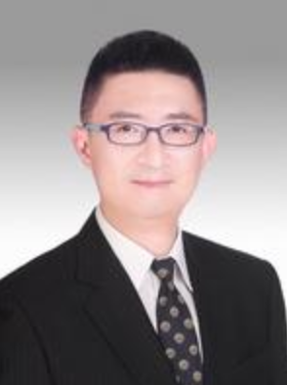
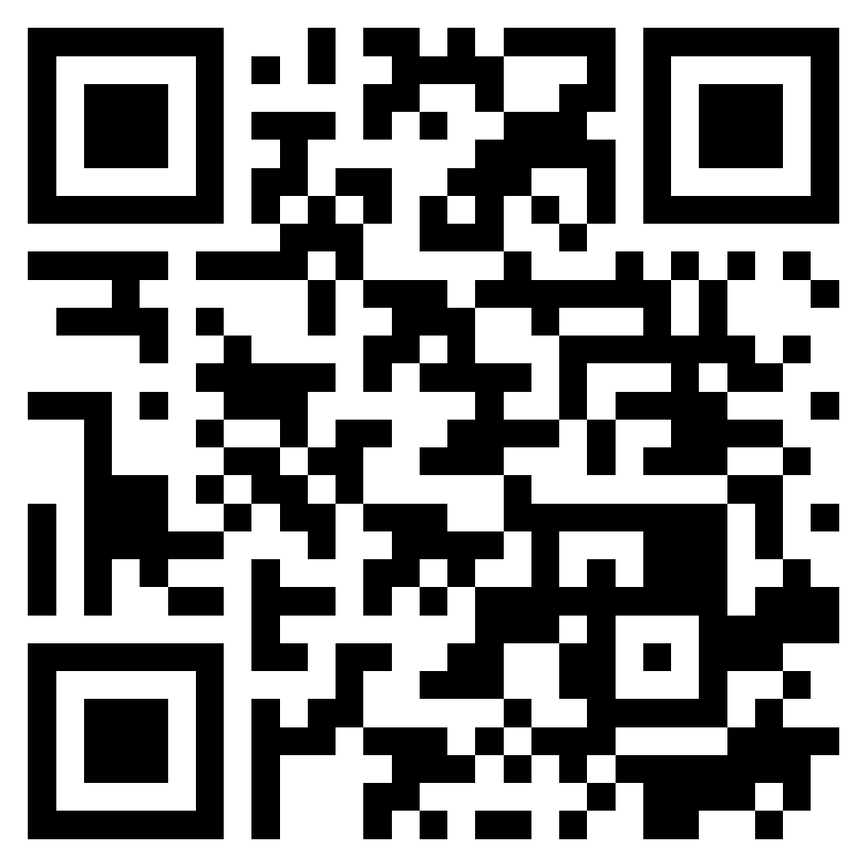
Agile Principles Patterns and Practices in FinTech and Digital Transformation
FinTech x EMI AACSB NTPU
2
Spring 2022
Shihyu (Alex) Chu
Senior Industry Analyst/Program Manager Market Intelligence & Consulting Institute (MIC)
https://meet.google.com/ish-gzmy-pmo
9:10 - 12:00, May 11, 2022 (Wednesday)

Slide 9
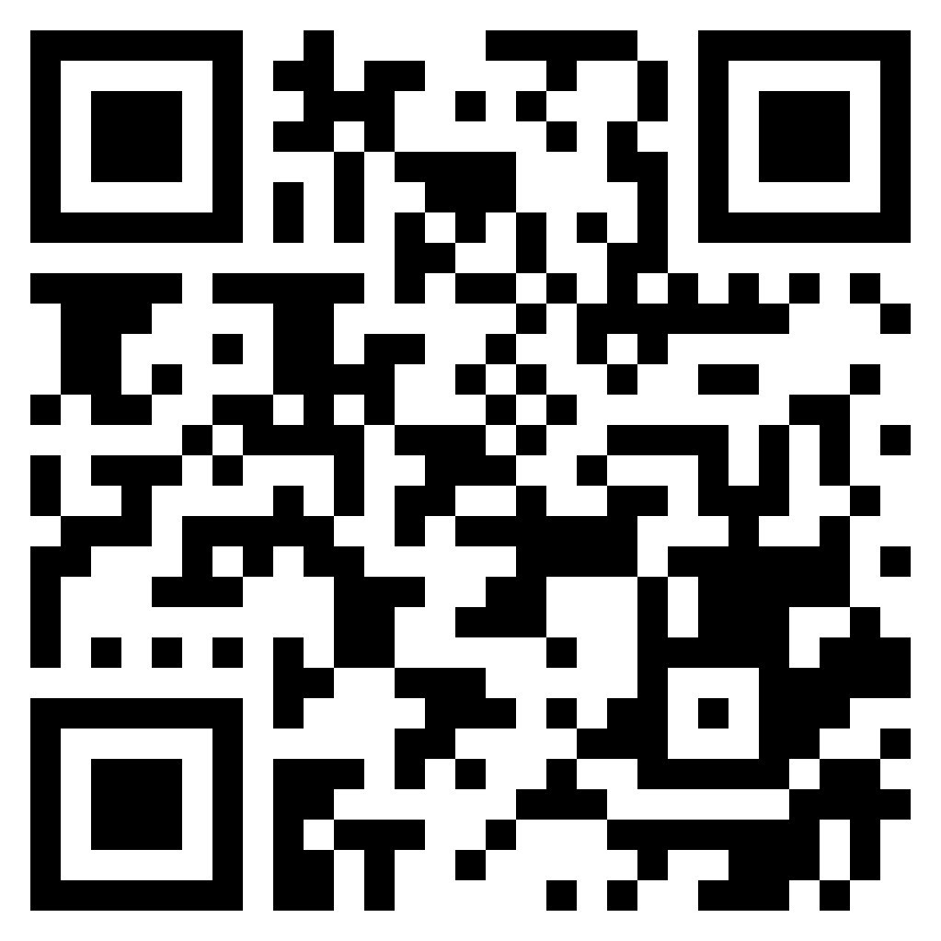
Professional Business Presentations in English
FinTech x EMI AACSB NTPU
3
Spring 2022
Shihyu (Alex) Chu
Senior Industry Analyst/Program Manager Market Intelligence & Consulting Institute (MIC)
http://meet.google.com/uaq-vmjj-vff
12:10 - 13:00, May 11, 2022 (Wednesday)

Slide 10

Web 3: From DeFi to WoFi
FinTech x EMI AACSB NTPU
4
Spring 2022
Prof. Shih-wei Liao National Taiwan University
http://meet.google.com/uaq-vmjj-vff
12:10 - 13:00, May 18, 2022 (Wednesday)

Slide 11
Experiences Sharing of NTPU EMI Teaching Community II
EMI AACSB NTPU
5
Spring 2022
Professors of EMI Teaching Community II
National Taipei University
http://meet.google.com/uaq-vmjj-vff
12:00 - 13:00, May 27, 2022 (Friday)

Slide 12

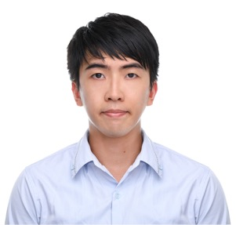
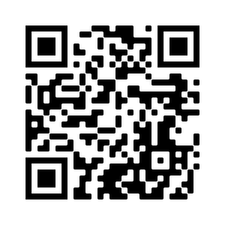
FinTech for Social Good
EMI x FinTech x IM AACSB NTPU
1
Fall 2022
Dr. Chung-Chi Chen Researcher, Artificial Intelligence Research Center, National Institute of Advanced Industrial Science and Technology, Japan
https://meet.google.com/paj-zhhj-mya
12:10 - 14:00, Oct. 19, 2022 (Wednesday)

Slide 13
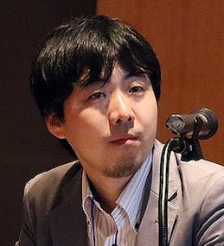
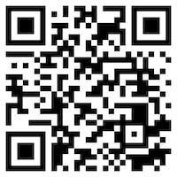
Matching Texts with Data for Evidence-based Information Retrieval
EMI x FinTech x IM AACSB NTPU
2
Fall 2022
Prof. Makoto P. Kato Faculty of Library, Information and Media Science
University of Tsukuba, Japan
https://meet.google.com/miy-fbif-max
9:10 - 12:00, Nov. 23, 2022 (Wednesday)
(Hybrid) B8F40, National Taipei University, Taiwan

Slide 14

The Truth of Crypto & NFT Economy (虛擬貨幣與NFT經濟老實說)
EMI x FinTech x IM AACSB NTPU
3
Fall 2022
Mu Jou (周書丞) CTO of Infinitas NFT
GM of Asiania
https://meet.google.com/paj-zhhj-mya
12:10 - 14:00, Nov. 30, 2022 (Wednesday)
(Hybrid) B3F02, National Taipei University, Taiwan

Slide 15
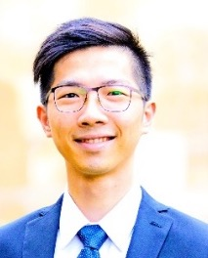
Index Design – Methodology, Data Analysis and the Application of Quantitative Investing
EMI x FinTech x IM AACSB NTPU
4
Fall 2022
Jervis J.G. Li
Fund Manager, Yuanta SITC
https://meet.google.com/paj-zhhj-mya
9:10 - 12:00, Dec. 6, 2022 (Tuesday)
(Hybrid) B8F40, National Taipei University, Taiwan

Slide 16
Agile Principles Patterns and Practices using AI and ChatGPT
EMI x USR x FinTech x IM AACSB NTPU
1
Spring 2023
Shihyu (Alex) Chu
Division Director, Software Industry Research Market Intelligence & Consulting Institute (MIC)
https://meet.google.com/ish-gzmy-pmo
9:10 - 12:00, May 17, 2023 (Wednesday)
(Hybrid) B8F40, National Taipei University, Taiwan

Slide 17
國際碳中和產業趨勢與數位轉型永續發展 (International Carbon Neutral Industry Trends and Digital Transformation for Sustainable Development)
EMI x USR x FinTech x IM AACSB NTPU
2
Spring 2023
Shihyu (Alex) Chu (朱師右)
Division Director, Software Industry Research Market Intelligence & Consulting Institute (MIC)
https://meet.google.com/paj-zhhj-mya
12:10 - 13:00, May 17, 2023 (Wednesday)
(Hybrid) B302, National Taipei University, Taiwan

Slide 18
Teaching Experiences Sharing

Slide 19

Teaching Experiences (EMI)
Artificial Intelligence for Text Analytics
Spring 2022
Software Engineering
Fall 2020, Fall, 2021, Spring 2022, Spring 2023
Artificial Intelligence in Finance and Quantitative
Fall 2021, Fall 2022
Artificial Intelligence
Spring 2021, Fall 2022
Data Mining
Spring 2021
Big Data Analytics
Fall 2020, Spring 2023
Foundation of Business Cloud Computing
Spring 2021, Spring 2022, Spring 2023
https://web.ntpu.edu.tw/~myday/teaching.htm

Slide 20
Teaching Experiences (EMI)
AI in Finance Big Data Analytics (Fall 2019)
MBA, DBETKU (3 Credits, Elective) [Full English Course] [Distance Learning]
Big Data Mining (Fall 2018)
MBA, DBETKU (3 Credits, Required) [Full English Course]
Social Media Apps Programming (Fall 2013 - Fall 2018)
MBA, IMTKU (2 Credits, Elective) [Full English Course]
Fall 2018, Fall 2017 , Fall 2016 , Fall 2015 , Fall 2014 , Fall 2013
https://web.ntpu.edu.tw/~myday/teaching.htm

Slide 21
EMI Courses in AI for Business Applications

Slide 22
EMI Courses in AI for Business Applications
Big Data Analysis
Spring 2023
Software Engineering
Spring 2023, Spring 2022
Artificial Intelligence
Fall 2022
Artificial Intelligence in Finance and Quantitative Analysis
Fall 2022
Artificial Intelligence for Text Analytics
Spring 2022
https://web.ntpu.edu.tw/~myday/teaching.htm

Slide 23
Introduction to Big Data Analysis
Big Data Analysis
1112BDA01
MBA, IM, NTPU (M6031) (Spring 2023) Tue 2, 3, 4 (9:10-12:00) (B8F40)
Min-Yuh Day, Ph.D, Associate Professor
Institute of Information Management, National Taipei University
https://web.ntpu.edu.tw/~myday
https://meet.google.com/paj-zhhj-mya
2023-02-21

Slide 24
Course Syllabus National Taipei University Academic Year 111, 2nd Semester (Spring 2023)
Course Title: Big Data Analysis
Instructor: Min-Yuh Day
Course Class: MBA, IM, NTPU (3 Credits, Elective)
Details
In-Class and Distance Learning EMI Course (3 Credits, Elective, One Semester) (M6031)
Time & Place: Tue, 2, 3, 4, (9:10-12:00) (B8F40)
Google Meet: https://meet.google.com/paj-zhhj-mya
https://meet.google.com/paj-zhhj-mya

Slide 25
Course Objectives
Understand the fundamental concepts and research issues of Big Data Analysis.
Equip with Hands-on practices of Big Data Analysis.
Conduct information systems research in the context of Big Data Analysis.

Slide 26
Course Outline
This course introduces the fundamental concepts, research issues, and hands-on practices of Big Data Analysis.
Topics include:
Introduction to Big Data Analysis
AI, Data Science and Big Data Analysis
Foundations of Big Data Analysis in Python
Machine Learning: SAS Viya, Data Preparation and Algorithm Selection
Machine Learning: Decision Trees and Ensembles of Trees
Machine Learning: Neural Networks (NN) and Support Vector Machines (SVM)
Machine Learning: Model Assessment and Deployment
ChatGPT and Large Language Models (LLM) for Big Data Analysis
Deep Learning for Finance Big Data Analysis
Case Study on Big Data Analysis

Slide 27
Syllabus
Week Date Subject/Topics
1 2023/02/21 Introduction to Big Data Analysis
2 2023/02/28 (Day Off)
3 2023/03/07 AI, Data Science and Big Data Analysis
4 2023/03/14 Foundations of Big Data Analysis in Python
5 2023/03/21 Case Study on Big Data Analysis I
6 2023/03/28 Machine Learning: SAS Viya, Data Preparation and Algorithm Selection

Slide 28
Syllabus
Week Date Subject/Topics
7 2023/04/04 (Children's Day) (Day off)
8 2023/04/11 Midterm Project Report
9 2023/04/18 Machine Learning: Decision Trees and Ensembles of Trees
10 2023/04/25 Machine Learning: Neural Networks (NN) and Support Vector Machines (SVM)
11 2023/05/02 Case Study on Big Data Analysis II
12 2023/05/09 Machine Learning: Model Assessment and Deployment

Slide 29
Syllabus
Week Date Subject/Topics
13 2023/05/16 ChatGPT and Large Language Models (LLM) for Big Data Analysis
14 2023/05/23 Deep Learning for Finance Big Data Analysis
15 2023/05/30 Final Project Report I
16 2023/06/06 Final Project Report II
17 2023/06/13 Self-learning
18 2023/06/20 Self-learning

Slide 30
Teaching Methods and Activities
Lecture
Discussion
Practicum

Slide 31
Evaluation Methods
Individual Presentation 60 %
Group Presentation 10 %
Case Report 10 %
Class Participation 10 %
Assignment 10 %

Slide 32
Introduction to Software Engineering
Software Engineering
1112SE01
MBA, IM, NTPU (M5010) (Spring 2023) Wed 2, 3, 4 (9:10-12:00) (B8F40)
Min-Yuh Day, Ph.D, Associate Professor
Institute of Information Management, National Taipei University
https://web.ntpu.edu.tw/~myday
https://meet.google.com/ish-gzmy-pmo
2023-02-22

Slide 33
Course Syllabus National Taipei University Academic Year 111, 2nd Semester (Spring 2023)
Course Title: Software Engineering
Instructor: Min-Yuh Day
Course Class: MBA, IM, NTPU (3 Credits, Elective)
Details
In-Person and Distance Learning EMI Course (3 Credits, Elective, One Semester) (M5010)
Time & Place: Wed, 2, 3, 4, (9:10-12:00) (B8F40)
Google Meet: https://meet.google.com/ish-gzmy-pmo
https://meet.google.com/ish-gzmy-pmo

Slide 34
Course Objectives
Understand the fundamental concepts and research issues of software engineering.
Equip with Hands-on practices of software engineering.
Conduct information systems research in the context of software engineering.

Slide 35
Course Outline
This course introduces the fundamental concepts, research issues, and hands-on practices of software engineering.
Topics include:
Introduction to Software Engineering
Software Products and Project Management: Software product management and prototyping
Agile Software Engineering: Agile methods, Scrum, and Extreme Programming
Features, Scenarios, and Stories
Software Architecture: Architectural design, System decomposition, and Distribution architecture
Cloud-Based Software: Virtualization and containers, Everything as a service, Software as a service
Cloud Computing and Cloud Software Architecture
Microservices Architecture, RESTful services, Service deployment
Security and Privacy; Reliable Programming
Testing: Functional testing, Test automation, Test-driven development, and Code reviews
DevOps and Code Management: Code management and DevOps automation
Case Study on Software Engineering

Slide 36
Syllabus
Week Date Subject/Topics
1 2023/02/22 Introduction to Software Engineering
2 2023/03/01 Software Products and Project Management: Software product management and prototyping
3 2023/03/08 Agile Software Engineering: Agile methods, Scrum, and Extreme Programming
4 2023/03/15 Features, Scenarios, and Stories
5 2023/03/22 Case Study on Software Engineering I
6 2023/03/29 Software Architecture: Architectural design, System decomposition, and Distribution architecture

Slide 37
Syllabus
Week Date Subject/Topics
7 2023/04/05 Tomb-Sweeping Day (Holiday, No Classes)
8 2023/04/12 Midterm Project Report
9 2023/04/19 Cloud-Based Software: Virtualization and containers, Everything as a service, Software as a service
10 2023/04/26 Cloud Computing and Cloud Software Architecture
11 2023/05/03 Microservices Architecture, RESTful services, Service deployment
12 2023/05/10 Security and Privacy; Reliable Programming; Testing: Test-driven development, and Code reviews; DevOps and Code Management: DevOps automation

Slide 38
Syllabus
Week Date Subject/Topics
13 2023/05/17 Industry Practices of Software Engineering
[Agile Principles Patterns and Practices using AI and ChatGPT, Invited Speaker: Shihyu (Alex) Chu, Division Director, Software Industry Research Center, Market Intelligence & Consulting Institute (MIC)]
14 2023/05/24 Case Study on Software Engineering II
15 2023/05/31 Final Project Report I
16 2023/06/07 Final Project Report II
17 2023/06/14 Self-learning
18 2023/06/21 Self-learning

Slide 39
Introduction to Artificial Intelligence in Finance and Quantitative Analysis
Artificial Intelligence in Finance and Quantitative Analysis
1111AIFQA01
MBA, IM, NTPU (M6132) (Fall 2022) Tue 2, 3, 4 (9:10-12:00) (B8F40)
Min-Yuh Day, Ph.D, Associate Professor
Institute of Information Management, National Taipei University
https://web.ntpu.edu.tw/~myday
https://meet.google.com/paj-zhhj-mya
2022-09-13

Slide 40
Course Syllabus National Taipei University Academic Year 111, 1st Semester (Fall 2022)
Course Title: Artificial Intelligence in Finance and Quantitative Analysis
Instructor: Min-Yuh Day
Course Class: MBA, IM, NTPU (3 Credits, Elective)
Details
In-Class and Distance Learning EMI Course (3 Credits, Elective, One Semester) (M6132)
Time & Place: Tue, 2, 3, 4, (9:10-12:00) (B8F40)
Google Meet: https://meet.google.com/paj-zhhj-mya
https://meet.google.com/paj-zhhj-mya

Slide 41
Course Objectives
Understand the fundamental concepts and research issues of Artificial Intelligence in Finance and Quantitative Analysis.
Equip with Hands-on practices of Artificial Intelligence in Finance and Quantitative Analysis.
Conduct information systems research in the context of Artificial Intelligence in Finance and Quantitative Analysis.

Slide 42
Course Outline
This course introduces the fundamental concepts, research issues, and hands-on practices of AI in Finance and Quantitative Analysis.
Topics include:
Introduction to Artificial Intelligence in Finance and Quantitative Analysis
AI in FinTech: Metaverse, Web3, DeFi, NFT, Financial Services Innovation and Applications
Investing Psychology and Behavioral Finance
Event Studies in Finance
Finance Theory
Data-Driven Finance
Financial Econometrics
AI-First Finance
Deep Learning in Finance
Reinforcement Learning in Finance
Algorithmic Trading, Risk Management, Trading Bot and Event-Based Backtesting
Case Study on AI in Finance and Quantitative Analysis.

Slide 43
Syllabus
Week Date Subject/Topics
1 2022/09/13 Introduction to Artificial Intelligence in Finance and Quantitative Analysis
2 2022/09/20 AI in FinTech: Metaverse, Web3, DeFi, NFT, Financial Services Innovation and Applications
3 2022/09/27 Investing Psychology and Behavioral Finance
4 2022/10/04 Event Studies in Finance
5 2022/10/11 Case Study on AI in Finance and Quantitative Analysis I
6 2022/10/18 Finance Theory

Slide 44
Syllabus
Week Date Subject/Topics
7 2022/10/25 Data-Driven Finance
8 2022/11/01 Midterm Project Report
9 2022/11/08 Financial Econometrics
10 2022/11/15 AI-First Finance
11 2022/11/22 Industry Practices of AI in Finance and Quantitative Analysis
12 2022/11/29 Case Study on AI in Finance and Quantitative Analysis II

Slide 45
Syllabus
Week Date Subject/Topics
13 2022/12/06 Deep Learning in Finance; Reinforcement Learning in Finance
14 2022/12/13 Algorithmic Trading; Risk Management; Trading Bot and Event-Based Backtesting
15 2022/12/20 Final Project Report I
16 2022/12/27 Final Project Report II
17 2023/01/03 Self-learning
18 2023/01/10 Self-learning

Slide 46
Introduction to Artificial Intelligence
Artificial Intelligence
1111AI01
MBA, IM, NTPU (M6132) (Fall 2022) Wed 2, 3, 4 (9:10-12:00) (B8F40)
Min-Yuh Day, Ph.D, Associate Professor
Institute of Information Management, National Taipei University
https://web.ntpu.edu.tw/~myday
https://meet.google.com/miy-fbif-max
2022-09-14

Slide 47
Course Syllabus National Taipei University Academic Year 111, 1st Semester (Fall 2022)
Course Title: Artificial Intelligence
Instructor: Min-Yuh Day
Course Class: MBA, IM, NTPU (3 Credits, Elective)
Details
In-Class and Distance Learning EMI Course (3 Credits, Elective, One Semester) (M6132)
Time & Place: Wed, 2, 3, 4, (9:10-12:00) (B8F40)
Google Meet: https://meet.google.com/miy-fbif-max
https://meet.google.com/miy-fbif-max

Slide 48
Course Objectives
Understand the fundamental concepts and research issues of Artificial Intelligence.
Equip with Hands-on practices of Artificial Intelligence.
Conduct information systems research in the context of Artificial Intelligence.

Slide 49
Course Outline
This course introduces the fundamental concepts, research issues, and hands-on practices of Artificial Intelligence.
Topics include:
Introduction to Artificial Intelligence
Artificial Intelligence and Intelligent Agents
Problem Solving
Knowledge, Reasoning and Knowledge Representation, Uncertain Knowledge and Reasoning
Machine Learning: Supervised and Unsupervised Learning
The Theory of Learning and Ensemble Learning
Deep Learning, Reinforcement Learning
Deep Learning for Natural Language Processing
Computer Vision and Robotics
Philosophy and Ethics of AI and the Future of AI
Case Study on AI

Slide 50
Syllabus
Week Date Subject/Topics
1 2022/09/14 Introduction to Artificial Intelligence
2 2022/09/21 Artificial Intelligence and Intelligent Agents
3 2022/09/28 Problem Solving
4 2022/10/05 Knowledge, Reasoning and Knowledge Representation; Uncertain Knowledge and Reasoning
5 2022/10/12 Case Study on Artificial Intelligence I
6 2022/10/19 Machine Learning: Supervised and Unsupervised Learning

Slide 51
Syllabus
Week Date Subject/Topics
7 2022/10/26 The Theory of Learning and Ensemble Learning
8 2022/11/02 Midterm Project Report
9 2022/11/09 Deep Learning and Reinforcement Learning
10 2022/11/16 Deep Learning for Natural Language Processing
11 2022/11/23 Invited Talk: AI for Information Retrieval
12 2022/11/30 Case Study on Artificial Intelligence II

Slide 52
Syllabus
Week Date Subject/Topics
13 2022/12/07 Computer Vision and Robotics
14 2022/12/14 Philosophy and Ethics of AI and the Future of AI
15 2022/12/21 Final Project Report I
16 2022/12/28 Final Project Report II
17 2023/01/04 Self-learning
18 2023/01/11 Self-learning

Slide 53
Introduction to Artificial Intelligence for Text Analytics
Artificial Intelligence for Text Analytics
1102AITA01
MBA, IM, NTPU (M5026) (Spring 2022) Tue 2, 3, 4 (9:10-12:00) (B8F40)
Min-Yuh Day, Ph.D, Associate Professor
Institute of Information Management, National Taipei University
https://web.ntpu.edu.tw/~myday
https://meet.google.com/paj-zhhj-mya
2022-02-22

Slide 54
Course Syllabus National Taipei University Academic Year 110, 2nd Semester (Spring 2022)
Course Title: Artificial Intelligence for Text Analytics
Instructor: Min-Yuh Day
Course Class: MBA, IM, NTPU (3 Credits, Elective)
Details
In-Class and Distance Learning EMI Course (3 Credits, Elective, One Semester) (M5026)
Time & Place: Tue, 2, 3, 4, (9:10-12:00) (B8F40)
Google Meet: https://meet.google.com/paj-zhhj-mya
https://meet.google.com/paj-zhhj-mya

Slide 55
Course Objectives
Understand the fundamental concepts and research issues of Artificial Intelligence for Text Analytics.
Equip with Hands-on practices of Artificial Intelligence for Text Analytics.
Conduct information systems research in the context of Artificial Intelligence for Text Analytics.

Slide 56
Course Outline
This course introduces the fundamental concepts, research issues, and hands-on practices of Artificial Intelligence for Text Analytics.
Topics include:
Introduction to Introduction to Artificial Intelligence for Text Analytics
Foundations of Text Analytics: Natural Language Processing (NLP)
Python for Natural Language Processing
Natural Language Processing with Transformers
Text Classification and Sentiment Analysis
Multilingual Named Entity Recognition (NER), Text Similarity and Clustering
Text Summarization and Topic Models
Text Generation
Question Answering and Dialogue Systems
Deep Learning, Transfer Learning, Zero-Shot, and Few-Shot Learning for Text Analytics
Case Study on Artificial Intelligence for Text Analytics

Slide 57
Syllabus
Week Date Subject/Topics
1 2022/02/22 Introduction to Artificial Intelligence for Text Analytics
2 2022/03/01 Foundations of Text Analytics: Natural Language Processing (NLP)
3 2022/03/08 Python for Natural Language Processing
4 2022/03/15 Natural Language Processing with Transformers
5 2022/03/22 Case Study on Artificial Intelligence for Text Analytics I
6 2022/03/29 Text Classification and Sentiment Analysis

Slide 58
Syllabus
Week Date Subject/Topics
7 2022/04/05 Tomb-Sweeping Day (Holiday, No Classes)
8 2022/04/12 Midterm Project Report
9 2022/04/19 Multilingual Named Entity Recognition (NER), Text Similarity and Clustering
10 2022/04/26 Text Summarization and Topic Models
11 2022/05/03 Text Generation
12 2022/05/10 Case Study on Artificial Intelligence for Text Analytics II

Slide 59
Syllabus
Week Date Subject/Topics
13 2022/05/17 Question Answering and Dialogue Systems
14 2022/05/24 Deep Learning, Transfer Learning, Zero-Shot, and Few-Shot Learning for Text Analytics
15 2022/05/31 Final Project Report I
16 2022/06/07 Final Project Report II
17 2022/06/14 Self-learning
18 2022/06/21 Self-learning

Slide 60
Project-based Learning (PBL)

Slide 61
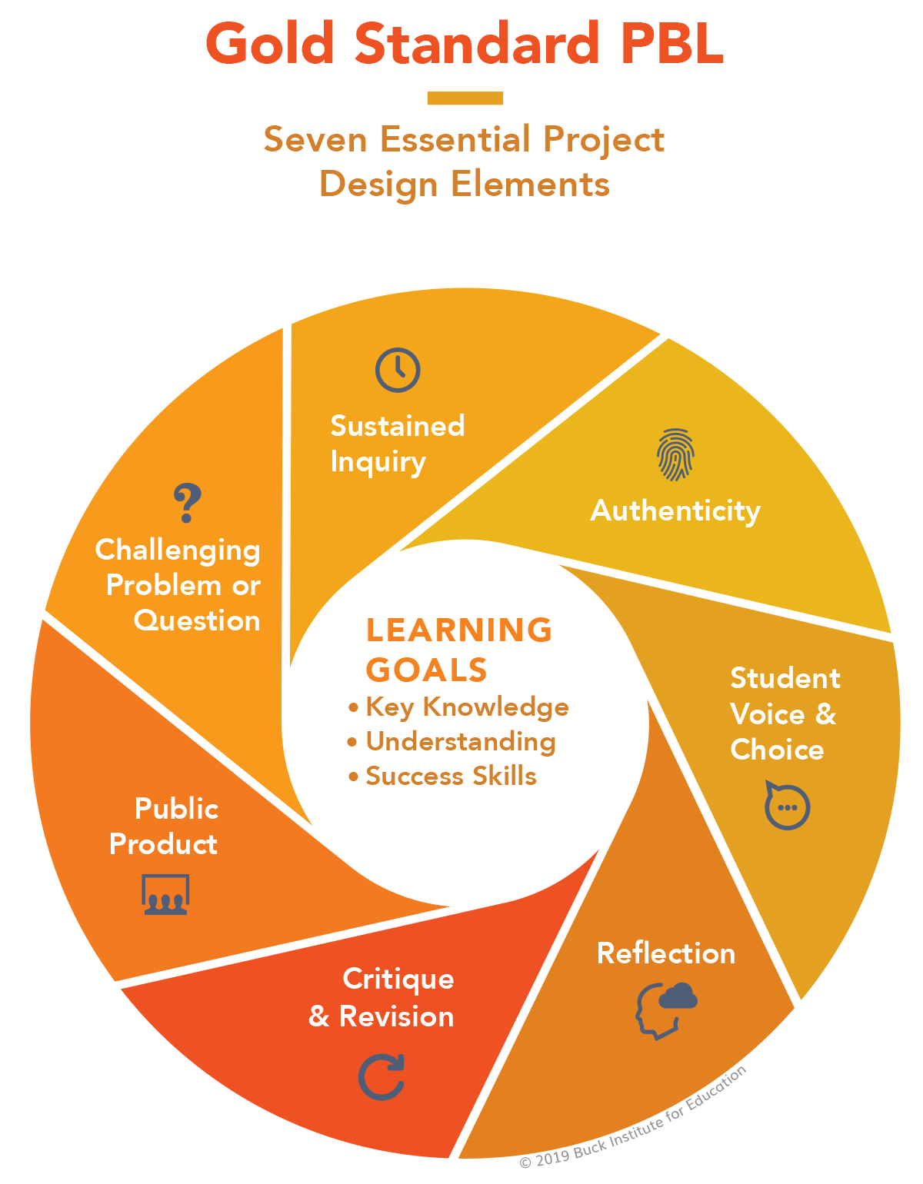
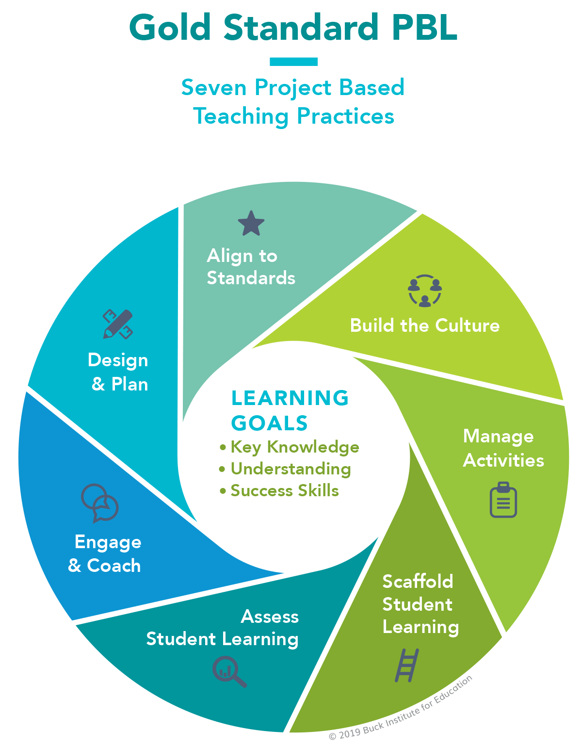
PBL Design Teaching
2
2
1
1
3
3
7
7
4
4
6
6
5
5

Slide 62
Information Management (MIS) Information Systems
Organizations
Technology
Information Systems
Management

Slide 63
Fundamental MIS Concepts
Business Challenges
Management
Organization
Information System
Business Solutions
Technology

Slide 64
Agile Software Engineering

Slide 65
Software Engineering and Project Management
Analyze
Requirements definition
Design
System and Software design
Build
Implementation and
unit testing
Test
Integration and system testing
Deliver
Operation and maintenance
Project Management

Slide 66
Software Development Life Cycle (SDLC) The waterfall model
Requirements definition
System and Software design
Implementation and unit testing
Integration and system testing
Operation and maintenance

Slide 67
Plan-based and Agile development
Plan-based development
Requirements engineering
Requirements specification
Design and implementation
Requirements change requests
Agile development
Requirements engineering
Design and implementation

Slide 68




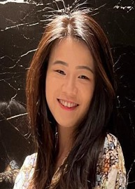
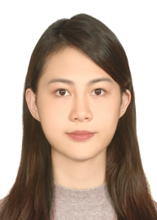
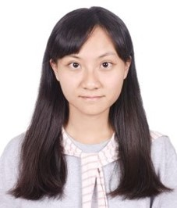
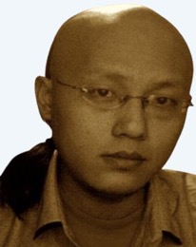
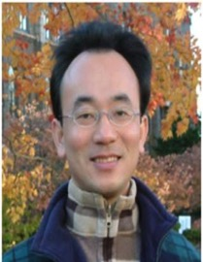
2022
IMNTPU at the NTCIR-16 FinNum-3 Task: Data Augmentation for Financial Numclaim Classification
¹ Information Management, National Taipei University, New Taipei City, Taiwan
² Zeals Co., Ltd. Tokyo, Japan
Yung-Wei Teng ¹
Pei-Tz Chiu ¹
Ting-Yun Hsiao ¹
Mike Tian-Jian Jiang ²
Min-Yuh Day ^{1,*}
myday@gm.ntpu.edu.tw

Slide 69
2022
IMNTPU Dialogue System Evaluation
at the NTCIR-16 DialEval-2
Dialogue Quality and Nugget Detection
¹ Information Management, National Taipei University, New Taipei City, Taiwan
² Zeals Co., Ltd. Tokyo, Japan
Ting-Yun Hsiao ¹
Yung-Wei Teng ¹
Pei-Tz Chiu ¹
Mike Tian-Jian Jiang ²
Min-Yuh Day ^{1,*}
myday@gm.ntpu.edu.tw

Slide 70
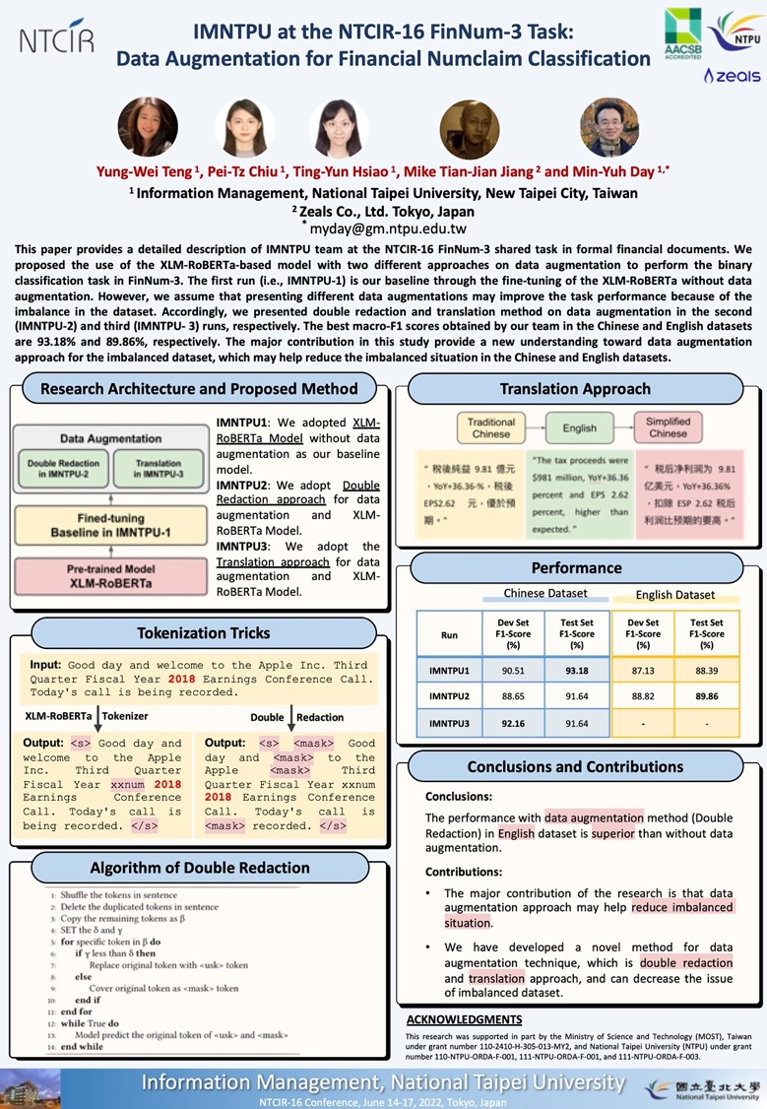
2022
NTCIR-16 Best Poster Presentation Award

Slide 71
The 12th IEEE International Workshop on Empirical Methods for Recognizing Inference in TExt (IEEE EM-RITE 2023) In conjunction with IEEE IRI 2023 August 4 - August 6, 2023 Bellevue, WA, USA
IMPORTANT DATES
Regular paper submission: May 15, 2023
Notification of acceptance: June 12, 2023
Camera-ready paper due: June 26, 2023
Author registration due: July 3, 2023
Conference events: August 4 - August 6, 2023
https://sites.google.com/view/emrite2023

Slide 72
The 14th International Workshop on Mining and Analyzing Social Networks for Decision Support (MSNDS 2023) In conjunction with IEEE/ACM ASONAM 2023 Marrakesh, Morocco 6-9 November 2023
IMPORTANT DATES
Paper submission deadline: August 21, 2023
Acceptance notification: September 25, 2023
Camera-ready paper deadline: October 10, 2023
Author registration due: October 20, 2023
Conference events: November 10-13, 2023
https://sites.google.com/view/msnds2023

Slide 73
Acknowledgments: Research Projects
Applying AI technology to construct knowledge graphs of cryptocurrency anti-money laundering: a few-shot learning model
MOST, 110-2410-H-305-013-MY2, 2021/08/01~2023/07/31
Fintech Green Finance for Carbon Market Index, Corporate Finance, and Environmental Policies. Carbon Emission Sentiment Index with AI Text Analytics
NTPU, 112-NTPU_ORDA-F-003，2023/01/01~2024/12/31
Research on speech processing, synthesis, recognition, and sentence construction of people with language disabilities. Multimodal Cross-lingual Task-Oriented Dialogue System
NTPU, 112-NTPU_ORDA-F-004, 2023/01/01~2025/12/31
Use deep learning to identify commercially dental implant systems - observational study
USTP-NTPU-TMU, USTP-NTPU-TMU-112-01, 2023/01/01~2023/12/31
Metaverse Avatar Automatic Metadata Generation Module
FormosaVerse x NTPU, NTPU-111A413E01, 2022/12/01~2023/11/30
Establishment and Implement of Smart Assistive Technology for Dementia Care and Its Socio-Economic Impacts. Intelligent, individualized and precise care with smart AT and system integration
MOST, 111-2627-M-038-001-, 2022/08/01~2023/07/31

Slide 74
Summary
EMI Teacher Community, AACSB, NTPU
Teaching Experiences Sharing
EMI Courses
Project-based Learning (PBL)

Slide 75
Sharing Teaching Experiences in EMI Courses and Project-based Learning (PBL)
Q & A
Shih Hsin University
2023/5/22 (Monday) 13:00 - 15:00
Host: Prof. Yu-Chin Liu
Information Management, College of Management, Shih Hsin University (SHU)
2F, No. 111, Muzha Road, Section 1, Wenshan District, Taipei, Taiwan
Min-Yuh Day, Ph.D, Associate Professor
Institute of Information Management, National Taipei University
https://web.ntpu.edu.tw/~myday
2023-05-22

